Slide 1
Introducing: The Stroke Hyperglycemia Insulin Network Effort (SHINE) Trial
Karen C. Johnston
Amy C. Fansler
For the SHINE team
NIH-NINDS U01 NS069498
NETT CCC U01 NS056975
NETT SDMC U01 NS059041

Slide 2
The Problem
Over 750,000 strokes/ year (~80% ischemic)
~30-50% hyperglycemic on admission
Hyperglycemia associated with worse clinical outcome
Hypoglycemia bad for ischemic brain
Unknown if Rx of hyperglycemia improves outcome or if benefit outweighs risk
No definitive guidance on glucose management

Slide 3
Phase III SHINE Trial NIH-NINDS U01 NS069498
Multicenter (~60 sites), randomized, controlled trial
Phase III (definitive efficacy trial)
Hyperglycemic acute ischemic stroke patients
Comparison of standard SQ insulin versus insulin infusion
Funded by NIH-NINDS
Conducted in conjunction with NIH-NINDS funded Neurological Emergencies Treatment Trials Network (NETT)

Slide 4
Phase III SHINE Trial NIH-NINDS U01 NS069498
Specific Aim 1
To determine the efficacy of tight glucose control to a target range of 80-130 mg/dL with IV insulin infusion in hyperglycemic acute ischemic stroke patients within 12 hours of symptom onset as measured by mRS at 90 days after stroke.
Specific Aim 2
To determine the safety of tight glucose control with IV insulin infusion in hyperglycemic acute ischemic stroke patients treated for up to 72 hours.

Slide 5
Eligibility Criteria - Inclusion
Age 18 years or older
Clinical diagnosis of ischemic stroke
Randomization w/in 12 hrs after stroke symptom onset and recommended w/in 3 hrs of hospital arrival
Known history of type 2 diabetes mellitus and glucose >110 mg/dL OR admission blood glucose ≥150 mg/dL in those w/o known diabetes mellitus
Baseline NIHSS 3-22 (3-7 mild, 8-14 mod, 15-22 severe)
mRS of 0 if NIHSS 3-7; mRS of 0-1 if NIHSS of 8-22
Able to provide a valid informed consent

Slide 6
Eligibility Criteria – Exclusion
Known type 1 diabetes mellitus
Substantial preexisting confounding neuro/ psych illness
Received experimental therapy for enrollment stroke
Pregnancy
Other serious conditions- pt unlikely to live to f/u
Inability to follow protocol or return for 90 day f/u
Renal dialysis (hemo or peritoneal)

Slide 7
Phase III SHINE Trial Design/Protocol NIH-NINDS U01 NS069498
~1400 hyperglycemic acute ischemic stroke patients
12 hr window from stroke symptom onset
Treatment Groups
Intervention group - Insulin drip (target 80-130 mg/dL )
Control group - SQ insulin (target 80-179 mg/dL)
Up to 72 hrs treatment
Single blind Rx; double blind outcomes
Primary outcome - 90 day mRS

Slide 8
Treatment Groups - General Concepts
Two groups: both glucose control, both get insulin
Both groups get IV infusion & SQ injections (up to 4/day)
Frequent glucose checks
60 gram carbohydrate diet/meal
All patients must be in unit that supports IV insulin
72 hr treatment period from randomization (early d/c ok)
Daily neuro & AE assessments
All sites provided with study laptops for study treatment dosing and data capture

Slide 9
SHINE Intervention Group
Infusion: IV insulin
Injections:
SQ meal insulin, OR
SQ saline if not taking PO
Glucose checks: q1-2 hours per GlucoStabilizer®
GlucoStabilizer® also instructs on insulin dosing and hypoglycemia protocol

Slide 10
SHINE Control Group
Infusion: IV saline
Injections: SQ insulin (per sliding scale)
Escalating doses of insulin per sliding scale if not in target which may include basal insulin
Glucose checks q1-3 hours
Study laptop displays dosing of IV saline, SQ insulin and hypoglycemia protocol

Slide 11
Summary – Clinical Outcomes
Primary efficacy outcome – 3 month mRS
Primary safety outcome – severe hypoglycemia (<40 mg/dL)
Outcomes Assessments (blinded)
6 week phone call – mRS and SAEs
3 month – mRS, NIHSS, BI, SSQOL

Slide 12
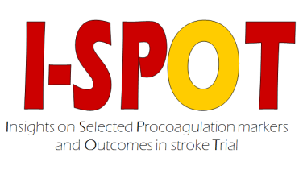
I-SPOT & SHINE
I-SPOT nested within the SHINE trial
Only sites participating in the SHINE trial will be eligible to perform I-SPOT
Consent for I-SPOT embedded into SHINE consent
Separately funded so sites will get additional funds to perform I-SPOT
Requires 2 blood draws & QVSFS at 90 days

Slide 13
Recruitment, Enrollment & Retention Tips
Amy Fansler, MPH, CCRP
SHINE Project Director

Slide 14
Recruitment Tips
Engagement of front line teams (ED, residents)
24/7 screening
EMR-based automated alerts
Partnership with clinical team re consent
DNR is not an exclusion/ comfort care is

Slide 15
Enrollment Glucose Tips
Recheck glucose if close – most recent counts
If glucose meets criteria, no need to recheck
Pts who get insulin or glucose in the field/ED may still be eligible
Borderline diabetes is not diabetes
Type 1 vs type 2 diabetes – call PI on call
Pts that require insulin drip not eligible
Pts with insulin pump unlikely to be eligible
Glucose >500 mg/dL require safety monitor

Slide 16
Enrollment NIHSS Tips
Must have NIHSS score within 30 min prior to randomization
Intubation is exclusion (can’t get NIHSS score)
Recheck NIHSS if close – most recent counts

Slide 17
Retention Tips
Build relationship/establish trust
Research team present during acute care
Lots of contact info (both directions)
Contact patient/LAR just to check in
Watch for patient visits for other reasons
Be flexible re follow up

Slide 18
Study Update

Slide 19
SHINE Sites – 59 Enrolling
Arizona | University of Arizona MC
 | University of Arizona South Campus
Baylor | Baylor College of Medicine
Buffalo | SUNY Buffalo/Kaleida General
Cincinnati | University Hospital
Emory | Emory University Hospital
 | Emory University Hospital Midtown
 | Grady Memorial Hospital
GRU | Georgia Regents University
HFHS | Henry Ford Hospital
 | University of Michigan
Kentucky | University of Kentucky
Maryland | University of Maryland
Mayo Jacksonville | Mayo Clinic, Jacksonville
MCW | Froedtert Memorial
MGH | Mass General
Minnesota | HCMC
 | UMMC Fairview
 | University of Kansas
NYP | NYP Columbia
OSF | OSF Saint Francis
OHSU | Harborview MC
OSU | Summa Akron City MC
 | Wexner Medical Center
Penn State | Penn State Hershey MC
Pittsburgh | UPMC Mercy
 | UPMC Presbyterian
Stanford | Stanford University MC
St. Thomas NRI | St. Thomas NRI
SUNY Downstate | Kings County Hospital
SUNY Downstate | Lincoln Medical
 | Maimonides Medical Center
 | University Hospital of Brooklyn
Temple | Hackensack University MC
 | Temple University Hospital
UCLA | Long Beach Memorial MC
 | UCLA Medical Center
UCSF | CPMC Davies
 | CPMC Pacific
 | San Francisco General
 | UCSF Medical Center
UPenn | Abington Memorial
 | Hospital of UPenn
 | York Wellspan Hospital
UT Houston | Austin Brackenridge
 | Austin Seton
 | Memorial Hermann
 | Valley Baptist MC
Utah | University of Utah
UTSW | UTSW - Zale
 | UTSW - Parkland
UVA | University of Virginia
Vanderbilt | Vanderbilt University MC
WSU | Beaumont Royal Oak
 | Beaumont Troy
 | Detroit Receiving Hospital
 | Sinai Grace
WVU | West Virginia University

Slide 20
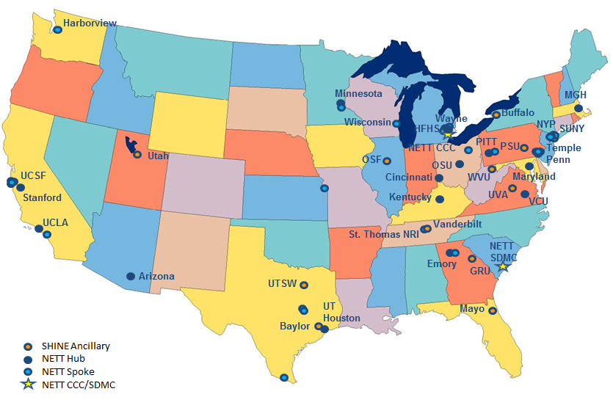
SHINE Trial – Participating Sites

Slide 21
Recruitment Update
480 subjects enrolled (as of Nov 10)
59 sites actively recruiting – 16 are currently regional centers in StrokeNet
8 more sites to start by Jan 2015 including numerous StrokeNet Sites
Northwestern – already enrolled
MedStar (Washington Hospital Ctr)
Iowa
UW – Madison
NYC Collaborative (NYU)
Interim Analysis – Spring 2015

Slide 22
Questions/Discussion

