Slide 1

FVIIa for Acute hemorrhagic Stroke Administered at Earliest Time (FASTEST) Trial
<<Insert Site Principal Investigator Name>>

Slide 2

Topics foToday
Discuss what is a brain hemorrhage or intracerebral hemorrhage (ICH)?
Explain what recombinant Factor VIIa is.
Explain the FASTEST Trial and what it is trying to accomplish.
Discuss emergency research and consent

Slide 3

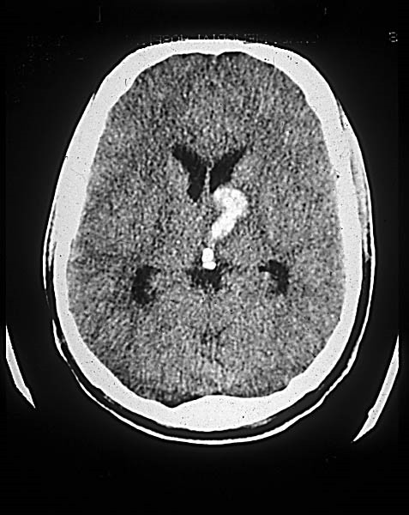
What is a Brain Hemorrhage?

Slide 4
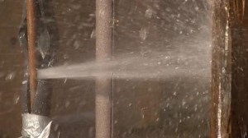
ICH: Old or Damaged Blood Vessels Break Under Pressure

Slide 5
Background
Brain Hemorrhage or intracerebral hemorrhage (ICH) is a type of stroke that accounts for more than 10% of the estimated 17 million strokes worldwide each year or about 1,700,000 cases per year.
More than 40% of patients die and only 20% of survivors are functionally independent at 6 months.
The size of blood in the brain is the most important determinant of outcome and most bleeding occurs within 2-3 hours.
There is no scientifically proven effective treatment for ICH.

Slide 6
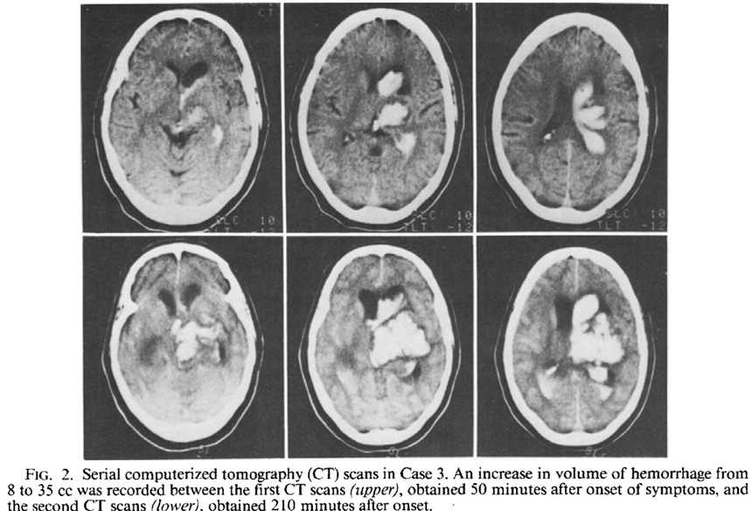
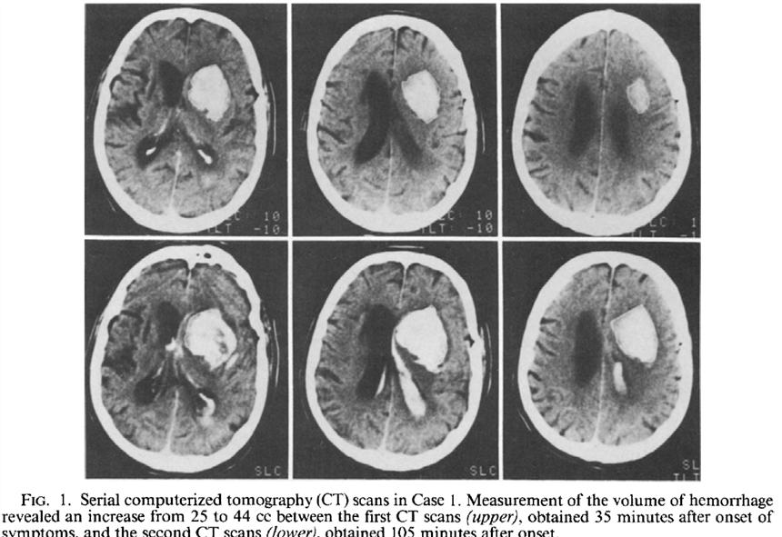
Growth of bleeding in the Brain Leads to Bad Outcomes
J. Neurosurg: 72: 195-199, 1990

Slide 7

Has anyone here had or know of someone who has had a stroke? A brain hemorrhage?

Slide 8
Treatment of Brain Hemorrhage
Admission to intensive care unit.
Treatment of blood pressure which is often very elevated.
Often ventilator machine to help breathe.
Treatments to help relieve pressure in the brain.
Occasionally surgery to remove blood.
THERE IS NO SCIENTIFICALLY PROVEN TREATMENT FOR BRAIN HEMORRHAGE.

Slide 9
What is Recombinant Factor VIIa
Factor VIIa is normal protein in our body that helps stop bleeding.
Recombinant Factor VIIa (identical to Factor VIIa but given in much larger amounts) is the only medication that has been shown to substantially decrease bleeding in patients with hemorrhage in the brain.
It is easily administered intravenously with rapid onset of action.
It is approved for other medical indications that involve bleeding (hemophilia) but not for brain hemorrhage.
Prior trials of rFVIIa showed that it slowed bleeding in the brain but that its benefits in improving outcomes are most likely when given within 2 hours of onset of symptoms.

Slide 10
Potential Risks of rFVIIa in Patients with ICH
Patients with brain hemorrhage are also at risk for other vascular diseases and blood clots where there are damaged blood vessels. rFVIIa stimulates formation of blood clots.

Slide 11
Primary Specific Objective – FASTEST Trial
The objective of the FVIIa for Acute hemorrhagic Stroke Administered at Earliest Time (FASTEST) Trial is to establish whether rFVIIa within two hours of the onset of brain hemorrhage in appropriately selected patients improves outcome at 180 days, as compared to placebo.
NIH Funded: 1U01NS110772-01

Slide 12
Has anyone here been involved in a research study? What was it like?

Slide 13
Who would be in the FASTEST Study?
Patients aged 18-80 years with spontaneous bleeding in their brain.
Able to be treated with study medication within 120 minutes of stroke onset or last known well

Slide 14
Who would not qualify for the FASTEST Study?
Persons who already are in deep coma or who have very large areas of bleeding in the brain who are already destined to die.
Person with recent heart attacks, strokes, or blood clots within prior 3 months.
Persons on blood thinners such as warfarin.
Women known to be pregnant.
Persons carrying an Opt-Out Card

Slide 15
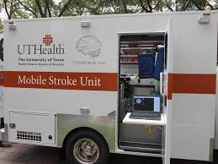
How to Minimize Time to Treatment
Mobile stroke care units

Slide 16
How does study work
All patients will get a CT of the brain to make sure that they have bleeding in the brain and qualify.
Eligible patients will receive best medical care including control of blood pressure and careful management of breathing in mobile stroke units when available, the emergency department and intensive care unit.
Patients will have an intravenous line placed as part of the standard care.

Slide 17
Participants will be put into one of two groups.
One group will receive rFVIIa in the intravenous line and the other group will receive placebo. This will be determined by chance (like flipping coin).

Slide 18
Intervention
Participants will get another CT of the brain within the first 24 hours to measure if there hemorrhage has increased in size.
They will receive treatment in the intensive care unit for as long as necessary.
They will have follow-ups with the study team by phone at 30 and 90 days and in person at 180 days.

Slide 19
What are potential risks?
Since rFVIIa helps stop bleeding by enhancing blood clots, there is a risk of heart attacks, stroke due to blockage of brain arteries, and clots in the lung.
In prior studies, this occurred about 5 % more commonly in persons treated with rFVIIa as compared to placebo. In other words, if 100 persons were treated with rFVIIa as compared to 100 persons treated with placebo, 5 more patients would have heart attack, stroke due to blockage of brain arteries or clots in lungs.

Slide 20
What are potential benefits?
If rFVIIa slows bleeding and improves outcome, participants may benefit from this study.
Future patients with bleeding in the brain may benefit from what is learned in the study.

Slide 21
How are emergency studies different?
In most studies, investigators describe what will happen, discuss potential risks and benefits, answer questions, and then eligible patients decide whether or not to participate. This process is called informed consent.
In this study, eligible patients cannot communicate or decide if they want to participate in the study. Also, treatment is needed to be started often before family or patient legal representative are available to decide for the patient.

Slide 22
So how do we do emergency research?
Specific federal regulations allow for exception from informed consent for emergency research or EFIC
EFIC is only allowed when:
  The condition under study is life threatening
  Existing treatment are unproven or inadequate
  There is potential benefit for patients
  Informed consent cannot be obtained.

Slide 23
Enrollment of Study Population
Subjects to be enrolled - 860.
Anticipated number of trial sites – 100 hospitals including 15 mobile stroke units.
Country(ies) participating. USA, Canada, Germany, Spain, UK, and Japan.

Slide 24
Requirement for EFIC
Community consultation (why we are here)
Public disclosure before and after study
Oversight during study

Slide 25
How does EFIC work in FASTEST
If family member or representative is available within the 2 hour time window, they will decide for patient.
If they are not available, eligible patients will be started in study without consent.
Patients, family members and representatives are told about the study as soon as possible and asked if they want the patient (or themselves) to continue in the study.

Slide 26
What if I don’t want to be in FASTEST?
Ask for an Opt-Out Card that says that you don’t want to be in the FASTEST Research Study and let your family members know your wishes.
Call your local study team to have a card sent to you.
Go to the Stroke Net website to print an Opt-out Card
  https://nihstrokenet.org/fastest/home
If you have bleeding in the brain, you will not be enrolled if you are carrying this Opt-Out Card when you arrive at the hospital.

Slide 27
What do you think about FASTEST?
The study hasn’t started yet, so…
  We want to hear your thoughts.
  Tell us about your experiences.
  Do you think that it is OK for the study to be done?
  The study team and medical review board will consider your input in deciding whether it is OK for this study to be done in our community.

Slide 28
Questions?
If you have any concerns or questions please call us or contact us.
Principal Investigator: Name phone number, email
Study Coordinator:
Name, phone number, email

