Slide 1
Welcome

Slide 2

NCC and NDMC
MPIs
  Pooja Khatri
  Joe Broderick
Administrative Co-Directors
  Laura Benken
  Jamey Frasure→Iris Davis
Managers
  Here today: NCC PMs: Harriet Howlett-Smith, Lesley Butler, Cristina Francois, Joelle Sickler, Melissa Hoffman, Maxwell Mays, Amy Sulken, Kalli Beasley, & Emily Stinson; Imaging Core Manager: Vivek Khandwala
New roles
  Trial Budget and Operations Planning Liaison: Eva Mistry
  Digital Content Physician Liaison: Yasmin Aziz
Administrative Coordinator
  Rose Beckmann
MPIs
  Jordan Elm
  Catherine Dillon
  Wenle Zhao
Associate Director of Trial Operations
  Jessica Griffin
NDMC Program Manager
  Logan Williams → Jocelyn Craven
(STEP Project Director)
Statistical Core
  Renee Martin, Christy Cassarly, Jonathan Beall, Sherry Livingston

Slide 3

RCCs—Three New RCCs
Duke-University of North Carolina (UNC) Eastern North Carolina and Southern Virginia Regional Stroke trIal cONsortium (ENVISION)
  MPIs: Wayne Feng, David Hwang, and Alexander Limkakeneg
New York City Collaborative Regional Coordinating Center (NYCC-RCC)
  MPIs: J Mocco, Aaron Lord, and Mark Mahler
The Southwestern Stroke Alliance Regional Coordinating Center
  PI: Michel Torbey

Slide 4
RCCs—24 Returning RCCs
BUSHNELL, CHERYL D (contact); WOLFE, STACEY QUINTERO | Wake Forest StrokeNet
FRANKEL, MICHAEL ROSS (contact); WOLF, STEVEN L; WRIGHT, DAVID W | NIH StrokeNet- Regional Coordinating Stroke Centers for year 2023
GROPEN, TOBY (contact); HARRIGAN, MARK ROBERT; LAZAR, RONALD M | StrokeBelt StrokeNet
KASNER, SCOTT E (contact); CUCCHIARA, BRETT LEE | Philadelphia Regional Stroke Trials Network Coordinating Center (PRSTNCC)
KIM, ANTHONY SUYOUNG | NIH StrokeNet- NorCal Regional Coordinating Center RCC13
LANSBERG, MAARTEN G | Stanford University Regional Coordinating Stroke Center for the NIH Stroke Trials Network
LEIRA, ENRIQUE CARLOS | The University of Iowas Regional Stroke Research Network
MAJERSIK, JENNIFER JUHL | UT StrokeNet
MARSHALL, RANDOLPH S (contact); CONNOLLY, EDWARD SANDER; LEIFER, DANA ; STIEG, PHILIP | Stroke Trials Network of Columbia and Cornell
MEYER, BRETT C | San Diego StrokeNet+
MISTRY, EVA (contact); DEMEL, STACIE | Ohio Valley Regional Coordinating Center for NINDS Stroke Trial Network
PANAGOS, PETER DAVID (contact); FORD, ANDRIA LEE | Mid-America Regional Coordinating Center (MARCC)

Slide 5
RCCs—24 Returning RCCs Continued
PRABHAKARAN, SHYAM | Chicago Stroke Trials Consortium
ROCHA, MARCELO (contact); NOGUEIRA, RAUL | NIH StrokeNet Regional Coordinating Center - University of Pittsburgh (STN-UP)
ROMANO, JOSE G | Florida Regional Coordinating Center for the NINDS Stroke Trials Network
SAVER, JEFFREY L (contact); SUNG, GENE YONG | Los Angeles - Southern California (LASC) NIH StrokeNet Regional Coordinating Center
SAVITZ, SEAN I | Gulf Regional Area Stroke Program and Oklahoma
SCHWAMM, LEE H | New England Regional Coordinating Center for the NINDS Stroke Trials Network (StrokeNet)
SCOTT, PHILLIP (contact); BROWN, DEVIN L | University of Michigan Regional Coordinating Stroke Center
SHETH, KEVIN NAVIN (contact); ALBERTS, MARK JAY; FURIE, KAREN L; TEMES, RICHARD ELIAS | Southern New England Partnership In Stroke Research, Innovation and Treatment (SPIRIT)
STREIB, CHRISTOPHER (contact); LAKSHMINARAYAN, KAMAKSHI | Upper Midwest StrokeNet Regional Coordinating Center (RCC)
SUNDARARAJAN, SOPHIA (contact); UCHINO, KEN | Case Western Reserve University StrokeNet University Regional Coordinating Center
TURAN, TANYA N (contact); HOLMSTEDT, CHRISTINE | Southeast Collaborative Alliance for Stroke Trials (SE-CoAST)
TURKELTAUB, PETER ETHAN (contact); HSIA, AMIE ; WORRALL, BRADFORD B | Stroke Central Atlantic Network for Research (SCANR)

Slide 6
StrokeNet Cores
Clinical Research Professional Education/Training Core
  Kinga Aitken MD, Univ Utah
  Heena Olalde MD, Univ Iowa
Diversity, Equity, Inclusion Core
  Bernadette Boden-Albala MPH PhD, UC-Irvine
  Lesli Skolarus MD, Northwestern Univ
Fellow Education/Training Core
  Randy Marshall MD, Columbia Univ
  Devin Brown MD, Univ Michigan

Slide 7
Advisory Committees
Patient Representative/Advocacy
  Flannery O’Neil, MPH
Preclinical
  Lauren Sansing, MD, Yale Univ
Pediatrics
  Heather Fullerton, MD, UCSF
Telestroke
  Chris Streib, MD, Univ Minnesota

Slide 8
Working Groups
Acute
  Karen Johnston MD, UVA
  Jeff Saver MD, UCLA
Prevention
  Hooman Kamel MD, Cornell Univ
  Marc Chimowitz MD
Recovery/Rehabilitation
  Steve Cramer MD, UCLA
  Steve Wolf PhD PT

Slide 9



















21 Ongoing Trials/Studies
PREVENTION OF STROKE (11)
CREST-2 Treatment of asymptomatic carotid stenosis (N=2480)
CREST-H Hemodynamic impairment ancillary study in CREST-2 (N=500)
ARCADIA Apixaban vs. aspirin for cryptogenic stroke (N=1100)
ARCADIA-CSI Apixaban for cognition and silent infarcts (N=500)
SATURN Statin use in ICH survivors (N=1456)
SATURN-MRI Statins for silent stroke (N=912)
ASPIRE Anticoagulation of atrial fibrillation in ICH survivors (N=700)
CAPTIVA Anticoagulation vs antiplatelets for intracranial stenosis (N=1683)
CAPTIVA MRI MRI biomarkers of recurrent stroke in intracranial atherosclerotic stenosis (n=300)
Sleep-SMART Treatment of obstructive sleep apnea (N=3062)
FOCAS Corticosteroids for pediatric stroke due to focal cerebral arteriopathy (n= 80)
ACUTE STROKE TREATMENT (5)
MOST Adjunctive antithrombotics (epfibatide, argatroban) to thrombolysis (N=1200)
FASTEST FVIIa for acute hemorrhagic stroke (N=860)
RHAPSODY-2 3K3A-APC with thrombectomy and thrombolysis (N=1400)
SISTER Dose-finding novel clot-dissolving Ab, TS23, in extended time window ischemic stroke patients (n=300)
STEP Platform Adaptive, registry-supported trial platform to optimize outcomes after LVO
STROKE RECOVERY & REHABILITATION (3)
TRANSPORT-2 Transcranial direct stimulation to aid recovery (N=129)
I-ACQUIRE Intensive infant rehabilitation for pediatric stroke (N=240)
VERIFY Acute prediction of motor recovery (N=657)
PRIMARY STROKE PREVENTION IN COVID (2)
ACTIV 4A Antithrombotic approach for inpatient COVID-19 patients

Slide 10
21 Ongoing Trials/Studies
PREVENTION OF STROKE (11)
CREST-2 Treatment of asymptomatic carotid stenosis (N=2480)
CREST-H Hemodynamic impairment ancillary study in CREST-2 (N=500)
ARCADIA Apixaban vs. aspirin for cryptogenic stroke (N=1100)
ARCADIA-CSI Apixaban for cognition and silent infarcts (N=500)
SATURN Statin use in ICH survivors (N=1456)
SATURN-MRI Statins for silent stroke (N=912)
ASPIRE Anticoagulation of atrial fibrillation in ICH survivors (N=700)
CAPTIVA Anticoagulation vs antiplatelets for intracranial stenosis (N=1683)
CAPTIVA MRI MRI biomarkers of recurrent stroke in intracranial atherosclerotic stenosis (n=300)
Sleep-SMART Treatment of obstructive sleep apnea (N=3062)
FOCAS Corticosteroids for pediatric stroke due to focal cerebral arteriopathy (n= 80)
ACUTE STROKE TREATMENT (5)
MOST Adjunctive antithrombotics (epfibatide, argatroban) to thrombolysis (N=1200)
FASTEST FVIIa for acute hemorrhagic stroke (N=860)
RHAPSODY-2 3K3A-APC with thrombectomy and thrombolysis (N=1400)
SISTER Dose-finding novel clot-dissolving Ab, TS23, in extended time window ischemic stroke patients (n=300)
STEP Platform Adaptive, registry-supported trial platform to optimize outcomes after LVO
STROKE RECOVERY & REHABILITATION (3)
TRANSPORT-2 Transcranial direct stimulation to aid recovery (N=129)
I-ACQUIRE Intensive infant rehabilitation for pediatric stroke (N=240)
VERIFY Acute prediction of motor recovery (N=657)
PRIMARY STROKE PREVENTION IN COVID (2)
ACTIV 4A Antithrombotic approach for inpatient COVID-19 patients

Slide 11
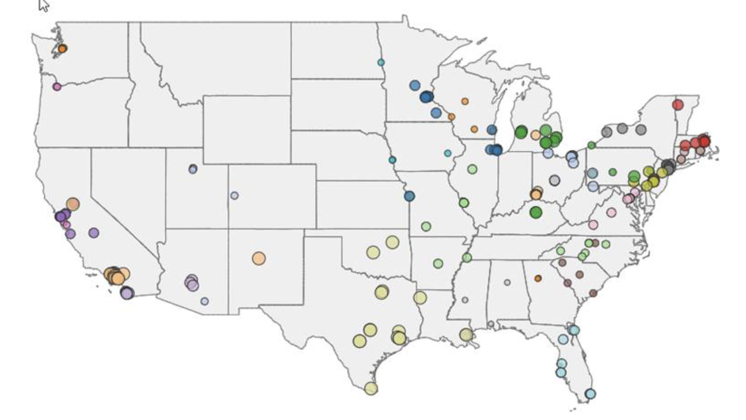
Countless Others—
NCC, NDMC, RCCs, Trial-Specific Investigators and Coordinators, Committees, Enrolling Hospitals

Slide 12
Almost 12k Enrolled, Over 6k Randomized

Slide 13
Goals
Today
  Continue to build our StrokeNet community
  Identify operational challenges and opportunities for targeted future efforts on local and national levels
Upcoming Year
  Identify topics 1-2 targeted future open conferences organized by StrokeNet
    Facilitate community stakeholder discussions that identify areas of high unmet need and priorities in stroke research
  Continue our mission
    NINDS established NIH StrokeNet to harness the leadership and experience of the stroke field to efficiently create and complete high-quality, multi-site trials, related biomarker validation studies, and ancillary studies

Slide 14
Goals
Today
  Continue to build our StrokeNet community
  Identify operational challenges and opportunities for targeted future efforts on local and national levels
Upcoming Year
  Identify topics 1-2 targeted future open conferences organized by StrokeNet
    Facilitate community stakeholder discussions that identify areas of high unmet need and priorities in stroke research
  Continue our mission
    NINDS established NIH StrokeNet to harness the leadership and experience of the stroke field to efficiently create and complete high-quality, multi-site trials, related biomarker validation studies, and ancillary studies

Slide 15
A Look Back to 2022 StrokeNet F2F (Atlanta)
✔ | Diversity core funding/Cultural humility training | DEI core starting 12/1/2023
✔ | More guidance on prime trial budgeting | Appointment of Trial Budget and Operations Planning Liaison, Eva Mistry Additional resources in development
✔ | Budget for translators for outcomes assessments, in addition to ICF | Currently in templates
✔ | Improve per patient/startup budgets for screening and local PI efforts | Increased template amounts
✔ | Leverage CTSA resources | RedCAP, eCONSENT, coordinator CRP education opportunities
✔ | Coordinator education/training/development | CRP education/training core starting 12/1/2023
✔ | Refer to coordinators vs RCC PMs for consistency in SN; individual sites can still use institutional titles | Implemented
✔ | RCC PM specific mtgs | Quarterly meeting 10/22/22, 3/7/23, 6/1/23, 9/20/23
✔ | RPPR report prep training | Many webinars discussing RPPRs on website Website reorganization in progress
✔ | Determine group rate on certifications if possible | SoCRA not able to give group rate, materials for continuing education credits
✔ | General coordinator office hours | Encouraged trials encouraged to host office hours during start up
 | Have core group of experienced coordinators who take on 7-10 sites for mentoring and guidance | CRP Education/Training Core to consider best approach
 | Site PI education about roles/responsibilities relative to Coordinators | Pending Steering Committee agenda item Local initiatives have occurred

Slide 16
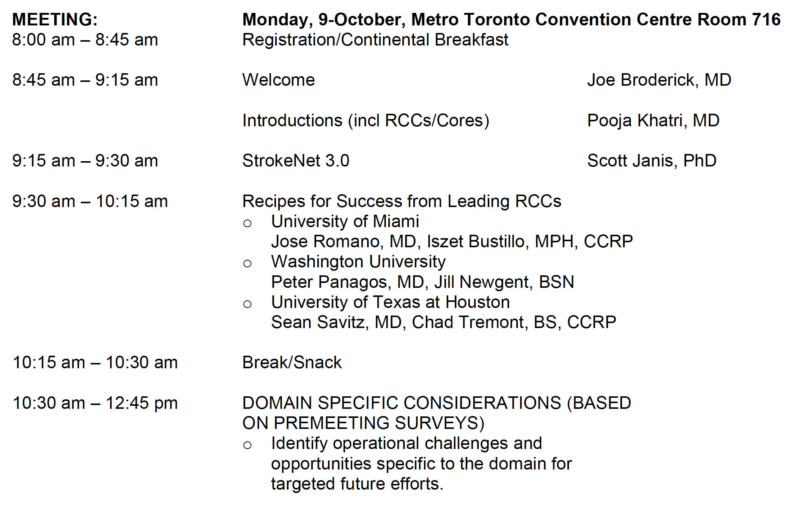
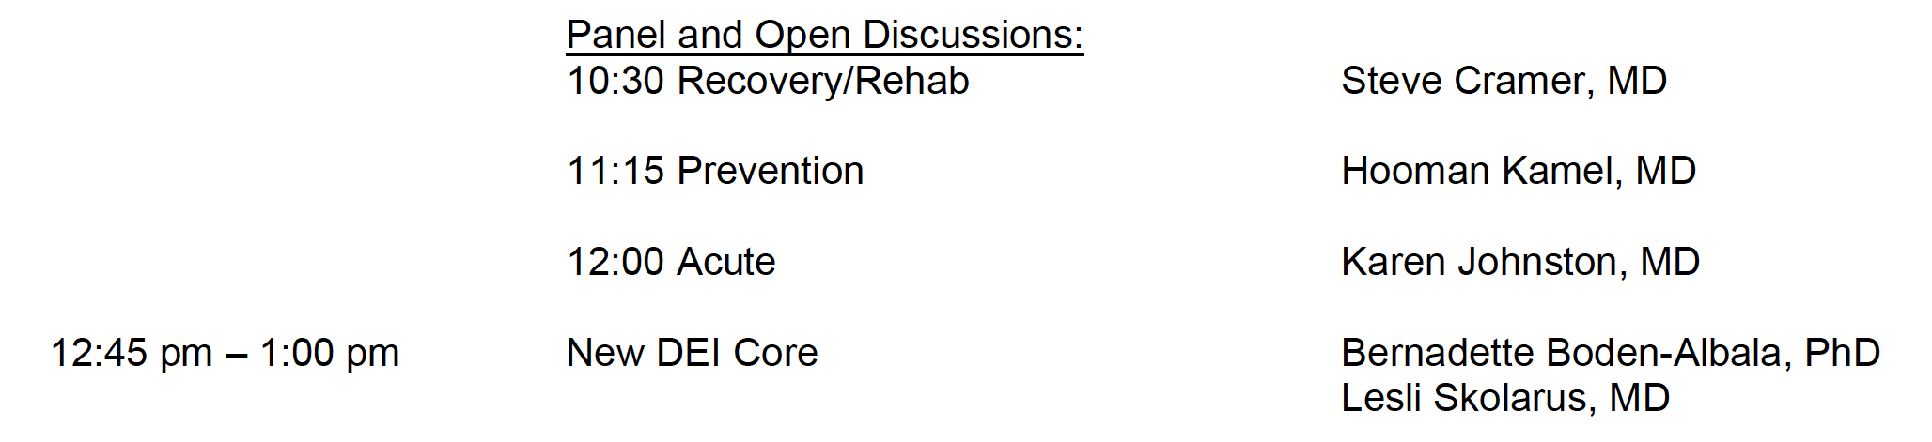
Agenda

Slide 17
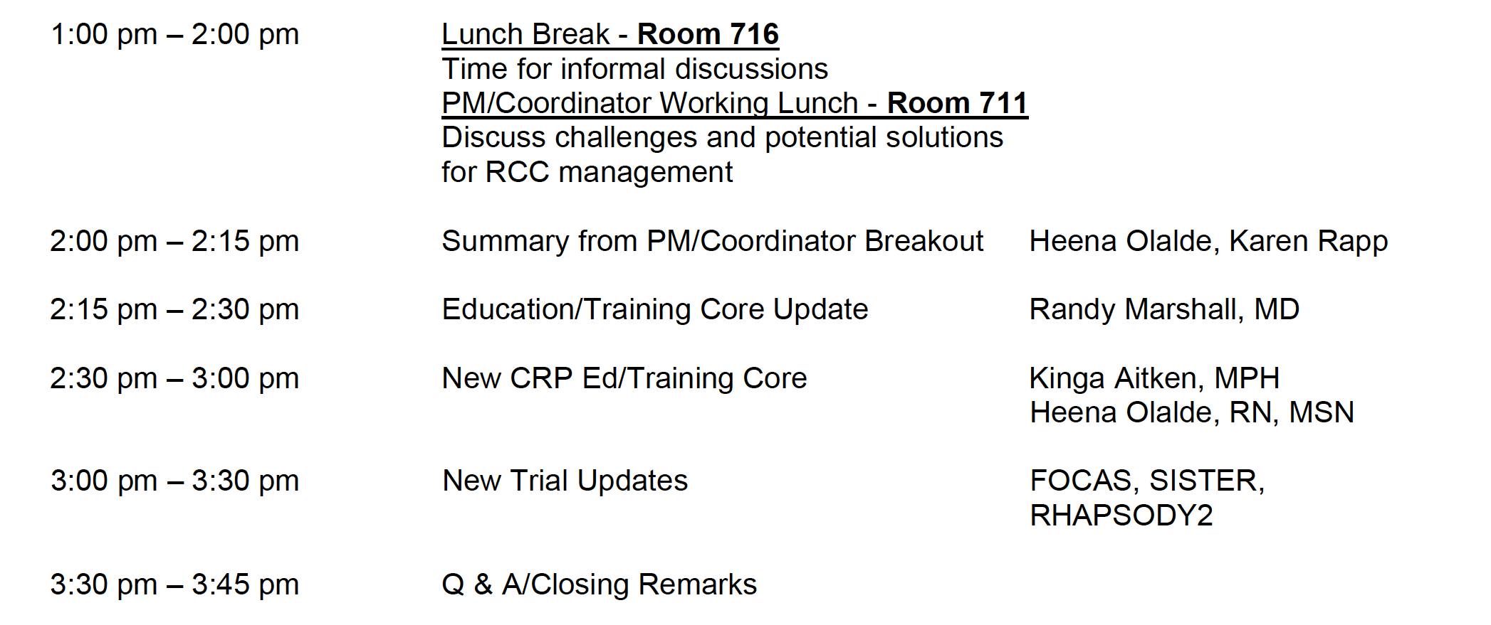
Agenda
PMs/Coordinators released first
Separate buffet will be set in front of the breakout room (Rm 711) for the working lunch
Note: Two extra rooms if people want to spread out and have smaller chats (Rms 707-709)

Slide 18
Housekeeping
Wireless internet
  Network: WSC-2023
  Password: wsc-2023
Live streamed and recorded
Microphones/introduce yourself
Chat questions—Emily Stinson
Speakers: Slide upload in back

