Slide 1
Annual RPPR, WebDCU Trial Resources, Additional Screening Tools, and Trial Updates
Mariam Afzal NINDS
Jama Olson NDMC
Stephanie Kemp Stanford University
StrokeNet Trial PMs University of Cincinnati

Slide 2
Objectives
CRP Coordinator Mentoring Program
Review Annual RPPR
  What needs to be done
  Due Dates
WebDCU Trial Resources
RedCap for Screening
Updates from StrokeNet Trial Project Managers

Slide 3
CRP Coordinator Mentoring Program
Starting in 2025
Mentees will be able to sign up via REDCap link and select research topics they need mentoring on (link will become active October 1) Topics include:
Informed Consent Role Play | Documentation Best Practice | StrokeNet Structure, Policy, and Resources
eConsent Role Play with REDCap | Reliance on a Central IRB / Central IRB submissions | Preparing for a Monitor Visit
Informed consent – Communication / Teach Back / Participant or LAR Comprehension | Trial Start-up – Local Responsibilities | Communication with Clinicians / Patients / Families
Good Clinical Practice | Data Management | Event Reporting

Slide 4
CRP Coordinator Mentoring Program
Mentees will meet 1 per month with a mentor on research topics they select. (no more than 5 mentees to 1 mentor)
Mentor materials will be interactive, come prepared to participate
After completion of 6 mentoring sections, mentees will receive a certificate of completion from the StrokeNet CRP Coordinator Mentoring Program and 6 hours of continuing education credits good toward any clinical research certification program

Slide 5
Call for Mentors
Open call for Mentors – RCC Managers, NCC Staff, and NDMC Staff
Mentor responsibilities include:
Create interactive materials on your area of expertise that will be reviewed and approved by the CRP Coordinator Mentoring Program Task Force and StrokeNet Leadership
Scheduling a 1 hour monthly interactive meeting with your assigned mentees
Leading a 1 hour monthly interactive meeting with your assigned mentees
Tracking mentee meeting completion in REDCap
To sign up to be a mentor, please complete the REDCap survey here: https://redcap.link/CRP_Mentor_Sign-up

Slide 6
Annual RPPR

Slide 7
Annual RPPR
Mariam Afzal, NIH StrokeNet Program Official
8/28/24

Slide 8
What is the RPPR?
Research Performance Progress Report
RPPR is an annual progress report required of recipients of federally funded research projects, to document achievements, challenges, and compliance with terms of award.
Annual RPPR is required near the end of each budget period, prior to awarding the next non-competitive segment.
Interim RPPR is required at the end of the current competitive segment, when a competing renewal application is submitted.
  When renewal is awarded, the Interim RPPR will be treated as the annual RPPR and no other progress reporting will be needed for that segment of the award.
Final RPPR is required for any award that has ended and that will not to be extended through award of a new competitive segment.
Notes:
When awarded a 5-year project, for the first 4 years, you submit an annual RPPR. In the last year, you submit either an Interim or Final RPPR.
Any questions? Feel free to raise your hand or put questions in the chat.

Slide 9
Step-by-step instruction guide for the RPPR
NIH and Other PHS Agency Research Performance Progress Report (RPPR) Instruction Guide
Detailed instructions about how to access, initiate, and edit the RPPR module in eRA Commons
Basic instructions for completing Sections A through H of the RPPR (section I is not applicable for annual RPPR)
  See Instruction Guide Section 6 (page 77)
Supplemental instructions for specific grant types (like U24)
  See Instruction Guide Section 7.6 (page 130)
Notes:
We’ll go over each relevant section in more detail.

Slide 10
How do you access and submit the RPPR?
eRA Commons
RPPRs (annual, interim, and final) are submitted through an electronic form in eRA Commons.
Only the Program Director/Principal Investigator (PD/PI) or their delegate can initiate an RPPR. When there are multiple PIs (MPI), only the Contact PI (or their delegate) can initiate the report.
  Select the Status tab from the Commons menu options.
  Select the List of Applications/Awards option from the Status screen.
  From the List of Applications/Awards screen, locate the grant and click the + sign to expand the list of award years. Once you’ve found the correct year for that award, go to the Action column on the right of screen and click the RPPR link.
You can edit an RPPR only if you are the current reviewer. The PI who initiated the RPPR is automatically the current reviewer. When the RPPR is routed to someone else, that person becomes the current reviewer and can edit.
Only the institutional signing official (SO) can submit an RPPR.
Notes:
SO is typically in Office of Contracts / Sponsored Programs
Any questions? Feel free to raise your hand or put questions in the chat.

Slide 11
RPPR – the basics
Annual RPPR
Due in eRA on the 1st of the month prior to budget end date
  If end date is 11/30/24, annual RPPR is due 10/1/24 **
Due on 10/1/2024 for all StrokeNet Coordinating Centers
Required Sections:
  A. Cover Page
  B. Accomplishments
  C. Products
  D. Participants
  F. Changes
  G. Special Reporting Requirements
  H. Budget
** This is the NIH deadline. RCCs may have earlier institutional deadlines. **
Notes:
Any questions? Feel free to raise your hand or put questions in the chat.

Slide 12
Section A: Cover Page
(Instruction Guide p. 78)
Mostly prepopulated from eRA Commons data, but some fields are editable
Includes information about the award, PD/PI, organization, and project/reporting/budget periods

Slide 13
Section B: Accomplishments
(Instruction Guide p. 80-81)
B.1 Goals
  List the major goals/specific aims of the project as stated in the approved application or as approved by NINDS
  Specific aims were modified during the competitive renewal – do not copy/paste from last RPPR.
B.2 Accomplishments under these goals
  Focus on this budget period only
  Include major activities and key outcomes/achievements that support StrokeNet and distinguish your RCC from others
    E.g. StrokeNet trials conducted at the RCC/satellite sites; Leadership roles and participation in Committees, Working Groups, Cores; Addition of satellite sites; Master Trial Agreements established; Site visits and other oversight activities; RCC/site performance metrics; QA/QC activities, RCC/Site PI’s role as Protocol PI; Development of clinical trial proposals, etc.
  Include a discussion of stated goals that were not met, if any
B.3 Competitive Revisions/ Administrative Supplements
  If applicable, list the grant # and describe specific aims and accomplishments
Notes:
Goals generally won’t change from year to year. But since this is the first year since the competitive renewal, make sure to include specific aims from your application.
“For most NIH awards, the response (in B.2) should not exceed 2 pages.”
Please try to stick to this guideline. Longer is not necessarily better. Format is up to you – paragraph form, tables/bullets

Slide 14
Section B: Accomplishments (continued)
(Instruction Guide p. 81-83)
B.4 Training and professional development
  Describe opportunities for training and professional development provided to anyone who worked on the project or anyone who was involved in the activities supported by the project.
  Training activities may include, for example, courses or one-on-one work with a mentor.
  Professional development activities may include workshops, conferences, webinars. (Include any not already listed in B.2.)
B.5 Dissemination of results to communities of interest
  Describe any outreach activities to enhance public understanding and increase interest in research, etc.
  If outreach is not included in specific aims, a response is not required.
B.6 Plans for next award period
  Describe briefly what you plan to do during the next reporting period to accomplish the goals and objectives.

Slide 15
Section C: Products
(Instruction Guide p. 83-90)
C.1 Publications
  Only report publications if
    the publication was accepted for publication or published during the period since the last progress report was submitted, and
    the publication directly arises from the award (e.g., the award supported trainees or personnel activity that contributed to the publication, such as authorship, consulting with authors, preparing manuscripts, running analyses reported in the publication).
  The tables draw information from the PD/PI’s My NCBI account
  Compliance with the NIH Public Access Policy is indicated, using information from My NCBI
Notes:
C2-C5 are likely not applicable

Slide 16
Section D: Participants
(Instruction Guide p. 90-96)
D.1 Individuals who have worked on the project
  Complete the table to include all PDs/PIs, plus each person who has worked at least one person-month per year on the project during the reporting period, regardless of the source of compensation
D.2 Personnel Updates
  Describe changes in:
    Level of effort
    Senior/Key personnel
    Other support
    Other significant contributors
    MPI Leadership Plan (not a change in PD/PI)
Notes:
See instruction guide for lots more details for each section.

Slide 17
Section F: Changes
(Instruction Guide p. 98)
F.1 Not applicable
F.2 Challenges or delays and plans to resolve them
  Describe only significant challenges that may impede the research (e.g., accrual of patients, hiring of personnel, need for resources or research tools) and emphasize their resolution.
F.3 Not applicable
Notes:
Section E (Impact) is not applicable for most awards.

Slide 18
Section G: Special Reporting and Section H: Budget
(Instruction Guide p. 111-116)
G.10 Estimated unobligated balance
  Carryovers are not automatic – a prior approval request must be submitted (generally a few months into the next budget period)
H.1 Budget form
H.2 Subaward Budget form
**Work with your grants office for these sections**
Notes:
Most of Section G is not applicable, including the human subjects section. Inclusion data is collected in each trial’s RPPR, not RCC RPPRs.
Section I Outcomes is not required for annual RPPRs

Slide 19
Helpful links
StrokeNet
Coordinator Webinar – Feb 28, 2024 (Interim RPPR Slides)
Coordinator Webinar - April 28, 2022 (RPPR Slides)
eRA Commons
Research Performance Progress Report (RPPR) Module (nih.gov)
RPPR Frequently Asked Questions (FAQs) | grants.nih.gov
NIH and Other PHS Agency Research Performance Progress Report (RPPR) Instruction Guide
Research Performance Progress Report | eRA (nih.gov) – tutorials

Slide 20
Questions?
eRA Service Desk
Need Help? | eRA (nih.gov)
Submit a Web Ticket
Toll-free: 1-866-504-9552 (Press 1 for eRA Commons)
NIH StrokeNet Program Official
Mariam Afzal – mariam.afzal@nih.gov

Slide 21
Thank you!

Slide 22
WebDCU Trial Resources

Slide 23
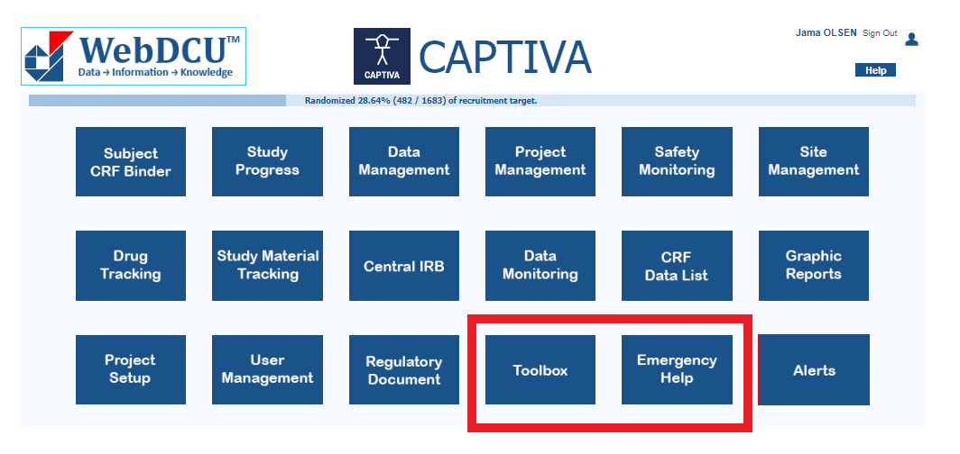
Who you gonna call?
Resources in WebDCU

Slide 24
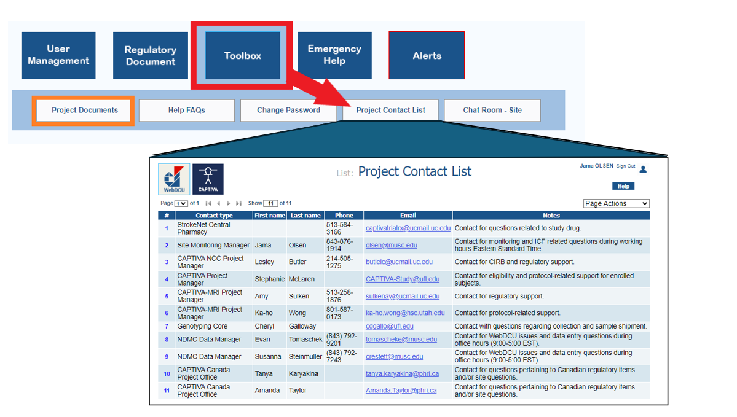

Slide 25
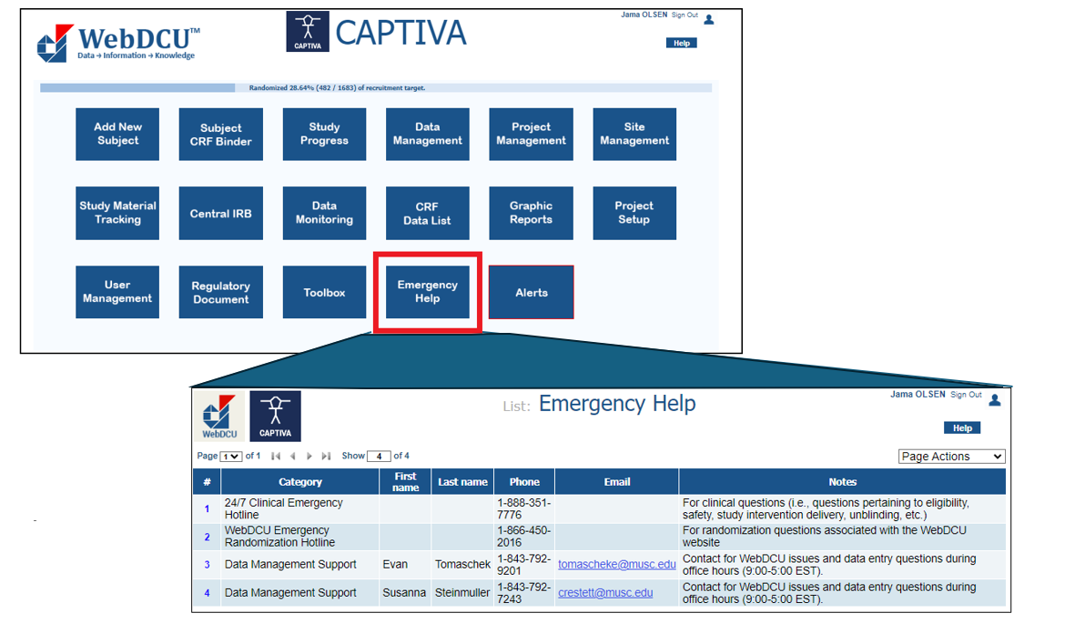

Slide 26
RedCap for Screening

Slide 27
Stanford Stroke & Neurocritical Care
Research Study Screening Tool
August 28, 2024
Stephanie Kemp

Slide 28
BACKGROUND

Slide 29
Challenges to screening
Among other things…
Parallel screening by research coordinators and clinicians
Screening for multiple simultaneous trials
Complexity of unique inclusion/exclusion criteria in each trial
Limited prioritization of research screening by clinicians during busy clinical times

Slide 30
How to improve
2015 ~ multidisciplinary group, including stroke & NCC faculty and fellows, research coordinators, and biostatisticians
Developed an electronic tool to improve the efficiency and efficacy of screening for multiple simultaneous acute clinical stroke trials
Goals:
automate the evaluation of inclusion and exclusion criteria
improve screening procedures
streamline the communication process between the stroke research coordinators and the stroke clinicians.
Publication:
Spokoyny I, Lansberg M, Thiessen R, Kemp SM, Aksoy D, Lee Y, Mlynash M, Hirsch KG. Development of a Mobile Tool That Semiautomatically Screens Patients for Stroke Clinical Trials. Stroke. 2016 Oct;47(10):2652-5. doi: 10.1161/STROKEAHA.116.013456. Epub 2016 Sep 8. PMID: 27608822; PMCID: PMC5039105.

Slide 31
Why REDCap?
Institutionally approved for protected health information
HIPAA complaint
Free to our researchers as part of Stanford’s CTSA Award
Update the tool quickly and easily - various studies starting and stopping unpredictably, the ability to rapidly update both survey content and the branch logic algorithms as well as personnel access to the results database
Accessible via a weblink from any internet browser
Provides an automatic record of all patients screened, which is helpful for clinical metrics and research screening logs
Uses simple conditional logic to sort the applicable trial eligibility choices

Slide 32
WORKFLOW
Clinical team enters:
Basic demographic information (name, MRN)
Patient location (in-patient vs outpatient)
Diagnosis- 4 choices:
Ischemic (stroke or TIA)
Hemorrhagic
Not stroke
Cardia Arrest & TBI (recently added for SIREN studies)
Date & time of onset
Additional details depending on diagnosis (ie. NIHSS, GCS, etc)

Slide 33
WORKFLOW
Clinical team receives:
a list of trials for which the patient may be eligible, along with a brief description of each trial and inclusion criteria
Clinical team selects one of the following
choices for each study presented:
* Eligible
* Not Eligible
* Not Eligible Now-Continue Screening
A free text box allows the clinical team to enter pertinent details that may help the coordinators with screening (ie. patient expressed interest in studies, patient unable to consent, need LAR, etc)

Slide 34
WORKFLOW
REDCap system automatically generates a secure e-mail to the study coordinators, who then follow a hyperlink to review the screening results
Coordinators continue to screen / help determine eligibility / enroll!
Coordinator updates REDCap with the final outcome of the screening (patient enrolled, determined not eligible, continue screening, etc)

Slide 35
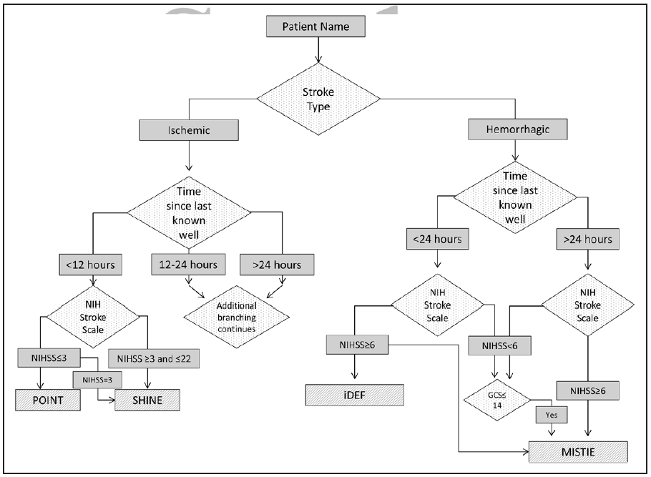
Sample branching logic

Slide 36
Sample branching logic
Patient name & MRN
Diagnosis
Ischemic
Hemorrhagic
Cardiac Arrest or TBI
Time from LKW
< 12 hrs
12 - 24 hrs
> 24 hrs
NIH Stroke Scale
NIHSS > 4
PRECISE
NIHSS < 4
LIBREXIA
Study X
Time from LNW
< 24 hrs
> 24 hrs
additional branching logic
additional branching logic
NIH Stroke Scale
Boost
Comments
ICECAP
None of the above
Location

Slide 37
THANK YOU!

Slide 38
StrokeNet Trial Updates

Slide 39

Strategy for Improving Stroke Treatment Response

Slide 40

SISTER Updates
  48 Sites Participating – interviewing 2 more. (50 US sites max)
  Conversation is ongoing regarding expansion to foreign countries. A survey will be sent to many foreign PIs for prospective sites to complete.
  Protocol v4 will be submitted after FDA review and approval.
  DSMB meeting is preliminarily scheduled for 10/7/2024
  All sites sent start-up packets prior to June 2024 are expected to be released to enroll by 9/30/2024 or risk being replaced.
  An IM is being planned for next spring.
CDAs Executed | cIRB Approved Sites | CTAs Executed | Sites Released to Enroll | Subjects Randomized
48 | 38 1 pending & 3 sites close to submission | 38 | 30 | 5

Slide 41

STEP

Slide 42
STEP Status
Accomplishments
  First Study Wide Webinar occurred 02Aug2024
    Included Study Updates, Outcomes Assessment Training, Heidelberg Bleeding Classification Training
  CIRB approvals: 11
  Fully executed Clinical Trial Agreements: 14
Milestones
  Start-up officially initiated 21May2024
  First DSMB Meeting scheduled 18Sep2024
Hurdles
  Subaward between MUSC and UC took a little longer than anticipated which impacted initiating site start-up
Updates
  Working through CIRB modification requests for PRIME submission that included addition of biobank sample collection to Master Protocol appendix/new informed consent along with various Domain A protocol/informed consent updates
Is STEP Accepting New Sites?
  Currently we are not accepting new sites
  May engage new sites when STEP expands with new domains

Slide 43


Slide 44
ASPIRE
Subjects in the ASPIRE trial are survivors of Intracerebral hemorrhage (ICH) who have atrial fibrillation (AF)
Study is comparing anticoagulants in patients with AF after ICH
  Subjects randomized to receive 5 mg apixaban BID or 81 mg ASA QD
  Subjects are followed for outcomes up to 36 months
Study target is 700 randomized subjects
  Study is at 47% enrollment
We are finalizing ASPIRENet 3.0 teams- reach out to join!
ASPIRE is still adding interested sites – ASPIRE@yale.edu

Slide 45

FVIIa for Acute hemorrhagic
Stroke Administered at Earliest
Time(FASTEST) Trial

Slide 46

Primary Specific Objective – FASTEST
The objective of the FVIIa for Acute hemorrhagic Stroke Administered at Earliest Time (FASTEST) Trial is to establish whether rFVIIa within two hours of the onset of brain hemorrhage in appropriately selected patients improves outcome at 180 days, as compared to placebo.
NIH Funded: 1U01NS110772-01

Slide 47

Enrollment updates:
Current Subject Enrollment- 520 (142 US/377 OUS)
Current Sites Released to Enroll -90 (52 US/ 38 OUS)
US MSU’s Released to Enroll- 12 (10 US/ 2 OUS)
Country | Total # of Sites | Total # of Subjects | Average Active Month* | Average Enrollment per Active Month^*
Canada | 8 | 62 | 17.98 | 0.43
Germany | 6 | 29 | 22.31 | 0.21
Japan | 14 | 232 | 25.05 | 0.66
Spain | 6 | 35 | 15.50 | 0.40
UK | 4 | 14 | 16.88 | 0.28
US | 52 | 139 | 17.83 | 0.19
Data as of August 12, 2024 *Active month is defined as the number of months since released to enrolled ^Average Enrollment per Active Month is calculated by taking the average of the sites’ enrollment per active month for each country.

Slide 48
Trial updates:
Pending FDA approval for protocol v8 to change trial design and update SAP
Once FDA approval will seek cIRB approval in the US and regulatory authority approval in all participating international countries
Final EFIC approval by all remaining participating US sites by end of Aug 2024
WebDCU Database freeze scheduled for Oct to prepare for interim analysis
DSMB meeting in November 2024
If trial is to continue plans to add Australia to trial in 2025

Slide 49
Sleep Smart

Slide 50
Sleep SMART Enrollment Update
Enrolled: 5,006
Randomized: 1,581

Slide 51
Sleep SMART Continuing Review
CR was approved by the CIRB. The approval email was sent on 7/29.
Please upload the CIRB re-approval letter into WebDCU in the CIRB Approval (Protocol v11 – 14Oct2022) placeholder. Please enter 10Jul2024 for the “Effective Date” and 09Jul2025 for the “Expiration Date”.
Please assure you have your CR submitted locally for acknowledgement

Slide 52
Sleep SMART DSMB recommendations (accepted by NINDS)
Prevention aim
  Pause new enrollments
  Continue with 3- and 6-month outcome assessments
  Repeat interim analysis after participants enrolled before 6/28/24 have outcomes available
Continue enrollment in recovery aim
  Continue with new enrollments
  (Continue with 3- and 6-month outcome assessments)

Slide 53
Sleep SMART Amendment
Protocol v12 and ICD template v11 were approved on 8/14/2024
The NCC regulatory specialists are making the amendment changes to site specific ICDs and will submit to the CIRB on your behalf.
Please continue to use your currently CIRB-approved consent form v10 until you receive your CIRB approved ICD v11.

Slide 54
Sleep SMART Amendment Changes
Change in inclusion criteria:
  Age ≥18
  Ischemic stroke within prior 7 days [from last known well/stroke onset until consent]
  NIHSS ≥1 at time of enrollment
Exclusion criteria
  Unchanged
  Training
  ABCD2 no longer needed. There will be an option to waive the requirement in WebDCU.
Outcome assessments
  Unchanged. Please continue to collect 3- and 6-month outcome assessments (entire visit blinded) on ALL Sleep SMART participants

Slide 55
Practical implications
Targeted enrollment/randomization
  Currently, 1,043/1,362 (76.6%) randomized for the recovery aim
    We need 319 more randomized! (We likely need about 988 more enrolled.)
  Please try to maintain or grow your previous recruitment volume for Sleep SMART.

Slide 56
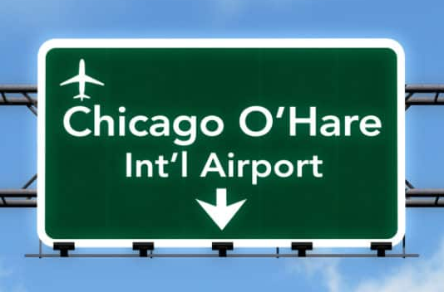
In-person investigator/coordinator meeting
Chicago! Hilton Chicago O'Hare Airport
Oct 24 (evening reception)/Oct 25 meeting
Departure on Oct 25, if possible
PIs participation ends earlier than coordinators to accommodate a WebDCU training and hands-on FusionHealth training
Notes:
- I have not sent out an email regarding flights and accommodation, so sit tight. You have not missed anything. Everything is covered by the trial.

Slide 57


Slide 58
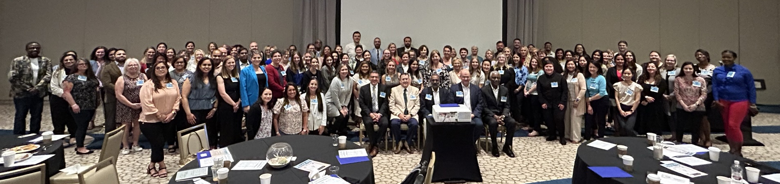
Strokenet meeting
Wednesday, August 28, 2024

Slide 59
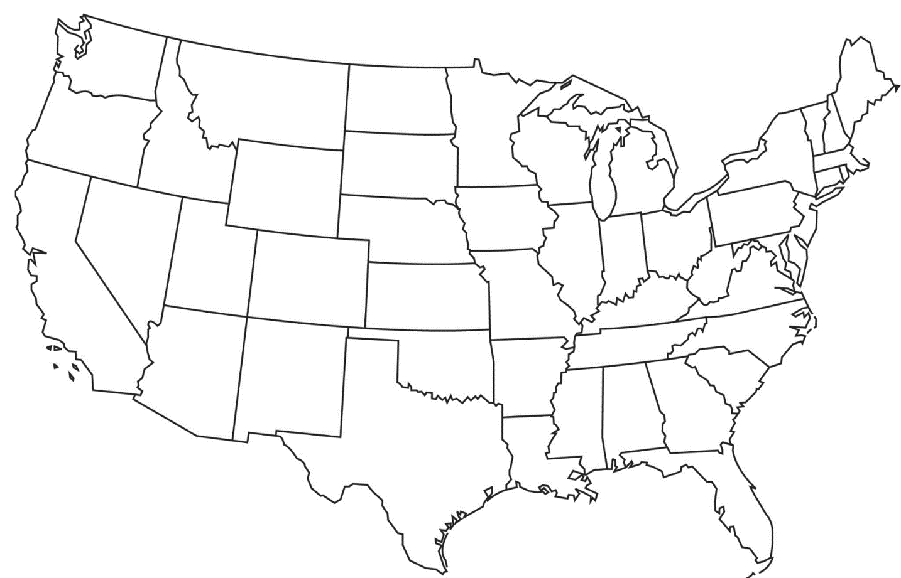
a big team
Statistical Data Coordinating Center
  Lloyd Edwards, PhD;
  George Howard, Dr.P.H.
181 sites in 5 countries
3 cores
  Medical Management
  Tanya Turan, MD
  Imaging
  Brajesh Lal, MD
  Adjudication
    Robert Brown, MD
Columbia (Randy Marshall, MD) CREST-H (392 patients)
CEA
CAS
Both

Slide 60
CREST-2: A big job for a big team
16,836 patient visits
7,557 cognitive visits
Carotid Endarterectomy Trial
Carotid Artery Stenting Trial
1241
Completed 9/29/2023
1240
Completed
7/10/2024

Slide 61

Close-out
Follow up for 1-year of the last patient randomized in each trial
  CEA-MED complete September 29th
  CAS-MED complete July 31st, 2025
Publication in New England Journal (hopefully) February 2026 or earlier
Results will impact patient care world-wide
Unique opportunities to study the relationship between revascularization and cognition
Notes:
AT LEAST 8 MONTHS OF LEAD TIME

Slide 62
Crest-2 long-term observational extension
7/5/22
First patient enrolled
8/28/24
50 sites activated
251 participants enrolled

Slide 63

Update
StrokeNet Coordinator Webinar
August 28, 2024

Slide 64
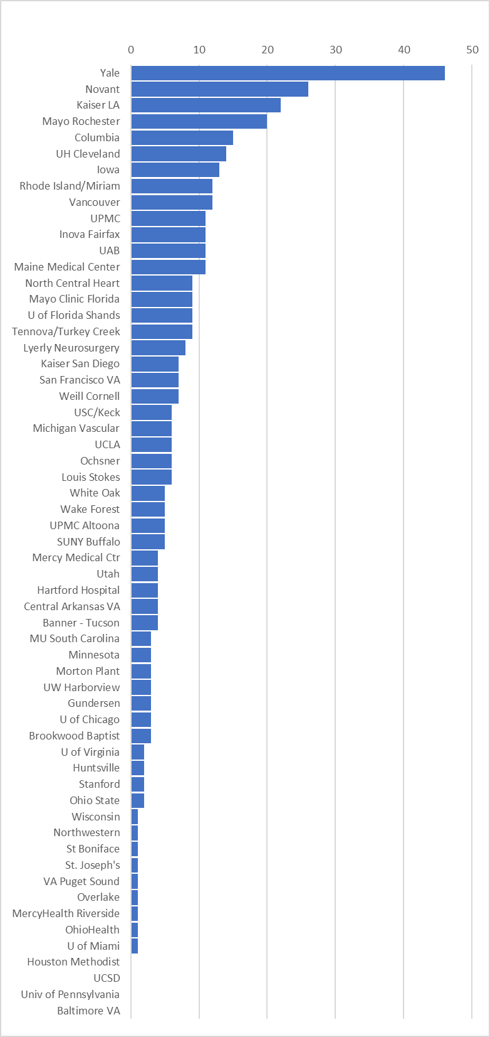
Enrollment by Site
Overall Enrollment Summary:
Total Enrollments: 392
Reached our goal on July 3rd!
Overall Enrollment by Center:
Yale first with 46 enrollments
Novant/Forsyth second with 26
Kaiser LA third with 22
Mayo Rochester fourth with 20

Slide 65
Reminder: Data Completion/Patient Follow-up
Enter any outstanding H01-03 Baseline Forms on eDES
Enter H04 after Year 1 Scan (if eligible) on eDES
Upload scan images via Sharepoint or send to University of Maryland as quickly as possible to ensure timely review
Remember also that the 12-month cognitive exam is critically important as our primary outcome. If for some reason the patient misses that, it is important that a subsequent cognitive exam at 2 years, 3 years and 4 years be completed as we can still make use of those data points!
CREST-H follow-up will continue until CREST-2 follow-up concludes (Cognitive Testing is part of the CREST-2 protocol, but this data is used by CREST-H)

Slide 66
I-Acquire

Slide 67
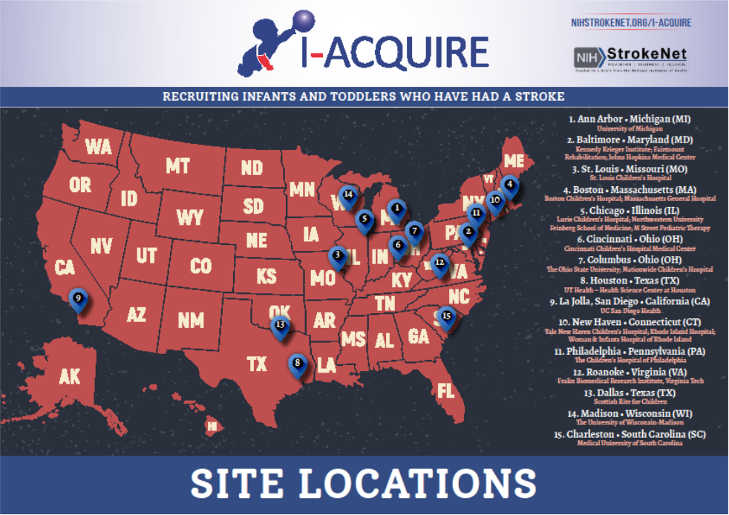

Slide 68
The I-ACQUIRE Phase 3 Trial for PAIS
  Patient Population: 8- to 36-mth olds with Perinatal Arterial Ischemic Stroke (PAIS) and hemiparesis. Treatment: Casting of the non-paretic arm & hand and receiving therapy for either 3 hrs or 6 hrs/day, 5 days/wk X 4 wks in home or natural setting + parent support.
  Primary Aims: To assess the effects of 2 dosage levels of an intensive form of pediatric Constraint-Induced Movement Therapy - known as I-ACQUIRE - compared to Usual & Customary Treatment on:
      Functional skills on the paretic upper extremity
      Bilateral functional use
  Secondary Aims: To explore association of I-ACQUIRE to changes in other developmental domains (language, gross motor, cognition) and development at 12-mos Post-Treatment
  IMPACT: Findings are critical to inform treatment recommendations; currently, there is no evidence-based standard-of-care for this patient group.
  15 sites currently have enrolled 212 children and their families. Our Parent Council has been active from the beginning. We project completing enrollment by October 2024 and data collection by October 2025.

Slide 69
Transport 2

Slide 70



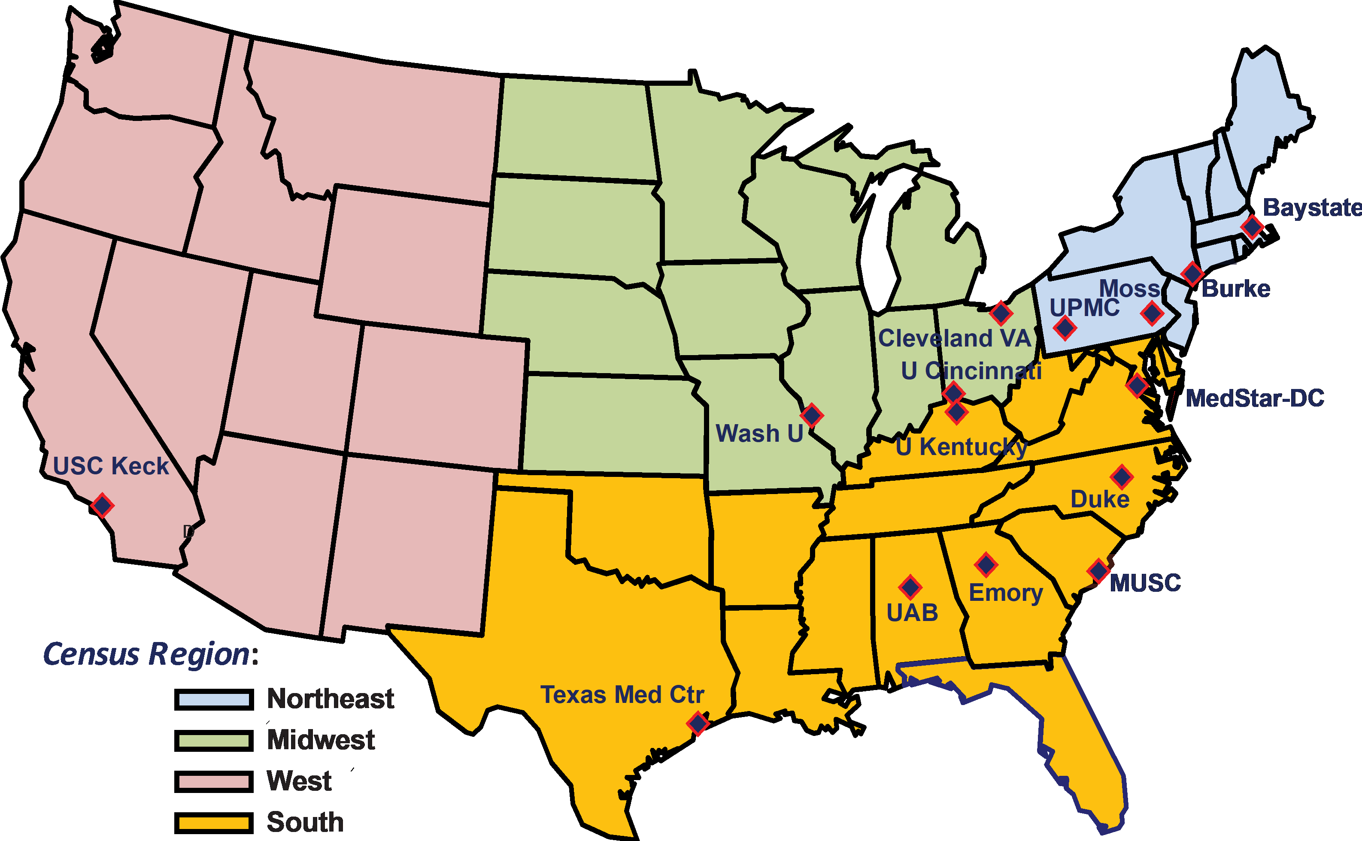
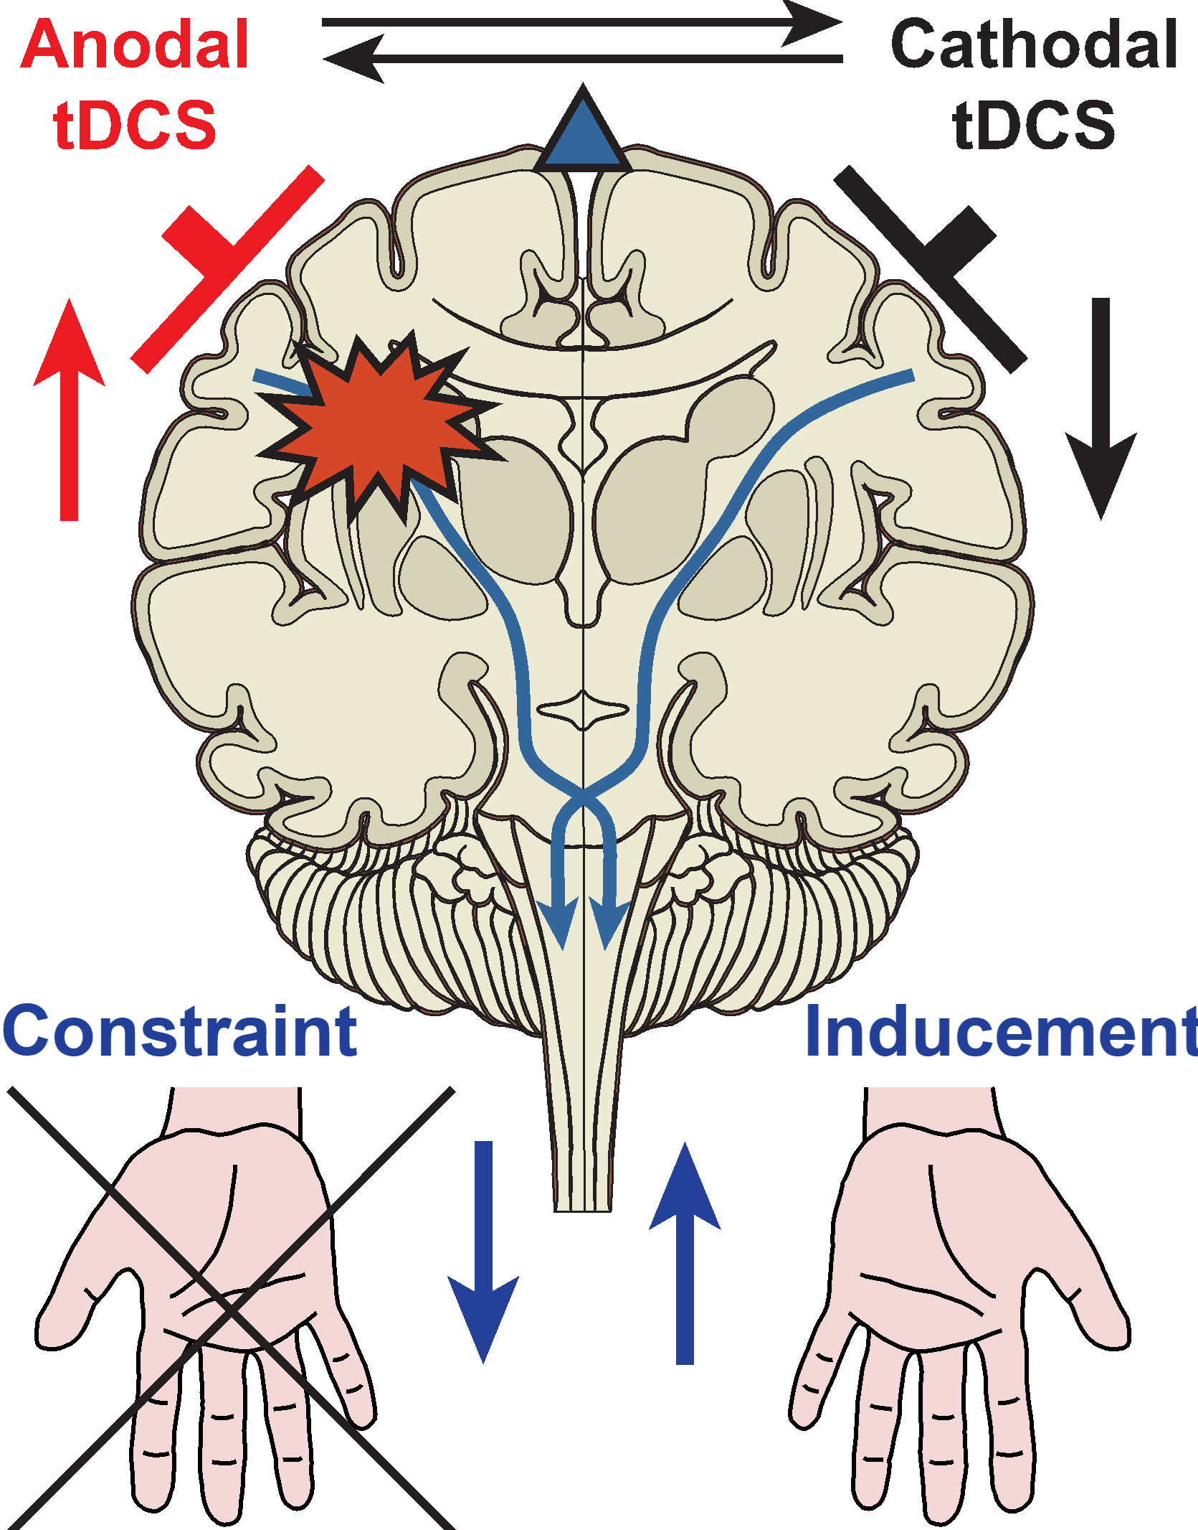
Four NIH StrokeNet sites have participants on study. As of 8/28/2024, all 129 (out of 129) subjects were randomized and 122 completed the study.
Clinical Trial NCT03826030.
Design
Multi-center, double-blinded, randomized sham-controlled Phase 2 trial involving 129 subjects (43 per arm) in a 1:1:1 ratio to either modified Constraint Induced Movement Therapy (mCIMT) mCIMT+2 mA tDCS, mCIMT+4 mA tDCS.
Funding: NIH U01NS102353 and U01NS102353-4S1

Slide 71

SATURN and SATURN MRI
SATURN Enrollment : 587/1458
SATURN MRI Enrollment: 227/894

Slide 72
Enrollment By RCC June 2024

Slide 73


Slide 74
Study Updates
Protocol v2.0
  Training occurred April 29th
  Main changes
    Consent study window extended
    Study MRI window extended
    Day 60 visit added
    Participants who receive both biomarkers but have unusable data for either (as deemed by blinded central assessors) will not be followed beyond hospitalization
      No further study activities will be performed, and these enrollments will be replaced
  Source Book updated
  WebDCU CRFS updated
New Sites:
  VERIFY will be accepting news sites
  Please email Kalli Beasley to request a feasibility survey
    Beasleki@ucmail.uc.edu
Enrollment Snapshot:
Total Enrollment: 245
Early Terminated: 3
Total Subjects Enrolled and confirmed to be in primary analysis all sites: 231 (pending confirming 11)
Enrollment Contest
Time frame: August 1st – October 31st
Reward: Activated sites will get a pizza party & preparing for activation sites will receive VERIFY brain pins!
How to qualify:
  Activated sites:
    Must enroll at least 3 subjects in the 3-month period
    early terminated subjects do not count
  Preparing for activation sites:
    Must be activated in WebDCU by the end of October

Slide 75
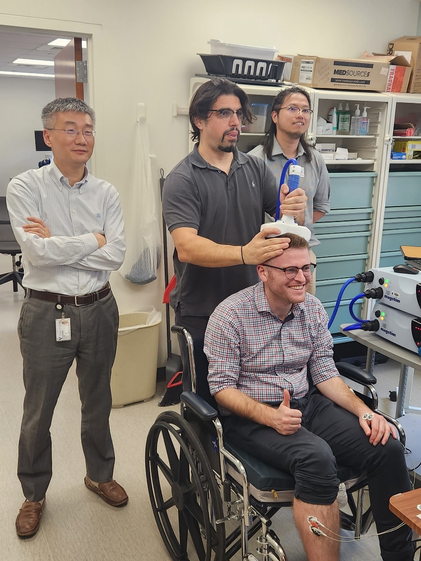
Study Wins:
Baseline Biomarker Data:
  TMS biomarker collection continues to be above 90%!
  MRI biomarker collection continues to be above 80%!
Site recruitment:
  7/10 sites issued a site warning letter for lack of recruitment, enrolled at least 1 subject within 2 months!
Study Challenges:
In-person day 90 visits:
  Currently at 47/211 missing FM & ARAT 90-day assessments (23%)
  137/211 have complete primary analysis data for baseline & 90-day (64.9%)
Enrollment:
  Current enrollments per-month (average): 9
  Goal enrollments per month: 17
  4/30 sites that have been active for 3 or more months have enrolled 0 subjects
    7 activated sites total with 0 enrollments

Slide 76

CAPTIVA
Subjects Randomized: 483
Sites Released to Enroll: 100
  Sites in startup: 15
  Currently considering new sites. Reach out to Lesley Butler (butlelc@ucmail.uc.edu) if your site is interested.
Canadian expansion underway
  UF and PHRI subcontract executed
  15 sites to be opened this fall
IP re-supply for all sites anticipated in 1-2 weeks
Next DSMB meeting – October 4th
CAPTIVA CCC Hotline: 888-351-7776
**for urgent questions

Slide 77


Slide 78
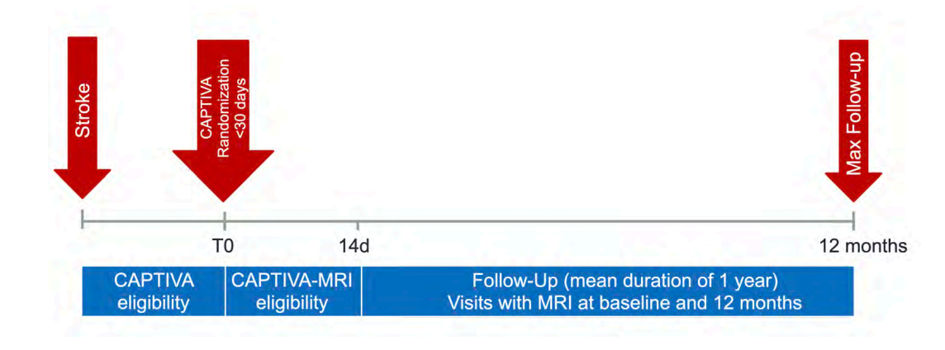

CAPTIVA-MRI
CAPTIVA-MRI is an observational multimodal MR imaging study that is ancillary to CAPTIVA
We will enroll 300 subjects at up to 30 CAPTIVA sites
+7

Slide 79
CAPTIVA-MRI
Primary Goal
  To determine if MRI biomarkers can potentially identify ICAS patients who fail best medical management
Active Sites: 3/30 and Enrolled Subjects: 2/300
  Barnes Jewish Hospital, St. Louis, MO, Dr. Wang (1st subject enrolled)
  Baptist Medical Center Jacksonville, Jacksonville, FL, Dr. Hanel
  North Shore University Hospital, Manhasset, NY, Dr. Arora (2nd subject enrolled)
17 Sites in Startup
  Wave 1 – 7 sites
  Wave 2 – 10 sites
Wave 3
  In the process of finalizing the last group of 10 sites

Slide 80
CAPTIVA-MRI
1. Regulatory*
2. NOVA*
3. vwMRI protocol build*
4. Full Protocol Human Subject Volunteer Scan
5. Imaging Training/Upload to InteleShare
*1, 2 & 3 can be done in parallel

Slide 81
CAPTIVA-MRI
Open Office Hours – 4th Wednesday of the month held at 10:00 am ET
  September 25, 2024
  October 23, 2024

Slide 82


Slide 83
FOCAS (Focal Cerebral Arteriopathy Steroid) Trial
Overall Goal
  To test the hypothesis that among children with suspected focal cerebral arteriopathy (FCA), early corticosteroid treatment to prevent FCA progression (Study Arm A) leads to overall better outcomes than selective, delayed treatment in only the subset that progresses (Study Arm B).
21/28 Sites Released to Enroll
  4 US sites and 3 Canadian sites are still in Startup
6 subjects enrolled
24 screen failures
  Stroke/TIA with “suspected FCA” but ended up having another cause for their stroke so they were not approached
  Declined participation

Slide 84
FOCAS Enrolling Sites
Subject 1. Cook Children’s Medical Center, Fort Worth, TX, PI Dr. Marcela Torres
Subject 2. Memorial Hermann Texas Medical Center, Houston, TX, PI Dr. Stuart Fraser
Subject 3. Primary Children’s Hospital, Salt Lake City, UT, PI Dr. Lisa Pabst
Subject 4. UCSF Benioff Children’s Hospital, San Francisco, CA, PIs Dr. Heather Fullerton & Dr. Christine Fox
Subject 5. Primary Children’s Hospital, Salt Lake City, UT, PI Dr. Lisa Pabst
Subject 6. Phoenix Children’s Hospital, Phoenix, AZ, PI Dr. Neil Friedman

Slide 85
FOCAS (Focal Cerebral Arteriopathy Steroid) Trial
Milestone 1: 20/25 sites released to enroll by 1/31/2024 (end of Year 1)
  Completed 8/2/2024
Milestone 2: Total of 4 patients enrolled by 7/31/2024 (6th month of Year 2)
  Completed 7/20/2024
Milestone 3: Total of 9 patients enrolled by 1/31/2025 (end of Year 2)
  Ahead of schedule - Already enrolled 6 of 9 patients with the last patient enrolled on 8/12/24

Slide 86
FOCAS (Focal Cerebral Arteriopathy Steroid) Trial
Open Office Hours – last Wednesday of the month held at 4 pm ET
  August 28, 2024
  September 25, 2024
  October 23, 2024
Investigator & Study Team Meeting – first Friday of every other month (even-numbered) at 2 pm ET
  October 4, 2024
Investigator Meeting @ Child Neurology Society Conference, San Diego
  November 11, 2024 – Time TBD

Slide 87
FOCAS (Focal Cerebral Arteriopathy Steroid) Trial
  Site Continuing Review Reports due 8/31/24
  Modifications in the process to update the links to the recruitment videos in the ICFs to open the Spanish version of the videos which are now posted on the FOCAS website
  If you indicated you needed a Spanish translation of the ICFs in your Advarra application and haven’t submitted a modification, NCC staff will be submitting that on your behalf now that the Spanish version of the videos are available

Slide 88

Questions?

