Slide 1
ARCADIA-CSI
An ancillary study to the ARCADIA trial
Joe Broderick, Christy Cassarly, George Howard, Stephanie Kemp, Faria Khattack, Maarten Lansberg, Ron Lazar, Terina Myers, Kevin Sheth, David Tirschwell

Slide 2


Thank you !
a very brief
This slide-set provides you with 8 hours of investigator training for ARCADIA-CSI, an ancillary study to the ARCADIA trial.
Thank you in advance for taking the time to review the slides.
Once you have viewed them, please fill out the ‘Training Attestation Form’ that will be posted on Training Campus (webdcu.musc.edu/campus)

Slide 3
Background
ARCADIA Parent Trial
Apixaban vs. aspirin for secondary stroke prevention
1100 patients with cryptogenic stroke and atrial cardiopathy
2.5 years of enrollment; 1.5-4 (median 3) years of follow-up
No data on cognitive and neuroimaging outcomes
ARCADIA-CSI Ancillary Study
Adds key cognitive and neuroimaging outcomes
Integrates seamlessly with ARCADIA study visits
Low patient / investigator burden
Potentially high impact

Slide 4
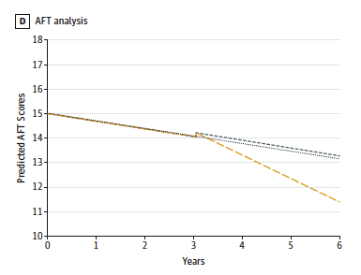
Post-stroke Cognitive Decline
Cognitive decline accelerates after stroke
Stroke doubles the risk of developing dementia
30% prevalence of dementia post-stroke
Levine. JAMA 2015

Slide 5
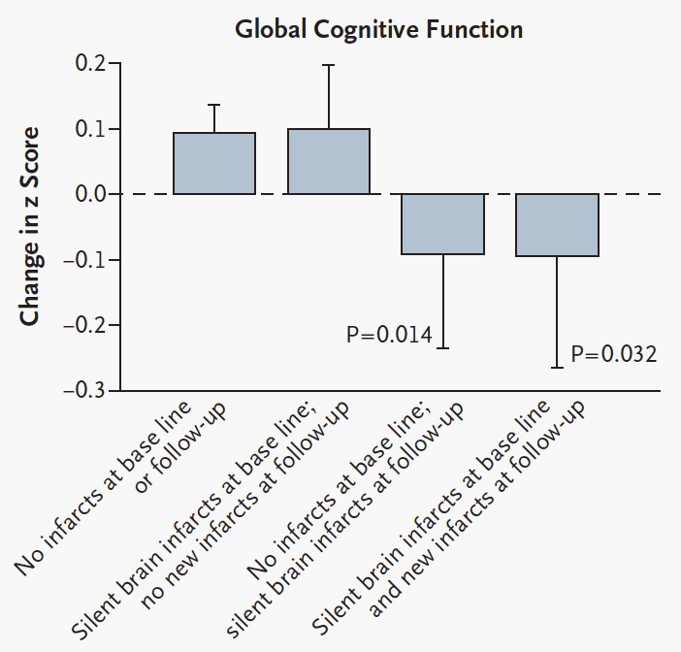
Silent Infarcts
Common
  Prevalence 30-50%
  Incidence up to 19% annually after TIA
Accelerate cognitive decline
Double risk of dementia
Secondary stroke prevention studies have not focused on preventing silent infarcts and cognitive decline
Vermeer. NEJM 2003
Vermeer. Lancet 2007

Slide 6
Aims
To determine the effect of anticoagulation (vs antiplatelet therapy) on the slope of cognitive function after stroke (primary clinical outcome)
To determine the effect of anticoagulation (vs antiplatelet therapy) on the incidence of silent infarcts after stroke (primary imaging outcome)

Slide 7
Inclusion / Exclusion Criteria
Inclusion Criteria
Randomized in ARCADIA
Able to undergo MRI
Able to provide self-consent for ARCADIA-CSI in English
Score of 0-1 on NIHSS language at time of ARCADIA-CSI enrollment
Exclusion Criteria
Diagnosis of dementia
Active illicit drug use
Psychiatric admission or ECT for major depression within last two years
Education less than 8 years
History of traumatic brain injury with loss of consciousness of more than 30 minutes
ARCADIA study drug permanently discontinued

Slide 8
Study Events
ARCADIA
events
ARCADIA-CSI
events
Index stroke
Baseline MRI
Enrollment
>3 months after index stroke
ASAP after ARCADIA-CSI consent (when possible on same day)
No more than 3 months after ARCADIA-CSI consent
Randomization
ARCADIA-CSI Enrollment (can occur
anytime after ARCADIA randomization)
f/u visit
Baseline Neurocog test
Baseline MRI – only if no clinical MRI at time of index stroke
1 yr ± 3 months
f/u visit
Neurocog test – Year 1
1 yr ± 30 days
f/u visit
Neurocog test – Year 2
1 yr ± 30 days
f/u visit
Neurocog test – Year 3
1 yr ± 30 days
f/u visit
Neurocog test + MRI – Year 4 (or exit from ARCADIA whichever occurs earlier)

Slide 9
Annual neurocognitive test
22 minute phone battery
Covers 4 cognitive domains relevant to post-stroke cognition
Demonstrated sensitivity to cognitive change.
Centrally administered by trained interviewers to reduce interrater variability
Tested in >30,000 subjects in REGARDS and CREST-2 studies

Slide 10
Study End MRI
Simple protocol with standard sequences
Preferably on 3T (1.5T acceptable)
15 minute scanning time
30 minutes total time
MUSC will collect and store the images
Stanford Radiology Core will analyze the images:
  New Silent infarcts
  White matter disease burden
  Micro-hemorhages

Slide 11
Enrollment / Baseline
Consent
MRI
Neurocognitive testing

Slide 12

General Consenting Guidelines
The research subject should have an opportunity to read the consent and ask questions about anything they do not understand.
Enough time should be given to the subject to consider whether or not to participate in the study
The subject should know that participation in the study is voluntary and that he/she may stop the study at any time

Slide 13
When do ARCADIA subjects become CSI eligible ?
When a site becomes active for ARCADIA∙CSI, all patients already randomized in ARCADIA become immediately ARCADIA∙CSI eligible
Additional patients will become eligible as the site randomizes new ARCADIA patients

Slide 14
Timing of Consent
Scenario 1: Patients who are already randomized in ARCADIA and on study drug when site becomes ARCADIA-CSI active
  If next ARCADIA clinic visit ≤ 3months, obtain consent during that visit
  If next ARCADIA clinic visit > 3months, schedule a dedicated visit for ARCADIA-CSI consent
ARCADIA∙CSI consent should be obtained as soon as feasible after the patient meets ARCADIA∙CSI eligibility criteria
(goal is within 2 weeks and not to exceed 3 months
after a patient becomes ARCADIA∙CSI eligible)

Slide 15
Timing of Consent
Scenario 1: Patients who are already randomized in ARCADIA and on study drug when site becomes ARCADIA-CSI active
  If next ARCADIA clinic visit ≤ 3months, obtain consent during that visit
  If next ARCADIA clinic visit > 3months, schedule a dedicated visit for ARCADIA-CSI consent
Scenario 2: Patient who are consented and randomized in ARCADIA after a site becomes ARCADIA-CSI active
  Obtain ARCADIA-CSI consent during randomization visit

Slide 16





ARCADIA subjects on study drug
Introduce study and if interested, reserve time for cognitive assessment after upcoming clinic visit
0
1
2
3
4
5
6
7
8
Time (months)
Scheduled ARCADIA visit
Site activation for ARCADIA-CSI

Slide 17


Obtain consent
Perform cognitive test at visit
+
Introduce study
+
Introduce study
Obtain consent
Attempt same day cognitive test
0
1
2
3
4
5
6
7
8
Time (months)
Scheduled ARCADIA visit
Scheduled ARCADIA visit

Slide 18
Schedule cognitive test at home if same day test is not possible
Introduce study & schedule appointment
0
1
2
3
4
5
6
7
8
Time (months)
Scheduled ARCADIA visit too far out

Slide 19
New ARCADIA
consent
Participant meets randomization criteria
Schedule randomization visit
Introduce ARCADIA-CSI
Introduce study & schedule appointment
Obtain consent
Perform cognitive test
+
0
1
2
3
4
5
6
7
8
Time (months)
Dedicated ARCADIA-CSI enrollment visit

Slide 20
Randomize in ARCADIA
Obtain ARCADIA-CSI consent
Perform cognitive test
+
0
1
2
3
4
5
6
7
8
Time (months)
ARCADIA randomization visit

Slide 21
Baseline MRI
Patient had standard-of-care MRI post index stroke
No
Obtain Research MRI
≤ 2 weeks of ARCADIA-CSI enrollment
Yes
Upload MRI to WebDCU
Radiology Core Lab Review
You will be notified if:
MRI quality insufficient or Unexpected findings on Research MRI

Slide 22
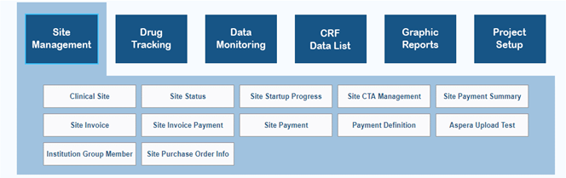
Transfer of MR Images: Aspera®
What is Aspera ? Aspera® is the platform by which imaging will be uploaded into WebDCU.
How to test Aspera ? Download and test Aspera® before starting to enroll subjects
How to use Aspera ? Upload an MRI through a link in the subject’s eCRF
Need more info ? Detailed instructions will be in the StrokeNet WebDCU User Manual

Slide 23
Baseline Neurocognitive Testing
Baseline cognitive testing should be obtained:
At least 3 months after the index stroke
As soon as feasible (and no more than 3 months) after the patient signs ARCADIA∙CSI consent
Preferably on the day of ARCADIA∙CSI consent during a routine ARCADIA visit

Slide 24
Please, please, pretty please …..
Do all you can to obtain the neurocognitive phone assessment in clinic, typically following a routine ARCADIA study visit.
If assessment during clinic is absolutely impossible, we can call the participant at home but this not preferred because it often results in missing data.

Slide 25
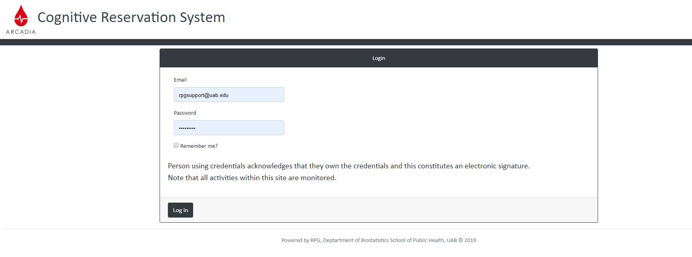
Scheduling of Neurocognitive Testing
A weblink to the Cognitive Reservation System will be on the ARCADIA-CSI WebDCU page
Detailed scheduling instructions are listed in the ARCADIA-CSI Manual of Procedures, posted in the ARCADIA-CSI toolbox on WebDCU

Slide 26
Cognitive Assessment Phone Line
Step 1
Dial 205.934.2462
Please make sure you have completed a reservation.
Step 2
Talk to a live person!!
You will get a live person when you dial in for the assessment. This person will then transfer and connect the call to the interviewer.
Step 3
Share your experience
Please contact your friendly UAB team (Terina Meyers) if you have any questions, complaints or ideas! We need your input to know how we are doing.

Slide 27
Annual Follow-Up Visits
Neurocognitive testing

Slide 28
Neurocognitive Follow-Up Visits
The first follow-up visit will be scheduled to coincide with a routine ARCADIA clinic visit (9-15 months after the baseline cognitive evaluation).
Subsequent evaluations are scheduled every 12 months (±30 days) thereafter to coincide with routine ARCADIA clinic visits
Six weeks prior to the due date of each neurocognitive evaluation, the local ARCADIA∙CSI study coordinator will be reminded by e-mail
Coordinator will schedule a time for the neurocognitive evaluation on the UAB Cognitive Reservation System

Slide 29
Final Visit
MRI
Neurocognitive testing

Slide 30
End of Study MRI
If the patient exits ARCADIA∙CSI because (s)he reaches final ARCADIA follow-up, a dedicated research MRI scan will be scheduled on the day (± 2 weeks) that study drug is discontinued.
If the patient exits ARCADIA∙CSI because (s)he has a clinical stroke, an MRI will be obtained as soon as possible after the stroke, typically during hospital admission. If a clinical MRI has been obtained, it will serve as the final study MRI if it meets the MRI requirements

Slide 31
MRI Protocol
T1 (3D)
FLAIR (3D)
DWI / ADC
GRE
SWI / SWAN (optional)

Slide 32
End of Study Neurocognitive Testing
If the patient exits ARCADIA∙CSI because (s)he reaches final ARCADIA follow-up, a final cognitive evaluation will be scheduled at the time of study-drug discontinuation (± 2 weeks, preferably during the final ARCADIA visit) if ≥6 months have elapsed since the previous cognitive evaluation.
If the patient exits the study because (s)he has a recurrent stroke or dies, the most recent neurocognitive evaluation will serve as the final cognitive assessment.

Slide 33
Impact of ARCADIA-CSI
Will provide large scale data on the effect of anticoagulation on silent infarction and cognitive decline
Will yield results that are important regardless of the results of the parent trial
Will provide deeper insight in the incidence of silent infarcts, the slope of post-stroke cognitive decline, and the relationship between them
Will set the stage for future trials to prevent silent infarction and post-stroke cognitive decline

Slide 34
Questions ?
?
?
WebDCU Faria Khattak (khattak@musc.edu)
WebDCU Hotline (866) 450-2016
MRI Max Wintermark (mwinterm@stanford.edu)
Cognitive testing Terina Meyers (tmeyers@uabmc.edu)
(205) 996-5592
Contract Wren Hanson (hansonwm@ucmail.uc.edu
IRB Tashia Harris (herndotl@ucmail.uc.edu)
Enrollment / Eligibility Maarten Lansberg (lansberg@stanford.edu)

Slide 35

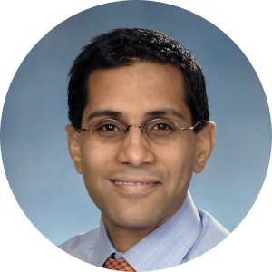
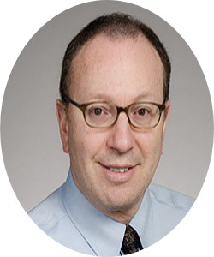


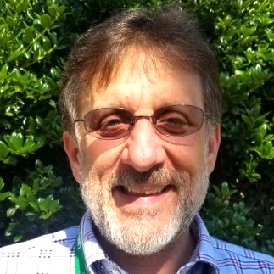
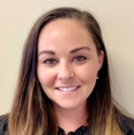
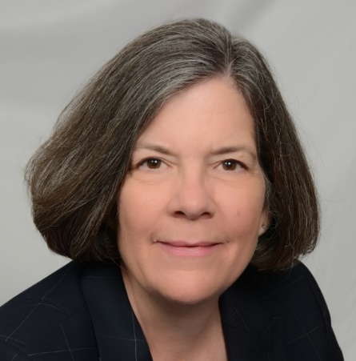
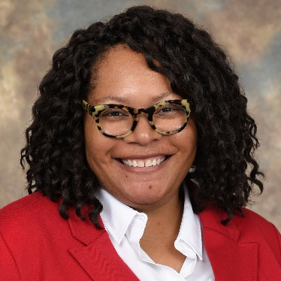

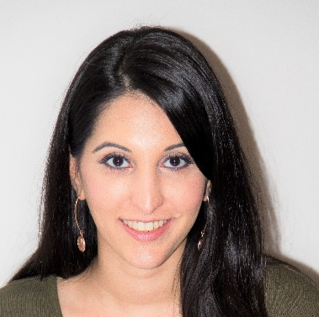
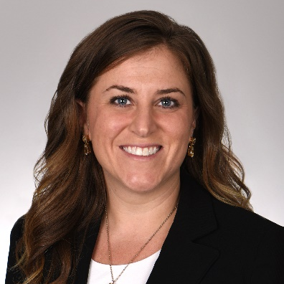
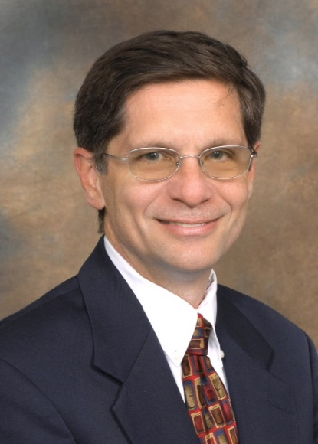
Stanford University
Imaging Core
Yale University
Enrollment
University of Washington
ARCADIA Parent Trial
UAB
Cognitive Core
Maarten Lansberg
Kevin Sheth
David Tirschwell
George Howard
Ron Lazar
University of Cincinnati
StrokeNet NCC
Stephanie Kemp
Paul Wolff
Terina Meyers
MUSC
StrokeNet DCC
Jamey Frasure
Tashia Harris
Max Wintermark
Faria Khattak
Christy Cassarly
Joe Broderick

