Slide 1
PI and Coordinator Webinar
October 22, 2019

Slide 2
Site startup
123 sites released to enroll
117 sites with at least one consent
93 sites with at least one randomization

Slide 3
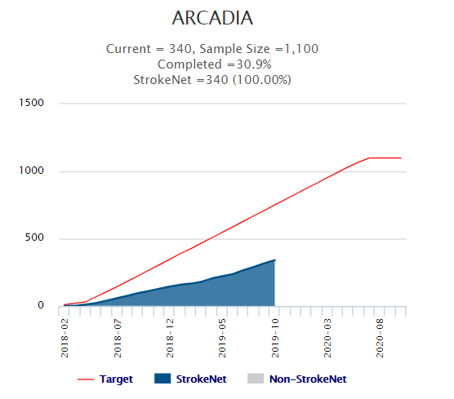
Enrollment
1292 patients consented
340 patients randomized

Slide 4
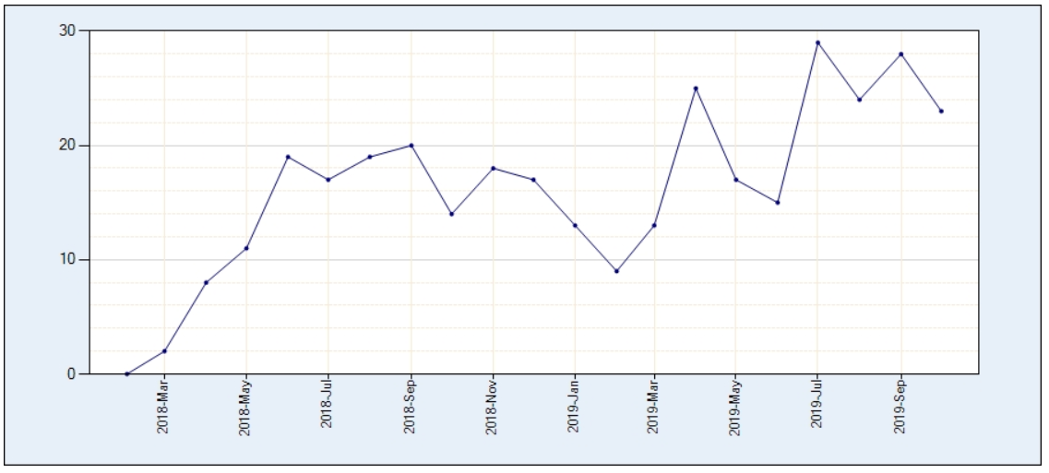

Slide 5
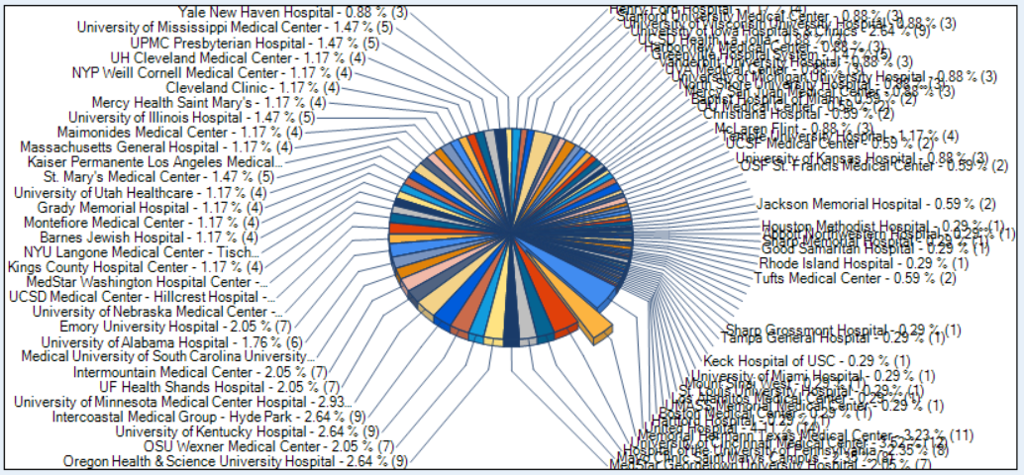

Slide 6
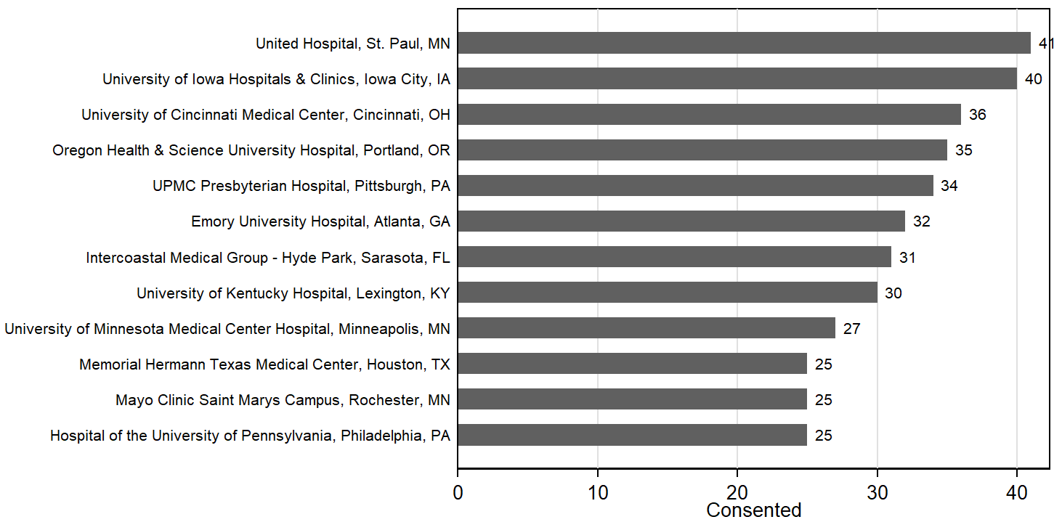

Slide 7
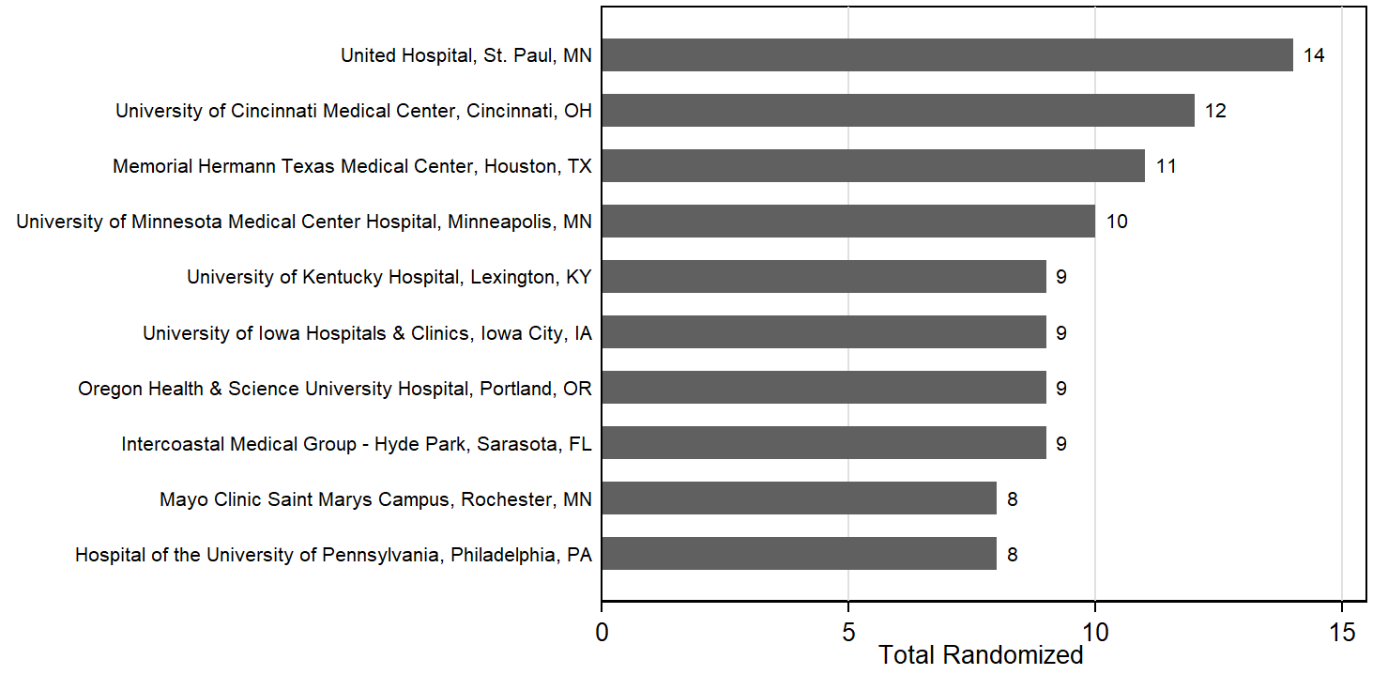

Slide 8
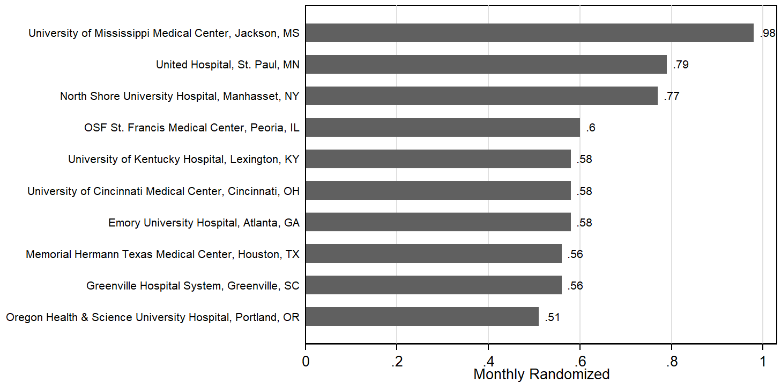

Slide 9
CANADIAN SITE PROGRESS
PHRI will be the Canadian Coordinating Center
CSC has approved the protocol and sent call to the Canadian sites
We have received HealthCanada approval for the protocol
Local REB submission with clarifications have been made
BARL: Canadian Drug Depot contracted, working on process, labels, etc.
Fogarty approved 2 sites in June & submitted 13 for budget revision/approval
Investigator Meeting held at the CSC in Ottawa 10/4: ~40 attended / 15 sites
~22 Canadian sites submitting documents to participate
NDMC has already added 9 sites to WebDCU

Slide 10
Site startup: Adding New Sites
Current
133 sites released / 123 active
Pending
1 submitted to cIRB / 8 working on submission
Expected
9 cIRB approved / Pending Readiness Call
4 (12?) slow moving
30 Canadian Sites
178+ active/site released to enroll
3 suspended / coming back

Slide 11
ARCADIA-CSI Site startup
78 cIRB packets sent to sites, 25 cIRB site approvals
70 CTAs sent to sites, 27 CTAs approved
3 site readiness calls completed

Slide 12
Coordinator hero
Lisa Bertrand, St. Mary’s Medical Center, Grand Junction, CO
We want thank her & the site for their continued following of a patient that moved to another state to make sure he stays engaged and committed to the trial despite the distance and the complications to transfer the subject to another site.
We appreciate the many extra miles you have gone to keep this subject in the trial!

Slide 13
Emergency unblinding
Make sure subject has wallet card at every f/u (and during emergencies!) —unblinding without Subject ID will lead to loss of valuable time!
Remind subject AND study team
Post ARCADIA Trial Hotline #
Unblinding should only be considered when there is an implication for immediate emergency treatment

Slide 14
Reminders: Echo & Prescreening
Please don’t “pre-screen”
You will lose out on eligible patients!
Most eligible patients come from NTproBNP & ECG results
If ONLY eligible via echo (TTE), please make sure ALL data entered is correct to avoid randomizing ineligible subjects

Slide 15
Physician Letter
Why do we send the letter?
To let the Physician know that their patient is on a new medication.
Who to contact for questions/concerns.
Who gets the letter?
The subject’s PCP and Cardiologist (if they have one)
When do you send the letter?
After the subject has been randomized?
Where do we find the letter?
The Physician Letter is located in the toolbox in WebDCU
**Make sure that you document in your subject’s notes that you have sent a letter to the physician(s). Keep a copy of the letter(s) in the subject’s study binder.

Slide 16
Physician Letter continued…

Slide 17
Withdrawn Subjects
Subjects eligible for randomization = 418
Subjects that randomized = 340
Withdrew consent prior to randomization 78
Get to know your subjects before consenting.
For subjects that withdraw in the period between consenting to the study and randomization, there will be a mandatory comment line.
You must enter the reason that the subject did not randomize.
This is needed for CR and invoicing purposes.

Slide 18
Lost-to-Follow Participants
Preparations to decrease loss to follow up begins at screening
Screen efficiently
If the patient has a history of “no shows”, known social issues, and/or non-compliance, consider not consenting
Develop a relationship with the patient
After consent, send birthday cards, holiday cards, etc…
Provide a list of all study visits and windows for those visits
This should also contain detailed instructions for the visits and site contact information
Send visit reminder postcards or emails; Reminder visit calls
Consenting
Educate the patient thoroughly regarding the study visits and their commitment
Why it’s important to complete the study visits
Obtain a contact sheet after completing consent
◦ Email address(es) ◦ Work numbers ◦ Emergency contacts ◦ Friends & Family numbers (Children/Siblings/Neighbors)

Slide 19
BMS Response: Subject taking OTC CBD
BMS and/or Pfizer: no studies on concomitant use of apixaban and cannabis.
EMBASE lit search to June 2019, apixaban and (cannabis, cannabinoid, THC, CBD, or marijuana), did not retrieve any relevant information.
Apixaban is a substrate of both cytochrome P450 3A4 (CYP3A4) and P-glycoprotein (P-gp). Inducers of CYP3A4 and P-gp decrease exposure to apixaban and increase the risk of stroke and other thromboembolic events.
CBD is metabolized by the CYP enzymes and may affect the P-gp proteins.
The decision to prescribe apixaban in patients who are concomitantly using cannabis is a clinical decision for the treating physician
Notes:
Subject taking OTC CBD oil for anxiety and concerned about concomitant use with apixaban
Document is available for review
CBD = cannabidiol
Apixaban is a substrate of both cytochrome P450 3A4 (CYP3A4) and P-glycoprotein (P-gp). Inducers of CYP3A4 and P-gp decrease exposure to apixaban and increase the risk of stroke and other thromboembolic events.
CBD is metabolized by the CYP enzymes2 and may affect the P-gp proteins.

Slide 20
Mini Journal Club
JAMA Cardiol. 2018;3(1):11-17

Slide 21
BNP – Brain Natriuretic Peptide
First discovered in brain, largely produced in heart, both ventricular and atrial myocardium
Increases natriuresis, diuresis and vasodilatation, results in ↓ cardiac workload
NT-proBNP has a longer plasma half-life, higher concentrations, more stable at room temperate and lab assays are highly sensitive and specific
Widely used marker of CHF, but also elevated in atrial fibrillation
Circulation. 2009;120:1768-1774
Int J Cardiol. 2016 Oct 15;221:1031-8

Slide 22
Racial Differences in NT-proBNP (REGARDS)
~2000 African-American and Caucasian CVD free individuals
Measured NT-proBNP
Compared with other studies
Looked for association with outcomes
JAMA Cardiol. 2018;3(1):11-17

Slide 23
Racial Differences in NT-proBNP (REGARDS)
JAMA Cardiol. 2018;3(1):11-17

Slide 24
Racial Differences in NT-proBNP (REGARDS)
NT-proBNP associations with outcomes
Increased overall mortality
Increased CV mortality, adjusted HR 1.7 (1.2-2.4)
Association with outcomes did not differ by race
Hypothesized that lower NT-proBNP in African-American group may play a role in known higher risk of CV disease
JAMA Cardiol. 2018;3(1):11-17

Slide 25
Racial Differences in Atrial Cardiopathy (AC)?
AC may be due to a variety of factors
Fibrosis, Remodeling, Increased LA size, Inflammation, Endothelial dysfunction, Myocyte dysfunction, Mechanical dysfunction in the left atrial appendage
Race/ethnicity groups may vary on most common pathology
ISC Abstract submitted partially addressing this topic
SO IMPORTANT to get all 3 AC screening tests on every patient
NT-proBNP, ECG for PWTFV1, TTE for LA size Index
SO IMPORTANT NOT to pre-screen, may selectively exclude one group

Slide 26
ARCADIA Survey
What type of cardiac monitoring do you routinely do in patients with ESUS?
EKG only
In-hospital telemetry
Holter monitor
Short-term MCOT (up to 30 days)
Implanted cardiac monitor
Other

Slide 27
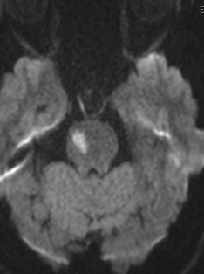
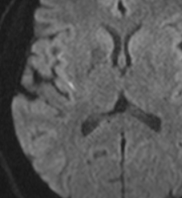
FAQs
Question: This patient had a left hemiparesis. The clinicians diagnosed a right pontine penetrator infarction (lacune). Is the patient eligible?
Vote:
Yes
No

Slide 28
FAQs
Question: This patient had a left hemiparesis. The clinicians diagnosed a right pontine penetrator infarction (lacune). Is the patient eligible?
Vote: Answer: Yes. Although the patient had a right pontine infarction, there was also a second infarct in the right insula, indicating a non-lacunar mechanism. Multiple infarcts in different territories is consistent with a cardioembolism, or ESUS.

Slide 29
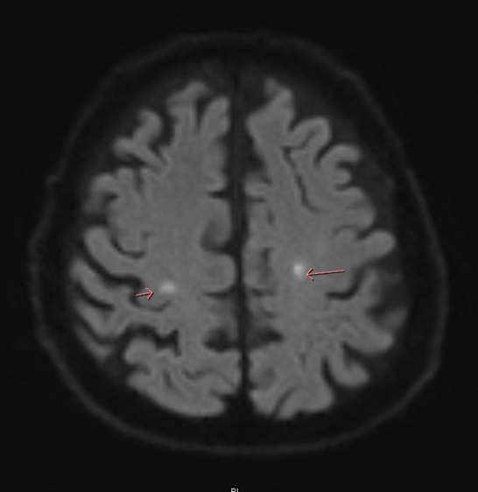
FAQs
A patient had been celebrating his birthday with his wife in Las Vegas. He fell on his right shoulder. He continued to be weak for 4 days and so his wife brought him in to the hospital.
On exam he had dysarthria, right facial droop, and left leg weakness.
MRI showed:
Is the patient eligible?
Yes
No
Note sure yet

Slide 30
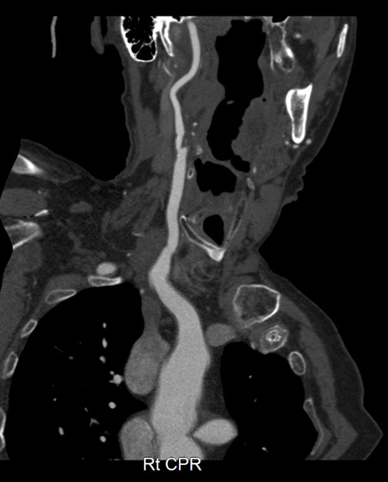
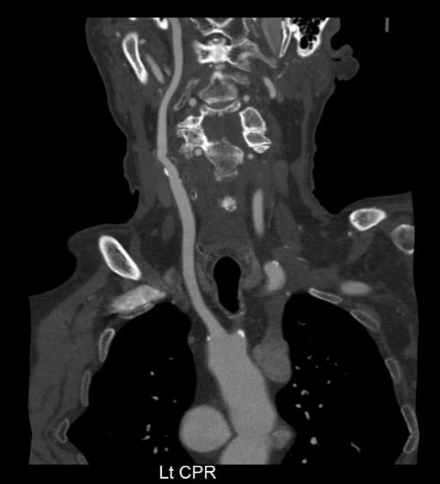
FAQs
Echo and intracranial vessel imaging were normal.
CTA showed a 60% luminal stenosis on the right; there was no stenosis on the left.
Is the patient eligible?
Vote:
Yes
No.

Slide 31
FAQs
Is the patient eligible?
Answer: Yes
Although the patient has an infarct in territory of a stenosis > 50%, this cannot explain the contralateral infarct. Thus simultaneous bihemispheric infarcts are consistent with ESUS.

Slide 32
FAQs
Question: Do we need to include the Flu shot or other vaccinations as part of their concomitant medications?

Slide 33
FAQs
Question: Do we need to include the Flu shot or other vaccinations as part of their concomitant medications?
Answer: No. we do not need to include these.

Slide 34
FAQs
Question: Does having an implantable cardioverter-defibrillator (ICD) an exclusion for a subject who has history of Vtach and NICMP?

Slide 35
FAQs
Question: Does having an implantable cardioverter-defibrillator (ICD) an exclusion for a subject who has history of Vtach and NICMP?
Answer: No. The ICD is not an exclusion as long as the EF is ≥30%, his stroke is considered ESUS and key physicians (esp. cardiologists) are okay with randomization to only aspirin or only apixaban without any open-label antithrombotics.

Slide 36
Feel free to reach out!
24-hour telephone hotline
Please use it for any urgent questions
Eligibility, unblinding, etc.
WebDCU™ Emergency Randomization Hot Line: 1-866-450-2016.
1-877-427-2234 (1-877-4AR-CADI): useful to save in your cell phone
The hotline automatically calls the four PIs in succession
Please let it ring
And call back if no luck—one of us will pick up!
Please email arcadia@ucmail.uc.edu with non-urgent questions

