Slide 1
PI and Coordinator Webinar
November 26, 2019

Slide 2
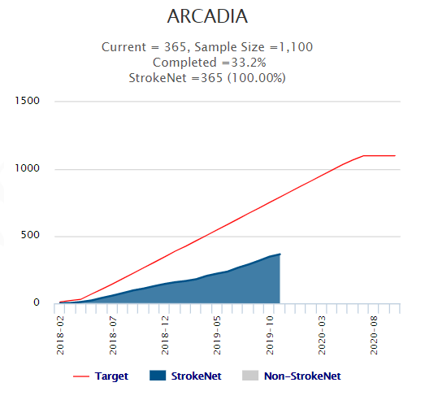
Enrollment

Slide 3
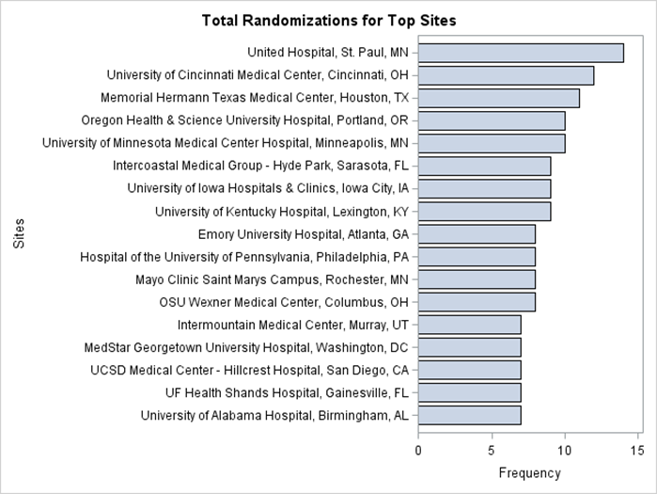

Slide 4
How do you usually monitor for AF at your site?
No post-discharge heart-rhythm monitoring
Several days of post-discharge monitoring (e.g., Holter)
Several weeks of post-discharge monitoring with external monitor (e.g., MCOT, Cardionet, Lifewatch, Spectocor, Zio patch, etc)
Several months of post-discharge monitoring with implanted monitor (e.g., Reveal, Linq, etc)

Slide 5
When do you monitor in relation to ARCADIA?
Not applicable – we don’t do post-discharge monitoring
Usually finish monitoring before randomization
Usually randomize first and then start/continue monitoring
Either B or C depending on the situation

Slide 6
CANADIAN SITE PROGRESS
PHRI will be the Canadian Coordinating Center
All regulatory approvals in place except for Fogarty of some sites
  23 sites interested
    19 sites confirmed by Canadian PI s
    4 sites pending documentation
  13 sites have FWA#s and 10 are pending
    2 sites have Fogarty/State Department approval since June (11 pending post submission)
CUMC & PHRI contracting counsel & specialist have met to iron out subaward and PHRI will send CTA template to CUMC for review before starting their site subaward process

Slide 7
Site startup: Adding New Sites
Current
136 sites released / 126 active
Pending
No new CIRB submissions while CR is in process/ 8 working on submission
Expected
8 cIRB approved / Pending Readiness Call
4-16 slow moving/?
23 Canadian Sites
175+ active sites released to enroll
3-4 suspended sites working on reinstatement

Slide 8
Coordinators /heros
Cary Murphy (Sharp at San Diego/Mesa) and Karen Rapp (RCC/UCSD Hillcrest/La Joya/Scripps San Diego),
They work tirelessly with various sites and are always looking for ways to facilitate the process for subjects and their colleagues.
They also carefully read the documents we send and help us edit these when necessary.
They are great team players and we appreciate the support they give participants and others in the ARCADIA!

Slide 9
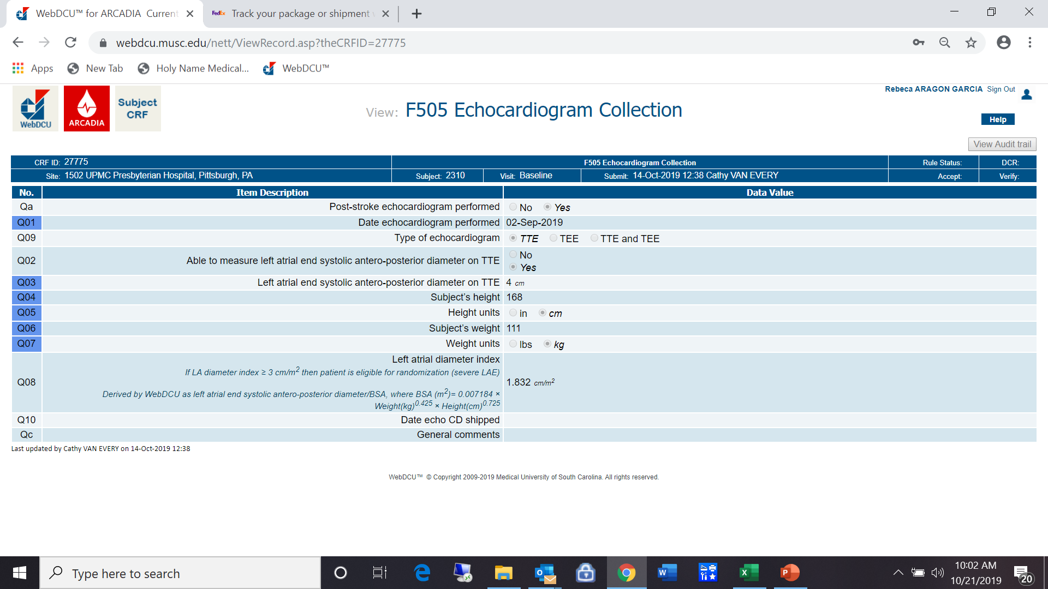
Reminders: Echo
TTE or TEE within 3 months of index stroke needed for ESUS dx
TTE post-index stroke is for randomization criterion
Please mail in EVEN if the subject is not eligible for randomization
Please don’t “pre-screen”
  You will lose out on eligible patients!
  If ONLY eligible via echo (TTE), please make sure ALL data entered is correct to avoid randomizing ineligible subjects
    Please record atrial diameter but do not “calculate” the index or atrial diameter

Slide 10
Spanish Patient Facing Documents
Various English patient facing documents had been CIRB approved but had not be uploaded into the Toolbox. These are now there for sites who may need them:
  Prohibited Medication list v2 (Spanish)*
  Subject Information Sheet (Spanish)
  Patient wallet/alert card (Spanish)
  These are all noted on the CIRB approval letter for Amendment 5 – also now in the Toolbox
We have another set of documents which have been translated and will be submitted to the CIRB as soon as the CR is completed:
  Certified Lost to Follow-up Letter (amendment 2)
  Recruitment letter to screen potential subjects (amendment 6)
  Recruitment phone script for potential subjects (amendment 6)
  Medication Reminder (amendment 13)
Notes:
*NEW version 3 is on the way

Slide 11
MOP: Change Log (p. 80)
4.1 18 Oct 2019
  Updated staff roster (Section 2).
  Updated membership of leadership committees (Section 3.11).
  Clarified that the study team does not need to complete a specific CRF if emergency unblinding is performed (Section 13.2).
  Clarified responsibilities of Medical Safety Monitor (Section 16.2.1)
4.2 14 Nov 2019
  Clarified the concomitant medications to be collected from randomization during each follow up visit/call (Section 15.3)
    Enter subject’s OTC & Rx medications after each f/u

Slide 12
ARCADIA FedEx Account
This meant for sites to ship:
  Lab kits w/samples to the LAB Core at CALM labs at Columbia University
    New York-Presbyterian Hospital
    Center for Advanced Laboratory Medicine (CALM)
    622 West 168th Street, PH7-200
    New York, NY 10032
    Attn: Jane Netterwald / 212-305-4837
  DVD shipments to the Echo Core at Columbia University
    Columbia University Medical Center
    PH 3 Stem, Room 133
    622 West 168th street
    New York, NY 10032
    Attn Rui Liu / 212-305-3233
Follow the Lab & Echo shipping instructions as audits can produce fines and additional charges
Please do not use the account for any other shipping unless it has been approved by the Pam (NCC Project Manager) or Rebeca (Prime Project Manager)

Slide 13
Follow Up Schedule: After Randomization
Protocol v.4.1 page 31:
Q180+/-5 days after 1 year

Slide 14
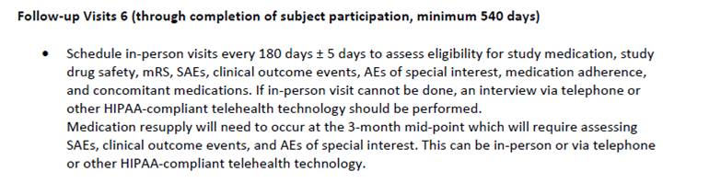
Follow Up Schedule: After Randomization (q3mos=90 days)
Protocol v.4.1 page 30:
Whether the subject is taking study drug or not, 1 year post-randomization, every 3 months:
  complete Follow Up form
  ask about AEs
  Assess if drug eligible (if taking study drug), complete drug forms F513/F514 noting the subject does/doesn’t require a drug kit & if dispensed or not
Difference between q3 months & q6months = NO mRS every 3 months f/u visit after 1 year

Slide 15
Withdrawal of Subjects
Some subjects are being withdrawn after randomization which did not require withdrawal.
  If subject develops afib* → study medication stops, BUT don’t withdraw
  If subject stops taking study drug (clinical reason or personal choice)→ don’t withdraw
  If subject doesn’t want to continue active follow up (phone/in-person)
  → ask if we can continue to follow them in your site’s medical records
If the subject isn’t taking study drug or doesn’t want to come in for f/u, simple to offer phone follow ups
If a subject reaches a primary efficacy outcome (stroke of any kind) → please wait for the adjudication of the SAE before doing the EOS & withdrawing the subject
If a subject wishes to withdraw & doesn’t want us to check their medical records (as passive f/u), that is their right → withdraw the subject

Slide 16
NDMC

Slide 17
Obtaining Informed Consent
Many cases where informed consent not properly obtained or documented
Extremely important that this be done correctly
Use the most current cIRB approved version of the ICF when obtaining consent.
  This version (and all approved versions) must be uploaded into the regulatory database in WebDCU™
Consent should be obtained ONLY by staff who have been delegated this responsibility on the DOA.
Double check consent document to make sure all sections have been correctly signed/dated by subject/LAR and person obtaining consent.
  Subject/LAR must personally sign and date consent

Slide 18
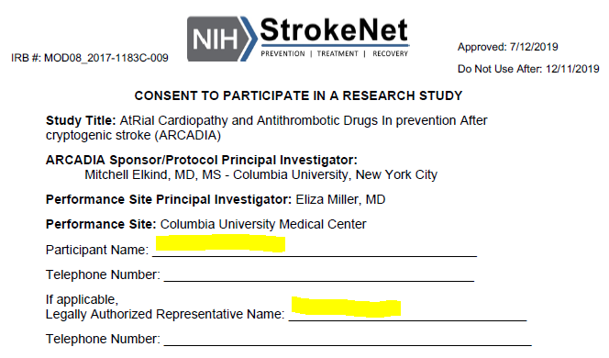
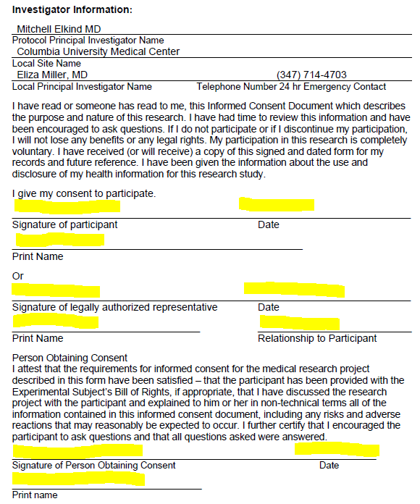
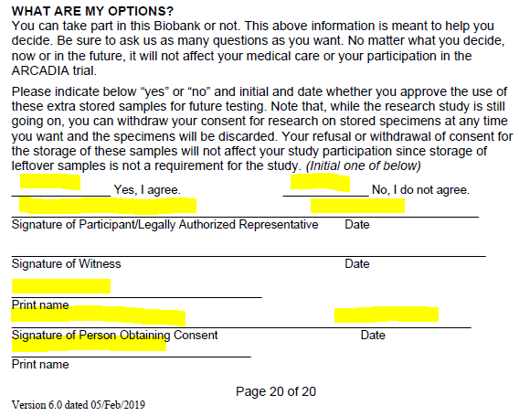

Slide 19
Determining capacity to consent and use of LAR
Subjects who lack cognitive ability to make decisions about study participation cannot give consent.
If there is any question about a subject’s cognitive ability, a trained site investigator must assess the subject for capacity to consent. This assessment must be documented in the subject’s medical record.
If a subject lacks capacity to consent, a legally authorized representative may consent on behalf of the subject.
If a subject regains the ability to consent during study participation, the consent process should be completed with the subject at that time.

Slide 20
Inappropriate use of LAR/surrogate consent
LAR signature on an ICF = LAR made decision b/c subject was not capable.
Examples of when LAR signature is used to incorrectly document a subject’s consent:
Subject has trouble physically signing the ICF
Subject is illiterate
Subject is blind
Subject does not speak English
Subject prefers to have friend/family member sign documents

Slide 21
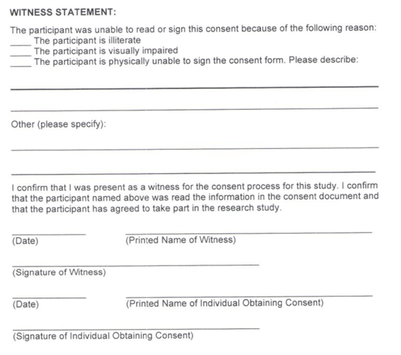
Documenting consent for subjects with non-cognitive impairments
When subject is capable of giving consent, but is unable to physically sign the consent:
  Impartial witness must be present during the consent process and sign consent document.
  If possible, subject should make their mark on signature lines.
When a subject is illiterate or visually impaired:
  The entire consent must be read aloud to the subject.
  Impartial witness must be present during the consent process and sign consent document.
  If possible, subject should make their mark on signature lines.

Slide 22
Obtaining consent from non-English speaking subjects
To obtain consent from non-English speaking subjects, you must have either a cIRB approved Full Translated ICF or a translated Short Form consent in the subject’s language.
The presentation of the consent must be done in the subject’s language. Either the person obtaining consent must be fluent in the subject’s language or an interpreter must be used. The subject’s friends or family members MAY NOT be used as interpreters.

Slide 23
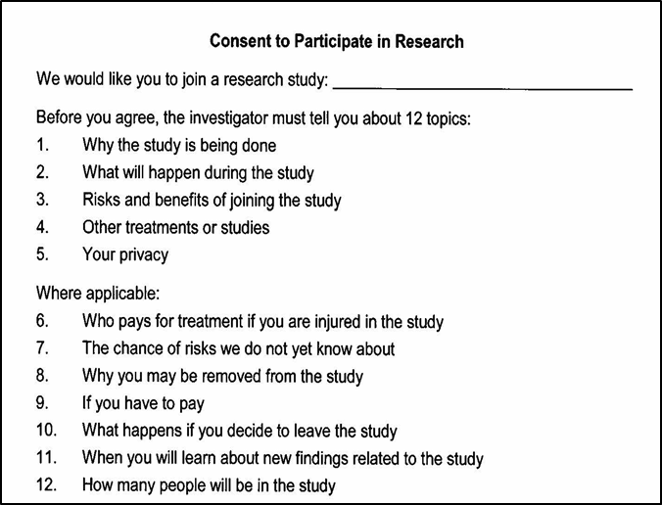
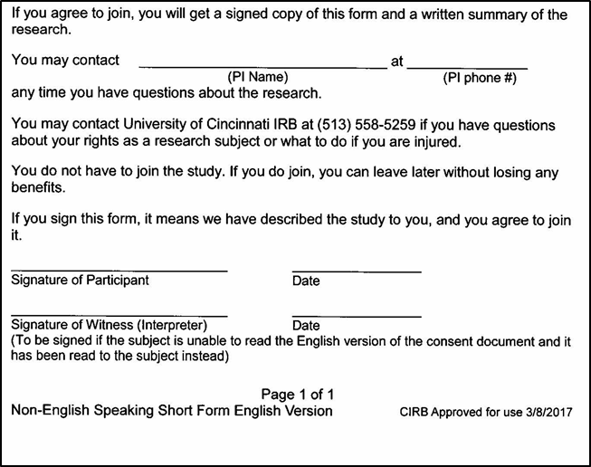
Short Form Consent
The short form is used when the consent is presented orally (because there is no translated full consent document).

Slide 24
Short Form Consent
The subject should read and sign the short form
A study team member who has been delegated responsibility to obtain consent should perform the consent process orally. If the person obtaining consent is not fluent in the subject’s native language, an interpreter should be used.
A witness, who is fluent in both English and the subject’s native language must witness the entire consent process. If an interpreter is used, the interpreter may serve as witness. The witness/translator will sign the English consent as well as the short form as the “witness”
The study team member who obtains consent must sign the English ICF. A copy of the short form and English ICF must be provided to the participant.
Notify the project manager who will request a fully translated consent in that language to be signed by the subject within 30 days.

Slide 25

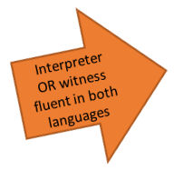
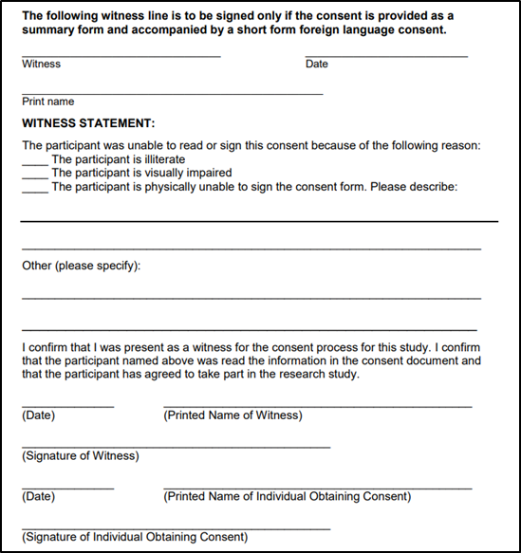

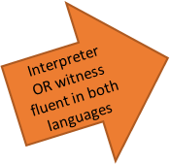

Documenting Short Form Consent
On Short Form: On Consent:

Slide 26
WebDCUTM Reminders
Please do NOT open WebDCUTM in multiple tabs or windows!
Please remember the Questionnaire for Verifying Stroke Free Status (QVSFS) should be used to verify a subject’s stroke free status at each follow up visit.
  The QVSFS source document is posted in Project Documents under Toolbox in WebDCUTM
  Also posted in each study book packet for each follow up visit

Slide 27
Who to Contact?
Aaron Perlmutter at NDMC
perlmutt@musc.edu
When to contact: If you have WebDCU-related DOA/regulatory database questions, Informed Consent Remote Monitoring questions, or Site Monitoring questions
Faria Khattak at NDMC
khattak@musc.edu
When to contact: Any other WebDCU-related or CRF-related questions
Patty Hutto at NDMC
huttoja@musc.edu
When to contact: Any other WebDCU-related or CRF-related questions
NOTE: Please refer to the Data Collection Guidelines posted in [Project Documents] under [Toolbox] in WebDCUTM, or email Faria or Patty for CRF related questions

Slide 28
FAQs
(aka – discovering the infinite number of ways
we can try to confuse the PIs)

Slide 29
FAQs
Question: We currently have a patient that seems eligible for consent. However, he does have an elevated hemoglobin concentration of 17.6 g/dL. Given the association between elevated hemoglobin concentration and increased risk of subsequent ischemic stroke/mortality, would you recommend we proceed with consenting the subject?

Slide 30
FAQs
Question: We currently have a patient that seems eligible for consent. However, he does have an elevated hemoglobin concentration of 17.6 g/dL. Given the association between elevated hemoglobin concentration and increased risk of subsequent ischemic stroke/mortality, would you recommend we proceed with consenting the subject?
Answer: Yes. This is more of a risk factor and not a mechanism of stroke so if there is no known mechanism like afib or carotid stenosis, etc. and the patient is otherwise eligible, it is fine to consent.
  The main distinction would be whether the doctors plan to anticoagulated the patient if they were not in the trial. If not, then they should be considered eligible.

Slide 31
FAQs
Question: A site has a patient who had bilateral strokes plus a cerebellar infarct and has noted “bilateral carotid stenoses of 50-59%” on their doppler. Although the site understands the ESUS inclusion criteria of not allowing for ≥50% stenosis of artery supplying the area of ischemia, they are questioning the ultrasound findings as they state, “The common carotid velocities are elevated, but probably due to cardiac output rather than stenosis”

Slide 32
FAQs
Question: A site has a patient who had bilateral strokes plus a cerebellar infarct and has noted “bilateral carotid stenoses of 50-59%” on their doppler. Although the site understands the ESUS inclusion criteria of not allowing for ≥50% stenosis of artery supplying the area of ischemia, they are questioning the ultrasound findings as they state, “The common carotid velocities are elevated, but probably due to cardiac output rather than stenosis”
Answer:
If there is a stroke in several (2 or 3) territories, then even if there is a stenosis of vessel supplying one of those territories, then that stenosis cannot account for all the strokes. In that case, the patient WOULD be eligible.
In other words, if there is a cerebellar as well as both hemispheres, then the carotid stenoses, even if bilateral would not be expected to explain the cerebellar infarct. if there is no vertebral stenosis, then the patient's combination of strokes could not be explained by the carotid stenoses, even if present on CTA.
Similarly, were a patient to have bilateral frontal strokes, with >50% stenosis of just one carotid, they should most likely not be excluded, because the single carotid stenosis would not be expected to cause the stroke on opposite side. (There are issues with one carotid potentially supplying both sides, have seen this, but rare...this is why we must leave up to PI in these cases. We always have our insurance policy--atrial cardiopathy being present--as well.

Slide 33
FAQs
Question: If a patient from your site is now at another facility that is not part of your site, can you visit them there and conduct trial activities at that other facility?

Slide 34
FAQs
Question: If a patient from your site is now at another facility that is not part of your site (i.e. independent rehab center) -- can you visit them there to conduct trial activities at that unaffiliated facility?
Answer: No. The CIRB and your local IRB have approved study procedures for subjects to be done at specific locations and you cannot conduct consent & blood draws at a rehab or other facility that has not been approved to be part of your site’s locations. Remember that you can always stay in touch and wait until they are discharged to bring them back to your site for trial procedures.

Slide 35
FAQs
Question: We have a patient who had a diagnostic cardiac cath and embolic stroke during the procedure despite minimal aortic atherosclerosis. Would this patient qualify for enrollment in ARCADIA?

Slide 36
FAQs
Question: We have a patient who had a diagnostic cardiac cath and embolic stroke during the procedure despite minimal aortic atherosclerosis. Would this patient qualify for enrollment in ARCADIA?
Answer: No. If the periprocedural stroke happens during or immediately post-procedure it would be too much of a coincidence to think this was not caused by the procedure. Having a known cause such as this would mean this patient is not ESUS.

Slide 37
FAQs
Question: A randomized subject is having a planned surgical procedure done (loop recorder) and their doctor has advised them to stop taking study drug 3 days prior to the procedure and asked them to take aspirin during that 3-day period. Is this okay?

Slide 38
FAQs
Question: A randomized subject is having a planned surgical procedure done (loop recorder) and their doctor has advised them to stop taking study drug 3 days prior to the procedure and asked them to take aspirin during that 3-day period. Is this okay?
Answer: Yes, that should be fine to stop taking study drug those days and to take open-label aspirin during that time. We have it on page 47 of the MOP: “Local investigators will be responsible for having participants stop study medications prior to procedures. In some cases, a surgeon may be willing to perform the procedure while the patient is on aspirin, but not apixaban; in this case, open-label aspirin can be used after study medications are stopped.” The key is to have the patient stop both study drug bottles simultaneously, take open aspirin during this period, then stop open label aspirin and restart both study drug bottles simultaneously.

Slide 39

Thanksgiving Holiday Shipping to CALM
Please do not complete subject blood draws on Wednesday or Thursday (11/27 or 11/28) as the sample cannot keep that long without being processed.
You can draw blood on Friday (11/29), process as per manual, and then ship next Monday (12/2)

Slide 40
Feel free to reach out!
24-hour telephone hotline
  Please use it for any urgent questions
  Eligibility, randomization, unblinding, etc
1-833-427-2234 (= 1-833-4AR-CADI): useful to save in your cell phone
The hotline automatically calls the four PIs in succession
  Please let it ring
  And call back if no luck—one of us will pick up!
Please email arcadia@ucmail.uc.edu with non-urgent questions
Corrected numbers!!

