Slide 1
PI and Coordinator Webinar
March 26, 2019

Slide 2
Site startup/recruitment profile
In past month:
116 sites released to enroll; no change
  143 sites in WebDCU; goal 180 sites
63 → 64 sites with at least one randomization
  Randomizations 0-10
  Randomizations per month: 0 – 0.93 (mean 0.18)
101 → 106 sites with at least one consent
  Range 0 to 31 consents per site

Slide 3
Enrollment
In past month:
677 → 748 patients consented
~40% eligible for randomization
166 → 179 randomized
38 eligible but not yet randomized

Slide 4
ARCADIA-CSI (Cognition and Silent Infarcts)
First ancillary study funded!
PIs: George Howard, DrPH; Maarten Lansberg, MD, PhD; Ronald Lazar, PhD; Kevin N. Sheth, MD; David Tirschwell, MD
Aims:
To determine the effect of anticoagulation (vs antiplatelet therapy) on cognitive function after stroke (primary clinical outcome)
To determine the effect of anticoagulation (vs antiplatelet therapy) on the incidence of silent infarcts after stroke (primary imaging outcome)
To determine the imaging and clinical predictors of cognitive impairment after stroke

Slide 5
Plans to increase recruitment by adding sites
Adding additional sites: StrokeNet, non-StrokeNet US sites, Canadian
If you have sites that are interested in participating, let us know and we will have them complete a site selection survey
If you have clinics or rehab facilities near you where you could possibly screen subjects for ARCADIA, let us know and we can work with you on what you would need to do to add them

Slide 6
How to address common patient and other physician concerns
Patients concerned about the possibility that they will not be able to get tPA when they have a recurrent stroke;
Patients whose primary doctor or cardiologist think they need to be on aspirin/clopidogrel (after POINT trial);
Patients whose doctors think they must be on rivaroxaban and aspirin (after COMPASS trial);
Patients who had their stroke while taking aspirin and who are afraid to be randomized to aspirin alone;
Patients who do not want to travel to the clinic for follow up.

Slide 7
Question: A 72 year old ARCADIA patient is seen in the emergency room with acute aphasia and right hemiplegia, within 1 hour of symptom onset. The patient cannot receive IV tPA.
True or false?

Slide 8
Question: A 72 year old ARCADIA patient is seen in the emergency room with acute aphasia and right hemiplegia, within 1 hour of symptom onset. The patient cannot receive IV tPA.
The correct answer is false!
The patient may be eligible for IV tPA IF:
They were randomized to aspirin;
They were randomized to apixaban but had not taken it within 48 hours
Emergency unblinding is needed, and is possible
CALL THE HOTLINE

Slide 9
Concern about possibility that patient will not be able to get tPA when they have a recurrent stroke
The best stroke is the one prevented.
  The purpose of the study is to decrease likelihood that patient will have stroke in first place
Emergency unblinding is available
Less than 5% of patients will be unable to get IV tPA (1/2 of the ~7% estimated to have an outcome event)
If there is large vessel occlusion, patients still able to get thrombectomy

Slide 10
Question: A 69 year old woman with a history of diabetic neuropathy presents with mild left hemiparesis (NIHSS 3). MRI shows a small superficial right frontal infarction. Evaluation shows no significant large vessel disease or source of embolism.
You approach the patient to discuss ARCADIA, and she asks you to call her primary treating neurologist. The primary neurologist says that she would like the patient to be on aspirin and clopidogrel for at least 6 months.
Do you:
Thank her and consent the patient for ARCADIA eligibility screening.
Thank her and tell the patient she cannot be in ARCADIA.
Explain that dual antiplatelet therapy has not been shown to be of benefit beyond 90 days after acute stroke, and is likely to be of benefit for only up to 30 days.

Slide 11
Question: A 69 year old woman with a history of diabetic neuropathy presents with mild left hemiparesis (NIHSS 3). MRI shows a small superficial right frontal infarction. Evaluation shows no significant large vessel disease or source of embolism.
You approach the patient to discuss ARCADIA, and she asks you to call her primary treating neurologist. The primary neurologist says that she would like the patient to be on aspirin and clopidogrel for at least 6 months.
Do you:
Thank her and consent the patient for ARCADIA eligibility screening.
Thank her and tell the patient she cannot be in ARCADIA.
Explain that dual antiplatelet therapy has not been shown to be of benefit beyond 90 days after acute stroke, and is likely to be of benefit for only up to 30 days.

Slide 12
Patients whose primary doctor/cardiologist think they need to be on aspirin/clopidogrel
POINT trial
Double-blind randomized trial of aspirin vs. aspirin/clopidogrel
4,881 subjects enrolled at 269 sites in 10 countries:
  Minor stroke (NIHSS ≤3) or high-risk TIA (ABDC² score ≥4) in prior 12 hours
  Excluded if thrombolysis/thrombectomy, anticoagulation, carotid surgery
Required testing:
  Echo, 20 hours of heart-rhythm monitoring, extracranial vessel imaging
Treatment arm 1: Aspirin (50-325 mg daily) + placebo
Treatment arm 2: Aspirin + clopidogrel (600-mg load + 75 mg daily)
Johnston SC et al. NEJM. 2018

Slide 13
POINT trial: Discussion relevant to ARCADIA
POINT does not apply to everyone
  Trial limited to those stroke patients with NIHSS ≤3
  Those who did not undergo thrombolysis/thrombectomy
Nearly all of benefit appears to occur during the first 7 days:
  Reduction in risk of early ischemic events up to 7 or 21 days after stroke
  Increase in risk of major hemorrhage at days 8-90 days
Johnston SC et al. NEJM. 2018

Slide 14
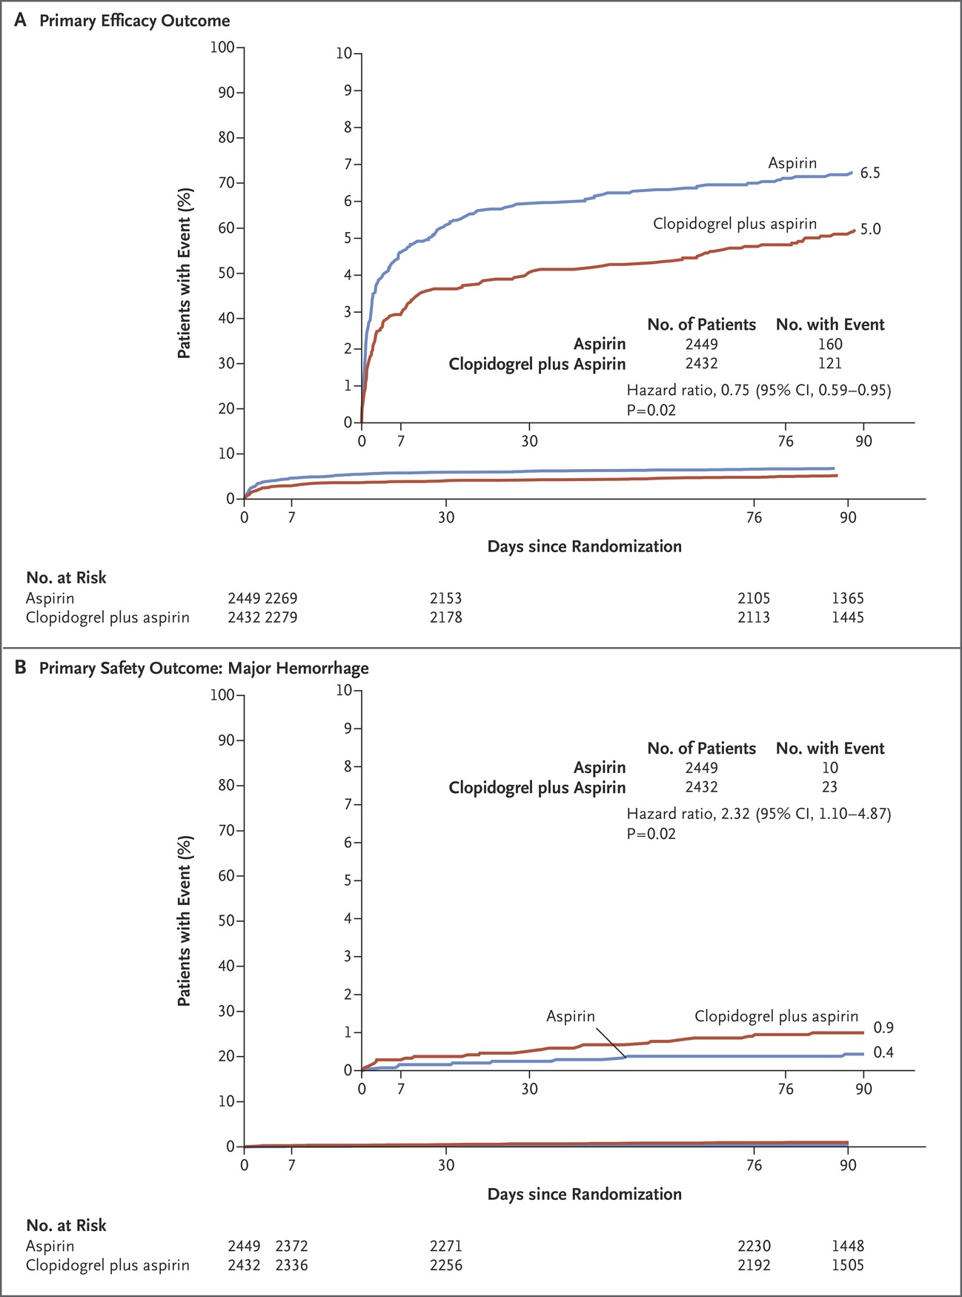
POINT trial: Discussion relevant to ARCADIA
The benefits appear early in the curve for the primary outcome, and the lines become parallel afterwards. The curves continue to diverge in the curves for risk.
Johnston SC et al. NEJM. 2018

Slide 15
POINT trial: Discussion relevant to ARCADIA
POINT does not apply to everyone
Most of benefit appears to occur during the first 7-21 days
No evidence of long-term benefit of dual antiplatelet therapy
Stroke patients are older than cardiac patients and have higher risk of bleeding complications
Can delay randomization until PI comfortable with single anti-platelet but would not defer consent/eligibility determination

Slide 16
Question: A 64 year old man with a history of coronary artery disease (CAD) and MI presents with right hemianopsia. He had a coronary stent placed 8 years ago, but has been stable since then. Medications include aspirin 81 mg daily.
He has a left occipital infarction on MRI. Evaluation shows no significant large vessel disease or source of embolism.
You tell the patient’s cardiologist about the ARCADIA trial. He is interested in learning about it, but says that the patient should remain on aspirin and is therefore not eligible for the study.
Which of the following statements is true:
All patients with CAD must be on antiplatelets indefinitely.
In patients with CAD, aspirin provides additional benefit for stroke prevention to anticoagulation alone.
There is evidence that oral anticoagulants are as effective for CAD as antiplatelet therapy.

Slide 17
Question: A 64 year old man with a history of coronary artery disease (CAD) and MI presents with right hemianopsia. He had a coronary stent placed 8 years ago, but has been stable since then. Medications include aspirin 81 mg daily.
He has a left occipital infarction on MRI. Evaluation shows no significant large vessel disease or source of embolism.
You tell the patient’s cardiologist about the ARCADIA trial. He is interested in learning about it, but says that the patient should remain on aspirin and is therefore not eligible for the study.
Which of the following statements is true:
All patients with CAD must be on antiplatelets indefinitely.
In patients with CAD, aspirin provides additional benefit for stroke prevention to anticoagulation alone.
There is evidence that oral anticoagulants are as effective for CAD as antiplatelet therapy.

Slide 18
Anticoagulants as effective as aspirin for patients with atherosclerotic disease
Several trials provide evidence that aspirin and warfarin have similar efficacy in reducing risk of recurrent MI and death in CAD patients
ASPECT 2, van Es et al. lancet 2002;360:109-113.
WARIS II, Hurlen M et al. NEJM 2002;347:969-974.
AFTER study, Julian DG, et al. BMJ 1996;313:1429 –1431.
EPSIM trial, EPSIM Research Group. N Engl J Med. 1982;307:701–708.
German-Austrian Aspirin Trial, Breddin K et al. Circulation 1980;62 (suppl V):V-63-V-72).
These trials also show that there is increased risk of bleeding with combination of aspirin and oral anticoagulation without added benefit.

Slide 19
WARIS II
N=3630 patients after MI
  1216 randomized to warfarin (INR 2.8-4.2)
  1206 randomized to aspirin 160 mg daily
  1208 aspirin 75 mg plus warfarin (INR 2.0-2.5)
  Primary outcome: composite of nonfatal MI, thromboembolic stroke, death
Rate ratio, 95% CI
Warfarin vs ASA 0.81 (0.69-0.95)
Warfarin + ASA vs ASA 0.71 (0.60-0.83)
Warfarin + ASA vs warfarin 0.87 (0.73-1.03)
alone
Warfarin and the combination of warfarin and aspirin were associated with an increase in risk of major bleeding.

Slide 20
Expert consensus opinion suggests that anticoagulation is as effective as antiplatelet therapy for prevention of cardiac events
In patients with AF, “risk for major bleeding side effects is increased substantially with combination therapy, and such therapy may not be needed in most patients with combined AF and CAD, because prior studies demonstrated that oral anticoagulation with VKA therapy is at least as effective as antiplatelet therapy for prevention of MI.”
Kernan WN, et al. AHA Secondary prevention guidelines. Stroke 2014;45:2160-2236.
“The conclusion that can be drawn from the studies of warfarin in MI patients is that it is at least as effective as aspirin and possibly more so in reducing the risk of recurrent MI, thromboembolic stroke, and death… These data taken together…suggest that [warfarin] can serve as a stand-alone therapy in MI patients who also have AF requiring warfarin to reduce stroke risk.”
“Published data to date offer no obvious rationale for adding aspirin to warfarin in CAD patients with AF unless they have a coronary stent, because the combination appears to increase bleeding risk substantially, and warfarin alone protects against the risk of both stroke and recurrent MI.”
Marc Fisher and Joe Loscalzo. Stroke 2011;42:278-281.

Slide 21
Patients whose doctors think they must be on rivaroxaban or other DOAC and aspirin
COMPASS trial
Double-blinded randomized trial in patients with stable atherosclerotic disease of:
  rivaroxaban 2.5 mg BID PLUS aspirin 100 mg daily
  rivaroxaban 5 mg BID
  aspirin 100 mg daily
27,395 participants enrolled at 602 sites in 33 countries:
  CAD, PAD
  If < 65 yo: athero in 2 vascular beds or 2 additional RFs, including non-lacunar ischemic stroke > 1 month earlier
  Excluded: recent stroke or previous hemorrhagic or lacunar stroke
Eikelboom JW et al. N Engl J Med ;377:1319-1330.

Slide 22
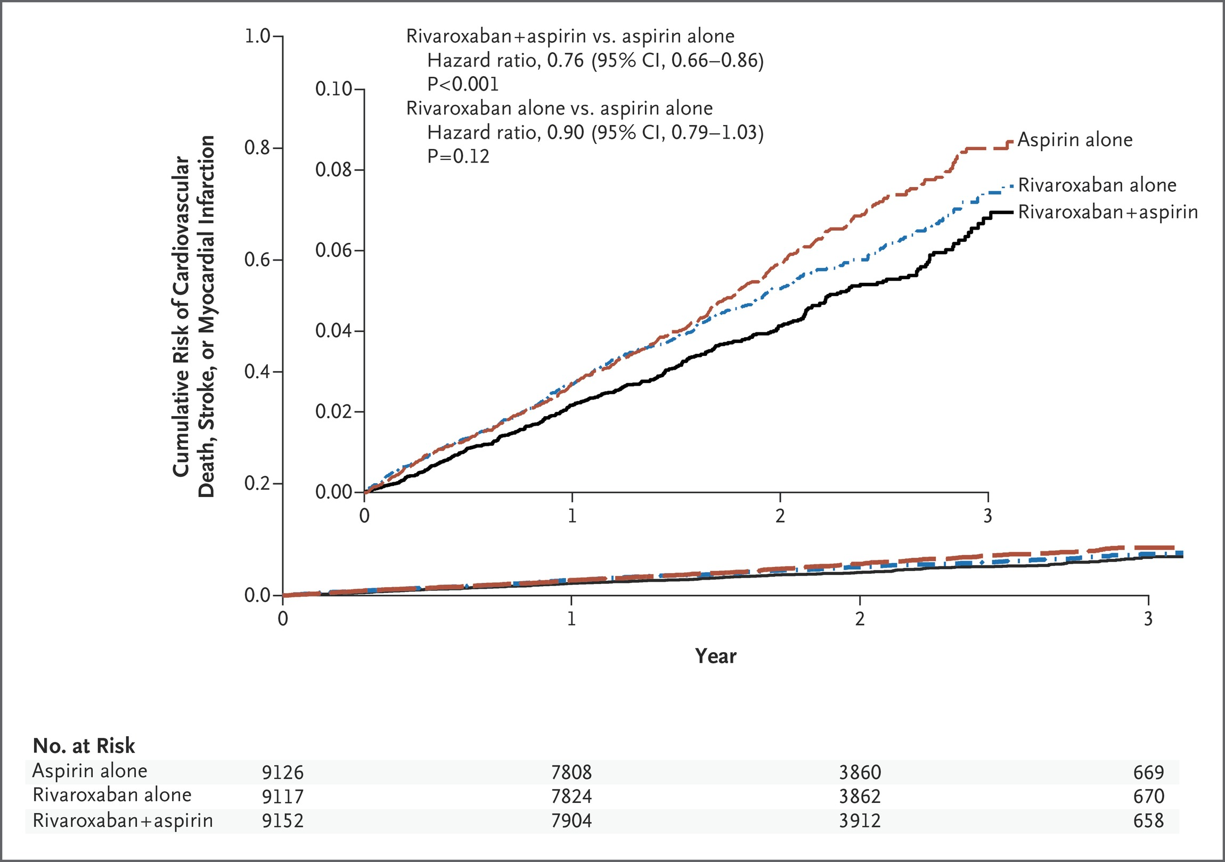
COMPASS: Primary outcome=composite of cardiovascular death, stroke, or myocardial infarction.
 | Overall primary outcome | Major bleeding
Aspirin alone | 5.4% | 1.9%
Rivaroxaban alone | 4.9% | 2.8%
Rivaroxaban + ASA | 4.1% | 3.1%
Eikelboom JW et al. N Engl J Med ;377:1319-1330.

Slide 23
Eikelboom JW et al. NEJM;377:1319-1330.

Slide 24
COMPASS Stroke Outcomes
Sharma M et al. Circulation 2019;139(9):1134-1145.

Slide 25
Patients whose doctors think they must be on rivaroxaban or other DOAC and aspirin
COMPASS is not relevant to our patient population
The COMPASS trial was not a trial in stroke patients
Patients were eligible because they had other forms of atherosclerotic disease
Less than 4% of patients had a history of stroke
ARCADIA patients are specifically eligible because of having cardiac embolism, not atherosclerosis, as likely cause of stroke
COMPASS also confirms prior trials with warfarin showing that OAC is as effective as aspirin at preventing recurrent cardiovascular events in patients with CAD (and PAD): p value for difference between DOAC and ASA 0.12.
COMPASS does not show any net clinical benefit for rivaroxaban over aspirin.
Eikelboom JW et al. N Engl J Med ;377:1319-1330

Slide 26
Question: An 81 year old man with a past history of minor stroke presents with right hemiparesis. He has a small left frontal infarction. He had been taking aspirin 81 mg daily for secondary prevention, as well as simvastatin 40 mg.
You discuss the ARCADIA trial with the patient. His daughter asks why he should be in the trial if there is a chance that he could get ASA 81 mg. He was already on aspirin 81 mg, she says, and it clearly didn’t work.
Which of the following statements is true:
There is no evidence from randomized trials that increasing the dose of aspirin from 81 to 325 mg daily reduces the risk of recurrent stroke.
There is evidence from randomized trials that atorvastatin 80 mg daily reduces risk of recurrent stroke.
Patients on either aspirin or anticoagulants may experience recurrent stroke despite treatment (“treatment failure”).
All of the above.

Slide 27
Question: An 81 year old man with a past history of minor stroke presents with right hemiparesis. He has a small left frontal infarction. He had been taking aspirin 81 mg daily for secondary prevention, as well as simvastatin 40 mg.
You discuss the ARCADIA trial with the patient. His daughter asks why he should be in the trial if there is a chance that he could get ASA 81 mg. He was already on aspirin 81 mg, she says, and it clearly didn’t work.
Which of the following statements is true:
There is no evidence from randomized trials that increasing the dose of aspirin from 81 to 325 mg daily reduces the risk of recurrent stroke.
There is evidence from randomized trials that atorvastatin 80 mg daily reduces risk of recurrent stroke.
Patients on either aspirin or anticoagulants may experience recurrent stroke despite treatment (“treatment failure”).
All of the above.

Slide 28
Patients who had their stroke while taking aspirin and are afraid to be randomized to aspirin 81 mg alone
The limitations of concept of aspirin failure
Patients could have had the event sooner had they been on a different agent
Patients could have had a bleeding event, even a fatal one, had they been on a higher dose of aspirin
Misconception that it is only about failure of antithrombotics
  Compliance
  Patients could have had “statin failure”
  Importance of addressing other risk factors (BP and hyperglycemia)
No evidence that 325 mg is more effective than 81 mg
FDA recommends dose of aspirin 50-325 mg daily

Slide 29
Potential patient concerned about travel?
Many sites get referrals from far away
We have heard that some potential patients do not want to travel for follow-up visits

Slide 30
Potential patient concerned about travel?
Many sites get referrals from far away
We have heard that some potential patients do not want to travel for follow-up visits
Coordinators may consider home visits
PROTOCOL AMENDMENT:
  “If in-person visit cannot be done, an interview via telephone or other HIPAA-compliant telehealth technology should be performed.”
  Study drug will need to be resupplied by mail

Slide 31
Screen failure logs
Screen failure logs should include ONLY patients that have ESUS
  i.e., you do NOT need to include patients with known atrial fibrillation, lacunar strokes, etc.
  Do NOT include subjects for whom stenosis is the cause of stroke
  Do NOT include subjects who have not had a stroke
Deceased subjects should not be included
Subjects that have been consented should not be included
When selecting ‘Other’ as the primary reason patient is not consented, please make sure that the reason you are entering in the specify field cannot be coded as one of the available options.
  If the subject refused consent/said they do not want to participate in research/lives too far away/said they do not want to return for follow-ups, this needs to be coded as ‘17 = Inability to obtain written, informed consent from patient or surrogate for trial participation’, not as ‘Other’
Many of the reasons that are being entered in the specify field can be coded under the ‘16 = Considered by the investigator to have a condition that precludes follow-up or safe participation’ option
  i.e., atherosclerosis, ‘documented history of medication noncompliance’, ‘Not a good candidate. Many comorbidities’, alcohol/drug abuse, etc.
Please clean up your screen failure logs accordingly.

Slide 32
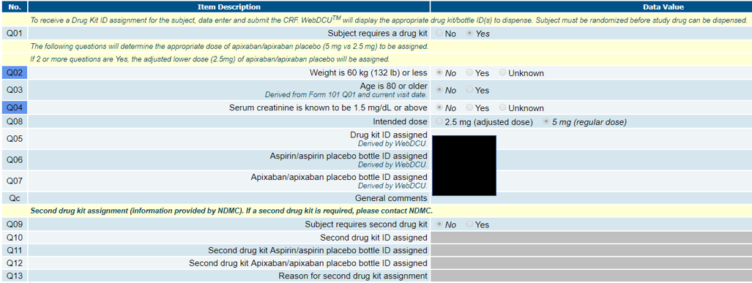
F512, F513, & F514 ‘Second Drug Kit’ Section
These 3 CRFs have been updated to include a ‘second drug kit’ section at the bottom of each form

Slide 33
F512, F513, & F514 ‘Second Drug Kit’ Section
This section will only need to be completed if a subject requires an extra drug kit to be dispensed between visits
If you encounter such a scenario, please reach out to the NDMC immediately
The NDMC will update this section on F512 & F513 for you; sites do not have edit permissions to this section on these two forms

Slide 34
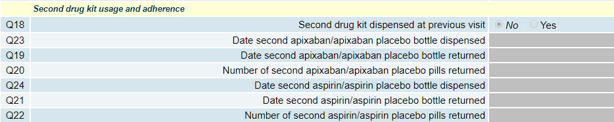
F512, F513, & F514 ‘Second Drug Kit’ Section
You will need to document the return of the ‘first’ drug kit bottles on F514 at the subject’s next visit, in addition to the return of the second set of bottles
  Q18 on F514 ‘Second drug kit dispensed at previous visit’ will be updated to ‘Yes’ by NDMC. You will need to complete the remainder of that section

Slide 35
Delegation of Authority Logs
Edit your DOA whenever you have changes to your study team
New personnel need to be approved by the CIRB prior to beginning research activities
An Administrative Amendment will be submitted for you, however, for any new investigator or coordinator, you need to upload a COI and HSP before the amendment can be submitted.
Please try to bundle changes in personnel when possible to improve efficiencies.

Slide 36
Changing your site PI
Notify us as soon as you know you are going to change site PIs.
Provide a CV for the new Site PI so the ARCADIA PIs can approve this investigator.
Contracting will need to edit your site CTA
All regulatory documents with the Site PI name will need to be edited.
An Administrative Amendment will need to be submitted and approved prior to the new site PI taking over.

Slide 37
Reminders
Sending echo images
  Please be sure to send ECHOs to the Core Reading lab for both patients consented and not eligible as well as those eligible and randomized
  Only first technically adequate post-stroke transthoracic echo should be sent
  Please check with your echo lab to determine if it is transthoracic or transesophageal before sending
  DO NOT SEND TRANSESOPHAGEAL ECHOS FOR CENTRAL REVIEW

Slide 38
StrokeNet Coordinator Roundtable
Wednesday, March 27th - 1:30 PM Eastern Time
Discussion will include but is not limited to, announcements, news, study updates, data center updates, coordinating center updates, etc.
To join the meeting: https://nihstrokenet.adobeconnect.com/coordinator/
To take part in the conversation you MUST dial in.
1 (877) 621-0220 Pass Code: 434578

Slide 39
Feel free to reach out!
24-hour telephone hotline
  Please use it for any urgent questions
  Eligibility, randomization, unblinding, etc
1-877-427-2234 (1-877-4AR-CADI): useful to save in your cell phone
The hotline automatically calls the four PIs in succession
  Please let it ring
  And call back if no luck—one of us will pick up!
Please email arcadia@ucmail.uc.edu with non-urgent questions, including eligibility of challenging cases

