Slide 1
PI and Coordinator Webinar
July 23, 2019

Slide 2
Study Sites
120 sites actively enrolling
21 other sites actively working on being released to enroll
120 sites have consented at least one subject
1047 total consents
Since July 15th

Slide 3
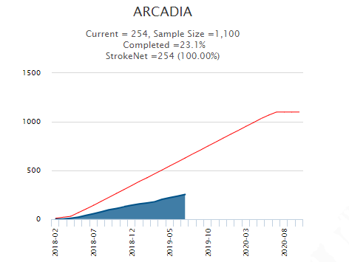
More sites
Continued efforts at every site to try to identify every possible patient
Efforts to randomize eligible patients

Slide 4
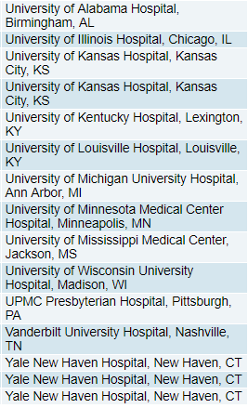
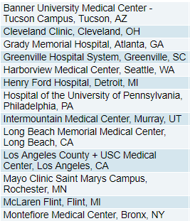
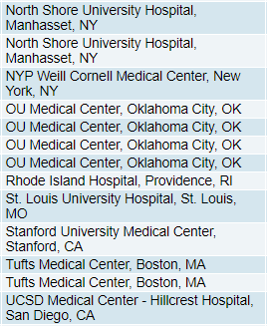
Eligible not yet Randomized N = 41

Slide 5
ARCADIA Heroes
Lots of new (and our dedicated existing) coordinators (and PIs) trying hard to help identify and consent patients
Susan Hetzel - University of Mississippi Medical Center has enrolled 5 subjects this month – the site was released to enroll 5/20. She consented 3 subjects in one week!

Slide 6
DCU Slides - Faria

Slide 7
ICF v5 vs. v6 (F245 vs. F246)
If your site has not yet been approved to use ICF v6, it should be left blank for now.
You should re-consent all active subjects once you receive ICF v6 approval.

Slide 8
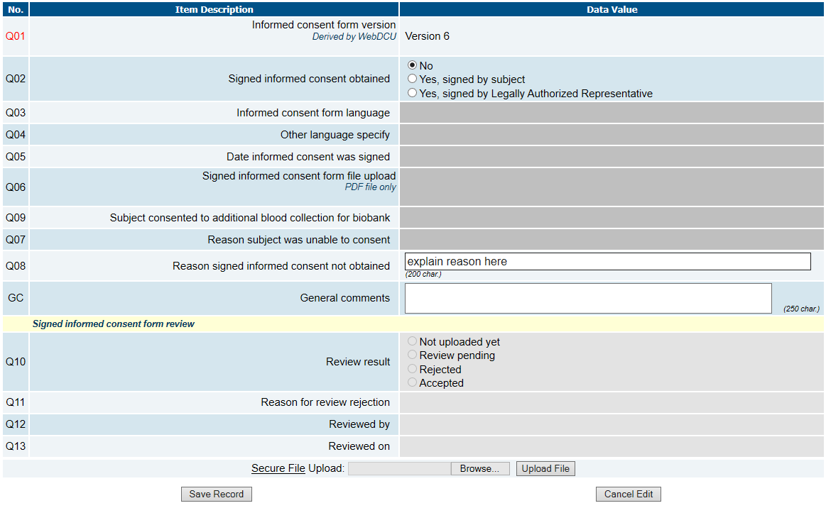
What happens when you are unable to re-consent subject due to LTFU, withdrawal of consent, or moved to EOS?
-Mark Q02 as no
-Explain why in Q08

Slide 9
Subject LTFU prior to randomization
In order to document this in WebDCUTM , please do the following:
Edit F101 Q06 ‘Able to be randomized no later than 120 days after stroke onset’ to ‘No’
This will generate a warning on the right hand side, which needs to be addressed. Click on the blue pencil icon to respond to the warning and provide an explanation. Responding to the warning will also allow you to save and submit the CRF.
Due to Q06 now being an eligibility violation on F101, F126 Q12 ‘Eligible for randomization’ should be ‘No’
Please do not mark LTFU subjects as ‘consent withdrawn’ on F126 End of Study

Slide 10
Documenting Eligibility Violations on F101
Similar to documenting a subject as LTFU prior to randomization, we use F101 to document other eligibility violations that occur prior to randomization
Atrial fibrillation detected
Indication for anticoagulant therapy
Indication for antiplatelet agent
Etc.
Update the answer to the F101 question relevant to your findings
Please make sure to always respond to the warning and save and submit the CRF
Warnings can trigger on any CRF and the data will show as outstanding until the CRF has been submitted.
Please provide sufficient explanation to avoid DCRs/queries for clarification
Ex: In response to a warning for ‘Able to be randomized no later than 120 days after stroke onset’ please do not respond with ‘unable to be randomized’/’not eligible’. Instead, you need to explain WHY
Similarly, for ‘specify’ fields such as ‘Consent withdrawn, specify’ on EOS, please explain WHY the subject withdrew consent, do not restate that consent was withdrawn or this will need to be queried.

Slide 11
New Study Book Format
The study book is no longer posted under Project Documents.
To find the new study book, go to [Project Setup] -> [CRF Collection Schedule]. There are CRF packets for each visit uploaded under the visit name.

Slide 12
Who to Contact?
Srikala Appana at NDMC
appana@musc.edu
When to contact: If you have WebDCU-related DOA/regulatory database questions, Informed Consent Remote Monitoring questions, or Site Monitoring questions
Faria Khattak at NDMC
khattak@musc.edu
When to contact: Any other WebDCU-related or CRF-related questions
Patty Hutto at NDMC
huttoja@musc.edu
When to contact: Any other WebDCU-related or CRF-related questions
NOTE: Please refer to the Data Collection Guidelines posted in [Project Documents] under [Toolbox] in WebDCUTM, or email Faria or Patty for CRF related questions

Slide 13
Regulatory Updates Slide - Emily

Slide 14
Regulatory Updates:
Amendment progress for the v6, v3 consents.
70 + sites have been sent current versions of the consent template
Some sites will remain on the v2 Pregnant Partner consent.
Please upload the approval letter sent with your approved ICD to the 4.1 space holder in WebDCU. The Prime Approval letter for the 4.1 should not be uploaded.
Please upload your updated consents to WebDCU as soon as possible
WebDCU will be archiving the v5 space holders soon
Translations will be sent to the site once received, please upload to WebDCU as soon as possible
Reach out to the NCC for a short form if needed

Slide 15
Loss to Follow Up Slides - Pam

Slide 16
Lost-to-Follow Participants
Preparations to decrease loss to follow up begins at screening
Screen efficiently
If the patient has a history of “no shows”, known social issues, and/or non-compliance, consider not consenting
Develop a relationship with the patient
After consent, send birthday cards, holiday cards, etc…
Provide a list of all study visits and windows for those visits
This should also contain detailed instructions for the visits and site contact information
Send visit reminder postcards or emails; Reminder visit calls
Consenting
Educate the patient thoroughly regarding the study visits and their commitment
Why it’s important to complete the study visits
Obtain a contact sheet after completing consent
◦ Email address(es) ◦ Work numbers ◦ Emergency contacts ◦ Friends & Family numbers (Children/Siblings/Neighbors)

Slide 17
When Lost-to-Follow Up Occurs
Check your facility’s EMR; we have permission in consent to consult EMR for outcomes
Consider seeing patient at another scheduled visit at the facility
Call emergency contacts or friends/ family members from contact sheet
Standard letter x3 followed by a registered letter (signature required) if needed
Try calling participant from a non-facility number
Visit their home
Social Media – only to search, not contact
FaceBook
Instagram
Twitter
Search internet
Google People
Social Security Death Index

Slide 18
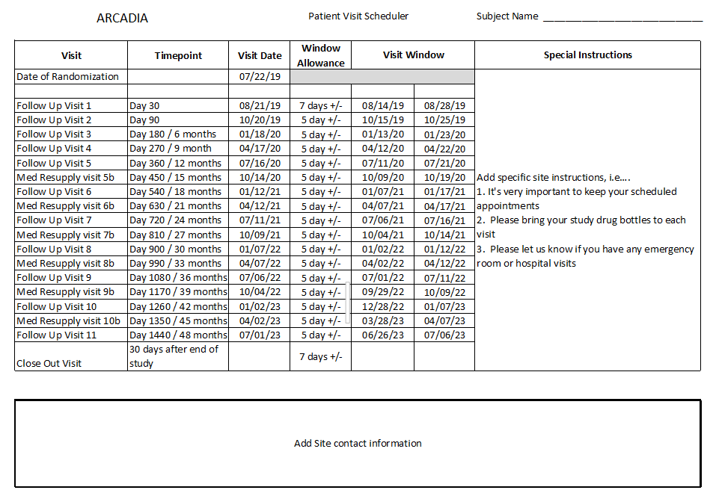
ARCADIA
Subject
Scheduler

Slide 19
ECHO Slides - Marco

Slide 20
Transthoracic Echocardiogram (TTE) Transesophageal Echocardiogram (TEE) THE ONE WE WANT THE ONE WE DO NOT WANT

Slide 21
Transthoracic Echocardiogram – Left atrial diameter

Slide 22
Transthoracic Echocardiogram (TTE) Transesophageal Echocardiogram (TEE) The cardiac apex is UP The cardiac apex is DOWN

Slide 23
ARCADIA cases
Shashank Shekhar MD, MS
Site PI
University of Mississippi Medical Center
Jackson, MS

Slide 24
Case #1
79 yo African American female presents with acute onset gait instability. MRI reveals acute DWI lesion in the cerebellar vermis >1cm and multiple cortical lesions on FLAIR.
DWI
FLAIR

Slide 25
CTA of head and neck
Right vertebral artery:- hypoplastic with focal moderate to severe stenosis (>50% stenosis) at C3-C4 from uncovertebral osteophytes (arrow).
Lt vert unremarkable.
Rest of work up unremarkable.
CTA

Slide 26
Q: Would you consent this patient if no other exclusions?
Answer: Yes, even though the non-dominant vertebral artery is significantly stenotic, it is believed to be due to external compression from osteophytes and not due to intrinsic atherosclerotic disease and thus unlikely to be related etiology.

Slide 27
Case #2
93 yo Caucasian female with HTN, DM, presents with left hemibody weakness, CTH shows heavily calcified extra-axial mass with mild surrounding edema. MRI shows DWI embolic appearing lesions in right MCA territory. Patient lives independently. No contraindications for study.
T1 W
FLAIR
DWI

Slide 28
Q: Will this patient be eligible for consenting?
Answer: Yes.

Slide 29
Literature Update Slides - Mitch

Slide 30
Literature update
Ntaios G et al. Carotid plaques and detection of atrial fibrillation in ESUS. Neurology 2019; 92:e2644-2652.
Background: Substenotic plaque (i.e., carotid plaque <50%) may be a cause of ESUS. If so, then patients with ipsilateral substenotic plaque should be LESS LIKELY to have AF detected during follow-up.
Hypothesis: Patients with ESUS with substenotic plaque are less likely to have AF detected during follow up.

Slide 31
Literature update
Retrospective analysis
777 patients from 3 different registries (Lausanne, Athens, Larissa)
Follow up 2642 patient-years (mean 3.4 years per patient)
Primary outcome: detection of AF; no systematic monitoring for AF
Ntaios G et al. Neurology 2019; 92:e2644-2652.

Slide 32
Literature update
Retrospective analysis
777 patients from 3 different registries (Lausanne, Athens, Larissa)
Follow up 2642 patient-years (mean 3.4 years per patient)
Primary outcome: detection of AF; no systematic monitoring for AF
Results:
38.6% of patients (n=341) had an ipsilateral substenotic plaque
The detection rate was 8.5% in patients with substenotic plaque vs 19.0% in patients without substenotic plaque.
After adjusting for other factors, presence of plaque associated with ~50 likelihood of detecting AF (adj HR 0.57, 95%CI 0.34-0.96).
Ntaios G et al. Neurology 2019; 92:e2644-2652.

Slide 33
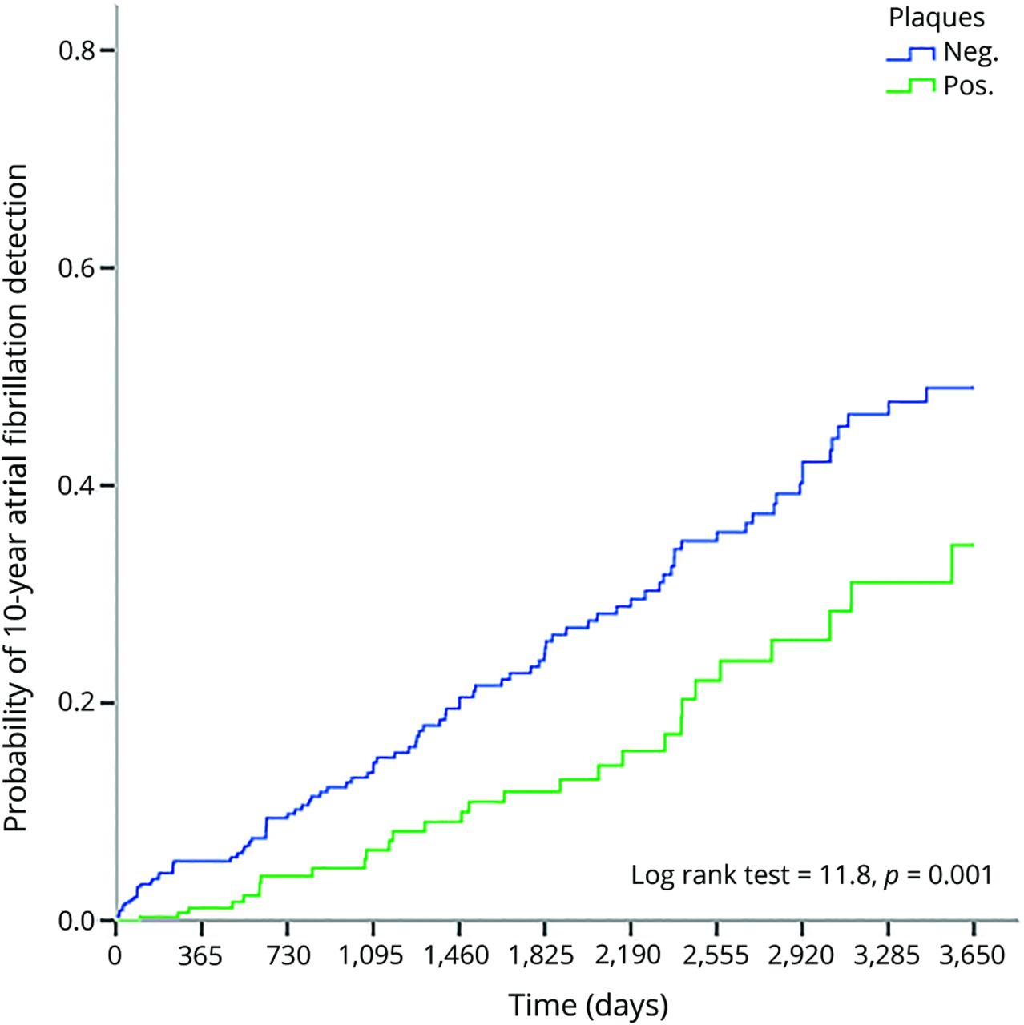
Ten-year cumulative probability of atrial fibrillation detection in embolic stroke of undetermined source patients with and without nonstenotic carotid plaques ipsilateral to the index stroke
George Ntaios et al. Neurology 2019;92:e2644-e2652
© 2019 American Academy of Neurology
Notes:
Ten-year cumulative probability of atrial fibrillation detection in embolic stroke of undetermined source patients with and without nonstenotic carotid plaques ipsilateral to the index stroke

Slide 34
Literature update
Potential implications:
Substenotic plaque may be causally associated with ESUS
The finding of substenotic plaque may be a reason to pursue more or less aggressive monitoring for AF (i.e., look less hard in those without the plaque)
Patients with substentoic plaque may similarly be less likely to have atrial cardiopathy
Limitations
The incidence of AF detection is high even in those with substenotic plaque (~9% over 3 years).
Study was retrospective
No systematic monitoring for AF or uniform detection protocol (i.e., based on clinical detection)
Patients did not have intracranial imaging for “pragmatic reasons”: may not have all had ESUS
Ntaios G et al. Neurology 2019; 92:e2644-2652.

Slide 35
Open mike…

Slide 36
Feel free to reach out!
24-hour telephone hotline
Please use it for any urgent questions
Eligibility, randomization, unblinding, etc
1-877-427-2234 (1-877-4AR-CADI): useful to save in your cell phone
The hotline automatically calls the four PIs in succession
Please let it ring
And call back if no luck—one of us will pick up!
Please email arcadia@ucmail.uc.edu with non-urgent questions

