Slide 1
Anticoagulation in Intracerebral Hemorrhage (ICH) Survivors for Stroke PreventIon and REcovery

Slide 2
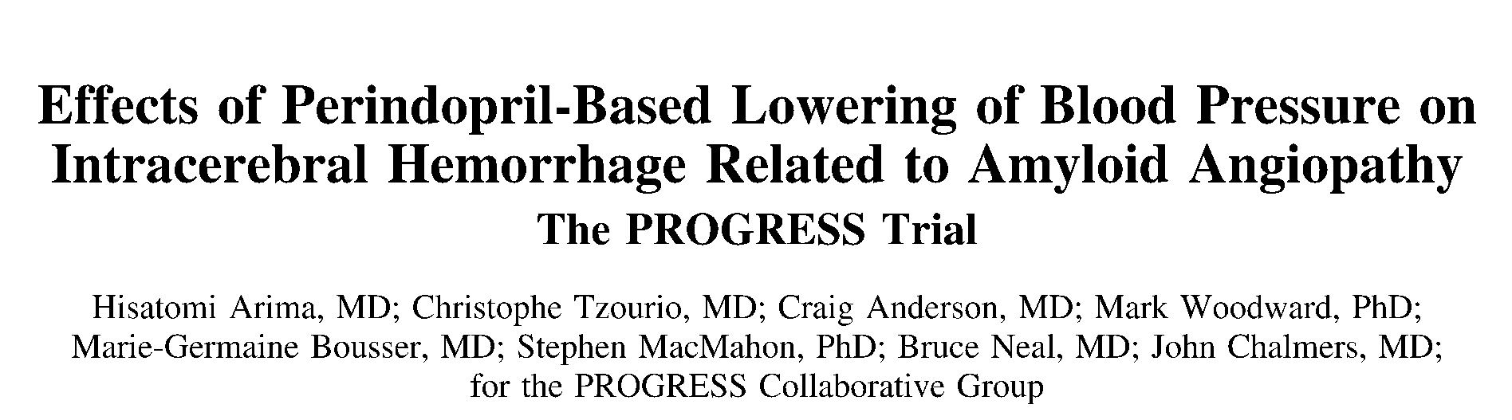
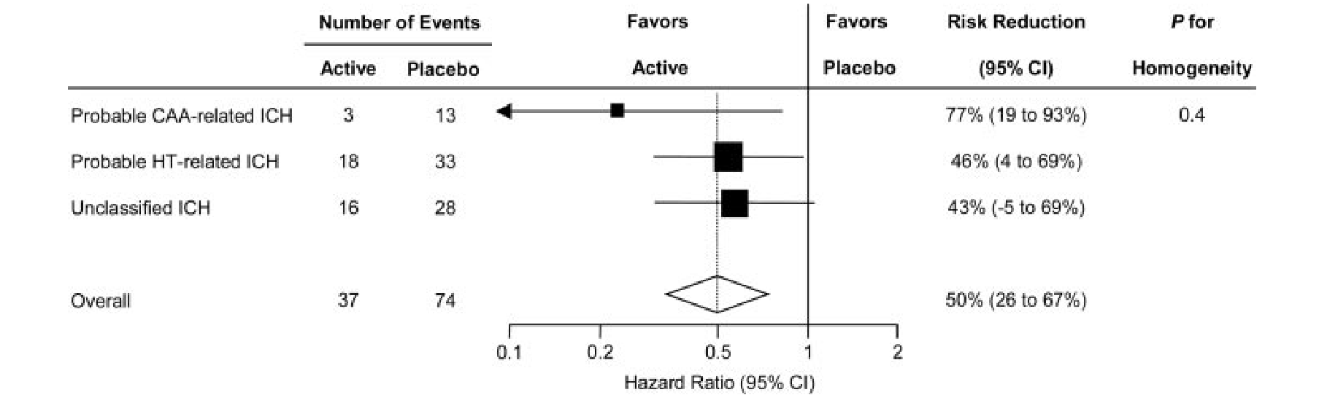
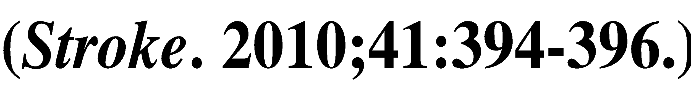
Mean reduction of 9/4 mm Hg

Slide 3
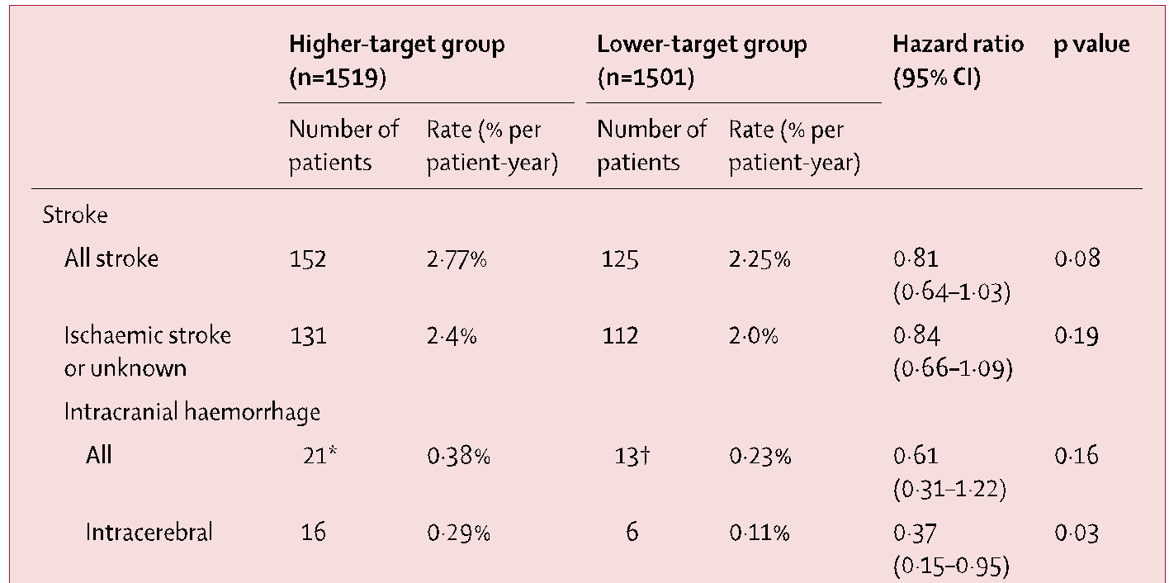

Slide 4
Of course you want to join the first ICH prevention study – ASPIRE – in recent NIH history!
This is a great trial to contribute to an active clinical practice question and a wonderful way to build out your StrokeNet trial portfolio!
Start thinking about your screening, consent and randomization workflow!

Slide 5
Cross-sectional registry of outpatients with AF enrolled in the American College of Cardiology National Cardiovascular Data PINNACLE (2008-2012) Registry ~ 430 000 AF patients
45% received anticoagulation
  90.3% Warfarin
  26% ASA
CHADS₂≥3 50% prescribed anticoagulation
Notes:
28 088 patients deemed not able to be prescribed antiplatelet or OAC therapy as assessed by the treating health care professional and specified on data collection forms.

Slide 6
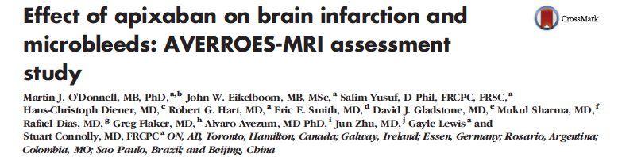
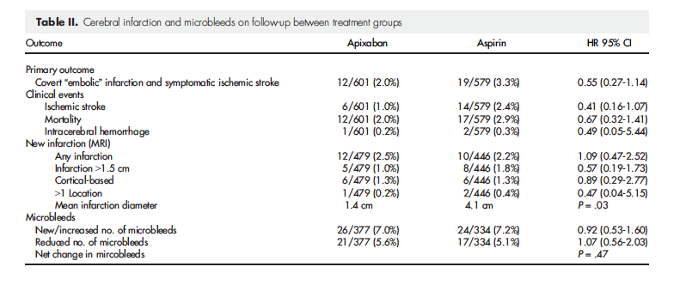
Notes:
ICES database

Slide 7
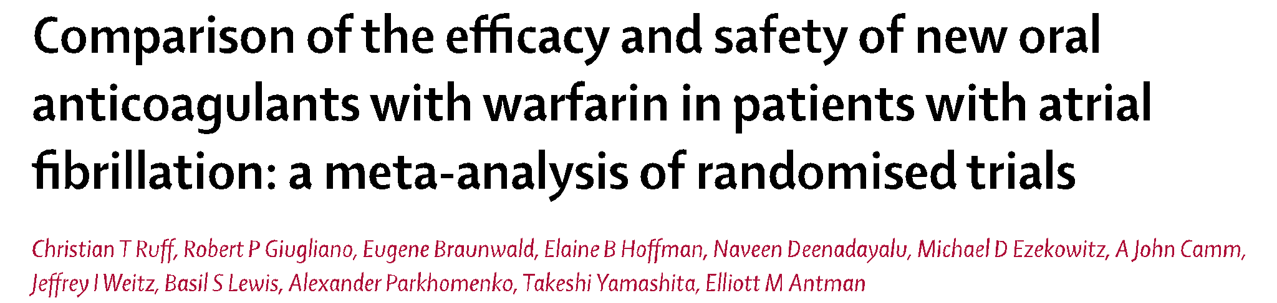
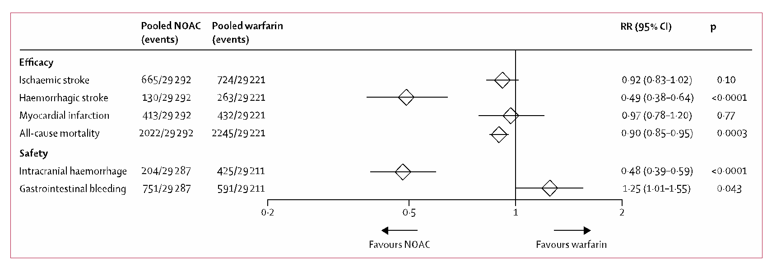

51% reduction in hemorrhagic stroke

Slide 8
As many as 20% of ICH survivors have or develop atrial fibrillation. This subset faces an especially high risk for ischemic stroke and poor outcome.
In patients with AF and a CHA₂DS₂-VASc score ≥ 2, treatment with oral anticoagulants (OAC) is a IA recommendation from the AHA
In all OAC studies of “newer” agents, which have improved safety profiles, ICH patients have been excluded

Slide 9
AHA ICH Guidelines (2015)
“Anticoagulation and antiplatelet therapy after non-lobar ICH might be considered” (IIb, B)
“The usefulness of dabigatran, rivaroxaban, or apixaban in patients with atrial fibrillation and past ICH is uncertain” (IIb, C)
“An important question to be addressed is the possible role of the newer direct OAC’s in patients at increased ICH risk and the identification of the subgroup that might derive the greatest benefit from the reduced tendency of these agents to trigger intracranial bleeding”

Slide 10

  Intracerebral Hemorrhage (ICH) related to
  Oral Anticoagulation Treatment (OAT):
    ~ 80% cases with atrial fibrillation → high ischemic stroke risk
    underlying small vessel disease → high re-bleeding risk
Resumption of oral anticoagulation is
a major clinical dilemma in ICH care
Currently available evidence:
Thrombosis Risk
CNS: ischemic stroke
Systemic Thromboembolism
Hemorrhage Risk
CNS: recurrent ICH
Systemic Bleeding
Mortality

Slide 11
 | RETRACE |  | MGH |  | ERICH
 | Lobar ICH | Non-lobar ICH | Lobar ICH | Non-lobar ICH | Lobar ICH | Non-lobar ICH
No. subjects | 202 | 340 | 106 | 162 | 78 | 139
Age (years) | 74.7 (7.9) | 74.6 (7.8) | 73.4 (10.8) | 70.2 (9.9) | 73.8 (11.1) | 71.3 (12.0)
Sex (male) | 119 (59) | 211 (62) | 51 (48) | 99 (61) | 46 (59) | 76 (55)
ICH Volume | 26.9 (10.5 - 56.0) | 10.2 (4.8 - 22.0) | 27.3 (11.0 - 57.4) | 11.2 (4.6 - 21.9) | 18.4 (6.2 - 43.7) | 6.2 (1.6 - 15.8)
OAT Resumption | 38 (19) | 72 (21) | 38 (36) | 74 (46) | 12 (15) | 33 (24)
Biffi, Annals of Neurology, 2017

Slide 12
OAT Resumption and Outcomes
Non-lobar ICH
Outcome at 1 Year | Effect of OAT Resumption
 | HR | 95% CI | p
Favorable Outcome (mRS 0 -3) | 4.41 | 2.92-6.67 | <0.0001
Mortality | 0.26 | 0.17-0.39 | <0.0001
All-cause Stroke | 0.45 | 0.28-0.71 | 0.0008
- Recurrent ICH | 1.12 | 0.94-1.34 | 0.22
- Ischemic Stroke | 0.42 | 0.22-0.81 | 0.011
Lobar ICH
Outcome at 1 Year | Effect of OAT Resumption
 | HR | 95% CI | p
Favorable Outcome (mRS 0 -3) | 4.15 | 2.81-6.13 | <0.0001
Mortality | 0.29 | 0.20-0.42 | <0.0001
All-cause Stroke | 0.51 | 0.32-0.80 | 0.004
- Recurrent ICH | 1.26 | 0.99-1.60 | 0.059
- Ischemic Stroke | 0.48 | 0.27-0.85 | 0.013

Slide 13
Possible CAA (n=137)
Outcome at 1 Year | Unadjusted |  |  | Adjusted
 | HR | 95% CI | p | HR | 95% CI | p
Favorable Outcome (mRS 0 -3) | 3.44 | 1.16-10.22 | 0.027 | 3.40 | 1.22-9.46 | 0.020
Mortality | 0.21 | 0.05-0.89 | 0.034 | 0.27 | 0.08-0.86 | 0.028
Probable CAA (n=55)
Outcome at 1 Year | Unadjusted |  |  | Adjusted
 | HR | 95% CI | p | HR | 95% CI | p
Favorable Outcome (mRS 0 -3) | 3.33 | 1.03-10.77 | 0.046 | 3.11 | 1.08-8.97 | 0.038
Mortality | 0.28 | 0.09-0.91 | 0.035 | 0.30 | 0.10-0.92 | 0.037
Biffi, Annals of Neurology, 2017

Slide 14
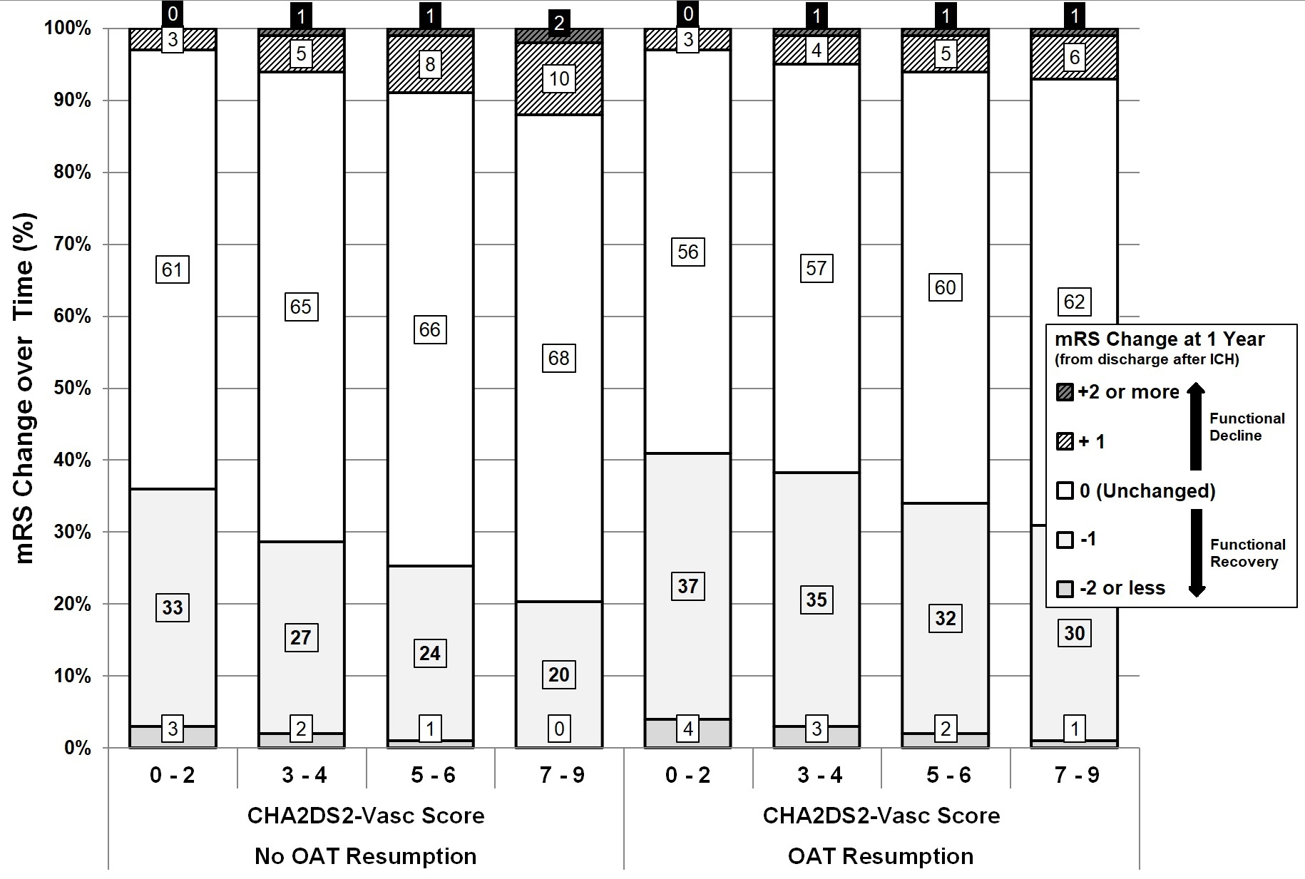
Murphy, Stroke, 2018

Slide 15
Conclusions
OAT resumption after both lobar and non-lobar ICH
was associated with the following outcomes at 1 year:
  Improved functional outcome
  Decreased mortality risk
  Decreased ischemic stroke risk
OAT resumption after ICH due to possible / probable CAA
was associated with improved outcome and decreased mortality
Limitations:
  Observational study framework
  Follow-up limited to one year
  Very few patients on NOAC

Slide 16
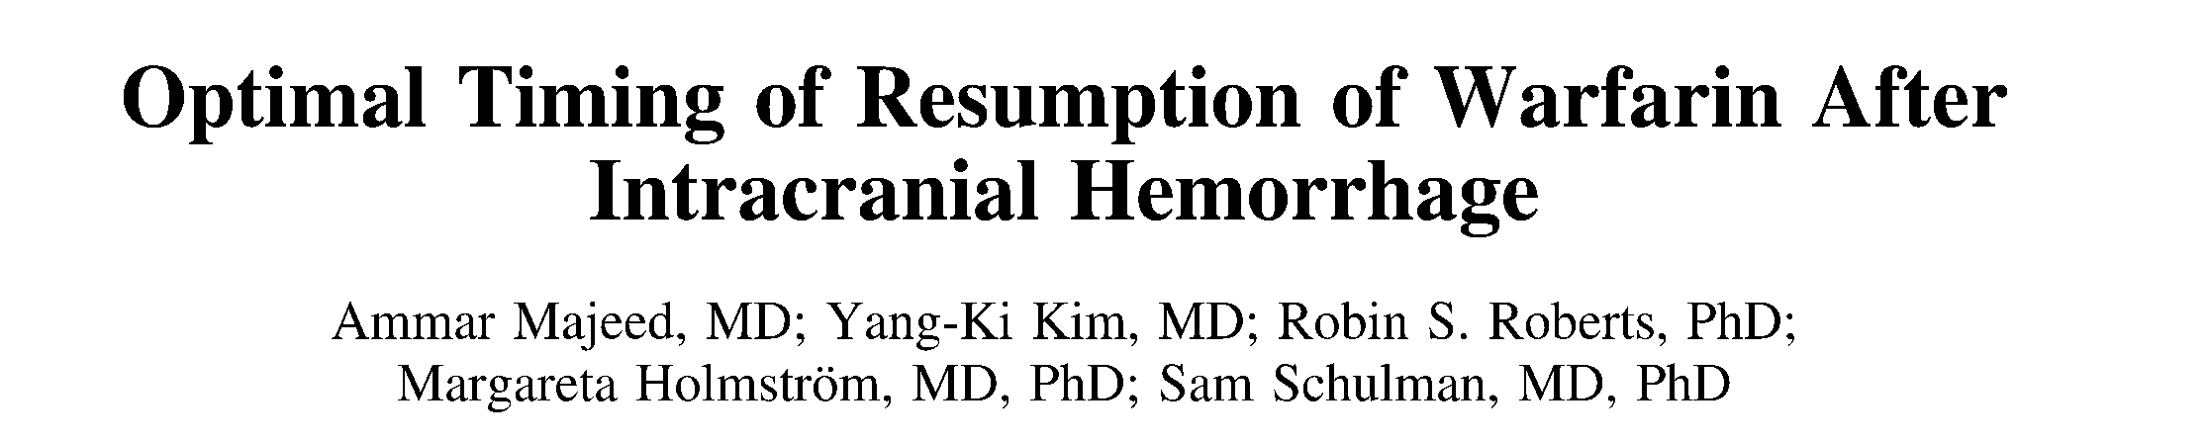
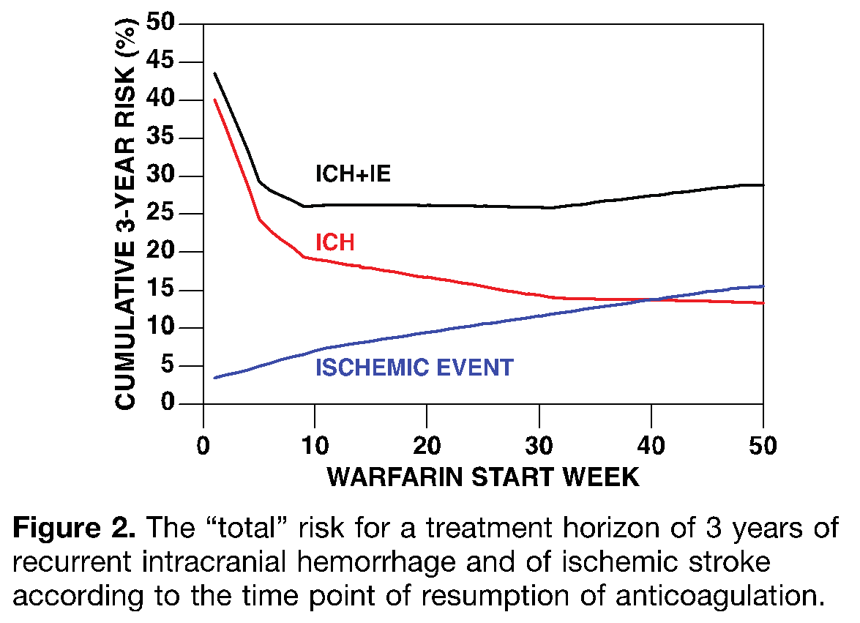
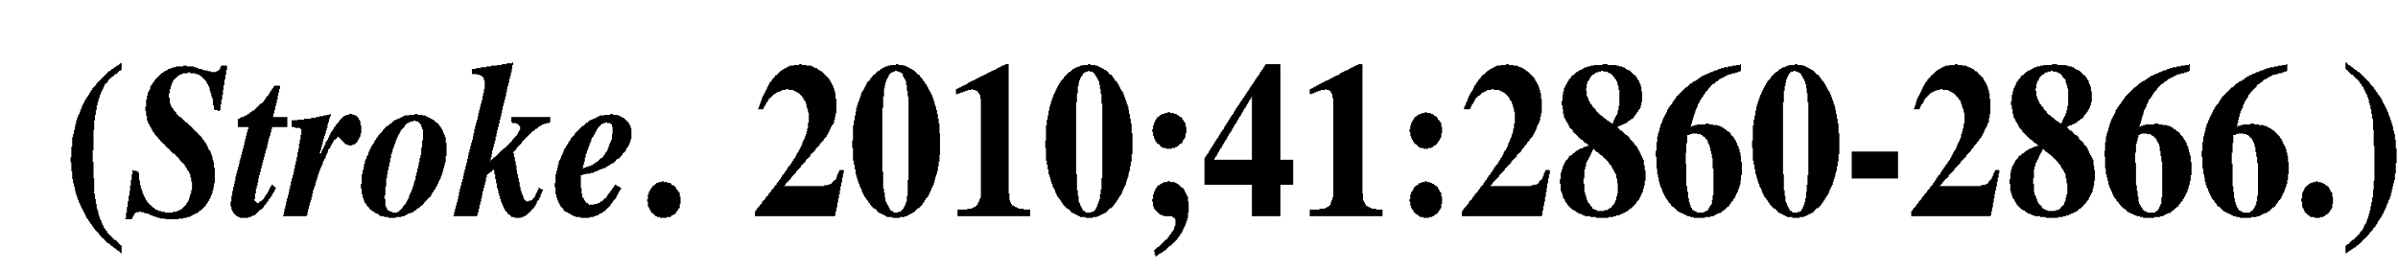
Indication
  AF 48% (9 w)
  MV 49% (2-3 w)
  VTE 17%
Baseline
  47% ICH
  43% SDH
  10% SAH
Recurrence
  67% SDH
  33% ICH
N=234
Sweet spot: 10 – 30 weeks

Slide 17
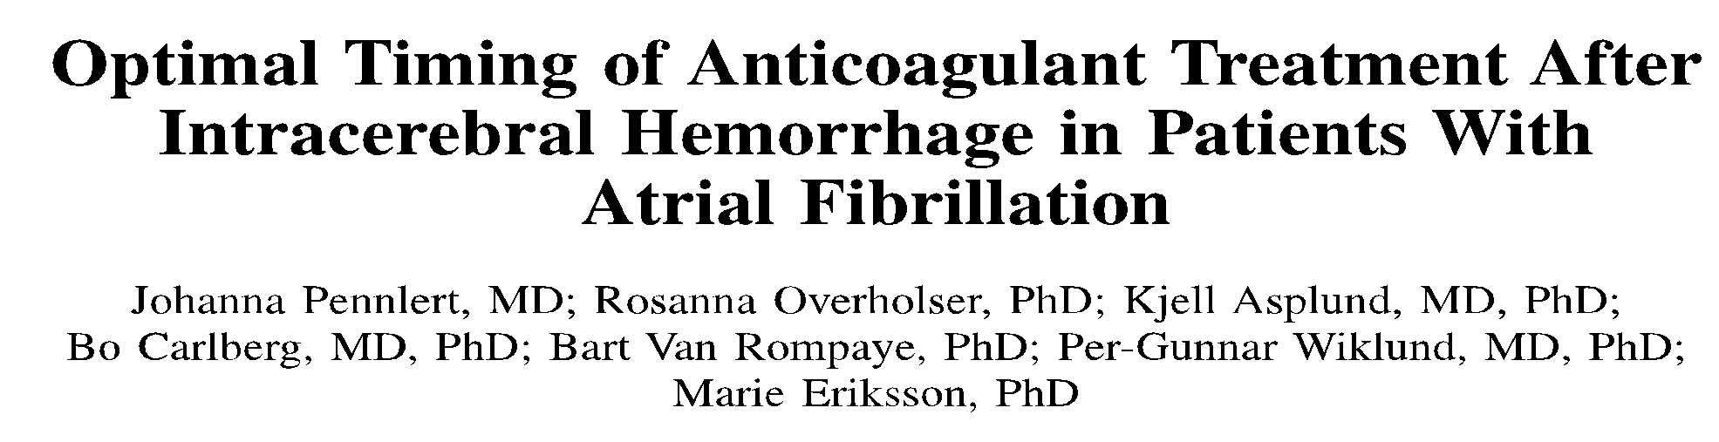
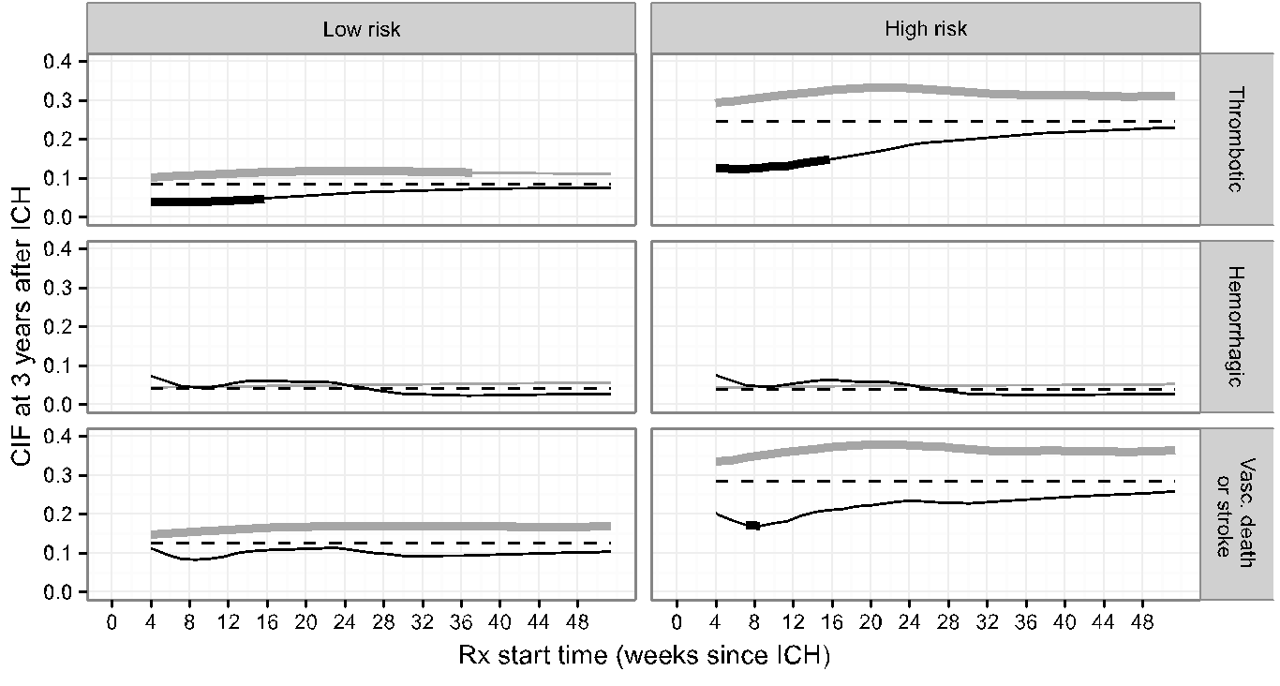
N=2662 Swedish National Rikkstroke hospital-based database
4-16 weeks
No increase In HE
7-8 weeks

Slide 18
Anticoagulation in Intracerebral Hemorrhage (ICH) Survivors for Stroke PreventIon and REcovery

Slide 19
ASPIRE
Primary hypothesis: Apixaban is superior to aspirin for prevention of recurrent stroke/death in patients with prior ICH and AF
Secondary hypothesis: Benefit of apixaban will also result in improved functional outcomes
  -Patient centered outcomes are pathology, location, and size naive and will complement hard traditional endpoints

Slide 20
Study Design
Randomized, double-blinded, phase III clinical trial
Apixaban
5.0 mg twice daily*
N=700
1 to 3 years follow-up
(2 years median)
Stroke (any type)
Death
Aspirin
81 mg once daily
Blinding is achieved through use of active and matching placebo medications for both aspirin and apixaban.
*Reduced 2.5 mg dose apixaban may be used following standard criteria.

Slide 21
Inclusion Criteria
Age ≥ 18 years
Qualifying ICH
  - Includes trauma but no subdural hemorrhage
  - Cortical SAH, AVM if secured
Ability to be randomized 14-120 days after index ICH
Non-valvular AF and CHA₂DS₂-VASc score ≥ 2

Slide 22
Exclusion Criteria
History of ICH before index event
Lobar ICH with “high-risk” cerebral amyloid angiopathy
Clear indication for antithrombotic therapy
Left atrial appendage closure

Slide 23
“High-Risk” Lobar ICH
Definition:
≥5 lobar microbleeds on brain MRI
    Lobar microbleeds ranging from 2mm to 10 mm on T2* or GRE lesions
OR
Disseminated cortical superficial siderosis (cSS) on T2*-GRE or other susceptibility-weighted imaging (SWI) MRI
    cSS is defined as well-defined, homogenous hypointense curvilinear signal intensity (black) in the superficial layers of the cerebral cortex, within the subarachnoid space (‘sulcal siderosis’), or both.
    Disseminated cSS is defined as cSS affecting at least four sulci.

Slide 24
Enrollment Process
Apply inclusion/exclusion criteria
Obtain consent as soon as possible
Follow 2 temporary exclusion criteria:
  - Systolic blood pressure ≥ 180 mm Hg
  - Vascular etiology which requires surgery (i.e. AVM)

Slide 25
Post-Consent Work Flow
  Draw blood sample any time and send to ASPIRE Biobank
  Identify location, logistics, and timing of baseline visit
      - Ideally randomize early within window
  Confirm eligibility criteria including blood pressure measurement
  Randomize and make plan to deliver/mail study drug asap
  Follow-up contacts every 3 months to resupply study drug/identify outcomes
    - Maximum follow-up of 36 months

Slide 26
Study Outcomes
Primary: Stroke of any type or Death
    - Ischemic
    - Hemorrhagic (i.e., symptomatic, nontraumatic ICH)
    - All-cause death
  Secondary: Modified Rankin Scale
  Tertiary and Safety:
      - Cognition/quality of life (MoCA, PROMIS)
      - Thromboembolic events
      - Intracranial/non-intracranial major bleeding

Slide 27
Statistical Analysis Plan
Intention-to-treat approach
Survival analysis with log-rank test to compare treatment groups
Interim analysis after 2/3 of primary outcome events
Secondary analysis: test interaction apixaban vs. aspirin and change in modified Rankin Scale from baseline visit

Slide 28
Tips to Find and Enroll Patients
Use EPIC clinical trial search function periodically
“Hot pursuit” ID – scan ICU and stroke service lists daily
Reach out to cardiology, stroke and NSG clinics

Slide 29
ASPIRE Protocol Key Points
Identify ICH patients with possible AF
Apply inclusion/exclusion criteria
Consent asap
Make plan for randomization (baseline) visit
Follow-up visits q3 months

Slide 30
Likely Benefits of ASPIRE
Provide clear answer to clinically relevant question that will directly inform guidelines
Provide point estimates for risk and treatment effect
Allow personalized treatment for preventing recurrent stroke and death
Advance understanding of risk factors in recurrent ischemic and hemorrhagic stroke
Set stage for trials of comparative effectiveness in other high risk populations of AF

