Slide 1
Career Path Development
One managers experience

Slide 2

Day 1 – Meeting the coordinators

Slide 3
General Observations
Coordinating staff
Examples
Low morale
Burnout
No clear understanding of career growth/ job satisfaction.
Salary concerns
Broken equipment, little or no office space.
No management of workloads.
Job advancement based on unknown timelines or lack of advancement.
Only annual salary increases.

Slide 4
Improvement Plan
Reviewed the Infrastructure.
Create a research team culture.
Establish a work/life balance.
Requested HR to run a market analysis of staff salaries.
Promoted growth and development.
Established clear mile stones for advancement.
Encouraged projects outside of clinical trials.
Meet regularly with coordinating staff- team lead.
My mindset is to serve the staff.

Slide 5
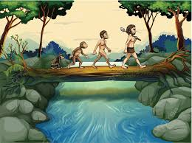

Evolution of a career pathway for the coordinating staff
Did not happen over night
What I was learning

Slide 6
Building a Career Pathway
Created 3 distinct levels
Level I = Entry level
Level 2 = 2 or more years
Level 3 = 4 or more years
Work responsibilities / limitations based on the level.
Salary milestones set within each level, strategy for critical time points.
Educational opportunities are structured within each level.
Annual reviews new approach.

Slide 7

Level I
Entry level (day 1- to two year of experience)
Learn all aspects of clinical trial coordinating responsibilities.
Complete all credentialing responsibilities / checklists.
Mastering ICF, AE and SAE, data entry and query resolution.
Appointed a level II or III mentor.
Step / status raise after 1 year. Critical timepoint.
Work in a team environment.
Will only be listed as a back-up coordinator.

Slide 8
Level II
2 or more years of experience.
Now appointed as the primary coordinator on clinical trials.
Assist in training and oversight of new hires.
Work on National research credentialing.
Can be appointed as a Mentor for a level I coordinator.
Salary Promotion Increase.
Midpoint milestone status / step increase.
Educational opportunities specific to this step
Annual review focused on growth and goals.
Able to do or assist in departmental projects outside of clinical trials.

Slide 9
Level III
4 or more years
National Research Credentialing.
Functions as a work leaders for their team.
Assist in running research meetings.
Will be assigned to mentor a Level II coordinator.
Salary Increase. Pay for Credentialing License.
Will be mentored by MD’s, Administrators, Others based on goals.
Special project assignments.
Annual review build on the momentum.

Slide 10
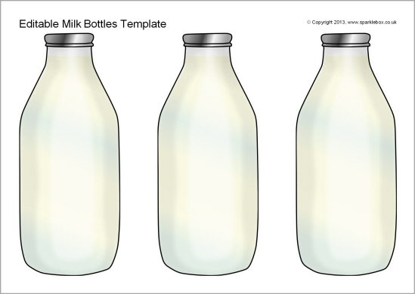
Milk Bottle Challenge

Slide 11
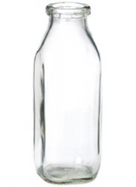
Concrete Thinkers

Slide 12
Concrete Thinking

Slide 13
Cognitive development

Slide 14
Cognitive Thinking

Slide 15
Retention
Staff knows that you are interested in their professional growth.
Staff is highly encouraged to participate in educational opportunities.
Work place flexibility. (flex time, change of hours, change teams)
Staff feels you have their financial growth in mind. (Do it before they ask)
Make it hard for them to want to move on.(Job to career)
Highlight the growth within the department and make them feel apart of that trend. (rankings, finances, newsletters, website).
Encourage events out side of clinical trials. (community events, hospital events).
Do stop at the NO’s!
Have fun…
Strive to serve the staff and hopefully they will serve each other.
Unpresented event, challenging times, changing tech, narrow profit margins, managers need to look for ways to improve the research environment.

Slide 16
Conclusion
12 trails to now over 90.
Staffing at the start 7 FTE’s now 21 FTE’s.
We have swager.
All levels I, II and III to date are still on staff. Experience years from 2-20.
Lost (1) staff to retirement, (3) for health reasons and (1) to promotion.
Comments from staff:
I feel like I found a work home.
At this present time this was a good choice for me.
I'm building a career.
Laughter.
Social events.

Slide 17


