Slide 1

Coordinator Webinar and Round Table Discussion
January 23, 2019

Slide 2
Coordinator Call
Announcements and Reminders
Next Coordinator Webinar :
Next Coordinator Call February 20th, 2019.
Today’s Roundtable Hosts: To join Coordinator Webinars: https://nihstrokenet.adobeconnect.com/coordinator/ Please enter as a guest, then add your first and last name or email address. For Audio: Dial-In Number: (877) 621-0220 Passcode 434578.
Upcoming StrokeNet Meetings:
Plan Ahead: StrokeNet National webinar meeting will be in late April or May TBD.
An in-person StrokeNet meeting in the fall of 2019.

Slide 3
Project Updates
CREST 2
Study Updates:
Study Project Manager: Mary Longbottom, CCRP, CREST Director for Data Quality
Study Investigator: Tom Brott, MD

Slide 4
Project Updates
ARCADIA
Study Updates:
Study Project Manager: Irene Ewing, RN, BSN
Study Investigator: Hooman Kamel, MD;
Mitch Elkind, MD
Data Manager’s: Faria Khattak, Holly Pierce,
Jocelyn Anderson

Slide 5
Project Updates
Sleep Smart
Sleep Smart PI: Devin Brown MD
Project Manager’s: Kayla Gosselin
Joelle, Sickler
Sleep SMART Data Manager’s: Faria Khattak and
Jocelyn Anderson

Slide 6


MOST Study Team
Principal Investigators
  (Lead) Opeolu Adeoye, MD, MS, University of Cincinnati
  Andrew Barreto, MD, MS, University of Texas-Houston
  Jim Grotta, MD, Memorial Hermann Hospital-Texas Medical Center, Houston
  Joe Broderick, MD, University of Cincinnati
  Colin Derdeyn, University of Iowa
University of Cincinnati Clinical Coordinating Center
  S. Iris Deeds, CCRP – Lead Trial Coordinator
    deedsss@ucmail.uc.edu
National Coordinating Center
  Dana R. Acklin Winfrey, BA – NCC MOST Lead Project Manager
    dana.acklin@uc.edu

Slide 7
MOST Update
CIRB Packets are being distributed to sites
The Investigator Meeting is scheduled for May 6, 2019 in Philadelphia, PA
  Details to follow. Please do not begin making arrangements until instructions are provided

Slide 8
NCC/NINDS Updates
NCC Staff Members:
Joe Broderick, PI
Jamey Frasure, Co-Director Judith Spilker, Co-Director
Sue Roll, CIRB Liaison Keeley Hendrix, CIRB
Diane Sparks, Contracts Jeanne Sester, Training Coordinator
Mary Ann Harty, Finances Rose Beckmann, Administration
Joanna Vivalda, NINDS Scott Janis, NINDS

Slide 9
Data Management Center Updates
WebDCU/MUSC Team:
Yuko Palesch, PI Wenle Zhao, PI
Catherine Dillon, Operations Mgr.
Jessica Griffin, Project Mgr.

Slide 10
CIRB Updates
CIRB Team Members:
Sue Roll, CIRB Liaison
Keeley Hendrix CIRB Coordinator
Jo Ann Behrle CIRB HPA

Slide 11
Roundtable Discussion
Today’s Roundtable Discussion:
Corrective Action Plans & How to Execute Them and Follow Up
Today’s Hosts:
Devin Qualls
Clinical Trials Project Manager
J. Philip Kistler Stroke Research Center
Massachusetts General Hospital

Slide 12
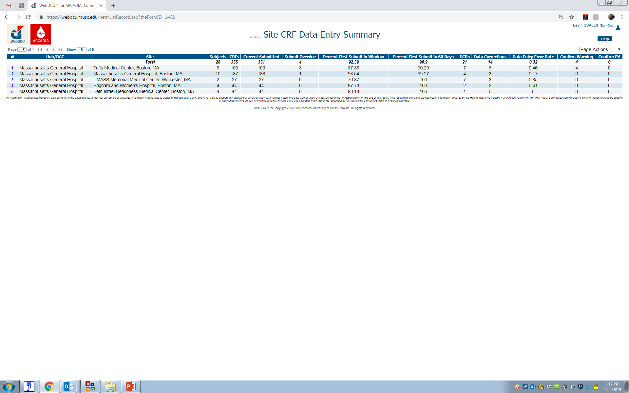
CAP - Red Flags
When a site is under performing in tracked metrics
  Data error rates
  Timeliness to data completion
  Timely responses to queries

Slide 13
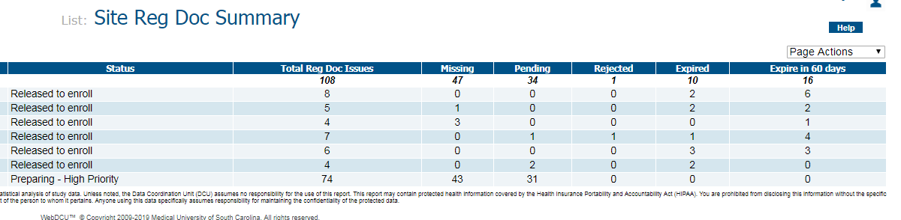
CAP – Red Flags
If a site has routine outstanding regulatory documentation issues
If a site is not meeting minimum enrollment standards
If a site routinely misses deadlines for CR, Screening Logs, or not active on study webinars

Slide 14
CAP – Red Flags
When notified by the national study team of a major deviation, event that may increase harm to subjects, or continuation of previously correct issues.

Slide 15
How to implement a CAP
Work with the study team to identify the root cause of the issue:
  New or junior study staff
  Recent staff turn-over
  Site new to StrokeNet research practices and policies
  Site practices conflicting with study protocol
  Staff over-committed on too many projects or site enrolling faster than anticipated

Slide 16
How to implement a CAP
Set up a meeting with key stakeholders to discuss precipitating event
  Include members from:
    The site study team: PI & Lead CRC at minimum
    The RCC
    The National Study Team
    The Data Management Team
Set expectations for site during the meeting
  Work with the team to create action plans to ensure they can achieve these expectations

Slide 17
At this point, it may be necessary to suspend the site or pause enrollment in order to implement the CAP

Slide 18
Possible Actions
All staff retraining
  Ensure staff has had ample time to review and process training materials
  Customize materials for the site
  Document the training provided:
    Who was in attendance?
    What did the training entail?
    Was post-training evaluation completed?

Slide 19
Possible Actions
On-Site Monitoring
  Set up date and time for study team to meet monitor
  Ensure all study documents are in order
    Subject binders
    Source documents available for review
    Regulatory documents on-site
    Notes to File generated
  Work with the monitor to close out any queries prior to monitors departure
  Follow-up with any items remaining in the Monitor Report

Slide 20
Possible Actions
Re-assignment of staff roles
  Adding a more senior PI
  Requiring PI to be involved with data collection/data entry
  Having RCC take active role within site
  Adding secondary CRC
Site Termination

Slide 21
Completing a CAP
Set urgent, but realistic timelines for the site to complete all activities
  If there are multiple steps involved, make sure each item has its own timeline
  Create a checklist of activities
Document who is responsible for each item
  Will the RCC provide training?
  Does the site have a CRO who can provide training?
  Who will collect the training attestations?

Slide 22
Completing a CAP
Provide feedback to the study team each time an action is completed
Make sure all documentation is submitted to the appropriate entities:
  National study team
  CIRB
  Local IRB
Confirm all action items are complete before requesting site to be re-opened

Slide 23
Example
Back to back consenting issue led to site suspension
  Use of English language consent when Spanish language consent was available
  Date/time on second consent was not contemporaneous for the enrollment, left a question of who consented the patient first?
  Errors were identified by Data Management team from uploaded ICFs in WebDCU

Slide 24
Example
Meeting was set up with Study Project Manager, Site PI, Site CRC, Site PM, RCC Manager, and RCC PI
Determined deviations were caused by need for education on the use of WebDCU, and knowledge on resources available.

Slide 25
Example
CAP involved:
  Site protocol retraining
  Site ICF training provided by RCC
  Site attestation of process for consent
  Use of a ICF checklist moving forward
  Re-consenting of the previously consented patients

Slide 26
Example
RCC created a detail memo of the event:
Memo included
  The exact items leading to site suspension
  What the next steps are
  Who is responsible for each step
  Education on how to ensure the event does not occur again

Slide 27
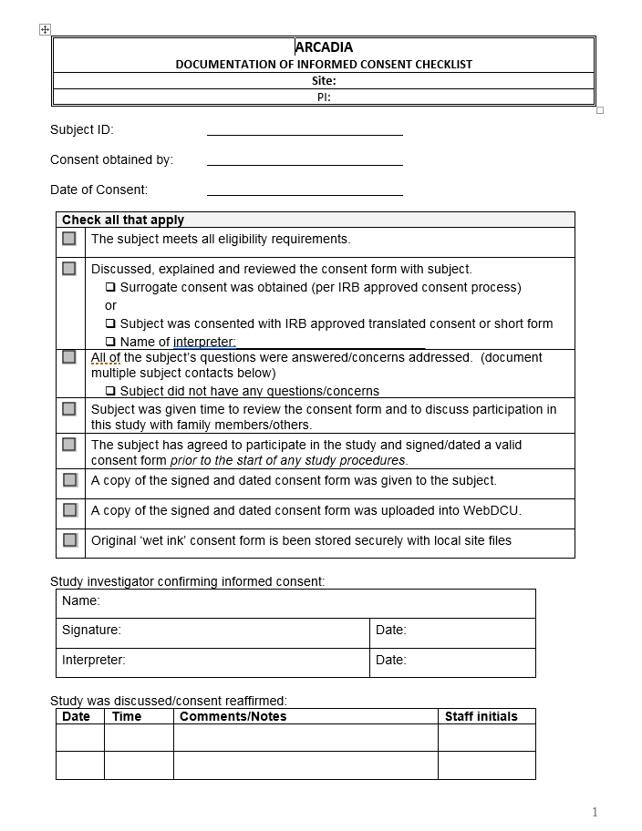
Example

Slide 28

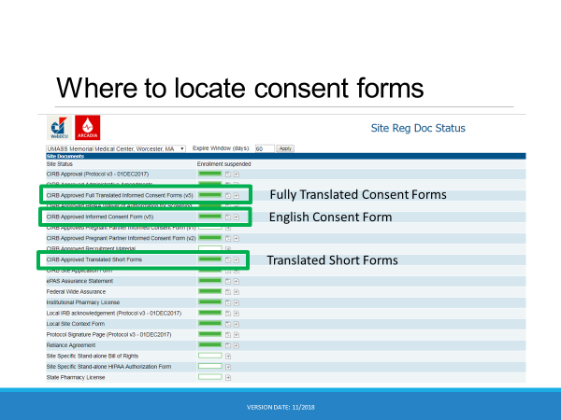
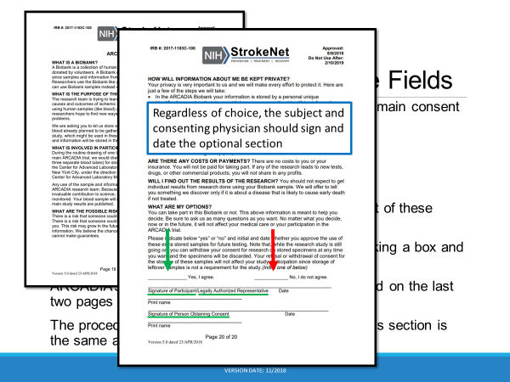
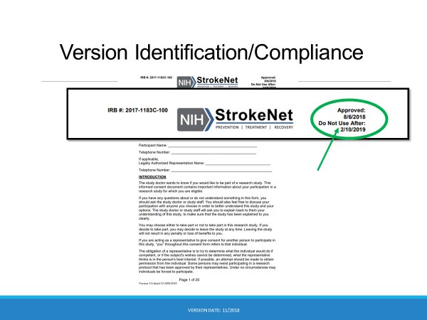
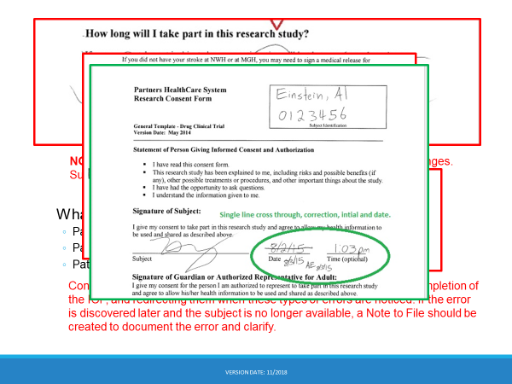
Example

Slide 29
Example
Site completed all retraining in less than one week
A monitor visit occurred the following week
All documentation was provided to national study team and CIRB
The site was re-opened to enrollment
Subjects were successfully re-consented

Slide 30
Questions/Discussion

Slide 31
General Information and Reminders
Sleep Smart IV Meeting Feb 22, 2019
Upcoming CREST Coordinators meeting May 2-3, 2019.
Presenters for upcoming Meetings/Coordinators Calls.
StrokeNet Network webinar will be in late April or May.
StrokeNet National Meeting in-person meeting in the fall of 2019.

