Slide 1

Coordinator Webinar and Round Table Discussion
March 27, 2019

Slide 2
Coordinator Call
Announcements and Reminders
Next Coordinator Call May 29, 2019
Today’s Roundtable Hosts: To join Coordinator Webinars: https://nihstrokenet.adobeconnect.com/coordinator/ Please enter as a guest, then add your first and last name or email address. For Audio: Dial-In Number: (877) 621-0220 Passcode 434578.
Upcoming StrokeNet Meetings:
I-ACQUIRE Investigator Meeting May 1, 2019
CREST 2 Coordinator’s meeting May 2-3, 2019.
MOST Investigator Meeting May 5th, 2019.
Plan Ahead: StrokeNet National webinar meeting will be held on April 10th, 2019 from 12-4pm EST.
The in-person StrokeNet meeting will be Oct. 30th, 2019.

Slide 3

Project Updates
CREST-2
Study Project Manager: Kassondra Guzman, BS
Study Investigators: Tom Brott, MD
James Meschia, MD
Data Managers: University of Alabama

Slide 4






CREST-2 Recruitment
128 sites with at least one patient enrolled
148 green-lighted sites
1360 Overall
  711 CEA 649 CAS
25 in March
  15 CEA 10 CAS

Slide 5
Continuing Review due April 26th
Updated COI from everyone listed on eDOA log
Completed continuing review form
De-identified copy of informed consent last signed closest to March 12th
Current eDOA log generated and printed from WebDCU in pdf
Deadline for submissions is April 12th
  Ex. New team members, changes to consent, etc.

Slide 6

Project Updates
Sleep SMART
Study Project Managers: Kayla Novitski,(Gosselin), MPH
Joelle Sickler, MSN, RN
Study Investigators: Devin Brown, MD
Ron Chervin, MD
Data Managers: Faria Khattak, MPH
Jocelyn Anderson, MPH

Slide 7


MOST Project Updates
Prime Project Manager: Iris Deeds, BS, CCRP
NCC Project Manager: Dana R. Acklin Winfrey, BA
Study Investigators: Opeolu Adeoye, MD, MS
Andrew Barreto, MD, MS
Jim Grotta, MD,
Joe Broderick, MD
Colin Derdeyn, MD
Data Managers: Holly Pierce, MS
Jocelyn Anderson, MPH
Monitoring Manager: Srikala Appana, MPH

Slide 8
Project Updates
MOST
The Investigator Meeting is quickly approaching. Scheduled for May 6, 2019, we are trying to have all sites with a FEO CTA, approved by the CIRB prior to the IM.
So far 32% of the sites with a FEO CTA have been CIRB approved.
Thank you to all who are helping us to meet this goal.

Slide 9

Project Updates
TRANSPORT2
Study Project Managers: Kelly Krajeck, BS
Jamey Frasure, PhD, RN
Study Investigators: Wayne Feng, MD
Gottfried Schlaug, MD
Data Managers: Patty Hutto

Slide 10
Perinatal Arterial Stroke:
A Multi-site RCT of Intensive Infant Rehabilitation (I-ACQUIRE)
Investigators:
  Sharon Landesman Ramey, Ph.D. (Lead PI), Virginia Tech, Roanoke, VA
  Warren Lo, M.D. (Co-PI), Nationwide Children’s Hospital & The Ohio State University, Columbus, OH
Virginia Tech
  Laura Bateman, Study Coordinator
    laurapb2@vt.edu
National Coordinating Center
  Teresa Murrell-Bohn, RN, CCRC, ACRP-PM – Project Manager
    murreltm@ucmail.uc.edu
Data Manager
  Jessica Griffin, BS, CCRP
  Sara Butler

Slide 11
I-ACQUIRE Study Update
  I-ACQUIRE Trial Summary is now active on the StrokeNet Website
  “How-to Webinars” are scheduled:
    CTA & Regulatory Webinar – Thursday, April 18th, 2-3 pm EST
    CIRB Webinar – Thursday, April 25th, 2-3 pm EST
  Upcoming Investigator Meeting
    May 1st in Chicago, IL
    Meeting details were emailed to selected site PI/PSCs on March 18th
    Deadline for room reservations is April 12th
    Contact Laura Bateman @ laurapb2@vt.edu with any questions pertaining to the meeting details

Slide 12
Project Updates
SATURN
Logo
in Process
Study Project Managers: Kimberlee Bernstein, BS, CCRP
Study Investigator: Magdy Selim, MD, PhD
Data Managers: TBN

Slide 13
Project Updates
ASPIRE
Logo
in Process
Project Managers: Catherine Viscoli, PhD
Laura Benken, MBA, BS, CCRP
Study Investigators: Kevin Sheth, MD
Hooman Kamel, MD
Data Managers: TBN

Slide 14

Project Updates
ARCADIA
Study Project Manager: Irene Ewing, RN, BSN
Rebeca Aragón Garcia, BS
Study Investigators: Mitch Elkind, MD
Hooman Kamel, MD
Data Managers: Faria Khattak, MPH
Jocelyn Anderson, MPH
Patty Hutto

Slide 15
Site Activity
124 sites CIRB approved (inclusive of 6 VA sites)
116 sites released to enroll
106 sites have consented at least 1 subject.
Unfortunately we are still behind on enrollment.

Slide 16
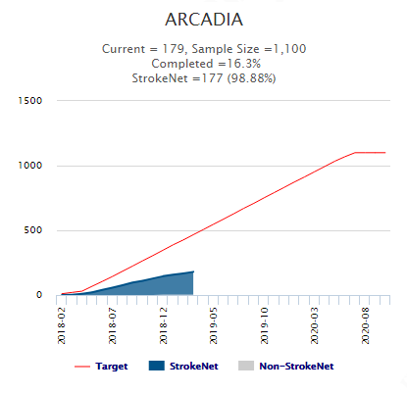

Slide 17
Addressing Recruitment Challenges
Various sites are struggling to consent and randomize subjects
We created an agenda to understand a site’s processed, strategies & challenges
We wanted to know the features of our most successful enrolling sites (PIs/coordinators)
  Reviewed proposed agenda
  Discussed their processes/strategies/challenges
We will now set up calls with the 36 sites which have not consented/randomized a subject in last 3 months to see if we can help them become more effective (10 have not consented 1 subject)
  Will use the proposed agenda to guide the conversation
  We want to know each site’s challenges & strategize feasible ways to address these
  Ultimate goal: Improve the site’s research experience & improve ARCADIA enrollment
Adding more sites

Slide 18
Recruitment Strategies
What we found top enrolling sites do:
  Foremost, they work as a team → Commitment to be all in
    support, accountability, motivation & credit
  PI/SubI accessibility
  Real-time daily screening (inpatient & clinic)
  Study clinicians introduce the trial to the patients & are available to address concerns w/patient & their PCPs
  Charting ARCADIA screening, eligibility, consented, to approach at clinic, or refused (when reviewed provides accountability and flags patients to be seen in the clinic)
  Research meetings to keep clinicians and study team at the site informed of all active research trials

Slide 19
Recruitment Strategies
What we found (continued):
  Reward attending/fellow research participation
    Contests
    Educational credits/meeting rewards
    Protected research time
  Update clinical personnel on research that impacts ARCADIA
  Coordinators are prepared (kits, CFs, subject binder/worksheets/computer)
  What they do for ESUS patients:
    Discuss the type of stroke they had & what is SOC & what is known for secondary stroke prevention
    Offer home visits
    Respect patient’s agency
    Coordinators become source of assistance (access)

Slide 20
Recruitment Strategies
We’re also working w/RIC at Vanderbilt
  Reviewed and approved the Agenda created to address research at sites
  They would like to re-start site surveys
    In the process of revising them
    Would like to send to a larger sample
  Potential for Marketing group to assist w/Facebook presence, Facebook ads, and webpage
Emphasize the sense of teamwork for all participating sites
  ARCADIA is like a cooperative, if all participating sites don’t take ownership, then the whole team cannot succeed!

Slide 21
Additional sites
Canadian sites-We are actively working with the Drs. Jeff Healey and David Gladstone and the team at McMaster to bring ARCADIA into Canada. The current plan is to add 30 Canadian sites.
US sites- we are still looking for additional recruiting sites.
Referral Sites- please let us know if you have any rehab facilities, clinic or hospitals within your local area where you could screen subject or that could refer patients to you. We will work with you on getting appropriate approvals for this.

Slide 22
Screen failure logs
Establish a plan to be notified about ALL patients who present to the ED, Neurology inpatient service, Neurology outpatient clinics, or any associated rehabilitation facilities.
Include patients who are transferred from an outside facility with suspected stroke.
Include patients seen in outpatient facilities for second opinions, or who do not come through the ED.
Screen all stroke patients to identify those that are ESUS (Embolic stroke of undetermined source).
Screen failure logs should include ONLY patients that have ESUS
  i.e., you do NOT need to include patients with known atrial fibrillation, lacunar strokes, etc.
Please use the correct Inclusion/Exclusion code # rather than dumping the reason for exclusion on code #99: Other.

Slide 23
F512, F513, & F514 ‘Second Drug Kit’ Section
This section will only need to be completed if a subject requires an extra drug kit to be dispensed between visits
If you encounter such a scenario, please reach out to the NDMC immediately
The NDMC will update this section on F512 & F513 for you; sites do not have edit permissions to this section on these two forms

Slide 24
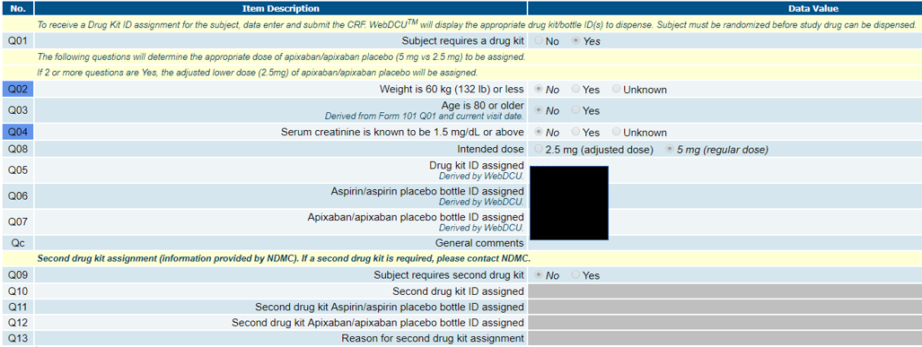
F512, F513, & F514 ‘Second Drug Kit’ Section
These 3 CRFs have been updated to include a ‘second drug kit’ section at the bottom of each form

Slide 25
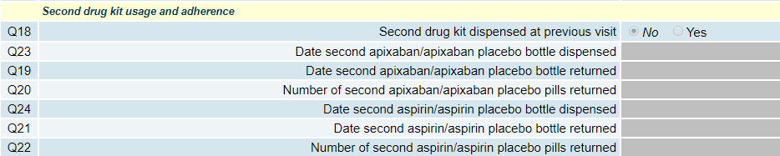
F512, F513, & F514 ‘Second Drug Kit’ Section
You will need to document the return of the ‘first’ drug kit bottles on F514 at the subject’s next visit, in addition to the return of the second set of bottles
  Q18 on F514 ‘Second drug kit dispensed at previous visit’ will be updated to ‘Yes’ by NDMC. You will need to complete the remainder of that section

Slide 26
Upcoming Amendment
Mild mitral stenosis is no longer an exclusion.
Procedure outlined for obtaining consent from LAR using phone & fax.
Tests to determine ESUS (Echo, ECG) will be accepted if done prior to stroke, but they must be done within 3 months of index stroke.
Procedure outlined for contacting/screening potential subjects by phone.
Allowing additional FU visits by phone or HIPAA compliant telehealth technology.
Clarification that study must be stopped if subject experiences a suspected primary outcome (stroke) pending adjudication decision. (Previously it was left to the site Investigator to decide).

Slide 27
Amendment Process
Once the ARCADIA Amendment is approved we will provide detailed instructions.
The new Protocol version and CIRB approval letter for the prime award will be saved in the WebDCU toolbox.
Your site specific informed consents will be edited by the research compliance specialists and submitted on your behalf.
Once they are CIRB approved, they will be emailed to you. This process will reduce the workload on all of the coordinators and expedite the amendment approval process.
If your local IRB needs to review/approve the new CIRB approved consent, your site will not be able to enroll during that review period. It will be imperative to submit this to them as soon as you receive it.

Slide 28
Informed consent reminders
Always confirm you are using the most recent version approved for your site.
Review the rules for when to use LAR and when a witness is used.
Review the rules for using Short Forms.
If you use a short form notify the project manager immediately so a full translated consent can be obtained.
Consents should be signed at the time of the consenting process.
  If you provide a consent to a patient to take home or review-make sure they do not sign it until they are in the presence of a study team member delegated to obtain consent, who can also sign and answer any questions.

Slide 29

NCC/NINDS Updates
The National Coordinating Center
Joe Broderick, MPI Pooja Khatri, MPI
Jamey Frasure, Director Teresa Murrell-Bohn, Sr. Project Manager
Jeanne Sester, Ed Coord Rose Beckmann, Administration
Emily Stinson, Regulatory Jen Golan, Regulatory
Diane Sparks, Contracts Wren Hanson, Contracts
Mary Ann Harty, Finances StrokeNet Central Pharmacy
The NINDS
Scott Janis
Joanna Vivalda

Slide 30
Research Performance Progress Report (RPPR)
Annual RPPR – Use to describe a grant’s scientific progress, identify significant changes, report on personnel, and describe plans for the subsequent budget period or year
Awards under the Streamlined Non-Competing Award Process (SNAP) must submit a non-competing application via the eRA Commons by the 15th of the month preceding the month in which the budget period ends (June 15, 2019)

Slide 31
Research Performance Progress Report (RPPR)
The non-competing application can be submitted using the Research Performance Progress Report (RPPR) format via the RPPR link in eRA Commons
Instructions can be found in the RPPR User Guide
  https://grants.nih.gov/sites/default/files/rppr_instruction_guide.pdf
Work with your institutional grants management office
Contact Joanna Vivalda with any questions

Slide 32
Data Management Center Updates
WebDCU™/NDMC Team:
Yuko Palesch, MPI
Wenle Zhao, MPI
Catherine Dillon, MS, Operations Manager
Jessica Griffin, BS, CCRP, Project Manager

Slide 33
CIRB Updates
CIRB Team Members:
Sue Roll, CIRB Liaison
Keeley Hendrix, CIRB Coordinator
Jo Ann Behrle, CIRB HPA

Slide 34
Roundtable Discussion
Today’s Roundtable Discussion:
Open Forum:
Cheryl Grant and Preethy Feit to discuss upcoming managers survey.
Future calls to allow sites to present their RCC’s.
Topics or presenters for the Atlanta Meeting.

Slide 35
General Information and Reminders
QAR due April 1st.
RPPR due in June.
Selection of StrokeNet Trainee Awardee.
Presenters for upcoming Meetings/Coordinators Calls.
StrokeNet Network Webinar be on April 10th.
StrokeNet National Meeting in-person meeting Oct 30th, 2019.

