Slide 1

Coordinator Webinar and Round Table Discussion
May 22, 2019

Slide 2
Coordinator Call
Announcements and Reminders
Next Coordinator Call June 19, 2019
Today’s Roundtable Hosts: To join Coordinator Webinars: https://nihstrokenet.adobeconnect.com/coordinator/ Please enter as a guest, then add your first and last name or email address. For Audio: Dial-In Number: (877) 621-0220 Passcode 434578.
Upcoming StrokeNet Meetings:
The in-person StrokeNet meeting will be Oct. 29th, 2019. Atlanta Georgia.

Slide 3

Project Updates
CREST-2
Study Project Manager: Kassondra Guzman, BS
Study Investigators: Tom Brott, MD
James Meschia, MD
Data Managers: University of Alabama

Slide 4






CREST-2 Recruitment
128 sites with at least one patient enrolled
149 green-lighted sites
1406 Overall
  740 CEA 668 CAS
14 in May
  7 CEA 7 CAS

Slide 5
CREST-2 Coordinators’ Meeting
Slides from the meeting are uploaded onto the CREST-2 website
Crest2trial.org » For Medical Professionals » Presentations » CREST-2 Coordinators’ Meeting Slides
  Password: stroke

Slide 6
Adverse Event Reporting
For patients that are taking name brand Plavix or Praulent (alirocumab), please report all serious adverse events that occur
This is regardless of relationship to the protocol, intervention, or time frame
Please reach out to your CREST-2 site manager for any further questions

Slide 7

Project Updates
ARCADIA
Study Investigators: Mitch Elkind, MD Hooman Kamel, MD Will Longstreth, MD David Tirshwell, MD
ARCADIA NDMC PI Caitlyn Ellerbe, PhD
StrokeNet NDMC PI Yuko Palesch, PhD
ARCADIA Project Manager: Rebeca Aragón García, BS

Slide 8
Site Activity
129 sites CIRB approved (inclusive of 6 VA sites)
123 sites released to enroll
111 sites have consented at least 1 subject.
72 sites have randomized at least 1 subject.
Consented 885/Randomized 217
We’re doing better but we still need to catch up on enrollment!

Slide 9
General DOA Changes
As part of their initial CIRB submission
  Need PI CV, HSP, COI & PSC HSP,COI
  Need Pharmacy/person to dispense & maintain study drug accountability
  Can add members w/o amendment until CIRB submitted/approved
Sites Released to Enroll require CIRB Administrative Amendment for all personnel, role and task changes
  No change is effective until it receives CIRB approval
Each DOA must show sites have: PI, PSC & study drug dispensing/accountability member (at least)
  Submit any foreseen changes in advance (PI)
Each task must be covered by a team member
Notes:
I

Slide 10
General DOA Changes
When Adding/Removing Study members
  Make sure that “end date” and “start date” correspond when replacing personnel
  Upload to WebDCU the new personnel’s HSP and COI ASAP
    HSP: this is not the Good Clinical Practice (GCP) course
    HSP: make sure certificate states CITI, Site Name or other organizational identifier
    COI: If there are no conflicts to declare, then ONLY submit a completed/signed/dated pg1
    COI: If there are conflicts to declare, then submit both pages completed/signed/dated.
    COI: must have the same role as stated on DOA
Changing Tasks/Roles requires ending previous DOA entry and submitting the same person with new tasks/roles (again, end/start dates must correspond)
Notes:
I

Slide 11
When Changing PI: DOA Administrative Amendment
SITE: Notify us as soon as possible & send NEW Site PI’s CV
PROJ MGR: Send the CV for the new Site PI to the National Principal Investigators for approval.
PROJ MGR: Send the email approval from the Trial PI to Diane Sparks
NCC: Diane Sparks will send an amended CTA that will need to be signed by the site.
SITE: New PI needs to sign protocol signature page
SITE: New PI needs to sign CIRB Assurance Statement
SITE: Edit your local site context form
SITE: Edit your site performance application form
SITE: Edit your consents
SITE: Add New Site PI to DOA and put an end date for previous PI-you can put future dates in this situation
SITE: Upload a StrokeNet COI and a signed/dated CV for the new site PI to WebDCU. Make sure the CV lists site on it, i.e. shows that he/she is affiliated with your site.
PROJ MGR/Regulatory Manager: Submit the Administrative amendment to the CIRB
SITE: Upload any other required documents to WebDCU
SITE PI cannot take over until you have the CIRB approval letter.

Slide 12
NEW Site-Specific Consent Documents (main v6 & PPv3)
Your site specific informed consents are being edited by the research compliance specialists and submitted to the CIRB on your behalf (Emily & Jen).
Once yours are CIRB approved, they will be emailed to you. This process will reduce the workload on all of the coordinators and expedite the CIRB amendment approval process.
Until the CIRB approves your site-specific v6 & v3 consent forms, please continue screening and enrolling using your previously CIRB approved consent forms at your site.
Once the CIRB approves your site-specific main consent form v6 and Pregnant Partner v3, then you are officially working under the new protocol (now v4.1)
  If your local IRB needs to review/approve the new CIRB approved consents, your site may not be able to enroll during that review period (depending on your site’s requirements). It will be imperative to submit this to them as soon as you receive it for acknowledgement.
  Re-consent each active subject with the newly approved site-specific consent forms as soon as possible (both on & off study drug subjects)
NOTE: You need to have your PI sign the Protocol Signature Page for 4.0 AND the 4.1 (as the consent form changes are associated with v4.0)

Slide 13

Sleep SMART
Sleep SMART PI’s: Devin Brown MD, MS and Ronald Chervin MD, MS
Project Managers: Kayla Novitski and Joelle Sickler
Data Managers: Faria Khattak and Jocelyn Anderson
FusionHealth Clinical Operations Director: Helgi Helgason
FusionHealth Contracts Help: Greg Fletcher
StrokeNet Contracts Help: Diane Sparks and Wren Hanson
Regulatory Help: Jennifer Golan and Emily Stinson

Slide 14
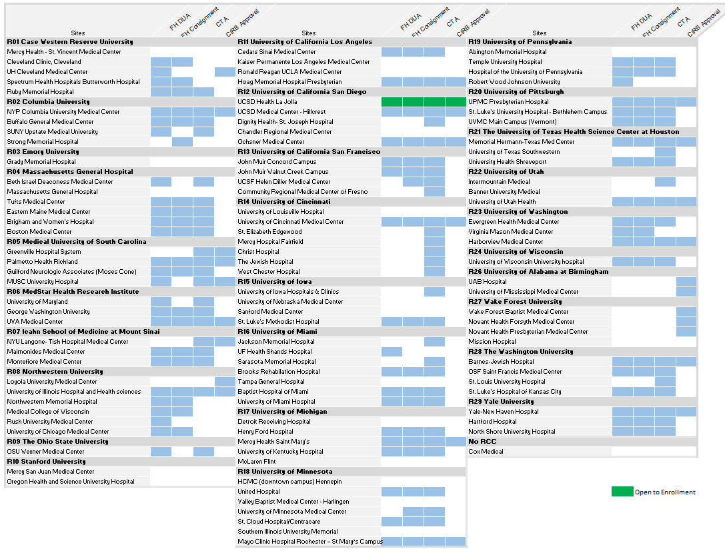

Slide 15
Sleep SMART Enrollment and Start up
Open to enrollment: 1 site, 3 pending
CIRB approval: 28
CTA’s: 71
FushionHealth Agreements (both consignment and DUA): 52

Slide 16
Reminders
DOA: If you have submitted to the CIRB or have CIRB approval- DOA changes will require an amendment.
If your site has not yet completed the clinical trial agreement (CTA) and/or FusionHealth consignment agreement or DUA please continue to work diligently with your contracts/legal teams to get them finalized. All of these will need to be finalized before your site can be released to enroll.
If you have all your contracts executed, you must have the majority of your trainings done before your site readiness call will be scheduled.

Slide 17
Reminders
StrokeNet Financial Conflict of Interest Form expiration date is 11FEB2020
Continue to work on CIRB submission, create and submit your DOA and upload people and regulatory documents.
You only need one RT on your DOA, and only that main RT will need to do the required Sleep SMART quizzes.

Slide 18


MOST Project Updates
Prime Project Manager: Iris Deeds, BS, CCRP
NCC Project Manager: Dana R. Acklin Winfrey, BA
Study Investigators: Opeolu Adeoye, MD, MS
Andrew Barreto, MD, MS
Jim Grotta, MD,
Joe Broderick, MD
Colin Derdeyn, MD
Data Managers: Holly Pierce, MS
Jocelyn Anderson, MPH
Monitoring Manager: Srikala Appana, MPH

Slide 19
Project Updates
Thank you to all who were able to join us at the Investigator Meeting (IM) in Philadelphia on May 6, 2019!
  Please Return your expense report and receipts for reimbursement to Iris Deeds at: deedsss@ucmail.uc.edu
  Training Modules from the IM will be available on WebDCU™ in the coming weeks
We have started making Readiness Calls which take the place of the Site Initiation Visits. In order to prepare:
  Please upload your site’s Pharmacy License and drug shipment address into WebDCU
  Please upload any outstanding regulatory and people documents into WebDCU™ at your earliest convenience

Slide 20

Project Updates
TRANSPORT2
Study Project Managers: Kelly Krajeck, BS
Jamey Frasure, PhD, RN
Study Investigators: Wayne Feng, MD
Gottfried Schlaug, MD
Data Managers: Patty Hutto

Slide 21
Perinatal Arterial Stroke:
A Multi-site RCT of Intensive Infant Rehabilitation (I-ACQUIRE)
Investigators:
  Sharon Landesman Ramey, Ph.D. (Lead PI), Virginia Tech, Roanoke, VA
  Warren Lo, M.D. (Co-PI), Nationwide Children’s Hospital & The Ohio State University, Columbus, OH
Virginia Tech
  Laura Bateman, Study Coordinator
    laurapb2@vt.edu
National Coordinating Center
  Teresa Murrell-Bohn, RN, CCRC, ACRP-PM – Project Manager
    murreltm@ucmail.uc.edu
Data Manager
  Jessica Griffin, BS, CCRP
  Sara Butler

Slide 22
  I-ACQUIRE Study Update
  12 Clinical Performing Sites (CPS) participating in the I-ACQUIRE Study are:
The Center for Advanced Pediatrics at Children’s Healthcare of Atlanta, Atlanta, GA
Boston Children’s Hospital, Boston, MA
Kennedy Krieger Institute Fairmount Rehabilitation Program, Baltimore, MD
Fralin Biomedical Research Institute, Roanoke, VA
Ann & Robert H. Lurie Children’s Hospital of Chicago, Chicago, IL
UC San Diego Health La Jolla (including Jacobs Medical Center), La Jolla, CA
Cincinnati Children's Hospital Medical Center, Cincinnati, OH
OSU Martha Morehouse Medical Plaza, Columbus, OH
Michigan Medicine C.S. Mott Children’s Hospital (including the Pediatric Rehabilitation Center – Commonwealth), Ann Arbor, MI
Children's Hospital Of Philadelphia (CHOP), Philadelphia, PA
Memorial Hermann-Texas Medical Center - Children's Memorial Hermann Hospital, Houston, TX
Yale New Haven Health Yale New Haven Children's Hospital (New Haven CT)

Slide 23
  I-ACQUIRE Study Update (continued)
11 out of 12 CTAs have gone out to sites; 4 are fully executed as of 17 May 2019
18 – 21 June, 2019 I-ACQUIRE Therapist Training and Study Certification in Roanoke, VA
  Sites will send 2 therapists to this 4 day training
Reimbursement for attendance at the Investigator Meeting (IM):
  Payment to your institution in the amount of $3,600 ($1800 per person x2 people per site) will be made upon full execution of the Clinical Trail Agreement (CTA).
  For those sites who have yet to submit a signed CTA for full execution, please do so as expeditiously as possible so that reimbursement for attendance at the IM can be processed accordingly.
  The NCC does not require receipts be submitted for proof of attendance at the investigator meeting; however, those in attendance should keep their receipts in the event they are required at your institution for reimbursement.

Slide 24

Project Updates
Project Manager: Kimberlee Bernstein, BS, CCRP
Study Investigator: Magdy Selim, MD

Slide 25
Project Updates
SATURN
This is a multi-center, pragmatic, prospective, randomized, open-label, and blinded end-point assessment (PROBE) clinical trial. To determine the effects of continuation vs. discontinuation of statins on the risk of ICH recurrence
1,456 subjects
Number of sites: 140, US and Canada
Participant duration: 24 months

Slide 26
Project Updates
SATURN
Upcoming Events:
  Pending NOA
  Collecting Site contact information from RCCs
    ***Thank You to RCCs who have responded
    ***Reminder to RCCs who have not yet responded to please do so ASAP
  Summer 2019: Site Selection Finalized, CTA and IRB packet distribution

Slide 27

Project Updates
ASPIRE
Project Managers: Catherine Viscoli, PhD
Laura Benken, MBA, BS, CCRP
Study Investigators: Kevin Sheth, MD
Hooman Kamel, MD
Data Managers: Teldon Alford

Slide 28

Project Updates
ASPIRE
Randomized, double-blinded, phase 3 clinical trial designed to test the efficacy and safety of apixaban, compared with aspirin, in patients with a recent intracerebral hemorrhage (ICH) and high-risk non-valvular atrial fibrillation (AF)
700 patients 18-80 years old with high-risk non-valvular AF (CHA₂DS₂-VASc score ≥ 2) and a first-ever ICH 14-120 days before entry
Number of sites: 125
Participant duration: minimum of 1 year and maximum of 3 years

Slide 29
Project Updates
ASPIRE
Upcoming Events:
  Welcome letter will be sent out this week
  Summer 2019: CTA and IRB packet distribution

Slide 30

NCC/NINDS Updates
The National Coordinating Center
Joe Broderick, MPI Pooja Khatri, MPI
Jamey Frasure, Director Teresa Murrell-Bohn, Sr. Project Manager
Jeanne Sester, Ed Coord Rose Beckmann, Administration
Emily Stinson, Regulatory Jen Golan, Regulatory
Diane Sparks, Contracts Wren Hanson, Contracts
Mary Ann Harty, Finances StrokeNet Central Pharmacy
The NINDS
Scott Janis
Joanna Vivalda

Slide 31
Research Performance Progress Report (RPPR)
The non-competing application can be submitted using the Research Performance Progress Report (RPPR) format via the RPPR link in eRA Commons
Instructions can be found in the RPPR User Guide
  https://grants.nih.gov/sites/default/files/rppr_instruction_guide.pdf
Work with your institutional grants management office
Contact Joanna Vivalda with any questions

Slide 32
Data Management Center Updates
WebDCU™/NDMC Team:
Yuko Palesch, MPI
Wenle Zhao, MPI
Catherine Dillon, MS, Operations Manager
Jessica Griffin, BS, CCRP, Project Manager

Slide 33
2018 Site Clinical Profile Annual Survey
The Site Clinical Profile Annual Survey for 2018 is now ready for data entry in WebDCU! Please start working on completing this survey for each of the sites under your RCC.
Reminders:
Data entered on these surveys are used for feasibility and site selection purposes.
Data entered on these surveys should be for the 2018 calendar year.
2016 survey is still available for viewing in WebDCU in case you need to refer back to what was entered for a site that year.

Slide 34
Instructions for WebDCU™
From the StrokeNet main menu page in WebDCU, click on [Project Management] and then [Site Clinical Profile Annual Survey]
Click on the blue # link in the left hand column of the site and year (2018) that you want
Once on the survey page, click [Edit Record] in the upper right hand corner of the screen
Complete the survey and click [Save Record]. You are not required to enter all data at once.
If you have any questions or issues, please contact Jessica Griffin at simonsjl@musc.edu.

Slide 35
CIRB Updates
CIRB Team Members:
Sue Roll, CIRB Liaison
Keeley Hendrix, CIRB Coordinator
Jo Ann Behrle, CIRB HPA

Slide 36
Roundtable Discussion
Today’s Roundtable Discussion: Streamlining the CTA Process.
Karen Rapp, RN, BSN, CCRC
Program Manager
UCSD Stroke Center
Chad Tremont, CCRP
Program Manager
UT Health Institute for Stroke and Cerebrovascular Disease

Slide 37
Fast Tracking the CTA Process – Let’s Brainstorm!
Karen Rapp, RN, BSN, CCRC
Program Manager – UCSD Stroke Center

Slide 38
Walking thru the process….
Approximately 1 year
Approximately 1-4 months
Expectation is 20 – 30 business days
Feasibility
Protocol Synopsis
Site Survey
Site Selection
You’ve been picked!
Contract
3b
CTA
Signed CTA

Slide 39
Institution Obstacles – What are they?
Contract office feels compelled to review and send revisions
  Non-negotiable
Institutional policy – administrative budget analysis must be completed
  NIH budget
Institutional policy – can’t release contract until IRB approval
  Why?

Slide 40
Contract Office: Wants vs. Needs
What documents do they want? | What is a potential compromise?
Protocol | Draft Protocol
Budget | Draft budget or total amount per pt
IRB Approval | CIRB approval of the Prime award
Informed Consent | CIRB approved Prime award Consent DRAFT Consent
Conflict of Interest | N/A

Slide 41
Examples of Contract Fast Tracking
EXAMPLE SITE 1
Administrative application completed
  Do the bulk of this prior to the CTA arriving
  Requires a local IRB# (not approval)
  Protocol or protocol synopsis
Conflict of Interest
Confirmation from PI “accepts terms of award and project period”
EXAMPLE SITE 2
Protocol (or draft)
Consent (or draft to review language to ensure it doesn’t conflict with bylaws of institution)
Budget (or draft)

Slide 42
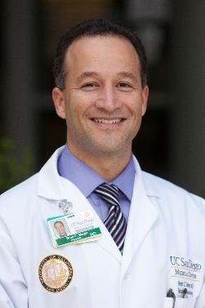
What’s a PI got to do with it?
PI’s must be engaged!
At the RCC level and most importantly at the site level
Email vs. phone call vs. face-face
Metrics matter
  Showing data speaks volumes
  Future site selection
  Future funding with NIH

Slide 43
General Information and Reminders
RPPR due June 1st.
Selection of StrokeNet Trainee Awardee.
Presenters for upcoming Meetings/Coordinators Calls.
StrokeNet National Meeting in-person meeting Oct 29th, 2019.
StrokeNet Meet and Greet Night before National Meeting.
Cheryl Grant and Preethy Feit to discuss upcoming managers survey.
Future calls to allow sites to present their RCC’s.
Topics or presenters for the Atlanta Meeting.

