Slide 1

Coordinator Webinar and Round Table Discussion
May 27, 2020

Slide 2
Coordinator Call
Announcements and Reminders
Next Coordinator Call June 24th, 2020
Survey results
Hosting: Cheryl Grant and Preethy Feit and the Planning Committee.
RPPR due June 1, 2020
Today’s Roundtable Hosts: To join Coordinator Webinars: https://nihstrokenet.adobeconnect.com/coordinator/ Please enter as a guest, then add your first and last name or email address. For Audio: Dial-In Number: (877) 621-0220 Passcode 434578.

Slide 3

Project Updates
NCC Project Manager: Kimberlee Bernstein, BS, CCRP
Study Investigator: Magdy Selim, MD
Prime Project Manager: Sarah Marchina, PhD

Slide 4
Trial Updates
SATURN
SATURN enrollment reopened 5/18/2020
SATURN Protocol v4 and ICF v4 amendment approved and distributed to sites
  Added possibility of remote consent and telehealth follow up visits
SATURN first PI/Coordinator webinar 5/28/20 12:30pm; will discuss reopening enrollment
Work with sites who still have outstanding cIRB submissions or CTAs

Slide 5
Project Updates
SATURN
cIRB/REB Approved | CTA Executed | Readiness Calls Completed | Sites Released to enroll
75 | 94 | 52 | 23
Pending CTAs | Pending cIRB | Pending Both cIRB/CTA
40 | 58 | 33

Slide 6

Project Updates
CREST-2
Study Investigators: Tom Brott, MD
James Meschia, MD
Study Project Manager: Kassondra Guzman, BS
Data Managers: University of Alabama

Slide 7

CREST-H
CREST H PIs: Randolph Marshall, MD
          Ron Lazar, PhD
          David Liebeskind, MD
          Sander Connolly’s , MD
          Project Managers: Jaya Vijayan, CCRC – Mayo Clinic
          Kevin Slane – Columbia University

Slide 8

Project Updates
ARCADIA
                Study Investigators: Mitch Elkind, MD
                Hooman Kamel, MD
Study Project Managers: Rebeca Aragon Garcia, BS
                Pam Plummer, MSN, RN, CCRC
                Data Managers: Faria Khattak, MPH
                Patty Hutto
                Site Monitoring Manager: Aaron Perlmutter

Slide 9
Enrollment
March 21, enrollment paused study-wide due to COVID-19
  1,709 patients consented, 440 randomized
…….COVID-19 pause
May 6, letter to cIRB proposing approach to re-opening
May 8, cIRB approved plan to re-open (more on that later…)
May 21, Stanford team randomized previously consented patient!

Slide 10
Protocol v5.0 – Key updates
Incorporated all changes from Canadian protocol version 4.1 and 4.2 into combined U.S./Canada version 5.0
Updated study/participant duration in Protocol Summary and Schematic of Study Design
  Minimum 1.5 years, maximum 7 years participation
  Schematic no longer says “48 Month visit (MAXIMUM)”
Changed inclusion criteria to require randomization no later than 180 days after stroke onset, rather than 120 days (5.1, 7.2.1, 7.2.2)

Slide 11
Protocol v5.0 – Key updates
All subjects will need to be reconsented with ICD v7.0
Specified that remote consent can be obtained from patients as well as their LARS
Clarified procedure for handling subject withdrawal
1st dose study drug window is now 48 hrs.
COVID-19 added as Adverse Event of Special Interest

Slide 12
Compensation plan changes (pending NIH final approval)
Increase payment for patients that are consented but do not get randomized from $100 to $300 per patient.
  We will require that all data be collected and entered for this full “screen failure” payment to be made.
Cover the cost of shipping drug from the site to the patient.
  We will establish a FedEx number that sites will be able to use for this purpose and this will allow us to track their shipments, as well.
  If sites must ship with another carrier, we will reimburse for this as well.

Slide 13
Time to re-start safely and as possible at each site…
5/8/2020 Re-Start Plan was cIRB approved (in the WebDCU Toolbox Project Documents)
5/13/2020 Re-Start Plan was sent to PIs and PSCs
Re-starting will be done site by site as your institutions & team staffing allow
Restart activities have 1st focused on randomization of potential participants previously consented and found eligible for randomization (up to 180 days)
June 1, 2020 (date Laboratory Core expects to be able to re-start ARCADIA sample processing): next phase/re-start for NEW subject enrollment

Slide 14
The cIRB Approved Re-Start Plan
a. Your local institution approves the resumption of all ARCADIA activities, including consenting, recruiting, screening including phlebotomy, randomization, and follow-up.
b. Local conditions permit resumption without:
  Jeopardizing the safety of staff, patients, or community.
  Deviating from study protocol.
  Contributing to a shortage of resources, such as essential clinical staff and personal protective equipment (PPE) that are needed to take care of COVID-19 infected patients.
  Interfering with clinical procedures put in place to treat COVID-19 patients.
c. The site study team will conduct study-specific tasks via remote means as much as possible, as local conditions dictate.

Slide 15
The cIRB Approved Re-Start Plan
d. When in-person contact is needed, the site study team will follow best practices for infection control in keeping with institutional rules, guidance, and resources current at the time. These best practices may include:
  Before any study-specific in-person contact with subjects (subjects already in the trial or potential subjects), the subject will be screened for COVID-19 symptoms and exposure. This will be done by study staff via telephone or other HIPAA-compliant telehealth technology prior to clinic visits, or by study staff or treating clinicians on service prior to in-person contact with inpatients.
  In light of the potential for transmission by asymptomatic COVID-19 infected individuals, study staff will use masks, physical barriers (e.g., faceshields, plexiglass barriers between cubicles, etc.), and social distancing (maintaining at least 6 feet of distance, staggered shifts) to the greatest degree possible given their institutional supplies and policies. This applies both to in-person interactions with subjects and among study staff and treating teams. Such in-person interactions will be minimized as much as possible to minimize person-to-person transmission and conserve PPE.
  These standards for in-person contact will be relaxed as deemed appropriate at individual sites based on local institutional rules, guidance, and resources.
e. The site PI will monitor their local situation with respect to COVID-19, including their local institutional guidelines, and notify the national ARCADIA team if conditions require pausing enrollment again.

Slide 16
How do sites get re-started?
Protocol v5.0 has been cIRB approved and the site specific consent forms (ICD v7.0) are being sent to the sites as they become available.
You will need to upload these regulatory documents onto WebDCU including
    cIRB Protocol v5.0 approval letter under CIRB Approval (Protocol v5 - 16APR2020)
    Your site specific ICD v7.0 cIRB approval letter under CIRB Approved Administrative Amendments
    Your new ICD v7.0 under CIRB Approved Informed Consent Form (v7)
    Have your PI sign onto the new protocol Protocol Signature Page (Protocol v5 - 16APR2020)
Let us know if you need to submit these to your local IRB for acknowledgment prior to use
You will need to have lab kits and study drug at the site
Keep your WebDCU COVID-19 Impact Assessment V2 up to date

Slide 17
How does our site get re-started?
Complete the COVID-19 Impact Assessment v2 including the General Comment statement as your PI attestation (or study coordinator or other appropriate designee)
  “I attest that our site meets the requirements indicated by the ARCADIA trial leadership to resume study activities.”
  Q04, Q07 & Q10 need to show some level of allowed screening, enrollment and f/u
    Contact us if this is an issue
Email Rebeca (ra2356@cumc.columbia.edu) when your site is ready to be considered for re-release to enroll even if only doing remote screening, enrollments and follow ups.

Slide 18
ARCADIA-CSI
ARCADIA-CSI PIs: Maarten Lansberg, MD, PhD
Ron Lazar, PhD
George Howard, PhD
Kevin Sheth, MD
David Tirschwell, MD
Max Wintermark, MD
Project Managers: Stephanie Kemp
Tashia Harris, MS
Data Managers: Faria Khattak, MPH
Site Monitoring Manager: Aaron Perlmutter, MPH

Slide 19
ARCADIA-CSI COVID-19 update
MARCH 16 TO PRESENT
Central Study Team Activities:
  The UAB Survey Research Unit (SRU) for telephone cognitive testing is open to conduct neurocognitive assessments for participants that have already been consented.
  Supporting Site Activities:
    Enrolling new sites and conducting site initiation calls
Site Activities
  Continue screening already-enrolled ARCADIA patients for CSI candidacy

Slide 20
ARCADIA COVID-19 update
Proposal to StrokeNet/CIRB:
  Approval of protocol amendment to permit site personnel to remotely consent ongoing ARCADIA patients who meet CSI eligibility criteria
  Schedule baseline cognitive examinations through the SRU reservation system for calls to patients’ homes.
  As already done, Site Coordinators will obtain and upload clinical MRI from ARCADIA index event.
  For patient without clinical MRI, we would obtain baseline study MRI when feasible.
  No risks to patients or coordinators.
  Maintains scientific integrity of study since remote cognitive exams were already performed.

Slide 21

Sleep SMART
Sleep SMART PIs: Devin Brown, MD, MS
Ronald Chervin MD, MS
Project Managers: Kayla Novitski, MPH, CCRP
Joelle Sickler, MSN, RN, CCRC, CCRA
Data Managers: Faria Khattak, MPH
Jocelyn Anderson, MPH
Site Monitoring Manager: Katie Trosclair, MPH
FusionHealth Clinical Operations Director: Helgi Helgason, MS
FusionHealth Contracts Help: Diane Sparks, RN, BS Wren Hanson, MBA
Regulatory Specialists: Jennifer Golan, MS
Emily Stinson, MS

Slide 22


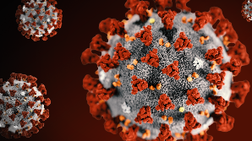
Brief update
May 27, 2020

Slide 23
Protocol v5.0: summary of major changes
Relax criteria for repeat Nox T3 and aCPAP run-in nights
Addition of home aCPAP run-in nights – at the request of some sites
Help intervention subject program FH # in cell phone; initiate call b/f discharge
CPAP bag: now with magnet (FH # and Sleep SMART URL), hand sanitizer with FH # (coming soon – on back order), new CPAP resources document, COVID CPAP info document
$10 to intervention subjects who complete call w FH within 1 wk of d/c (UM to manage)

Slide 24
Additional tools
New brochure
CPAP sign – can hang in room to remind about CPAP use
Updated recruitment challenges doc to include COVID related q’s
Please visit our website to see all tools: https://www.nihstrokenet.org/sleep-smart-trial/research-team

Slide 25
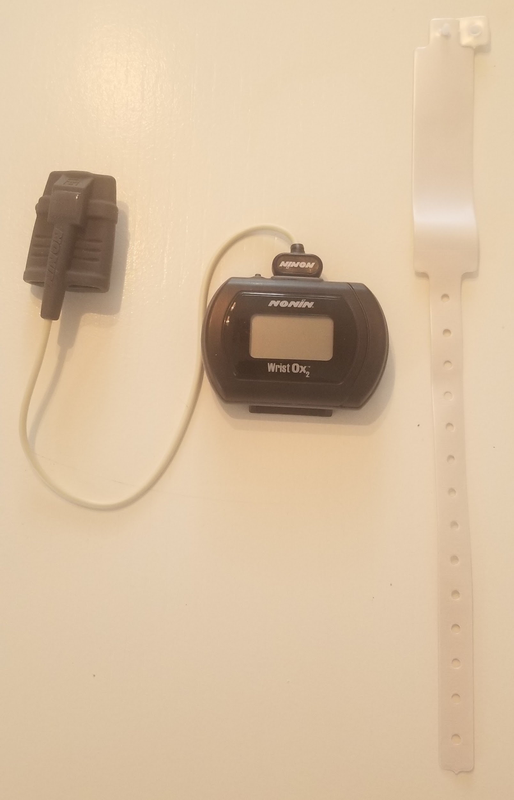
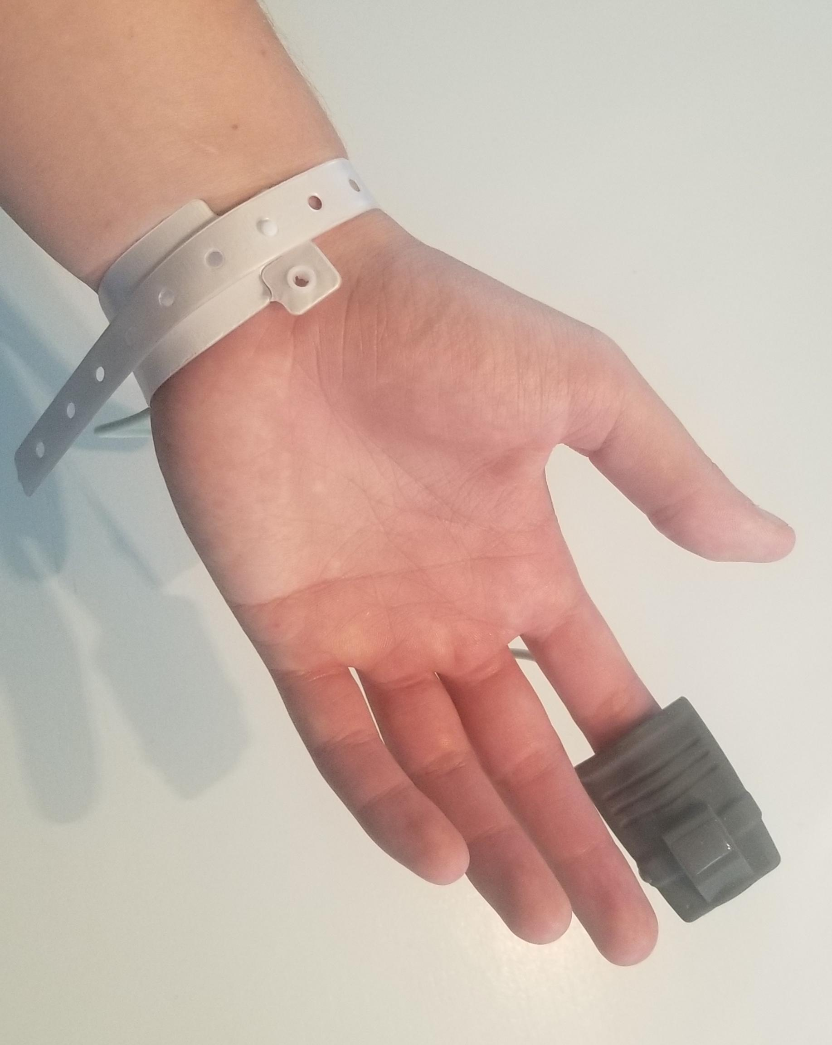
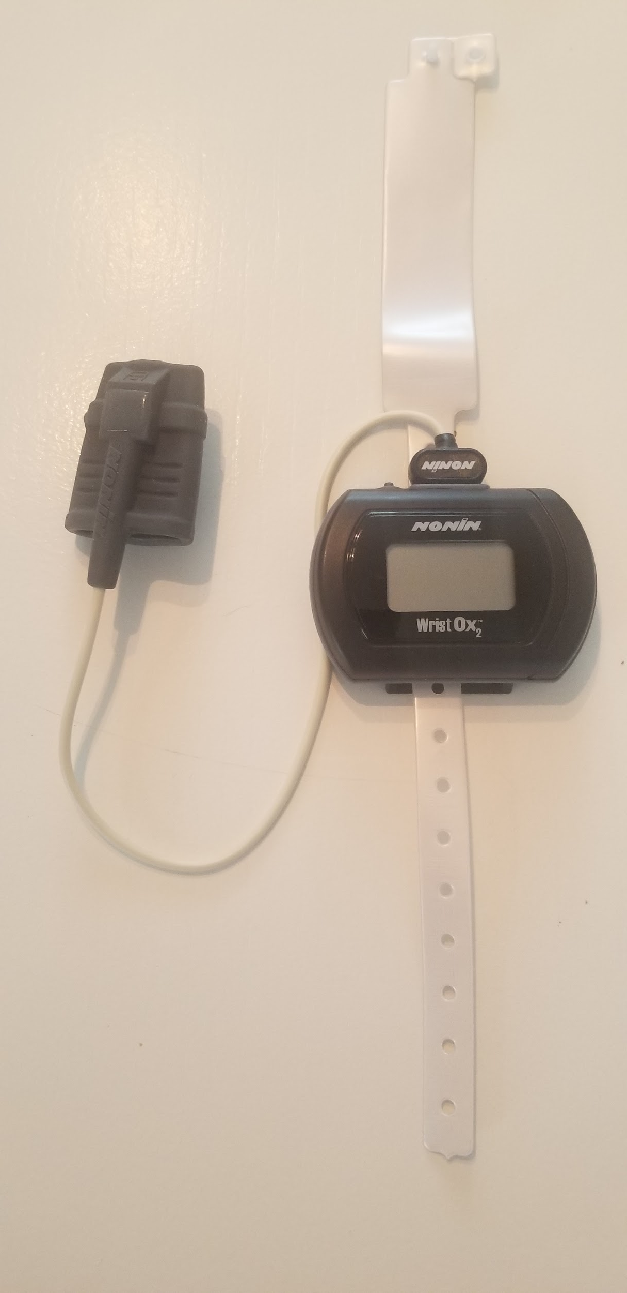
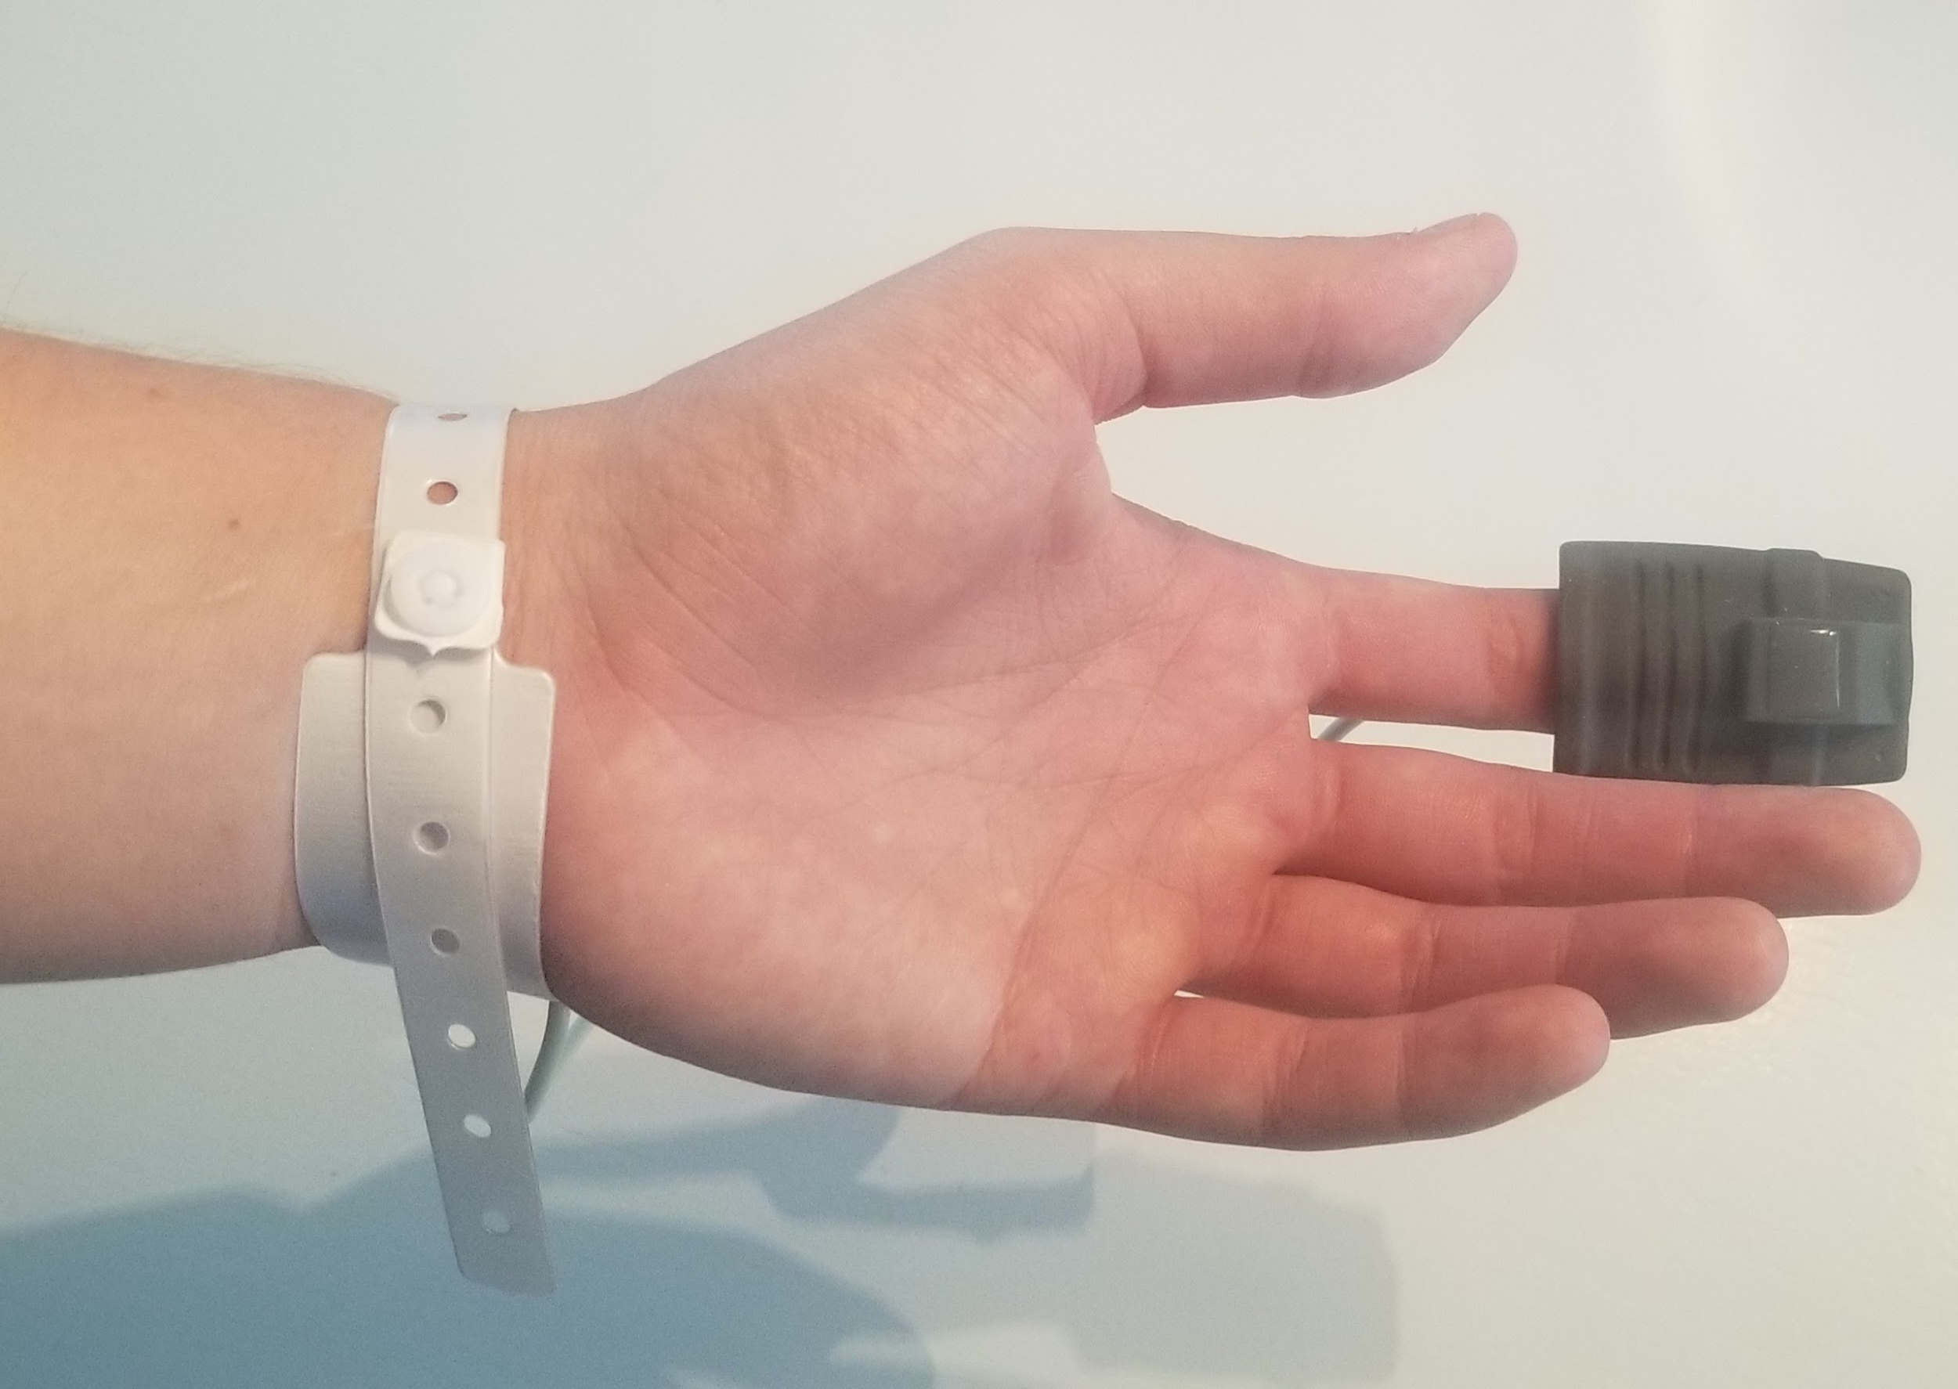

Slide 26
COVID and Sleep SMART
Any patient under contact, droplet, or respiratory/airborne precautions – EXCLUDED from enrollment
If a subject enrolled in Sleep SMART is placed in contact, droplet, or respiratory/airborne precautions after enrollment but before randomization:
  study-related activities should be paused immediately and the subject should be withdrawn from the trial (unless precautions are lifted in time for study procedures to resume).

Slide 27
COVID…
Clinical enrollment sites should apply their own local policies for use of PPE for study staff who apply the Nox T3 sleep apnea test or assist the subject with the aCPAP run-in night.
Outcome assessment: in person vs phone
  Prior to any in-person outcome assessment, each subject should be screened (typically) by phone for symptoms of and exposure to COVID-19.
  A tool for this purpose is provided, but use local screeners if available
  If the subject screens positive, the outcome assessment should be performed by phone.
  Participants with active or recent COVID-19 should not return for in-person assessments unless cleared based on their local guidance to do so.

Slide 28
COVID…
All intervention subjects should be provided with COVID/CPAP info sheet – because of theoretical risk to household members
  Assure that info sheet is in CPAP bag
  FusionHealth will include with new CPAP shipments
  Please include with all CPAPs you already have
Adding a SARS-CoV-2 testing CRF to 6-month outcome assessment
COVID-19 added as an adverse event of special interest

Slide 29
When can your site be re-activated?
When local procedures allow for enrollment and in-person interaction for research
Site PIs verify that study visits or procedures will not contribute to shortage of resources, such as essential clinical staff and Personal Protective Equipment (PPE) that are needed to take care of COVID-19 infected patients
Site PIs will verify that study procedures would not interfere with clinical procedures put in place to treat COVID-19 patients
Ready with the procedures described on previous slides
In WebDCU, please update your COVID Impact Assessment survey
To confirm the statements in the recently sent re-activation memo, please type “confirmed” in the general comments
You cannot re-start in-person activities until you are reactivated

Slide 30
When can your site be re-activated, cont
Respond to open queries by NDMC
Submit re-opening to local IRB, if needed
Achieve CIRB approval for consent form
Receive local acknowledgement of amendment, if needed
RECEIVE NOTICE FROM NDMC!!

Slide 31
Sites not yet released to enroll prior to the COVID hold:
Continue to work toward site activation.
If your institutional guidelines allow, please proceed with start-up activities:
  CIRB submission
  Finalize the Clinical Trial Agreement and FusionHealth DUA and Consignment agreement
  Upload site and people documents to WebDCU
  Complete online trainings (https://webdcu.musc.edu/campus/)
  Complete readiness call
  Please review the site to-do checklist found in the WebDCU toolbox

Slide 32
Additional Required Training:
In January we informed sites that the PI and primary study coordinator needed to complete ICF training
Now anyone who is delegated the responsibility of obtaining informed consent will need to complete the ICF training (and upload the attestation to WebDCU)

Slide 33

MOST Project Updates
Study Investigators: Opeolu Adeoye, MD, MS
Andrew Barreto, MD, MS
Jim Grotta, MD
Joe Broderick , MD
Colin Derdeyn, MD
Prime Project Manager: Iris Deeds, BS, CCRP
NCC Project Manager: TBA
Data Managers: Laura Arnold
Jocelyn Anderson, MPH
Monitoring Manager: Katie Trosclair, MPH

Slide 34


MOST Updates
MOST received CIRB approval to reopen enrollment on 4/27/2020
In order to be (re)released to enroll:
  Site must be approved on Protocol v4, Informed Consent Form v5, and the Participant Study Information Sheet v6
  Confirm the statements outlined in the letter regarding resuming enrollment from the MOST PIs by indicating on the COVID Impact Assessment in WebDCU that your institution allows subject enrollment
  Notification will be sent when site enrollment suspension is lifted in WebDCU

Slide 35
MOST Updates
The process by which sites will be approved to utilize remote consent methods is currently under review at the CIRB, therefore only in-person consent may be sought at this time.
As soon as the process is approved by the CIRB, the MOST team will reach out to sites to provide information on the approved remote consenting procedures, including the use of a centrally managed eConsent process using REDCap.
Each site will complete a form indicating which procedures they will use.

Slide 36
MOST Updates
Congratulations to the following teams that have reactivated enrollment at their sites!
  Greenville Hospital
  St. John Tulsa
  University of Virginia
  Memorial Hermann
  Mayo Clinic Jacksonville
  University of Michigan
  Houston Methodist
  Yale New Haven Hospital
  University of New Mexico
  Cedars Sinai

Slide 37

Project Updates
TRANSPORT2
Study Investigators: Wayne Feng, MD
Gottfried Schlaug, MD
Study Project Managers: Kristina Balderson, MHA, CCRC
Max Mays, BS
Data Manager/Site Monitoring Manager: Patty Hutto

Slide 38
Perinatal Arterial Stroke:
A Multi-site RCT of Intensive Infant Rehabilitation (I-ACQUIRE)
Investigators:
  Sharon Landesman Ramey, Ph.D. (Lead PI), Fralin Biomedical Research Institute, Virginia Tech, Roanoke, VA
  Warren Lo, M.D. (Co-PI), Nationwide Children’s Hospital & The Ohio State University, Columbus, OH
Fralin Biomedical Research Institute, Virginia Tech, Roanoke, VA
  Laura Bateman, Study Coordinator
    laurapb2@vt.edu
National Coordinating Center
  Max Mays– Project Manager
    maysmw@ucmail.uc.edu
Data Manager/Site Monitoring Manager
  Sara Butler

Slide 39

Project Updates
FASTEST
Study Investigator: Joe Broderick, MD
James Grotta, MD
Andrew Naidech, MD
Study Project Managers: Pooja Khanolkar, MPH
Data Managers: TBN
Site Monitoring Manager: TBN

Slide 40

The FASTEST Trial
Protocol amendment approved
Regulatory packets and 3Bs to be sent to sites within the next week
  Sites identified as not having a Reliance Agreement with Advarra will be communicated with separately, but can begin regulatory work on the trial
    Advarra will be managing the execution of Reliance Agreements
Exception from Informed Consent (EFIC)
  Model EFIC plan created
  Memorandum of guidance developed in conjunction with Advarra due to COVID-19
  Online tools being developed:
    Survey platform
    Focus group platform
  Webinar being planned for June
  Additional EFIC materials to be sent to sites in the coming weeks
Target enrollment start date: October 1st

Slide 41

Project Updates
ASPIRE
Study Investigators: Kevin Sheth, MD
Hooman Kamel, MD
Project Managers: Catherine Viscoli, PhD
Laura Benken, MBA, BS, CCRP
Data Managers: Kyle Hatcher
Site Monitoring Manager: Aaron Perlmutter

Slide 42

Updates:
  On May 11, 2020, the cIRB approved ASPIRE re-open trial to enrollment and procedures for remote consent, randomization, and participant follow-up.
  Before being re-released to enroll, site PI must attest that resumption can take place safely, in conformity with local restrictions, and without contributing to shortage of resources needed for care of cOVID-19 patients.
  cIRB must be notified if site plans to use remote procedures for consent
    Remote Informed Consent Implementation Form submitted as a modification to the cIRB.
    Email completed form to ASPIRE@yale.edu
  ASPIRE Remote Procedures and Implementation Form in ASPIRE TOOLBOX

Slide 43
Updates:
  ASPIRE Webinar #2 – Today @ 3pm – 4pm
  Topic: ASPIRE Procedures for Remote Consent and Enrollment
  To join meeting: https://nihstrokenet.adobeconnect.com/trials/ - Enter as a guest, then your first and last name.
  To take part in the conversation you MUST dial in. 1 (877) 621-0220 Pass Code: 745694

Slide 44
NINDS
Scott Janis, PhD
Claudia Moy, PhD
Joanna Vivalda, RN
NCC/NINDS Updates
The National Coordinating Center
Joe Broderick, MPI Pooja Khatri, MPI
Jamey Frasure, Director Rose Beckmann, Administration
Emily Stinson, Regulatory Jennifer Golan, Regulatory
Diane Sparks, Contracts Wren Hanson, Contracts
Jeanne Sester. Ed Coord Keri Davidson Pinger, Business Mgr.

Slide 45
Data Management Center Updates
WebDCU™/NDMC Team:
Jordan Elm, PhD, MPI
Wenle Zhao, PhD, MPI
Catherine Dillon, MS, CCRP, Associate Director of Trial Operations
Jessica Griffin, MHA, CCRP, Trial Operations Manager
Logan Sirline, MPH, Project Manager

Slide 46
CIRB Updates
CIRB Team Members:
Michael Linke, PhD, CIP, CIRB Chair
Sue Roll, RN, BSN, CIRB Liaison
Keeley Hendrix, CIRB Coordinator
Jo Ann Behrle, CIRB HPA

Slide 47
General Information and Reminders
Presenters for upcoming Meetings/Coordinators Calls.
StrokeNet National Meeting (in-person meeting) TBD 2020.
Potential RCC Managers StrokeNet Meeting. TBD
RPPR Due June 1st.
Teach 2 due June 3rd.
Send in Survey questionaires.

