Slide 1

Coordinator Webinar and Round Table Discussion
JUNE 28, 2017

Slide 2
Coordinator Call
Announcements and Reminders
Next Coordinator Webinar :
Jennifer Reckner RCC Project Manager
University of Wisconsin – Madison
Title: Site Auditing and Monitoring 101
Wednesday, 26-July at 1:30 PM ET
To join Coordinator Webinars: https://nihstrokenet.adobeconnect.com/coordinator/ Please enter as a guest, then add your first and last name or email address. For Audio: Dial-In Number: (877) 621-0220 Passcode 434578.
Upcoming StrokeNet Meetings:
StrokeNet Meeting Tuesday, 12-September, 2017, Atlanta Airport Marriott, Atlanta Georgia. Managers Meet and Greet on Sept, 11th at 7pm in the hotel lobby.
StrokeNet Meeting Monday, 22-January, 2018, ISC Los Angeles, California
Plan Ahead: Montreal meeting Sept 2018.

Slide 3
Project Updates
TELE-REHAB
Study Updates:
Study Project Managers: Lucy Dodakian, MA, OTR/L
Judith Spilker, RN, BSN
Study Investigator: Steve Cramer, MD

Slide 4
Project Updates i-DEF
Study Updates:
Study Project Manager: Aaron Perlmutter, MPH, MSW
Study Investigator: Magdy Selim, MD

Slide 5
Project Updates
CREST 2
Study Updates:
Study Project Manager: Mary Longbottom, CCRP, CREST Director for Data Quality
Study Investigator: Tom Brott, MD

Slide 6
Project Updates
DEFUSE 3
Study Updates:
Study Project Manager: Stephanie Kemp, BS
Janice Carrozzella, MSN, CNP, RT(R), CCRA
Study Investigator: Greg Albers, MD

Slide 7
Project Updates
ARCARDIA
Study Updates:
Study Project Manager: Irene Ewing, RN, BSN
Study Investigator: Hooman Kamel, MD;
Mitch Elkind, MD

Slide 8
StrokeNet/ARCADIA Travel Reminders for
11-13 Sep 2017
StrokeNet will reimburse TWO people from each RCC ONE night room and tax only (11-Sep). StrokeNet meeting attendees book their rooms SEPARATELY from ARCADIA attendees via the link provided on the StrokeNet travel memo sent to all coordinators. StrokeNet participants book their own flight; these are not reimbursed by the NCC.
Up to FIVE attendees can participate in the StrokeNet meeting from each RCC. Coordinators RSVP to Rose with your five by 19-August.
ARCADIA will cover the cost of TWO people from each PERFORMING SITE one night room and tax and airfare. Please complete and return the flight travel form that Irene sent to you. Your flights will be made for you by DMS travel and a room will be reserved for you for one night (12-Sep). Any additional attendees need to RSVP to Irene and pay for their own travel.
NO ONE should reserve directly through the hotel unless they are an extra ARCADIA participant OR the StrokeNet room block is full.

Slide 9
Project Updates
Recognized NIH Trials
Study Updates:
POINT
SHINE
ATTACH 2
MISTIE 3
RHAPSODY

Slide 10
NCC Updates
(Forum for CC to communicate to coordinators information on reminders, common questions/issues, changes, suggestions, best practices, upcoming meetings, and for coordinators to ask questions):
NCC Staff Members:
Joe Broderick, PI Judith Spilker, Co-Director
Jamey Frasure, Co-Director Sue Roll, CIRB Liaison
Jo Ann Behrle, CIRB, HPA Keeley Lynch, CIRB Coordinator
Kelly Reinert, Contracts Asst. Diane Sparks, Contracts Mgr.
Mary Ann Harty, Finances Rose Beckmann, Administration
Jeanne Sester, Training Coordinator

Slide 11
Data Management Center Updates
(Forum for MUSC to communicate to coordinators information on reminders, common mistakes, changes, suggestions, best practices and for coordinators to ask questions):
WebDCU/MUSC Team:
Yuko Palesch, PI Wenle Zhao, PI
Catherine Dillon, Operations Mgr. Jessica Griffin, Data Mgr.

Slide 12
CIRB Updates
CIRB Team Members:
Sue Roll, CIRB Liaison
Keely Lynch, CIRB

Slide 13
Roundtable Discussion
Today’s CC Host is:
Sherry Goldfarb; MPH
RCC Site Manager for the University of Michigan

Slide 14
StrokeNet
Roadmap to “Ready to Enroll”
Network Introduction
Checklist
Outline of Procedures for Study Start Up
“Living Document” – Review and Revise as needed
Our goal today is for RCC manager review and comment to ensure that the document is useful and clear
We have received input from both the NDMC and the NCC as well as a few of the RCC coordinators
We would like additional input from the RCC coordinators (both positive and negative as well as suggestions for improvement)
Is this worthwhile?
Notes:
We are developing a ready to enroll checklist for use by study sites who may or may not have been involved in a StrokeNet Trial. The goal is to outline the process and make it more transparent to the new or even seasoned user. This is an initial draft and we should consider it a living document that we can revise as necessary.

Slide 15
Table of Contents
Section 1 – Network Organization | 2
Network Organizational Chart | 2
Website Links | 3
Section II – Important Contacts
National Coordinating Center Contacts | 3
MUSC National Data Management Center (NDMC) | 4
Study Specific Contacts | 5
Regional Coordinating Center (RCC) Contacts | 5
Section III - Checklist for Ready to Enroll | 6
Protocol Trial Agreement (PTA) (Grant Subawards) | 6
Local Subaward Requirements | 7
Central IRB (CIRB) Process | 8
Project Subaward | 10
WebDCU™ Process for Regulatory Documents | 10
WebDCU™ Toolbox | 11
Training | 11
Local Workflow | 11
Site Initiation Visit | 12
Appendix 1 – Abbreviations and Definitions | 14

Slide 16
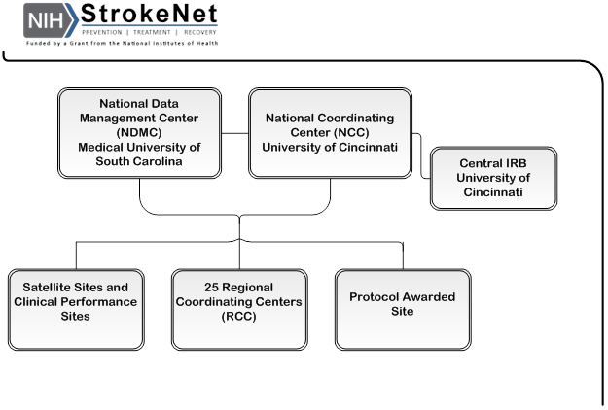
Section 1 - Network Organization
Notes:
Graphical representation of the network. It is a streamlined version

Slide 17
Network Organization, Continued
The network is organized with a National Clinical Coordinating Center (NCC) at the University of Cincinnati and a National Data Management Center (NDMC) at the Medical University of South Carolina (MUSC). All network trials utilize a central IRB (CIRB) which is housed at the University of Cincinnati. There are 25 Regional Coordinating Centers (RCC), each with satellite sites (SS) and clinical performance sites (CPS).
Notes:
Background on the responsibilities of the two main network components

Slide 18
Contact Information
Links to the NIH StrokeNet and MUSC WebDCU™ Websites are provided
Contacts at both the NCC and NDMC are provided
Intent is to add study specific contacts as well as RCC contacts when distributed

Slide 19
Checklist for Ready to Enroll
Protocol Trial Agreement (PTA) (Grant Subawards)Process
  General outline of the protocol trial agreement and subaward process
  Includes any local requirements establish data use agreements
Central IRB (CIRB) Process
  Outline of the CIRB process
  We may wish to outline the renewal process as well in another document
WebDCU™ Process for Regulatory Documents
WebDCU™ Toolbox
Training
Local Study Work-Flow
Study Initiation Visit
Enroll

Slide 20
Discussion
Useful?
Clear?
What’s missing
More……………
Next Steps – Performance measures?

Slide 21
General Information and Updates
StrokeNet FOA released on 5/10/2017.
Letter of Intent due 30 day prior to application deadline.
Open Date (earliest date) 8/25/2017.
Application Due Date 9/25/2017 by 5pm.
Steering Committee comments on the Competitive renewal:
  Open Competition, Seamless Funding
  5 Year funding period
  Up to 25 Centers
  Mechanism changing from U-10 to U-24
  Research Strategy will be limited to 12 pages
  Funding reduced from 250K to 200K.

Slide 22
General Information and Reminders
QAR Due July 5,2017.
StrokeNet Sites Clinical Profile Annual Surveys
Calls for hosting of upcoming CC roundtable discussions.
PM forum breakout session agenda items.
Meet and Greet on September 11th in Hotel lobby starting at 7pm.
Investigators meeting for ARCARDIA Trial
Sept 13,2017.

