Slide 1

Coordinator Webinar and Round Table Discussion
March 28th, 2018

Slide 2
Coordinator Call
Announcements and Reminders
Next Coordinator Webinar :
Next Coordinator Call April 25, 2018.
Devin Qualls, Kinga Aitken and Henna Olalde.
Today’s Roundtable Host is STEPHANIE WILBRAND, University of Wisconsin.
To join Coordinator Webinars: https://nihstrokenet.adobeconnect.com/coordinator/ Please enter as a guest, then add your first and last name or email address. For Audio: Dial-In Number: (877) 621-0220 Passcode 434578.
Upcoming StrokeNet Meetings:
Plan Ahead: Montreal World Stroke Conference, October 16th, 2018.
NCC will reimburse for one night stay at $250.

Slide 3

Network Meeting at WSOC, Montreal
16-October 2018
StrokeNet will reimburse two people from each RCC ONE night room and tax, up to $250.
Meeting venue is the Palais des Congrès, downtown Montreal, not a hotel; book your hotel via the Congrès link to receive Congrès rates: https://hotel.kenes.com/en/congress/WSC18; this link, and a link to the WSOC can also be found in the BWU.
Meeting will tentatively run 9:00 am to 2:00 pm.
There will be no formal breakout sessions, however, the Coordinator/Managers can meet informally after the meeting if desired , as we have the room until 4:00 pm.
RSVP information will be sent out soon.
Passports can take six weeks to process. Please apply as early as possible. StrokeNet cannot reimburse for costs associated with passports. https://travel.state.gov/content/travel/en/passports/apply-renew-passport/how-to-apply.html

Slide 4
Project Updates
TELE-REHAB
Closed to Enrollment:
Study Updates:
Study Project Managers: Lucy Dodakian, MA, OTR/L
Judith Spilker, RN, BSN
Study Investigator: Steve Cramer, MD
Data Manager: Kavita Patel

Slide 5
Project Updates i-DEF
Closed to Enrollment:
Study Updates:
Study Project Manager: Jessica Griffin
Study Investigator: Magdy Selim, MD

Slide 6
Project Updates
DEFUSE 3
Closed to Enrollment:
Study Updates:
Study Project Manager: Stephanie Kemp, BS
Janice Carrozzella, MSN, CNP, RT(R), CCRA
Study Investigator: Greg Albers, MD
Data Manager: Jessica Griffin

Slide 7
Project Updates
CREST 2
Study Updates:
Study Project Manager: Mary Longbottom, CCRP, CREST Director for Data Quality
Study Investigator: Tom Brott, MD

Slide 8
Project Updates
ARCADIA
Study Updates:
Study Project Manager: Irene Ewing, RN, BSN
Study Investigator: Hooman Kamel, MD;
Mitch Elkind, MD
Data Manager: Faria Khattak

Slide 9


ARCADIA Site Readiness update
CIRB submissions-60 sites
CIRB Approvals-46 sites
Readiness Calls-22 sites
Released to enroll-17 sites

Slide 10
ARCADIA Enrollment Update
Consented/Enrolled-16 subjects
Randomized- 2 subjects
Screen failure logs submitted- 65 (due on the 10th of the month)
For Eligibility questions email the PIs at arcadia@ucmail.uc.edu or call the ARCADIA hotline 1-833-427-2234.

Slide 11
Core Eligibility Criteria
Central lab – NT-proBNP/Biobank- notify when sending, include copy of CRF 503
ECG-De-identify prior to uploading!
Echo- Site enters atrial diameter results- WebDCU™ will calculate the atrial index- Save on DVD, de-identify and batch shipments.
Eligibility/Randomization
Email notification of subject eligibility
Sites can check subject eligibility status in WebDCU under to Project status/Subject status
Result of BNP will be visible after randomization

Slide 12
Pharmacy
The pharmacy license and a pharmacist license are needed to ship the study drug to your site. Be sure to have an address listed in WebDCU™ for this as well as Lab kits.
Consider listing more than one pharmacist on your DOA so there are multiple people who can accept study drug shipments.
Please invite your pharmacist to join your readiness call.
Pharmacy video is posted on the WebDCU™ campus training site
If your site is not planning on having study drug shipped to an actual pharmacy, notify us now and we will send you a checklist that will walk you through what we need to do to ensure the alternate shipping location is allowable.

Slide 13
Project Updates
Sleep Smart / MOST
Most:
Project Manager: Teresa Murrell-Bohn
Iris Deeds
Sleep Smart:
Manager: TBD

Slide 14
Project Updates
Recognized NIH Trials
That remain open to enrollments:
Study Updates:
SHINE
Project Manager: Heather Haughey

Slide 15
NCC/NINDS Updates
(Forum for CC to communicate to coordinators information on reminders, common questions/issues, changes, suggestions, best practices, upcoming meetings, and for coordinators to ask questions):
NCC Staff Members:
Joe Broderick, PI
Jamey Frasure, Co-Director Judith Spilker, Co-Director
Sue Roll, CIRB Liaison Keeley Hendrix, CIRB
Diane Sparks, Contracts Jeanne Sester, Training Coordinator
Mary Ann Harty, Finances Rose Beckmann, Administration
Joanna Vivalda, NINDS Scott Janis, NINDS

Slide 16
Data Management Center Updates
(Forum for MUSC to communicate to coordinators information on reminders, common mistakes, changes, suggestions, best practices and for coordinators to ask questions):
WebDCU/MUSC Team:
Yuko Palesch, PI Wenle Zhao, PI
Catherine Dillon, Operations Mgr. Jessica Griffin, Project Mgr.

Slide 17
CIRB Updates
CIRB Team Members:
Sue Roll, CIRB Liaison
Keeley Hendrix CIRB Coordinator
Jo Ann Behrle CIRB HPA

Slide 18
Roundtable Discussion
Today’s Roundtable Discussion:
“QAR Reporting”
Making it Better and Easier
Today’s Host:
Stephanie M. Wilbrand, PhD
Clinical Research Manager
Department of Neurological Surgery
University of Wisconsin – Madison

Slide 19

Stephanie M. Wilbrand, PhD

Slide 20

Quarterly Activity Reports – best practices
Know what everybody in your RCC does
    PI(s)
    Co-PIs
    Collaborators
    Satellites
    Study coordinators
    Fellow/Trainees
    Researchers, etc.
Have a good relationship with faculty administrative support
    I talk to them daily/weekly
    Have them forward you faculties completed activities
Keep a checklist of all activities that your RCC needs to complete
Weekly meeting PI and Research Program Manager

Slide 21
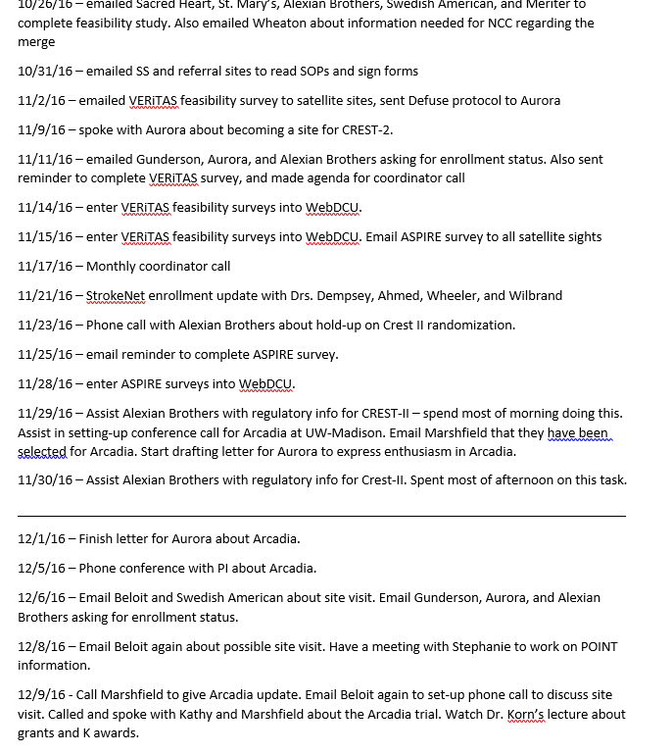
Quarterly Activity Reports – best practices
Keep a list of activities throughout the quarter – both Jen and I keep logs

Slide 22
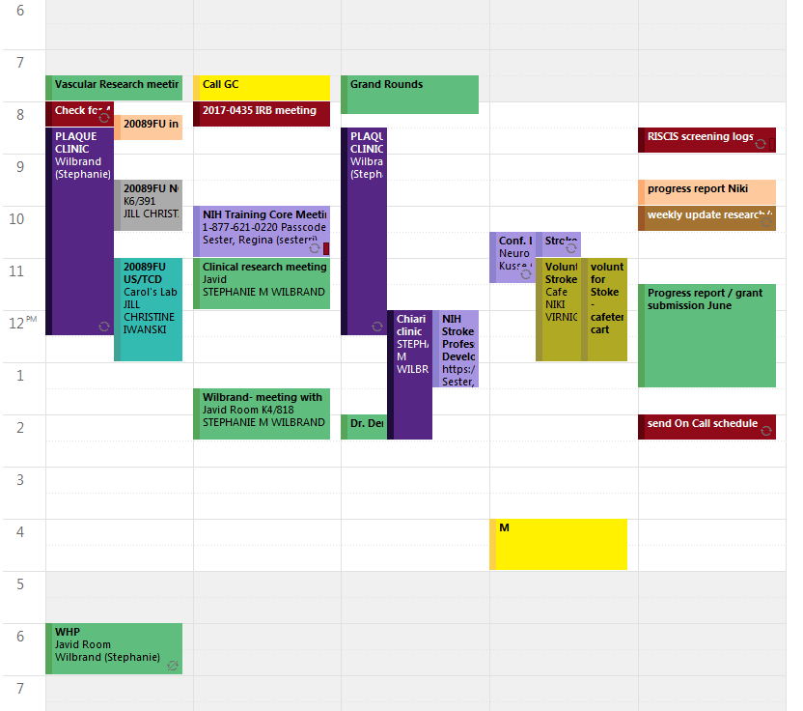
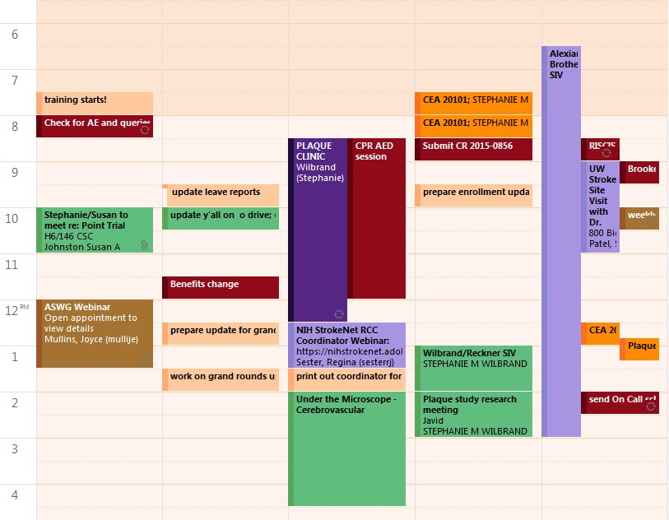
Quarterly Activity Reports – best practices
I add all StrokeNet activities to my calendar – mark different colors

Slide 23
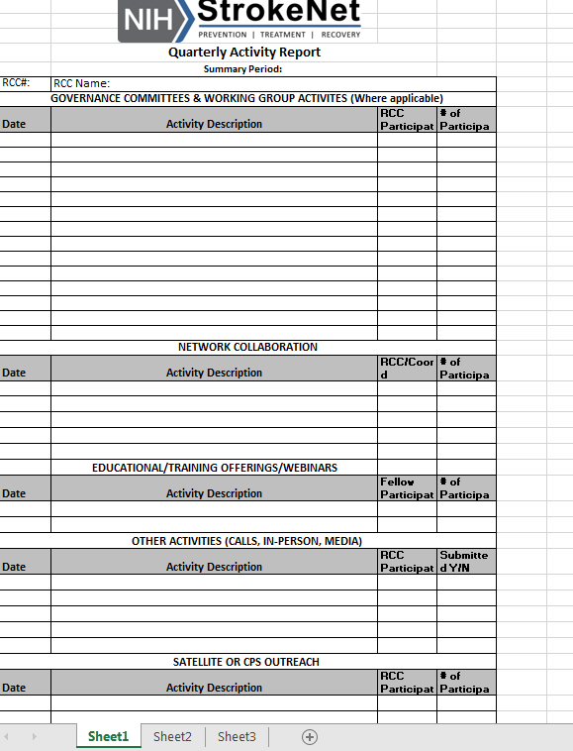
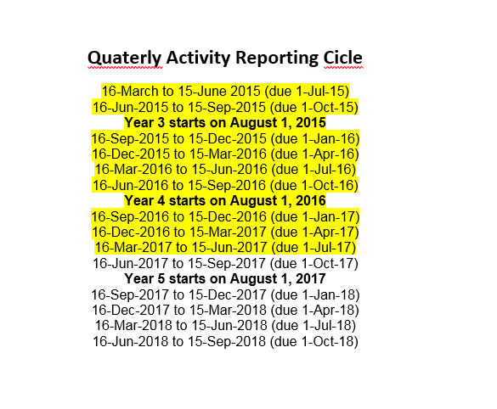
Quarterly Activity Reports – best practices
Once one is completed
I add it to QAR template

Slide 24
Quarterly Activity Reports – best practices
Quarterly reminders in calendar
Set reminder in you calendar a month before to collect information
Start asking for information that is missing
Set another reminder when the quarter has ended
Set another reminder 1-2 weeks before deadline

Slide 25
Quarterly Activity Reports – best practices
Compare your checklist with metrics send by the RCC
List everything including cancelled calls/webinars – mark them as cancelled
Follow chronological order
Add items in groups
When submitting email the QAR to NCC and post on intranet immediately

Slide 26
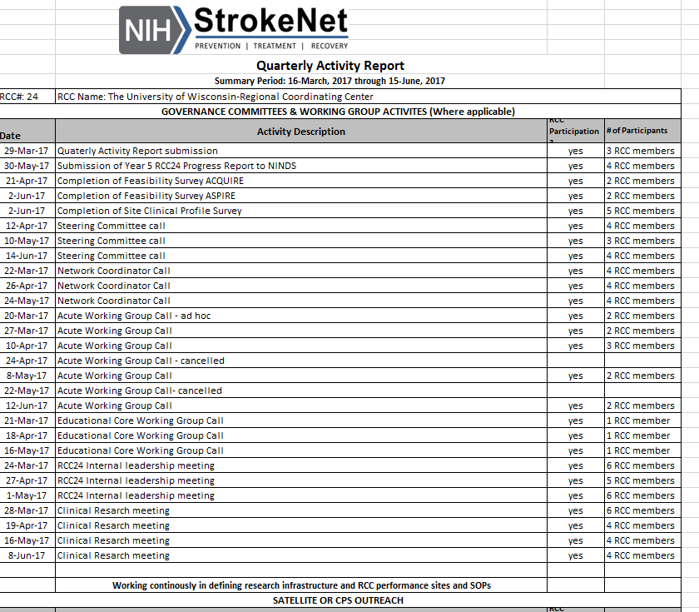
Quarterly Activity Reports – best practices

Slide 27
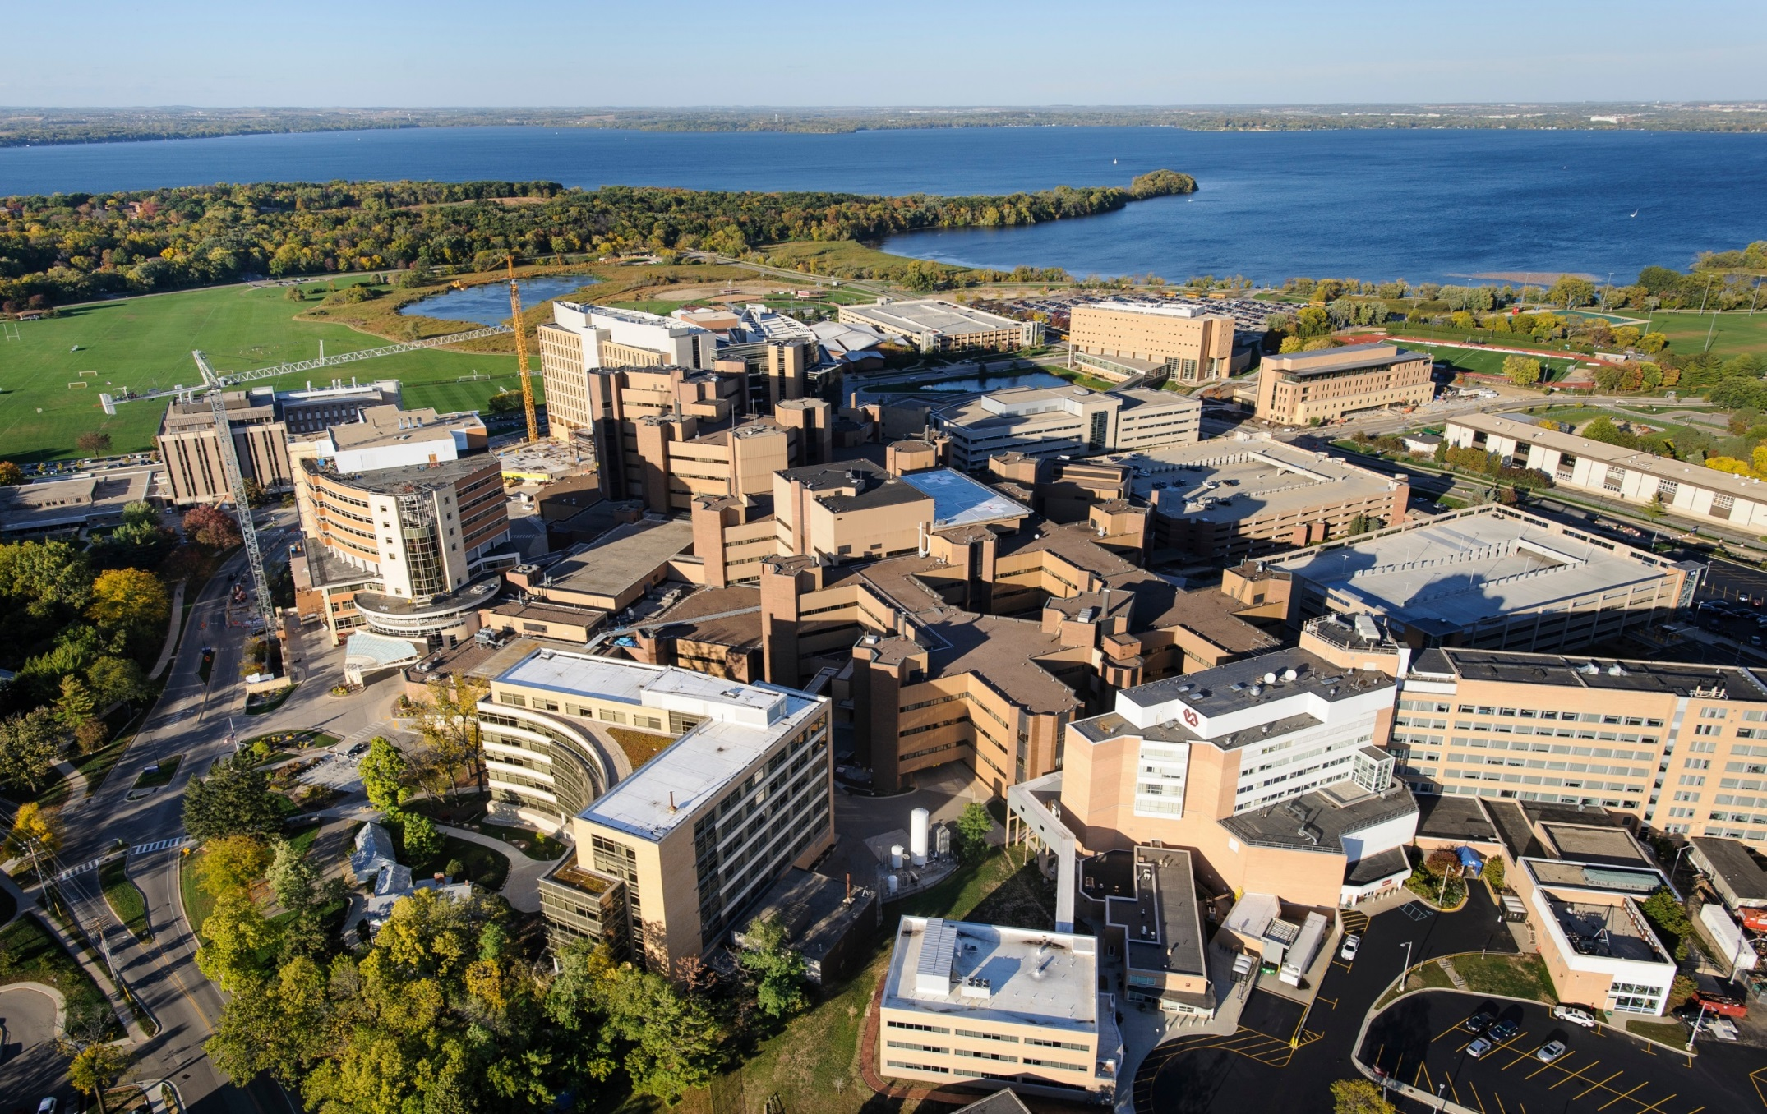
Thank you

Slide 28
General Information and Reminders
Help Wanted:
Presenters for upcoming meetings/Coordinators Calls.
Next call any RCC manager wants to share insights.
No Montreal Managers Breakout Session.
Upcoming Polling questions for next months call.
Per Joanna Vivalda, RCCs will need to submit a Final-RPPR no later than 120 calendar days from the period of performance end date (7/31/2018). Earlier in the window is preferred for centers that will receive an award as an RCC for the 2nd cycle of NIH StrokeNet.
QAR Due 4/1/18

