Slide 1

Coordinator Webinar and Round Table Discussion
May 23rd, 2018

Slide 2
Coordinator Call
Announcements and Reminders
Next Coordinator Webinar :
Next Coordinator Call June 27th, 2018.
Joanna Vivalda and Diane Sparks to host the round table discussion.
Today’s Roundtable Hosts: Preethy Feit and Cheryl Grant.
To join Coordinator Webinars: https://nihstrokenet.adobeconnect.com/coordinator/ Please enter as a guest, then add your first and last name or email address. For Audio: Dial-In Number: (877) 621-0220 Passcode 434578.
Upcoming StrokeNet Meetings:
Plan Ahead: Montreal World Stroke Conference, October 16th, 2018.
NCC will reimburse for one night stay at $250.

Slide 3
Project Updates
TELE-REHAB
Closed to Enrollment:
Study Updates:
Study Project Managers: Lucy Dodakian, MA, OTR/L
Judith Spilker, RN, BSN
Study Investigator: Steve Cramer, MD
Data Manager: Kavita Patel

Slide 4
Project Updates i-DEF
Closed to Enrollment:
Study Updates:
Study Project Manager: Jessica Griffin
Study Investigator: Magdy Selim, MD

Slide 5
Project Updates
DEFUSE 3
Closed to Enrollment:
Study Updates:
Study Project Manager: Stephanie Kemp, BS
Janice Carrozzella, MSN, CNP, RT(R), CCRA
Study Investigator: Greg Albers, MD
Data Manager: Jessica Griffin

Slide 6
Project Updates
CREST 2
Study Updates:
Study Project Manager: Mary Longbottom, CCRP, CREST Director for Data Quality
Study Investigator: Tom Brott, MD

Slide 7
Project Updates
ARCADIA
Study Updates:
Study Project Manager: Irene Ewing, RN, BSN
Study Investigator: Hooman Kamel, MD;
Mitch Elkind, MD
Data Manager: Faria Khattak and Holly Pierce

Slide 8
Project Updates
Sleep Smart / MOST
Most:
Lead Trial Coordinator: S. Iris Deeds, CCRP
NCC Project Manager: Teresa Murrell-Bohn, RN, CCRC
Sleep Smart:
Project Manager: Kayla Gosselin

Slide 9



Slide 10


Study Team
Principal Investigators
  (Lead) Opeolu Adeoye, MD, MS, University of Cincinnati
  Andrew Barreto, MD, MS, University of Texas-Houston
  Jim Grotta, MD, Memorial Hermann Hospital-Texas Medical Center,
  Houston
  Joe Broderick, MD, University of Cincinnati
  Colin Derdeyn, University of Iowa
University of Cincinnati Clinical Coordinating Center
  S. Iris Deeds, CCRP – Lead Trial Coordinator
NIH StrokeNet National Coordinating Center
  Teresa Murrell-Bohn, RN, CCRC – NCC MOST Project Manager

Slide 11
Study Outline
Multi-arm, adaptive, blinded, randomized controlled Phase 3 clinical trial
3 treatment arms for adjunctive-thrombolysis
110 sites nationwide
1,200 subjects enrolled
Enrollment over 4 years

Slide 12

Background
IV rt-PA alone opens ~50% of occluded arteries; 14-34% reocclude leading to worse outcomes
50% of rt-PA treated ischemic stroke patients are disabled at three months
Adjunctive IV antithrombotic medications may augment rt-PA thrombolysis and reperfusion

Slide 13
Adjunctive Treatments to rt-PA
Medications (Study Drug)
  Argatroban - Thrombin inhibitor
  Eptifibatide - Platelet inhibition
  Both medications were previously combined with rt-PA in SPOTRIAS projects
Six Phase 2 trials completed (CLEAR and ARTSS Trials)
The best available evidence for adjunctive medications that combined with rt-PA may:
  Augment thrombolysis
  Prevent re-occlusion
  Result in improved outcomes over standard IV rt-PA

Slide 14
Study Aim and Primary Endpoints
Study Aim: Confirm safety and establish efficacy of IV rt-PA plus IV argatroban OR IV rt-PA plus IV eptifibatide over standard IV rt-PA alone for acute ischemic stroke
Primary Efficacy Endpoint: 90-day functional outcome as measured by the mRS translated into utilities
Primary Safety Endpoint: sICH rate (overall and ET-specific)

Slide 15
Inclusion and Exclusion
Inclusion Criteria
1. Acute ischemic stroke patients
2. Treated with 0.9mg/kg IV rt-PA within 3 hours of stroke onset or time last known well
3. Age ≥ 18
4. NIHSS score ≥ 6 prior to IV rt-PA
5. Able to receive assigned study drug within 60 minutes of initiation of IV rt-PA
Exclusion Criteria:
1. Known allergy or hypersensitivity to argatroban or eptifibatide
2. Previous stroke in the past 90 days
3. Previous intracranial hemorrhage, neoplasm, subarachnoid hemorrhage, or arterial venous malformation
4. Clinical presentation suggested a subarachnoid hemorrhage, even if initial CT scan was normal
5. Surgery or biopsy of parenchymal organ in the past 30 days
6. Trauma with internal injuries or ulcerative wounds in the past 30 days
7. Severe head trauma in the past 90 days
8. Systolic blood pressure >180mmHg post-IV rt-PA
9. Diastolic blood pressure >105mmHg post-IV rt-PA
10. Serious systemic hemorrhage in the past 30 days
11. Known hereditary or acquired hemorrhagic diathesis, coagulation factor deficiency, or oral anticoagulant therapy with INR >1.5
12. Positive urine pregnancy test for women of child bearing potential
13. Glucose <50 or >400 mg/dl
14. Platelets <100,000/mm3
15. Hematocrit <25 %
16. Elevated PTT above laboratory upper limit of normal
17. Creatinine > 4 mg/dl
18. Ongoing renal dialysis, regardless of creatinine
19. Received Low Molecular Weight heparins (such as Dalteparin, Enoxaparin, Tinzaparin) in full dose within the previous 24 hours
20. Abnormal PTT within 48 hours prior to randomization after receiving heparin or a direct thrombin inhibitor (such as bivalirudin, argatroban, dabigatran or lepirudin)
21. Received Factor Xa inhibitors (such as Fondaparinaux, apixaban or rivaroxaban) within the past 48 hours
22. Received glycoprotein IIb/IIIa inhibitors within the past 14 days
23. Pre-existing neurological or psychiatric disease which confounded the neurological or functional evaluations e.g., baseline modified Rankin score >3
24. Other serious, advanced, or terminal illness or any other condition that the investigator felt would pose a significant hazard to the patient if rt-PA, eptifibatide or argatroban therapy was initiated
a. Example: known cirrhosis or clinically significant hepatic disease
25. Current participation in another research drug treatment protocol - Subjects could not start another experimental agent until after 90 days
26. Informed consent from the patient or the legally authorized representative was not or could not be obtained
27. High density lesion consistent with hemorrhage of any degree
28. Large (more than 1/3 of the middle cerebral artery) regions of clear hypodensity on the baseline CT Scan - Sulcal effacement and/or loss of grey-white differentiation alone are not contraindications for treatment

Slide 16
Study Arms
  3 Study Arms:
  argatroban (100µg/kg bolus and a 12-hour infusion at
  3µg/kg/min)
  eptifibatide (135µg/kg bolus and a 2-hour infusion at
  0.75µg/kg/min)
  Placebo
  Administration of Study Drug:
  Bolus, 2-hour infusion, 10-hour infusion
  Bolus administered within 1 hour of rt-PA administration

Slide 17
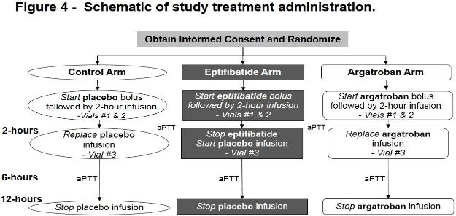
Protocol Flow

Slide 18
Follow-up
24 hours (+ 12 hours)
  NIHSS
  AE assessment
  CT/MRI (SOC)
Day 3/Discharge (+ 24 hours)
  AE assessment
Day 30 (+ 7 days)
  mRS
  AE assessment (SAEs only)
Day 90 (+ 14 days)
  mRS
  EQ-5D
  AE assessment (SAEs only)

Slide 19
Next Steps
  Notice of Award pending
  Study Drug
    Stability Testing in progress
    Manufacturing of study drug for kit assembly
  Site Selection (hope to finalize real soon)
  Start Up (Contracts and CIRB submissions/approvals)
  Anticipate First Patient In 6-months after NoA
  Stay Tuned for more…

Slide 20
NCC/NINDS Updates
(Forum for CC to communicate to coordinators information on reminders, common questions/issues, changes, suggestions, best practices, upcoming meetings, and for coordinators to ask questions):
NCC Staff Members:
Joe Broderick, PI
Jamey Frasure, Co-Director Judith Spilker, Co-Director
Sue Roll, CIRB Liaison Keeley Hendrix, CIRB
Diane Sparks, Contracts Jeanne Sester, Training Coordinator
Mary Ann Harty, Finances Rose Beckmann, Administration
Joanna Vivalda, NINDS Scott Janis, NINDS

Slide 21
Project Updates
Recognized NIH Trials
That remain open to enrollments:
Study Updates:
SHINE
Project Manager: Heather Haughey

Slide 22
Data Management Center Updates
(Forum for MUSC to communicate to coordinators information on reminders, common mistakes, changes, suggestions, best practices and for coordinators to ask questions):
WebDCU/MUSC Team:
Yuko Palesch, PI Wenle Zhao, PI
Catherine Dillon, Operations Mgr. Jessica Griffin, Project Mgr.

Slide 23
CIRB Updates
CIRB Team Members:
Sue Roll, CIRB Liaison
Keeley Hendrix CIRB Coordinator
Jo Ann Behrle CIRB HPA

Slide 24
Roundtable Discussion
Today’s Roundtable Discussion:
RCC Managers and Site Survey Results
Today’s Host:
Preethy Feit: Program Manager
Stroke National Capital Area Network for Research (SCANR)MedStar Health Research Institute.
Cheryl Grant: NIH StrokeNet RCC Manager
Medical University of South Carolina

Slide 25
StrokeNet RCC Manager Survey Results
5.23.18
Note: This survey was created by the Network Managers Planning Committee for NM/SC use for feedback purposes. None of the questions or content was constructed or requested by NINDS, the NCC, or NDMC. Aggregate results will, however, be shared with all.

Slide 26
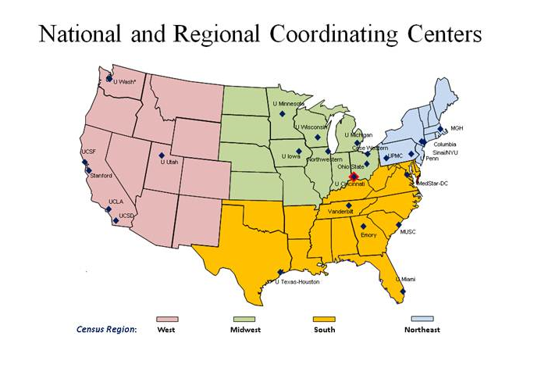

Slide 27
SS vs CPS-what’s the difference?
Clinical Performance Site (CPS)
    -an institution that is not legally affiliated with the awarded RCC
    -has agreed with the RCC to serve as a clinical trial performing sites
    for StrokeNet affiliated studies.
    -does not have a master trial agreement with NCC to participate in
    StrokeNet trials/activities but functions under the direct leadership
    of the RCC
    Satellite Site (SS)
    -an institution that is not legally affiliated with the awarded RCC
    -named by an RCC as a branch of its regional network
    -may or may not be a performance site for a clinical trial for StrokeNet
    affiliated studies
    -has executed a master trial agreement with the NCC to participate in
    StrokeNet trials/activities.

Slide 28
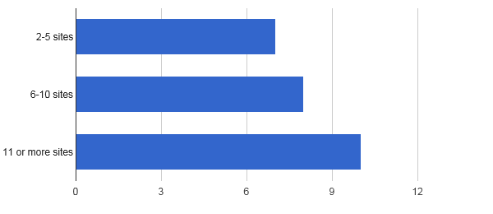
How many total Satellite Sites(SS)/ Clinical Performance Sites(CPS) are within your RCC (including your hub)?
7
8
10
Out of 25 RCCs

Slide 29
Do you have direct communication with your SS/CPS?
100% = YES

Slide 30
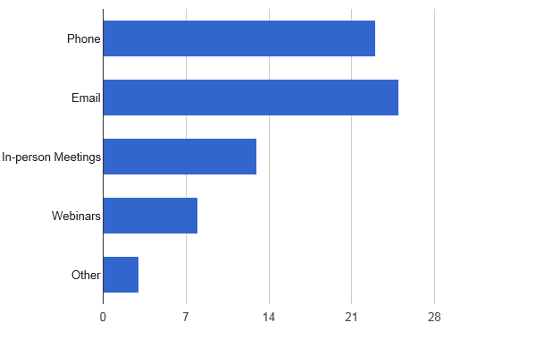
What is your style of communication with SS/CPS?
(23, 92%)
(25, 100%)
(13, 52%)
(8, 32%)
(3,12%)

Slide 31
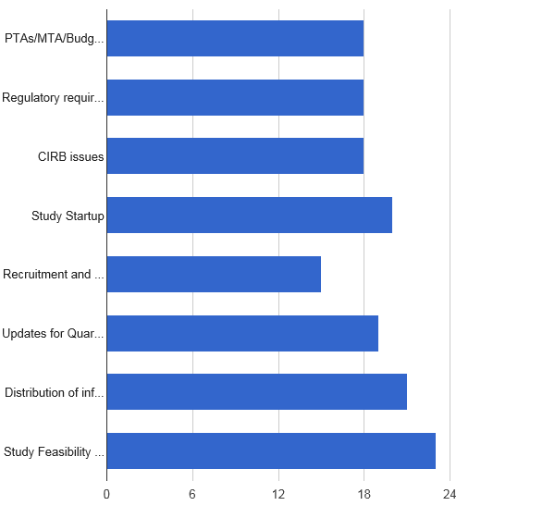
Is your communication mostly regarding (more than one can apply)…
23 - Study Feasibility Surveys
20 - Study Startup
21 - Distribution of information from RCC
18 - PTAs/MTA/Budget/Contract
18 - Regulatory Requirements
18 - CIRB issues
19 - Updates for Quarterly/Annual Reports
15 - Recruitment and Retention Efforts
72.0%
72.0%
72.0%
80.0%
60.0%
76.0%
84.0%
92.0%

Slide 32




What site specific communication tools with SS/CPS are you currently using?
Email, Phone Calls, Teleconference
Newsletters, Monthly updates
Performance metrics tables/excel spreadsheet
Setup specific email for StrokeNet
In-person meetings
Monthly distribution of StrokeNet dashboard
Feasibility/selection survey completion
Working dinner meetings (bi-annual)
Site visits

Slide 33
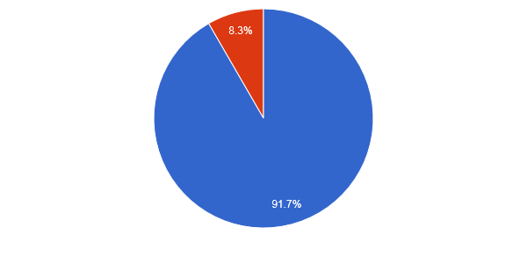
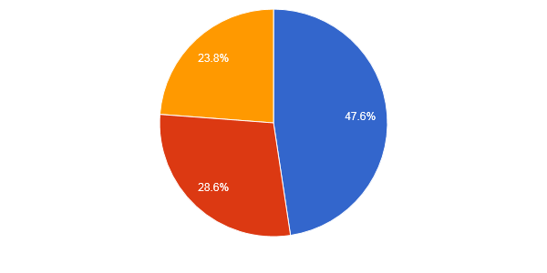
Does your RCC have SOP’s?
Yes (22)
No (2)
24 responses
Have your SOPs been shared with your SS/CPS?
Yes (2)
No (6)
Not Sure (5)
21 responses

Slide 34
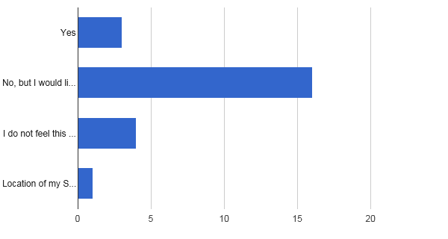
Do you conduct “monitoring” visits at your SS/CPS?
(3, 12.5%)
(16, 66.7%)
(4, 16.7%)
this is my role
(1, 4.2%)
SS makes this
difficult

Slide 35
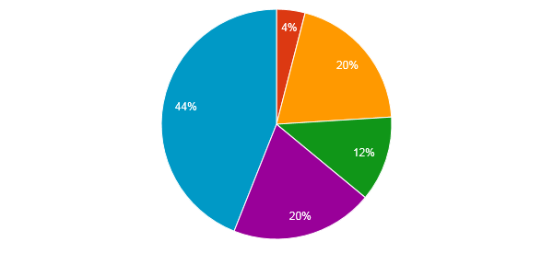
Rate the amount of support/involvement you receive from your RCC PI:
0 - None (0.0%) 3 - Above Average (12.0%)
1 - A little (4.0%) 5 - Excellent (20.0%)
5 - Average (20.0%) 11- Outstanding (44.0%)

Slide 36
What information do SS/CPS need from you ?
(sample RCC responses)
Regulatory Issues/cIRB guidelines
WebDCU enrollment plan
Best practices for recruitment
Network/RCC SOPs
Research training
Study initiation assistance
Other study specific checklists
Feasibility surveys
Information on upcoming trials
Educational opportunities in RCC/Career development through StrokeNet
Study specific budget/contracting assistance

Slide 37
Specific Highlighted RCC Manager Feedback
Mentorship of managers across RCCs/ Additional RCC manager training:
  “It would be great to have a tool for experienced managers/coordinators to help for new incoming staff”
  “I am somewhat new to my role and I would appreciate clearer guidelines on optimal frequency of communication and ways I can be more involved with the SS/CPS.”
  “I think more concrete guidelines would be helpful.”
  “Creation of 'StrokeNet Certification' for Project Managers and Study Coordinators”
Communication on feasibility surveys:
  “Keeping RCCs up to date with approximate expected dates for upcoming surveys and other requirements is extremely helpful in planning for dedicating time for prompt completion”
Streamlined defined processes for new trial submission
Streamlining study start up (advice and suggestions):
  When adding a new site, “there should be a conference call for MTA with key members at site including coordinator and RCC manager to smooth over process.”
  “Include all sites from a RCC in one cohort”
  “Perhaps have fewer cohorts for next study as some of my satellite sites were ready for startup process but had to wait several months to receive startup documents.”

Slide 38
THANK YOU for your participation and hard work!!

Slide 39
StrokeNet Site Engagement Survey Results
5.23.18
Note: This survey was created by the Network Managers Planning Committee for NM/SC use for feedback purposes. None of the questions or content was constructed or requested by NINDS, the NCC, or NDMC. Aggregate results will, however, be shared with all.

Slide 40
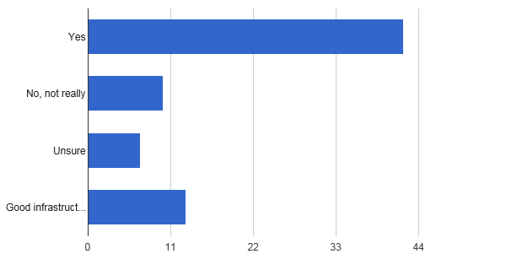
Has participation in StrokeNet helped your stroke research infrastructure at your facility?
(42, 59.2%)
(10, 14.1%)
(7, 9.9%)
(13, 18.3%)

Slide 41
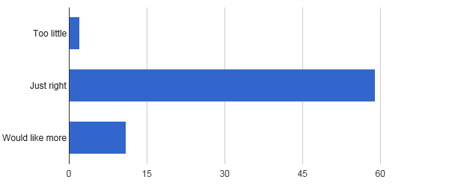
Is the amount of contact with your RCC/Satellite Sites/Clinical Performance Sites..
(2, 2.8%)
(59, 81.9%)
(11, 15.3%)

Slide 42
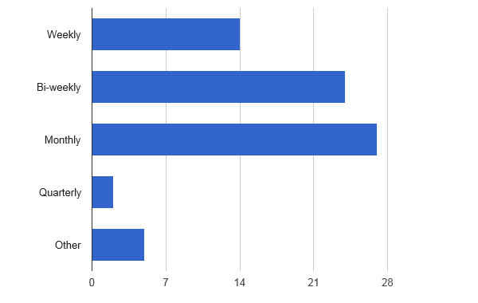
What is the frequency of contact with your RCC/SS/CPS?
(14, 19.4%)
(24, 33.3%)
(27, 37.5%)
(2, 2.8%)
(5, 6.9%)

Slide 43
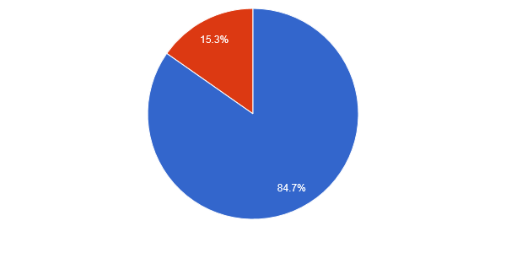
Do you feel you have a good understanding of regulatory requirements for StrokeNet trials?
YES -61
NO -11

Slide 44
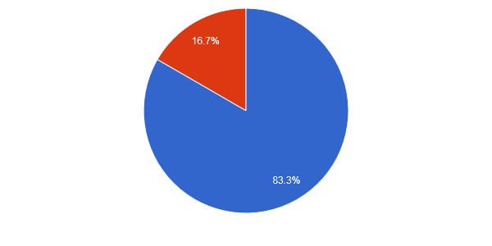
Are you aware of educational opportunities provided through StrokeNet for your staff?
YES -60
NO -12

Slide 45
Other Educational Opportunities Suggested By Satellites:
More timely webinars by the cIRB or study project managers regarding specific start up activities, regulatory documents and process with the cIRB
Overall training on general regulatory trial requirements including audit visits
Career development for junior coordinators
Seminars and webinars geared towards clinical coordinator and RCC Manager development

Slide 46

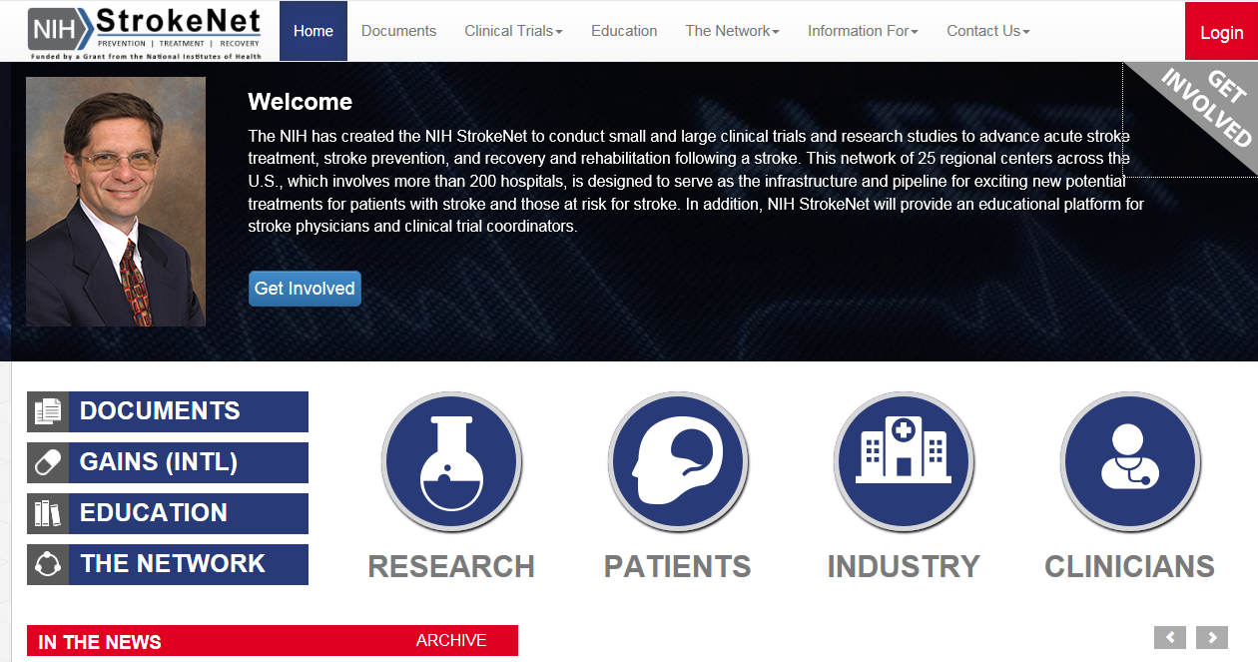
https://www.nihstrokenet.org/
https://www.nihstrokenet.org/

Slide 47
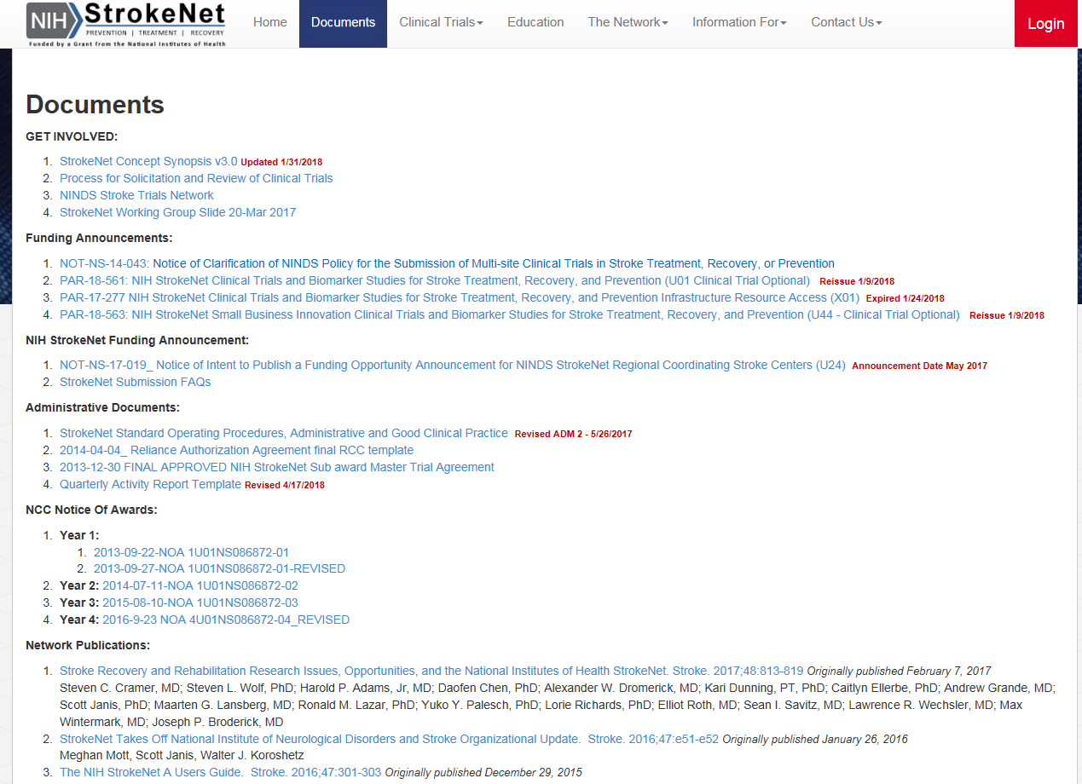

Slide 48
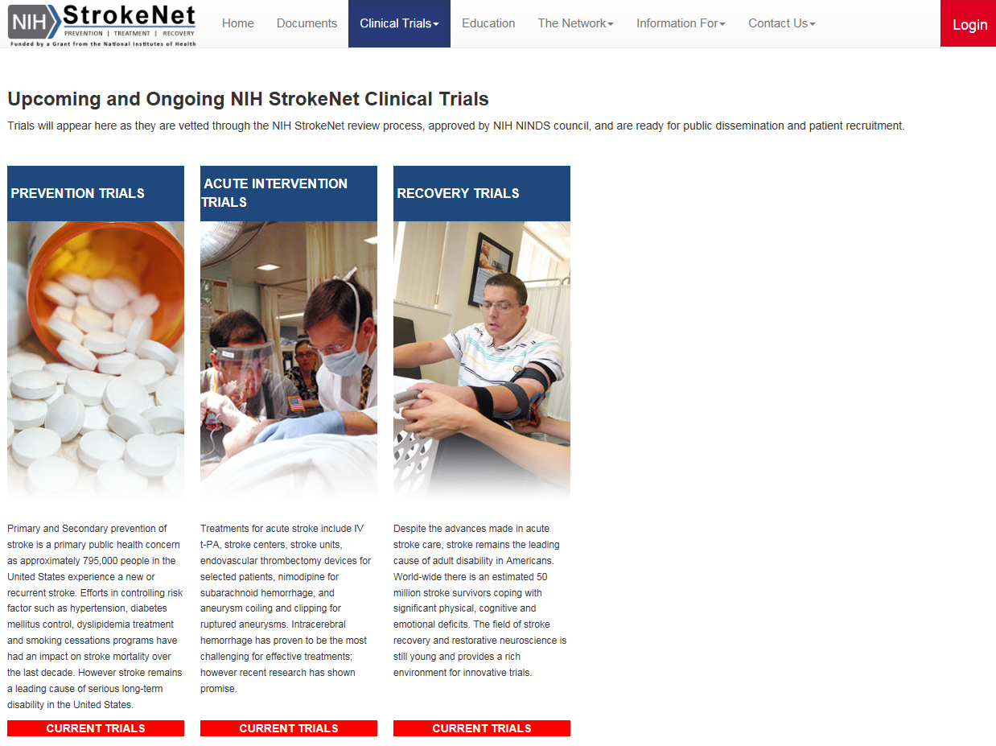

Slide 49
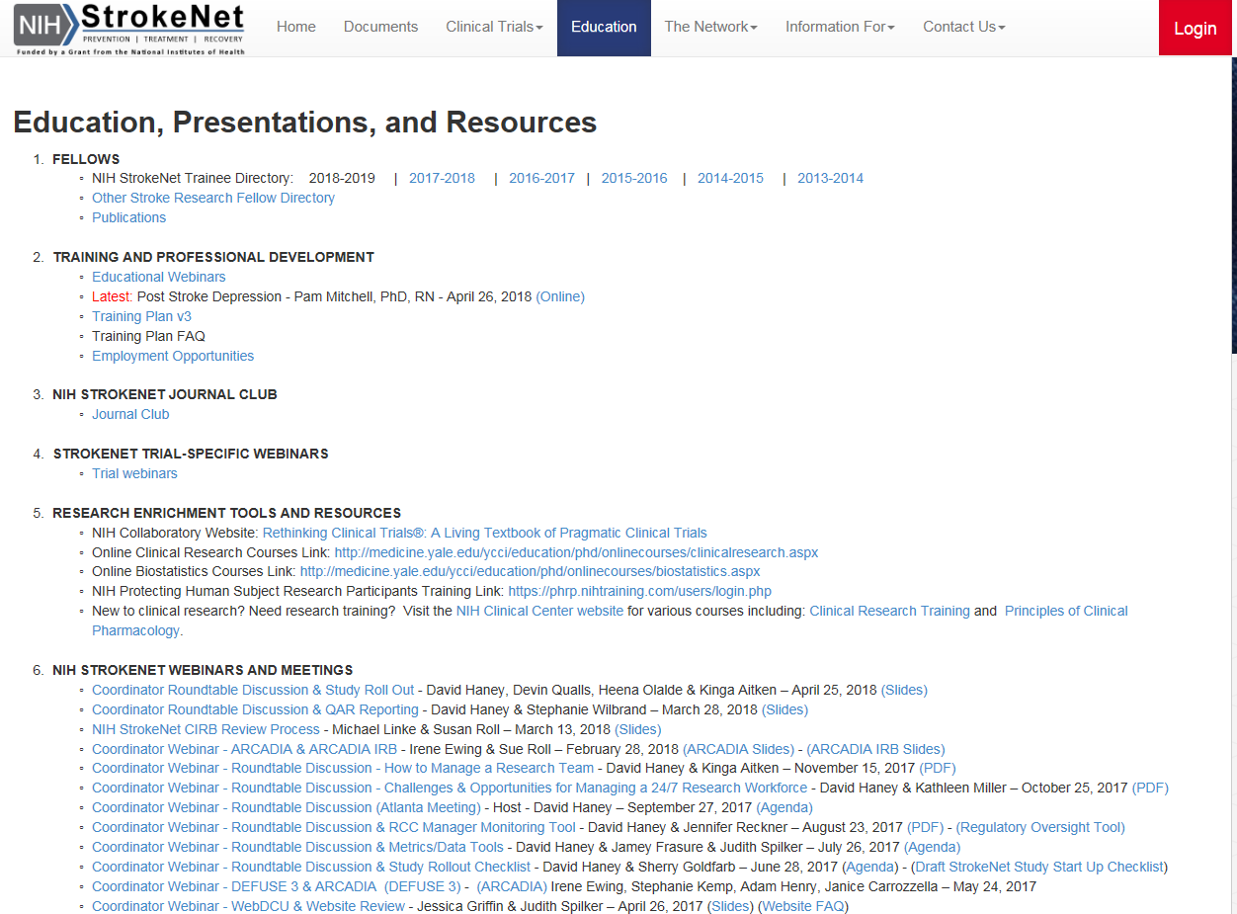

Slide 50
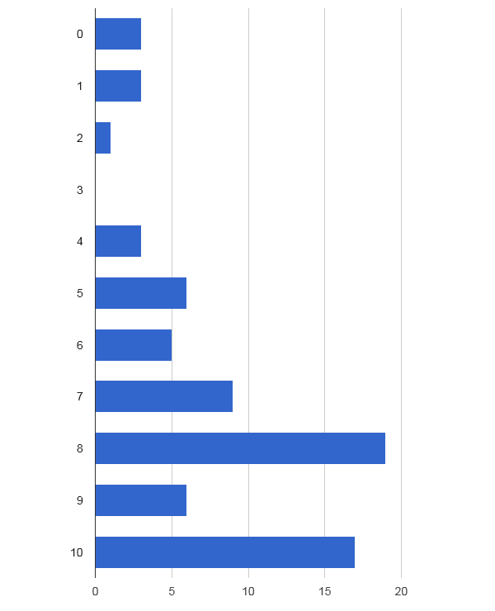
Please rate the level of communication of educational opportunities provided by StrokeNet National and Regional Coordinating Centers on a scale of 0-10
(0=none 10=excellent)

Slide 51
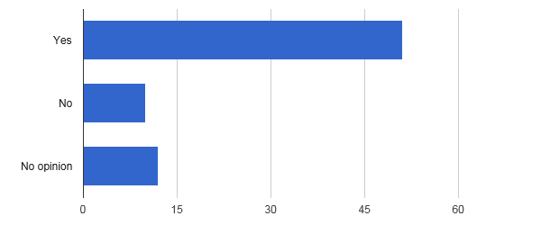
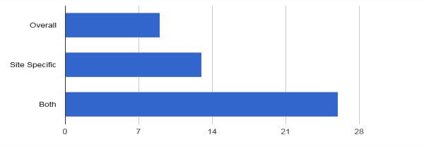
Do you wish to have feedback on the overall and/or specific site selection process for StrokeNet trials?
If Yes, Specify:

Slide 52
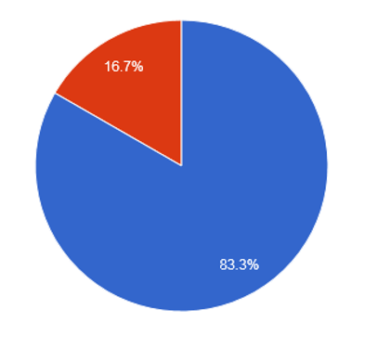
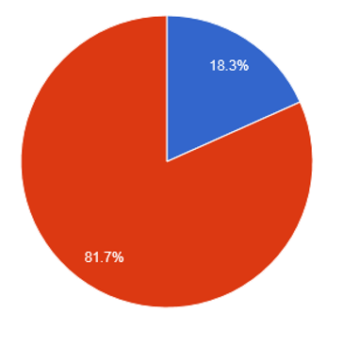
Does your facility utilize Telemedicine?
Does your study site currently use Telemedicine for Clinical Research?
No -12
Yes -13
Yes -60
No -58

Slide 53
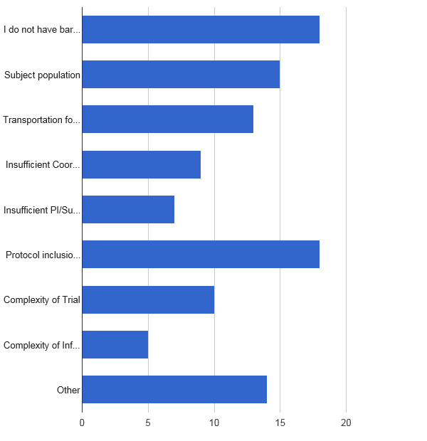
What is your biggest barrier to subject recruitment (check all that apply)?
25.7%
21.4%
18- I do not have barriers at my site
18- Protocol inclusion/exclusion criteria
13- Transportation for Follow-up Visits
15- Subject population
14- Other
10- Complexity of Trial
9- Insufficient Coordinator availability
7- Insufficient PI/Sub-I availability
5- Complexity of Informed Consent
18.6%
12.9%
10.0%
21.4%
14.3%
7.1%
20.0%

Slide 54
What is your biggest barrier to subject recruitment?
Other:
We do not have 24/7 research coverage at our site
Remote consent would substantially increase enrollment at our site
Timing- When working with stroke patients they are usually baffled at what happened to them. It's a horrible time to attempt to get them to participate in a research study.
Follow up commitment of potential participants

Slide 55
What is your biggest barrier to subject recruitment?
Other:
Insufficient per patient compensation for site
No current trials open
Long start up process for contracts
Presently there are no StrokeNet studies open at our site to assess a potential barrier for recruitment.
Appropriate trials that meet our patient population.
Site has not been approved to start study as yet

Slide 56
Additional Feedback from Satellite Sites/CPS:
Streamlined Communication:
    “Communication from the NCC can get very confusing with multiple people sending out various things: contracts, agreements, protocols, instructions, etc. An effort to have it more coordinated and more timely would be appreciated.”
More facetime with RCC Managers
    “I would like to see the RCC manager at every investigator meeting for a trial they are expected to oversee. If travel is not feasible, then please allow us to attend via webinar
Budget and Finance Constraints
    “One of the main difficulties we face at the time of initiating a StrokeNet study is the restricted funds provided for start-up. Our site has unavoidable up-front costs ;the institution many times should absorb that since the start-up funds provided by the studies are not sufficient to cover the costs”
    “Provide sites with a yearly budget to help with the salary support to hire staff just for research”
    Fixed-cost subaward agreements are very complicated ..would be very happy to see us use a different type of agreement to fund StrokeNet trials.”

Slide 57
Additional Feedback from Satellite Sites/CPS Cont’d:
Inclusion of more trial design types
    “offering trials that would meet our patient population, those that would be of interest to our physicians; neuro-hospitalists, neurologists, neurosurgeons.”
More feedback on site selection
    “Feedback and transparency is important. It would be very helpful to get an idea of where studies stand, particularly when we complete feasibility questionnaires”
    “Not knowing why your site is not selected when you have the target population would be helpful so continued effort isn't given if your site will never be selected over a large institution”

Slide 58
Overall Take Away:
  StrokeNET RCCs are operating in a common way, with similar styles and frequency of satellite communication
  Many RCC managers are interested in expanding ways to assist trial activities at satellite sites
  Most satellite sites are happy with the level and frequency of RCC Manager Contact
  Most satellite sites are familiar with the CIRB process and network SOPs
  Most satellite sites are familiar with the education offerings within StrokeNET and individual RCCs
  Areas of consideration: Improving feedback on site selection, Improving/streamlining processes for site start up
  KEEP UP THE GREAT WORK!!
  THANK YOU FOR YOUR PARTICIPATION!!

Slide 59
General Information and Reminders
Question for next months call:
Presenters for upcoming Meetings/Coordinators Calls.
RCC manager who would like to share insights.
No Montreal Managers Breakout Session.
Per Joanna Vivalda, RCCs will need to submit a Final-RPPR no later than 120 calendar days from the period of performance end date (7/31/2018). Earlier in the window is preferred for centers that will receive an award as an RCC for the 2nd cycle of NIH StrokeNet.

