Slide 1

Coordinator Webinar and Round Table Discussion
April 25th, 2018

Slide 2
Coordinator Call
Announcements and Reminders
Next Coordinator Webinar :
Next Coordinator Call May 30th, 2018.
Preethy Feit and Cheryl Grant to host survey results
Today’s Roundtable Hosts: Kinga Aitken, Heena Olalde and Devin Qualls.
To join Coordinator Webinars: https://nihstrokenet.adobeconnect.com/coordinator/ Please enter as a guest, then add your first and last name or email address. For Audio: Dial-In Number: (877) 621-0220 Passcode 434578.
Upcoming StrokeNet Meetings:
Plan Ahead: Montreal World Stroke Conference, October 16th, 2018.
NCC will reimburse for one night stay at $250.

Slide 3
Project Updates
TELE-REHAB
Closed to Enrollment:
Study Updates:
Study Project Managers: Lucy Dodakian, MA, OTR/L
Judith Spilker, RN, BSN
Study Investigator: Steve Cramer, MD
Data Manager: Kavita Patel

Slide 4
Project Updates i-DEF
Closed to Enrollment:
Study Updates:
Study Project Manager: Jessica Griffin
Study Investigator: Magdy Selim, MD

Slide 5
Project Updates
DEFUSE 3
Closed to Enrollment:
Study Updates:
Study Project Manager: Stephanie Kemp, BS
Janice Carrozzella, MSN, CNP, RT(R), CCRA
Study Investigator: Greg Albers, MD
Data Manager: Jessica Griffin

Slide 6
Project Updates
CREST 2
Study Updates:
Study Project Manager: Mary Longbottom, CCRP, CREST Director for Data Quality
Study Investigator: Tom Brott, MD

Slide 7
Project Updates
ARCADIA
Study Updates:
Study Project Manager: Irene Ewing, RN, BSN
Study Investigator: Hooman Kamel, MD;
Mitch Elkind, MD
Data Manager: Faria Khattak and Holly Pierce

Slide 8
ARCADIA Update
95 completed trial agreements
78 CIRB submissions
55 CIRB approvals
39 readiness calls completed
34 sites released to enroll

Slide 9
ARCADIA Current Enrollment
34 patients consented
13 eligible for randomization
10 randomized

Slide 10
Enrolling sites
Site | Consented | Randomized
University of Cincinnati Medical Center | 5 | 2
Memorial Hermann Texas Medical Center | 4 | 2
UPMC Presbyterian Hospital | 3 | 1
UF Health Shands Hospital | 2 | 1
OSU Wexner Medical Center | 2 | 1
Harborview Medical Center | 2 | 0
University of Iowa Hospitals & Clinics | 2 | 0
NYP Columbia University Medical Center | 2 | 0
Northwestern Memorial Hospital | 2 | 0

Slide 11
Enrolling sites
Site | Consented | Randomized
Hospital of the University of Pennsylvania | 1 | 1
University of Minnesota Medical Center | 1 | 1
NYP Weill Cornell Medical Center | 1 | 0
Christiana Hospital | 1 | 0
Hennepin County Medical Center | 1 | 0
Brigham and Women's Hospital | 2 | 0
Mercy St. Vincent Medical Center | 1 | 0
Intercoastal Medical Group | 1 | 1
Spectrum Health Hospitals Butterworth | 1 | 0

Slide 12
ARCADIA consent modification
Minor are changes required to both the main and pregnant partner consent for ARCADIA
  Main consent
    2 follow-up phone calls were missing and typographical errors were corrected
  Pregnant Partner consent
    Certificate of Confidentiality language added
    Minor revision to the confidentiality section for consistency with the language in the main consent
    Minor changes to keep terminology consistent throughout the document

Slide 13
Process for Change to the informed consent
The CIRB will administratively make the changes to the documents for the sites whose initial review is currently in process, so when they are approved they will have the changes incorporated in their approved documents.
For sites that have not yet submitted full packets to the CIRB (and for replacement sites), we will provide the new template and work with them to get the changes incorporated in their initial approval.
For the sites already approved we will administratively make the changes and submit the amendments for them and provide them new approved documents as quickly as possible over the coming weeks.

Slide 14
Steps for start-up
CIRB submission and approval
Local IRB acknowledgement
Confirmation of pharmacy documentation/ licenses/shipping address
Shipment of study drug and lab kits (shipping address)
Scheduling of readiness call
Confirmation of all documentation posted in webDCU
Released to enroll

Slide 15
Project Updates
Sleep Smart / MOST
Most:
Project Manager: Teresa Murrell-Bohn
Iris Deeds
Sleep Smart:
Project Manager: Kayla Gosselin

Slide 16
Project Updates
Recognized NIH Trials
That remain open to enrollments:
Study Updates:
SHINE
Project Manager: Heather Haughey

Slide 17
NCC/NINDS Updates
(Forum for CC to communicate to coordinators information on reminders, common questions/issues, changes, suggestions, best practices, upcoming meetings, and for coordinators to ask questions):
NCC Staff Members:
Joe Broderick, PI
Jamey Frasure, Co-Director Judith Spilker, Co-Director
Sue Roll, CIRB Liaison Keeley Hendrix, CIRB
Diane Sparks, Contracts Jeanne Sester, Training Coordinator
Mary Ann Harty, Finances Rose Beckmann, Administration
Joanna Vivalda, NINDS Scott Janis, NINDS

Slide 18
Data Management Center Updates
(Forum for MUSC to communicate to coordinators information on reminders, common mistakes, changes, suggestions, best practices and for coordinators to ask questions):
WebDCU/MUSC Team:
Yuko Palesch, PI Wenle Zhao, PI
Catherine Dillon, Operations Mgr. Jessica Griffin, Project Mgr.

Slide 19
CIRB Updates
CIRB Team Members:
Sue Roll, CIRB Liaison
Keeley Hendrix CIRB Coordinator
Jo Ann Behrle CIRB HPA

Slide 20
Roundtable Discussion
Today’s Roundtable Discussion:
Discussion: ARCADIA Study Roll Out
(PM and Satellite Experiences)
Today’s Host:
Devin Qualls – Massachusetts General Hospital
Heena Olalde – University of Iowa
Kinga Aitken - University of Utah

Slide 21


University of Utah RCC22
CCR
Kinga Aitken, MPH CCRP

Slide 22
Success story
Background:
1 satellite with 3 CPS sites under the same corporation
different level of experience and comfort re. clinical trials
ARCDIA- first StrokeNet trial at the CPS
  Meeting with local IRB to understand institutional requirements
  Hands on help from RCC Manager
      Met with local PI to explain regulatory process involving cIRB
      Had conference call with the coordinator explaining regulatory process, webDCU and required documents
      Helped with the regulatory submission
      Set up a site visit with institutional compliance officer
        Educational activity on regulatory requirements as well as institutional compliance

Slide 23
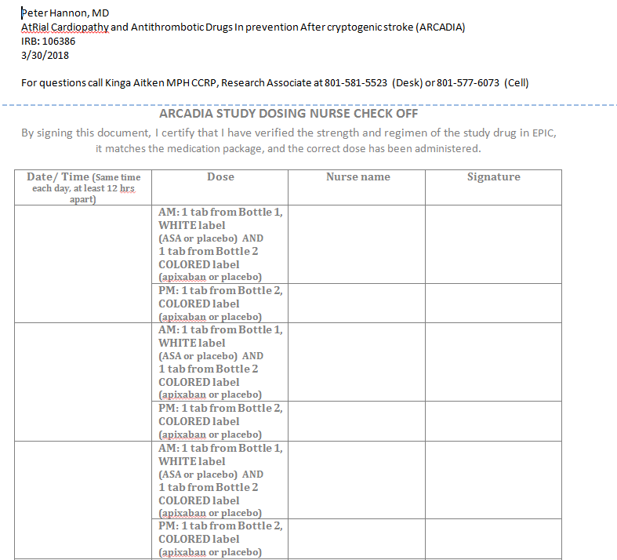
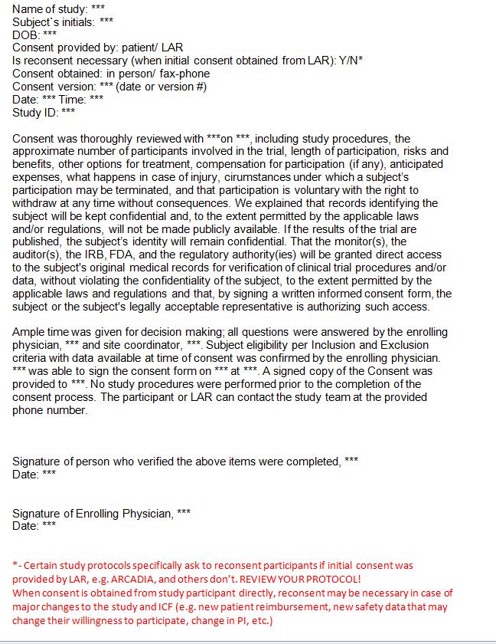
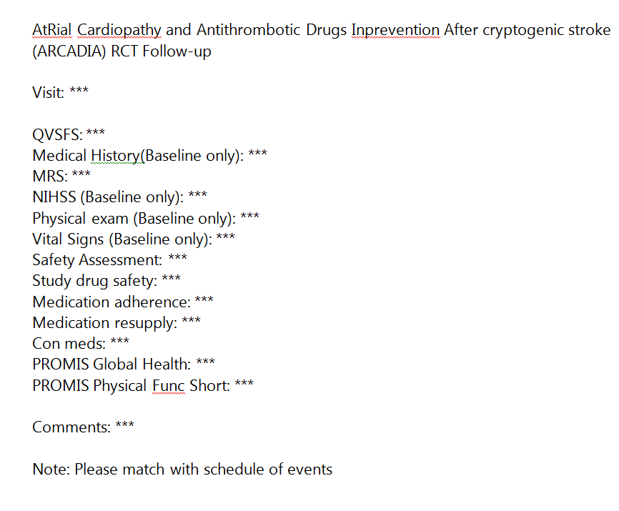
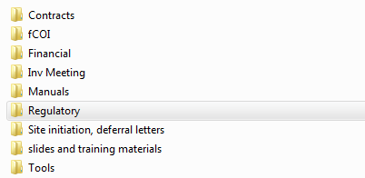
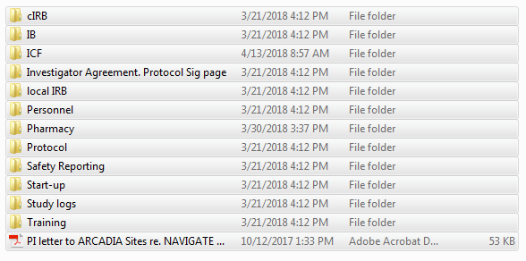
Education and helpful tools
Regulatory binder to help with organization
Consenting and statement of consent process
Visit templates
Nursing checklist

Slide 24
Education and helpful tools
DOA
Scheduling/ billing and invoicing
Documentation
Screening
Notes on AE/SAE and deviation reporting

Slide 25

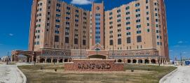
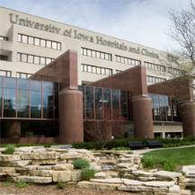
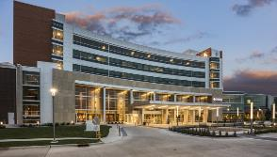
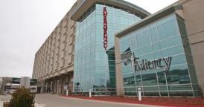


University of Iowa RCC (UIRCC)
Heena Olalde, RN, MSN

Slide 26

UIRCC ARCADIA Sites
6 sites originally selected to be in ARCADIA
  University of Iowa Hospitals and Clinics, Iowa City, IA
  Genesis Medical Center, Davenport, IA
  Mercy Medical Center, Des Monies, IA
  Unity Point Health - Iowa Methodist Medical Center, Des Moines, IA
  University of Nebraska Medical Center, Omaha, NE
  Sanford Medical Center, Fargo, ND
1 site (UPH – IMMC) declined participation once contracts were sent to site.

Slide 27
UIRCC ARCADIA Sites
3 site activated for enrollment
  University of Iowa Hospitals and Clinics, Iowa City, IA
  University of Nebraska Medical Center, Omaha, NE
  Genesis Medical Center, Davenport, IA
2 sites (Cohort 3) working on IRB review and approval
  Sanford Medical Center, Fargo, ND
  Mercy Medical Center, Des Monies, IA

Slide 28
Guidance to sites for start-up
All UIRCC satellite sites selected for ARCADIA are new to WebDCU and StrokeNet
Provide step by step guide of what to do
Touch base weekly on progress at site
Discussions with local staff (e.g. pharmacy, IRB) to provide education on process with study

Slide 29
Troubleshoot issues with sites
Examples of issues
  Budget not acceptable for satellite hospital
  Regulations regarding state board of pharmacy

Slide 30

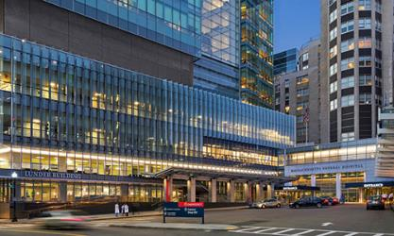
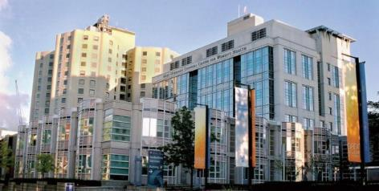

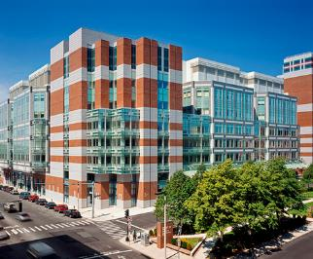
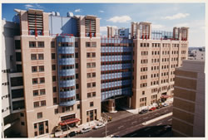
MGH Page
Devin Qualls, MS, MPH
Devin Qualls, MS, MPH

Slide 31
NERCC Start-Up
5 Sites Selected in RCC
  1 in cohort 1
  1 in cohort 2 (home site)
  1 in cohort 3
  2 in cohort 4
All sites but one had been involved previously with StrokeNet Trials (iDEF, CREST-2, DEFUSE 3)
Not all sites had used StrokeNet cIRB
  iDEF & CREST-2 activated through local IRBs
Notes:
Spread of the cohorts caused communication between sites to be difficult, emails had to be tailored to the step each site was in.
Two sites utilized the same local IRB, had previously submitted in tandem, but could not since they were not in the same cohort

Slide 32
Early Issues
Communication
  Sites were at differently levels of start-up, so ‘blast’ communications were not effective
  Cross talk between sites added to confusion
New Staff/Staff Turn-over
  New CRCS & PIs
  New admins in local IRBs & Contracts Offices
Notes:
Communication – problem with having sites in close proximity with PIs who are all professionally connected.
Even though the sites had all been involved with StrokeNet trials, new PIs were not familiar with process. CRCs did not have access to their predecesors documents.
New personnel in local IRBs added to confusion, multiple sites had new contracts officers or staff turn-over after contracts were submitted.

Slide 33
Early Issues
Local IRBs
  Some IRBs required almost a full review locally before approving documents
  Some IRBs want no involvement at all, including guidance on local policies or standards.
  Some IRBs were not aware of reliance agreements already in place
Staff Training
  New staff did not have local access to IATA trainings
  No local protocols on what roles could be delegated to CRCs
  No experience drafting HIPAA waivers, and ICF templates

Slide 34
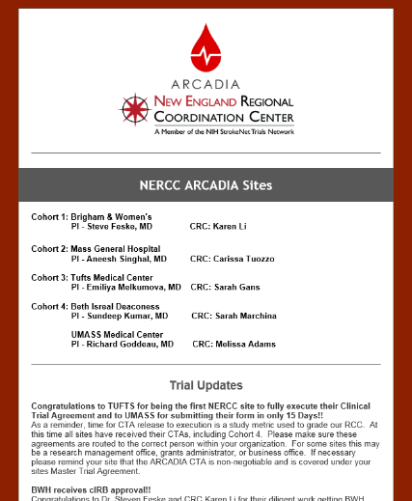
Solutions
Communication
  Quarterly ARCADIA newsletter
  Quarterly ARCADIA break-outs during RCC CRC calls
  Weekly status updates between RCC & Sites
    Get your PIs involved!!
  “How to” calls with site CRCs
    How to identify potential patients
    How to ship blood
    How to approach patient’s families
Notes:
Staff turn-over, there isn’t much we could do about it. Use your PIs to get involved when you have an outside department being non-responsive. Have at least one person in your study team who can reach out to department chairs as needed.

Slide 35
Solutions
Contracts
  Remind local contact this a non-negotiable contract
  Ask for timeline from reviewer
    Have PI maintain frequent contact with assigned reviewer as timeline approaches and if contract is not signed after deadline
Local IRBs
  Speak to your local IRB as soon as your site is selected
    Remind them your site has a reliance agreement in place
    Start drafting local documents and collecting study staff signatures
    Outline what ancillary reviews will be required
  Complete all local documentation requested
  Provide ‘marked’ and ‘clean’ versions of all documents
  If local IRB fully cedes review, created NTF
Notes:
Since a cede review may not be assigned a review date like a full board review, make sure to keep in communication with them. Make sure they create protocol in electronic systems for billing – MCA review

Slide 36



Solutions
Staff Training
  Make sure all site staff is aware of the WebDCU campus for NIHSS, mRS, and protocol specific trainings.
  Provide each site with sample materials for CIRB submission
    Template language for HIPAA waiver, review ICFs for site coordinators prior to submission
  Create enrollment documents
    Enrollment Checklists
    Informed Consent Checklists
    Excel files to pre-calculate study visit dates
  Conduct on-site visits for new sites and do enrollment walk through
    Review regulatory binder with CRC and make sure study supplies are easily accessible and stored appropriately.
    Meet with PI to confirm they are on the same page with their CRC
Notes:
Review items with CRCs based on site protocols, can the CRC draw blood, can the CRC consent patients, is the CRC trained to centrifuge samples, what timeline will the site preferentially enroll in (during in-patient stay, at first outpatient visit, ad hoc by calling potential subjects?).
Meeting with the study PI is especially important if the study PI is not your Satellite site PI.

Slide 37
Thank you!
Questions

Slide 38
General Information and Reminders
PM and Site Survey’s (results needed for next months call).
Presenters for upcoming Meetings/Coordinators Calls.
RCC manager who would like to share insights.
No Montreal Managers Breakout Session.
Per Joanna Vivalda, RCCs will need to submit a Final-RPPR no later than 120 calendar days from the period of performance end date (7/31/2018). Earlier in the window is preferred for centers that will receive an award as an RCC for the 2nd cycle of NIH StrokeNet.

