Slide 1

ARCADIA Coordinator Webinar
Irene Ewing, RN BSN
ARCADIA Project Manager
Feb 28, 2018

Slide 2
AtRial Cardiopathy and Antithrombotic Drugs In prevention After cryptogenic stroke (ARCADIA)
First Site released to enroll 2/1/2018
Three Subjects have been enrolled to date
None randomized- have not met atrial cardiopathy criteria

Slide 3
Trial Status Update
Currently have 117 Sites
Signed Protocol Trial Agreement-62 sites with fully executed PTA
CIRB submission/Approval- 47 submitted/26 approved
Readiness calls- 12 completed

Slide 4
ARCADIA Webinar overview
Project Document Requirements
Pharmacy
Site Readiness
Screening /Eligibility
Enrollment/Randomization
Follow-up
*CIRB- Sue Roll, RN BSN

Slide 5
Project document requirements
Delegation of Authority Log
List all team members
One 1 PI and 1 primary Coordinator must be identified
Pharmacist
Identify responsibilities- all must be assigned
StrokeNet COI required for all investigators and coordinators
If you edit this after your CIRB this constitutes an administrative amendment

Slide 6
Site Documents
FWA- https://ohrp.cit.nih.gov/search/search.
Protocol Signature Page- version 3
CIRB approval-upload after CIRB approval
Informed Consents-upload after CIRB approval
Administrative Amendments-upload if/when there are changes
Recruitment Material-NA at this time

Slide 7
People Documents
CV- signed/dated, expires every 5 years
Medical Licenses –can waive if not applicable
mRS- expires every 2 years unless indicated otherwise
NIHSS-expires every 2 years unless certificate indicates otherwise
Specimen Shipping certificate- expires every 2 years
StrokeNet COI- expires annually
Protocol and Study Coordinator training

Slide 8
https://webdcu.musc.edu/campus/
Protocol training & attestation form
Study coordinator training & attestation form
Pharmacy training video
Data training video
NIHSS and mRS training links

Slide 9
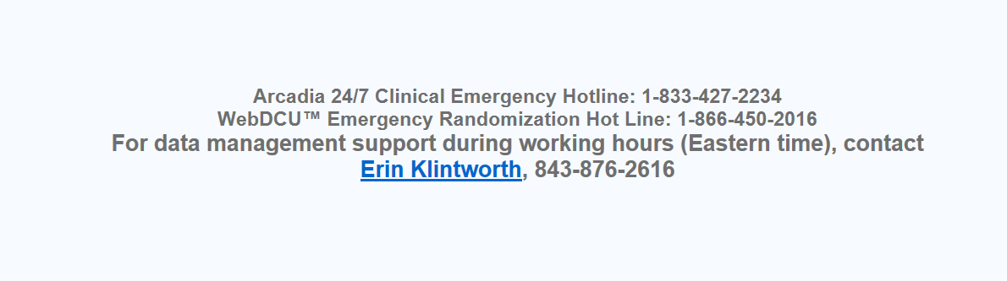
Contacts

Slide 10
Pharmacy set up
Trial designed that each site would use their institutional pharmacy or Investigational pharmacy.
Study Drug is being shipped from BMS and packaged at the central pharmacy here at the NCC.
The central pharmacy must follow the Ohio Board of Pharmacy laws as well as the state laws where they are shipping study drug.
WebDCU document requirements:
Pharmacy License uploaded under site documents
Pharmacist should be listed on your DOA and their license uploaded to webdcu under the people documents

Slide 11
Pharmacy Exceptions
Some ARCADIA sites do not have access to a hospital or IDS pharmacy
Important to note that the central pharmacy is not automatically able to ship study drug to a clinic or office even if you have done this for other studies.
**These situations will be evaluated on a individual basis.
Before the central pharmacy can ship study drug to a non-pharmacy:
1. You need to determine what the Board of Pharmacy in your state allows.
2. Is the Site PI/MD permitted by the Medical Board in your state to dispense study medication.
* In this situation the MD medical license will take the place of the pharmacy license requirement.

Slide 12
Site Readiness
Study Drug will be shipped and Readiness Calls will be scheduled :
PTA signed
CIRB approval
Pharmacy license in place
State pharmacy license confirmed
Shipping address is confirmed
The site PI, Site primary coordinator need to be on this call. Other members of the site team are invited and encouraged.
The checklist is sent in advance so sites can review and discuss with their team members.

Slide 13
Site Readiness
Following the Readiness call your site will be “released to enroll”
Confirm study drug and lab supplies are at your site
All local IRB / institutional approvals have been received
All required regulatory documentation is uploaded
All user permissions have been set up and approved

Slide 14
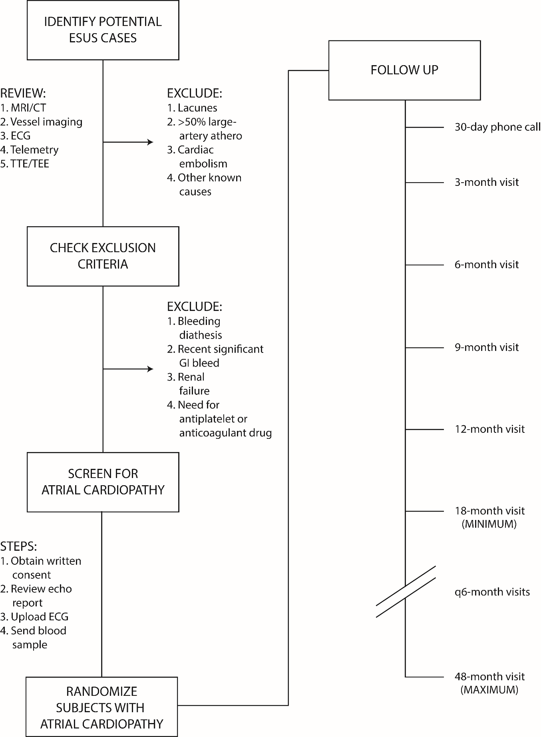
Screening

Slide 15
Screening Procedures to Identify
Atrial Cardiopathy
Standard-of-care ECG tracing scanned, de-identified and uploaded to WebDCU- it will be evaluated by the core lab for PTFV₁ measurement
Blood sample shipped to core lab for NT-proBNP assay
Standard-of-care echocardiogram for left atrial size measurement, interpreted locally, enter Atrial Diameter in webdcu. If a patient is eligible based on this criteria, you will be notified by webDCU™ and can proceed with randomization.
Otherwise you will wait on the NT-ProBNP and ECG results which will be available in webDCU™ within 24-48 hours.

Slide 16
The Echo and the 12-lead ECG must have been done after the index stroke. These are standard of care and should not be done for the purpose of the study.
It is permissable to use the Echo and ECG done at an outside facility if you can obtain a copy.
Always de-identify before uploading or sending the DVD

Slide 17
Eligibility Questions
The ARCADIA hotline 1-833-427-2234 is available to help with reviewing screening data and determining eligibility as well as for emergency unblinding.

Slide 18
Screening
Patients can be enrolled 3-120 days after stroke
Screening and randomization can both occur during initial hospitalization in certain cases, but in most situations these visits will be on separate days.
Once the patient is consented they are enrolled and will receive a study ID.
Baseline Visit information should be entered into WebDCU™

Slide 19
Randomization
Once you are notified that an enrolled subject meets one of the eligibility criteria you should schedule the randomization visit.
This should be done as soon as possible after the BL visit. It can be the same day if the subject qualifies based on the echo.
If done at a later time, you should verify the patient still qualifies based on I/E criteria. You do not need to repeat any of the exams except a new set of vitals signs should be collected.
The study drug should be started within 24 hours of randomization.
*If the subject does not qualify you need to enter end of study visit CRFs.

Slide 20
Subject Follow-up
Schedule of Events listed in the Protocol and the MOP
Follow-up visit 1 (30 +/- 7 days) phone call
Follow-up vists are every 3 months for the first year.
After 12 months in person visits are every 6 months, but medication refills are still every 3 months.
Discuss with your team what your plan is for study medication refills after 12 months. The protocol allows mailing of study drug and home visits if permitted in your state and institution. Bringing the patient back in every 3 months is ideal.

Slide 21
Data Entry
CRFS should be entered within 5 days of the visit
If an SAE or outcome event is reported to you please enter this information within 24 hours of becoming aware of it
We realize you may have very limited information up front but report what you can.
There are event packets posted to guide you on what documents you will need to collect.

Slide 22
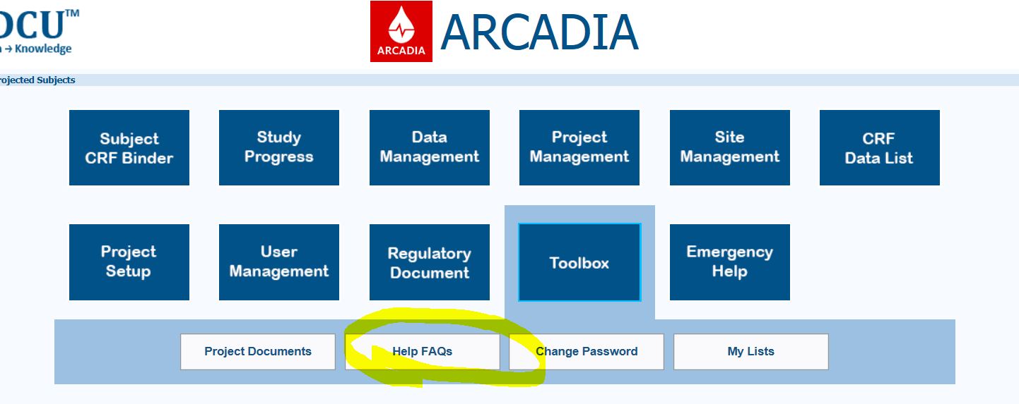
Questions?
FAQ list is posted in WebDCU toolbox/project documents.
There is also a link on the ARCADIA Page for FAQ help.

