Slide 1
StrokeNet Central IRB Update
Transition to a New Reliance Agreement

Slide 2
StrokeNet Studies Reviewed by CIRB

Slide 3
StrokeNet Reliance Agreement
UC IRB serves as StrokeNet Central IRB
Specific to StrokeNet studies
Approximately 340 executed agreements
First agreements executed in the spring of 2014

Slide 4
Process Changes Since 2014
Review of local ancillary reviews
Continuing review
COI review and management
Approval of local study staff
Approval of Central Electronic Informed Consent Process
https://www.nihstrokenet.org/docs/default-source/default-document-library/adm-24-central-electronic-informed-consent-process-7-23-2020.pdf?sfvrsn=0

Slide 5
Why transition to a new reliance agreement?
Some of the agreements have an expiration date 7/31/2023
We have learned a lot about the single IRB process since 2014
Availability of the SMART IRB Agreement
Notes:
Chance to reinforce that local IRBs should not be doing reviews

Slide 6
SMART IRB agreement
Created in response to the NIH’s mandate for sIRB review of multicenter research
May be used for any study.
Once it is signed, institutions can use it to serve as the sIRB for other parties to the agreement or to rely on an sIRB who is also party to the agreement.
There is no need to renegotiate any terms when starting a new study
Can be accepted by most research institutions

Slide 7
What Is SMART IRB?
SMART IRB is…
An IRB
An electronic system for Reviewing IRBs to receive studies for review
SMART IRB is NOT…
A federally funded project to support institutions and researchers in the implementation of single IRB
SMART IRB provides…
A master IRB reliance agreement
An Online Reliance System to initiate and track reliance
Other resources free to institutions and researchers

Slide 8
Polling Question
Has your institution joined SMART IRB?
  Yes
  No
  Don’t know

Slide 9
Networks Transitioning to SMART
NeuroNext
Collaborative Pediatric Critical Care Research Network (CPCCRN)
Notes:
Guidance needed soon
2-pager
Mike will draft and send out to Education Team/Ambassadors and then send out to networks folks (CCPRN, NeuroNext, StrokeNet)

Slide 10
https://onlinelibrary.wiley.com/doi/pdf/10.1002/eahr.500149

Slide 11
SMART IRB Resources

Slide 12
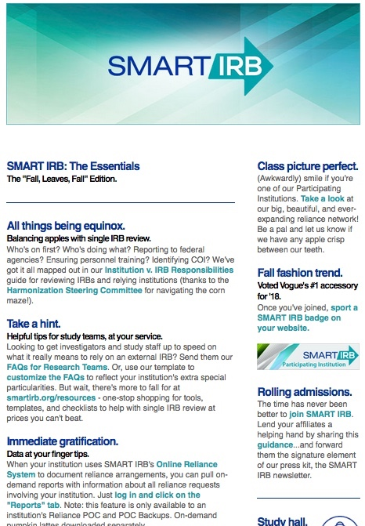
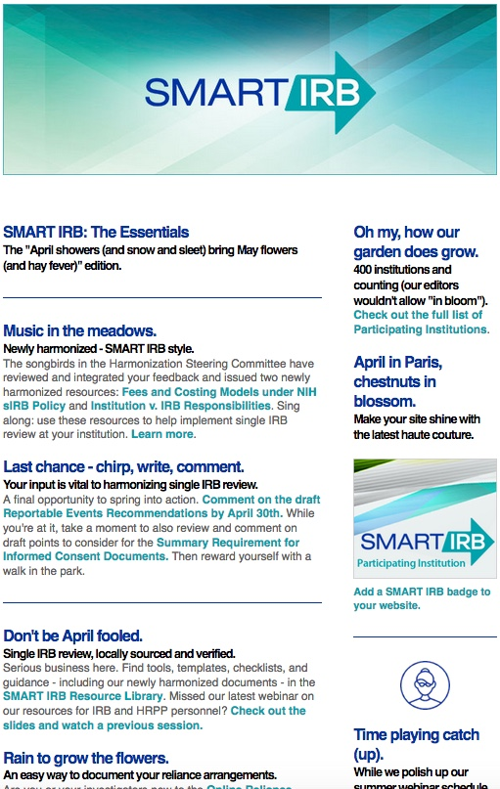
Building Community
A monthly email newsletter
Announcements, news
Resources, education
4600+ subscribers
The latest is always @SMARTIRB.

Slide 13
SMART Talks - Monthly virtual forums
Best practices
Emerging issues
Ask the experts

Slide 14
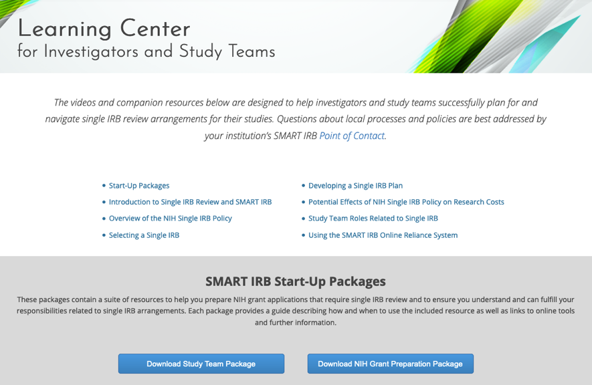
Key SMART IRB Resource: Learning Center
Learning Center pages for:
Investigators
IRB/HRPP Administrators
On-demand short videos and key resources aid in planning and implementation of single IRB arrangements.
smartirb.org/study-teams

Slide 15
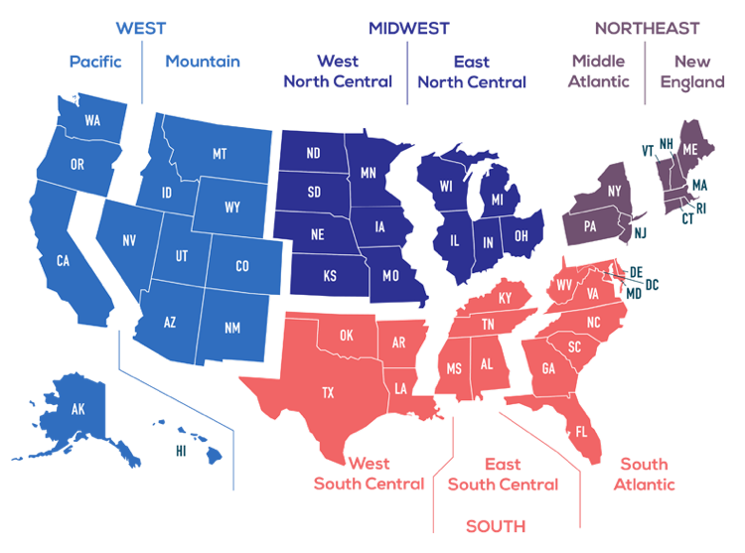
Ambassadors
SMART IRB Ambassadors can help you with getting the institution signed on.
Ambassadors are HRPP professionals knowledgeable in the processes and practicalities of IRB reliance who are available to assist institutions in joining and implementing the SMART IRB Agreement.

Slide 16

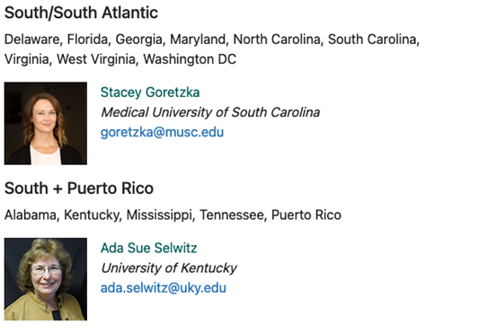

Ambassadors
Contact your ambassador smartirb.org/ambassadors

Slide 18
Finalized Harmonization Guidance
In progress:
Local considerations recommendations

Slide 20
CIRB vs. INSTITUTION RESPONSIBILITIES
RESPONSIBILITIES | StrokeNet CIRB | RELYING INSTITUTION | COMMENTS | Related Harmonization Guidance
Federalwide Assurance (FWA) |  | x | Each institution must ensure it maintains a current FWA | https://smartirb.org/assets/files/Institution-vs-IRB-responsibilities.pdf
IRB findings and determinations | x |  | The StrokeNet CIRB ensures study is compliant with federal IRB requirements The relying institution’s IRB must abstain from conducting redundant regulatory reviews and providing determinations. | https://smartirb.org/assets/files/Institution-vs-IRB-responsibilities.pdf
HIPAA determinations | x |  | HIPAA waivers and alterations of authorizations HIPAA authorization | https://smartirb.org/assets/files/Institution-vs-IRB-responsibilities.pdf
HIPAA implementation |  | x | Refers to the process of managing waivers of authorization including tracking (e.g., of disclosures) and recordkeeping. | https://smartirb.org/assets/files/Institution-vs-IRB-responsibilities.pdf
Identifying and providing local considerations |  | x | The relying institution must communicate state or local laws, regulations, institutional policies, and/or standards to the StrokeNet CIRB. | https://smartirb.org/assets/files/Institutional-Profile-20180726.pdf
Review of local considerations | x |  | The CIRB must incorporate the information into their review | new guidance under development
Reporting to federal agencies and sponsors | x |  | CIRB submits mandatory reports to federal agencies as required for determinations | https://smartirb.org/assets/files/Reportable_Events.pdf
Identification, analysis, and management of COI |  | x |  | https://smartirb.org/assets/files/HSC-COI-FINAL-ua.pdf
Review of COI and IRB determination |  |  | May require additional measures to manage conflict | https://smartirb.org/assets/files/HSC-COI-FINAL-ua.pdf
Review of study personnel |  | x |  | https://smartirb.org/assets/files/Review_of_Study_Personnel.pdf
Approval of PIs | x
Ancillary Reviews |  |  | The relying institution must communicate findings that impact the risk-benefit analysis of the ceded research | Recommendations for the Harmonization of Ancillary Reviews
 |  |  |  | https://smartirb.org/harmonization/

Slide 21
SMART IRB Participating Institutions
1048 Participating Institutions
  https://smartirb.org/participating-institutions/
Join SMART IRB
  https://smartirb.org/join/

Slide 22
BENEFITS OF SMART IRB AGREEMENT
Use of the SMART IRB agreement allows a consistent reliance process
Many StrokeNet site have already joined SMART IRB
Eliminates the need to negotiate individual reliance agreements for each site

Slide 23
StrokeNet Transition Process

Slide 24
StrokeNet Process
Some current executed reliance agreements expire on July 31, 2023
New reliance arrangements will be established without an expiration date and will remain in effect until the specified studies/sites are closed with the CIRB
Current SMART IRB participating institutions will receive a SMART IRB Acknowledgment Letter to document reliance arrangement
The components of the agreement will remain consistent during renewal

Slide 25
Non-SMART IRB institutions are encouraged to sign onto the SMART IRB agreement
Review the current SMART IRB agreement
Join SMART IRB
Find your ambassador for assistance

Slide 26
Documenting the Reliance Arrangement for SMART IRB Participating Sites
Sites will receive a signed SMART IRB Acknowledgment Letter to document the reliance arrangement
The flexible components of the SMART IRB Agreement are addressed in the letter
  NIH StrokeNet and UC CIRB SOPs will be used
  The UC CIRB will make HIPAA determinations
  Participating sites will incorporate HIPAA language or provide stand-alone
  Participating sites will perform COI reviews and provide management plans
  IRB-initiated audits or investigations will be conducted on a case-by-case basis
  The UC CIRB will draft and submit reports to regulatory and funding agencies

Slide 27
Documenting the Reliance Arrangement for Sites That are NOT able to join SMART IRB
Sites will receive a standard UC CIRB Reliance Agreement
The components of the reliance agreement will remain consistent with the current executed agreement
Site HRPPs will select applicable studies, sign and return

Slide 28
Contact Information
Questions regarding the reliance agreements should be directed to IRBReliance@uc.edu
Kareemah Mills, UC HRPP Associate Director, will oversee the reliance renewal process
Susan Roll, StrokeNet CIRB Liaison, will continue to be the main contact for all other StrokeNet related questions or issues
Michael Linke
  Chair, University of Cincinnati Institutional Review Board
  Chair, StrokeNet Central IRB
  SMART IRB Program Director, Education

