Slide 1
Roundtable Discussion
2019 RCC Managers and Site Survey Results
Today’s Host:
Preethy Feit: Program Manager
Stroke National Capital Area Network for Research (SCANR) MedStar Health Research Institute
Cheryl Grant: RCC Manager
Medical University of South Carolina

Slide 2
2019 RCC Manager Survey Results
6.26.19
Note: This survey was created by the Network Managers Planning Committee for NM/SC use for feedback purposes. None of the questions or content was constructed or requested by NINDS, the NCC, or NDMC. Aggregate results will, however, be shared with all.

Slide 3
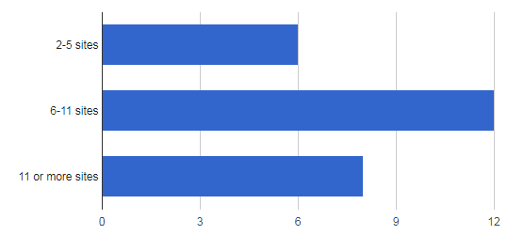
How many total SS/CPS are within your RCC (including your hub)?
6, 23%
12, 42%
8, 31%

Slide 4

Do you have direct communication with your SS/CPS?

Slide 5
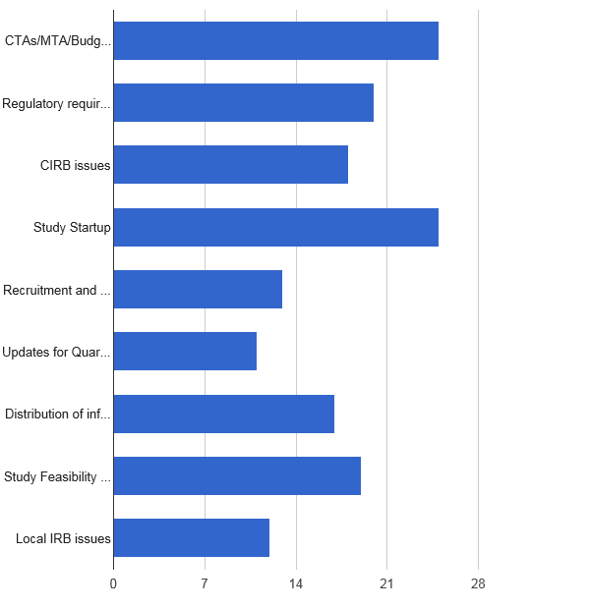

Is your communication mostly regarding…
2019 - 26 responses
25 (96.2%) – Study Startup
25 (96.2%) – CTAs/MTAs/Budget/Contract
20 (76.9%) – Regulatory Requirements
19 (73.1%) – Study Feasibility Surveys
18 (69.2%) – CIRB issues
17 (65.4%) – Distribution of information from RCC/NCC
11 (42.3%) – Updates for Quarterly/Annual Reports
12 (46.2%) – Local IRB Issues
13 (50.0%) – Recruitment and Retention Efforts
TOP 3 From 2018:
Site Feasibility Surveys
Study Startup
Distribution of Information from RCC/NCC

Slide 6

Do you feel your sites respond to requests in a timely fashion?
24 responses
  “Some SS are very responsive, others require many attempts (i.e., emails, calls with Site coordinator and PI before they send requested info)”
  “Split evenly, roughly half do and half does not”
  “Variable, at times some sites are better than other”
  “Mixed-bag – some respond quickly and others need consistent reminders”
  “For sites committed to doing a trial – communication is timely. For sites that have expressed interest in a trial but not committed – communication is not timely.”
13 (54%) | Yes
3 (13%) | Most and/or Usually
8 (34%) | Occasionally

Slide 7
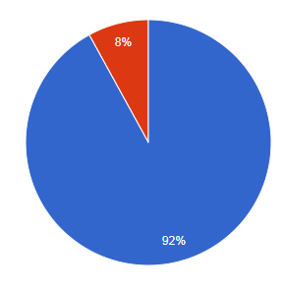
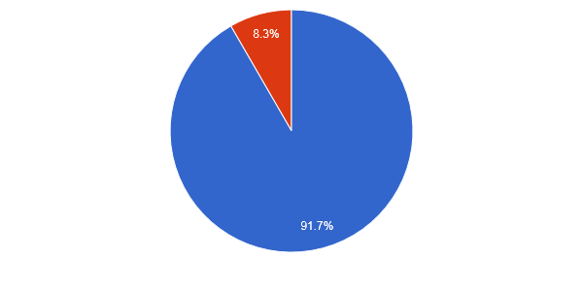
Does your RCC have SOPs?
2019
2018
Great work with RCC SOPs!!

Slide 8
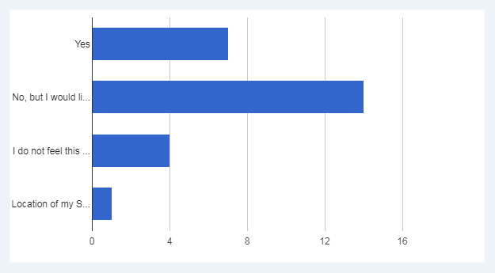
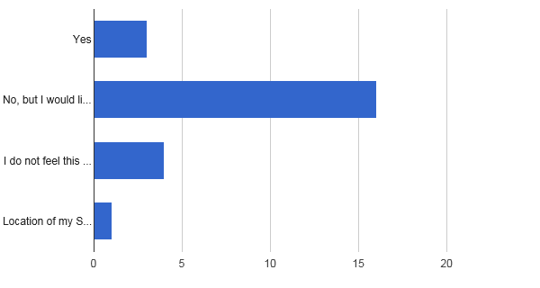
Do you conduct “monitoring” visits at your SS/CPS?
2019 – 26 responses
2018 – 24 responses
(7, 26.9%)
(3, 12.5%)
(14, 53.8%)
(16, 66.7%)
(4, 15.4%)
(4, 16.7%)
(1, 3.8%)
(1, 4.2%)

Slide 9
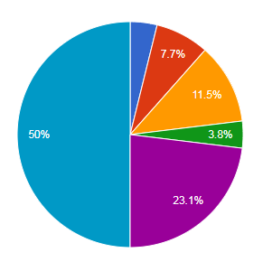
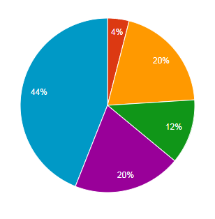
Rate the amount of support/involvement you receive from your RCC PI?
2019 – 26 responses
2018 – 25 responses
0 - None (0.0%) 3 - Above Average (3.8%)
1 - A little (7.7%) 4 – Excellent (23.1%)
2- Average (11.5%) 5- Outstanding (50%)

Slide 10

Over the past year, do you feel the amount of RCC PI support/involvement has:
24 responses
Remained the Same: 20 or 83.3%
Improved: 4 or 16.7%
Decreased: 0

Slide 11
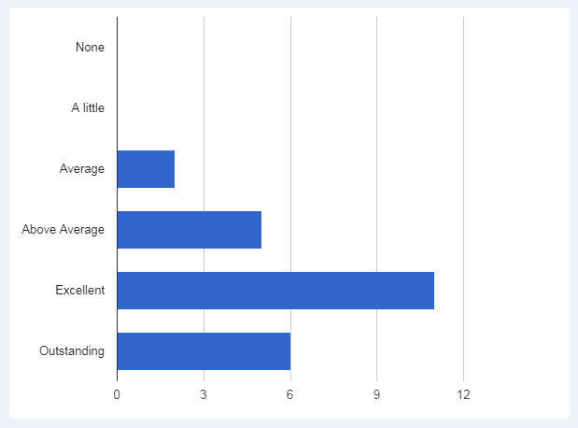
Rate the amount of support/involvement you receive from your study PI/Sub-I’s?
24 responses
None (0, 0.0%)
A little (0, 0.0%)
Average (2, 8.3%)
Above Average (5, 20.8%)
Excellent (11, 45.8%)
Outstanding (6, 25.0%)

Slide 12
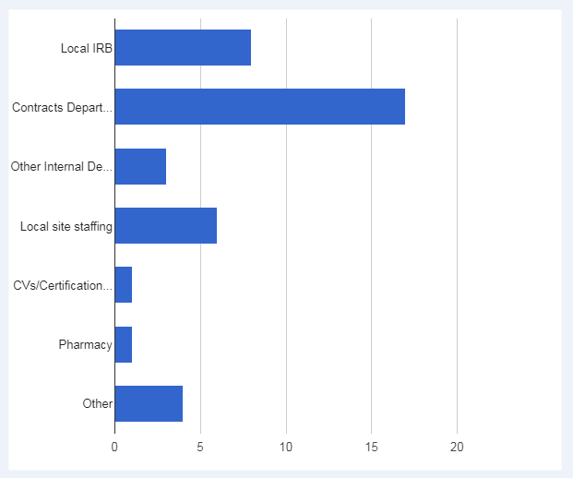
What is the biggest barrier for trial initiation at your site?
25 responses
Local IRB (8, 32.0%)
Contracts Department (17, 68.0%)
Other Internal Department (3, 12.0%)
Local site staffing (6, 24.0%)
CVs/Certifications of Study Staff (1, 4.0%)
Pharmacy (1, 4.0%)
Other (4, 16.0%)
Other Feedback:
“Fiscal and Epic processes”
“Relaying StrokeNet “Language” to all involved”
“Sometimes PI engagement”
“Variable dependent on the study-sometimes related to trial or central trial team”
“Long and bureaucratic process of obtaining authorization to conduct a trial when the CPS is a hospital not part of/owned by SS (academic institution)”
“Catch 22 – need help but taking time to hire additional staff and to train them”
“Time for local IRB to review the Local Site Context Form”

Slide 13
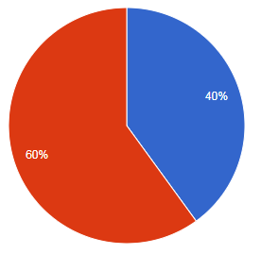
Does your site require an ICF or other regulatory documents prior to signing the CTA?
25 responses
YES
NO
Note: Processes have been amended to reflect this reality for many sites!!

Slide 14
Suggested barriers to overcome execution of CTA?
“We require IRB approval prior to signing contracts. We need all the documentation we can get.”
“Providing the current version (even though it is not finalized) of the protocol, ICF and budget PRIOR to sending CTA and regulatory package. Sites need to determine if feasible, and also start preparing submission for signatory signoff for CTA.”
“This is very trial dependent based on risk, anticipated benefit, and if there is an industry sponsor partner.”
“More thorough communication between C&G and local IRB to understand that a StrokeNet trial has a MTA and a RA in place.”

Slide 15
Suggested barriers to overcome execution of CTA Summary:
KEY TAKEAWAYS
A large number of sites request as much information to be sent at once, rather than staggering CTAs and Regulatory documents.
Many sites contract offices require the approved ICF, initial CIRB approval or local IRB submission prior to signing the CTA.
Many sites requested a trial budget as soon as possible after being selected as a site.
Suggestion to create a master Local Site Context Form that can be used for all StrokeNet trials.

Slide 16
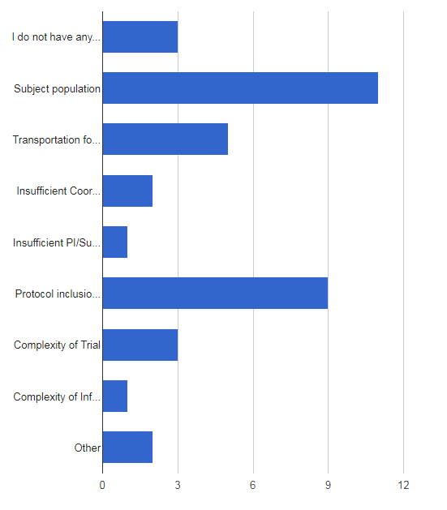
What is your biggest barrier to subject recruitment?
(This question was only asked on Site Surveys last year)
12.5%
24 responses
I do not have any barriers at my site (3)
Subject population (11)
Transportation for Follow-up Visits (5)
Insufficient Coordinator availability (2)
Insufficient PI/Sub-I availability (1)
Protocol inclusion/exclusion criteria (9)
Complexity of Trial (3)
Complexity of Informed Consent (1)
Other (2)
45.8%
20.8%
8.3%
4.2%
37.5%
Other:
“Potential under-funded trials”
“Identification of a potential subject and communication to the coordinator team in time”
“Re-imbursement for transportation(subject or coordinator HVs) really helps with recruitment”
“Some StrokeNet studies do not include non-English speakers and that is a significant part of our population”
12.5%
4.2%
8.3%

Slide 17
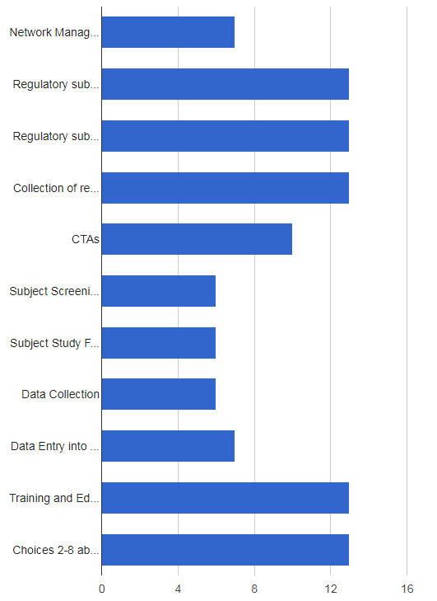
What is your role in StrokeNet clinical trials?
26 responses
Network Manager only (7, 26.9%)
Regulatory submissions to CIRB (13, 50.0%)
Regulatory submissions to local IRB (13, 50.0%)
Collection of regulatory documents (13, 50.0%)
CTAs (10, 38.5%)
Subject Screening/Recruitment/Enrollment (6, 23.1%)
Subject Study Follow-up Visits (6, 23.1%)
Data Collection (6, 23.1%)
Data Entry into WebDCU (7, 26.9%)
Training and Education on StrokeNet trials (13, 50.0%)
Choices 2-8 above (13, 50.0%)
KEY TAKEAWAY
Half of us are engaged in regulatory, training and education tasks
About a quarter of us are study coordinators

Slide 18
List the top 3 areas where most of your effort is spent…
24 responses
Top Area: Managing Regulatory Documents
“We have Study Coordinators assigned to each StrokeNet trial. I facilitate the CIRB and Local regulatory submission and other trial start-up activities and serve as a back-up to the coordinators for recruitment, follow-up and data collection.”
Top Area: Study start up tracking
“I would say recently, most of my effort has been on study start up for SleepSMART and MOST. But when there are not active trials in start up, then most of my effort is on network manager responsibilities.”
Top Area: Training
“Currently it is with new CRC training. We've had a lot of site CRC turn-over and many of the new CRCs are new to research.

Slide 19
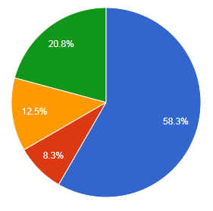
Who performs most of the subject screening at your site?
24 responses
Study Coordinator
Residents/Fellows
Sub-Investigators
RCC Manager (0)
Principal Investigator

Slide 20
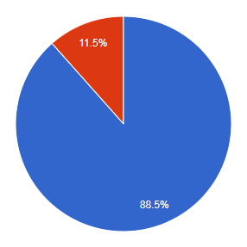
Do you use the WebDCU Dashboard?
26 responses
Yes (23, 88.5%)
No (3, 11.5%)

Slide 21
Please provide feedback on the WebDCU Dashboard?
Summary of Top Feedback: (16 comments)
In general, most RCC managers are using and find it helpful
  “It is very user friendly”/ “It is helpful and easy to use”
  “We take screenshots and distribute monthly to sites so they know where we rank.”
Many managers noted that the dashboard needs to be updated to remove older/completed trials
  “I feel the dashboard does not accurately reflect the work being done by the RCC. Studies like POINT and Several others did not allow many sites to participate as StrokeNet was underway.”
  “The dashboard needs to be updated to take off previous studies, updated timelines for new trials.”
    NDMC Response: The StrokeNet Dashboard was created to show enrollments over the life of StrokeNet which started in September 2013. There is a spot at the top of the dashboard where you can select a date range and which trials you want to include in your report view. In addition, by clicking on each of the trial names in the key under the graph, that trial will be removed from the graph view.

Slide 22
Please provide feedback on the WebDCU Dashboard (continued)?
Managers would like if CREST 2 data could be included
  “It would be helpful if CREST2 was included in the dashboard for total enrollments”
    NDMC Response: CREST-2 enrollments are included in the dashboard, but are not necessarily always up-to-date as we receive CREST-2 enrollment data on an irregular basis from NINDS. There is a footnote under section B of the dashboard that will tell you when the CREST-2 data was last updated. If your enrollments are still not showing up on the dashboard, please reach out to Jessica at simonsjl@musc.edu with the site name and date of enrollments that are missing and we will research what the issue is.

Slide 23
Please share any feedback on the WebDCU System?
Summary of Top Feedback (14 comments)
Most commenters have great things to say about WebDCU
  “A really good system. Much for user friendly than other EDCs we have used for other trials.”
  “Wonderful system to use!“
Additional feedback:
  “More continuity of documents between trials (only uploading an approved document once for multiple trials)”
    NDMC Response: Most documents are able to be shared across trials in WebDCU. For example, if an NIHSS certificate is uploaded and accepted for a study team member under ARCADIA, the document would not need to be re-uploaded in the MOST database for that study team member. Instead, you would simply “point” to the document you want under Q4: Existing Documents on the submission page.

Slide 24
Please share any feedback on the WebDCU System (continued)?
  “Would like to be routed immediately back to site docs page after uploading a document”
    NDMC Response: Thank you for the feedback. We will bring this comment back to the DCU team.
  “Can the expiration date of CIRB prime award approval auto-populate?”
    NDMC Response: Thank you for the feedback. We will bring this comment back to the DCU team.
  “There are times when our reg docs are uploaded but it takes several weeks for them to be reviewed and accepted. Does this have a negative impact on the accuracy of startup metrics that we are held accountable for?”
    NDMC Response: The NCC can address the time it takes to review documents, but any time lag in reviewing the documents does not effect your start-up metrics.

Slide 25
Overall Feedback from Managers
Most common response:
Study budgets and regulatory documents to the sites and managers as soon as possible
  This helps sites are struggling with coordinator staffing with rapid start-up of multiple trials
  Many sites require review of regulatory documents prior to reviewing the CTA
  Managers request as much streamlining of common forms between trials as possible

Slide 26
Thank You!!

Slide 27
2019 Site Engagement Survey Results
6.26.19
Note: This survey was created by the Network Managers Planning Committee for NM/SC use for feedback purposes. None of the questions or content was constructed or requested by NINDS, the NCC, or NDMC. Aggregate results will, however, be shared with all.

Slide 28
Has participation in StrokeNet helped your research infrastructure at your facility?
85 responses
Yes (52, 61.2%),
No, not really (10, 11.8%)
Unsure (14, 16.5%)
Good infrastructure already in place (12, 14.1%)
2018 – 71 responses (no significant changes except 9.9% unsure)

Slide 29
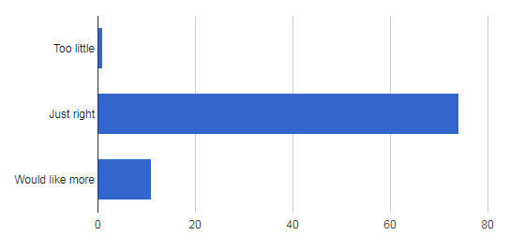
Is the amount of contact with your RCC/SS/CPS….
(1, 1.2%)
(74, 86.0%)
(11, 12.8%)

Slide 30
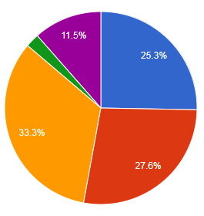
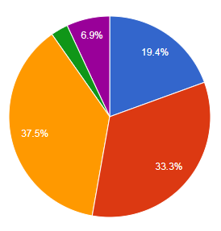
What is the frequency of contact with your RCC/SS/CPS?
2019 - 86 responses
2018 - 72 responses
Monthly (29 vs 27)
Bi-weekly (24 vs 24)
Weekly (22 vs 14)
Other (10 vs 5)
Quarterly (2 vs 2)
Other:
Top comment: Variable-as needed
Other:
Top comment: Variable-as needed

Slide 31
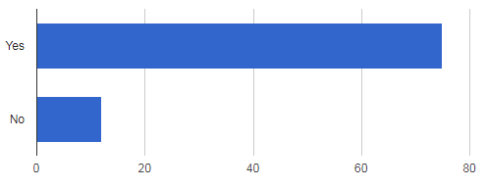
Do you feel you have a good understanding of regulatory requirements for StrokeNet trials?
87 responses
86.2%
13.8%
*Slight Improvement in responses from 2018 Survey ( 72 responses: 84.7% - Yes/ 15.3% - No)

Slide 32
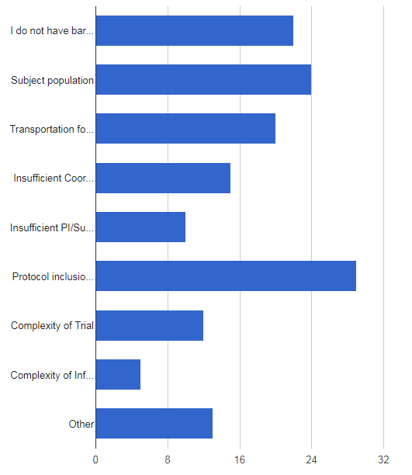
What is your biggest barrier to subject recruitment?
(22, 25.9%)
85 responses – check all that apply
(24, 28.2%)
Protocol inclusion/exclusion criteria
Subject population
I do not have barriers at my site
Transportation for Follow-up Visits
Insufficient Coordinator availability (15, 17.6%)
Complexity of Trial (12, 14.1%)
Insufficient PI/Sub-I availability (10, 11.8%)
Complexity of Informed Consent (5, 5.9%)
Other (13, 15.3%)
(20, 23.5%)
(29, 34.1%)
Compared to 2018 (70 responses):
Top responses 2018: No barriers (25.7%); Protocol Inclusion/Exclusion
(21.4%); Subject population (21.4%); Other (20%);
Transportation (18%); Trial complexity (14%):
Coordinator availability (13%)

Slide 33
“Other” reasons for recruitment barriers:
No current StrokeNet trials
Patients willingness/fear to participate
Relying on referrals for study patients
Issues with contracts holding trial startup
Per subject reimbursement
Other language materials not available for some trials
Contracts/budget/regulatory issues
IRB not allowing LAR consent over telemedicine

Slide 34
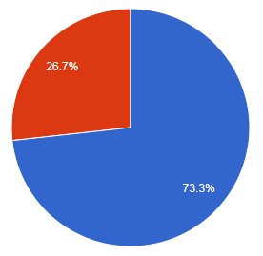
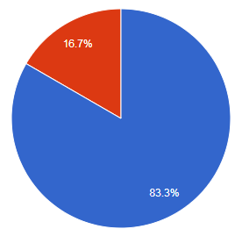
Does your facility utilize Telemedicine?
2019 - 86 responses
2018 - 72 responses
YES
YES

Slide 35
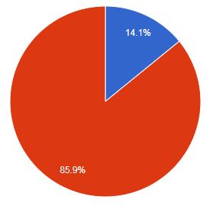
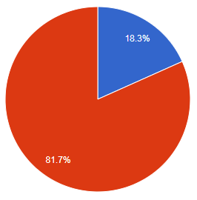
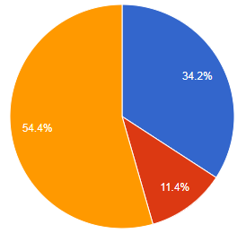
Does your study site currently use Telemedicine for Clinical Research? If not, do you plan/hope to?
No
No
2019 - 85 responses
Yes
2018 - 71 responses
Yes
No
2019 - 79 responses
Unsure
2018 – Future use not asked on survey
Yes

Slide 36
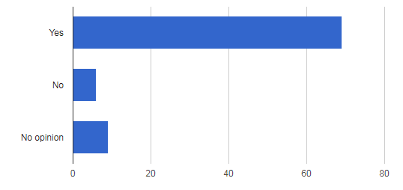
Do you wish to be notified when sites for a trial have been selected, whether or not your site has been chosen?
84 responses
82.1%
Most sites would like to be notified when sites are selected even if they were not chosen.

Slide 37
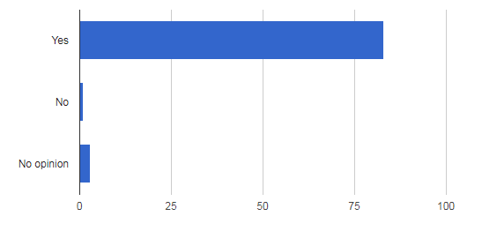
Do you wish to have feedback on reasons for non-selections as a study site?
2019 - 87 responses
Yes (83, 95.4%), No (1, 1.1%), No opinion (3, 3.4%)
2018 -73 responses: Yes (54, 74.0%), No (7, 9.6%), No opinion (12, 16.4%)

Slide 38
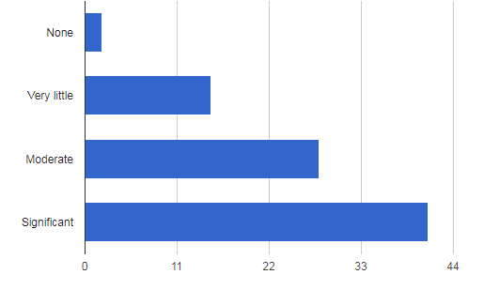
How important is your RCC Manager in assisting with study startup at your site?
86 responses
(2, 2.3%)
(15, 17.4%)
(28, 32.6%)
(41, 47.7%)

Slide 39
Please provide feedback on the WebDCU Data Management System:
45 comments
Overwhelmingly, the sites feel very positive about WebDCU
“It is a good system and nice that it is used across all StrokeNet trials.”
“I find that this system is straight forward and easy to use.”
“Useful, easier to navigate than other systems in use.”
“It's great. Love having one system for many trials.”

Slide 40
How to you feel about communication from WebDCU regarding project documents and approvals?
Many sites would like changes in missing document reminder emails
“Some automated emails are not sending the correct information regarding compliance with the study visit compliance”
  NDMC Response: Please contact your trial’s Data Manager when this occurs so that we can fix the issue.
“Notified of "missing documents" prior to those documents being available to us from the IRB
  NDMC Response: This was an error that occurred with Sleep SMART and is not the usual process. This has been fixed going forward.
“I would like initial guidance on the appropriate expiration dates to use for COI documents.”
  NDMC Response: We will discuss with the NCC the best way to communicate this to the sites.

Slide 41
How to you feel about communication from WebDCU regarding project documents and approvals?
“Notifications could be a little more specific.”
  NDMC Response: This has been a common request recently and will be discussed internally to see if more detailed information can be provided.
“Too much/too frequent and repetitive.”
  NDMC Response: Thank you for the feedback!
“Better regulation on Expiration dates on the People reg doc submission.”
  NDMC Response: We do not understand the issue. Please feel free to reach out to Jessica at simonsjl@musc.edu with more information so that we can address the issue.

Slide 42
Overall Feedback From Sites
Top Feedback: Streamlined/consolidated information and document dissemination is important
“Getting complete regulatory packets at the same or close to the same time as CTAs”
“Central StrokeNet team to offer an electronic video/tutorial geared toward sites' regulatory/IRB”
“As we are reviewing a new study it is important to have everything at the same time (ICF, CRFs, etc.).”
“Communication could be better from RCC to satellite sites.”
Top Feedback: Sites want more feedback on selection for studies
“Knowing which sites are selected for studies and why our site may not be selected for studies will help us determine which types of studies we target more.”
“Feedback to understand what would make us a better site for a StrokeNet trial would be much appreciated.”

Slide 43

THANK YOU TO ALL SITES AND MANAGERS WHO COMPLETED OUR SURVEY!!!

