Slide 1
Informed Consent – An ongoing process with basic steps
Susan K Roll
Aaron Perlmutter
Emily Stinson
May 26, 2021

Slide 2
Informed Consent Goal
Protect Human Subjects/Research Participants
Provide details of the study
  purpose and why
  activities
  expectations
  risks/benefits
  timelines
  options
Stimulate discussion of questions and provide answers and clarification
Obtain signatures for documentation of consent

Slide 3

Foundation steps – from Regulations and Guidance

Slide 4
Informed Consent (HHS.gov)
The requirement to obtain the legally effective informed consent of individuals before involving them in research is one of the central protections provided for under the HHS regulations at 45 CFR part 46. This requirement is founded on the principle of respect for persons, one of the three ethical principles governing human subjects research described in the Belmont Report. The principle of respect for persons requires that individuals be treated as autonomous agents and that the rights and welfare of persons with diminished autonomy be appropriately protected. The Belmont Report states that an autonomous agent is “an individual capable of deliberation about personal goals and of acting under the direction of such deliberation.” Respect for persons requires that prospective research subjects “be given the opportunity to choose what shall or shall not happen to them” and thus necessitates adequate standards for informed consent.

Slide 5
Informed Consent (FDA.gov)
FDA believes that obtaining a research participant's informed consent is only part of the process. Informed consent involves providing a potential participant with:
  adequate information to allow for an informed decision about participation in the clinical investigation.
  facilitating the potential participant's understanding of the information.
  an appropriate amount of time to ask questions and to discuss with family and friends the research protocol and whether you should participate.
  obtaining the potential participant's voluntary agreement to participate.
  continuing to provide information as the clinical investigation progresses or as the subject or situation requires.
To be effective, the process must provide sufficient opportunity for the participant to consider whether to participate. (21 CFR 50.20.) FDA considers this to include allowing sufficient time for participants to consider the information and providing time and opportunity for the participant to ask questions and have those questions answered. The investigator (or other study staff who are conducting the informed consent interview) and the participant should exchange information and discuss the contents of the informed consent document. This process must occur under circumstances that minimize the possibility of coercion or undue influence. (21 CFR 50.20.)

Slide 6
Informed Consent (StrokeNet SOP – GCP 03)
Informed consent is an ethical requirement for conducting research with human subjects and refers to the ongoing process of providing detailed information about the study to potential and continuing research subjects. Informed consent at NIH StrokeNet Clinical Trial Performance Site (CTPS) will be conducted in accordance with federal and state regulations and Good Clinical Practices (GCP), as set forth in the 1996 ICH E6 Consolidated Guidance.
The purpose of the informed consent process is to ensure that study subjects understand the nature of the research activity through all stages of the project, and that they are voluntarily choosing whether or not to begin or continue participation in the research study.

Slide 7

What guides and directs the steps - Guidance and SOPs
Regulations HHS
Guidance FDA
IRB requirements
StrokeNet SOPs
  GCP 03
  GCP 13
  ADM 24

Slide 8
Consent Process ends when study participation ends
The consent process is an ongoing process and does NOT end once the consent form is signed. Information and clear understanding from the participant should continue throughout the participants study participation.
Each encounter should provide the participant with an opportunity to state that they are still willing to continue in the study.
There is no penalty for deciding not to participate in the study as well as no penalty for discontinuing participation after the study procedures have started.

Slide 9
Preparation step – do I know what I need to know?
Review and know your study
  Can a LAR/surrogate consent for this study
  Who is delegated to obtain consent on the DOA
Review and know your consent methods
  In-person
  Remote by phone, fax, mail (postal)
  eConsent (using the acceptable platform)
Review and know your consent document
  Is the document the most recently approved version
  Is the document the IRB approved document (pdf with IRB approval “stamp”)
  Is there more than one place that requires signature

Slide 10
Assessment step – what else do I need to consider?
Is the potential participant capable of consenting
Does the potential participant have what they need to consent – example: glasses, hearing aid
If an LAR is needed, are they available
If a witness is needed, is there one available
If the potential participant can’t sign their name - they make a mark

Slide 11

Consenting step
The study should be introduced to the potential participant/LAR (if applicable) and the consent reviewed with the potential participant/LAR
The potential participant/LAR should be given time to read the ICD
The potential participant/LAR should be given time to ask questions and have their questions answered to their satisfaction
The discussion should involve family members if the potential participant/LAR desires

Slide 12
Translated consent step
To obtain consent from non-English speaking subjects, you must have either a cIRB approved full translated ICD or a translated Short Form in the potential participant’s native language
The presentation of the consent must be done in the potential participant’s native language
The subject’s friends or family members MAY NOT be used as interpreters
The short form is used when there is no translated full consent document available and provides the interpreter instruction of what must be included in the verbal reading of the English ICD
If a short form is used, notify the NCC PM immediately so a full ICD can be translated within 30 days

Slide 13
Use of LAR for surrogate consent step
LAR should not be used if the participant has the decision-making capacity of giving consent.
When assessing for capacity, the investigator should consider the potential research subject’s ability to:
  Make and express choice
  Understand relevant information
Examples of when the LAR signature has been used to incorrectly document a subject’s consent:
  Subject has trouble physically signing and dating the ICF
  Subject is illiterate
  Subject is blind
  Subject does not speak English
  Subject prefers to have friend/family member sign documents

Slide 14
Witness step – when is this required?
If the potential participant is cognitively capable of providing consent but there are special situations impacting the usual consenting process
If the potential participant is illiterate and the ICD must be “read aloud” by another person
If the potential participant is visually impaired and the ICD must be “read aloud” by another person
If the potential participant is being consented using a short form and the interpreter must “read aloud” the ICD in another language (the witness must understand both English and the potential participants native language)
If the potential participant is unable to physically sign and date the consent
  The subject should make their mark
  An impartial witness should be used to attest to the consenting process that they witnessed
Impartial witness must be present during the consent process and sign consent document
  Impartial witness = NOT a study team member
  Impartial witness = NOT a friend or family member or the subject

Slide 15

Check out step - What should be done before leaving the person who signed consent?
Review consent document to make sure all sections have been correctly signed/dated by the participant/LAR and the person obtaining consent
  Many consents have more than one signature page
  Participant/LAR must personally sign and date consent
  Ensure the participant/LAR has signed ALL appropriate sections
  Ensure the person obtaining the consent has signed ALL appropriate sections

Slide 16

Re-consenting – when is it necessary?
As directed by the IRB depending on the most recent approval
  Indicated in the approval letter of the most recent approval of the ICD version
  Based on changes that may impact the participant’s willingness to continue in the study
When a participant that was enrolled using a LAR regains the cognitive ability to consent for themselves

Slide 17
“Implementation” step
Remote and eConsent Implementation Form
Provides the IRB with the information needed about the consenting methods your site plans to use
Study Specific
Necessary for your site to be able to use remote and eConsent methods (Modification with IRB approval is needed prior to implementing these methods)

Slide 18

Note to file – when is this step needed?
A Note to File can be used to explain the consenting process when things don’t go according to plan or things that are “outside the box” occur
A Note to File can provide clarification that is needed to understand the circumstances surrounding unclear markings on the ICD
A Note to File concerning consenting should be included as an additional page at the end of the ICD when preparing a PDF to be uploaded in WebDCU™ as a single document

Slide 19
Variety is the spice of life, but it all comes together in the final steps
There are differences between the IRBs of Record being used by the NCC for StrokeNet trials (UC StrokeNet cIRB and Advarra)
Sue will cover GCP principles and UC cIRB perspective
Emily will cover Advarra details and eConsent
Aaron will answer questions on uploads in WebDCU™

Slide 20

NCC Central Electronic Consent (eConsent) process
StrokeNet Central eConsent process was approved for use 16Jun2020
  SOP ADM 24 includes process for use of 21CFR Part 11 compliant electronic signatures
  cIRB expedited approval process allows Trial level approval to use eConsent
  is being used as the technology platform for eConsent
  Most StrokeNet trials have been approved to use eConsent with many sites currently enrolling subjects across trials

Slide 21
NCC Central Electronic (eConsent) process
Consenting process using eConsent via REDCap
  Site request to use central eConsent using SOP ADM 24
    Implementation form UC cIRB
    CIRBI site submission application Advarra
  Site specific eICD will be built in REDCap by the NCC
  NCC will send site a link to their site specific eICD template in REDCap
  NCC will send instructions on how to use your project (eICD) in REDCap
  NCC will send you instructions on how to access your project and how to add users

Slide 22
NCC Central Electronic (eConsent) process
Consenting process using eConsent via REDCap continued :
  The link can be sent to the subject or LAR
  Site should use study approved email template to send with the link to the subject/LAR
  Process of consent does not change just the mode of consent
  Subject/LAR will sign the eICD with their finger, stylus or mouse
  Signed eICD is uploaded to WebDCU

Slide 23
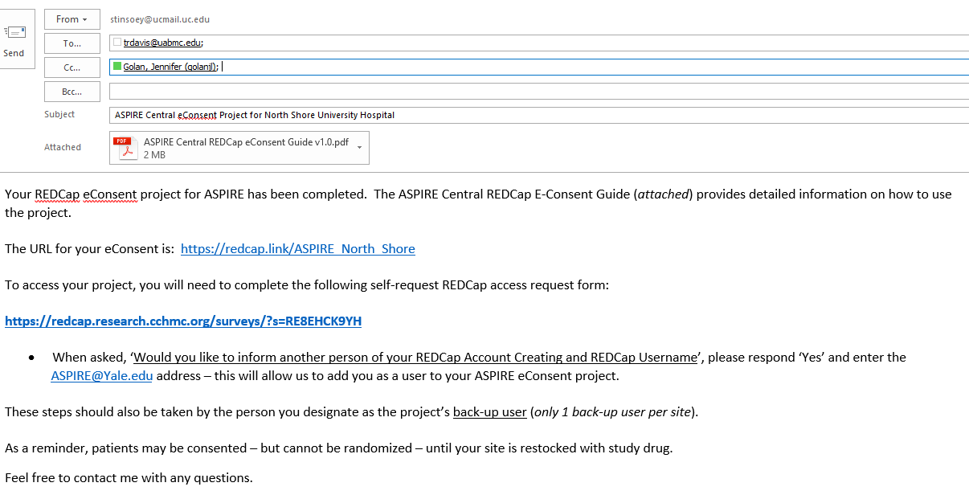

Slide 24
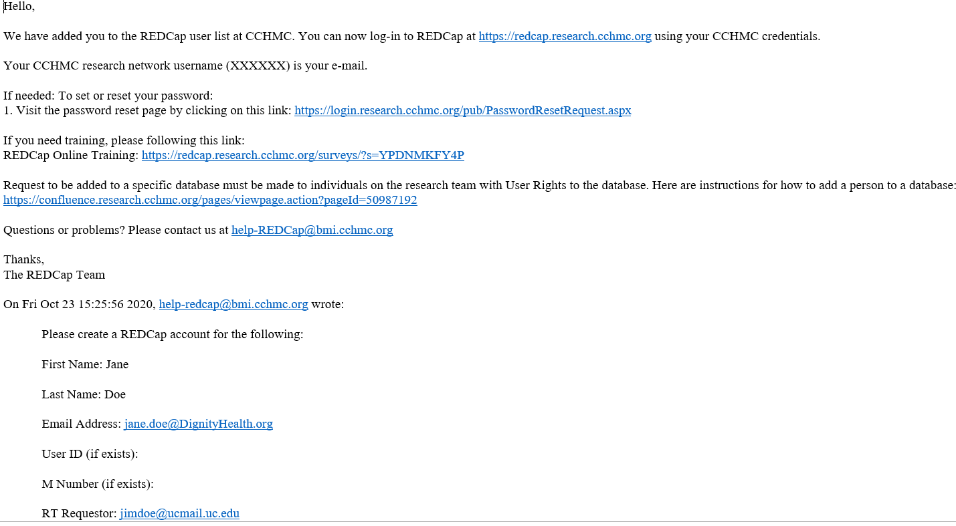

Slide 25
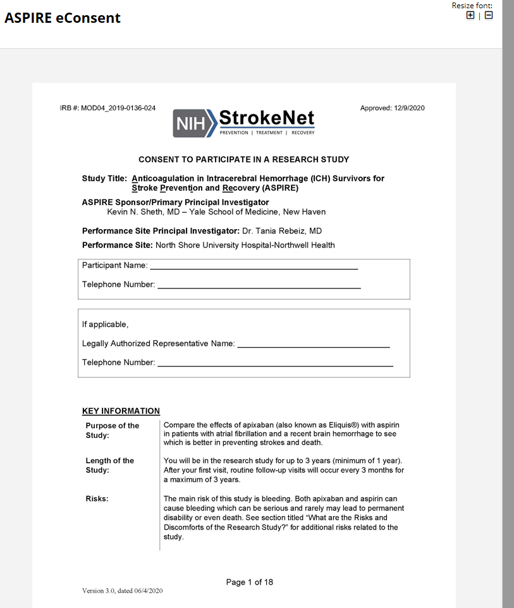
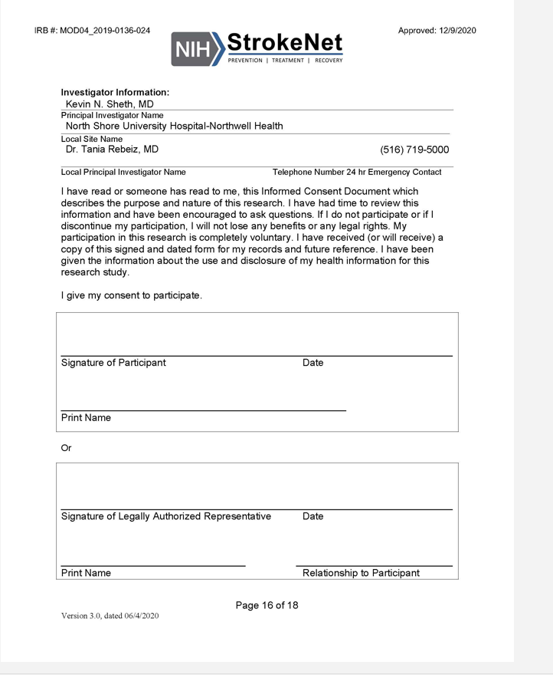
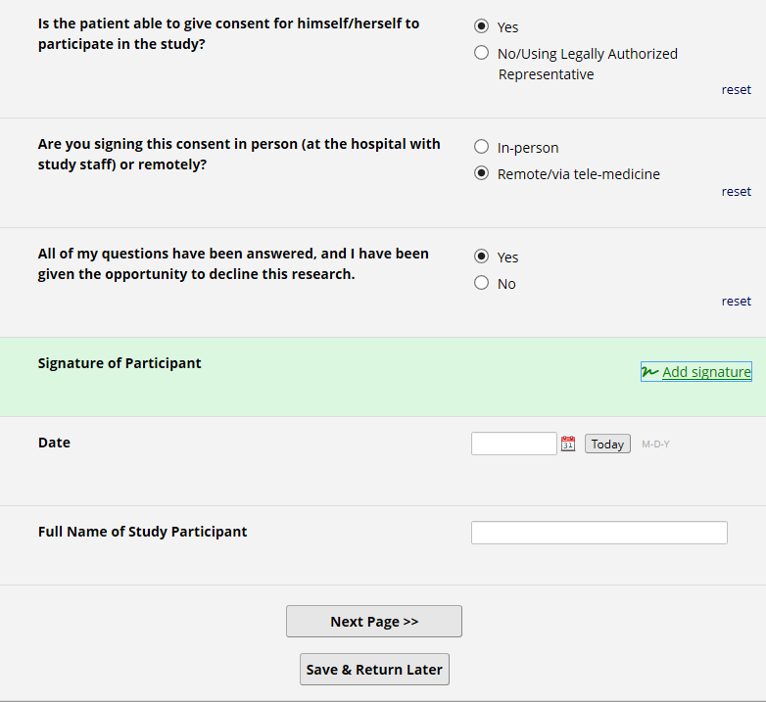
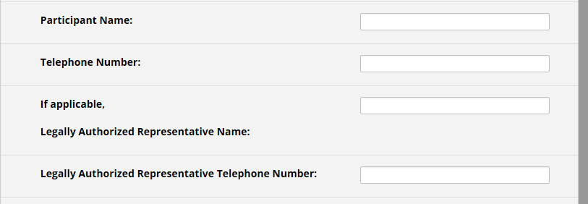

Slide 26


