Slide 1
MISTIE III

Slide 2
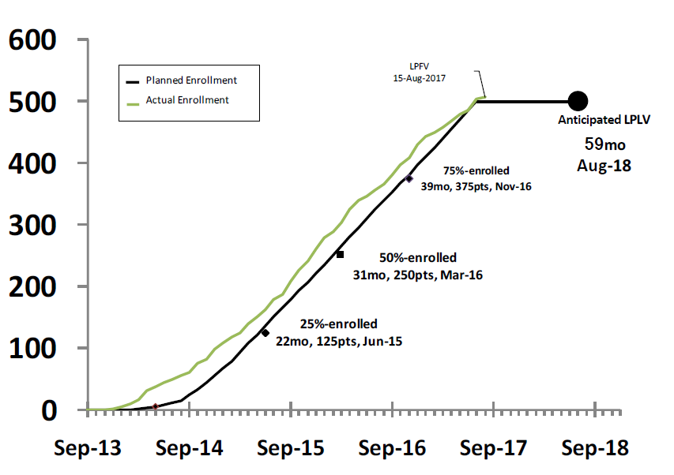
Enrollment (n=500 eligible subjects)

Slide 3
Close-Out Timeline
Final d180 collection: projected Feb 2018
DSMB review of d180 data: Jul 2018
Final d365 collection: projected Aug 2018
Primary and Secondary analyses complete: Fall 2018
Publication and ISC late-breaking presentation: Feb 2019

Slide 4
Figure 2. Efficacy of hematoma evacuation over time. A graph illustrating the distribution of clot evacuation rates in subjects randomized to the surgical arm in the first half of the trial. The plot also shows the overall consistency of ICH evacuation efficacy over time as demonstrated by average clot evacuation rate and percentage of subjects reaching target end-of-treatment volume < 15 mL. Two cases experienced hematoma size expansion by the end of treatment resulting in a negative clot evacuation rate.

