Slide 1
The NIH StrokeNet Experience From A Central IRB To Local IRB Perspective
Michael Linke, PhD, CIP
Health Science Officer,
Department of Veterans Affairs Medical Center-Cincinnati
Associate Professor
Department of Internal Medicine
University of Cincinnati College of Medicine
Chair, University of Cincinnati Institutional Review Board

Slide 2
Use of a Single Institutional Review Board for Multi-Site Research
Goals
To enhance and streamline the process of IRB review
Reduce inefficiencies
Improve efficiency without compromising ethical principles and protections

Slide 3
NIH StrokeNet Central IRB (CIRB)
Responsibilities
All sites participating in StrokeNet studies must rely on the CIRB
The single IRB will be the IRB of record for the other participating sites
The single IRB will be accountable for compliance with regulatory requirements for IRBs
Relying sites responsible for meeting other regulatory obligations (such as, ancillary reviews)

Slide 4
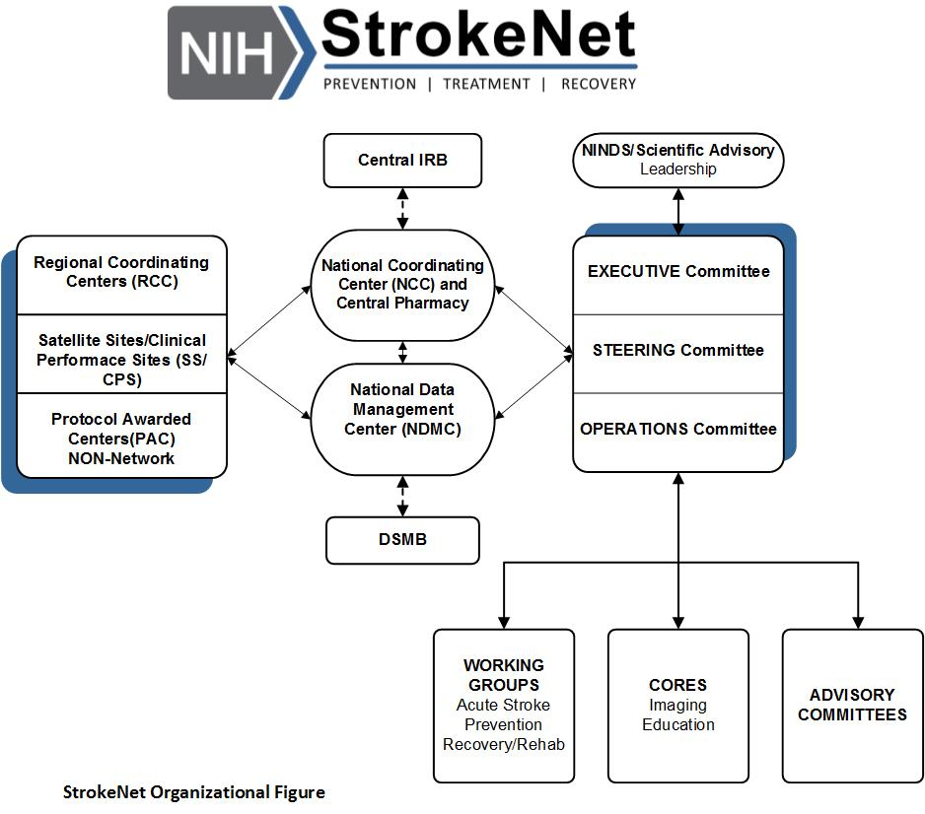
What Is NIH StrokeNet?
Funded by NINDS/NIH to conduct clinical trials for stroke prevention, treatment, and recovery.
Mott M, Janis S, Koroshetz WJ. StrokeNet Takes Off: National Institute of Neurological Disorders and Stroke Organizational Update. Stroke. 2016 Mar;47(3):e51-2.
Broderick JP, Palesch YY, Janis LS; National Institutes of Health StrokeNet Investigators. The National Institutes of Health StrokeNet: A User's Guide. Stroke. 2016 Feb;47(2):301-3
Notes:
Need a little more transition between the NIH mandate portion and the StrokeNet intro, maybe something like “So that’s the regulatory background. Now let’s look at a specific example of how an NIH-funded central IRB works via the NIH StrokeNet program.”

Slide 5
What Is NIH StrokeNet?
The University of Cincinnati serves as the National Coordinating Center and provides national leadership for StrokeNet.
Joseph P Broderick, MD Principal Investigator
Pooja Khatri, MD, MSc, FAHA Co-Investigator
Dawn Kleindorfer, MD Co-Investigator – Educational Core Chair
Judith Spilker, RN, BSN Administrative Director
Jamey Frasure, PhD, RN Director
Diane L. Sparks, RN, BS Contracts Manager, Legal Liaison
Rose Beckmann, CCRP Administrative Specialist
Mary Ann Harty, MBA, MLS Financial Manager
Jeanne Sester, Educational Coordinator

Slide 6
What Is NIH StrokeNet?
The National Data Management Center at the Medical University of South Carolina oversees all aspects of data management and provides full statistical support for StrokeNet research.
Yuko Y. Palesch, PhD, Co-Principal Investigator
Wenle Zhao, PhD, Co-Principal Investigator
Catherine Dillon, Director of Operations
Jessica Simons, Data Manager

Slide 7
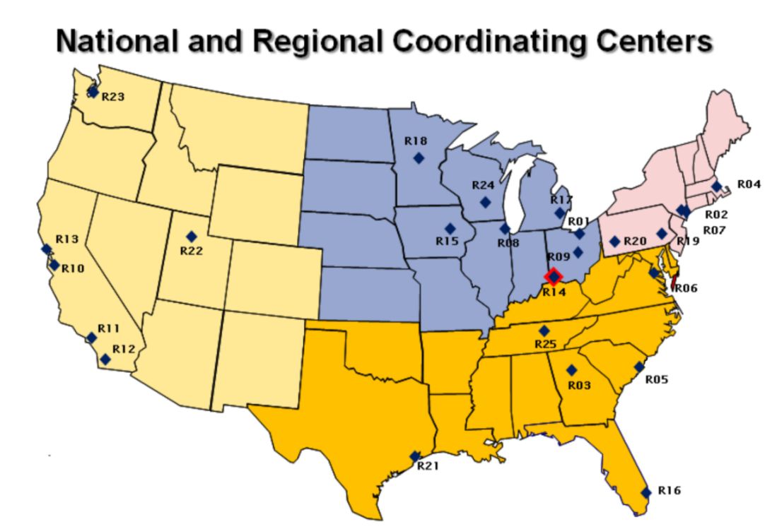
What Is NIH StrokeNet?
The network includes 25 Regional Coordinating Centers
1 CASE WESTERN RESERVE UNIVERSITY
2 COLUMBIA UNIVERSITY HEALTH SCIENCES
3 EMORY UNIVERSITY
4 MASSACHUSETTS GENERAL HOSP
5 MEDICAL UNIVERSITY OF SOUTH CAROLINA
6 MEDSTAR RESEARCH INSTITUTE
7 MOUNT SINAI SCHOOL OF MEDICINE
8 NORTHWESTERN UNIVERSITY AT CHICAGO
9 OHIO STATE UNIVERSITY
10 STANFORD UNIVERSITY
11 UNIVERSITY OF CALIFORNIA LOS ANGELES
12 UNIVERSITY OF CALIFORNIA SAN DIEGO
13 UNIVERSITY OF CALIFORNIA SAN FRANCISCO
14 UNIVERSITY OF CINCINNATI
15 UNIVERSITY OF IOWA
16 UNIVERSITY OF MIAMI SCHOOL OF MEDICINE
17 UNIVERSITY OF MICHIGAN
18 UNIVERSITY OF MINNESOTA
19 UNIVERSITY OF PENNSYLVANIA
20 UNIVERSITY OF PITTSBURGH AT PITTSBURGH
21 UNIVERSITY OF TEXAS HLTH SCI CTR HOUSTON
22 UNIVERSITY OF UTAH
23 UNIVERSITY OF WASHINGTON
24 UNIVERSITY OF WISCONSIN-MADISON
25 VANDERBILT UNIVERSITY MED CTR
Notes:
200 clinical sites. RCCs provide regional leadership for research conducted at StrokeNet the clinical sites.
RCCs select their Satellites
RCCs and Satellites are eligible to receive the Protocol Trial Agreements if selected by the Trial PI.
The trial Clinical Performing Sites are tracked through WebDCU™.

Slide 8
What Is NIH StrokeNet?
The University of Cincinnati IRB serves as the Central IRB (CIRB) for StrokeNet
Michael Linke, PhD, CIP, Chair CIRB – Email: michael.linke@uc.edu
Susan K. Roll, RN, BSN, Central IRB Liaison – Email: susan.roll@uc.edu
Angela Braggs-Brown, RAC, CIP, MA, UC HRPP Director
Jo Ann Behrle, Human Protection Administrator
Keeley Hendrix, RHIT, Research Compliance Analyst

Slide 9
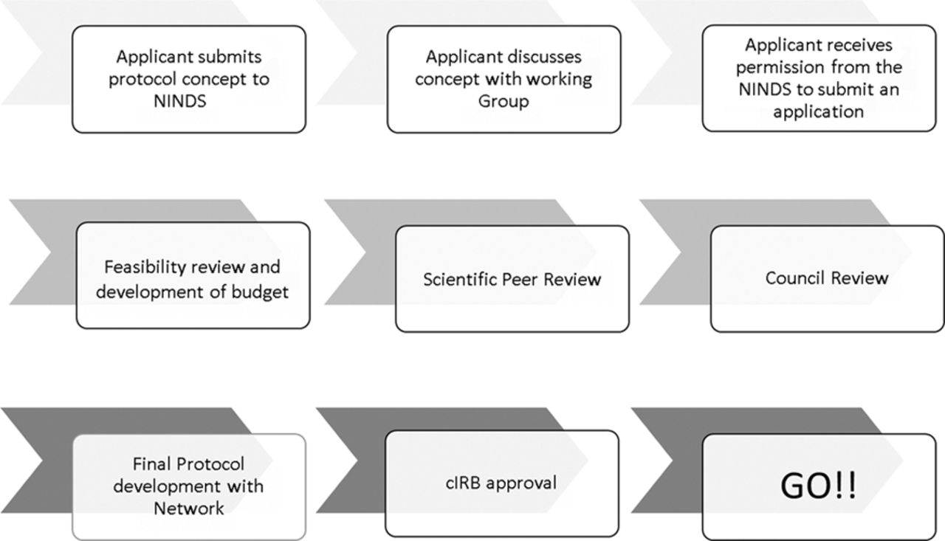
The Introduction and Implementation of Stroke Trials within National Institutes of Health StrokeNet.
“cIRB” indicates Central Institutional Review Board; “NINDS” is National Institute of Neurological Disorders and Stroke.
Joseph P. Broderick et al. Stroke. 2016;47:301-303
Copyright © American Heart Association, Inc. All rights reserved.
Notes:
The introduction and implementation of stroke trials within National Institutes of Health StrokeNet. cIRB indicates Central Institutional Review Board; and NINDS, National Institute of Neurological Disorders and Stroke.
Involvement of the CIRB in the early stages of protocol development provides an opportunity to identify potential regulatory issues that investigators can address prior to CIRB submission, thereby reducing the number of protocol review contingencies issued by the CIRB.
The CIRB Chair and Liaison work closely with the NCC, NDMC, and Principal Investigators to develop StrokeNet protocols that meet all human subjects research regulatory requirements.
Involvement of the CIRB in the early stages of protocol development provides an opportunity to identify potential regulatory issues that investigators can address prior to CIRB submission, thereby reducing the number of protocol review contingencies issued by the CIRB

Slide 10
Building the NIH StrokeNet Central IRB Process
“Non-share model” CIRB developed by Partners for Network for the Excellence in Neuroscience Clinical Trials (NeuroNEXT)*
Single IRB of record for NIH StrokeNet affiliated research as designated by NINDS
Central IRB fulfills all IRB-review requirements including
initial and continuing review, adverse events and amendments
*Kaufmann P, O'Rourke PP. Central institutional review board review for an academic trial network. Acad Med. 2015 Mar;90(3):321-3.
Notes:
NeuroNext and StrokeNet are “non-share” models. Are there any “share” models out there? Why did y’all choose the “non-share” model?
NeuroNEXT
Network of academic institutions established by NINDS
Facilitate rapid development and implementation of protocols in neurological disorders affecting adult and/or pediatric populations.
MGH is the Clinical Coordinating Center for NeuroNEXT (the “NeuroNEXT CCC”).
“Partners Human Research Committee” is the Central IRB for NeuroNEXT.
Partners Healthcare System, Inc. (“Partners”) is made up of Massachusetts General Hospital (MGH) and Brigham and Women’s Hospital, Inc. (BWH) and is collectively known as “Partners Human Research Committee” (Partners).

Slide 11
How a University-Based IRB Established a Central IRB

Slide 12
Resources required for establishing and administering a Central IRB
Reliance Agreement
SOPs
Notes:
Why do you not accept any site-specific changes to the Reliance Agreement?
You also mentioned looking into why you listed the 3 items at the bottom of the list.

Slide 13
Resources required for establishing and administering a Central IRB
Reliance Agreement
NIH and OHRP templates*
Draft reviewed by selected RCCs
Revised per comments
2nd draft reviewed by RCCs
Final Agreement
*
http://www.hhs.gov/ohrp/assurances/forms/irbauthorizpdf.pdf http://www.niaid.nih.gov/LabsAndResources/resources/toolkit/Documents/templateOutline.pdf
Notes:
Why do you not accept any site-specific changes to the Reliance Agreement?
You also mentioned looking into why you listed the 3 items at the bottom of the list.

Slide 14
Reliance Agreement
Request:
A signed copy of the site’s Federalwide Assurance (FWA)
Require the IO listed on the FWA agreement to sign
A contact name from the site who can help to facilitate the signing of the Reliance Agreement
Notes:
We require the IO listed on the FWA agreement to sign. I have one where the IO signed and a legal person co-signed. “The name of the individual who will sign the Reliance Agreement (RA) – if different than the Institutional Official (IO) listed on the FWA”
Slides 29-30: Why use this process? (I’m guessing it keeps things simpler.)

Slide 15
Reliance Agreement
Partially executed RA sent to the site contact to facilitate the signing of the RA by the site’s IO
Site contact obtains IO’s signature and sends fully executed RA back to the Contracts Manager/Legal Liaison

Slide 16
StrokeNet Reliance Agreements
Over 300 CIRB Reliance Agreements fully executed

Slide 17
Running a Central IRB through a University-Based IRB

Slide 18
StrokeNet CIRB-Related SOPs*
ADM 11 Central Institutional Review Board Reliance
ADM 12 Central Institutional Review Board Reporting
ADM 2 Reporting Conflict of Interest And Financial Disclosure
*network administrative SOPs available on the NIHSTROKENET.org
Notes:
these are just the CIRB related SOPs (3 of the 20 network administrative SOPs available on the NIHSTROKENET.org website) i.e. public access-(transparency)
Why did you set up these dedicated SOPs—didn’t the IRB already have these policies in place? Are these SOPs for all sites, or just for the CIRB? How did y’all develop these SOPs? (don’t need to necessarily address all of this on this slide, just organized all the questions here for simplicity)

Slide 19
ADM 11 Central Institutional Review Board Reliance
Defines the process for an Institution engaged in NIH StrokeNet affiliated research to transfer human subjects review to the CIRB
Provides an overview of the protocol review
Describes the information flow between the Institution and the CIRB throughout the lifecycle of the protocol

Slide 20
ADM 12 Central Institutional Review Board Reporting
Defines the process for required reporting by sites
Describes of the types of required reports
Defines the standards, time frames, and procedures for these reports

Slide 21
ADM 2 Reporting Conflict of Interest And Financial Disclosure
Document the process by which the NIH StrokeNet will assure compliance with HHS and FDA financial COI regulatory requirements
Details the NIH StrokeNet Network efforts to manage individual COI in a manner that is both ethical and practical
Notes:
Need more transition to slide 36, something like “Those are the SOPs we use, but I have a feeling many of you are curious how we’re actually running the CIRB and what the day-to-day is like.”

Slide 22
Running a CIRB through a University-Based IRB
How does it really work?
Notes:
Need more transition to slide 36, something like “Those are the SOPs we use, but I have a feeling many of you are curious how we’re actually running the CIRB and what the day-to-day is like.”

Slide 23
Running a CIRB through a University-Based IRB
UC IRB acts as the StrokeNet CIRB
CIRB Liaison
Dedicated HRPP Office Staff
Use UC HRPP electronic Protocol Administration System (ePAS)
Huron’s Click® IRB software platform
CIRB Liaison enters site information
Notes:
: Nice explanation of why you decided to take on a bigger role in managing COI, why you use a CIRB liaison, why no sites are currently using Click. Why is it important to have this kind of funding when running a CIRB?

Slide 24
How Do We Work Together?
CIRB Responsibility |  | Local Site Responsibility
IRB review tasks Initial review Continuing review Amendments, deviations, etc. COI |  | Site specific context Local laws Institutional policies Local context COI
HIPAA determinations of: Authorization forms and any accompanying request for alterations when authorization is combined with informed consent Requests for waivers of authorization |  | Ancillary reviews Nursing Radiation Safety
Local context review Collect local information required for IRB review Distribute a high-level protocol synopsis and highlights sheet |  | Other compliance areas HIPAA requirements outside those expressly covered by CIRB Oversight of research conduct Other required reporting and actions under federal, local, or institutional laws, regulations or policies
Notes:
You mentioned people might already be familiar with this content—might want to mention how they’d be familiar for context.
You mentioned local context is a common concern for CIRBs; can you explain a little how your CIRB handles it? Is this the way other CIRBs tend to do it? (In my experience at Schulman at least it’s a yes; thought including this info could be useful context.)
You mentioned you wanted to take a look at the “Others” content here.
including those stipulated under the FWA and those regarding financial disclosure and conflict of interest laws, regulations and policy

Slide 25
StrokeNet CIRB Experience
5 Prime Award Protocols using the Central IRB
164 approved sites
Notes:
UC IRB StrokeNet
Number of values 30 48
Minimum 17 1
Median 60.5 8.5
Maximum 184 65
Mean 69.6 13.79
Nice analysis of the numbers and the efficiency benefits. Glad to hear y’all will be publishing data on this.

Slide 26
Ways to Improve Interactions with Central IRBs
Develop internal SOPs
Define your organizational structure
Understand the process
Good communications
Develop relationships/networking
Notes:
Other challenges after 2 almost 3 years in.
Review of more FDA/NINDS approved fully developed protocols vs evolving protocols – less local input to actual protocol than anticipated initially
Duplicate reviews by site IRBs contribute to SC overload and resentment of CIRB
Obtaining actual/current FWA documents to upon which to base valid RAs – amazing how hard these are to find.
Working with the NDMS CTMS to facilitate CIRB reviews and reporting- we need more than the FDA!
No local site access to ePAS which produces a manpower shortage and limits the Liaison role effectiveness.

Slide 27
Central IRB Submission Components
Susan K Roll, RN, BSN
StrokeNet Central IRB Liaison

Slide 28
ARCADIA Prime Award Protocol
Approved Full Board
3/8/2017 Conditional approval with conditions being met on 3/9/2017
Amendment 1
Conditionally approved 8/9/2017, conditions met 8/10/2017
Protocol changes and ICD revisions, added vulnerable population of minors due to pregnancy surveillance, and Certificate of Confidentiality language
Amendment 2
Approved 10/9/2017
Protocol and ICD revision, study-wide participant information added
Amendment 3
Conditionally approved 12/13/2017, conditions met 12/18/2017
Protocol revision requested by BMS, minor changes to ICD
Ready for relying sites to be added 12/18/2017

Slide 29
Approval Documents available to sites

Slide 30
Necessary components of the submission
Documents accessed from WebDCU™
PI CV
Financial Conflict of Interest Forms
Delegation of Authority Report
Documents submitted to NCC Project Manager, via e-mail
ePAS Assurance Statement signed by Site PI
StrokeNet CIRB Performance Site Protocol Application Form Local Site Context Form
HIPAA Authorization Waiver for Screening Purposes (if needed per local screening policy)
Informed Consent Template modified with site specific required language (Track Changes and Clean versions)
Pregnant Partner Informed Consent Template modified with site specific required language (Track Changes and Clean versions)

Slide 31
StrokeNet CIRB Performance Site Protocol Application
Provides you with the information submitted to the Central IRB by the Prime Award PI
This is what the Central IRB has approved will be done under this protocol
There are only a few questions that the sites need to answer as they should be following the protocol as submitted by the Prime Award PI and approved by the Central IRB
If a description is requested, please cover each point listed
Example: Compensation/Reimbursement – amount, form of payment, who will payment be provided to, when will the payment occur, etc.

Slide 32
Local Site Context Form
Provides the Central IRB with necessary information about your local site, local laws, institutional policies and procedures – what does your specific local site need
The contact information for the person to whom CIRB communication should be directed is to be someone at your local IRB that we can contact if we need to communicate IRB to IRB
Signature from your local IRB confirms the information provided is accurate and that they are aware of your intent to participate in this study, and lets us know if there are local ancillary reviews that need to be done before we can issue approval
If you are not enrolling non-English speaking populations, use the text box for the “description of how interpreters for oral communication will be made available” to tell us that you are not enrolling non-English speaking populations and also provide a justification for not enrolling those populations
If you need additional space for answers you can always submit a WORD document with more details

Slide 33
HIPAA Authorization Waiver for Screening Purposes
The purpose of the this waiver is to be able screen for possible participants and to determine eligibility for the study without obtaining HIPAA Authorization from the possible participants
Need for this partial HIPAA Authorization is determined by the local screening policy. Example: should be requested when the research team is not involved in the potential participant’s care
The answers to the questions on the form should be directed at screening the medical record for possible eligibility

Slide 34
Informed Consent
Include a track changes version of all the changes you are making in the editable sections (please follow the instructions provided) of the template
After making those edits, accept all changes to make your clean version
The name of your site must be consistent throughout the document
Use complete formal first and last names of the site PI
Site logos are not accepted
Do not bold or italicize fonts
If you are adding local required language, make a comment to tell us it is “required language” as a courtesy

Slide 35
Pregnant Partner Informed Consent
All of the notes on the previous slide also apply to this consent
Keep in mind this consent is directed at the partner of a study participant, we do not consider the pregnant partner to be a research participant as they did not participate in the study intervention
The language in this consent is directed at the pregnancy follow-up instead of research participation
The pregnant partner translated versions will be provided once your site notifies the NCC Project Manager that a pregnancy has occurred

Slide 36
Administrative Amendments
Submitted via e-mail to the NCC Project Manager in a “timely” fashion, to allow for processing before the change takes place whenever possible
Examples of administrative amendments are:
Changes to the DOA
Changes to the site phone number

Slide 37
Local IRB acknowledgement
Local IRB acknowledgement confirms the communication has been shared with your local IRB
This can be as formal as a letter generate by the local IRB or as informal as a note to file or e-mail documenting receipt of the approval notice from the Central IRB
Local IRB acknowledgement confirms for the sponsor that all necessary communication with both IRBs has been completed

Slide 38
Questions?

