Slide 1
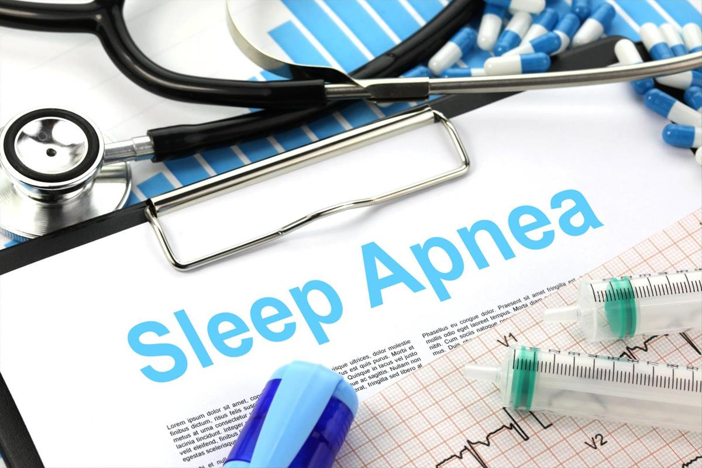
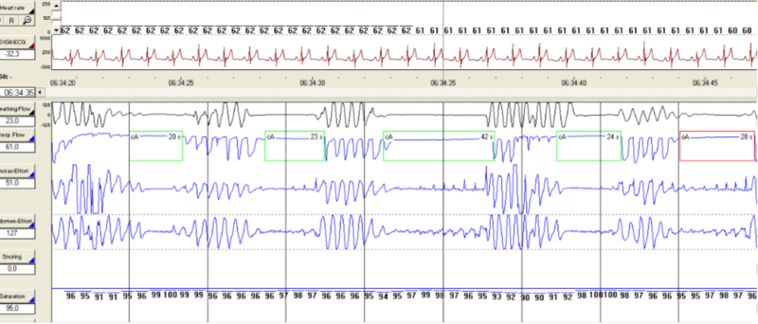
Sleep Apnea
Notes:
You may have heard of sleep apnea, but might not know a lot of details about it.

Slide 2
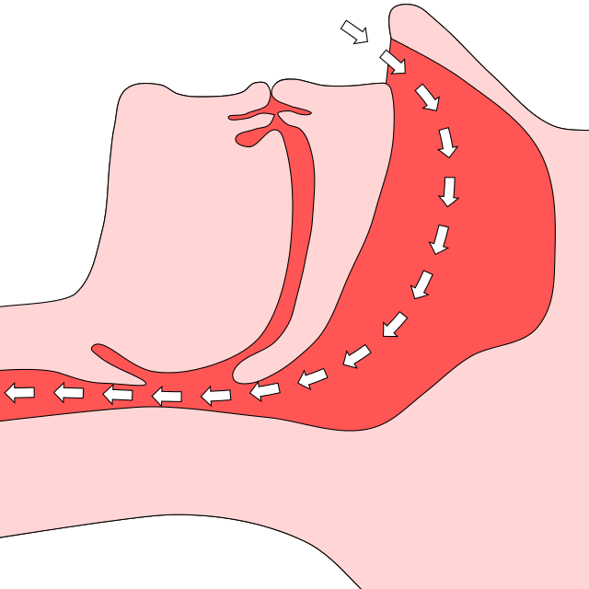
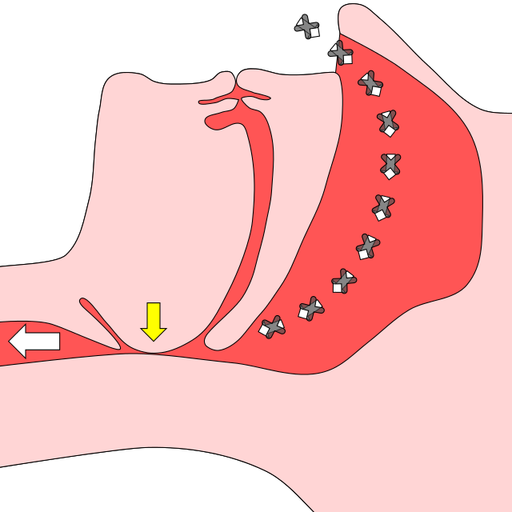
Open airway
Air flows through airway:
normal
Closed airway
Airflow blocked repeatedly during sleep: sleep apnea
Notes:
Normally, when you breathe, air travels through an open airway. The figure on the left shows this with airflow depicted by the white arrows.
With sleep apnea, the airway narrows or even closes off completely, making it hard for your body to get the air and oxygen it needs. This is shown on the right where there’s a blockage at the site of the yellow arrow. Air squeezing through a small opening of a narrowed airway can cause snoring. But many people who have sleep apnea don’t snore. And some people who snore don’t have sleep apnea.

Slide 3
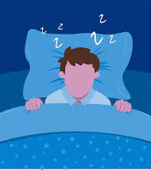
Sleep apnea →
Can stop breathing 100’s of times per night
Makes good night’s sleep very difficult.
Notes:
When your airway closes off – which can happen hundreds of times per night – your brain wakes you up just enough to jumpstart breathing.
Even if you don’t remember waking up repeatedly overnight, sleep apnea makes it very difficult to get a good night’s sleep.

Slide 4
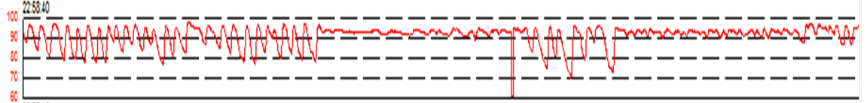
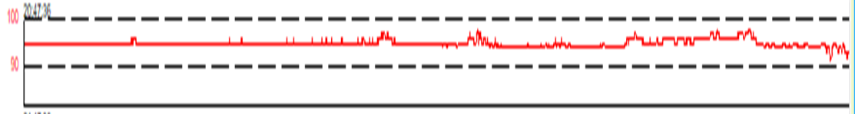
Oxygen levels during one hour with Sleep Apnea
Oxygen levels during one hour without Sleep Apnea
Notes:
As shown in the top panel, oxygen content of the blood can swing up and down, in a roller-coaster pattern, when you sleep with untreated sleep apnea.
Normally, as shown in the bottom panel, oxygen levels in the blood should remain high and fairly steady.

Slide 5
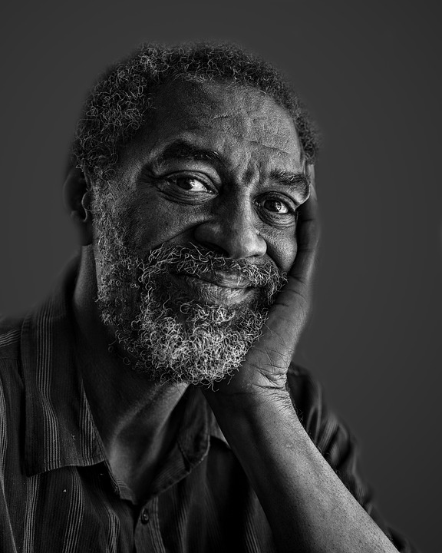



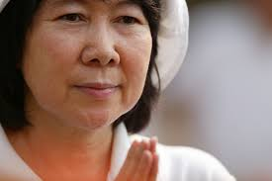





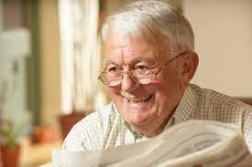
Who gets sleep apnea?
Anyone.
Notes:
So, who gets sleep apnea? You may think that only overweight people, or only men get sleep apnea. But sleep apnea affects all kinds of people.

Slide 6
About three quarters (75%) of people with stroke have sleep apnea.
Notes:
And as it turns out, sleep apnea is extremely common after stroke. It affects most - about three quarters - of stroke patients.

Slide 7
What kind of symptoms can sleep apnea cause?
Sleepiness
Lack of energy
Forgetfulness
Irritability
Heartburn
Notes:
What kinds of symptoms can sleep apnea cause?
Sleep apnea may cause you to feel really sleepy during the day. Or even if you don’t feel sleepy, you may lack energy, feel tired, or sense fatigue.
Sleep apnea can also cause you to have trouble concentrating and remembering things, or feel irritable, or sad without knowing why. During the night, you might have heartburn, or sweat a great deal, or get up to use the bathroom multiple times.

Slide 8
What kind of conditions can sleep apnea contribute to?
High blood pressure
Diabetes
Heart attacks
Strokes
Trouble recovering from stroke
Notes:
Even if you have no symptoms from sleep apnea, it can increase your risk for high blood pressure, diabetes, heart attacks, heart rhythm problems, heart failure, and other important medical conditions. Most relevant to you, sleep apnea may contribute to another stroke or may make it harder to recover from a stroke.

Slide 9
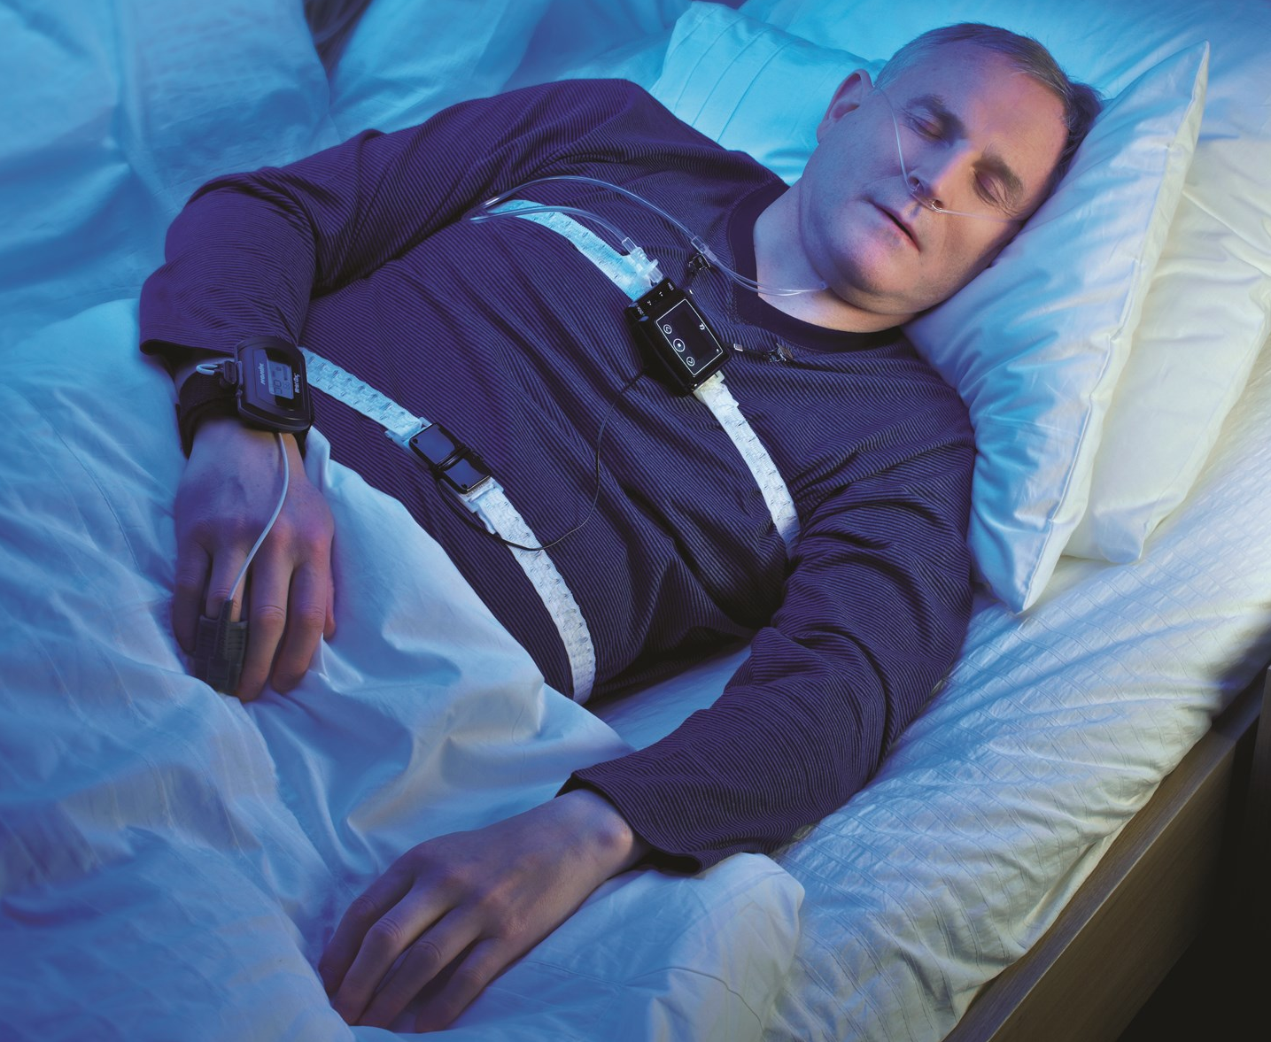
How do I know if I have sleep apnea?
GET TESTED!
Notes:
Many stroke patients with sleep apnea don’t realize that they have it, because they don’t have any symptoms from it.
The way to know if you have sleep apnea is to be tested for it. Testing your breathing overnight can be done with a pretty simple test.

Slide 10
Sleep apnea testing
Assesses:
Your breathing
Oxygen level in your blood
Movement of your chest and abdomen as you breathe
Notes:
Sleep apnea testing assesses the airflow through your nose, the oxygen level in your blood, and the expansion of your chest and abdomen as you breathe.

Slide 11
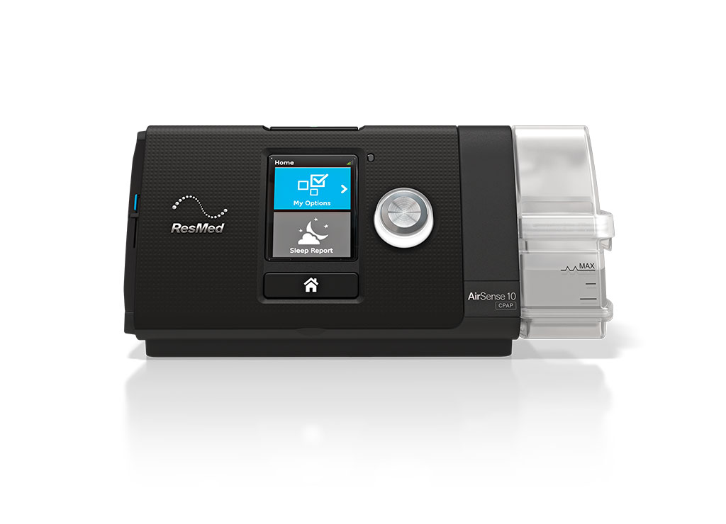
Is sleep apnea treatable?
Sleep apnea is very treatable!
Notes:
Thankfully, sleep apnea is very treatable!

Slide 12
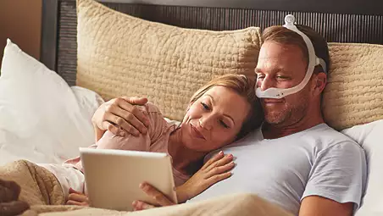
Commonly used treatment:
CPAP
Notes:
A standard, commonly used treatment for sleep apnea is called CPAP. It fixes the collapse of your airway when you use it overnight.

Slide 13
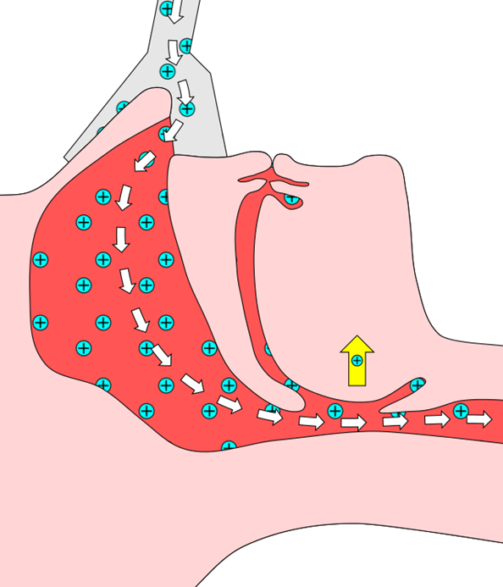
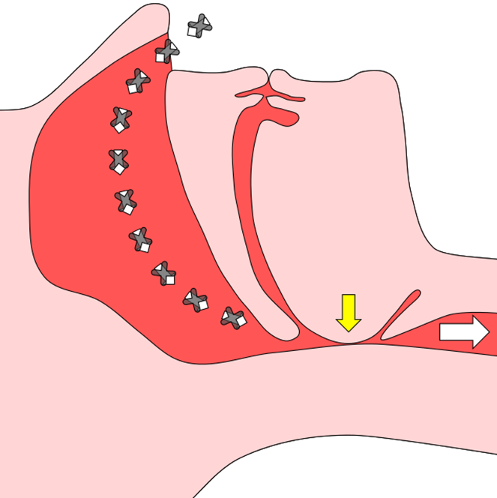
Sleep apnea: airway is closed
CPAP supplies air under pressure to hold open the airway. Normal breathing is restored.
Notes:
CPAP corrects breathing problems from sleep apnea. As you see here, the collapsed airway that occurs during sleep is fixed by pressurized air provided by CPAP.

Slide 14
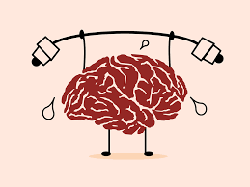
CPAP might improve your stroke symptoms, such as:
Weakness
Numbness
Speaking
Walking
Thinking
Notes:
By helping with breathing, CPAP might improve stroke symptoms such as: weakness, numbness, speaking, walking, and thinking.

Slide 15

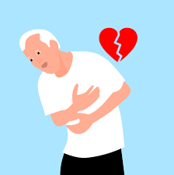

CPAP might also help prevent
Another stroke
A heart attack
Death
Notes:
CPAP might also help prevent another stroke, a heart attack, or even death.

Slide 16
Other possible benefits of CPAP
Less sleepiness
Increased energy levels
Better mood
Increased quality of life
16
Notes:
There are other possible benefits of CPAP. CPAP might help improve sleepiness, increase energy, improve mood, and increase quality of life.

Slide 17
Summary: sleep apnea
Affects most people with stroke
Involves blockage of airflow while you sleep
Is a risk factor for another stroke, heart attack, and death
May make it harder for you to recover function after a stroke
Can be treated with CPAP
Notes:
So to summarize, sleep apnea affects the majority of people with stroke; involves blockage of airflow while you sleep; puts you at increased risk of another stroke, a heart attack, and death; and may make it harder for you to recover function after your stroke.
Normal breathing can be restored with CPAP use.

Slide 18
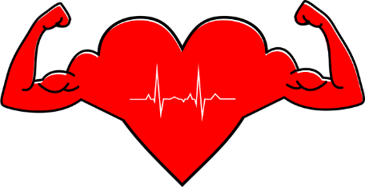
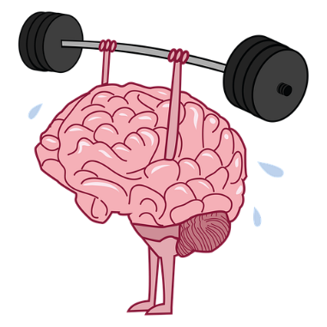

One Hitch:
CPAP can only have benefits ….
… If you use it!
Notes:
We think CPAP could have many important health benefits, especially after a stroke.
However, we know that to have a chance at those benefits, CPAP has to be used when you sleep.

Slide 19


Stroke can be a new start for a healthy lifestyle
CPAP can be a new start for your breathing
Notes:
Stroke can be a new start for a healthy lifestyle.
CPAP can be a new start for your breathing.

Slide 20
The clinical trial, Sleep SMART, will get you tested for sleep apnea and give you an opportunity to try out CPAP
Notes:
The clinical trial, Sleep SMART, will get you tested for sleep apnea and give you an opportunity to try out CPAP

