Slide 1

Annual Research Performance Progress Report
(RPPR)
https://era.nih.gov/grantees/submit-reports/rppr.htm

Slide 2
Where:
There is no RPPR form available for download. Submit RPPR data through eRA Commons. The links for each type of RPPR are accessed through the Commons Status tab.
Who:
Only the Principal Investigator (PD/PI) or their delegate can initiate RPPRs. For multi-PD/PI grants only the Contact PI or the Contact PD/PI’s delegate can initiate the RPPR.
Signing Officials typically submit the annual RPPR but may delegate preparation (Delegate Progress Report) on behalf of the Contact PD/PI. Additionally, a Principal Investigator (PI) can delegate “Progress Report” to any eRA Commons user in their organization with the Assistant (ASST) role.
https://era.nih.gov/erahelp/commons/default.htm#cshid=1021

Slide 3
What:
Annual RPPR – Used to describe a grant’s scientific progress, identify significant changes, report on personnel, and describe plans for the subsequent budget period or year.
How:
Follow the instructions in the RPPR User Guide to submit the RPPR
https://era.nih.gov/erahelp/commons/default.htm#cshid=1032
When:
Annual RPPR Due Date is approximately 45 days before the next budget period start date of August 01, 2021 (most centers).

Slide 4
The RPPR requests various types of information, including:
  Major goals and objectives of the project
  What was accomplished?
  Plans for the next reporting period
  Please document any challenges (COVID-19 delays, furloughs, etc.)
  Budget
https://era.nih.gov/erahelp/commons/Commons/rppr/rppr_fields.htm

Slide 5
Is this Human Subject Research? YES (change from last year)
DRAFT TEXT: “There is no change to the human subject work from what was originally proposed in the application. This award supports administrative tasks for this NIH StrokeNet Regional Coordinating Center. Direct human subject (research participant) activity is funded through separate NIH StrokeNet clinical trial awards”

Slide 6
Questions?
https://grants.nih.gov/faqs#/research-performance-progress-report.htm
Joanna.Vivalda@nih.gov

Slide 7
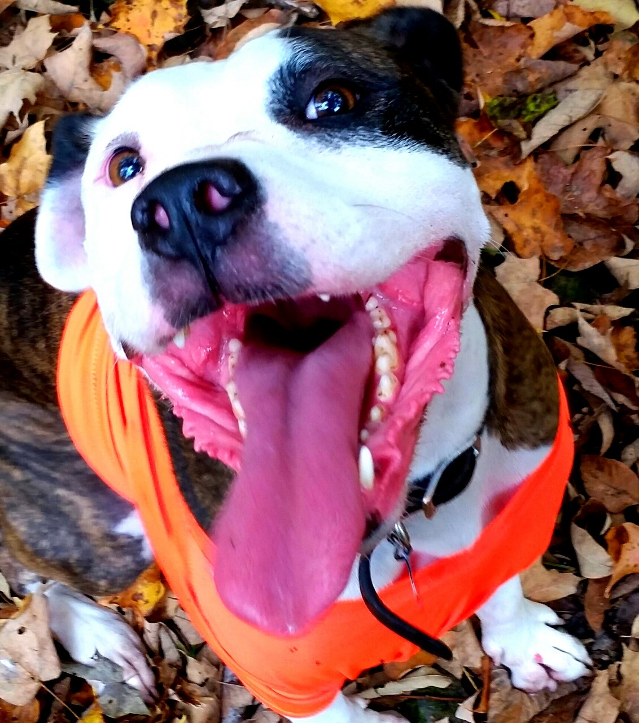
Thank you for all you do!

