Slide 1
Screening Tools for Trial Recruitment
Heena Olalde, RN, MSN University of Iowa
Angela Lewis, MSN, RN, CNRN, SCRN University of Iowa
Cathy Revere, BS University of Utah
Christina Marchese, BS University of Florida

Slide 2
Objectives
Discuss various tools for screening including:
  Manual screening
  Get With the Guidelines
  TriNetX
  Slicer Dicer

Slide 3
Manual Screening

Slide 4

Manual Screening
Screen inpatient roster on a daily basis
Round with the clinical team
Use methods such as EPIC Chat, Microsoft Teams, or other HIPPA compliant options to have the clinical team notify you about potential patients.
Screen outpatient roster for trials with longer recruitment windows
Be included on stroke alerts for acute stroke trials
RAPID emails or RAPID AI app

Slide 5
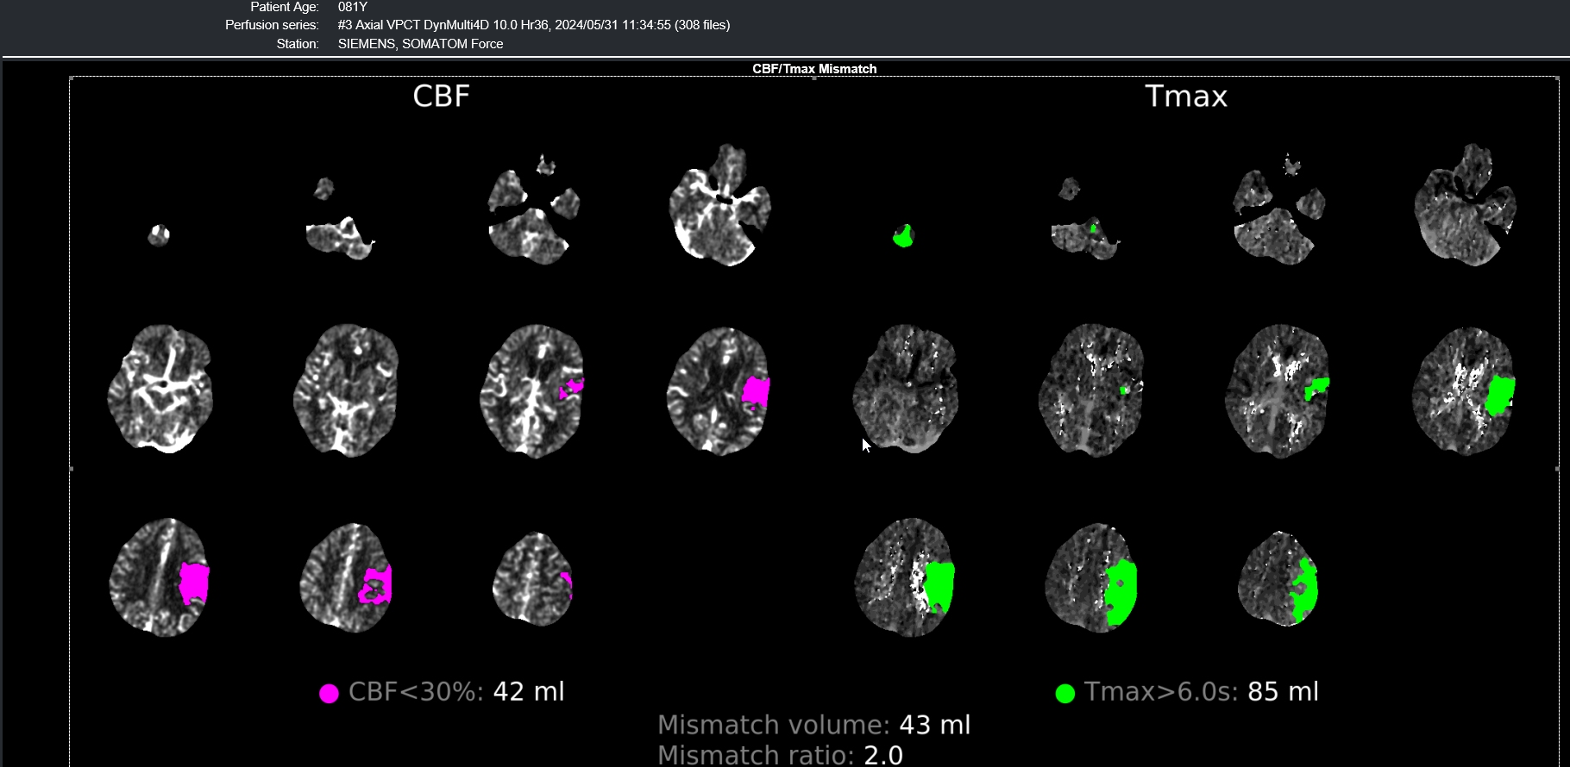
RAPID image

Slide 6
Get With the Guidelines

Slide 7
Stroke Net and GWTG abstractor
Angela Lewis MSN, RN, CNRN, SCRN
Registry Quality Improvement Engineer-Stroke
Quality Improvement Program (QuiP)
June 26, 2024

Slide 8

Objectives
To understand the role of an abstractor
To Increase knowledge of how an abstractor can assist with research

Slide 9
What do abstractors do?
Enter data into GWTG stroke based on principal discharge dx
Use of data dictionary
Entering the data-average 700 data points per patient
Abstraction time of 25 minutes to 1.5 hours
  Examples include:
    NIHSS upon admission, discharge, and 24 hours (if got tPA/TNK or MT)
    Last known well
    Categories of medications
    Past med history
    …much more!
Notes:
There are a total of 1518 data points that can be review and added. Time to abstract each patient is anywhere from 25 minutes to 1.5 hours depending on ability to locate elements in the patient chart. If you are interested in knowing all elements contact your abstractor and they can provide you a copy of the paper abstraction form for you to review.

Slide 10
Part of the Stroke Team
Provide monthly data reports to team
Collaborates with stroke team–coordinators and providers
Identifies area for process improvement as needed

Slide 11
Research Collaboration

Slide 12
How abstractor helps
Assist with stroke query reports for trial criteria (feasibility questionnaires)
GWTG-Aspire
  All ICH stroke population entered including if they have a Hx of Afib
  National GWTG ASPIRE team reviews data
  Aspire team identifies opportunities
  Research RN collaborates with abstractor regarding possible opportunities
  Abstractor crosswalk GWTG number to patient medical record number and information shared
Notes:
Time it takes to run information.

Slide 13
TriNetX

Slide 14
NINDS StrokeNet
Recruitment by TriNetX
Cathy Revere
Cathy.Revere@hsc.utah.edu

Slide 15
TriNetX Global Network
Healthcare organizations and life science companies that aggregate and harmonize clinical data pulled from EMR.
  120+ healthcare organizations
  250 million patient records
  40 billion clinical observations

Slide 16
TriNetX Data
TriNetX can pull data from the electronic medical records of one Health Care Organization (HCO) or many.
Diagnosis codes | Demographic Data
Visit dates | Medications
Lab and genetic testing | Procedures

Slide 17
TriNetX Utility
Protocol Development - assess feasibility of entry criteria early in protocol development using de-identified data from HCOs.
Feasibility - Sites can use de-identified data to accurately assess their HCO patients to determine site level feasibility.
Recruitment - Sites can find patients who meet entry criteria. Then single HCO patients can be re-identified to create a recruitment list. IRB approval is required to re-identify records.

Slide 18
TriNetX Access
Each institution has their own process for providing staff and faculty access TriNetX.
With institutional approval you can login with a username, password, and two-factor authentication.
After logging in, go to “Studies” and select “Create New” in the right upper corner.
Set includes a title, summary, phase, and NCT# (if available)

Slide 20
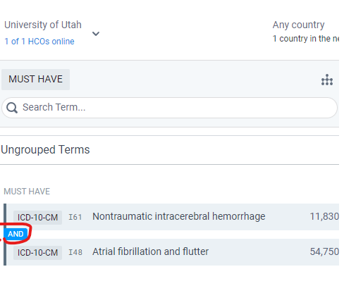
Inclusion Criteria
Search terms can be entered as a diagnosis, lab value, or clinical finding. Typically, the more inclusive code is higher in the search.
Inclusion Criteria - typically entered in the MUST HAVE column
Each criteria is followed by AND/OR. IE: ASPIRE requires Afib and ICH.

Slide 21
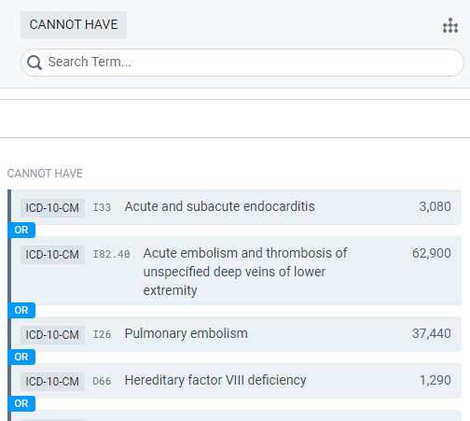
Exclusion Criteria
Exclusion criteria are best placed in the CANNOT HAVE column.
Most Exclusion criteria are separated by the OR since any one criteria is exclusionary.

Slide 22
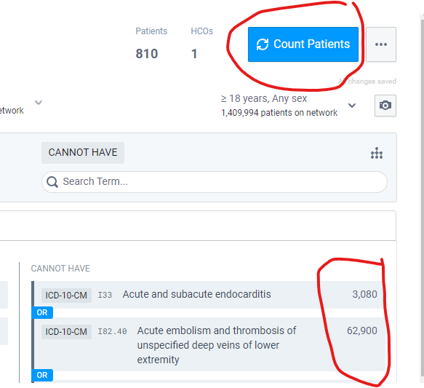
Patient Counts
Click “Count Patients” to see how a new term changes your search.
The number of patients is rounded, so an uncommon condition may not change your patient count.
Each search term shows how many patients in the HCO have the term searched.

Slide 23
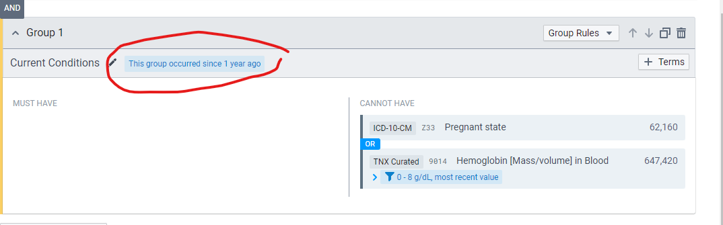

Grouped Terms - To allow people who are not pregnant or anemic in the past year, create a group of search codes with a time limit. This increased our patient count from 810 to 880.

Slide 24
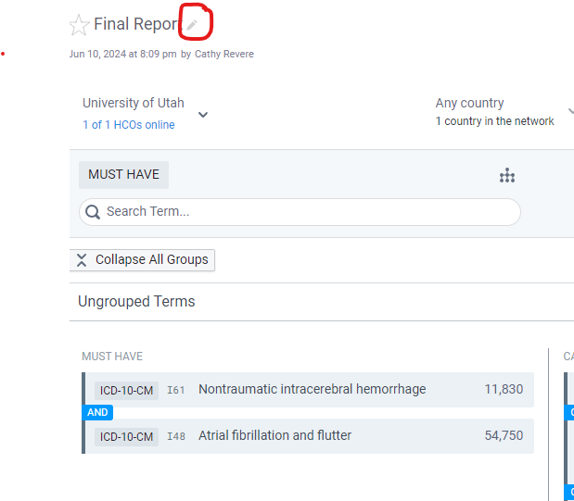
Reports and Dataset
Each time you add or remove a search term, you can create a dataset report by clicking “Count Patients”
Name the report by clicking the pencil icon in the upper left corner and typing the report name.
Click Count Patients and the report will populate on the far right.

Slide 25
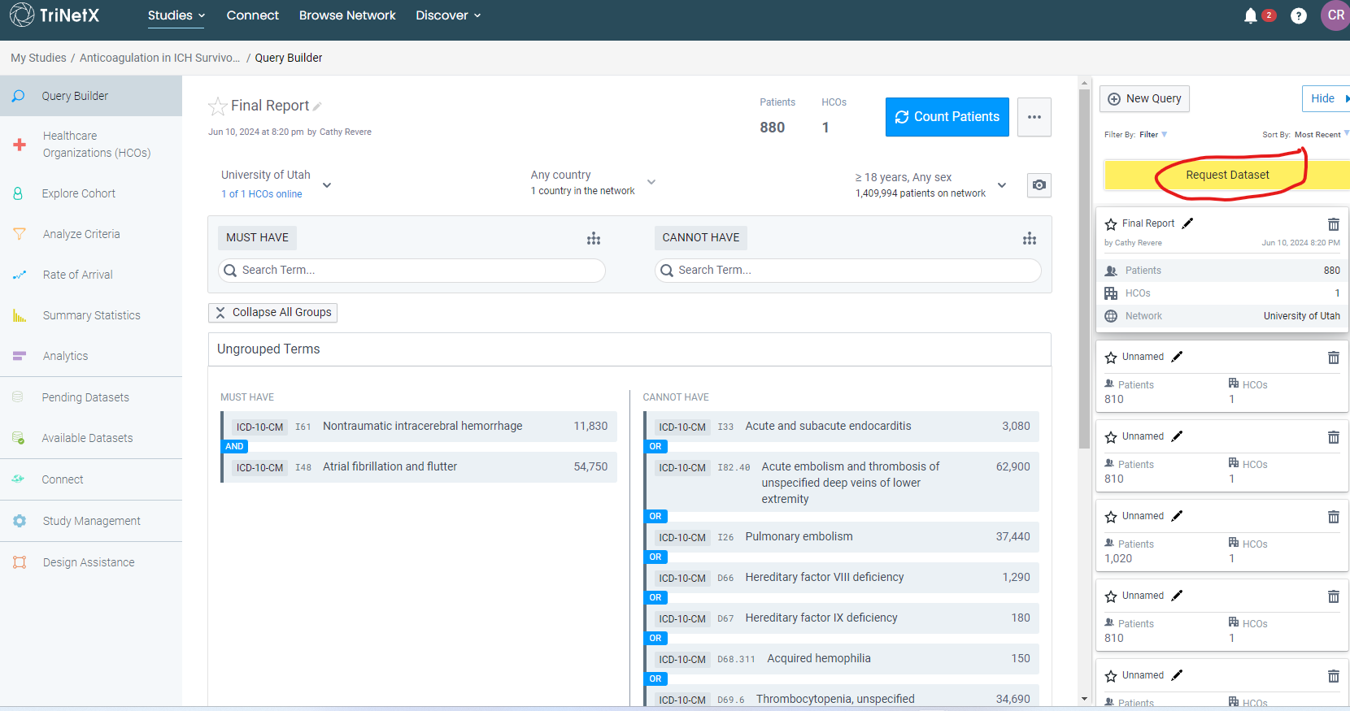
Student Success.

Slide 26
Analyze Cohort and Request Recruitment list
After you select the Dataset, your institution will review and send the data set.
On the left side of the screen are tools to analyze the cohort further.
To obtain a list for recruitment, submit a copy of the Dataset Report to your data science team along with you IRB #. Our list had MRN, gender, address, and distance from our site.
Under the Study menu go to Study Management then Team to add other users within your institution.

Slide 27
Slicer/Dicer

Slide 28

Using Slicer Dicer for Stroke
Clinical Trial Feasibility and Screening
Christina Marchese, BS

Slide 29

AGENDA
Welcome/Introductions
Using Slicer Dicer for Clinical Trial Feasibility
Using Slicer Dicer to Screen Patients for Stroke Clinical Trials
Using Slicer Dicer to Screen Patients for Acute vs. Preventative Stroke Clinical Trials

Slide 30
Introduction
Objectives of the presentation:
  Understand Slicer Dicer's functionality
  Evaluate feasibility for clinical trials
  Evaluate and refine patient lists for trial eligibility
  Understand the key differences in screening for acute vs. preventative stroke trials
  Learn to apply stroke-specific filters and criteria
  Learn to apply specific filters and criteria for each type of trial

Slide 31
What is Slicer Dicer?
A self-service data exploration tool integrated within Epic EHR
Allows users to filter and analyze patient data
Used for research, quality improvement, and clinical decision support

Slide 32
Accessing Slicer Dicer
Log in to Epic EHR with your credentials
Navigate to the Slicer Dicer tool (usually under the analytics or reporting section)
Select the appropriate data model (Patient, Encounter, Diagnosis, etc.)

Slide 33
Using Slicer Dicer for Clinical Trial Feasibility + Screening
Selecting a Data Model
  Choose the data model relevant to your clinical trial
    Patient: General health and demographic data
    Encounter: Visit-specific information
    Diagnosis: Specific diagnoses
    Procedure: Surgical or procedural data
    Medication: Prescribed medications
    Lab Results: Laboratory test results

Slide 34
Defining the Population
Set initial broad parameters to include potential stroke patients
  Example: All patients in neurology or emergency departments
Ensure broad criteria to start, then refine by narrowing down based on specific criteria.
Acute Stroke Trials:
  Set initial broad parameters to include potential acute stroke patients
    Example: All patients in emergency or neurology (neurocritical care departments
Preventative Stroke Trials:
  Set initial broad parameters to include patients at risk of stroke or with a history of stroke
    Example: Patients in primary care or cardiology departments

Slide 35
Applying Filters-Feasibility
Demographic Filters: Age, gender, race, location
  Example: Patients aged 50-70
Clinical Filters: Diagnoses, medications, lab results, procedures, vital signs
  Example: Stroke diagnosis (ICD-10 codes)
Temporal Filters: Time frames for events
  Example: Diagnoses within the last year
  Example: Encounters/admits for stroke diagnosis within the last year (or so)

Slide 36
Applying Filters-Stroke Screening
Demographic Filters: Age, gender, race, location
  Example: Patients aged 40-80
Clinical Filters: Diagnoses, medications, lab results, procedures, vital signs
  Focus on stroke-related criteria
  Diagnoses: Stroke (ICD-10 codes I63, I64)
  Symptoms: Hemiplegia, aphasia
  Medical history: Hypertension, atrial fibrillation
Temporal Filters: Time frames for recent stroke events
  Example: Stroke diagnosis within the last 6 months

Slide 37
Applying Filters for Acute Stroke Trials
Acute Stroke Trials: Focus on treatment during or immediately after a stroke
Demographic Filters: Age, gender, location
  Example: Patients aged 50-80
Clinical Filters: Focus on acute stroke criteria
  Diagnoses: Acute ischemic stroke (ICD-10 codes I63.x)
  Symptoms: Sudden onset of neurological deficits
  Timing: Stroke event within the last 24-48 hours
  Imaging: Recent CT or MRI confirming stroke
Temporal Filters: Very recent events (last 24-48 hours)

Slide 38
Applying Filters for Preventative Stroke Trials
Preventative Stroke Trials: Focus on preventing the occurrence or recurrence of stroke
Demographic Filters: Age, gender, location
  Example: Patients aged 40-70
Clinical Filters: Focus on stroke risk factors and history
  Medical history: Prior stroke (ICD-10 codes I63.x), TIA (ICD-10 codes G45.x)
  Risk factors: Hypertension, atrial fibrillation, diabetes, hyperlipidemia
  Medications: Antihypertensives, anticoagulants, statins
  Lab Results: Elevated cholesterol levels, HbA1c levels for diabetes
Temporal Filters: Longer timeframe, focusing on historical data and ongoing risk factors

Slide 39
Combining Criteria (Feasibility + Screening)
Use Boolean logic to refine search
  AND/OR logic for combining filters
Feasibility
  Example: Diabetes AND recent HbA1c > 7%
Screening
  Example: Stroke diagnosis AND recent hypertension AND age 40-80
Acute Stroke Trial
  Example: Acute ischemic stroke diagnosis AND symptom onset within last 24 hours AND recent imaging
Preventative Stroke Trial
  Example: Prior stroke history AND hypertension AND aged 40-70 AND current anticoagulant use

Slide 40
Reviewing and Refining Results
Review initial results
Adjust filters to fine-tune the patient pool
Ensure the population size is feasible and relevant
Review initial patient pool
Adjust filters to ensure manageable and relevant patient list
  Refine based on trial-specific inclusion/exclusion criteria
Acute Stroke Trials: Focus on immediate eligibility, proximity to clinical settings, and rapid intervention
Preventative Stroke Trials: Focus on long-term risk factors, patient adherence, and preventive measures

Slide 41
Exploring and Analyzing Data
Visualize data using charts, graphs, and tables
  Example: Bar charts for age distribution, pie charts for gender distribution
  Acute: Time to treatment, symptom onset
  Preventative: Risk factor distribution, medication adherence
Drill down into specific subsets for detailed analysis
  Example: Patients with recent hospitalizations

Slide 42
Saving and Sharing Results
Save search criteria and configurations
  Allows quick re-running of analyses
Export data (CSV, Excel) following privacy regulations
Share findings with colleagues or team members

Slide 43
Case Study Example
Real-world example of using Slicer Dicer for a clinical trial feasibility study
  Define population: Patients with Type 2 Diabetes
  Apply filters: Age 40-65, HbA1c > 7%, prescribed Metformin
  Review and refine: Ensure manageable number of participants
  Explore and analyze: Visualize demographic distribution and lab results

Slide 44
Case Study Example
Real-world example of screening for a stroke clinical trial
  Define population: Patients with ischemic stroke
  Apply filters: Age 40-80, recent stroke, no anticoagulant therapy contraindications
  Review and refine: Ensure patient list matches trial criteria
  Explore and analyze: Visualize comorbid conditions and demographic spread

Slide 45
Case Study Examples
Acute Stroke Trial: Screening for thrombolysis candidates
  Define population: Patients with acute ischemic stroke
  Apply filters: Onset within last 3 hours, no anticoagulant therapy
  Review and refine: Ensure immediate eligibility
  Analyze: Visualize time from symptom onset to hospital arrival
Preventative Stroke Trial: Screening for secondary prevention candidates
  Define population: Patients with prior stroke or TIA
  Apply filters: Aged 40-70, hypertension, on statins
  Review and refine: Ensure adherence to preventive medications
  Analyze: Risk factor distribution and demographic spread

Slide 46
Tips for Effective Use
Ensure proper training on Slicer Dicer and data interpretation
Regularly update search criteria based on feedback
Collaborate with IT, clinical teams, and research coordinators
Adhere to privacy laws and institutional policies

Slide 47
Slicer/Dicer Workshop
The link below is a public workshop to slicer dicer found online through Yale Med for reference.
  https://medicine.yale.edu/media-player/slicerdicer-workshop/
Also check with your local institution’s EPIC team to see if they offer trainings.

Slide 48
Conclusion
Recap key points:
  Accessing and navigating Slicer Dicer
  Applying and combining stroke-specific filters for acute and preventative trials
  Reviewing, refining, and analyzing data
  Saving and sharing results
Encourage practice and continuous learning
Q&A session

Slide 49
Conclusion
Use various tools to help with screening for the StrokeNet Trials
  Manual screening
  Get With the Guidelines
  TriNetX
  Slicer Dicer
    Recap key points:
      Accessing and navigating Slicer Dicer
      Applying and combining stroke-specific filters for acute and preventative trials
      Reviewing, refining, and analyzing data
      Saving and sharing results
    Encourage practice and continuous learning

Slide 50

Questions?

