Slide 1
Short Form Process
Presented by NCC Regulatory and NDMC

Slide 2
What is a Short Form?
  When individuals who do not understand English are to be enrolled in a clinical study, IRBs and investigators must ensure that the information given to such prospective participants, or their legally authorized representatives is in language understandable to the participants or their representatives.
  The short form method for obtaining informed consent should be used for the enrollment of a potential participant that does not understand English in a study for which no fully translated ICD is available in a language the individual understands.
  The short form method for obtaining informed consent is not available for use with eConsent at this time
  The short form method for obtaining informed consent can be used with remote consent if your local processes allow for this
Notes:
I am now going to go through the process of obtaining and using short forms. StrokeNet uses 2 central IRBs for their trials, UC IRB and ADVARRA, and I am going to explain the process for both central IRBs, starting with the UC IRB.

Slide 3
UC IRB Process
ASPIRE, SATURN, SISTER, Sleep SMART, STEP
All trials now have a bank of cIRB approved translated Short Forms that are available
Access to these forms is through WebDCU
The instructions for use and link are found in the Toolbox
  Category is “Instructions”
Also contains a bank of translated California Bill of Rights
Notes:
I am going to walk you through exactly how to locate the short form documents in WebDCU.

Slide 4
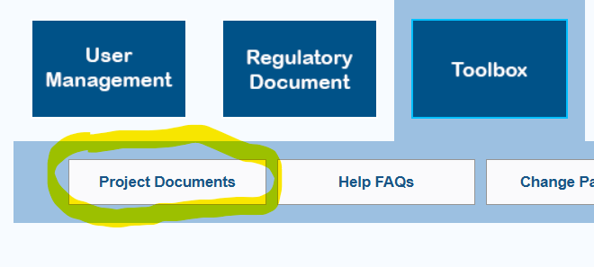
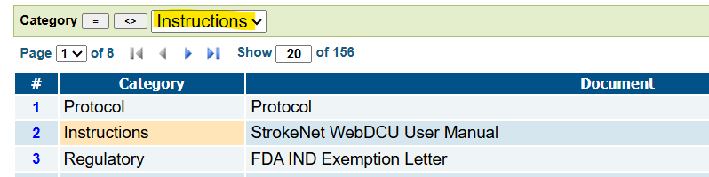
UC IRB Process
WebDCU Toolbox under Project Documents
Filter using the category “Instructions”
Notes:
Log in to WebDCU and go to your trials page. You click on Toolbox and then Project Document.
This will bring up a list of documents that you can sort. If you click on one under the Category Column listed as Instructions it will show up in the box at the top, as highlighted in the picture. You can then filter by clicking on the equal sign.

Slide 5
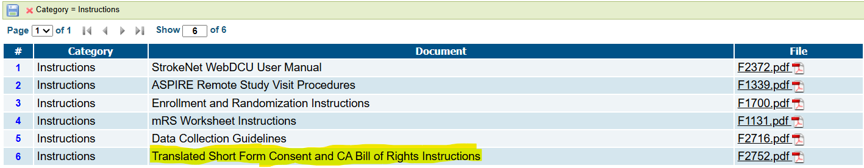
UC IRB Process
The document will be listed under a name similar to this one. Click on the PDF to open.
Notes:
This will then bring up a list of all instruction documents. One of those documents listed should have a name similar to “Translated Short Form Consent and CA Bill of Rights Instructions”
Click on the pdf to open. The file opened will be the instructions on how to use a SF and will have a link at the bottom.

Slide 6
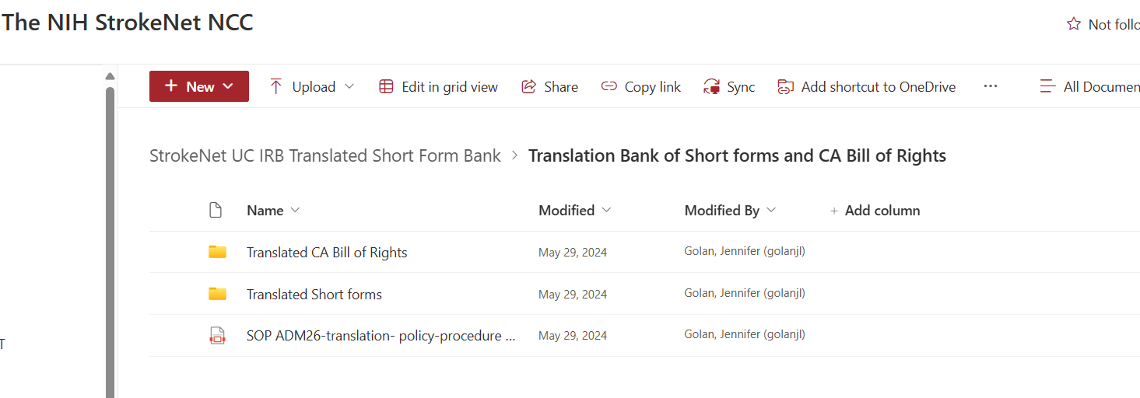
UC IRB Process
Link at bottom of PDF will take you the SharePoint that has folders with SOP and documents.

Slide 7
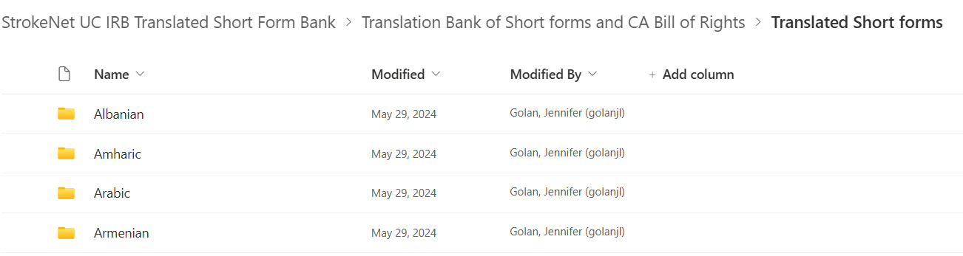
UC IRB Process
Short Forms and COTs are in folders listed in alphabetical order.
Notes:
That is the process of how to locate the SFs for the UC IRB. Now I will review how to use the SFs.

Slide 8
UC CIRB Short Form Process:
Investigator + Interpreter perform the informed consent process and provides an oral translation of the CIRB-approved English ICD.
  The oral presentation must be in a language understandable to the participant/LAR.
  Provide site-specific HIPAA authorization form, if applicable.
Investigator + Interpreter answers any questions from the prospective participant/LAR.
Participant/LAR given the CIRB-approved translated short form and a copy of the CIRB-approved English version of ICD, which serves as the written summary.
Witness (may be Interpreter) must be present and attest to the consent process and participant/LAR voluntary participation.
SOP ADM 26

Slide 9
UC CIRB Short Form Process:
Once the participant/LAR has consented and eligibility is confirmed, the English version of the CIRB-approved ICD is translated into the participant’s native language (coordinated by the NCC or Advarra) and CIRB approves for use.
The translated ICD must be provided to the participant within 30 days for the UC CIRB from initial consent with the short form process and the date of provision should be documented.
If your site used a site-specific HIPAA, this must also be translated by the site and provided to the participant
SOP ADM 26

Slide 10
Informed Consent Procedures for Participant/LAR Who Do Not Understand English is UNEXPECTED and a Fully Translated ICD is NOT Available -> Use a Short Form
 | Person Obtaining Consent | Interpreter | Impartial Witness | Participant / LAR
Performs the oral presentation of informed consent process | X | X
Present during the oral presentation of informed consent process | X | X | X must be fluent in the language of oral presentation | X
Signs Short Form |  |  | X* | X
Signs English Version of ICD | X |  | X*
Provide Fully Translated ICD within 30 days of Short Form Signature | X |  | X*^ | X
*interpreter may serve as the witness
^only if participant/LAR can not read or sign ICD
SOP ADM 26

Slide 11
UC IRB Process-SOP Number: ADM 26
Site investigators must provide the CIRB with a description of how interpreters for oral communication will be made available to participants during the consent process and while participating in follow-up for the study.
Sites should also describe if interpreters are utilized in person or remotely during the informed consent process.
Interpreters can be used as witnesses to the informed consent process; therefore, the site should describe their process for capturing the interpreter/witness signature if they are located remotely. This information should be documented on the StrokeNet CIRB Local Context Form.
Notes:
That is the UC IRB process. We are now going to switch to the ADVARRA IRB process.

Slide 12
ADVARRA IRB
CAPTIVA, CAPTIVA-MRI, FASTEST, FOCUS, VERIFY
Process similar to UC IRB, with highlighted differences
Bank of cIRB approved short forms available in ADVARRA portal
Found in Reference Materials tab
Click on ADVARRA IRB Reference Materials
Scroll to ADVARRA Generic Forms-courtesy copies
Please use “Revised Common Rule” version of SF
  DO NOT us “Old Common Rule” version

Slide 13

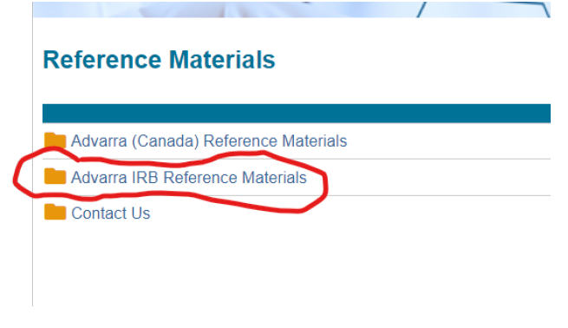
ADVARRA IRB
Reference Materials tab located in upper left-hand corner
Select “ADVARRA IRB Reference Materials” (red circle)

Slide 14
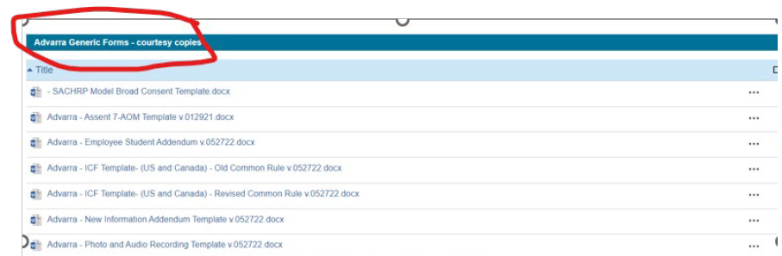
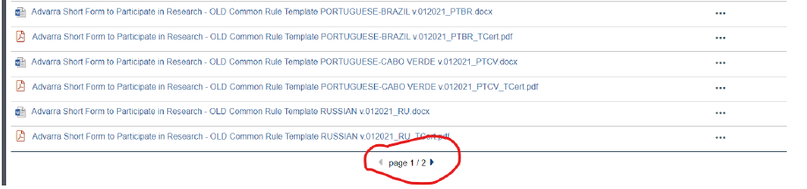
ADVARRA IRB
Scroll down to ADVARRA Generic Forms-courtesy copies
Scroll down and tab over to page 2

Slide 15
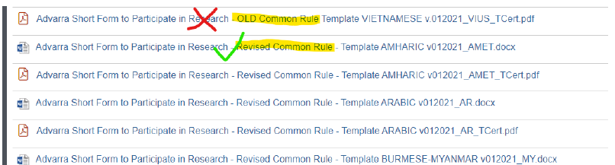
ADVARRA IRB
Please use the “Revised Common Rule” Short Form in the participant’s native language.
-DO NOT USE the “OLD Common Rule” Short Forms.
Certificate of translation is also available.

Slide 16
ADVARRA IRB
If Language You Need is Unavailable
  StrokeNet approved translated Short Form
  Local IRB approved Short Form
If using a SF outside of the ADVARRA bank, then the English Advarra Short Form IRB Oversight Addendum must be used to consent the participant.
  Informs the participant that Advarra is the IRB of Record
  The English Advarra Short Form IRB Oversight Addendum is located on the CIRBI portal on page 1 of the Advarra Generic Forms – courtesy copy (see previous instructions for navigation).
If a SF is used to consent, notify the NCC project manager and submit a modification to request a fully translated consent through the CIRBI portal.

Slide 17
Consenting Process-ADVARRA IRB HANDBOOK
A written summary embodying the basic and appropriate additional elements of consent must be submitted to and approved by the IRB (the IRB-approved long form English consent may be used as the written summary).
The oral presentation and the short form written document should be in a language understandable to the subject.
There must be a witness to the oral presentation.
When the person obtaining consent is assisted by a translator, the translator may serve as the witness.

Slide 18
Consenting Process-ADVARRA IRB HANDBOOK
If the translator is not serving as the witness, the translator name and /or ID number (for professional translational services providing only a translator ID number) should be documented on the short form along with the signature of the witness.
The subject, the subject’s parent/legal guardian or the subject’s LAR (if approved by the IRB) must sign and date the short form.

Slide 19
Consenting Process-ADVARRA IRB HANDBOOK
The witness must sign and date both the short form and a copy of the written summary.
  The witness, which may include family members, should be fluent in the participant’s language and should have observed the oral presentation of information.
  If the person obtaining consent uses a translator, the translator may ALSO serve as the witness.
  A member of the study staff may be the person who obtains informed consent and may be the translator, but CANNOT also be the witness.

Slide 20
Consenting Process-ADVARRA IRB HANDBOOK
The person obtaining consent must sign and date a copy of the written summary.
A copy of the short form and written summary must be given to the subject or the subject’s LAR.
For research involving children where the IRB requires that both parents/legal guardian provide parental permission, both parents/legal guardians should sign on the signature line.

Slide 21
Consenting Process-ADVARRA IRB HANDBOOK
HIPAA authorization: Use of a short form consent does not satisfy the requirements for authorization of Private Health Information (PHI) under HIPAA. The investigator should consult with the investigator’s institution to obtain a translated HIPAA authorization form and follow institutional policy for obtaining authorization from research subjects. Alternatively, investigators may contact Advarra to obtain a translation of an institution’s template HIPAA Authorization form.

Slide 22
Consenting Process-ADVARRA IRB HANDBOOK
The short form must state that the elements of informed consent required by the regulations (21 CFR 50.25 and 45 CFR 46.116) have been presented orally to the subject or the subject’s LAR.
  Additional Requirement for Studies Subject to the Revised Common Rule: The short form must additionally state that the key information required by 45 CFR 46.116(a)(5)(i) was presented first to the subject, before other information, if any, was provided.
  Note: ICH-GCP does not allow for use of a short form consent. Therefore, Advarra will generally not approve a short form consent for Canadian research. Canadian subjects must sign a translation of the IRB-approved study ICF in a language the subject can read and understand.
Notes:
That is the ADVARRA SF process

Slide 23
After Consenting Using a Short Form
Notify Project Manager Immediately
If ADVARRA trial, submit modification for fully translated ICF
Once IRB approval on fully translated ICD, must be provided to the participant within 30 days and the date of provision should be documented (UC IRB)
Notes:
Now I am going to hand it over to Jama to continue the discussion.

Slide 24
Short Form Monitor Review-
Frequently Asked Questions
I consented a subject with a short form and a full English informed consent. What should I upload it into WebDCU on my ICF CRF?
  Sites should upload a single PDF of:
    The short form
    The full English informed consent
    A note to file may be included but is not required.
How long do I have to reconsent the subject with the fully translated informed consent?
  StrokeNet SOP Adm 26 specifies that the translated ICD must be provided to the participant within 30 days and the date of provision should be documented

Slide 25
Short Form Monitor Review-
Frequently Asked Questions
Which parts of the full English informed consent document should the witness/translator sign and date?
  The designated witness blocks on the informed consent
    A witness/ translator should not complete the Statement of Consent, Statement of Authorization, or any optional study preferences on behalf of the subject on the fully English informed consent document.
Can I print the name of the subject on the fully English informed consent document?
  Yes, this is fine.

Slide 26
Short Form Monitor Review-
Frequently Asked Questions
What should I do if I’m unable to obtain the fully translated informed consent at a follow up visit?
  Contact your NCC project manager to ask for next steps.
The subject is physically unable to sign and date their name on the informed consent documentation. What should I do?
  Remember, good research documentation should be legible and attributable.
  The witnessed consent process should be used, and the subject should make their best effort to make their mark.

Slide 27
WebDCU Informed Consent CRFs
Currently the ICF case report forms do not capture whether a short form has been used.
  This makes tracking usage and ensuring timely reconsent very difficult.

Slide 28
WebDCU Informed Consent CRFs
How we’re improving the process:
  The informed consent CRFs will include a new question to collect data about whether a short form was used.
  If a short form is used, an automatic WebDCU email will alert the NCC that a short form has been used at your site.
  A new CRF will automatically populate in the subject binder.
    The new CRF will collect data about the fully translated consent, including uploading a PDF of the fully translated informed consent document.

Slide 29
Ongoing Updates to WebDCU F244
The following StrokeNet trials now/will soon track the specific use of short forms:
  ASPIRE
  CAPTIVA- Update in progress
  FASTEST
  FOCAS
  SATURN
  SISTER- Update complete
  SleepSMART
  STEP- Update complete
  VERIFY
Trial sites will be notified as the updates are complete.

Slide 30
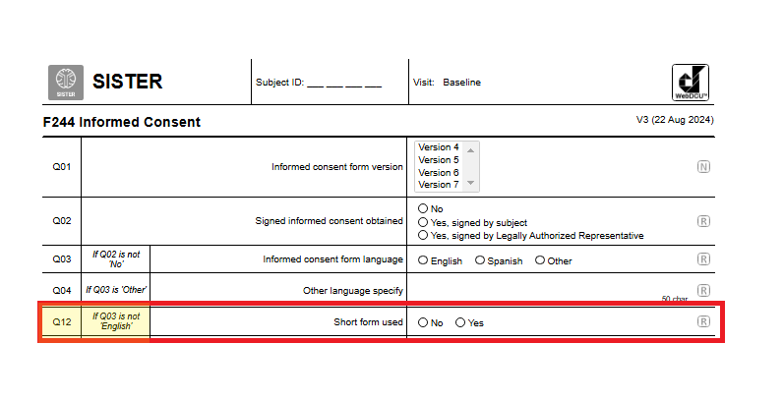
Ongoing Updates to WebDCU F244

Slide 31
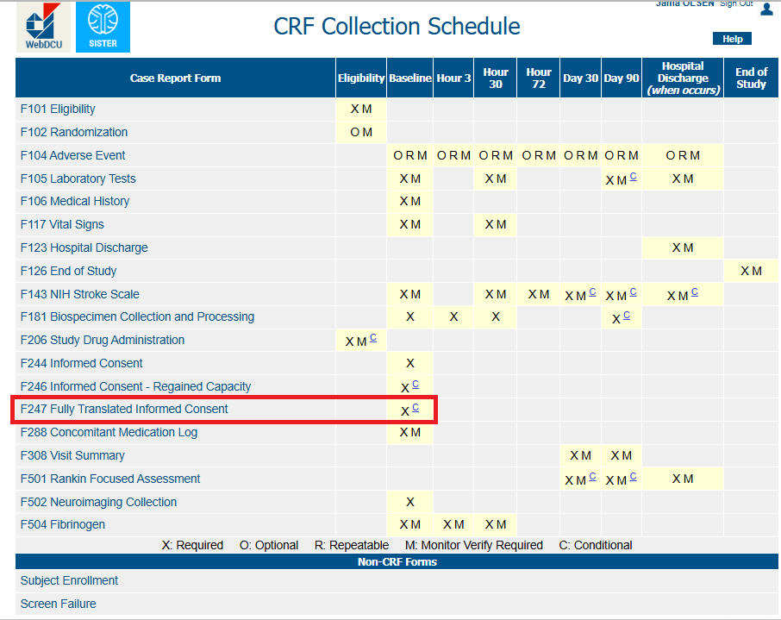
Ongoing Updates to WebDCU F244

Slide 32
Short Form Monitoring Questions?
ASPIRE- Helen Myers, myershe@musc.edu
CAPTIVA- Helen Myers, myershe@musc.edu
FASTEST- Katie Trosclair, trosclak@musc.edu
FOCAS-Caitlin Schaffner, schaffne@musc.edu
SATURN- Alyssa Straka, straka@musc.edu
SISTER- Jessica Griffin, simonsjl@musc.edu
SleepSMART-Katie Trosclair, trosclak@musc.edu
STEP- Caitlin Schaffner, schaffne@musc.edu
VERIFY- Natalia Hayes, hayesna@musc.edu

Slide 33
Last Questions?

