Slide 1
How can we work together to establish evidence for brain stimulation in treating post-stroke complications
Expand neuromodulation portfolios in post-stroke recovery;
Expand post-stroke motor impairment to other post-stroke complications
Shift from “too many single center under-powered study” to organized “multi-center Phase II/III study”, speed up the stroke translation process.

Slide 2
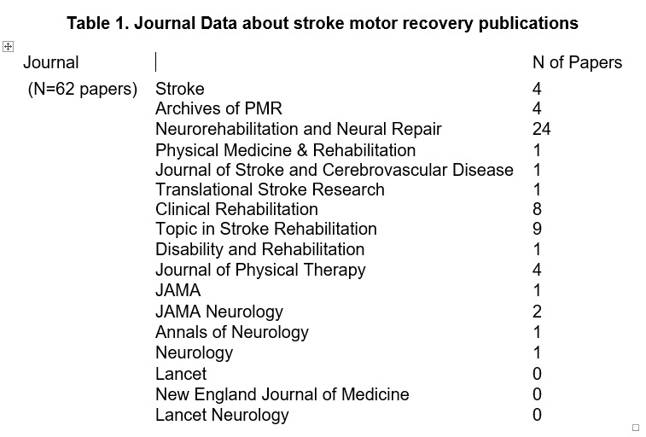
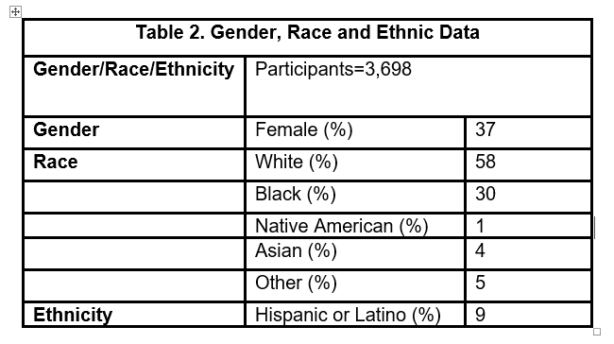
Increase Diversity of Enrolled Subjects in Stroke Recovery Studies
TRANSPORT2 Strategy and experience
(half enrollments are non-Caucasians and primary outcome retention rates is 95%)
To clearly explain that the purpose of informed consent is to protect, not to relinquish, participants’ rights.
To use straightforward and easy-to-understand layman language in the consent forms.
To focus attention on the fact that participants will be kept up to date on scientific developments in this field throughout the trial.
To emphasize that the overall goal is to recruit study subjects regardless of race or ethnicity.
To tag research visit to clinical visit.
Engage caregiver in addition to study subject. Protection of confidentiality
Increase travel reimbursement for subjects lives far away from medical center

Slide 3
Quality Control and Study Procedure Standardization for Multi-center Stroke Recovery Study
Increase scientific rigor and make future meta-analysis sensible
Reduce outcome variability and increase power
Increase research capacity for future studies
In TRANSPORT2, we piloted and implemented a series of quality control and study procedure standardization
Study procedure standardization ( tDCS, CIMT, TMS and Imaging protocol)
Outcome assessment certification and recertification
Fugl-Meyer Upper extremity Scale: online certification, in-person workshop, self-assessment, certification, re-certification every 4 participants, central adjudication.
First pass rate on FM-UE is < 70%. Recertification pass rate is >95%.

Slide 4
Experimental Interventions
Neurostimulation – made it through study section
Pharmacological Agents
SSRIs, GABAergic, etc.
Cell-based therapies
Are there common themes during the review process that we can address as a group?
Platform Trials

Slide 5
Satani et al. Frontiers in Neurology

Slide 6
StrokEnet Training Umbrella Program for Rehabilitation Centers (SET UP RC)
The paucity of research in rehab settings (especially IRFs) represents a major gap in the stroke field and poses major barriers to optimizing rehabilitation therapy, developing interventions and predictive outcomes models, and characterizing the underlying pathophysiology contributing to recovery
StrokeNet has over 150 rehabilitation centers and presents a unique opportunity to leverage the expertise of the network to address gaps
Create a StrokeNet Rehab Program of Training and Educational Cores
Build a network of clinical and academic partners within the StrokeNet rehabilitation facilities to conduct high quality research in future StrokeNet multicenter stroke rehabilitation and recovery clinical trials

