Slide 1
Challenges in Recruitment for Rehab & Recovery Trials
Jennifer Majersik, MD, MS
Utah StrokeNet PI
&
Cheryl Bushnell, MD, MHS
Wake Forest StrokeNet PI

Slide 2
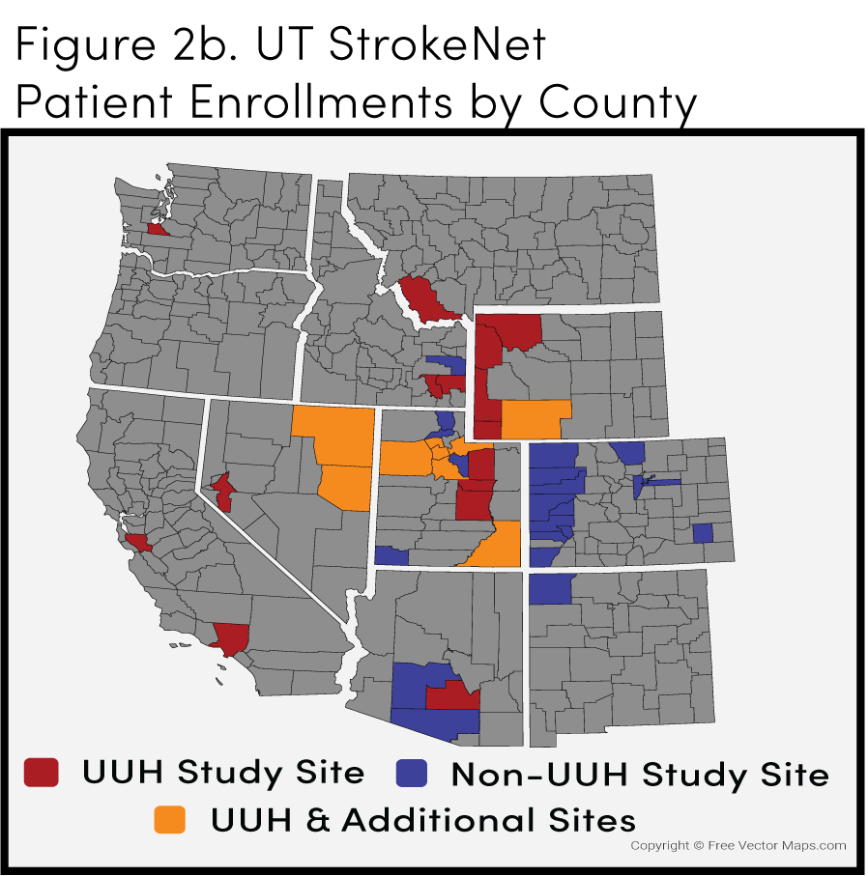
Problem Statement
1) Recovery trials can’t enroll stroke patients who don’t live next to a large rehab center
rural & frontier
transportation difficulties – either themselves or their partners
Notes:
Don’t / can’t

Slide 3
An example of 3 month outcome

Slide 4
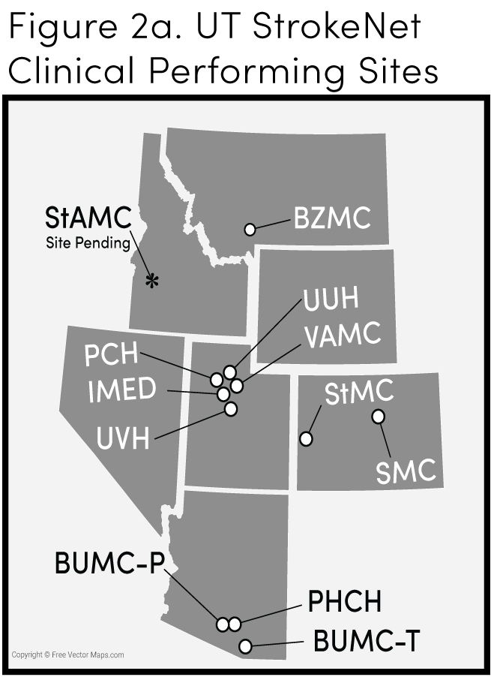
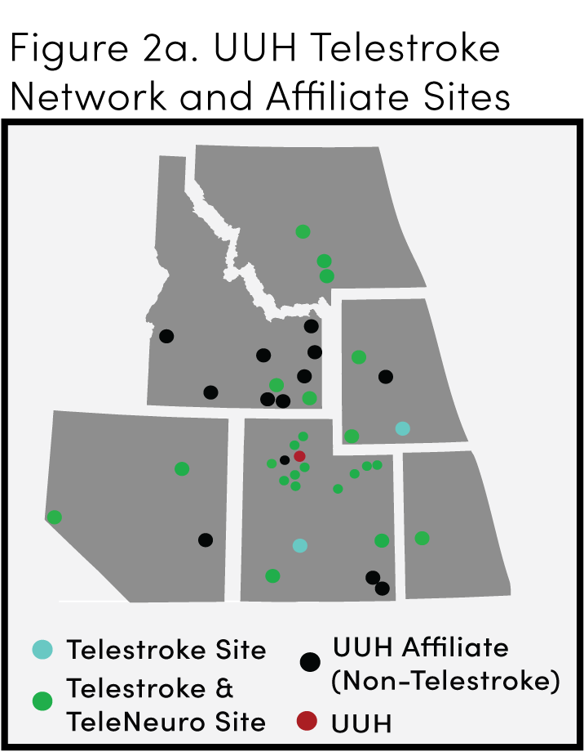
Problem Statement
2) Non-academic center participation lags
They don’t have the equipment or financial resources to participate in most recovery trials
Stroke severity - hospital mismatch
Notes:
Don’t / can’t

Slide 5
What do our remote & transportation-challenged patients want?
In-person visits that can be flipped to remote visits
Telemed or phone-based follow ups
Blood draws & MRIs that can be done in their communities
To receive research in their communities

Slide 6
What do our Coordinators and PI’s want?
Flexibility in method of follow up visits
Same reimbursement for remote and in-person visits
More reimbursement if team travels to the patient
A trial inclusive of ALL of our sites -- even non-academic centers & community hospitals without fancy equipment and with therapists needing salary support

Slide 7
What do our Coordinators and PI’s want?
Acceptable Outcomes Assessments:
Telemed-based
Tablet-based, web forms
Wearables
2 types of outcomes assessments possible (in person vs. remote)
If trials cannot be pragmatic:
Should RCC’s be penalized for not being able to broadly run specialized trials?
Is StrokeNet the right mechanism?

Slide 8
Thinking broadly about rehab & recovery designs and outcomes

Slide 9
Combining acute and recovery trials
Two-for-one example
Aim 1: Acute treatment with standard modified Rankin Scale
Aim 2: Continued follow-up with rehab intervention (structured therapy/coaching) and patient-centered recovery outcomes
Decentralized outcome assessments to accommodate remote recruitment and retention

Slide 10
Combining prevention and recovery trials
Two-for-one example:
Aim 1: prevention strategy with recurrent stroke and/or major adverse cardiovascular event and/or imaging outcome at 1-2 years
Aim 2: Impact of prevention strategy on recovery (cognition, quality of life, function, etc)
Decentralized outcome assessments to accommodate remote recruitment and retention

