Slide 1




FOCAS Trial
Focal Cerebral Arteriopathy Steroid Trial
Pediatric Comparative Effectiveness Trial
Heather Fullerton, MD, MAS
Mitchell Elkind, MD, MS
Joe Broderick, MD
Neurorads: Max Wintermark, MD
Neurorads: Nick Stence, MD
ID: Charles Grose, MD
Biostats: Jordan Elm, PhD
Adam Hartman, MD
NIH/NINDS project scientist

Slide 2
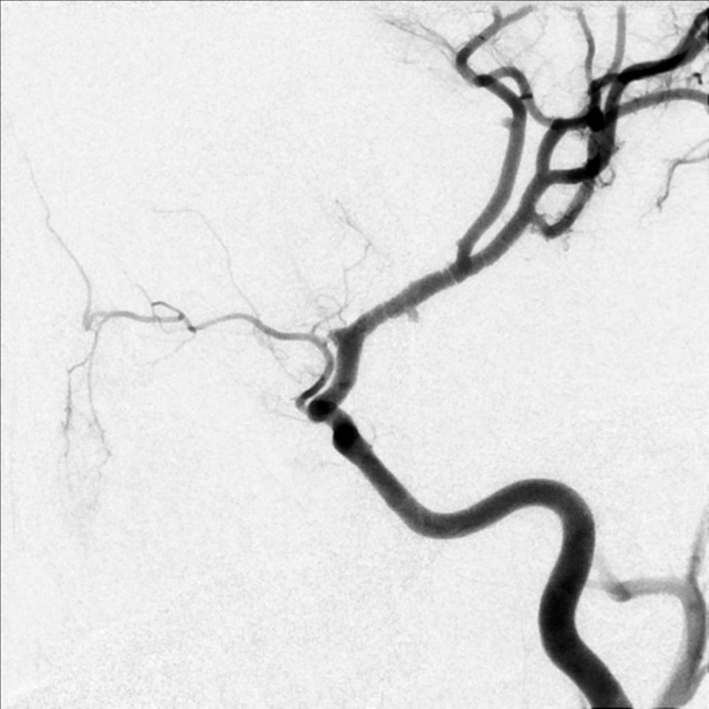
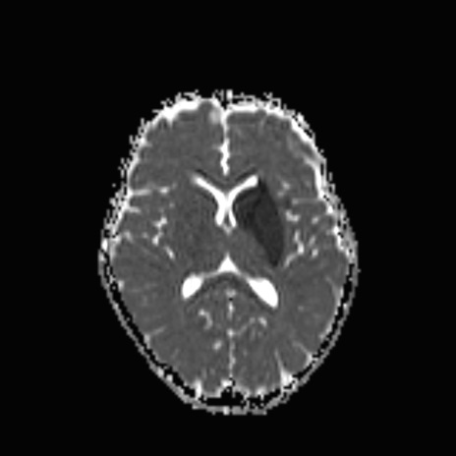

A cerebral arteriopathy of healthy children: acute, unilateral, predominantly anterior circulation, inflammatory, monophasic
Early imaging: banding on conventional angiography
MRA: mild irregularity or even normal
Lenticulostriate infarct
Wintermark, AJNR 2017
Notes:
TCA Cases: 26-14145 ; 445-17265; 12-19004; 55-2964; 29-4223; 26-11307 (extensive banding)

Slide 3
Natural history: worsens over days to weeks….
then improves over months
FCASS=FCA Severity Score
Fullerton, Wintermark, Stroke 2018

Slide 4

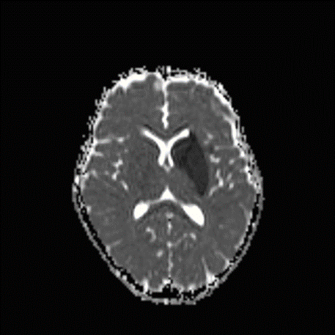
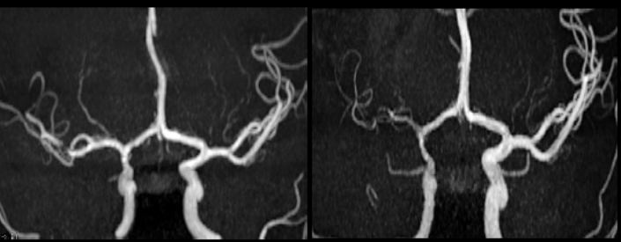
FOCAS Final Design: comparative effectiveness trial
Primary Aim: To compare the effectiveness of two current strategies for treating suspected FCA with corticosteroids:
(A) early treatment of all suspected FCA patients
(B) treatment of only FCA patients that demonstrate disease progression

Slide 5

FOCAS Primary Aim
Hypothesis: Early corticosteroid treatment to prevent disease progression (Strategy A) leads to overall better outcomes than delayed treatment in the subset that progress (Strategy B).
Primary endpoint (Imaging Outcome): Change in FCASS on MRA from baseline → 1 month (centrally determined; blinded)
Secondary endpoints (Imaging & Clinical Outcomes):
  FCASS and Infarct volume at 1 month
  Pediatric Stroke Outcome Measure at 6 months and 12 months (when available)
Baseline
1-month
Secondary Aim:
Safety and tolerability of steroids in this setting (including safety concern around steroids and herpesvirus infection)

Slide 6
FOCAS Participants:
Children with suspected FCA
Inclusion Criteria
Exclusion Criteria*
1-18 years
Stroke or TIA w/in 96 hrs
Imaging c/w early FCA
  Can include lenticulostriate infarct with normal MRA!
Able to return for 1 month MRI/A, same magnet strength
Alternate etiology known
Risk factors for an alternate etiology
  moyamoya, cardioembolism, traumatic dissection
Imaging c/w alternate etiology
  Old or bilateral infarcts
Contraindication to steroids
*Full list in FOCAS protocol

Slide 7
Child with stroke or TIA that may be due to FCA
Included if :
All inclusion/exclusion criteria met
Legal guardians give informed/sign consent
Able to return for 1 month MRI/A
N=80
1:1
Randomization
A: Start corticosteroids, aspirin, and supportive care
B: Start aspirin and supportive care
N=40
N=40
Clinical Observation & 5-day MRI/A
Disease Progression
No Disease Progression
Start corticosteroids; continue aspirin, and supportive care

Slide 8
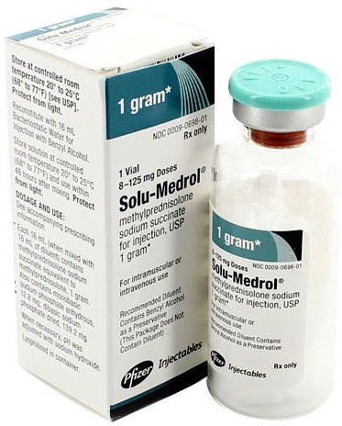
Intervention: Corticosteroids & Aspirin
Standard steroid “pulse” followed by oral taper
  Methylprednisolone IV 30 mg/kg/day (max 1 g/day) x 3 days
  prednisolone (or prednisone) taper po
    1 mg/kg/day (max 40 mg) x 2 weeks, then 0.5 mg/kg/day (max 20 mg) x 2 weeks
Arm A: treat immediately (ASAP, max 24 hrs of randomization)
Arm B: treat if/when disease progression consistent with FCA
Both arms will receive:
  aspirin, per FOCAS Protocol
  supportive care, per FOCAS Clinical Guidelines
Required
Recommended

Slide 9
FOCAS Updates
Officially started on February 1st, 2023
Meeting UG3 milestones
28 sites moving through the start-up process
  CTAs Sent: 22 / CTAs Fully Executed: 10
  CIRB Submitted: 10 / CIRB Approved: 4
First DSMB meeting in June 2023 with no major protocol changes
New FOCAS study materials just approved by the CIRB and will be distributed to sites soon
  Version 1.3 of the protocol and the ICFs
  Patient/Family recruitment materials including enrollment videos in English & Spanish
  Other patient-facing material: baseline interview, tolerability questionnaire, outcomes metrics

Slide 10
FOCAS Updates
The first version of the MOP was sent to sites, including the following appendices:
  Neuroradiology Guidelines
  FCA Clinical Guidelines
  Pharmacy Guidelines
The Lab Manual and Neuroimaging Manual are almost finalized
Sites now have access to WebDCU; CRFs will be done by Oct. 16th
Training: first protocol training completed; second protocol training on Oct. 18th and 30th
  Also completed: Neuroradiology training and a site investigator meeting at the CNS meeting
On track to have the first sites open to enrollment by the end of the month (UT Houston, Washington University, UCSF)
Goal of first patient enrolled by January 2024

Slide 11

FOCAS Team
UCSF Core
Heather Fullerton –PI
Maria Kuchherzki – Project Manager (Finances)
Kathleen Colao – Project Manager (Operations)
Christine Fox – UCSF Enrolling Site Investigator & Hotline support
Other Core Investigators
Mitch Elkind MD – MPI, Columbia
Adam Hartman – NIH project scientist
Max Wintermark – radiology
Nick Stence – radiology
Charles Grose – infectious disease
NDMC (MUSC)
Jordan Elm PhD – NDMC MPI
Jessica Griffin MHA – NDMC Associate Director
Jocelyn Anderson MPH – NDMC Program Manager
Rebecca Harrison MPH – Data Manager
Caitlin Schaffner MPH – Site Monitoring Manager
NCC (U Cincinnati)
Joseph Broderick MD – NCC PI
Amy Sulken – Project Manager
Jamey Frasure PhD RN – Administrative Co-Director
Laura Benken MBA – Administrative Co-Director
Sasha Simms- site contact for subcontracts
Aimee Nance- site contact for subcontracts

Slide 12

Questions?
UCSF Contacts:
Heather.Fullerton@ucsf.edu
Kathleen.Colao@ucsf.edu
NCC Contact: Amy Sulken
Sulkenay@ucmail.uc.edu

