Slide 1
SISTER Strategy for Improving Stroke Treatment Response
Eva Mistry, MBBS, MSCI, FAHA
Associate Professor, University of Cincinnati

Slide 2
SISTER Principal Investigators
Eva Mistry, MBBS, MSCI
SISTER Protocol PI
Guy Reed, MD, MS
TS23 Inventor and IND holder
Jordan Elm, PhD
Statistical PI
Pooja Khatri, MD, MSc
SISTER Contact PI

Slide 3
SISTER Trial Managers
Sarah Bailey, MS
Prime Project Manager
Aaron Perlmutter, MPH, MSW
Site Monitoring Manager
Katie Stever, MPH
NDMC Data Manager
Pam Plummer, MSN, RC, CCRC
NCC Project Manager

Slide 4
SISTER Study Timeline
July- October 2023
Grant Notice of Award (NoA) and 38 sites selected
Fall 2023
Sites complete CTA & cIRB with 4-6 weeks of receipt
January 2024
Investigator meeting (1/18)
Drug shipping
March 2024
First participant enrolled
IRB and FDA approval obtained
December 2023
MOPPs released to sites
February 2024
Monthly webinars start
PM office hours start
SISTER Site Kick-off Call
Individual site imaging training
1st DSMB Meeting

Slide 5
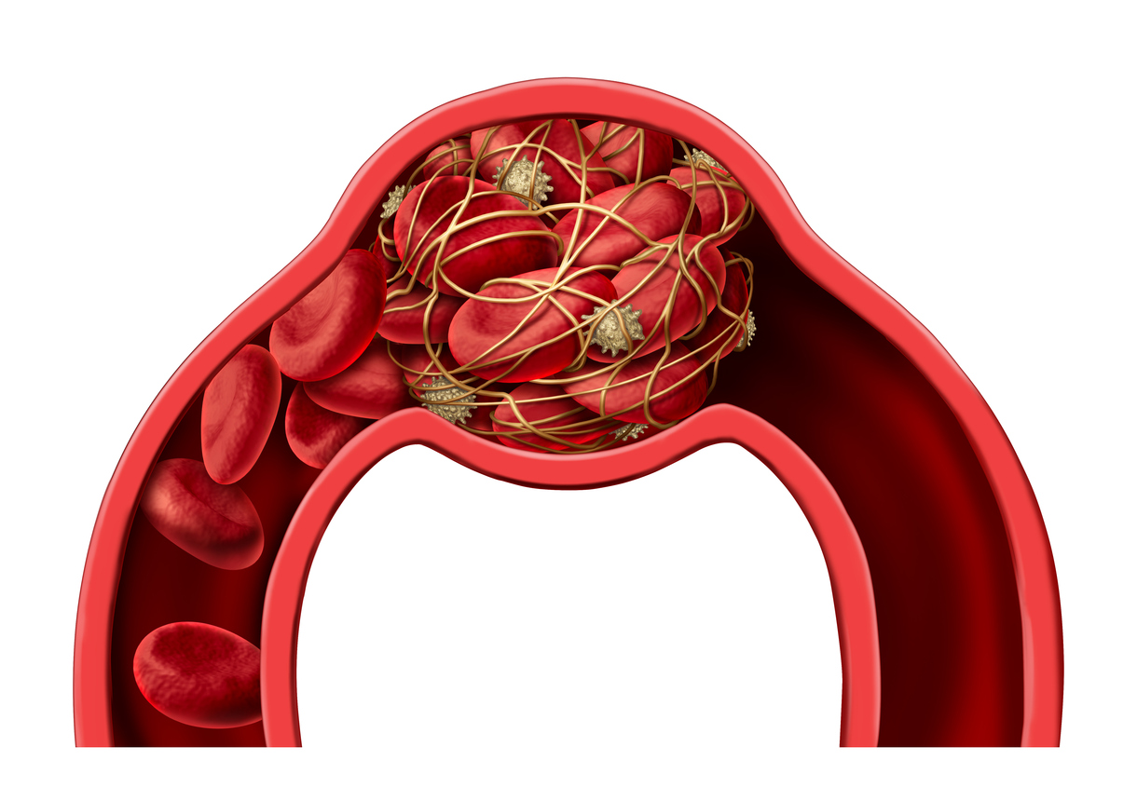
SISTER: Study Drug Background
Plasmin Plasminogen
Red Blood Cells
Platelets
tPA/TNK
Fibrin
Alpha-2 Antiplasmin
TS23

Slide 6
SISTER: Study Description
Phase-2
Prospective
Randomized
Placebo-controlled
Blinded
Adaptive Dose Finding

Slide 7
SISTER: Primary Objective
To identify a dose of TS23 that is safe and potentially more efficacious than placebo for the treatment of patients from 4.5 to 24 hours of ischemic stroke onset, who have evidence of core-penumbra mismatch on perfusion imaging.

Slide 8
SISTER: Basic Study Information
Study Population:
300 adults (≥18 years) with acute ischemic stroke
Study Duration:
Study intervention:
Participant Duration:
54 Months
4 dosing arms and a control arm
90 days

Slide 9
SISTER: Primary Endpoints
Safety:
Efficacy:
ANY intracranial hemorrhage (ICH) visualized on the CT scan 30 (±6) h after study drug administration.
NIH Stroke Scale Score at 30 (±6) h after study drug administration (adjusted for the baseline in analysis)

Slide 10
SISTER: Secondary Endpoints
Biomarker Efficacy:
Clinical Efficacy:
a2AP activity at 3 (±1) h after completion of therapy
Matrix metalloproteinase-9 (MMP-9) plasma level 3 (±1) h after completion of therapy.
% tissue reperfusion on 30 (±6) h perfusion scan compared to the baseline
Improvement in level of global disability (Modified Rankin Scale (mRS) distribution) at 90 (±7) days.
Frequency of excellent functional outcome (mRS 0-1) at 90 (±7) days.
National Institutes of Health Stroke Scale (NIHSS) at 72 (±12) h (or discharge if sooner; adjusted for the baseline in analysis)

Slide 11
Secondary Endpoints Continued
Pharmacokinetics & anti-drug antibodies:
Safety Endpoints:
Pharmacokinetic (PK) profile of TS23 at 3 (+/-1) h and 30 (±4) h after completion of therapy and 90 (±7) days.
Evaluation of anti-drug antibodies to TS23 (at baseline and 90 (±7) d follow-up visit).
Incidence of symptomatic ICH within 30 (±6) h of study drug administration (SITS-MOST definition)
Incidence of non-ICH major or clinically relevant non-major bleeding within 30 (±5) days of study drug administration.
Non-bleeding, serious adverse events (SAEs) within 90 (±7) days
Incidence of stroke-related and all-cause deaths within 90 (±7) days
Plasma fibrinogen levels at 3 (+/-1) h after completion of study drug administration

Slide 12
SISTER: Study Schema

Slide 13
SISTER: Study Population
≥18 years old with anterior circulation acute ischemic stroke
NIHSS ≥6 and are able to receive study drug within 4.5-24 hours after stroke onset (or last known well)
Evidence of core-penumbra mismatch on baseline perfusion imaging

Slide 14
SISTER: Key Inclusion Criteria
Age 18 years and older
Suspected anterior circulation acute ischemic stroke
Presenting NIH Stroke Scale score ≥ 6
Favorable baseline neuroimaging consisting of all of the following:
ASPECTS of 6 or more on CT (or ASPECTS of ≥ 7 on MRI
Favorable perfusion imaging on CT perfusion (CTP)/MR-perfusion weighted imaging (PWI) consisting of all of the following:
Mismatch ratio of penumbra:core >1.2
Mismatch volume >10 cc
Core <70 cc
Able to receive assigned study drug within 4.5 to 24 hours of stroke onset or last known well.
Able to receive assigned study drug within 90 minutes of qualifying perfusion imaging.*

Slide 15
SISTER: Key Exclusion Criteria
Received/planned clinical IV thrombolysis/EVT
Pre-stroke modified Rankin score (mRS) >2
GP IIB/IIIA inhibitors <14 days
Positive urine pregnancy test
Receiving renal dialysis, regardless of creatinine
Other standard alteplase exclusion criteria

Slide 16
SISTER Sites

Slide 17
SISTER Site PIs and PSCs
Site Name | Site Principal Investigator | Primary Study Coordinator
Ascension St. John | Dr. Rahul Rahangdale | Stacie Merritt
Barnes Jewish Hospital | Dr. Charles Kircher | Jenny Babka
Brigham and Women’s Hospital | Dr. Rahula Mahajan | Quinn Rademaker
Christiana Hospital | Dr. Jason Nomura | Rich Baker
Grady Memorial Hospital | Dr. Michael Frankel | Alicia Escobar
Harborview Medical Center | Dr. David Tirschwell | Lauren Klein
Houston Methodist Hospital | Dr. Vivek Misra | David McCane
Jackson Memorial Hospital | Dr. Gillian Gordon-Perue | Andrea Escobar
Kaiser Permanente Los Angeles | Dr. Navdeep Sangha | Vanessa Audea

Slide 18
SISTER Site PIs and PSCs
Site Name | Site Principal Investigator | Primary Study Coordinator
MHealth Fairview Southdale | Dr. Muhammad Affan | Julie Scherber
MHealth Fairview | Dr. Muhammad Affan | Julie Scherber
Massachusetts General Hospital | Dr. Aneesh Singhal | Elaina Hill
Mayo Clinic Phoenix | Dr. Gyan Kumar | Erica Boyd
MUSC | Dr. Christine Holmstedt | Caitlan LeMatty
Memorial Hermann | Dr. Andrew Barreto | Prasen Marella
Mount Sinai West | Dr. J Mocco | Cynthia Nguyen
Mount Sinai Hospital | Dr. J Mocco | Cynthia Nguyen
North Shore University Hospital | Dr. Rohan Arora | Kirendra Pasram

Slide 19
SISTER Site PIs and PSCs
Site Name | Site Principal Investigator | Primary Study Coordinator
NYP Columbia | Dr. Shivani Ghoshal | Angela Valazquez
NYU Langone- Brooklyn | Dr. Aaron Lord | Maria Cotrina
OSU Wexner Medical Center | Dr. Jan Bittar | Luke Herren
PRISMA Upstate | Dr. Sanjeev Sivakumar | Reilly Leonard
Rhode Island Hospital | Dr. Farhan Khan
SUNY Upstate | Dr. Claribel Wee | Lena Deb
Sutter Medical Center | Dr. Manoj Mittal | Dawn Lenakakis
Temple University Hospital | Dr. Nina Gentile | Hannah Reimer
USCD Health La Jolla | Dr. Royya Modir | Maryo Jajo

Slide 20
SISTER Site PIs and PSCs
Site Name | Site Principal Investigator | Primary Study Coordinator
USCD Hillcrest Hospital | Dr. Royya Modir | Maryo Jajo
UF Health Shands Hospitals | Dr. Amita Singh | Amy Holland
United Hospital | Dr. Ganesh Asaithambi | Maxwell Kaiman
University of Chicago | Dr. Shyam Prabhakaran | Elida Romo
University of Cincinnati | Dr. Yasmin Aziz | Marchelle Nowell-Bostic
University of Iowa Hospital | Dr. Malik Ghannam | Heena Olalde
University of Utah | Dr. Vivek Reddy | Theodore Rock
UNTHSC/Methodist | Dr. Balaji Krishnaiah | Quentin Thacker
UVA Medical Center | Dr. Amna Sohail | Andrew Weko
Wake Forest Baptist | Dr. Jakita Baldwin | Daniela Castro Castillo
Yale New Haven Hospital | Dr. James Giles | Michael Kampp

Slide 21
SISTER Study Timeline
July- October 2023
Grant Notice of Award (NoA) and 38 sites selected
Fall 2023
Sites complete CTA & cIRB with 4-6 weeks of receipt
January 2024
Investigator meeting (1/18)
Drug shipping
March 2024
First participant enrolled
IRB and FDA approval obtained
December 2023
MOPPs released to sites
February 2024
Monthly webinars start
PM office hours start
SISTER Site Kick-off Call
Individual site imaging training
1st DSMB Meeting

Slide 22
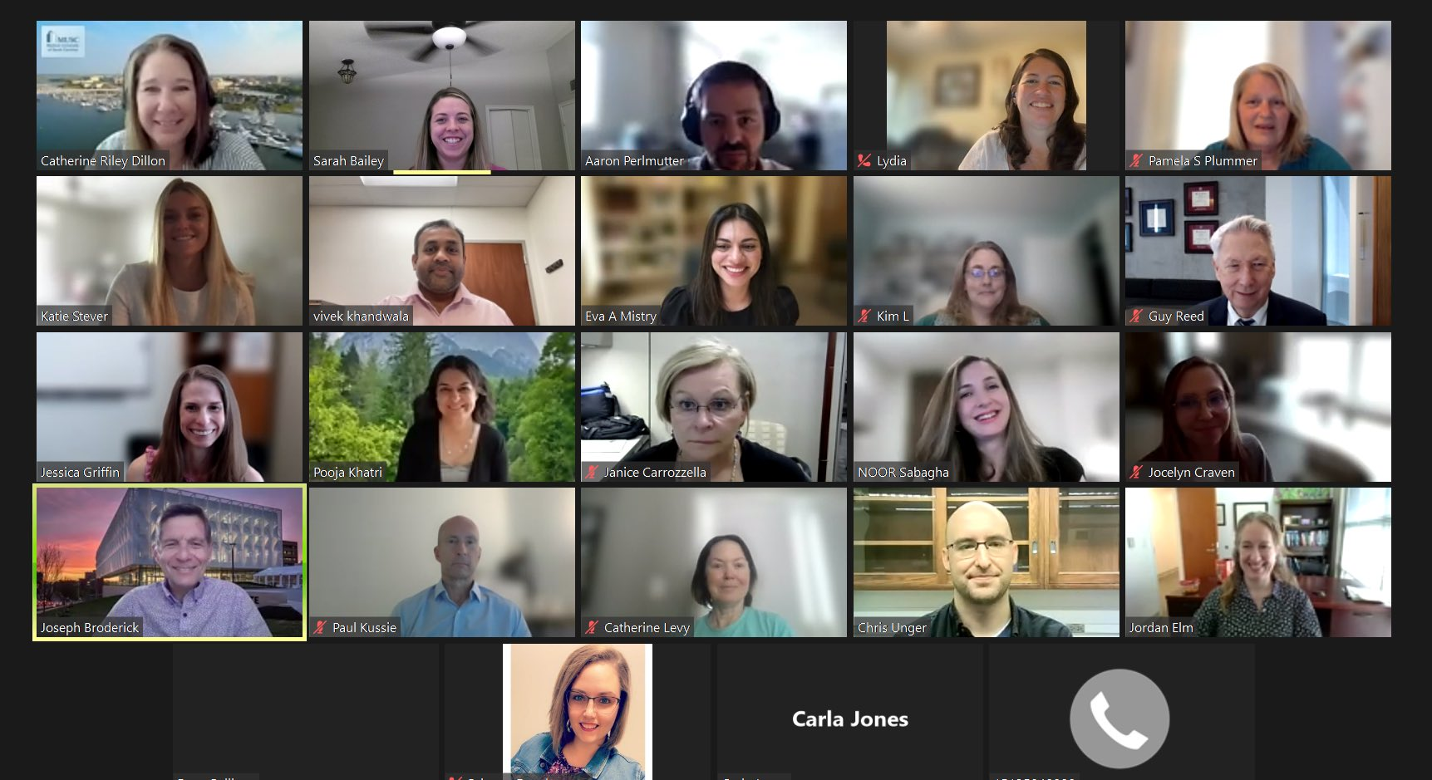
sister-trial@ucmail.uc.edu
@SisterTrial

