Slide 1
StrokeNet
Coordinator Webinar
April 28, 2021

Slide 4
StrokeNet Acronyms
Acronym - an abbreviation formed from the initial letters of other words and pronounced as a word.
NIH National Institutes of Health
NINDS National Institute of Neurological Disorders and Stroke
SN StrokeNet
NCC National Coordinating Center (University of Cincinnati) The NCC will manage ongoing operational issues, such as subcontracts for capitated payments, protocol-specific site training, and site monitoring.
NDMC National Data Management Center (Medical University of South Carolina [MUSC}) supports protocol data management, ensures data quality control (including data monitoring), and undertakes interim monitoring, analyses and reporting for the NCC, NINDS, and DSMBs.
FOA Funding Opportunity Announcement
DSMB Data and Safety Monitoring Board
EOB External Oversight Board
RCC Regional Coordinating Stroke Center (Each regional stroke center will also have strong collaborative relationships between vascular neurology, emergency medicine, interventional neuroradiology, neurosurgery, neurointensive care, neuroimaging, stroke rehabilitation, and pediatric neurology, indicating a commitment to offer every eligible patient the opportunity to participate in a trial conducted through the network.

Slide 5
SN Acronyms Cont.
Satellite geographically or organizationally linked partners or satellite stroke centers, such as other academic centers and/or private and community hospitals and clinics. The RCC will be responsible for providing scientific leadership and regular communication to satellite centers regarding protocols and study progress and for providing administrative and budget support for protocol initiation.
CPS Clinical Performance Site The hospital or clinic where the federally funded human subject research is conducted. Can be RCC CPS or Satellite CPS
WebDCU™ web based clinical trial management system developed by the Data Coordination Unit at the MUSC. WebDCU™ Copyright 2009-2021 MUSC. All rights reserved.
CIRB Central Institutional Review Board NOT-OD-20-058 Single Institutional Review Board for Multi-Site Research
RA Reliance Agreement (CIRB) or (Advarra) SN RAs are valid for the period of the NCC award. Amendments are issued for additional 5 yr award periods. Entities performing federally funded human subject research agree to rely on the single/central IRB. Out of Network site have to have a RA to participate in SN.
NOA Notice of Award (funding document) goes to an institution and lists the Principal Investigators.
Prime The institution that receives the funding NOA for a particular trial.
Sponsor For federally sponsored human subject research, the Prime Principal Investigator is the “Sponsor”. Not NIH or NINDS or the NCC.
CTA/CRA Clinical Trial Agreement/Clinical Research Agreement
SRS/Grants & Contracts Office/Research Office – Institutional entity that receives the CTA/CRA and funding on behalf of the CPS

Slide 6
SN Acronyms Cont
SAM.gov https://www.sam.gov/SAM/ All institutional entities receiving a CTA/CRA must be registered and Active. Applies to foreign and domestic entities.
OHRP DHHS Office for Human Research Protections - Approved Federal Wide Assurances (required to conduct research) and registered IRB, foreign and domestic.
CRO A contract research organization is a company that provides support to the research entities in the form of research services outsourced on a contract basis. (Using for ARCADIA Canada, FASTEST Europe, Canada & Japan)
Fiduciary Agent StrokeNet NCC that issues the CTA/CRA to the RCC/Satellite. Pays the Per Patient Payments based on an invoice generated from WebDCU. Funds are sent by Electronic Funds Transfer (EFT)

Slide 7
SN Clinical Trial Acronyms
CREST 2 Carotid Revascularization and Medical Management for Asymptomatic Carotid Stenosis (Mayo Jacksonville)
CREST H Carotid Revascularization and Medical Management for Asymptomatic Carotid Stenosis - Hemodynamics (Mayo Jacksonville)
TeleRehab Telerehabilitation for Patients with Stroke (UC Irvine)
DEFUSE 3 EnDovascular ThErapy Following Imaging EvalUation for ISchemic
StrokE 3 (Stanford)
ARCADIA AtRial Cardiopathy and Antithrombotic Drugs In prevention After cryptogenicstroke (Columbia)
ARCADIA CSI Cognition and Silent Infarcts (Stanford)
MOST Mult-Arm Optimization of Stroke Thrombolysis (UC/Wash U St Louis)
TRANSPORT 2 TRANScranial direct current stimulation for POst-stroke motor Recover - a phase II
sTudy (MUSC/Duke)
Sleep SMART Sleep for Stroke Management and Recovery Trial (Michigan)
ASPIRE Anticoagulation in ICH Survivors for Prevention and Recovery (Intracranial Hemorrhage) (Yale)
SATURN StATins Use in intRacerebral hemorrhage patieNts (BIDMC)
I-ACQUIRE Perinatal Arterial Stroke: A Multi-site RCT of Intensive Infant Rehabilitation (Va Tech)
FASTEST FVIIa for Acute hemorrhagic Stroke Administered at Earliest Time (UC)

Slide 11
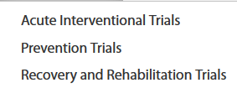
https://www.nihstrokenet.org/

Slide 12
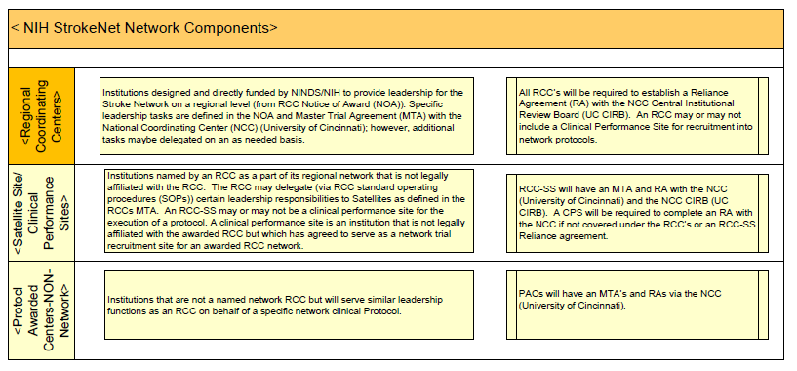

Slide 14
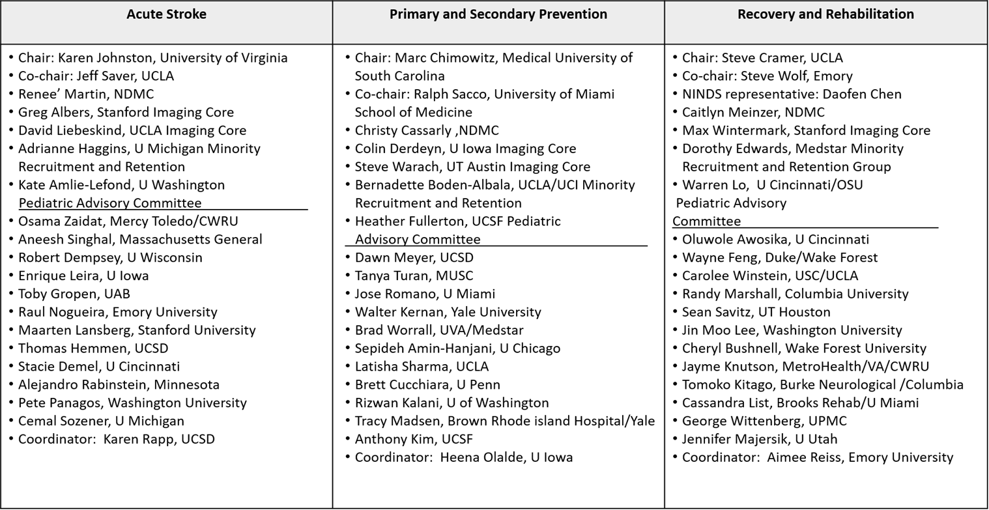

Slide 15
Documents
GET INVOLVED:
Funding Announcements:
NIH StrokeNet Funding Announcement:
Administrative Documents: (SN SOPs, Communication, Competing Trials, etc.
Central IRB:
Network Publications:
Education, Presentations, and Resources
STUDY COORDINATOR EDUCATION AND RESOURCES
https://www.nihstrokenet.org/education/study-coordinator-education
NIH StrokeNet Webinars and Meetings
Webinars & Meeting Topics
National Meetings
Professional development
Trial-Specific
https://www.nihstrokenet.org/education/nih-strokenet-webinars-and-meetings ***Coordinator Webinars

Slide 17
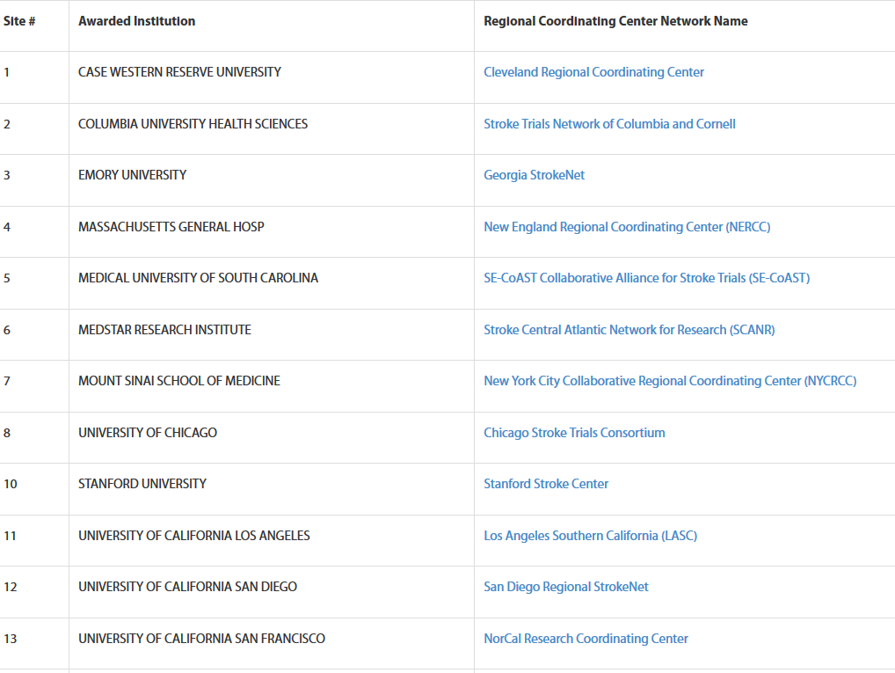

Slide 18
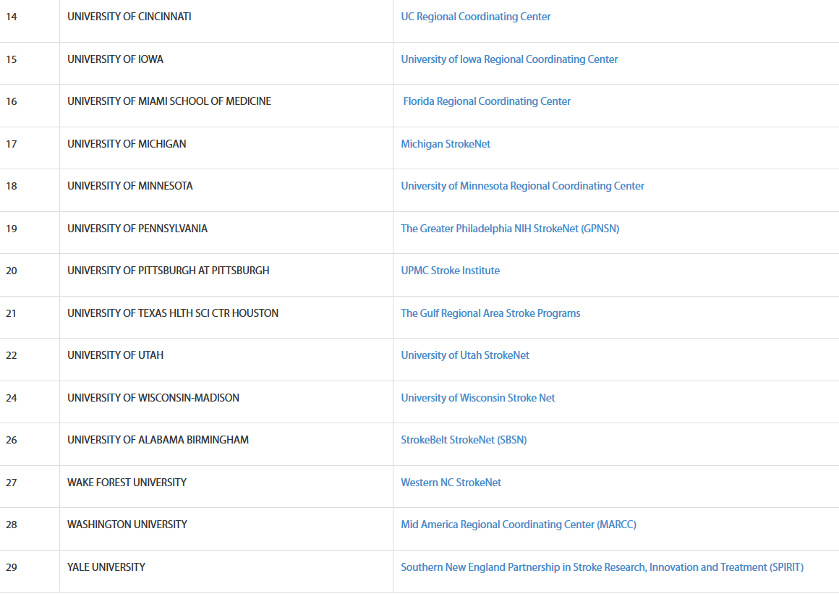

Slide 19
CONTACT US

Slide 20
RCC 06 and RCC Clinical Performance Sites
06 | MedStar Health Research Institute (Hyattsville MD)
106 |  | 06-106-1743 | National Rehabilitation Hospital, Inc. (Washington DC)
106 |  | 06-106-1464 | Washington Hospital Center Corp (Washington DC)
106 |  | 06-106-1747 | MedStar Southern Maryland Hospital Center (Clinton MD)
106 |  | 06-106-2367 | MedStar Good Samaritan Hospital (Baltimore MD)
106 |  | 06-106-2368 | MedStar Montgomery Medical Center (Olney MD)

Slide 21
RCC06 MedStar’s Satellites and Satellite Clinical Performance Sites
229 | Georgetown University (Washington DC)
 |  | 06-229-1745 | MedStar Georgetown Medical Center, Inc. (Washington, DC)
230 | Children’s National Medical Center (Washington, DC)
 |  | 06-230-1746 | Children’s National Medical Center (Washington, DC)
233 | Univof Virginia (Charlottesville VA)
 |  | 06-233-1382 | University of Virginia Medical Center (Charlottesville VA)
234 | Univ of Maryland (Baltimore MD)
 |  | 06-234-1143 | Univ of Maryland Medical Center (Baltimore MD)

Slide 22
RCC11 UCLA Kaiser Permanente
261 | Kaiser Foundation Hospitals d/b/a Kaiser Permanente (Oakland CA)
 |  | 11-261-1776 | Kaiser Permanente Baldwin Park Medical Center (Baldwin Park CA)
 |  | 11-261-1333 | Kaiser Permanente Los Angeles Medical Center (Los Angeles CA)
 |  | 11-261-1777 | Kaiser Permanente Woodland Hills Medical Center (Woodland Hills CA)
 |  | 11-261-2414 | Kaiser Permanente Fontana (Fontana, CA)

Slide 23
RCC12 USD Kaiser Permanente
283 | Kaiser Foundation Hospitals dba Kaiser Permanente (Oakland CA)
 |  | 12-283-2042 | Kaiser Permanente Zion Medical Center /Kaiser Foundation Hospital (San Diego CA)
 |  | 12-283-2278 | Kaiser Permanente San Diego Medical Center /Kaiser Foundation Hospital (San Diego CA)
 |  | 12-283-2294 | Viewridge Medical Offices (San Diego CA)
 |  | 12-283-2295 | Vandever Medical Offices (San Diego CA)

Slide 24
R13 UCSF Kaiser Permanente
290 | Kaiser Foundation Hospitals dba Kaiser Permanente (Oakland CA)
 |  | 13-290-1810 | Kaiser Permanente Antioch Medical Center ( Antioch CA)
 |  | 13-290-1811 | Kaiser Permanente Walnut Creek Medical Center (Walnut Creek CA)
 |  | 13-290-2242 | Kaiser Permanente Vallejo Medical Center Including Kaiser Foundation Rehabilitation Center (Vallejo CA)
 |  | 13-290-1081 | Kaiser Permanente-San Francisco (San Francisco CA)
 |  | 13-290-1240 | Kaiser Permanente South San Francisco Medical Center (South San Francisco CA)
 |  | 13-290-2249 | Kaiser Permanente San Rafael Medical Center (San Rafael CA)
 |  | 13-290-1182 | Kaiser Permanente Redwood City Medical Center (Redwood City CA)
 |  | 13-290-1238 | Kaiser Permanente Santa Clara Medical Center (Santa Clara CA)
 |  | 13-290-2261 | Kaiser Permanente San Leandro Medical Center (San Leandro CA)
 |  | 13-290-2262 | Kaiser Permanente Sacramento Medical Center (Sacramento CA)

