Slide 1
Source Documentation: Helpful Tips and Tricks
Heena Olalde, RN, MSN University of Iowa
Kinga Aitken, MD, MPH, CCRP University of Utah
Jama Olsen, MPA Medical University of South Carolina

Slide 2

What is Source Data?
Source data includes all information in original records of clinical findings, observations, or other activities in a clinical investigation used for reconstructing and evaluating the investigation.
Source data are contained in source documents.

Slide 3
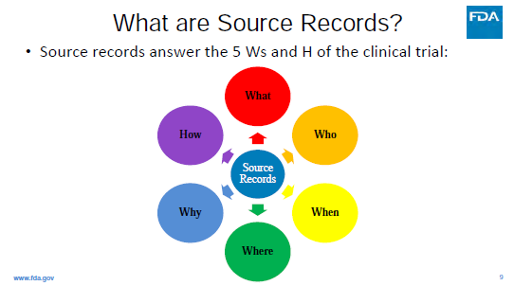
Source Documentation
A complete source record should answer the What, Who, When, Where, Why, and How
Notes:
Who collected the data? When?
Where was the data collected?
What data will be collected?

Slide 4
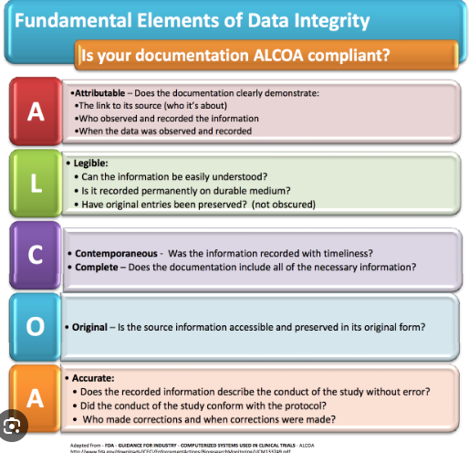
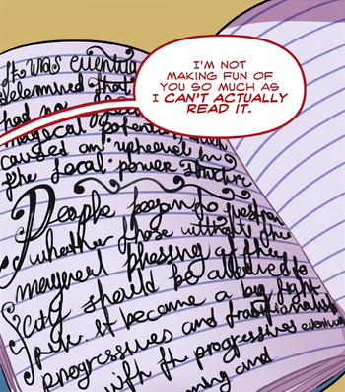
Good Clinical Practice for Documentation
Source data should meet ALCOA principles and must meet the regulatory requirements for recordkeeping.

Slide 5
Examples of Source Documents
Participant medical records including electronic medical records (EMR)
Phone encounters or notes
Lab and diagnostic test results
The paper or electronic informed consent document
If data are directly observed and directly entered into an electronic system (e.g., WebDCU), the electronic record is considered the source.
Specific research worksheets (CRFs) used to document key research data elements

Slide 6
Source Types
Electronic Medical Record (EMR) as source
  No need for paper source document if monitor can access EMR to verify information
  Over the shoulder EMR verification is allowed (coordinator should be available for the entirety of the visit)
Paper Medical Record as source
  If EMR access is not available to monitors, print information from EMR and file in subject binder (eBinder should follow the same flow as a physical binder)
Paper Case Report Forms (CRFs) as source (most common)
  Paper document is used to collect information that gets entered to WebDCU
  File paper source in subject binder
  Example: Printed CRF from WebDCU
Electronic Case Report Forms (eCRF)
  Information obtained in real time and entered directly to WebDCU
    Should ONLY be used as source from a contemporaneous observation
  Add “direct data entry” to general comments section
  This practice may reduce DCRs
  There will be no other source
  Check local institutional policy to ensure direct data entry is permitted
Note To Files (NTF) can be used for documentation of out of ordinary occurrences that need further clarification and file with source documentation.
  Can be paper (stored in subject research binder) or electronic (stored in the subject’s EMR)

Slide 7
Example of Note to File

Slide 8
Important things to note about Source Documents/Data
All data reported in WebDCU should match the source.
Source documents should be retained, and the site should make records available to monitors, auditors, and inspectors.
When multiple valid sources for a data item are available, the decision regarding which values will be considered as source must be documented.
  Example: If multiple labs are drawn in a day and the protocol does not specify, the PI could circle and date the source. The site could also compose a memo to specify what the source is for that site in particular circumstances.
Know if your StrokeNet trial requires the use of the Study book, or if using CRFs alone will suffice (e.g. VERIFY requires study book).

Slide 9
Tips for Source Documentation for StrokeNet Trials

Slide 10
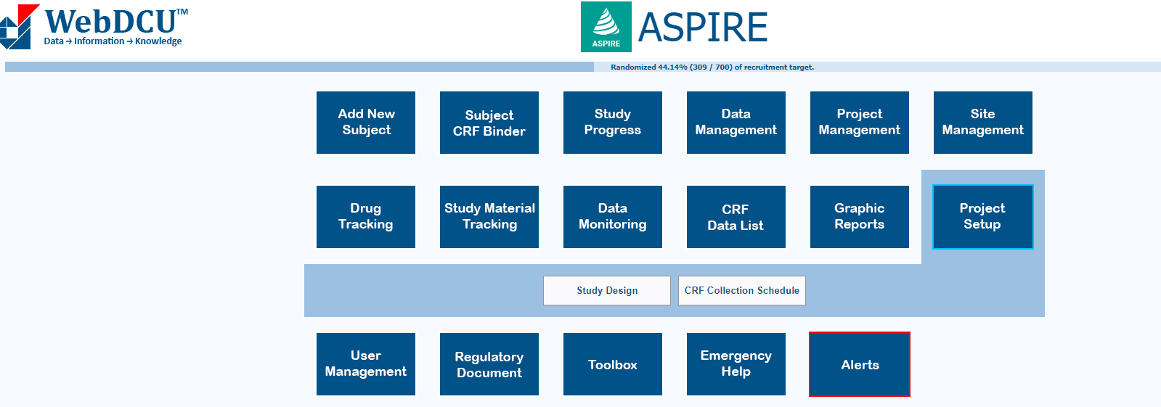
Study Books and CRFs in WebDCU
Find CRFs in Project Setup → CRF Collection Schedule

Slide 11
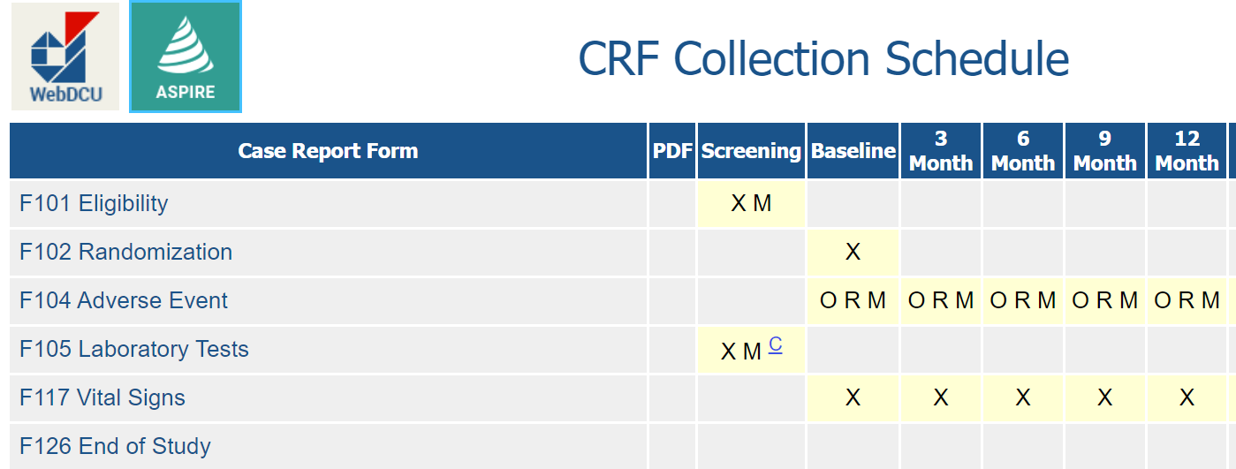
Accessing Study Books and CRFs in WebDCU
Click on the column header to view and print a study book, which includes all the required CRFs for that subject visit.
Click on any CRF to view and print the case report form.

Slide 12
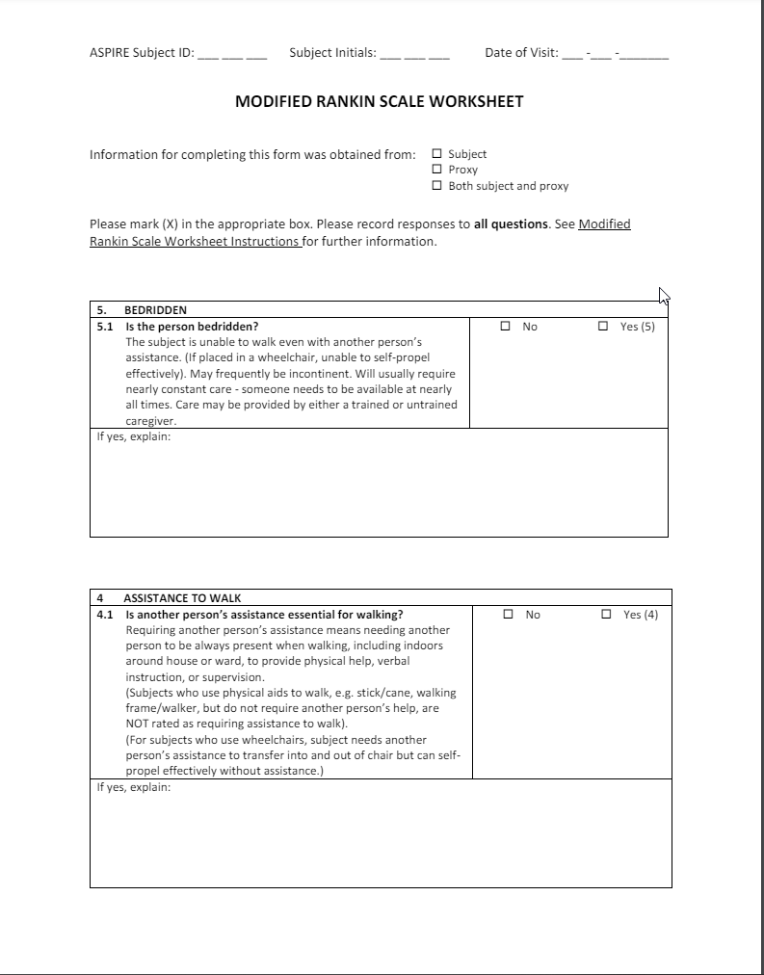
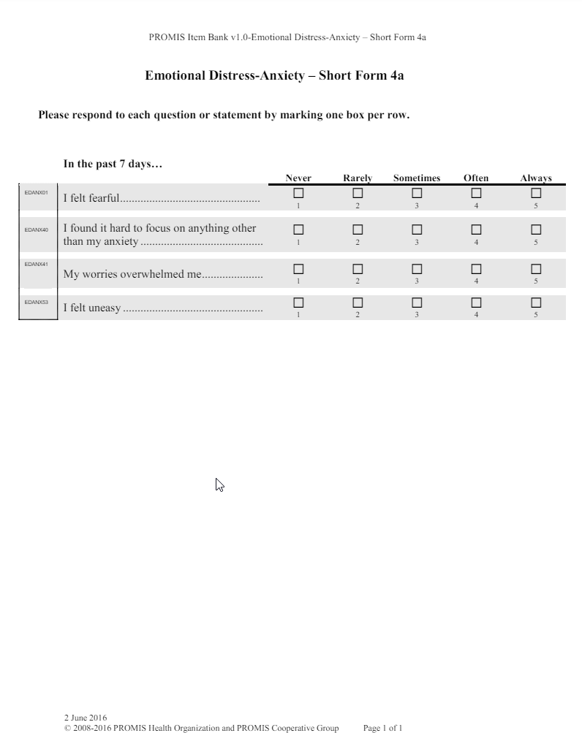
Study Books and CRFs in WebDCU

Slide 13
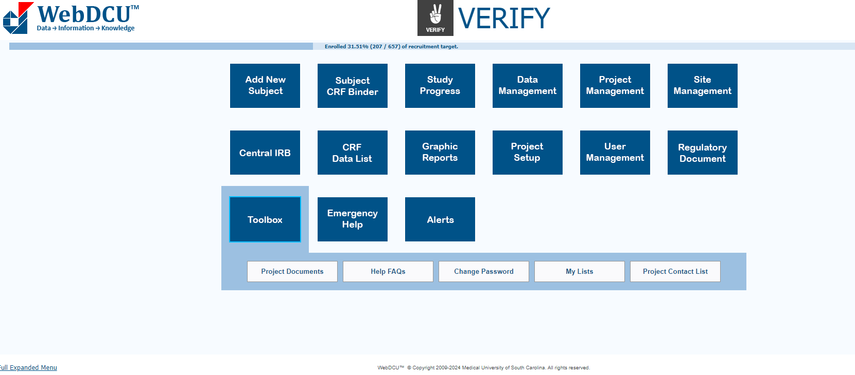
Study Books and CRFs in WebDCU

Slide 14
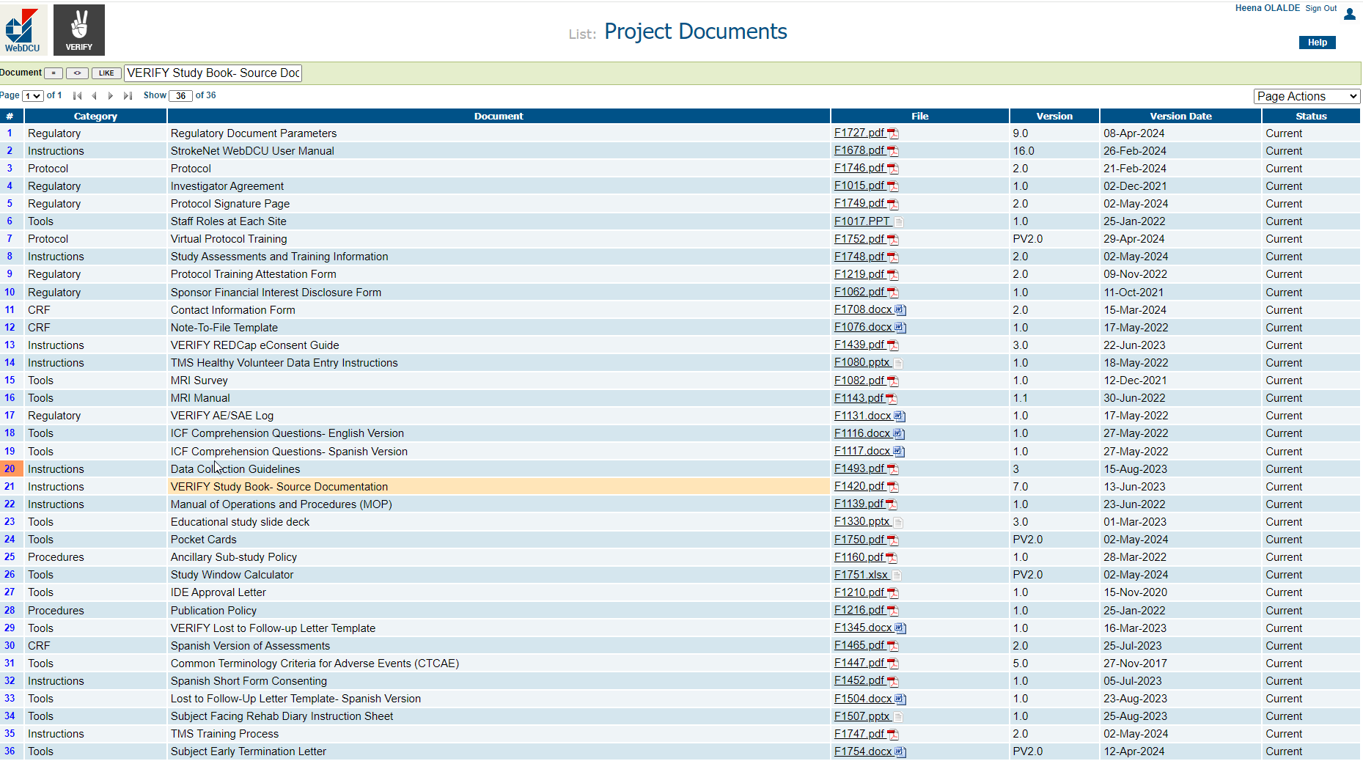
Study Books and CRFs in WebDCU

Slide 15
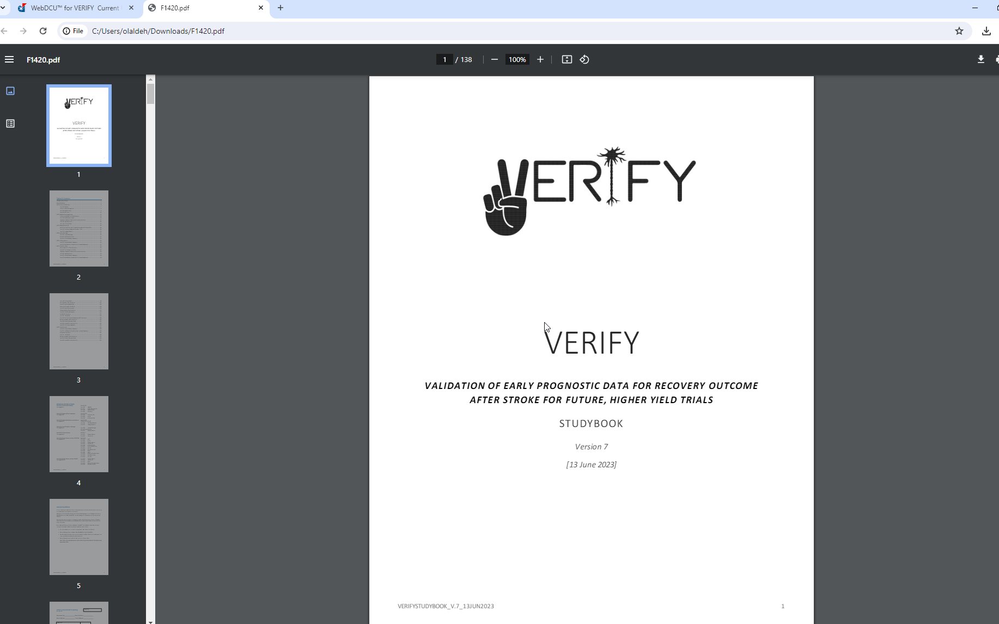
Study Books and CRFs in WebDCU

Slide 16
Using the EMR for Documentation

Slide 17
EMR Documentation
Template notes in the EMR can help with documenting study visits
  ICF consent process, visit details- history, medications, vitals, etc.
  Should be study specific, following the schedule of events
Template notes can be shared with team members who have charting abilities
Easy documentation of PI oversight
Helpful for non study care teams to know that patient is enrolled in a trial
Linking the subject to a trial in the EMR enables notifications (e.g. safety events, new hospitalizations) to study team

Slide 18
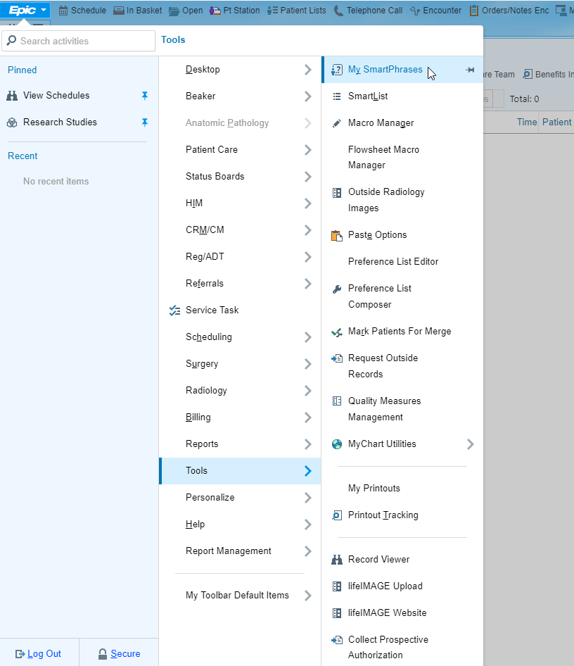
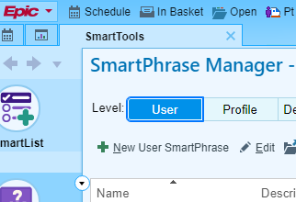
How to create a template note in the EMR: EPIC

Slide 19
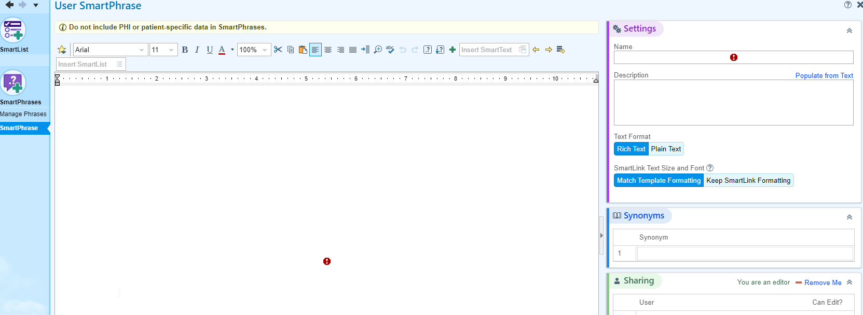
How to create a template note in the EMR: EPIC

Slide 20
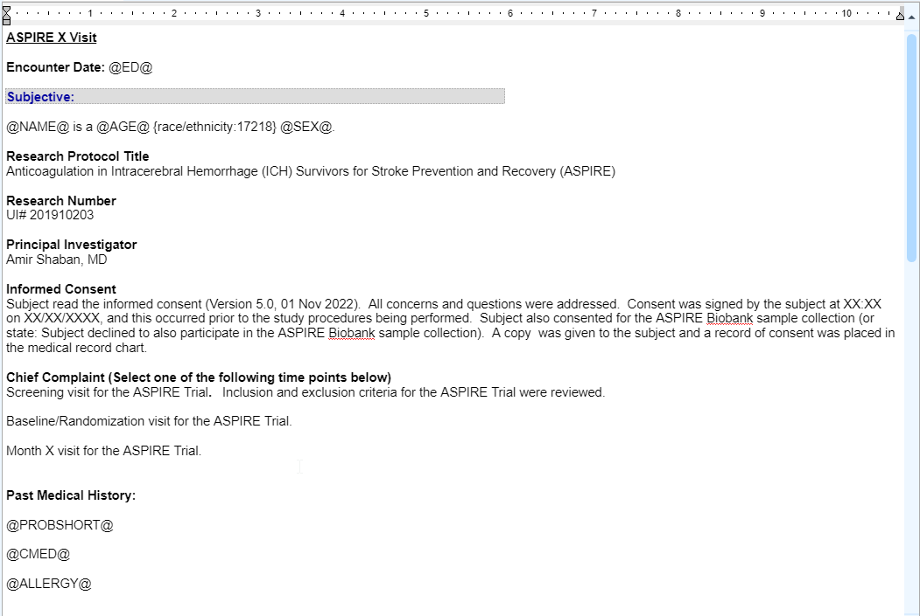
Example of a template note

Slide 21
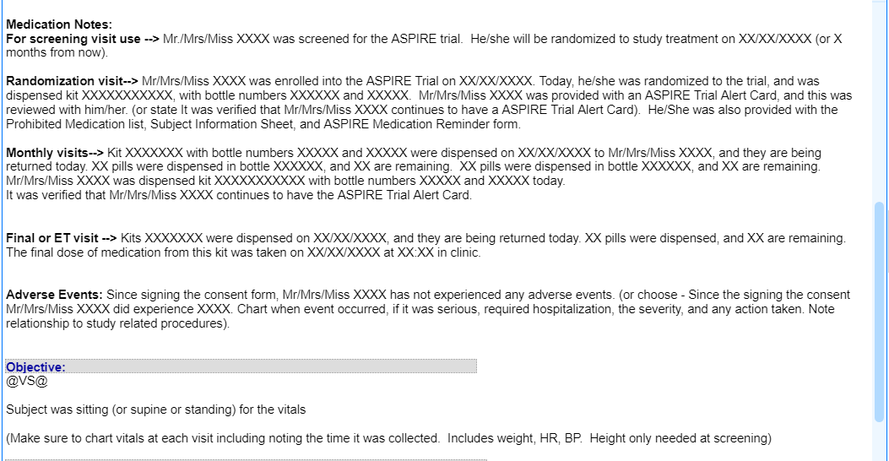
Example of a template note

Slide 22
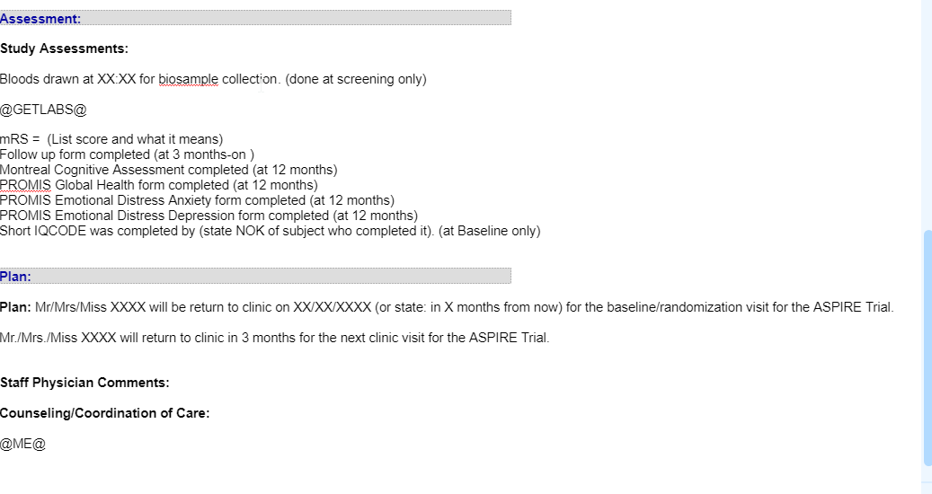
Example of a template note

Slide 23
Source Document Verification- aka Site Monitoring

Slide 24
Source documents and signature requirements
StrokeNet monitors will verify that data entered in WebDCU matches the site source documentation.
All source documentation should be attributable.
  Recall ALCOA
  Examples: wet ink, email, e-signature, EMR notes.
StrokeNet monitors always verify signatures on the following CRFs (though not limited to):
  F126: End of Study Form
  F101: Eligibility
  F104: Adverse Event
  Why?
    These are considered the highest risk

Slide 25
F126 Requires Wet Ink Signature
F126 End of Study*
  The PI as denoted on eDOA in WebDCU must sign this form.
    Sub-I is not acceptable.
  Qd (First/Last name of reviewing site PI) and Q12 (Date of site PI review and affirmation) are required in WebDCU and must match the source, i.e. the printable paper CRF.
  The paper source must have the PIs wet-ink signature and date.
    But why wet ink on paper? The PI signature and date affirm the review and the accuracy of the information reflected in all the case report forms (in WebDCU) for this study participant.
*At this time, PIs are NOT able to electronically sign CRFs in WebDCU at the end of the study.

Slide 26
F101 and F104- Signature Expectations
F101 Eligibility – Investigator signature is required to confirm a subject met all eligibility criteria prior to randomization.
  Investigator must be delegated responsibility C (Determine eligibility) on eDOA in WebDCU.
  Qd (First/Last name of investigator confirming eligibility) is required in WebDCU and must match the source.
  The source must have a wet-ink signature or equivalent documentation, i.e. e-mail, EMR, Adobe electronic signature.
F104 Adverse Event – Investigator signature is required to confirm that, at a minimum, an investigator assessed the grade (Q02), seriousness (Q03), and relatedness (Q04).
  Investigator must be delegated responsibility F (Assess adverse events) on eDOA in WebDCU.
  Qd (Last name of reporting site investigator) and Q19 (Date of reporting site investigator signature) are required in WebDCU and must match the source.
  The source must have a wet-ink signature or equivalent documentation, i.e. e-mail, EMR, Adobe electronic signature.

Slide 27
Q&A Source Documentation
Q: Who can enter data (including F101, F104, F126) into WebDCU?
A: Any study team member who has the appropriate permission on the eDOA (i.e., “Responsibility E- Complete Case Report Forms”).
Q: If the PI enters the data into WebDCU (using their login), is this considered an acceptable signature?
A: F126- NO! There must be a paper source with the PI’s wet ink signature and date.
A: F101, F104- If your site allows direct data entry, then this is acceptable. However, we would not recommend that the eCRF be the sole source.

Slide 28
Q&A Source Documentation
Q: Is it okay to print completed eCRFs and have the investigator sign off on those?
A: Yes, but remember, the source document must match what’s entered in WebDCU.
Q: Does each individual inclusion/exclusion criteria on F101 need to be listed for source documentation?
A: No, but it’s recommended that your site document that the investigator reviewed every inclusion/exclusion criteria.
  Example:
  “We print out of the eligibility criteria (F101), which is completed by the PSC. In the EMR, the PI completes an enrollment note stating “Patient met all the inclusion criteria of trial and none of the exclusion criteria. Is this sufficient in terms of capturing that the PI reviewed all I/E criteria and confirmed eligibility?”
  A: Yes, the EMR note is sufficient for F101.

Slide 29
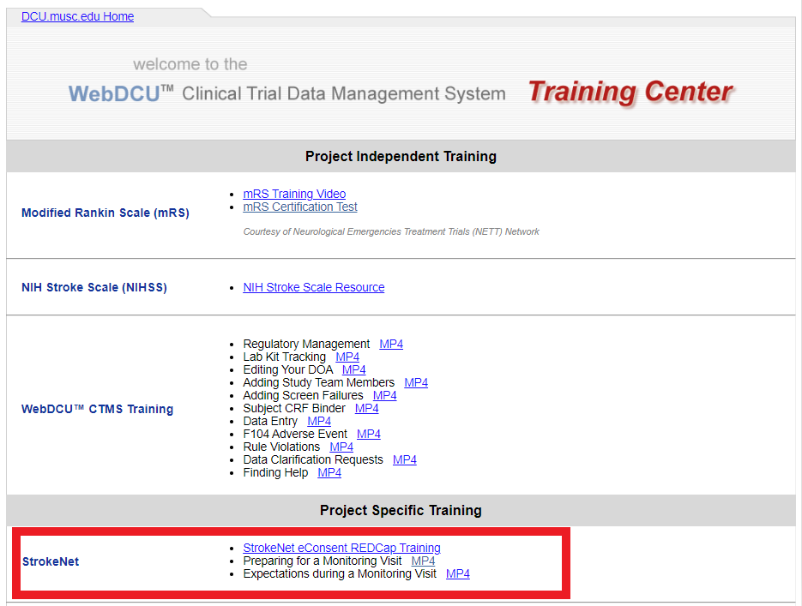
Monitoring Resources
https://dcu.musc.edu/campus/

Slide 30
Monitoring Contacts
Always contact your NDMC Site Monitoring Manager with questions about monitoring visits or documentation!
ASPIRE- Abagail Ault, ault@musc.edu
CAPTIVA- Jama Olsen, olsen@musc.edu
FASTEST- Katie Trosclair, trosclak@musc.edu
FOCAS- Caitlin Schaffner, schaffne@musc.edu
I-ACQUIRE- Abagail Ault, ault@musc.edu
SATURN- Aaron Perlmutter, perlmutt@musc.edu
SISTER- Aaron Perlmutter, perlmutt@musc.edu
Sleep SMART- Katie Trosclair, trosclak@musc.edu
STEP- Caitlin Schaffner, schaffne@musc.edu
TRANSPORT-2- Katie Trosclair, trosclak@musc.edu
VERIFY- Abagail Ault, ault@musc.ed

Slide 31

Questions?

