Slide 1
Stroke Outreach to Underserved Communities:
How to make an impact in Black Neighborhoods?
Olajide Williams MD. MS.
Columbia University

Slide 2
Disclosures
Work has been supported by:
NIH (NINDS) R01 NS067443 (PI- Williams)
NIH (NINDS) U54 NS081765 (MPI-Williams)
NIH (NINR) R01NR017571 (PI-Williams)

Slide 3
Goals of Community Stroke Outreach
Reduce Stroke Mortality and Morbidity through Preparedness
Reduce Stroke Incidence through Prevention
Reduce barriers to participation in Stroke Trials

Slide 4
Community-level barriers to Stroke Outreach
Lack of trust in healthcare system and providers
Low prioritization of health (Poverty, Social Determinants)
Low health literacy
Lack of capacity (resources e.g. human, financial, space)

Slide 5
Healthcare system-level barriers to Stroke Outreach
Lack of capacity (human, financial, time)
Low prioritization at leadership levels
Inadequate Cultural Competency, Implicit Bias
Low investment in Community Engaged Research

Slide 6
Community Stroke Outreach
        1. Independent of access to healthcare system (inclusive)
        2. Reaches individuals at all levels of risk
        3. Addresses socio-ecological conditions beyond clinical services
Notes:
HEALTHCARE-BASED OUTREACH (Patients and their Families)
1. Excludes those with poor access to care
(selection bias)
2. Ignores social determinants of health, which are often beyond a person’s control.
3. Typically lacks culturally tailoring
5. Insufficient touches to maintain changes
6. Challenge of ecological validity

Slide 7
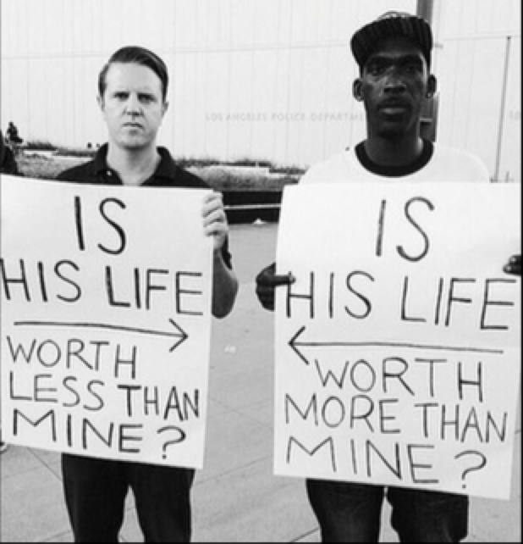
Community Advisory Boards
Building Trust
Facilitates CBPR approaches
Provides an equity lens
Insights into dynamics of local disparities
Perspective on cultural beliefs/values/sensitivity issues with intervention design and content
Acceptability of Research
Aids Dissemination and Implementation

Slide 8
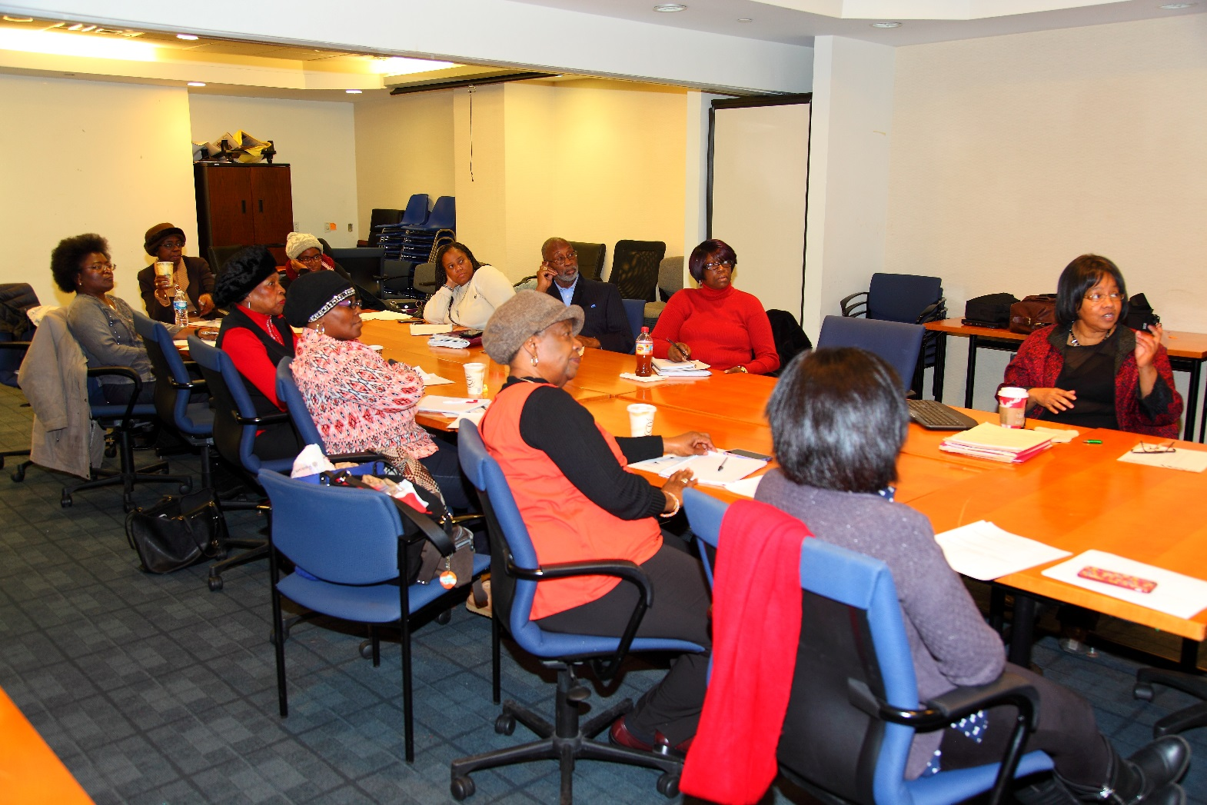
Organizing a CAB
Purpose, Mission
Pre-specified outcome goals
Process goals
Roberts Rules of Order
Research Staff Point Person
Determine compensation
Notes:
Begin to plan for logistical issues. These questions do not need to be answered before the group meets, but it is helpful to discuss these issues with senior leadership while planning for your CAB. How often will meetings be scheduled? Where will they be held? How long will they last? How formally will the meetings be structured? Will you use Robert’s Rules of Order (typical parliamentary procedure for running board meetings )? Will you provide food, childcare, or cover transportation costs? Identify a specific individual to oversee the process of organizing the CAB. Evaluate personality traits and interpersonal skills to assess suitability for this position. Cultural competence is particularly important. Protective time for point person. Compensation for CAB members should be offered to offset legitimate costs of participation in the advisory process, such as reimbursement for transportation, meals and other reimbursements that are deemed appropriate at the local level but that do not include payment.

Slide 9
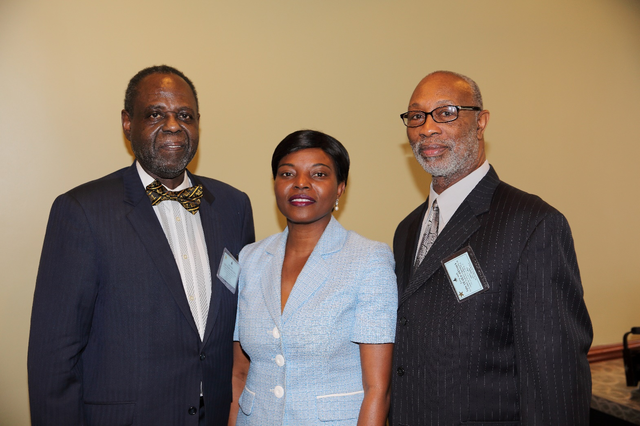
Recruitment
Recruiting and retaining CAB members is an ongoing process
Identify key community organizations that should be represented.
Determine which individual characteristics are essential for the CAB
Identify members from research staff
Notes:
Which characteristics are essential - consider race/ethnicity, sex, age, language. Is it important to have people who have any specific diagnoses? Plan for the inclusion of individuals with different levels of education, literacy and technological knowledge.
Identify Health Care Organization members and discuss how the CAB's input will be incorporated into organization protocol.

Slide 10
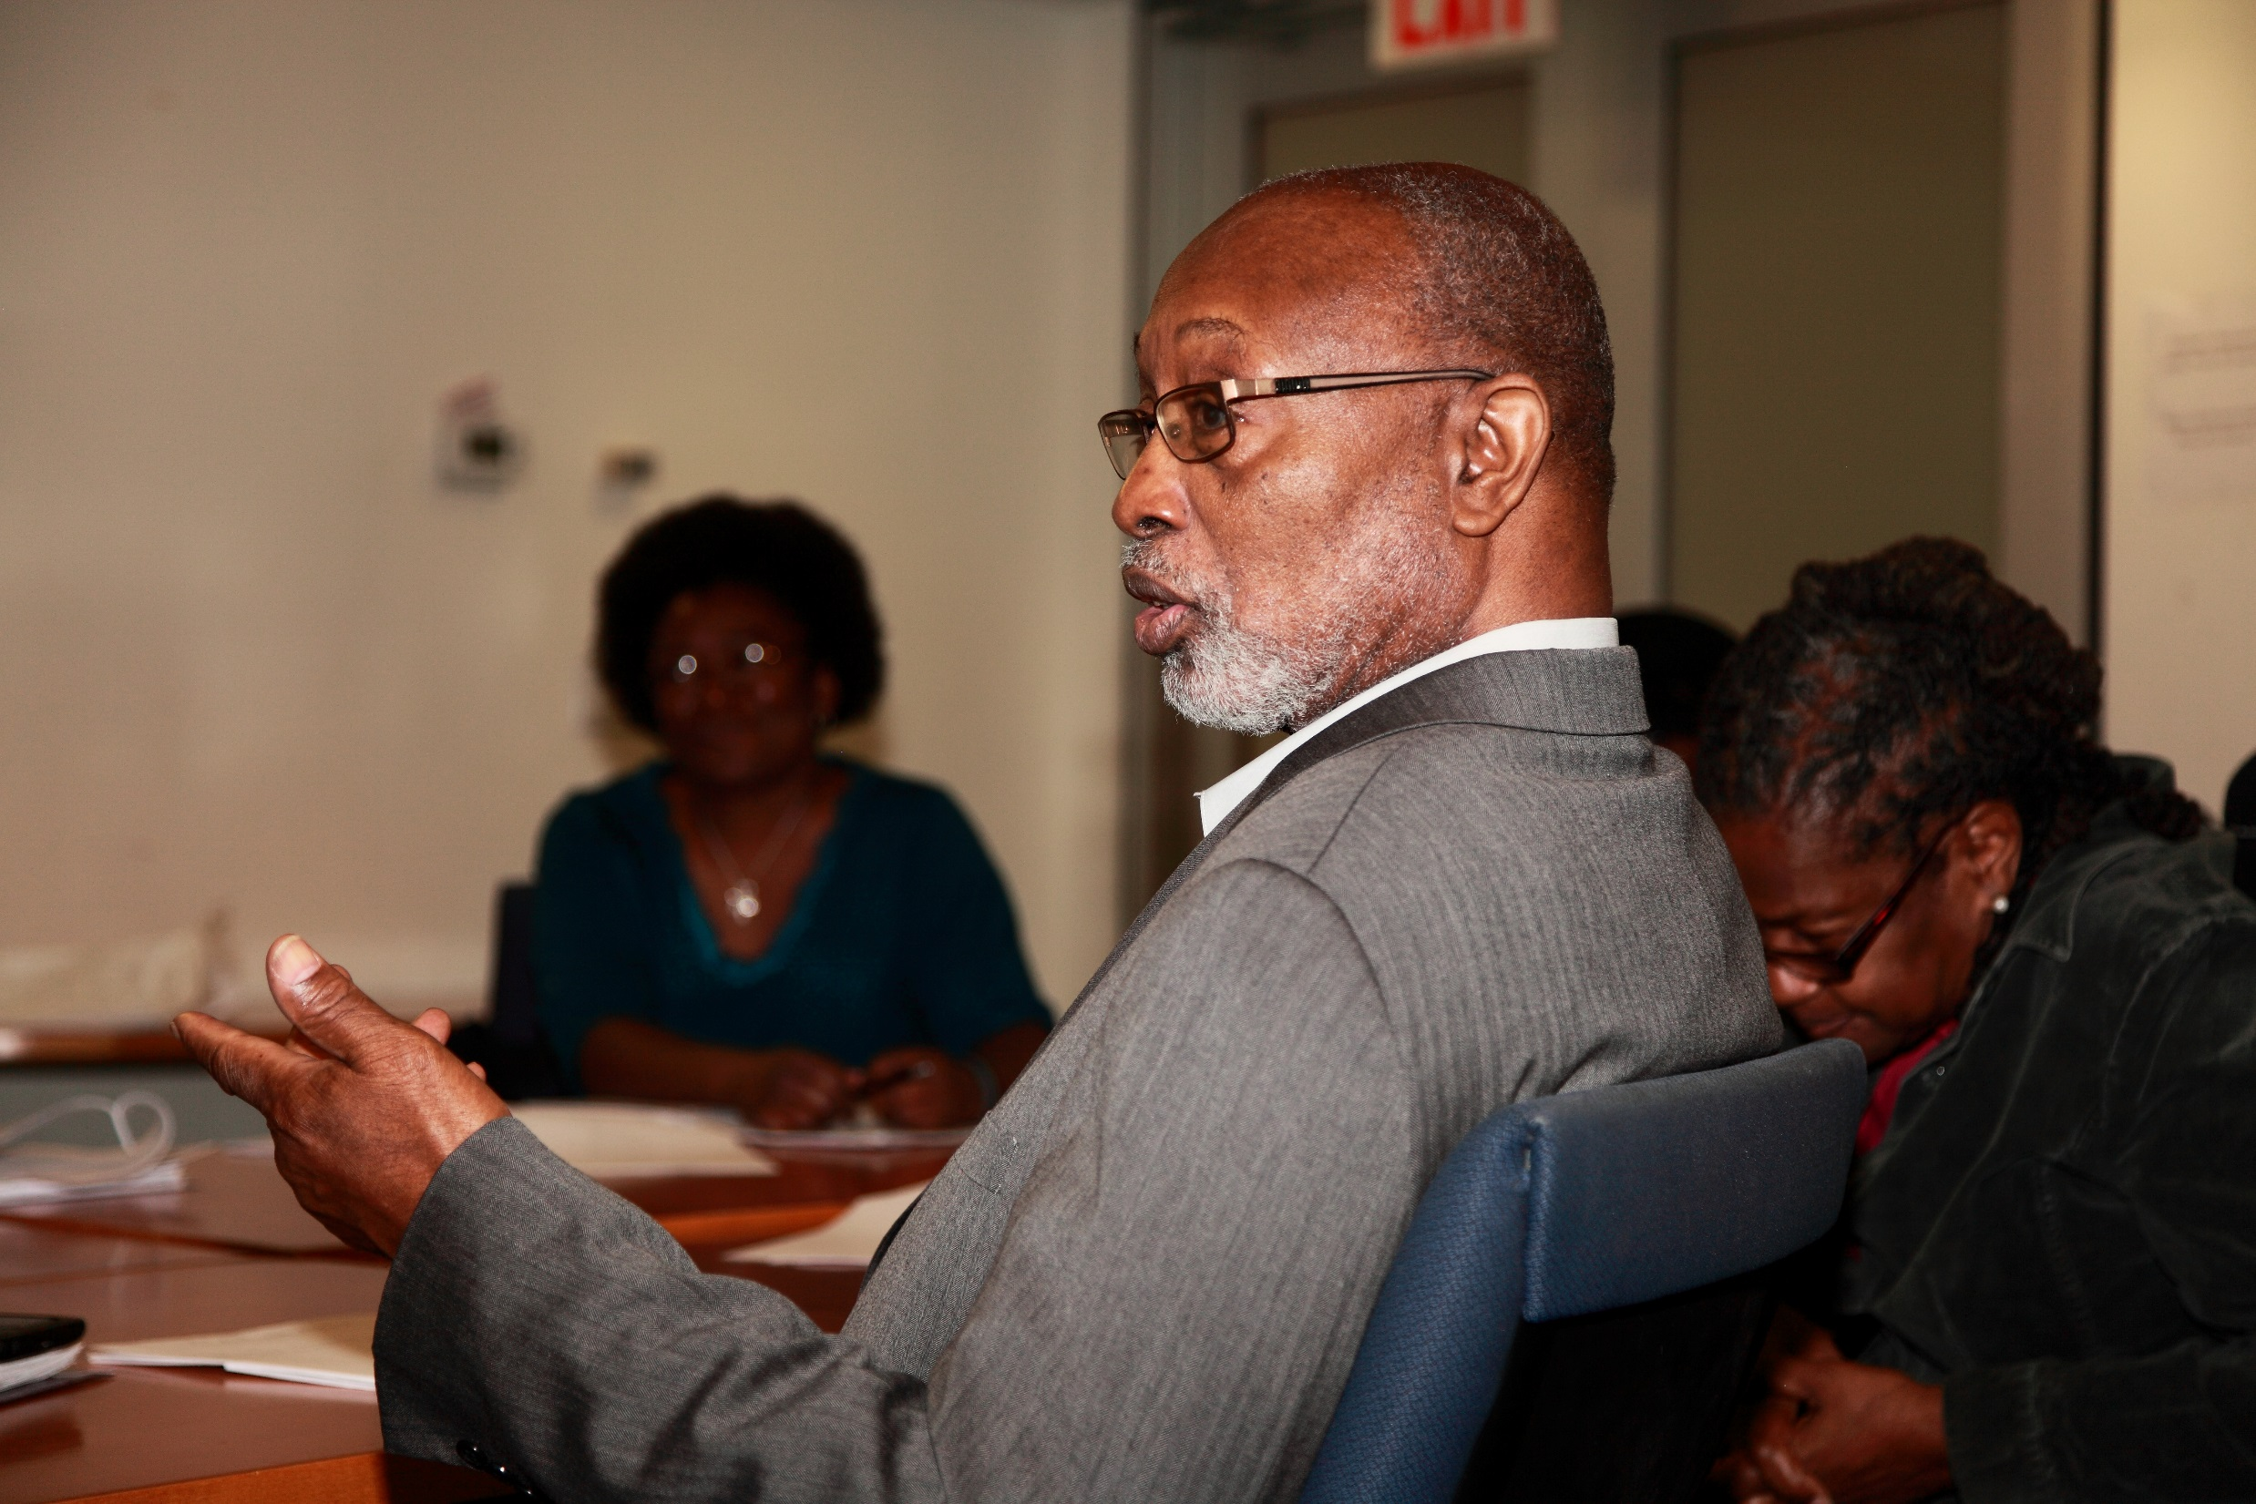
Once CAB is established
Review mission and operating guidelines
Delineate responsibilities and governance
Elect board chairperson at initial meeting
Notes:
Provide a document which outlines and codifies the board’s purpose, composition, tenure, selection, accountability, limitations, procedures, committees, time investments, responsibilities and outcomes
Clarify that even though every idea will be heard, not every idea will be implemented.
Recognize that the individuals in the CAB may have social and political agendas that aren’t shared by the majority of the group. Keep the group focused on priorities that the group as a whole has identified as relevant.

Slide 11
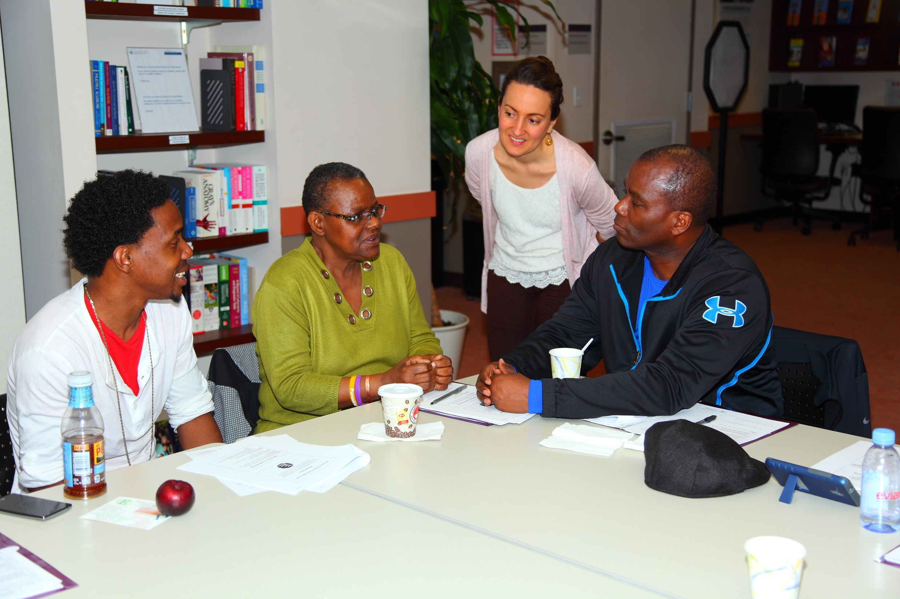
Create a Safe Space
Participants need a safe space to provide honest critiques of the research
Members should not be censored or penalized.

Slide 12
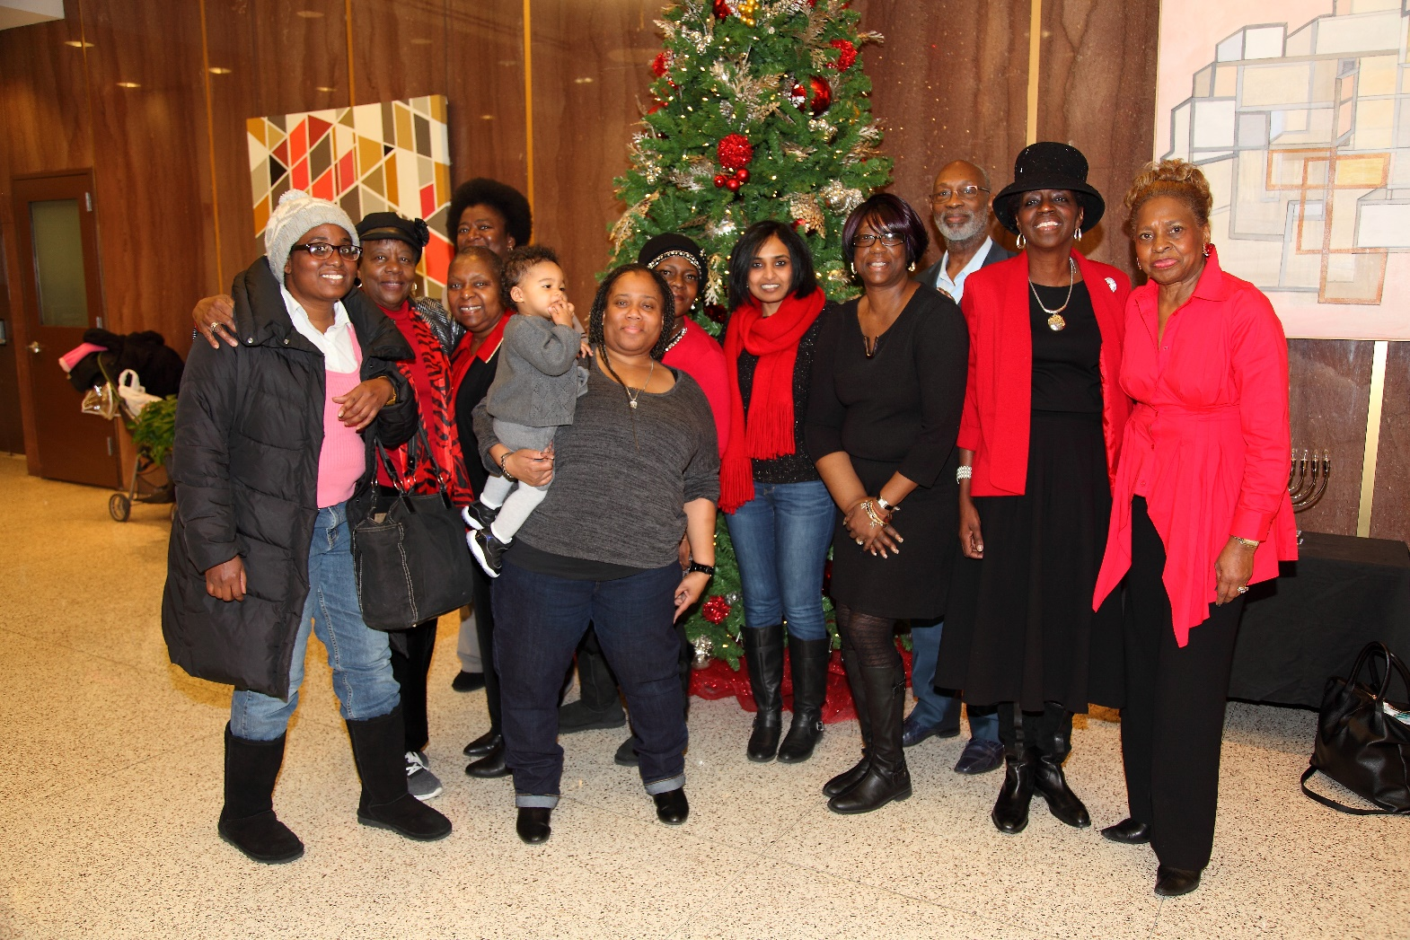
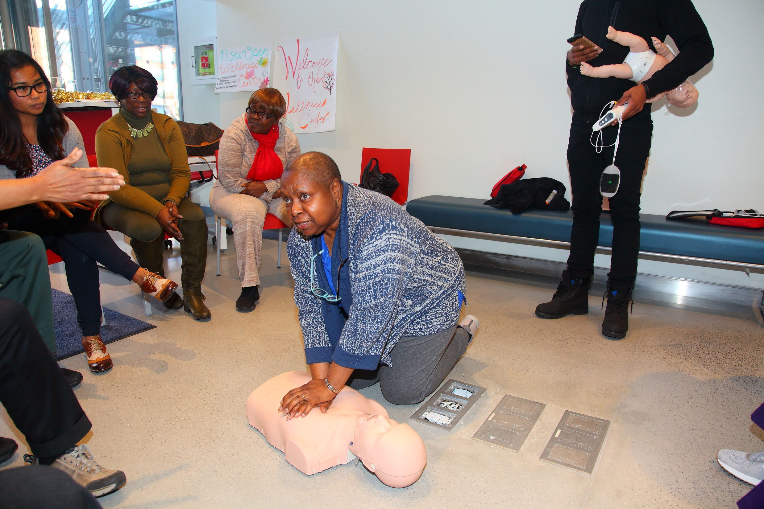
Incorporate team building activities

Slide 13
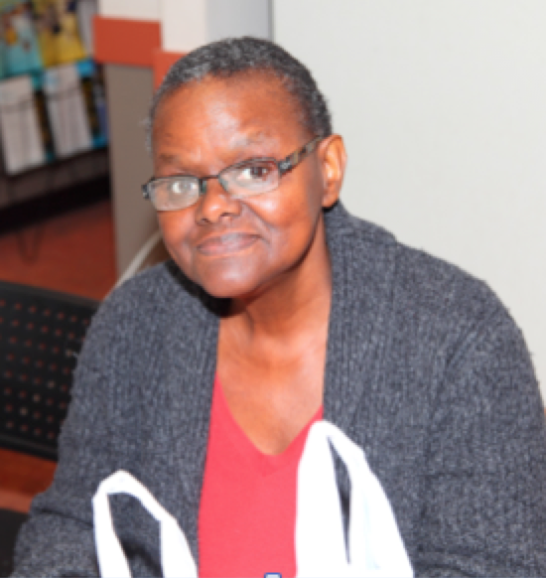
Example of CAB Responsibilities
Voice concerns from the communities and study participants.
Assist in the development and implementation of community education and outreach activities
Advise research team on the development of informed consent forms and other study related documents.
Notes:
Suggest strategies to address ethical and operational aspects of study conduct.
Inform research team about information, misinformation, and/or rumors circulating in the community about the study.
Disseminate study information to local community.

Slide 14
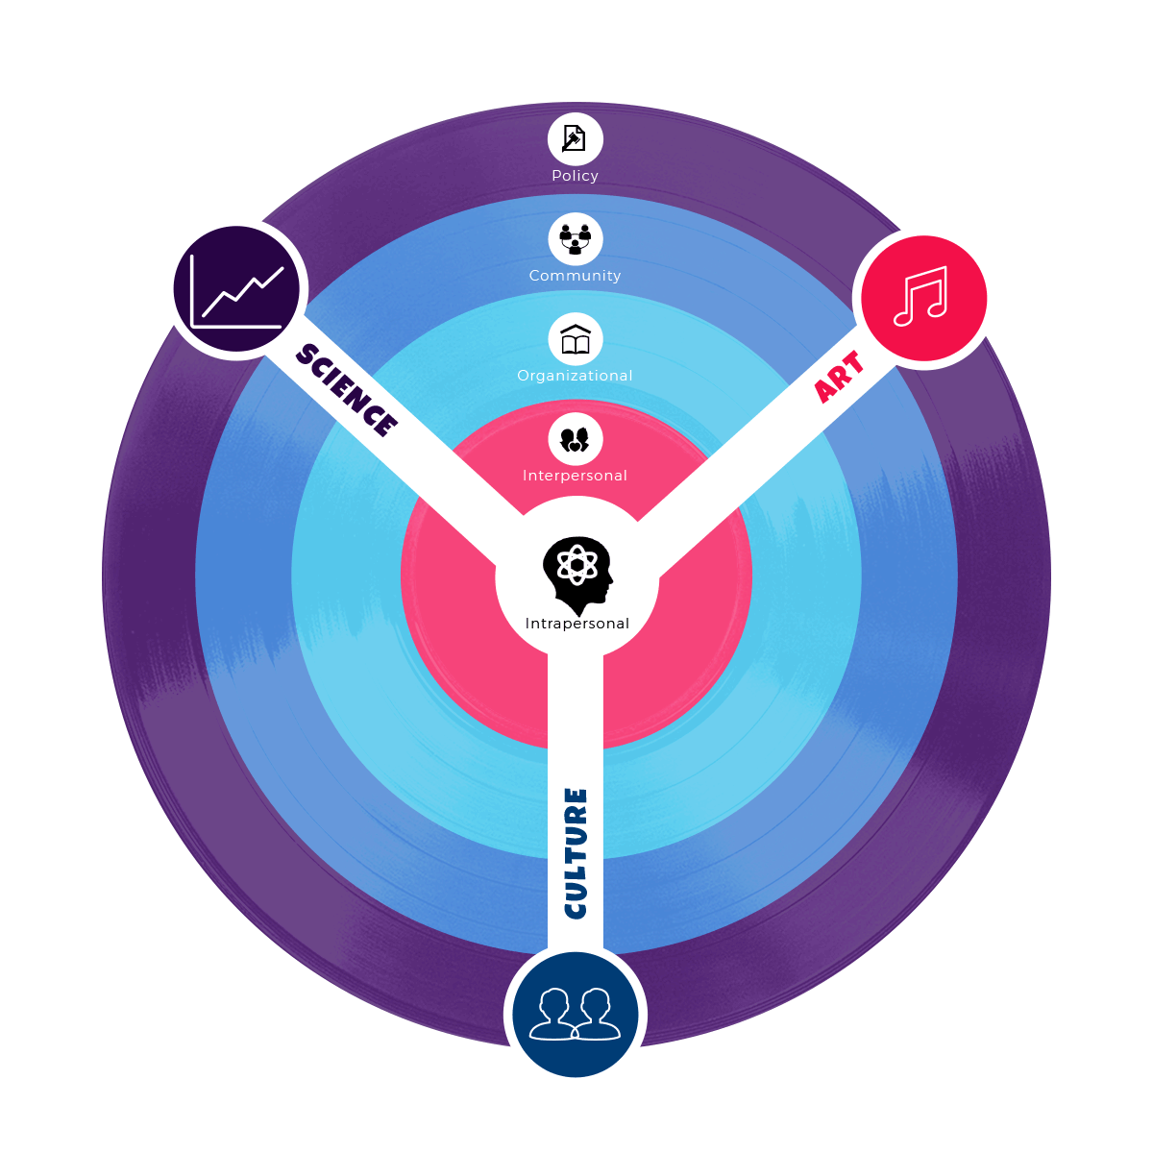
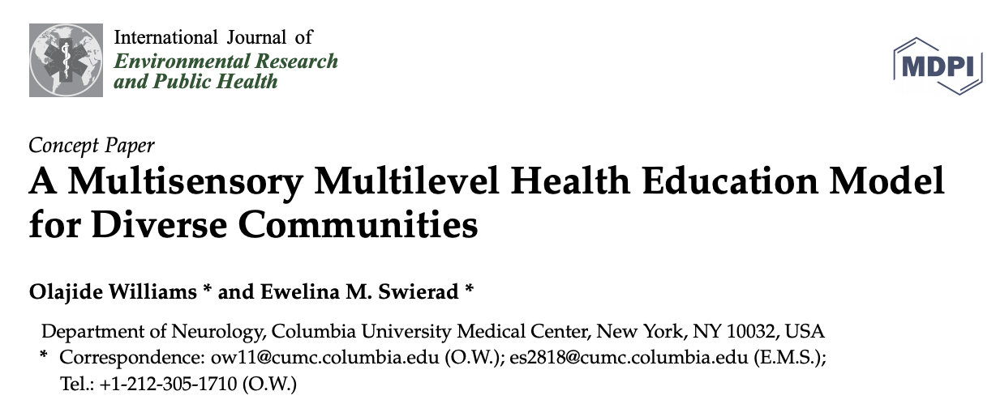
Developing Interventions
MULTISENSORY
MULTILEVEL HEALTH
EDUCATION MODEL
For Behavioral Interventions
Notes:
Aristotle believed that persuasion occurs when 3 components are represented: Ethos, which is credibility, Logos, which is persuasion through logic, data, and science, and Pathos, which is the act of appealing to emotions. Working with my associate research scientist, Dr ES, I developed the multisensory multilevel health education model that captures these 3 components . Our model does this by leveraging art, which appeals to emotions, culture, which helps with credibility and acceptance, and science, across as many socio-ecological levels of behavioral influence as possible as outlined in the well established SEM. Our model is currently being used by a number of groups to guide the development of their behavioral interventions.

Slide 15
Multisensory Multilevel Health Education Model
Williams and Swierad. Int. J. Environ. Res. Public Health 2019
Domains | Subdomains | Examples | Functions | SEM
Art | Aesthetics Multisensory | Music Storytelling Gamification Video/Animation | Attention Immersion Motivation Literacy barriers Learning | Individual Interpersonal
Culture | Cultural Tailoring Social Norms Digital Culture | CAB Qualitative Research Cultural adaptation frameworks Social media | Cultural Relevance Personal relevance Acceptance Social Networks | Individual Interpersonal Organizational Community
Notes:
Importance of cultural sensitivity frameworks that strengthen ecological validity. I use the ecological Validity Model for cultural adaptation (Bernal et al, 1995). This consists of 8 elements for adaptation, Language, Persons, Metaphors, Content, Concepts, Goals, Methods, Context

Slide 16
Multisensory Multilevel Health Education Model
Williams and Swierad. Int. J. Environ. Res. Public Health 2019
Domains | Subdomains | Examples | Functions | SEM
Science | Cognitive strategies Evidence-based Methods Evidence based Evaluation | Message science (governing stickiness + contagiousness) Best Practices Behavior- Change Science Validity of Measures Efficacy vs Effectiveness | Learning Retention Diffusion Scientific rigor Internal and External Validity | Individual Interpersonal Organizational Community ’’ Plus policy

Slide 17
Habit Forming | Habit Disrupting
Frequent Repetition | Cue disruption
Recurring Contexts | Environmental re-engineering
Associated Cues, nudges | Vigilant monitoring
Intermittent rewards
Behavior Change Science
Communication Approaches
Emphasize perceived benefits
Build self-efficacy (knowledge and skills)
Tailor strategies to transtheoretical stage of change
Habit forming approaches
Habit disrupting approaches
Wood & Neal
Behavioral Science and Policy
Notes:
Even the most powerful interventions with large effect sizes are subject to a triangular relapse pattern – a spike in the healthy behavior immediately following the intervention with a decline to baseline over time, and we could see the beginnings of this 2 weeks following our intervention. But this should not be viewed as a failure of will power but a failure to create the desired habit. The key word is habit, which is a context response association in our memory that makes us repeat behaviors everyday (e.g taking your meds with breakfast). Indeed antismoking campaigns have not succeeded simply because of knowledge, will power and self control and habit forming components but also through habit breaking components targeting cigarette purchases, and environmental re-engineering that included smoking bans in public places.
Environmental re-engineering includes improving access to healthier options, making them affordable, and strategies such as choice architecture that helps make the healthy choice the default choice. Perceived barriers/benefits and SE correlate with stage. High barrier, low SE in precontemplation, compared to contemplation and prepartatory, action, maintenance stages

Slide 18
Implementation and
De-implementation Science
Intervention
Art
Evidence based
Health promotion
Intervention
Hybrid Effectiveness -Implementation designs
Efficacy and Effectiveness trials
Science
Culture
Notes:
Efficacy can be defined as the performance of an intervention under ideal and controlled circumstances, which can overestimate the effect of the intervention, whereas effectiveness refers to its performance under ‘real-world' conditions. Therefor following efficacy trials, it is important to demonstrate effectiveness and understand the barriers and facilitators that influence successful implementation of the effective interventions across a heterogeneous sample
Implementation science enhances the extent to which the intervention is generalizable, representative, and comprehensive and includes a strong Strong focus on process measures and implementation fidelity. There are three broad types of Hybrid Effectiveness-Implementation designs.
Type 1 = test effectiveness of intervention, observe/gather info on implementation
Type 2 – test effectiveness and test implementation
Type 3 = test implementation, observe/gather info on intervention and outcomes

Slide 19
Stroke Outreach to Improve Stroke Preparedness
YOUNG ADULTS
CHILDREN
OLDER
ADULTS
Increasing stroke preparedness
has been shown to reduce delays
Traditional mass media campaigns
targeting awareness, show poor
penetration into low-income ethnic
minority communities.
Dearth of evidence-based interventions
addressing stroke preparedness
especially for minorities.

Slide 20
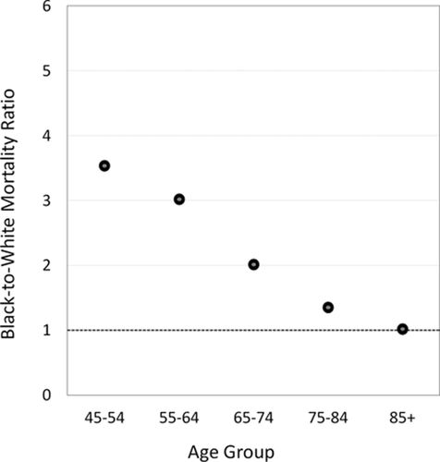
Stroke Outreach to Improve Stroke Preparedness
Where to begin along the continuum of risk?
YOUNG ADULTS Hard to Reach:
Highest incidence (3-4-fold higher incidence of first-ever stroke among aged 34-55 years) mirrors mortality
CHILDREN
OLDER
ADULTS
George Howard. Stroke. Where to Focus Efforts to Reduce the Black–White Disparity in Stroke Mortality. STROKE Volume: 47, Issue: 7, Pages: 1893-1898, DOI:

Slide 21
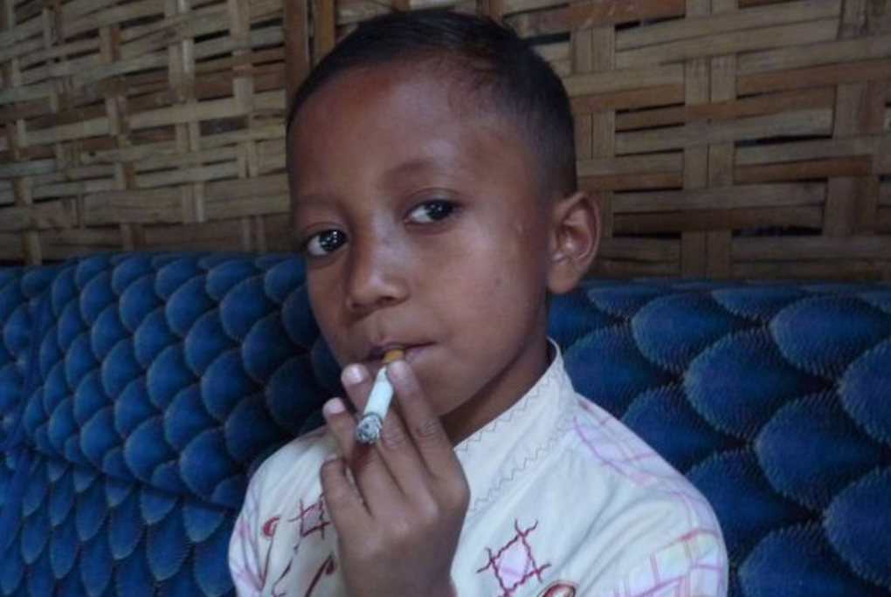
Early Life Interventions
Schools provide a sustainable access point
Parents of tweens are fall into highest incident stroke disparity age bracket between 35-45
30% being raised by grandparents - witness stroke and call 911.
Stroke preparedness conduits into home (transmission vector hypothesis)
Primordial Prevention – Early Life Risk Reduction

Slide 22

STROKE LITERACY ACTION MEASURE
A validated measure for children
Desorbo A, Allegrante J, Williams O. APHA 2016
Three sub-constructs: a) Stroke knowledge, b) Behavioral intention to call 911, c) Self-efficacy to take action (teach others and call 911).
Cronbach's Alpha for stroke knowledge was 0.73; for behavioral intention to call 911, 0.7; and for Self-efficacy, 0.89.
Flesch-Kincaid Grade level 4

Slide 23
Applying the MMHEM Framework
TRANSDISCIPLINARY TEAM
PUBLIC HEALTH SCIENTISTS (SMS) COMMUNICATION EXPERTS
Science
HEALTHCARE PROFESSIONALS
Science
ARTISTS MUSICIANS PRODUCERS STORYBOARD WRITERS
Art & Culture
REPRESENTATIVES OF TARGET GROUP
Culture
Notes:
I’’m a Neurologist where will I find these folks to join my research team?

Slide 24
Art Domain
Human attention is a scarce commodity for
which there is great competition
Aesthetics
Multisensory Approach

Slide 25
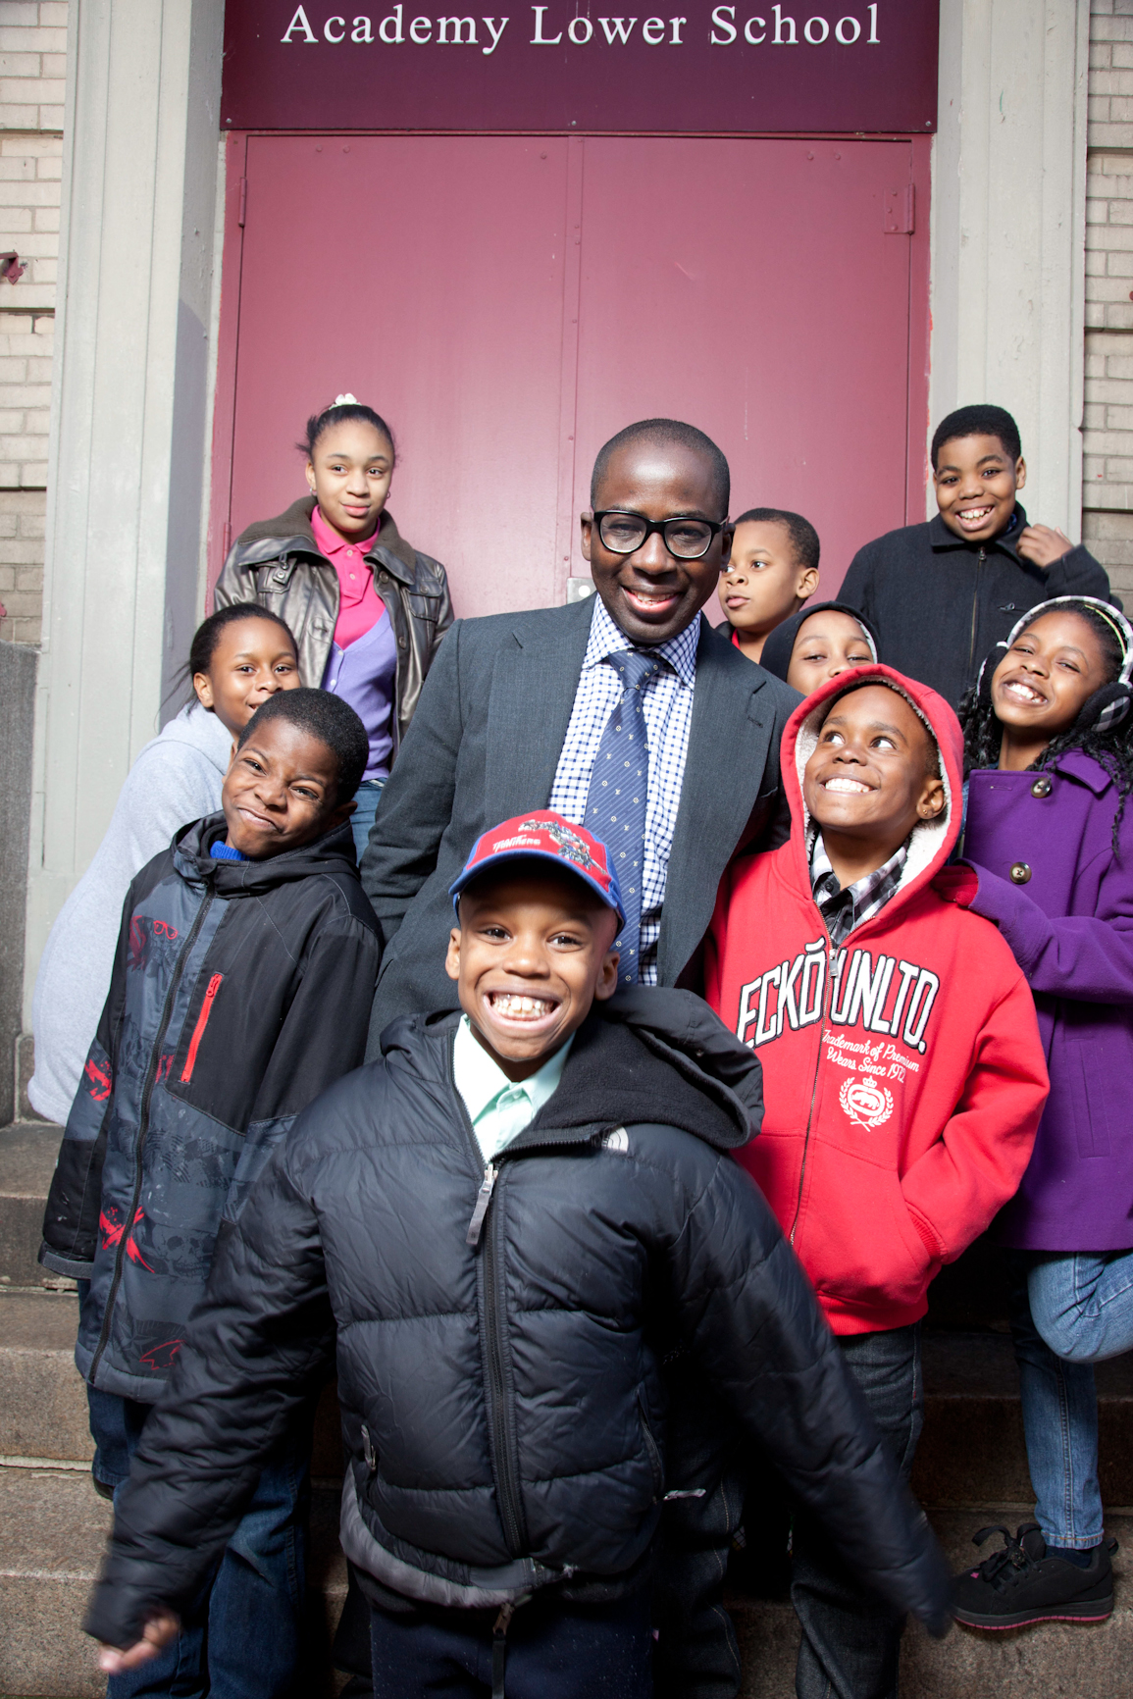
Culture Domain:
Student Advisory Board
Quarterly Meetings
Guide research design and implementation
3. Guide development of intervention tools
4. Rotate annually

Slide 26

Cultural Tailoring
Importance of cultural sensitivity
frameworks that strengthen
ecological validity
Ecological Validity Model for
cultural adaptation (Bernal et al, 1995)
Consists of 8 elements for adaptation:
Language, Persons, Metaphors,
Content, Concepts, Goals, Methods,
Context

Slide 27
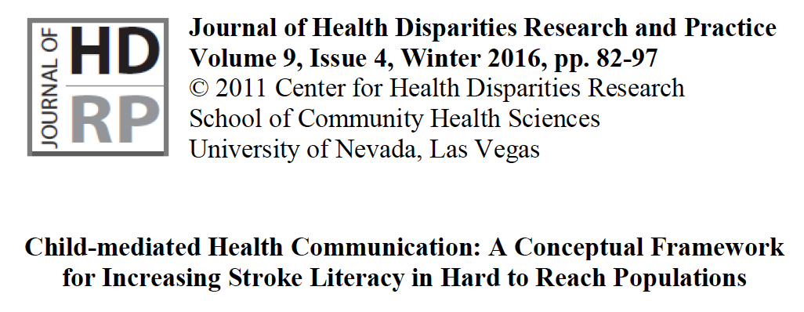
Science Domain:
Behavior Change Science and Communication Theory
Intervention Development using
Models of Behavior Change
Notes:
Conventionally, health education interventions are based on the assumption that communication and influence flows from parent to child and not the reverse. Our goal was to reverse this paradigm and demonstrate that children can educate and influence their parents health behaviors
CDC National Health Education Standards

Slide 28
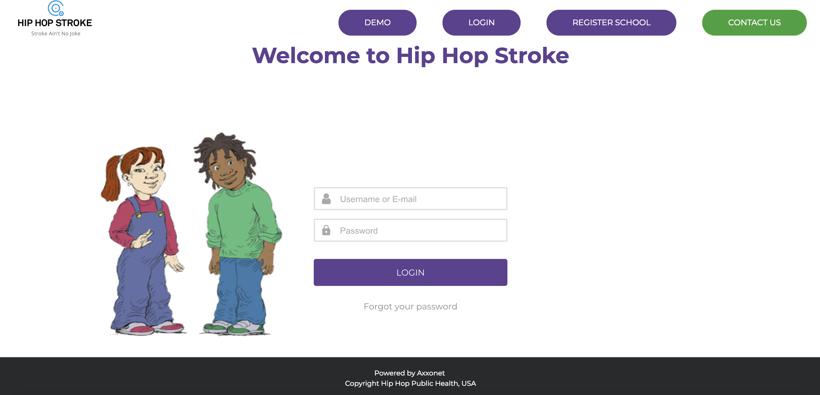
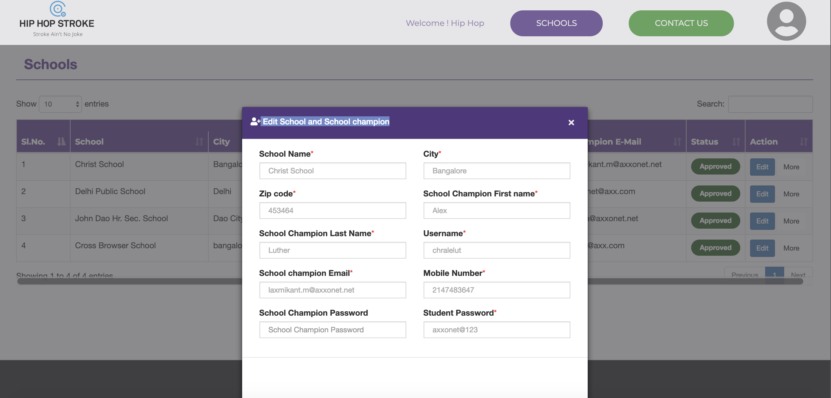
hiphopstroke.org
Program Portal
45 minute modules
2 interactive stroke recognition modules
1 module focused on prevention
Embedded Media and video games
Homework Assignments – built in CMSC
Notes:
REDCAP database

Slide 29
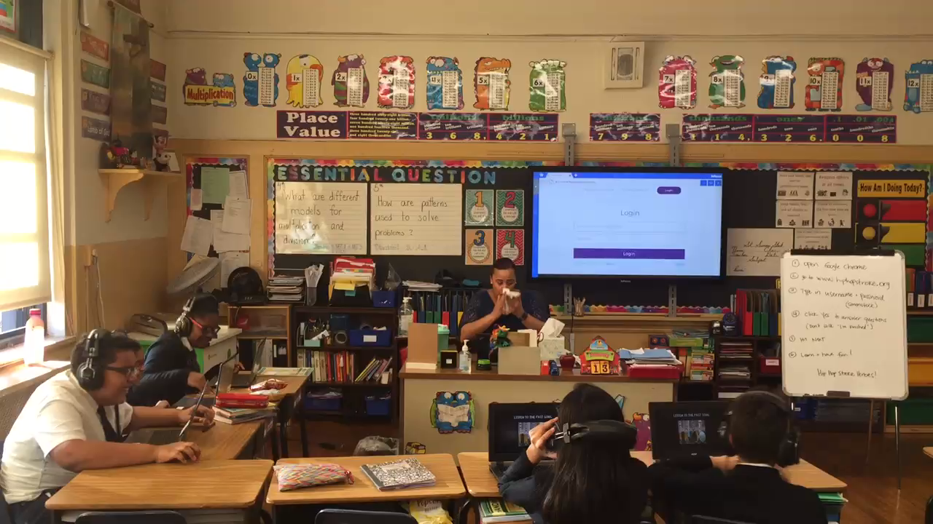

Slide 30
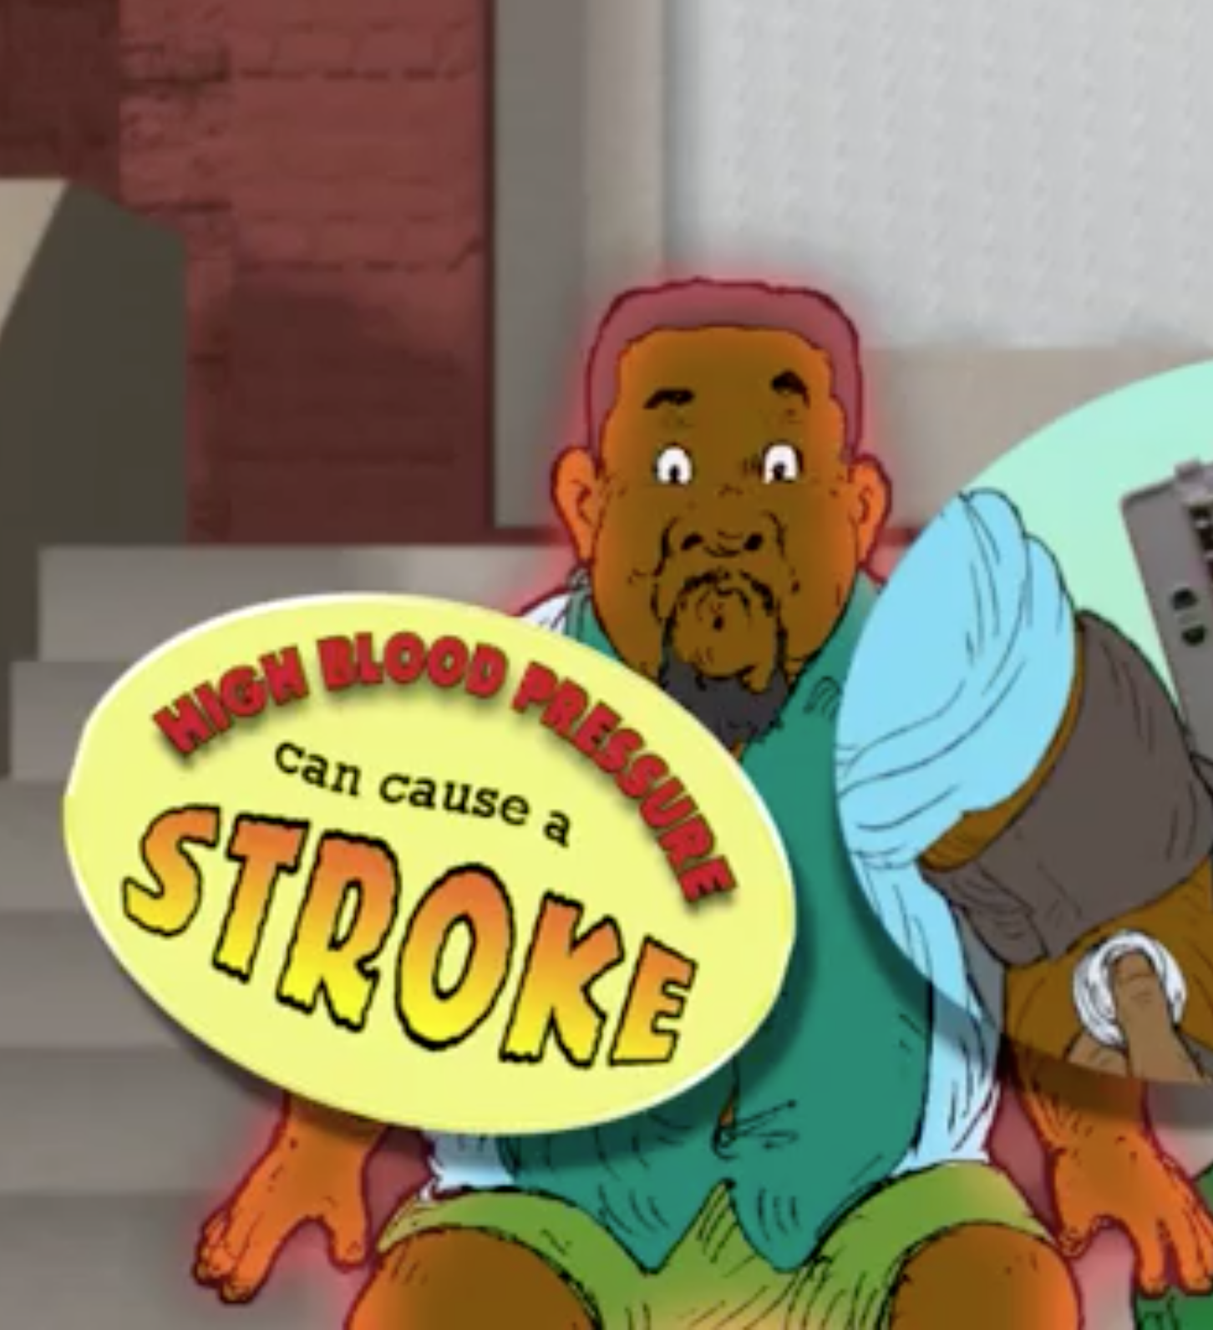
Mediation Tools
Sharing Score Composite
Watch Stroke Ain’t No Joke cartoon with
parents
Rap the FAST symptoms to parents
Read the comic with parents
Complete parent activities in comic book
Watch the stroke prevention cartoon with
parents

Slide 31

Science Domain: Pilot Studies
Hip hop Stroke: The Standalone Effect of Musical Cartoons on Stroke Knowledge of Fourth Grade Children Living in a Low-Income Neighborhood
Olajide Williams, Alexandra Desorbo, James Noble
Stroke. 2012;43:A2478
Effect of a Novel Video Game on Stroke Knowledge of 9-to-10 Year Old
Low-Income Children
Olajide Williams, Mindy Hecht, Alexandra Desorbo, Saima Huq, James Noble
Stroke. 2014 Mar;45(3):889-92
Child-Mediated Stroke Communication: Findings from Hip Hop Stroke
Olajide Williams, Alexandra Desorbo, James Noble, William Gerin
Stroke 2012, 43:163-169

Slide 32
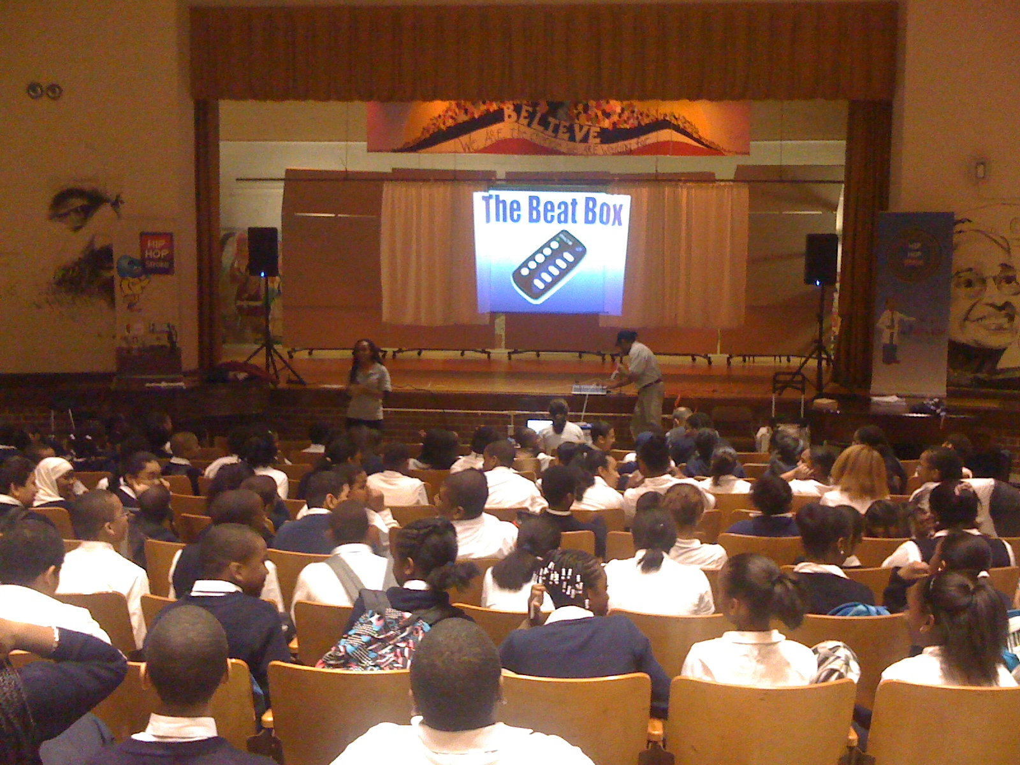
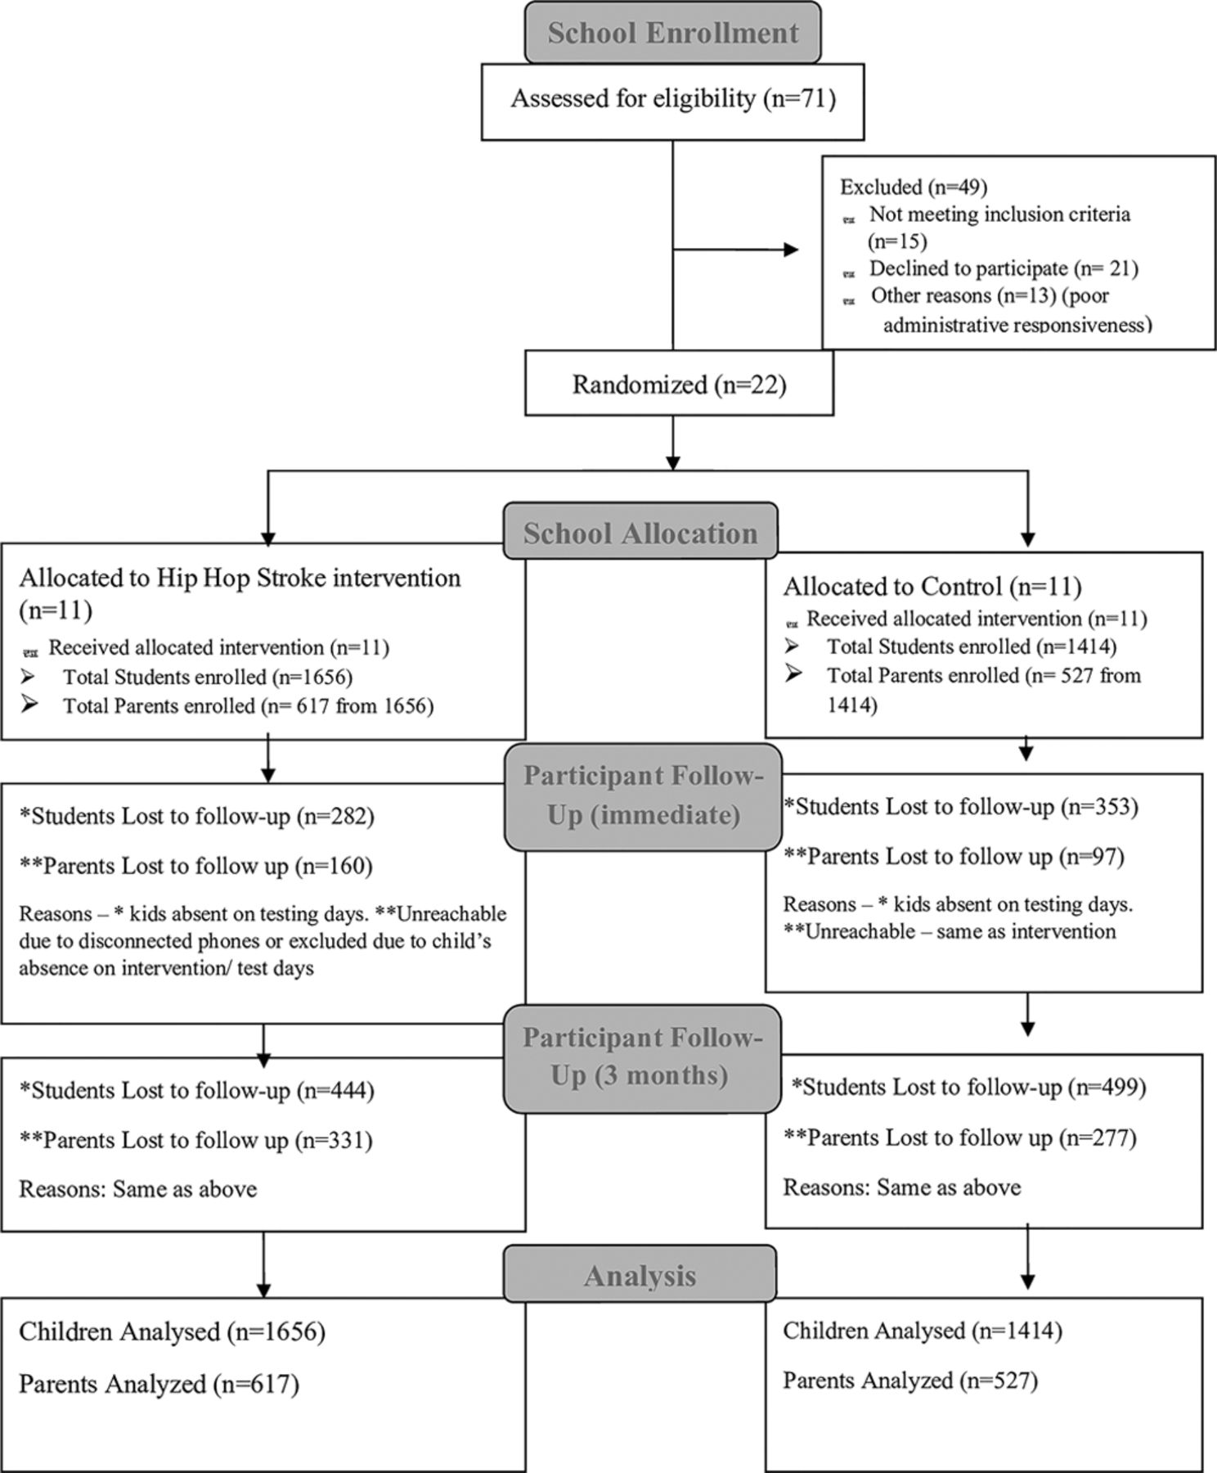

Science Domain: RCT
CONSORT flow diagram
Hip-Hop Stroke Trial.
Targeted Recruitment of High Need Schools:
High % Free Lunch Eligibility Students + High % Black Students
Notes:
Randomized 3070 children and 1144 parents from high need NYC public schools based on Peer Index scores into our HHS intervention vs an attentional control.

Slide 33
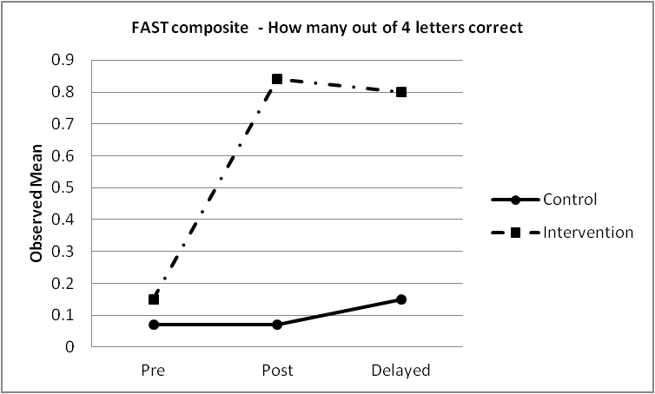
Effectiveness of Intervention
Improving Community Stroke Preparedness in the (HHS) Hip Hop Stroke
Randomized Cllinical Trial
Olajide Williams, Ellyn Leighton-Hermann Quinn, Jeanne Teresi, Joseph Eimicke, Jian Kong
Gbenga Ogedegbe, James Noble,
Stroke 2018 Apr; 49(4): 972-979
Children: High Self Efficacy for calling 911 for stroke, describing stroke event to operator, teaching a parent about stroke (high sharing scores), and high stroke preparedness scores with good retention.
Multiple Real World 911 calls
Parents

Slide 34






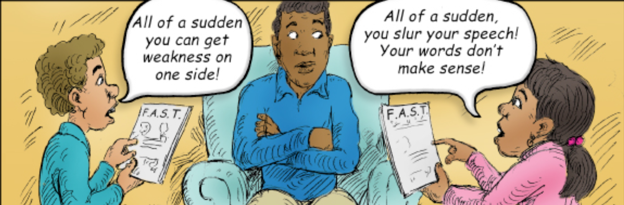
Stroke Hospital Accreditation
Statewide Dissemination of Hip Hop Stroke : Hybrid Type 3
CFIR+RE-AIM capturing of implementation variables
STROKE
CORDINATOR
CMHC
SCHOOL
CHAMPION
Teachers
Notes:
Goal was vertical and horizontal scaling using definitions from the Framework of Health Intervention Scale Up by Barker
Horizontal is replicating the intervention in different environments and vertical is when successful policy or health system changes needed to institutionalize the intervention is accomplished
HHS first to examine the scalability of a stroke preparedness intervention

Slide 35
Horizontal Scale Up
47/120
Hospitals
Syracuse
Rochester
Buffalo
Albany
New York State
Capital
Hip Hop Stroke Hospitals
Riverhead

Slide 36
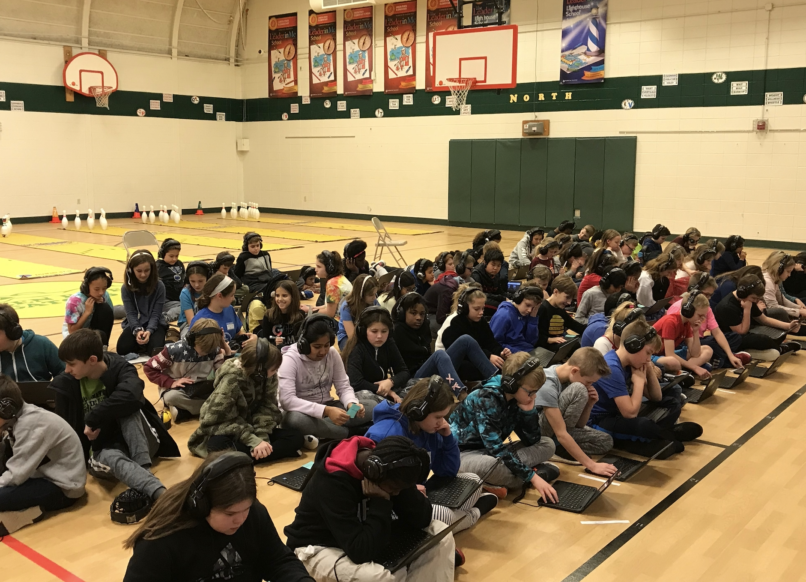


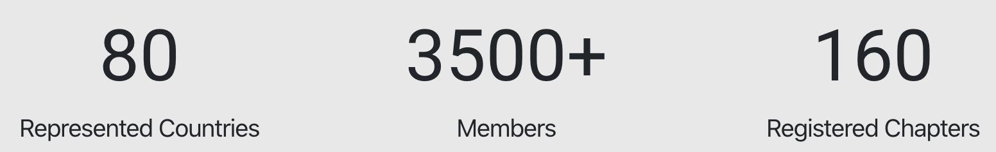
Independent Uptake of Hip Hop Stroke (Horizontal Scale up)

Slide 37


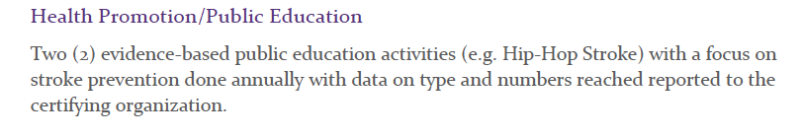
Vertical Scale Up

Slide 38



THANK YOU
Columbia University
James Noble
Luisa Gomez Chan
Madeline Hassankhani
Harmon Moats
Janhavi Mallaiah
Sandra Minchala
Lori Rose Benson
Ewelina Swierad
Vanessa Sawyer
Rachel Shelton
Hip Hop Artists
Adrian “Easy AD” Harris
Artie Green
Doug E Fresh
Darryl DMC McDaniels
Chuck D
Animation Story Board
Ian “Electric Black” James
Bill Davis ….RIP
Student Advisory Board

