Slide 1
Staffing Structure & Career Development University of Minnesota Stroke Research
10.23.2024
Department of Emergency Medicine-Acute Care Research Coordinator (ACRC)
Megan Tessmer, RN / Jessica Staloch, RN / Elizabeth Nierengarten, RN / Jessica Gieseke, RN / Julie Scherber, RN/ Abbey Staugaitis, RN
Department of Neurology Inpatient Stroke Group
Nicole Degerman, RN / Anna Brauch, RN/ Julie Scherber, RN, Abbey Staugaitis, RN

Slide 2

Staffing Crisis
Turnover rate has risen to 35%-61%
Projected to increase by 9.9% between 2016 and 2026¹
This Photo by Unknown Author is licensed under CC BY
Freel SA, Snyder DC, Bastarache K, Jones CT, Marchant MB, Rowley LA, Sonstein SA, Lipworth KM, Landis SP. Now is the time to fix the clinical research workforce crisis. Clin Trials. 2023 Oct;20(5):457-462. doi: 10.1177/17407745231177885. Epub 2023 Jun 2. PMID: 37264897; PMCID: PMC10504806.
Notes:
Among patient-facing clinical research professionals, the turnover rate has risen to 35%–61% and the US job market for clinical research coordinators predicted to grow by 9.9% between 2016 and 2026.¹
Freel SA, Snyder DC, Bastarache K, Jones CT, Marchant MB, Rowley LA, Sonstein SA, Lipworth KM, Landis SP. Now is the time to fix the clinical research workforce crisis. Journal of Clin Trials. 2023 Oct;20(5):457-462. doi: 10.1177/17407745231177885. Epub 2023 Jun 2. PMID: 37264897; PMCID: PMC10504806.
Most healthcare industries target a turnover rate of less than 20%.

Slide 3








UMN Stroke Research Team
Non-Acute Care
Research Coordinators
Acute Care
Research Coordinators
Based in Dept of Neurology
2 research nurses working at 0.75-1.0 FTE
Work on secondary and prevention stroke trials
Routine scheduling within regular business hours
Based in Dept of Emergency Medicine
3-4 research nurses working at 0.75-1.0 FTE + casual on-call coordinators
Collaborate with various departments to support a diverse portfolio
Provides 24/7 coordinator support to acute trials
Program Manager
Project Specialist
Regulatory
Notes:
Non-Acute Trials: CAPTIVA, ARCADIA , ASPIRE, SATURN
Acute: STEP, SISTER, FASTEST, MOST
Clustering acute trials and non-acute trials is key to our success.

Slide 4
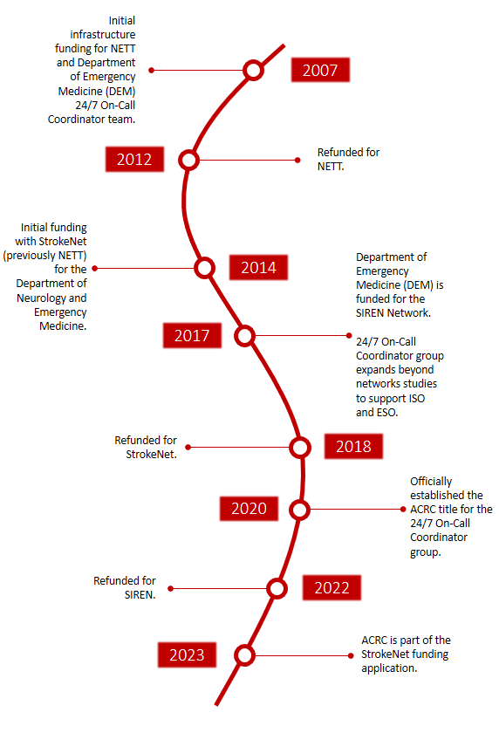
Acute Care Research Coordinators (ACRC)
Pooled Staffing Model
Full time FTE Research Nurses
  Responsible for day to day operations of a trial
  Are built into the on-call calendar and support on-call coordinators when needed
Casual on-call research coordinators
  Nurses, paramedics, international medical graduates
  Responsible for acute trial screening, enrollment and inpatient procedures
  Support weekend and night enrollments
Provides research coverage 24/7 in acute, clinically complex, inpatient clinical trials
Notes:
RNs: Stable, highly trained research nurses that serve as primary coordinators on all trials. Goal is to maintain these staff and support their career development as they progress from clinical research RN 2 to clinical research RN 4 to project specialist and even program managers as the department expands
Casual staff: These staff are with the ACRC for a brief period of time, typically 1-2 years. They are looking to gain research experience and build their resume to move on to the next step in their career path, usually either medical school or residency.

Slide 5
Research RN Career Projection
Project Specialist
Research RN 2
Research RN 3
Project Manager
Program Manager
Research RN 4

Slide 6
Research RN Career Milestones
 |  |  |  | + | Grants/Protocol/ Program Development
 |  |  | + | + | Contracts/ISO/ Infrastructure
 |  | + | + | + | Pre/Post award & Publication
 | + | + | + | + | Study Start-up/ closeout Clinical Team Training
 | + | + | + | + | B & I Study Coordination & CCRC
+ | + | + | + | + | Study Coordination (Network)
RN 2, RN3 | RN 2, RN3 | RN 3, RN 4 | PS/PM/RN 4 | PS/PM/PM

Slide 7
Temp/Casual Career Path & Research Fellowship
Stroke Research Fellowship
  Develop fundamental skills in clinical neurology and research
  Trained on research best practices and study protocols
  Individual support for independent research projects and publication opportunities
  1 to 2 year commitment
Resident
Research Fellow
Medical/ Graduate Student
Research Associate
Research Associate 2-4

Slide 8

Team Based Approach to Enrollments
All Coordinators in the ACRC are cross trained on all acute care trials in the portfolio and work as a team to enroll participants
Notes:
This pooled model is a team based approach.
All of the coordinators within this pool are cross trained on all acute trials in the portfolio.
Built on a culture of trust- All coordinators trust that other team members are adequately trained and can manage all delegated tasks without the oversight of the primary coordinator.
Requires good communication among team members, standardized training and clear enrollment workflow. The primary coordinator helps ensure adequate training and resources are available in the study in which they lead.

Slide 9
Benefits of a Pooled Staffing Model
Potentially minimizes protocol deviations and errors
  Shared responsibility for ensuring that a subject is screened and enrolled appropriately
Accommodates the fluctuating needs of acute care trials and supports 24/7 enrollment
  Supports the ability to re-distribute workloads if necessary to minimize burnout, overtime and paid idle time
Coordinators have the opportunity to work on a variety of clinical trials and keeps staff engaged in the acute enrollment process
Notes:
Minimizes PD: during an activation, we join an "enrollment meeting" which we have several eyes on a potential subject. Weekly meeting to debrief enrollments/screen failures which this provides an opportunity to learn and to make improvements of the workflow if needed.
Accommodates needs – since all are cross-trained, re-distrubuting workload is relatively easy. Many of the studies, we have a primary and a back up coordinator.
Coordinators – our portfolio is quite robust since we work with several departments and therefore, keeps staff engage

Slide 10
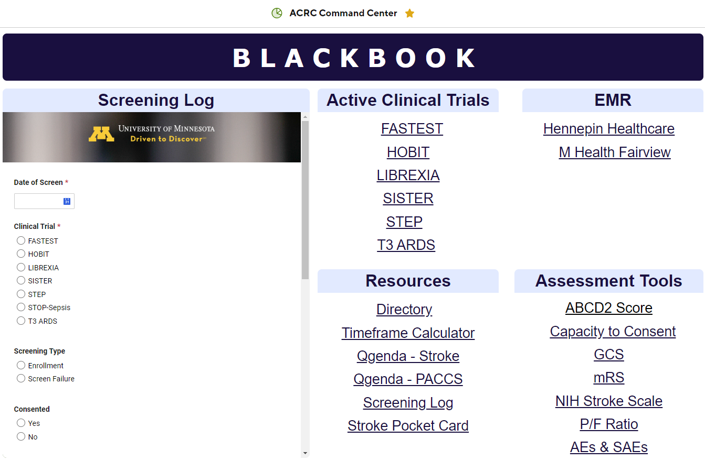
Pooled Staffing Model Essentials
"Project Based" vs. "Office Hour" based schedule
Standardized Training and Onboarding
  General Research Onboarding and Protocol Training
  Mock enrollment and mock consent training and shadowing
Remotely accessible tools and resources
Notes:
Project based vs office hour based: Time is structure around project needs not set office hours. Staff have flexibility in scheduling to meet the demands of the study.
Mock training: mock enrollments, mock consent training
Resources: Command center – one stop shop for all of our screening/enrollment needs. An electronic versions is necessary to ensure up to date workflows

Slide 11
Financial Operational Considerations
Monthly On-Call Fee
Primary On-Call
Back-up On-Call
ISO Hourly Rate
Salaries
Parking/mileage
Communication (hotspots, HIPAA app)
Non-billable work
Notes:
There is a cost to operating a 24/7 program but we manage this with two charges
Monthly on call fee – this is for the staff being on call 24/7. This is charged to the departments in which the study is housed. Our department is ED, but we work with several departments in the UMN (stroke, cardiology, pulmonology
ISO Hourly rate –
this covers the salaries of the group.
Non-billable hours – cannot bill everything to the study (general research training).
Mileage and parking – remotely working within several hospital in roughly a 20 mile radius.
Communications -
We have covered some NIH funded on call fees to prevent the studies from going into large deficits.
Limitations on implementation – institutional and financial investment up front. General research training requires time and money which is not billed to the studies.

Slide 12

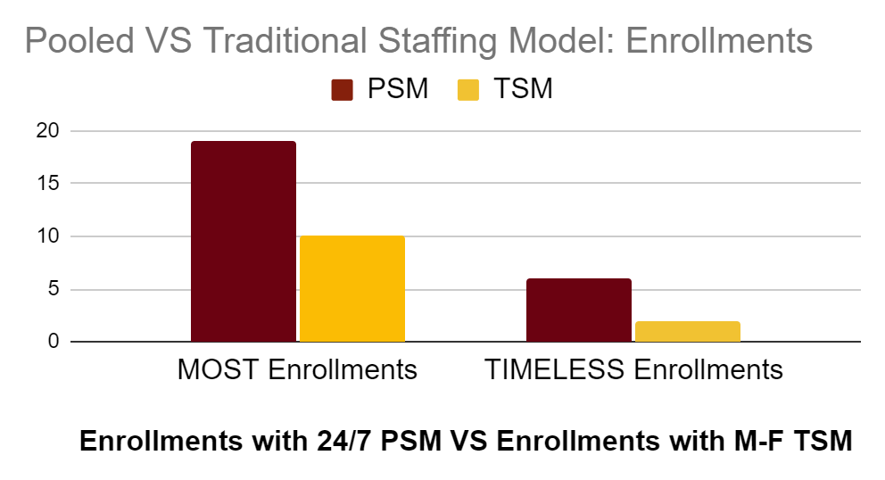
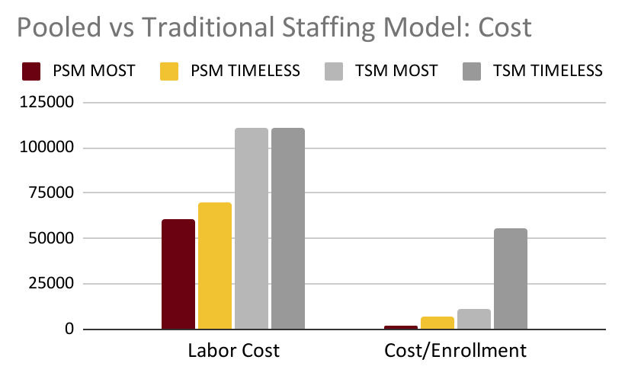
Abbey Staugaitis, RN, MSN, CCRC,¹ Jessica Staloch, MSN, RN¹; Christopher Streib,MD¹; Mike Puskarich, MD¹; Michelle Biros,MD¹ ^{1. University of Minnesota}
Cost Analysis of a Pooled Coordinator Model versus Traditional Staffing for Acute Stroke Trials
Background
Traditional staffing models (TSMs) assign a research coordinator to cover specific clinical trials. Pooled staffing models (PSMs) utilize research coordinators in enrollment and other tasks to cross-cover multiple clinical trials often enabling expanded coverage beyond daytime/weekday. We compared the PSM and TSM model to determine impact on overall cost to the study and trial enrollment.
Results
The calculated one-year cost (salary + fringe) of a 1.0 FTE RN research coordinator was $109,755.36. During the study period, there were 19 enrollments in MOST; 10 occurred outside daytime working hours. The MOST PSM cost was $60,813, equivalent to 0.55 FTE coordinator coverage in a TSM with 90.0% more enrolled subjects. There were 6 enrollments in TIMELESS; 4 occurred outside daytime working hours. The TIMELESS PSM cost was $70,134, equivalent to the cost of 0.64 FTE of standardized research coordinator in a TSM with 200% more enrolled subjects.
Methods
PSM costs were obtained from existing billing records for 1 year (1/1/21-12/31/21) for two Phase III acute trials (NCT03735979, NCT03785678). Actual cost for the PSM included the hourly rate: $78/hr and an on call retainer fee: $690/month. RN FTE rate was calculated based on the PSM model aggregate salary and institutional comparable RN salaries. Coordinator work included: enrollment, subject visits, data entry, query resolution, monitor visits, regulatory management, meetings, training/retraining.
Conclusions
PSMs may offer a solution to the staffing and coverage challenges faced by many institutions seeking to participate in emergent clinical trials. PSM for acute care clinical trials, like stroke, can be cost-effective for individual studies while increasing enrollment opportunities by supporting 24-7 coordinator coverage.
Notes:
Although there are upfront costs to get a PSM however, we found that it is cost-effective for implementing it into our team. We analyzed the cost of the PSM to a traditional staffing model (we defined the Traditional model to that of a single coordinator assuming work during the traditioanl working hours.) The poster illustrates two of our top enrolling stroke sites but since we have analyzed data from another stroke study. We found that we had approximately 2.25 the number of enrollments than the traditional model would have had during business hours. The PSM bills for hours worked (labor cost) on the study, it accommodates for the fluctuating study needs and fell between an equivalent a .25 and .65 FTE. of that traditional model. Cost per enrollment was lower with the pooled model because the more we enrolled we became more efficient in the coordinator work tasks.

Slide 13

Questions: acrc@umn.edu

