Slide 1
StrokeNet cIRB & e-Consent
Webinar
Introduction and Framework
Pooja Khatri, MD MSc

Slide 2
Welcome
Local IRB and HRPP officials
PIs and Coordinators
  RCC
  Satellite
  Trial

Slide 3
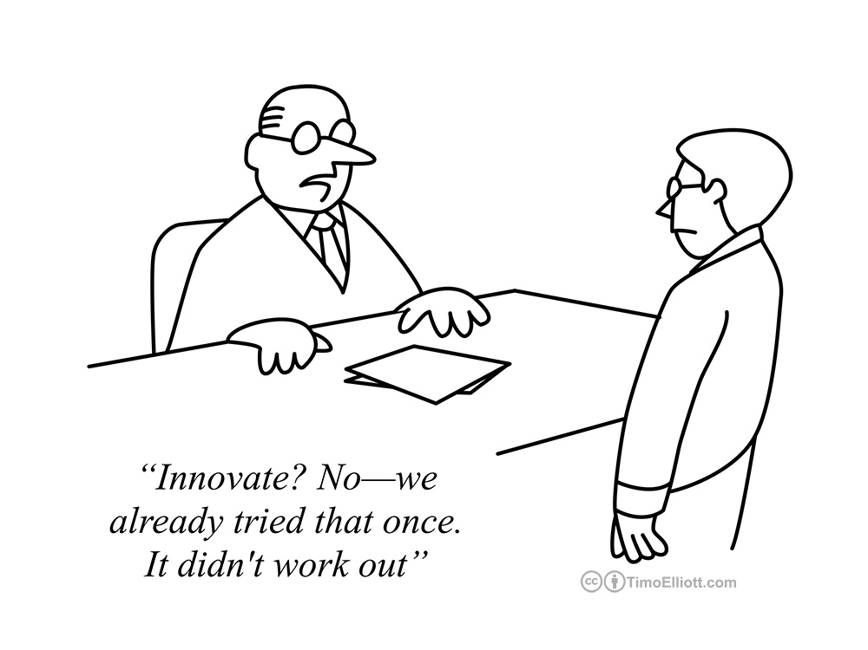
Why now?
COVID-19 increases urgency
Improves ICF process regardless
Successful models already
  SIREN network-wide
  Local stroke trial implementations
    Emory
    Minnesota
    Vanderbilt
    Others

Slide 4
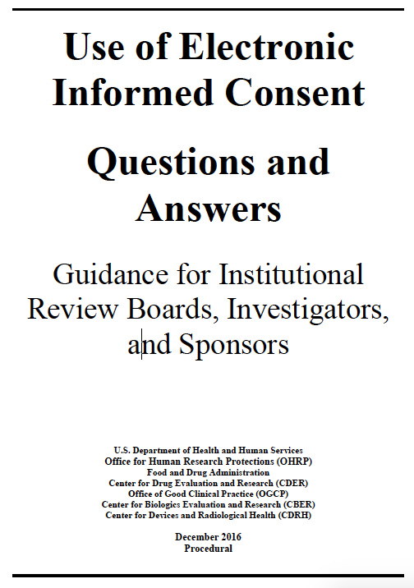
What is E-Informed Consent (eIC)?
Electronic platform for obtaining and documenting IC
Does not change the essential IC process for SN Trials
Only changes how it is presented (electronic vs paper) to the participant/LRA and how it is recorded and shared
Key components for our purposes
  Sending a secured link to by text or email
    Or share in person
  REDCap-based website
  Fillable and signature-capable
  User-friendly
  Compliant
  Immediate dissemination

Slide 5
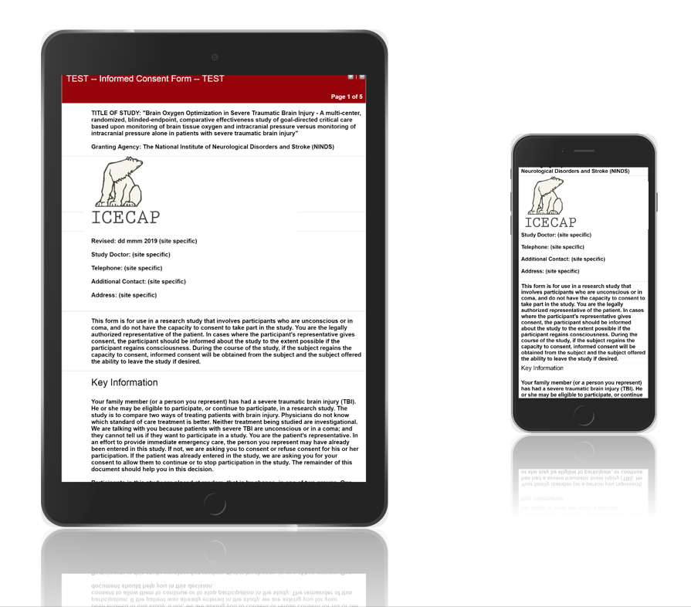
Advantages of Electronic Informed Consent
Improve experience of potential participant
  Make written information available to them in more ways
  Allow them to retain and share written information more easily
More easily allows remote consent for off-site LAR (or participant)
  Increase rate and speed of recruitment (ex: LAR can be in another state)
Makes immediate dissemination and retention possible
  To LAR/participant, local coordinator, and centrally
Also makes compliance and monitoring easier
  Correct version, no paper, real-time updates, secure

Slide 6

Some Clarifications
Three overlapping considerations
  Remote consent
    Electronic consent is one method of remote consent
  Electronic informed consent
    Can also be used as a platform for in-person consent
  Telehealth mediated consent
    Can include remote consent, or specifically e-consent
    Can consist of in-person consenting, via paper or e-consent
Remote
Consent
Electronic
Consent
Telehealth

Slide 7
E-Consent Process Development Effort
NCC Team
  Emily Stinson
    Lead SN Regulatory Specialist
  Iris Deeds
    MOST Prime Project Mgr
  Jennifer Golan
    SN Regulatory Specialist
  Laura Benken
    ASPIRE NCC Project Mgr
  Kimberley Bernstein
    SATURN NCC Project Mgr
  Jamey Frasure
    NCC Administrative Director
New StrokeNet Advisory Group
  Emory
    Kiva Shindler & Mike Frankel
  U-Minnesota
    Abbey Staugaitis & Chris Streib
  Vanderbilt
    Hayden LaFever, Kalli Beasley, & Eva Mistry
  SIREN
    Deneil Harney & Rob Silbergleit

Slide 8
Local Vs Centrally Administered Approach to E-Consent
LOCAL
CENTRAL
Local ICF build at each study site
Not all SN sites have REDCap
cIRB approves each process
Train each site coordinator in REDCap
Added work for local IRBs who are new at this
Central ICF build occurs once
Leverage REDCap centrally for all
cIRB approves one process
Train NCC PMs in REDCap
Saves time for sites with local process in long run

Slide 9
Local Vs Centrally Administered Approach to E-Consent
LOCAL
CENTRAL
Local ICF build at each study site
Not all SN sites have REDCap
cIRB approves each process
Train each site coordinator in REDCap
Added work for local IRBs who are new at this
Central ICF build occurs once
Leverage REDCap centrally for all
cIRB approves one process
Train NCC PMs in REDCap
Saves time for sites with local process in long run
RETROFIT RIGHT NOW FOR CURRENT TRIALS,
PROSPECTIVE ROLLOUT FOR FASTEST

Slide 10
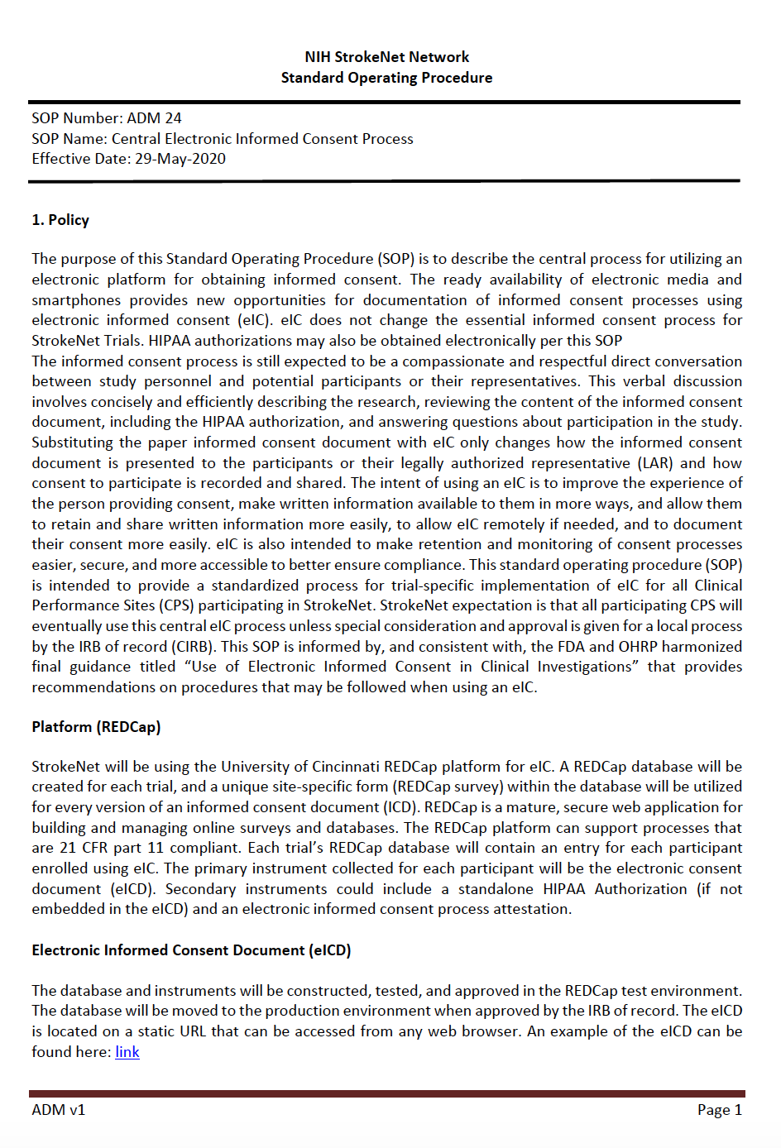
New NIH StrokeNet SOP
Central Electronic Informed Consent Process
SOP Number: ADM 24
Approved by UC cIRB
Link to example e-IC document (e-ICD)
Rose Beckmann, SN Administrative Coordinator
  beckmare@ucmail.uc.edu
Will be posted here:
  https://www.nihstrokenet.org/sop_gcp

Slide 12
Overview of Planned StrokeNet Central E-Consent Process
Emily Stinson, MS
Iris Deeds, BS CCRP

Slide 13
E-Consent Overview
REDCap is a mature, secure web application for building and managing online surveys and databases.
Facilitates presentation of an electronic Informed Consent Document (eICD) and capturing the patient or Legally Authorized Representative’s (LAR) signature.
To access and complete the eICD, the patient/LAR must have a smartphone, tablet or computer with Wi-Fi or cellular internet connectivity.
Individuals provide a handwritten signature by using a computer mouse, or by using their finger on a cell phone or tablet touchscreen.
REDCap automatically saves the signed eICD on its secure server and maintains an audit trail that logs all user actions.

Slide 14
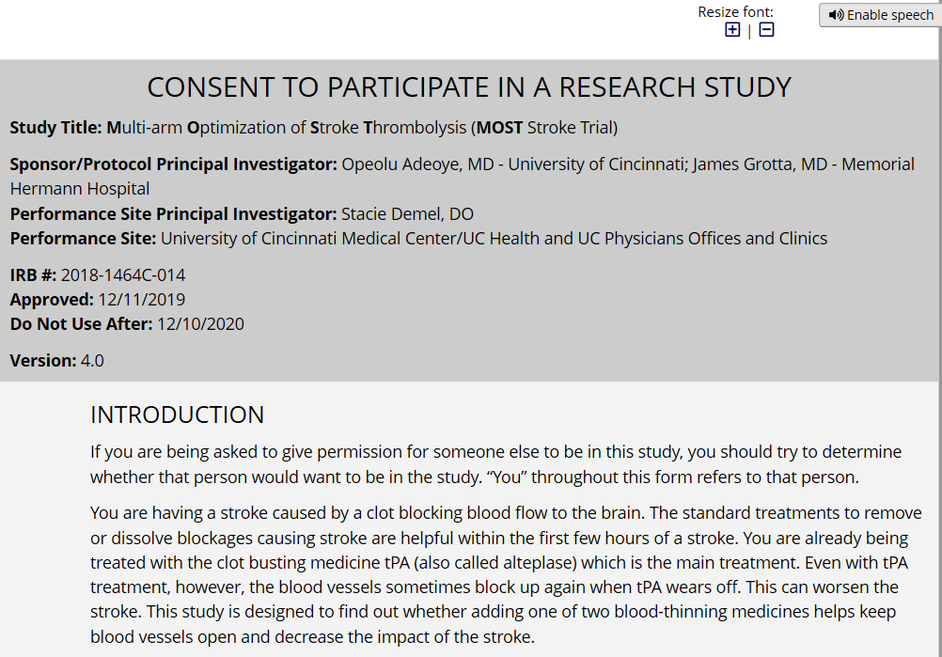
E-Consent Process
1. Each site will be
assigned a static URL to share with the patient/LAR.

Slide 15
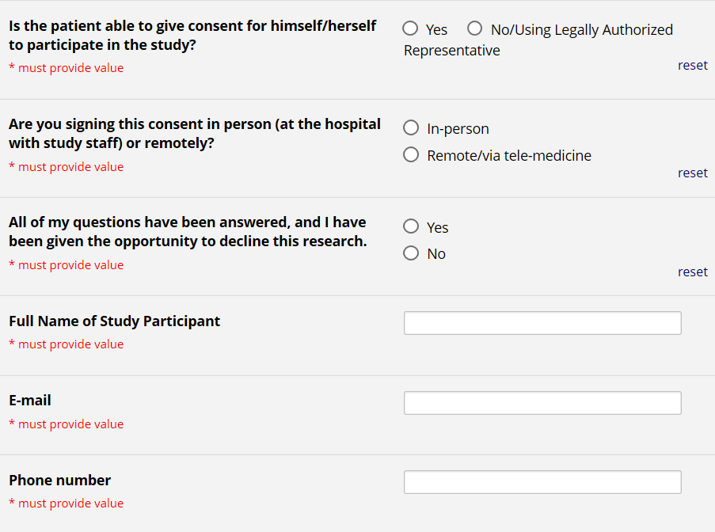
E-Consent Process
1. Each site will be
assigned a static URL to share with the patient/LAR.
2. The person obtaining
consent will review the eICD and provide instructions on completing the form.

Slide 16
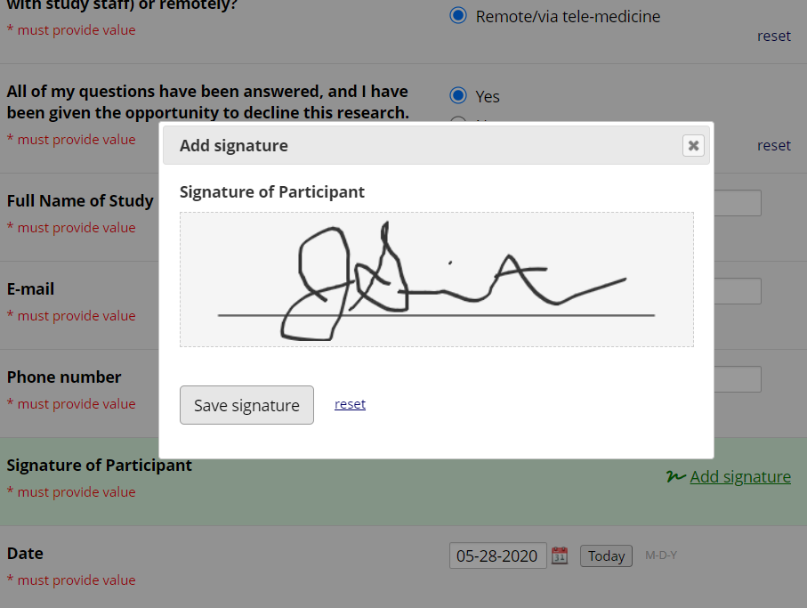
E-Consent Process
1. Each site will be
assigned a static URL to share with the patient/LAR.
2. The person obtaining
consent will review the eICD and provide instructions on completing the form.
3. The patient/LAR will
add their handwritten signature.

Slide 17
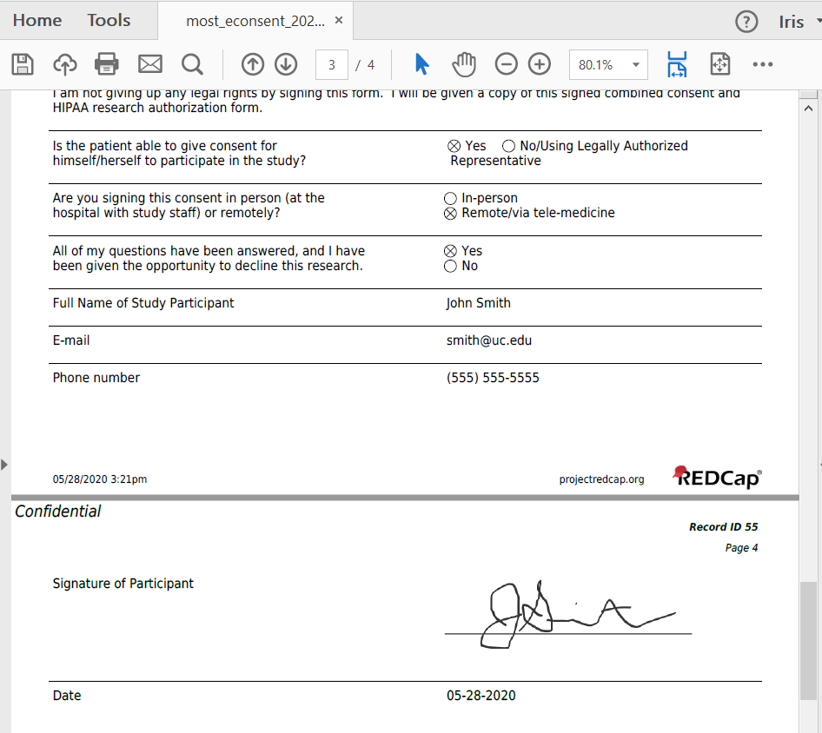
E-Consent Process
4. Upon completion of
eICD, the site’s study team will receive the completed eICD PDF via automated email.
5. The participant/LAR
may elect to receive the eICD PDF via email.

Slide 18
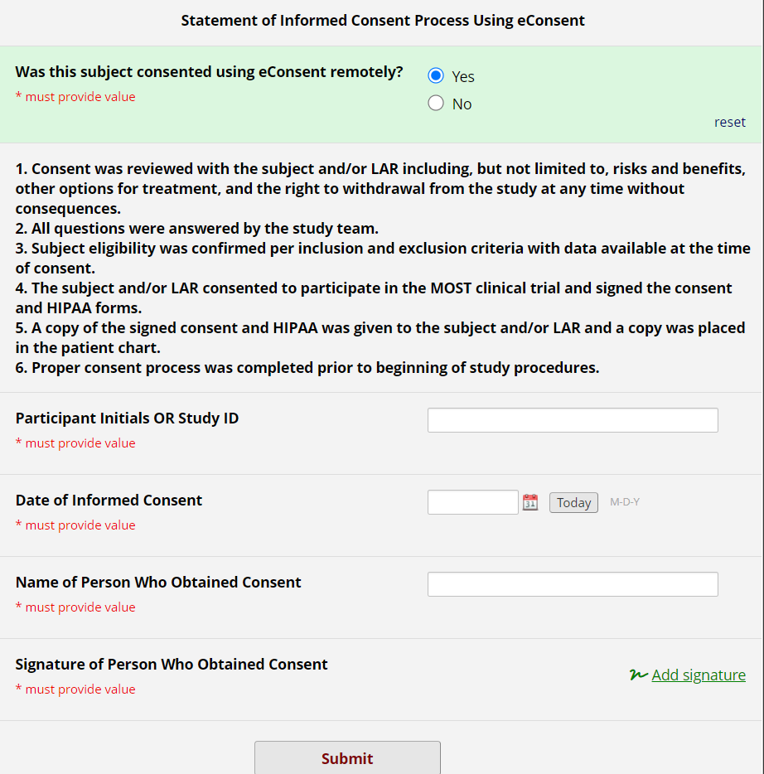
E-Consent Process
6. When the study team
and the participant/LAR are not in the same physical location both parties are not able to sign the eICD at the same time.
Only the participant/LAR will sign in real time and the person obtaining consent will subsequently complete a remote consent attestation form.

Slide 19
Responsibilities
NCC Responsibilities
The NCC will create a REDCap project for each site that elects to use E-Consent.
The NCC will ensure that the most recent CIRB-approved version of the site-specific ICD is available in REDCap for eICD use.
The NCC will provide the site with their cIRB approval to use the central E-Consent process and access to their study-specific and site-specific REDCap project.
The NCC will maintain the list of individuals who receive the completed eICD PDF via automated email according to the site’s DOA in WebDCUTM.
Site Responsibilities
The site will designate a primary and back-up user to access to their REDCap E-Consent project.
The site’s designated REDCap users will ensure the Remote Consent Attestation is completed, when required, by the person who obtained consent remotely.
The site will ensure the PDF versions of the eICD and Remote Consent Attestation, as applicable, are combined into one document and uploaded to WebDCUTM within 5 days of signature.

Slide 20
IRB/HRPP Role in the E-Consent Process
Michael Linke, PhD, CIP
Chair, University of Cincinnati IRB
Chair, StrokeNet Central IRB
Susan K Roll, RN, BSN
StrokeNet Central IRB Liaison

Slide 21

Use of a Single Institutional Review Board for Multi-Site Research
Goals of the NIH policy
1) enhance and streamline IRB review for multi-site research
2) maintain high standards for human subjects protections
3) allow research to proceed effectively and expeditiously
4) eliminate unnecessary duplicative IRB review
5) reduce administrative burden
6) prevent system inefficiencies

Slide 22
University of Cincinnati HRPP/IRB
Fully accredited by the Association for the Accreditation of Human Research Protection Programs (AAHRPP)
Research Administration Portal (RAP)
  electronic database utilized by the UC IRB
  Huron IRB (Click IRB)
Leadership
  Angela Braggs-Brown, RAC, CIP, MA, UC HRPP Director
  Kareemah Mills, UC HRPP Assistant Director

Slide 23
StrokeNet Studies Approved by the CIRB
TeleRehab
DEFUSE 3
CREST-2
CREST-H
ARCADIA
Sleep SMART
MOST
TRANSPORT 2
SATURN
I-ACQUIRE
ASPIRE

Slide 24
Reliance Agreement - Basic Responsibilities
  CIRB
    is the single IRB of record
    regulatory responsibility for assuring the protection of the rights and welfare of research participants
  Relying Institution (RI)
    sets standards to determine whether a research investigator can conduct research under its auspices.
    agrees to cede IRB review of the NIH StrokeNet research to the CIRB
    agrees to accept the decisions of the CIRB regarding review, approval and oversight of research covered by this Agreement

Slide 25
How Do We Work Together?
CIRB Responsibility |  | Local Site Responsibility
IRB review tasks Initial review Continuing review Amendments, deviations, noncompliance COI study review and management Approve informed consent documents and process |  | Site specific context Local laws Institutional policies Local context COI local review and management
HIPAA determinations of: Authorizations for Research Requests for waivers of authorization |  | Local Ancillary Review Requirements Nursing, Radiation, Bio Safety, etc.
Local context review Collect local information required for IRB review Distribute a high-level protocol synopsis and highlights sheet |  | Other compliance areas Ongoing oversight of research conduct Conflicts on interest

Slide 26
Use of Electronic Informed Consent- Questions and Answers Guidance for Institutional Review Boards, Investigators, and Sponsors December 2016 HHS and FDA Guidance
Q13. What are the IRB’s responsibilities in the eIC process?
  Review approve, all research activities covered by the applicable regulations
  A critical part of this responsibility is for the IRB to ensure there is an adequate informed consent process that protects the rights and welfare of subjects participating
  Must review and approve the eIC that the subject will receive and view

Slide 27
INFORMATION SHEET - Informed Consent Draft Guidance for IRBs, Clinical Investigators, and Sponsors - July 2014
The investigator should advise the IRB of the consent process to be used
The IRB must ensure that investigators seek consent from subjects under circumstances that minimize the possibility of coercion and undue influence
Ensure investigators allow sufficient time for subjects,
  to consider the information
  provide time and opportunity for the subjects to ask questions and have those questions answered
  allow time and opportunity for the subjects to consider fully whether to participate

Slide 28
INFORMATION SHEET - Informed Consent Draft Guidance for IRBs, Clinical Investigators, and Sponsors - July 2014
IRBs must review all materials used in the informed consent process.
If procedures other than a face-to-face consent interview are proposed, such as by telephone, the IRB should consider whether the procedures will provide effective communication and accomplish the goals of the informed consent process

Slide 29
INFORMATION SHEET - Informed Consent Draft Guidance for IRBs, Clinical Investigators, and Sponsors - July 2014
IRBs, clinical investigators, and sponsors have responsibility for ensuring that the informed consent process is adequate and meets FDA's regulatory requirements
The entire informed consent process involves,
  giving a subject adequate information concerning the study
  providing adequate opportunity for the subject to consider all options
  responding to the subject's questions
  ensuring that the subject has comprehended this information
  obtaining the subject's voluntary agreement to participate
To be effective, the process should provide ample opportunity for the investigator and the subject to exchange information and ask questions

Slide 30
Replacing paper consent forms with eIC
eIC does not change the essential informed consent process only changes how,
  the informed consent document is presented
  consent to participate is recorded and shared

Slide 31
Replacing paper consent forms with eIC
The intent of using an eIC is to,
  improve the informed consent experience
  make written information available to them in more ways
  allow information to be retained and shared more easily
  document consent more easily

Slide 32
Replacing paper consent forms with eIC
The consent process still must be a compassionate and respectful direct conversation between study personnel and potential participants or their representatives

Slide 33



Slide 34



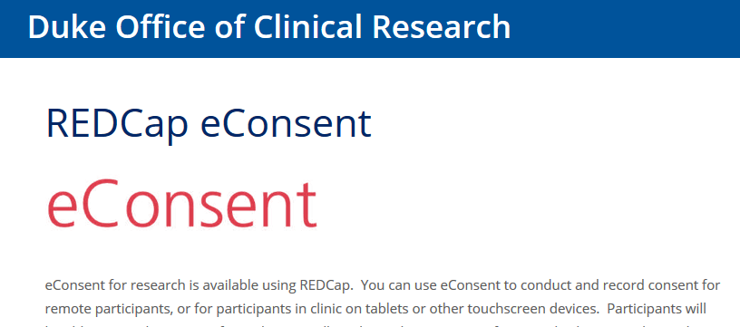


Widely used…

Slide 35
StrokeNet RedCap eConsent Process
Documentation with a handwritten signature
  Handwritten signature
    the scripted name or legal mark of an individual handwritten by that individual
    executed or adopted with the present intention to authenticate a writing in a permanent form
    the act of signing with a writing or marking instrument such as a pen or stylus is preserved
    the scripted name or legal mark, while conventionally applied to paper, may also be applied to other devices that capture the name or mark
  Electronic signature
    means a computer data compilation of any symbol or series of symbols executed, adopted, or authorized by an individual to be the legally binding equivalent of the individual's handwritten signature

Slide 36
StrokeNet RedCap eConsent Process
Potential participants will not fill out consents online without direct communication
eIC will be used with direct telephone or video communication with the LAR or subject
use existing measures already done in routine clinical care to determine with whom you are speaking
CIRB will approve the final StrokeNet Central Electronic Informed Consent Process SOP prior to implementation

Slide 37
StrokeNet RedCap eIC Process
CIRB approval of process for individual studies
  the IRB reviews the eIC content and the eIC platform.
  review the content in the same context as a participant will review it
  approve content with local context required language for the research sites

Slide 38


Questions?

