Slide 1
Informed Consent
Aaron Perlmutter
NIH StrokeNet NDMC
Medical University of South Carolina

Slide 2
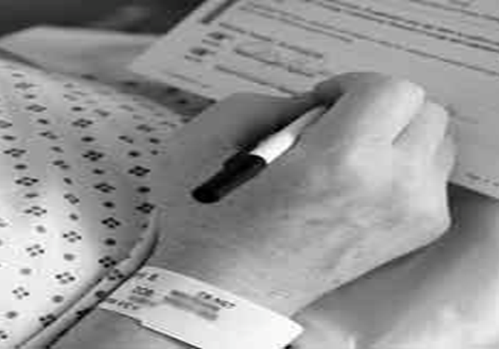
The Informed Consent Form
Used to DOCUMENT the Informed Consent process.
This documents:
  What information was provided to the subject
  Who obtained informed consent
  Who gave consent
  When consent was obtained (prior to intervention)

Slide 3
Obtaining Informed Consent
Use the most current cIRB approved version of the ICF when obtaining consent
  This version (and all approved versions) must be uploaded into the regulatory database in WebDCU
    These should be uploaded immediately upon receipt from the NCC
Consent should be obtained ONLY by staff who have been delegated this responsibility on the DOA
Review consent document to make sure all sections have been correctly signed/dated by subject/LAR and person obtaining consent.
  Subject/LAR must personally sign and date consent

Slide 4
Determining Capacity to Consent/Use of LAR
Subjects who lack cognitive ability to make decisions about study participation cannot give consent.
If there is any question about a subject’s cognitive ability, a trained site investigator must assess the subject for capacity to consent. This assessment must be documented in the subject’s medical record.
When assessing for capacity, the investigator should consider the potential research subject’s ability to:
    Make and express choice
    Understand relevant information
    Appreciate the significance of the information relative to the subject’s own situation
    Reason with this relevant information in making decisions
If a subject lacks capacity to consent, a legally authorized representative may consent on behalf of the subject.
If a subject regains the ability to consent during study participation, the consent process should be completed with the subject at that time.
Details regarding why an LAR was used must be entered on the Informed Consent CRF in WebDCU.

Slide 5
When NOT to use a LAR/Surrogate Consent
LAR signature on an ICF = LAR made decision because subject was not capable.
LAR signature is NEVER an appropriate way to document the consent of the subject.
Examples of when LAR signature is used to incorrectly document a subject’s consent:
Subject has trouble physically signing and dating the ICF
Subject is illiterate
Subject is blind
Subject does not speak English
Subject prefers to have friend/family member sign documents

Slide 6
When to use the Witnessed Consent Process
When subject is cognitively capable of providing consent, BUT:
Is illiterate
Is visually impaired
Is consenting using a short form
Is unable to physically sign AND date the consent
  The subject should make their mark if able
  An impartial witness should be used to attest to the process being followed correctly as good clinical practice. If the site cannot find an impartial witness, then they can create a note-to-file to detail the process followed, and the reason an impartial witness was unable to be used. The site can then add the NTF to the ICF they upload for the subject.

Slide 7
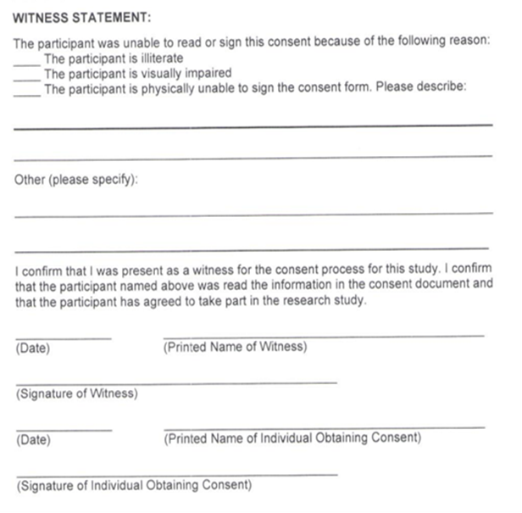
The Witnessed Consent Process
Impartial witness must be present during the consent process and sign consent document.
  Impartial witness = NOT a study team member
  Impartial witness = NOT a friend or family member or the subject
If possible, subject should make their mark on signature lines.
If the subject is visually impaired or illiterate, the entire consent must be read aloud to the subject.

Slide 8
Short Form Consent
To obtain consent from non-English speaking subjects, you must have either a cIRB approved Full Translated ICF or a translated Short Form consent in the subject’s language.
The presentation of the consent must be done in the subject’s language. Either the person obtaining consent must be fluent in the subject’s language or an interpreter must be used. The subject’s friends or family members MAY NOT be used as interpreters.
The short form is used when the consent is presented orally (because there is no translated full consent document available).

Slide 9
Short Form Consent Process
A study team member who has been delegated responsibility to obtain consent should perform the consent process orally. If the person obtaining consent is not fluent in the subject’s native language, an interpreter should be used.
The subject should read and sign the short form.
A witness, who is fluent in both English and the subject’s native language must witness the entire consent process. If an interpreter is used, the interpreter may serve as witness. The witness/translator will sign the English consent as well as the short form as the “witness”.
  If the interpreter is NOT willing to sign as the witness AND there is not another impartial witness available who is fluent in both English and the subject’s primary language, then an impartial witness who is not bilingual may be used, but the following must occur:
    Ensure that the interpreter relates all conversation to all parties in each language
    Write a note-to-file of the consent process with an explanation regarding the reasons for use of a non-bilingual witness to be maintained in the research record with the informed consent
    All of this info must be entered in the General Comments field of the informed consent CRF in WebDCU and the note-to-file should be uploaded with the consent to WebDCU
The study team member who obtains consent must sign the English ICF. A copy of the short form and English ICF must be provided to the subject.
Notify the NCC Project Manager immediately. They will request a fully translated consent in that language to be signed by the subject within 30 days.

Slide 10
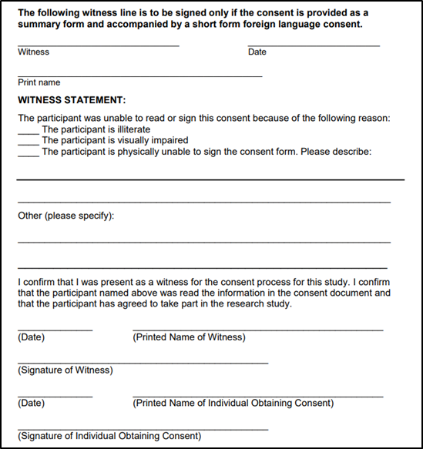
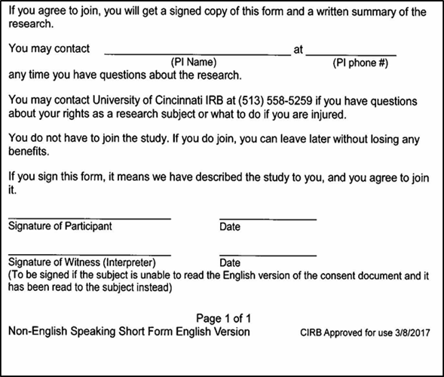


Document of Short Form Consent
On Consent:
On Short Form:

