Slide 1

NINDS Strokenet Steering Committee Presentation November 9, 2016
Sepideh Amin-Hanjani, MD
on behalf of the VERiTAS II investigators

Slide 2


VERiTAS II
Vertebrobasilar Flow Evaluation and Risk of Transient Ischemic Attack and Stroke II
Pilot study of submaximal angioplasty for hemodynamically impaired symptomatic vertebrobasilar stenosis
Study PIs:
Sepideh Amin-Hanjani, MD (UIC), Adnan Siddiqui, MD (UBNS)
Tanya Turan MD (MUSC)
Statistical PIs: Yi-Fan Chen, PhD (UIC), Yuko Palesch, PhD (MUSC)
Steering Committee: Fady T. Charbel, MD (UIC), Shyam Prabhakaran, MD
(NWM), Henry H. Woo, MD (SB)

Slide 3
Primary Aim
Primary Aim
  Determine the safety of submaximal balloon angioplasty for treatment of symptomatic intracranial vertebrobasilar stenosis with distal flow compromise.
Primary Hypothesis:
  Submaximal angioplasty can be performed with sufficient safety in patients with flow compromised VB stenosis to justify a future randomized controlled clinical trial.

Slide 4
Study Rationale
Posterior circulation stroke accounts for ~30% of all ischemic stroke
  High mortality /morbidity due to eloquence of territory
Large artery vertebrobasilar disease (VBD) implicated in
~30% of these strokes*
  Symptomatic VBD: high recurrent stroke risk (especially intracranial disease) 10-15% per year
  Current treatment risks (angioplasty/stent): up to 26% procedural risk for posterior circulation
  Randomized trials of stenting halted: SAMMPRIS** event rates at 30 days 15% (stent) vs 6% (medical) Procedural risk higher with basilar than other locations
*NEMC Registry, Caplan et al, Annal Neurol 2004
** SAMMPRIS, Chimowitz et al, NEJM 2011

Slide 5
Study Rationale
There is a significant unmet need in the treatment of patients with symptomatic VB stenosis
“ For endovascular therapy (e.g. angioplasty alone or new stents) to have any role, multicenter pilot studies will be required to establish the safety and potential efficacy of these devices in carefully defined patient populations”
Chimowitz and Derdeyn, JAMA 2015
Hemodynamically defined? – role of hemodynamic insufficiency in VB disease long suspected

Slide 6
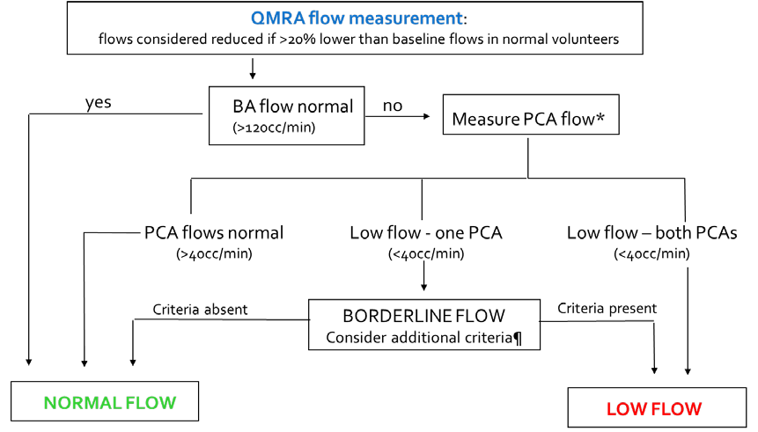
Study Rationale
Hemodynamics can be assessed in the posterior circulation
  Quantitative (phase contrast) MRA can reliably measure large vessel flow in the VB system and distal vascular bed
  Distal flow status (incorporating collateral capacity) can be determined
Amin-Hanjani et al, Stroke 2005

Slide 7
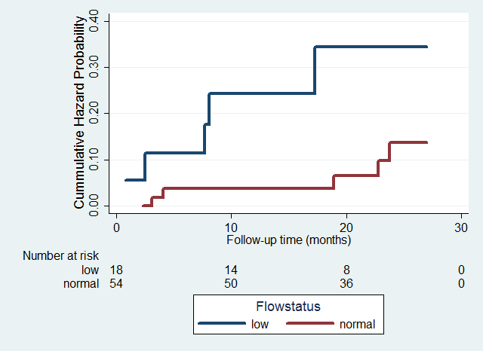
Study Rationale
Hemodynamic insufficiency is predictive of stroke in VB disease
  Retrospective single center study at UIC (50 subjects)*
  Prospective multicenter NIH funded Study, VERiTAS (72 subjects)**:
    Stroke risk: 22% low flow vs 4% normal flow at 12 months
    Adjusted HR 11.5 for low flow
Low flow is a robust biomarker for stroke risk
* Amin-Hanjani et al, Stroke 2005
**Amin-Hanjani et al, JAMA Neurol 2016

Slide 8
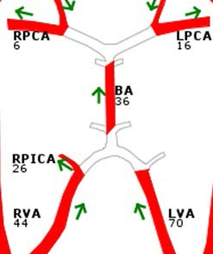
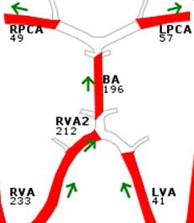
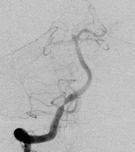
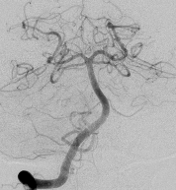
Study Rationale
Hemodynamic insufficiency can be reversed with endovascular intervention*
LOW FLOW
NORMAL FLOW
*Guppy et al, Neurosurgery 2002

Slide 9
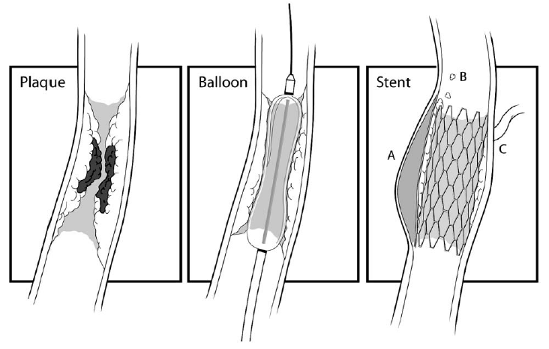
Study Rationale
There is an alternative endovascular strategy to stenting with promising safety profile
  Submaximal angioplasty: balloon under-sized to 50-70% of vessel diameter
Submaximal angioplasty alone less likely to result in
    trauma to the vessel wall causing dissection or perforation,
    plaque trauma,
    ‘snowplow’ effect of plaque into adjacent perforator vessels.
Dumont et al, J Neurosurg 2016

Slide 10
Study Rationale
Sub-maximal angioplasty
Authors | Design | Technique | N | 30 d stroke/ death
 |  |  |  | Vertebro- basilar | Vertebral | Basilar | All
Marks et al, 2005 | Retrospective, single center | undersized balloon 0.5mm | 21 | 4.8% | NS | NS | 8.3% (3/36)
Wojak et al, 2006 | Retrospective, single center | undersized balloon 0.25- 0.5mm | 40 | 7.5%* | 10.7% (3/28)* | 0% (0/12)* | 4.8 % (4/84)
Thanh et al, 2011 | Retrospective multicenter | undersized to 80% of normal diameter | 24 | 12.5% | 12.5% (1/8) | 12.5% (2/16) | 5% (4/74)
Dumont et al, 2012 | Retrospective , single center | undersized to 75% of normal diameter | 8 | 0% | 0% (0/2) | 0% (0/6) | 4.9% (2/41)
Dumont et al, 2016 | Prospective, single center | undersized to 50- 70% of normal diameter | 6 | 0% | 0% (0/2) | 0% (0/4) | 0% (0/24)
NS – not specified; *includes TIA

Slide 11
Study Concept
Unmet need: treatments to reduce high stroke risk in patients with symptomatic VBD
Addressing the need requires:
Identifying the appropriate high risk group
LOW FLOW patients
VERiTAS
Identifying a plausible and safe procedure
  Submaximal angioplasty: intervention that is reasonably expected to improve flow status and has favorable safety profile (compared
with stenting)
VERiTAS II proposal

Slide 12
Study Objectives
Primary Aim:
Aim 1
Determine the safety of submaximal balloon angioplasty for treatment of symptomatic intracranial vertebrobasilar stenosis with distal flow compromise (device safety)
  1⁰ endpoint: Periprocedural event rate: any stroke (ischemic or hemorrhagic) or
death within 30 days

Slide 13
Study Objectives
Secondary Aims
Aim 2
A. Evaluate the initial hemodynamic effect of submaximal balloon angioplasty for symptomatic intracranial vertebrobasilar stenosis with distal flow compromise (evidence of short term biomarker modification)
B. Evaluate the hemodynamic durability of submaximal balloon angioplasty at one year (evidence of sustained biomarker modification)
Aim 3
Estimate the risk of subsequent posterior circulation stroke (at one year) following submaximal balloon angioplasty for distal flow compromised symptomatic intracranial vertebrobasilar stenosis (preliminary clinical efficacy)

Slide 14
Study Objectives
Secondary Aims
Aim 4
Determine the feasibility of performing a future randomized phase III trial
(pivotal study feasibility)
A. Demonstrate feasibility of 1:1 randomization
B. Validate projected event rate in medical arm using a calibration cohort

Slide 15




Study Design
Pilot Safety and Feasibility Study
Prospective cohort study of submaximal angioplasty for patients with symptomatic low flow 50-99% VB stenosis
Patients recruited in two sequential stages:
Total sample | Stage 1 | Stage 2
(n=82) | Single arm | Concurrent randomized controls*
Intervention (n=62)
n=42
Single arm
n=20
1:1 randomization
Addresses Aim1 (periprocedural safety) and Aims 2, 3
Control (n=20)
n=20
1:1 randomization
Addresses Aim 4
Interim Safety analysis
* Concurrent controls in Stage 2 are non-comparative and serve to address secondary aims 4A (demonstrate feasibility of 1:1 randomization) and 4B (validating the event rate in medically managed subjects).

Slide 16
Study Protocol
Inclusion:
TIA or non-severe stroke attributed to 50-99% stenosis of intracranial vertebral or basilar artery*
Distal flow compromise based on QMRA blood flow measurements (designation as ‘low flow’)
Target vessel with minimal nominal diameter of 2mm
Target length of stenosis <18mm
Symptoms within 60 days of enrollment
Age 18 and above
Able to provide informed consent
* May be diagnosed by MRA, CTA to qualify for angiogram performed as part of the study, but must be confirmed by catheter DSA for enrollment into the study
Note: Tandem disease eligible for treatment as long as both lesions meet criteria to be treated (e.g. each stenosis <18mm length). For bilateral vertebral stenosis all accessible eligible lesions will be treated.

Slide 17
Study Protocol
Exclusion:
Neurologic:
Major disabling stroke i.e. mRS>3, progressive or fluctuating deficit within 24 hours
Hemorrhagic infarction (based on CT) within 14 days of enrollment; any large stroke (>5cm) to be at risk for hemorrhagic conversion
Medical
Any neurological disease which would confound follow-up assessment
Any co-morbid disease condition with <12 month life expectancy
Known cardiac disease associated with elevated cardioembolic risk, specifically, atrial fibrillation, prosthetic valve, endocarditis, left atrial/ventricular thrombus, cardiomyopathy with EF<25%, cardiac myxoma
Blood dyscrasias, specifically polycythemia vera, essential thrombocytosis, sickle cell disease
Active bleeding diathesis, h/o major systemic hemorrhage within 30 days, active PUD, platelets<100K (severe liver impairment (AST or ALT>3 x normal, cirrhosis)

Slide 18
Study Protocol
Exclusion:
Target lesion
Non-atherosclerotic stenosis including dissection, fibromuscular dysplasia, vasculitis, radiation induced vasculopathy, suspected recanalized embolus, suspected vasospastic process
Mori C classification of stenosis
Previous treatment of target lesion with stent, angioplasty or other mechanical device
Extracranial vertebral stenosis or occlusion prohibiting access to the target lesion
Patient
Unable or unwilling to undergo MRI
Unable to undergo cerebral angiography
Pregnancy
Concurrent participation in another study which would conflict with the current study
Allergy or contraindication to aspirin or Plavix
Indication for warfarin or NOAC beyond enrollment
Thrombolytic therapy within 24 hours

Slide 19
Study Protocol
Screening/Enrollment
Patients identified based on symptomatic 50-99% intracranial vertebral or basilar stenosis based on CTA, MRA or DSA
Patients meeting available I/E criteria will be consented, and will undergo QMRA for determination of flow status (if not done as SOC)
Patients confirmed to qualify as low distal flow status by central review will undergo DSA (if not done as SOC)
Patients with angiographically confirmed stenosis will undergo submaximal angioplasty (within 48 hours) plus medical therapy in Stage 1, or be randomized to intervention vs medical therapy alone in Stage 2.
Patients not meeting the QMRA or angiographic criteria will not continue in the study; those with study provided angiograms will be followed for 24 hours to document any complications of the test.

Slide 20
Study Protocol
Intervention
Pre-treatment with ASA/Plavix
May be performed under general anesthesia or conscious sedation
Intraprocedural heparin with ACT target >250
Submaximal balloon angioplasty with balloon sized to >50% but <80% nominal vessel diameter
Device:
Medtronic Sprinter balloon
FDA – IDE submission in progress

Slide 21
Study Protocol
Medical therapy
ASA/Plavix for 3 months then monotherapy
Rationale: based on SAMMPRIS regimen
RISK FACTOR | GOAL | MEASUREMENT
Primary Risk Factors
LDL | < 70 mg/dL | Local lab
Systolic Blood pressure | < 140 mm Hg | Study device
Secondary Risk Factors
Non-HDL | < 100 mg/dL | Local lab
HgA1c | < 7.0% | Local lab
Smoking | Cessation | Self (PACE score)
Weight Management | For initial BMI: 25 - 27 kg/m² - target < 25 kg/m² > 27 kg/m² - target 10% weight loss | Weight at each visit Height at baseline
Exercise | ≥ 30 min moderate exercise 3 x /wk | Self (PACE score)

Slide 22
Study Protocol
Assessments and Follow-up
MONTHS | 0 | PTD | 1 | 2 | 3 | 4 | 5 | 6 | 7 | 8 | 9 | 10 | 11 | 12
Demographics | x
Baseline Evaluation | x
Cerebral angiogram | x
QMRA (NOVA) | x | x* |  |  |  |  |  |  |  |  |  |  |  | x
Telephone interview |  |  |  |  | x
Clinical Follow-up Evaluation | x | x | x |  |  | x |  |  |  | x |  |  |  | x
NIHSS, mRS | x | x | x |  |  | x |  |  |  | x |  |  |  | x
BP measurements | x |  | x | _{x}# |  | x |  |  |  | x |  |  |  | x
Laboratory test – LDL | x |  | _{x}# |  |  |  |  |  |  |  |  |  |  | x
Laboratory test – LFTs | x
Laboratory test - HGb AIC** | x |  |  |  |  |  |  |  |  |  |  |  |  | x
Weight measurement | x |  | x |  |  | x |  |  |  | x |  |  |  | x
Smoking status | x |  | x |  |  | x |  |  |  | x |  |  |  | x
Physical Activity Status Score (PACE) | x |  | x |  |  | x |  |  |  | x |  |  |  | x
PTD – prior to discharge
* Within 2 weeks
# As needed if target LDL or BP not achieved
** schedule for diabetics – quarterly AIC until in target

Slide 23
Sample size
Total sample size: n=82 (62 intervention, 20 controls)
Sample size justification (intervention): n=62
Based on determining a 30d peri-procedural event rate of 6%, 90% CI (0,12%):
Current literature – 6% target and (0,12%) CI consistent within reported range
Supports an effect size that would be clinically meaningful in future trial:
  Medical management: 20% 1 yr risk estimated from VERiTAS, and adjusted for aggressive medical therapy
  Intervention: 12 % 1 yr risk (40% reduction), considered meaningful based on survey data
  Periprocedural risk of 6% would accommodate expected 4% 1 yr stroke risk (estimated from the normal flow patients in VERiTAS) and additional 2% risk that may arise from hemodynamic re-stenosis
Approximates 30 day event rate (5.6%) observed in low flow patients in VERiTAS

Slide 24
Sample size
Sample size calculation: confidence interval approach
Based on 6% peri-procedural event rate
Two sided 90% confidence interval of (0%, 12%)
Interim analysis following recruitment of 50% of intervention patients
Factoring 3% attrition and 1.03 inflation factor for interim analysis, total sample size (n)= 62 patients
Additional analysis considerations:
Go/no go parameter for future trial:
  Periprocedural safety (i.e. lower bound of 93% CI of observed estimate) exceeding target of 6%
  Secondary clinical and hemodynamic endpoints at 12 months to be taken into consideration

Slide 25
Sample size
Total sample size: n=82 (62 intervention, 20 controls)
Sample size justification (controls): n=20
Based on determining feasibility of future trial
Demonstrate the feasibility of 1:1 randomization which mimics the practice of a future phase 3 trial with most statistical power
Add precision to the estimate of the 12 month event rate of patients with low flow VB disease treated with medical therapy when pooled with the VERiTAS low flow group
  Provides 80% CI (12%, 32%) around the one year event rate of 22% observed in the
original VERiTAS cohort

Slide 26
Recruitment
Timeline: 4 year total
6 month start-up
2.5 years recruitment
12 month follow-up
Proposed # of sites:
20 sites
average 1-2 (1.65) /year enrollment: 82 patients

Slide 27
Site selection
Site selection:
High volume for VB disease
  Ideal site seeing >8-10 symptomatic VB disease patients per year
  20% are expected to be low flow and intervenable
NOVA software for QMRA already available
  for clinical or research use
Interventionalist with appropriate expertise
  willing to comply with protocol
  credentialing committee

Slide 28
Summary
Symptomatic VB disease is an under-studied high risk disease
We now have a robust imaging biomarker for future stroke risk: hemodynamic compromise measured using a novel noninvasive tool - QMRA
Submaximal angioplasty represent a biologically plausible, and safer alternative to endovascular stenting for reversing hemodynamic compromise
A pilot study to establish safety of angioplasty prior to pursuing a definitive randomized trial is necessary
Establishing safety in the VB circulation would ultimately be generalizable to the anterior circulation should similar high risk biomarkers emerge in that population in the future

