Slide 1
Revised Unanticipated Event – PD Report Form
Presented by
Sue Roll, RN, BSN
StrokeNet CIRB Liaison

Slide 2
Reason for today’s presentation
The Unanticipated Event Report form (UAE) has been updated to include Protocol Deviation (PD) in the title and to be streamlined with the types of events (or categories) in the CIRB Research Administration Portal (RAP) electronic system for more accurate and complete reporting.
More importantly to answer questions that you may have as you complete this form.

Slide 3
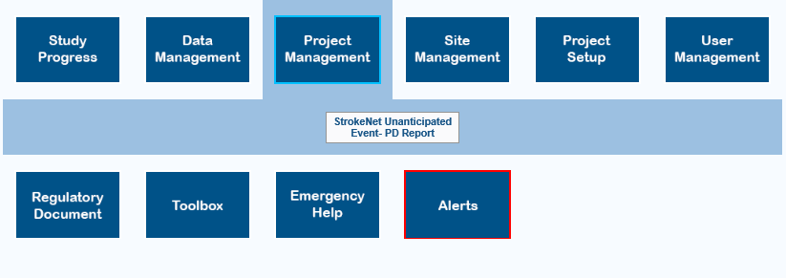
Where to find this report

Slide 4
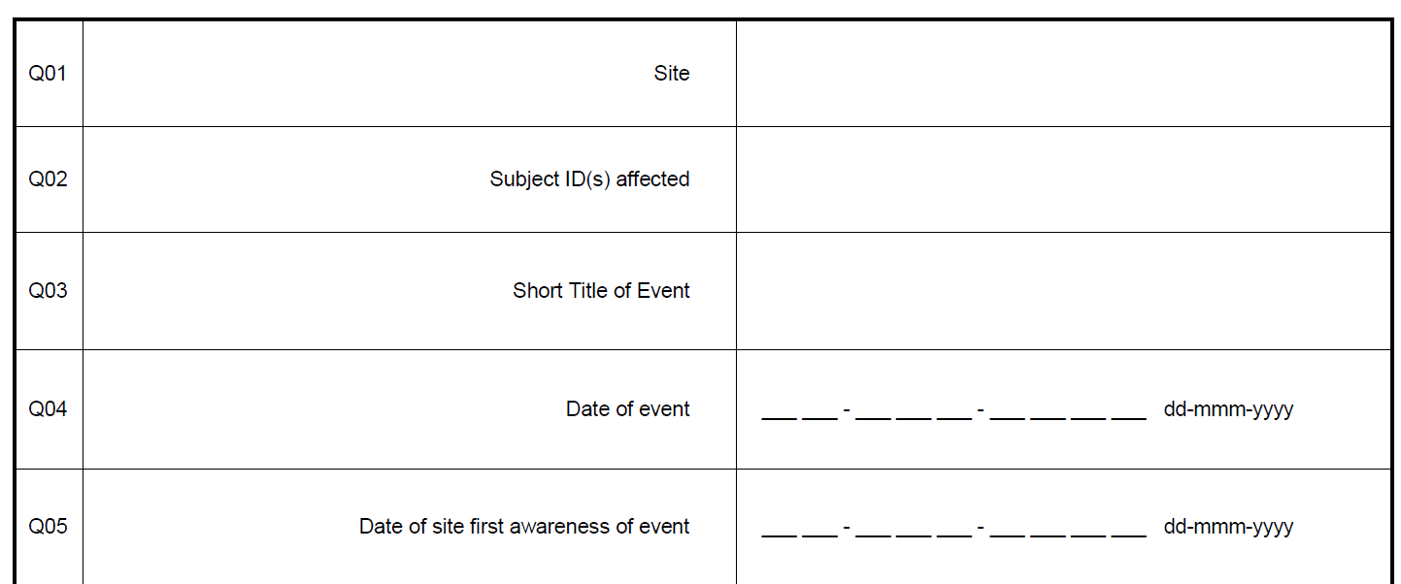
Basic Information
This title should give enough information to briefly describe the event: Subject enrolled that did not meet I&E

Slide 5
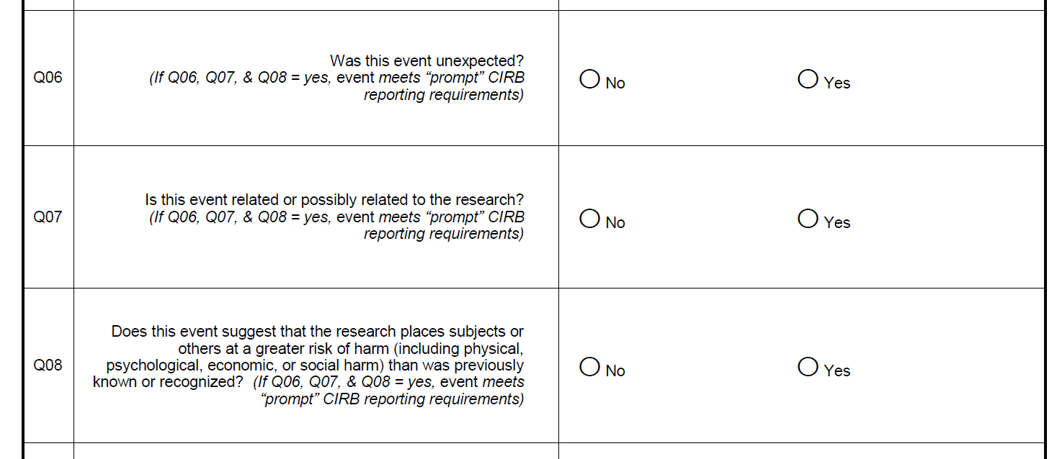
UPIRTSO (Unanticipated Problem Involving Risk To Subjects or Others)

Slide 6
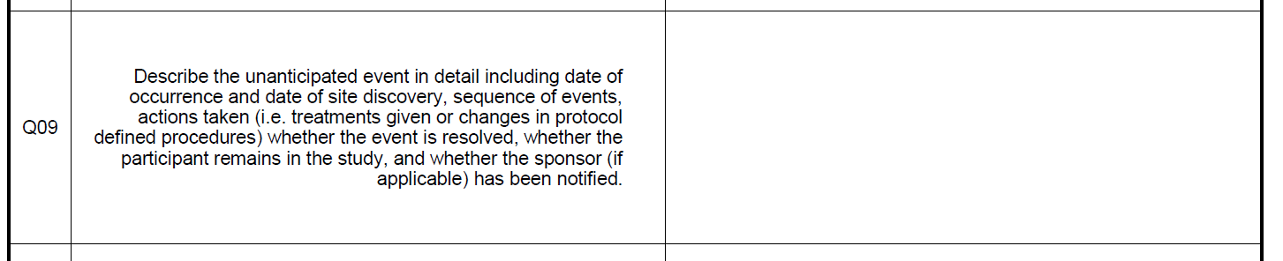
Describe the event
Think of this as your story to the reviewer
– explain things that the reviewer needs to know to understand the event and the outcome of the event
The facts, just the facts
– do not use names or place blame, limit superfluous details

Slide 7
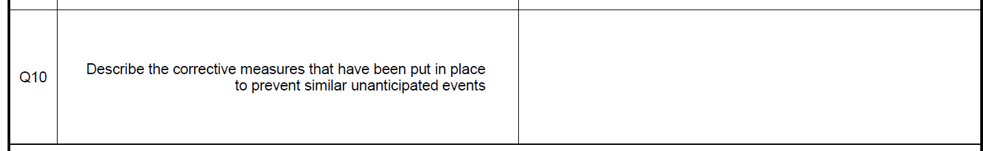
Corrective action plan (prevention plan)
Describe the plan to correct or prevent this type of event from occurring again

Slide 8
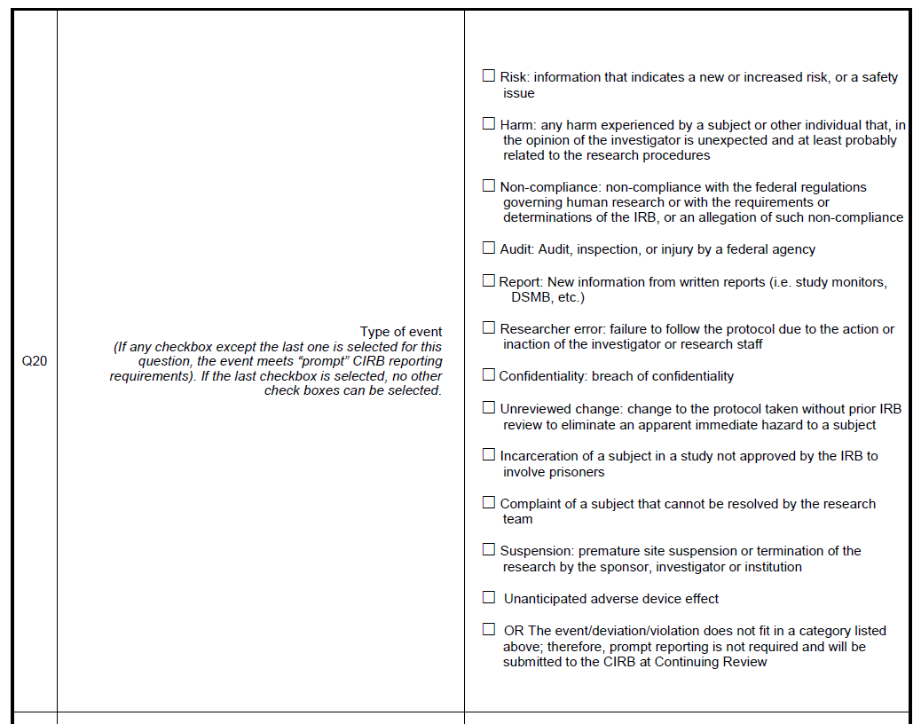
Type or category of event

Slide 9

StrokeNet sites using the CIRB will choose internal event

Slide 10
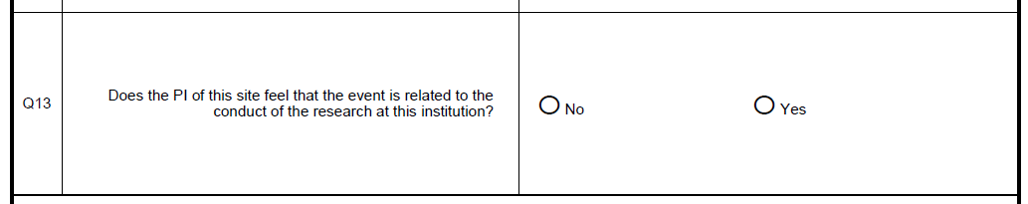
Event related to the conduct of the research at this institution

Slide 11
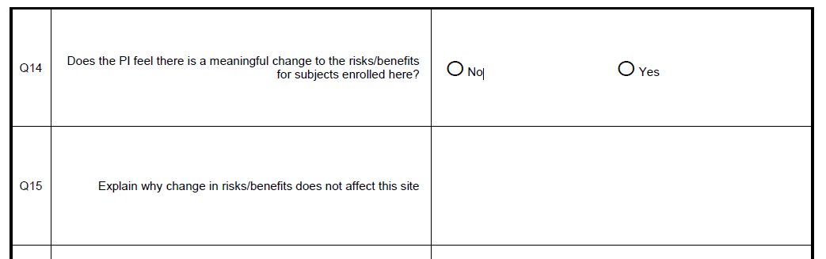
Meaningful change to the risks/benefits

Slide 12
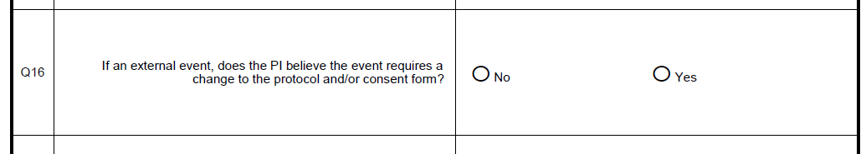
Change to protocol or ICD needed?

Slide 13
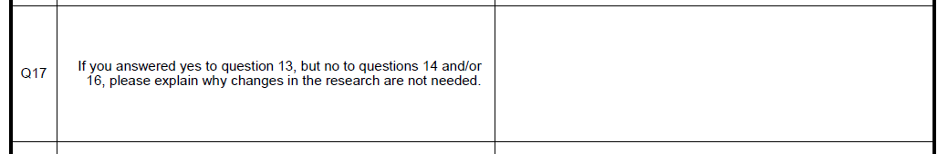
Further clarification

Slide 14
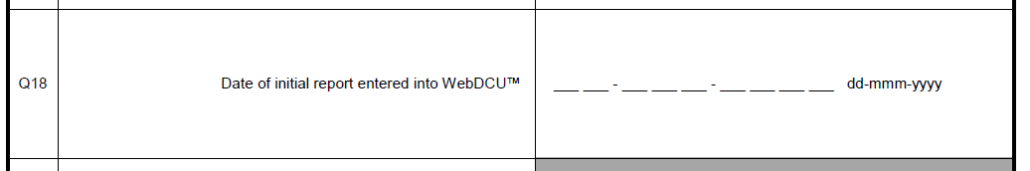
Date entered

Slide 15
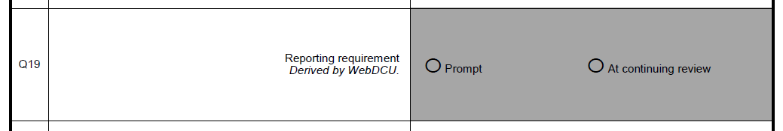
Autogenerated to provide reporting guidance

Slide 16
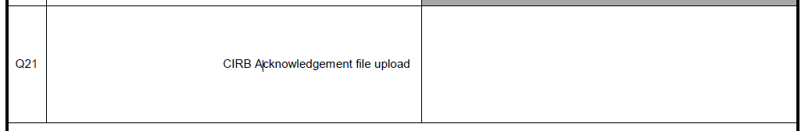
CIRB Acknowledgement uploaded
NCC Project Managers will upload the CIRB
Acknowledgement
Making changes to the form after it has been reported to the CIRB causes a discrepancy in the
information that was reviewed by the CIRB; therefore, changes should not be made after the
information has been submitted to the CIRB.
If information needs to be added or changed, it should be done by submitting a follow-up report
and stating it is follow-up to the previously reported event (remember to provide history from
the initial report as background information to make the connection between the two reports).

Slide 17
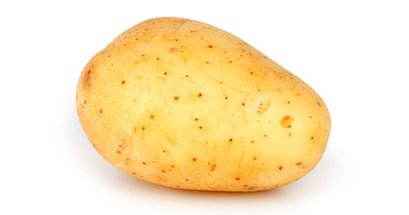
Terminology and event types
Protocol Violation vs Protocol Deviation
Doing something that is different than what is in the protocol, or
not doing something that is in the protocol
Terms can be used interchangeably
Potato (Po-tay-toe) Potato (Po-tah-toe)

Slide 18
Risk
Information that indicates a new or increased risk, or a safety issue
New information (e.g., an interim analysis, safety monitoring report, publication in the literature sponsor report, or investigator finding) indicates an increase in the frequency or magnitude of a previously known risk, or uncovers a new risk.
An investigator brochure, package insert, or device labeling is revised to indicate an increase in the frequency or magnitude of a previously known risk, or to describe a new risk.
Withdrawal, restriction, or modification of a marketed approval of a drug, device, or biologic used in a research protocol.
Protocol violation that harmed participants or others or that indicates participants or others might be at increased risk of harm.
Complaint of a participant that indicates participants or others might be at increased risk or harm or at risk of a new harm.
Any changes significantly affecting the conduct of research.

Slide 19
Harm
Any harm experienced by a subject or other individual that, in the opinion of the investigator is unexpected and at least probably related to the research procedures
A harm is “unexpected” when its specificity or severity is inconsistent with risk information previously reviewed and approved by the IRB in terms of nature, severity, frequency, and characteristics of the study population.
A harm is “probably related” to the research procedures if, in the opinion of the investigator, the research procedures or determinations of the IRB, or an allegation of such non-compliance.

Slide 20
Non-compliance
Non-compliance with the federal regulations governing human research or with the requirements or determinations of the IRB, or an allegation of such non-compliance

Slide 21
Audit
Audit, inspection, or injury by a federal agency
This does not include internal post approval monitoring; however, it could include an audit done by the local IRB if they investigating the research practices

Slide 22
Report
New information from written reports (i.e. study monitors, DSMB, etc.)
This could include a report from an audit done by the local IRB if they investigating the research practices

Slide 23
Researcher error
Failure to follow the protocol due to the action or inaction of the investigator or research staff

Slide 24
Confidentiality
Breach of confidentiality

Slide 25
Unreviewed change to eliminate hazard
Change to the protocol taken without prior IRB review to eliminate an apparent immediate hazard to a subject

Slide 26
Incarceration
Incarceration of a subject in a study not approved by the IRB to involve prisoners

Slide 27
Complaint
Complaint of a subject that cannot be resolved by the research team

Slide 28
Suspension
Premature site suspension or termination of the research by the sponsor, investigator or institution

Slide 29
Unanticipated DEVICE effect
This only applies to device trials

Slide 30
But it doesn’t really fit in any of the types listed
OR The event/deviation/violation does not fit in a category listed above; therefore, prompt reporting is not required and will be submitted to the CIRB at Continuing Review

Slide 31
Unsure of what to choose?
Contact your NCC Project Manager for assistance

Slide 32

Questions?

