Slide 1
Reporting Unanticipated Events to the CIRB and in WebDCU™
Susan K. Roll, RN, BSN, CCRP, Central IRB Liaison
National Central Institutional Review Board
Jessica Simons, BS, CCRP, Data Manager, MUSC
National Data Management Center

Slide 2
Location in WebDCU™

Slide 3
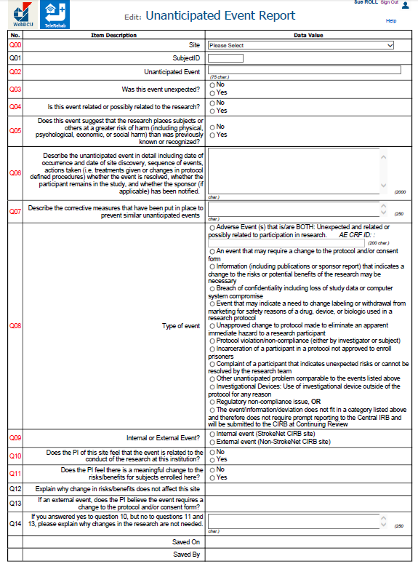
Unanticipated Event Report Form

Slide 4
Select site from drop down
Title of event
(brief but individualized)
Example: Hospitalization for pneumonia
Enter subject ID (if applicable, otherwise leave blank)

Slide 5
Was the event unexpected?
Is the event related or possibly related to the research?
Does this event suggest that the research places subjects or others at a greater risk of harm than was previously known or recognized?

Slide 6
Describe the event with details (date of occurrence and site awareness, sequence of events, actions taken or treatments given, resolution, if participant remains in the study, and if applicable has the sponsor been notified.
Assure that your descriptions do not include PHI other than the dates indicated
2000
Briefly describe any corrective actions or plan to prevent this type of event from happening again. If this is not a preventable event then indicate this is not preventable or N/A

Slide 7
Types are either one of the first 12 OR 13
Events or information fits into one of these 12 types of events
Keep in mind the choice “Other unanticipated problem comparable to the events listed above”
OR
The event or information does not fit the list above

Slide 8
Currently all sites are StrokeNet sites – answer Internal event

Slide 9
PI Assessment of risks/benefits and need for change
Does the PI feel the event is related to the conduct of the research at the local site?
Does the PI feel there is a meaningful change to the risks/benefits for the participants at the local site?
If no is selected for question 11, explain why there is no change to the risks/benefits at the local site.

Slide 10
Only opens for entry if question 9 is answered: External Site
The answer options will be yes/no radio buttons

Slide 11
Only opens if the answer to question 10 is yes and questions 11 & 13 are no.
If PI feels the event is related to the conduct at the local site but there is no meaningful change to the risks/benefits at the local site and it is an external event

Slide 12
Once you select Save Record, the screen will change and you will receive guidance on prompt reporting vs reporting at the time of continuing review.
Prompt reporting = within 10 days of site knowledge

Slide 13
The following question on the Adverse Event Form relates to this form.
There may be cases in which you may need to fill out the Unanticipated Event From first for guidance on the answer to this question.

