Slide 1

Training & Navigation
January 2025

Slide 2
Table of Contents
Introduction | Slides 3 - 8
WebDCU Setup & Overview | Slides 9 - 14
View, the Audit Trail, Filter & Sort | Slides 15 - 25
Screen Failures | Slides 26 - 32
Study Progress Tile | Slides 33 - 50
Subject CRF Binder Basics | Slides 51 - 57
Rule Violations | Slides 58 - 60
Data Clarification Requests (DCRs) / Queries | Slides 61 - 62
For these slides as training videos:
https://dcu.musc.edu/campus/

Slide 3
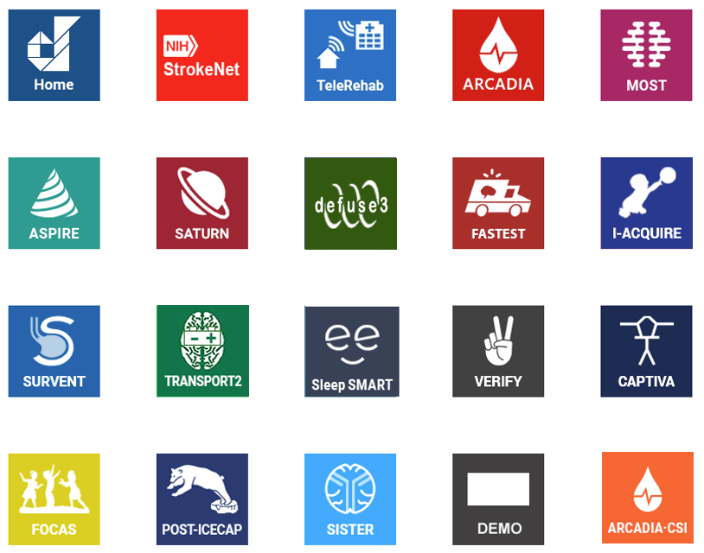
Introduction

Slide 4
Security
Ensures patient safety and confidentiality
Dependent on maintaining individual password security.
  Do not leave passwords where they can be discovered.
  Do not to share your password with others.
If someone needs to access WebDCU - they will need their own password and account.
Each new user will be emailed a temporary password.
  Emailed after site DOA/user permissions are approved.
First log in - will be prompted to create a unique password.
Periodically - prompted to change password to maintain greater security.
Do not leave your computer unattended while logged in to WebDCU.
  WebDCU will lock the screen after 20 minutes of inactivity.

Slide 5

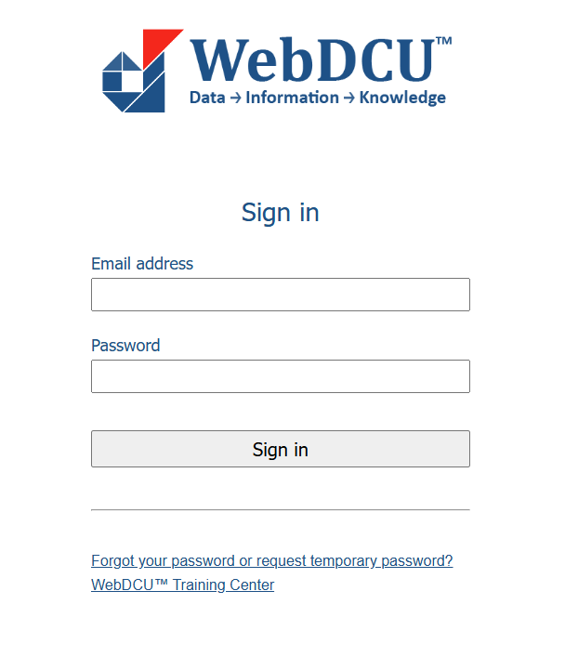
Logging In
Go to webdcu.musc.edu/login.asp
1.
Enter your institutional email address
2.
Logging In
Enter your unique password
3.
Select the ‘Sign in’ button
4.

Slide 6
Changing Password
Can’t remember or want to reset password? Select the ‘forgot your password’ link at the bottom of the page.
Enter institutional email address and then select ‘Request’.
WebDCU will automatically send you an email with information on how to reset your password if you have an existing account in WebDCU.

Slide 7
WebDCU Training Center
This link will take you to the WebDCU Clinical Trial Data Management System Training Center.

Slide 8
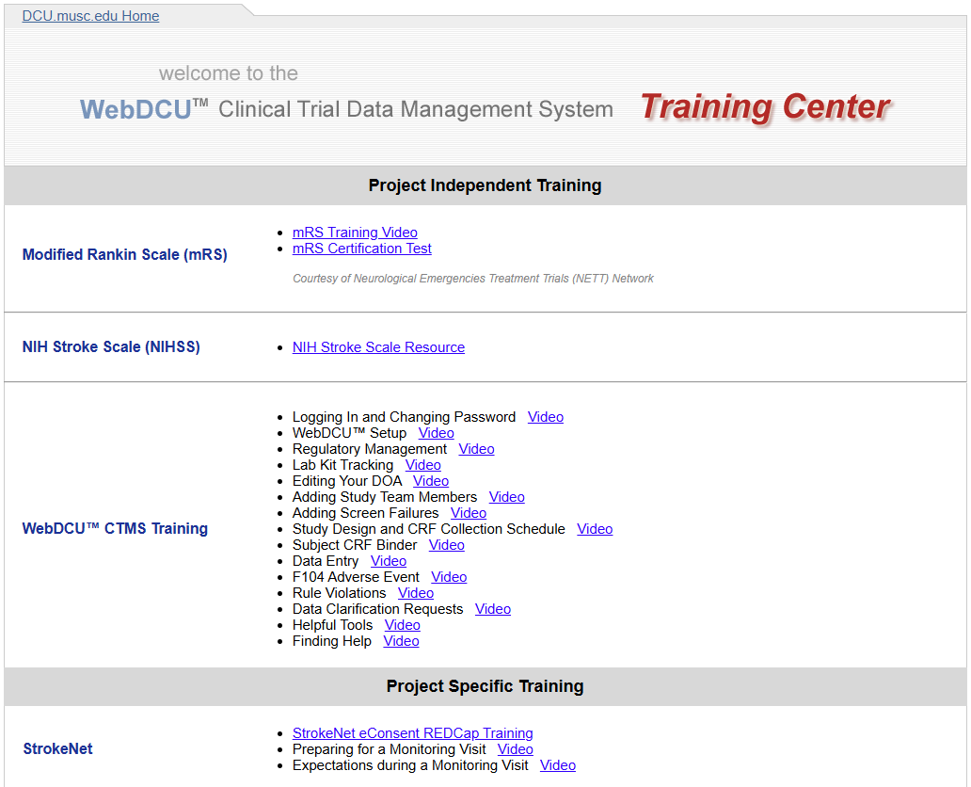
WebDCU Training Center
https://dcu.musc.edu/campus/
Find this training as short videos, StrokeNet specific, and Project specific trainings here.

Slide 9
WebDCU Set Up
& Overview

Slide 10
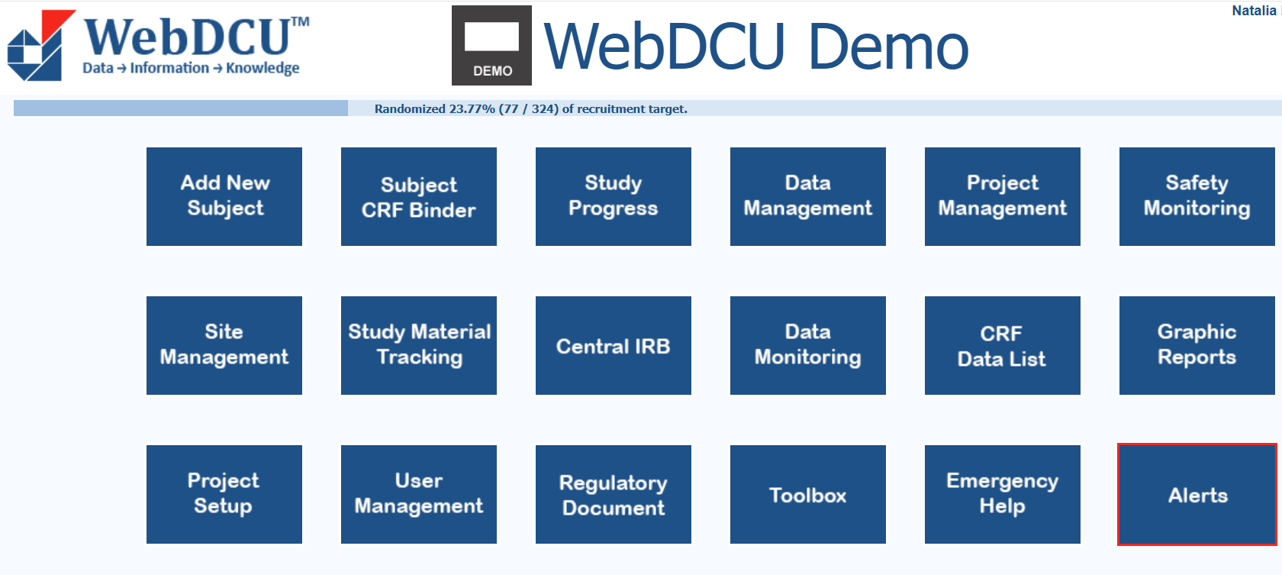

WebDCU Main Menu Page
Each main menu page might vary slightly by study and depending on your user permissions.

Slide 11
Full Expanded Menu
View all tiles and their tables to quickly find what you need.
Note - Avoid opening multiple WebDCU tabs, as it can cause saving and data entry issues.

Slide 12
Add New Subject - Takes you to the Subject Enrollment form. Only those with ‘Complete Case Report Forms’ responsibility on your site’s Delegation of Authority Log (DOA) will be able to access this form.
Subject CRF Binder - Find and enter data for all the case report forms for each of your subjects.
Data Management - Shows summary tables of pending CRF actions, rule violations, DCR queries, and site data entry metrics. The Subject CRF List shows details for each subject's CRF. Additional tables may appear based on your study permissions.
Study Progress - Houses study related forms and tables such as screen failures, subject enrollments, subjects’ status’s, the study calendar and visits, and summary reports.
Project Management - See project specific events and reporting tables.
Safety Monitoring - Where the study’s Medical Safety Monitors can review Adverse Events.

Slide 13
Site Management - Payment information and site start up information.
Study Material Tracking - Houses all tables related for central lab personnel, tracking biosamples and specimens, and maintain accountability of samples collected.
Central IRB - Included for projects with Advarra as their cIRB to document site or subject problems for review and potential IRB reporting.
Data Monitoring - Where the study’s Monitors can review monitoring reports.
CRF Data List - Includes a listing of all entered Case Report Form Records.
Graphic Reports - Houses enrollment and randomization graphs or any other graphic displays of data your study may have available.

Slide 14
Project Setup - Find the Study Design and CRF Collection Schedule here.
User Management - Where you can add new study team members and submit or view your site’s DOA.
Regulatory Document - Houses all tables related to regulatory documents. Here is where you can submit site and people reg docs and view things like current or historical Reg Docs.
Toolbox - Access project documents, FAQs, password settings, and the Project Contact List. Find study team contacts and your Data Manager's info for WebDCU assistance.
Emergency Help - Provides WebDCU Emergency Randomization hotline number and a clinical hotline number, for immediate assistance.
Alerts - Pending action items including open DCRs, CRFs past due, and reg docs that need your site’s attention.

Slide 15
View, the Audit Trail,
Sort, & Filter

Slide 16
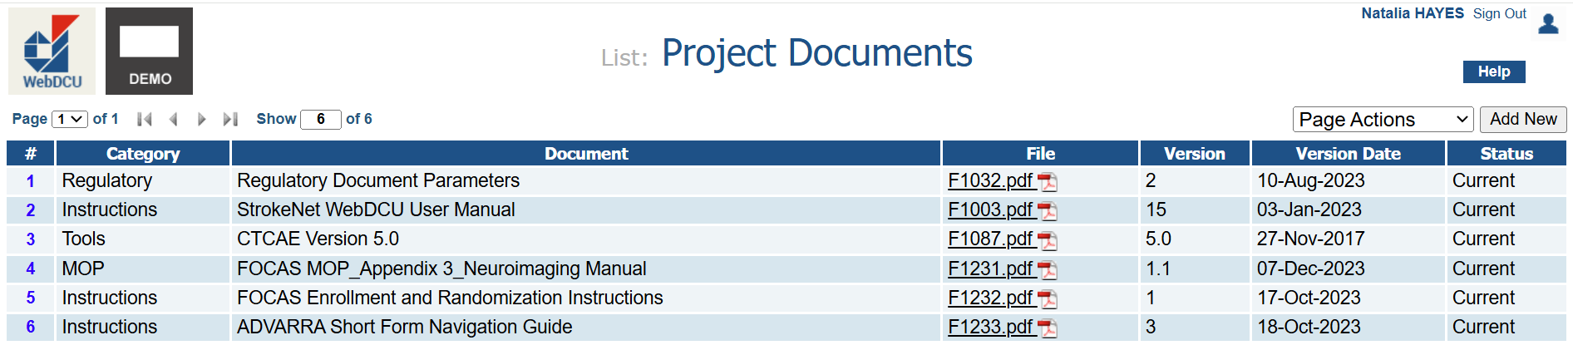

View
This is the List Record page of the Project Documents in the Toolbox tile.
To view a record in more detail, click on the blue highlighted number at the far left of the row.

Slide 17
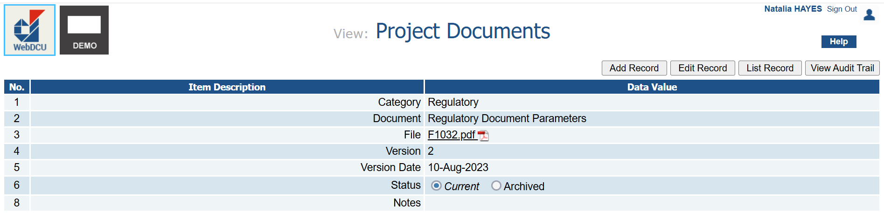
View
Add Record: Add a new record – same as clicking ‘Add New’ on the List Record page
Edit Record: Edit this record
List Record: Return to the List Record page
View Audit Trail: View the changes made to this record

Slide 18
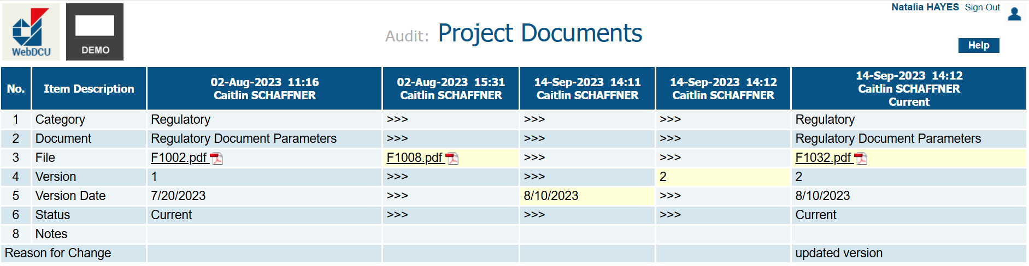
The Audit Trail
Click 'View Audit Trail' to see edits or archived versions. Yellow-highlighted fields show updates, with change reasons at the bottom. The timestamp shows who made the change and when.

Slide 19
Sort
To sort, click on the column header you want to sort.
This will sort alphabetically if words, numerically if numbers, or chronologically if dates.

Slide 20
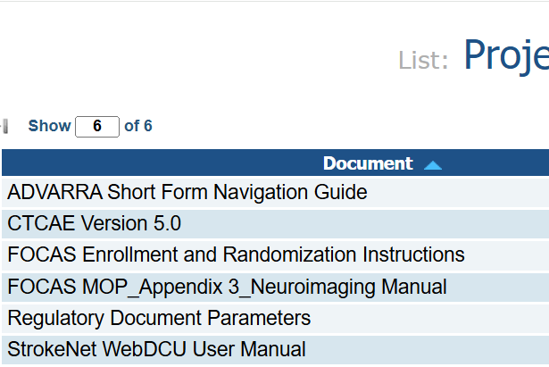
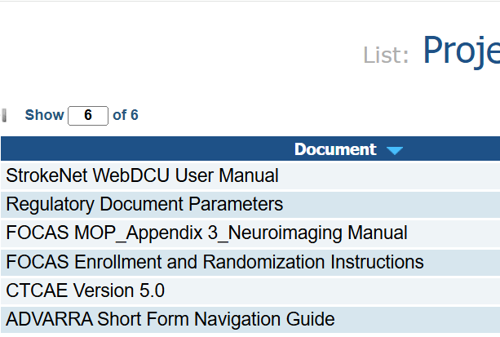
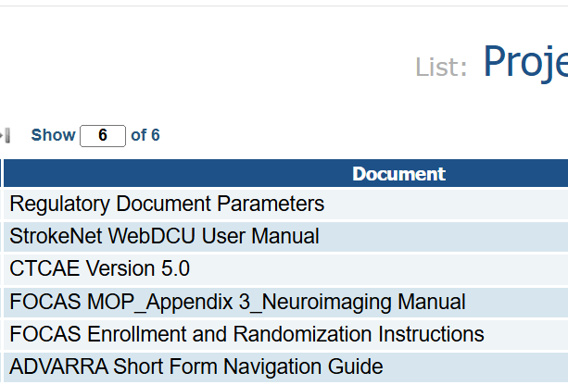
Sort
One click will sort by ascending order
Second click will sort by descending order
Third click will remove the sort

Slide 21
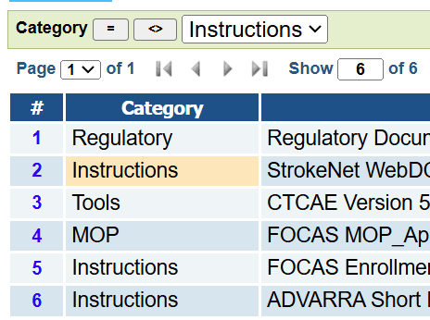
Filter
To filter, click within any cell under any column you want to filter.
This will prompt the filter function to appear above the table and will auto populate whatever text was in the cell you clicked, into the text box.
You can also use the Page Actions filter function to find premade filters.

Slide 22
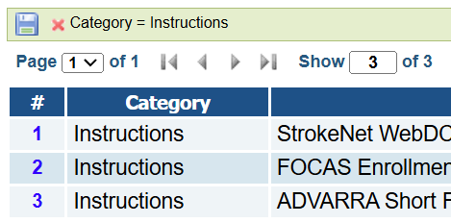
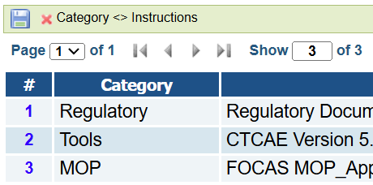
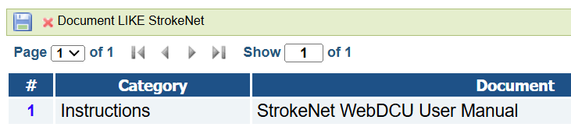
Filter
The filter function will show the exact text you first clicked.
Clicking “LIKE” filters for items similar to what is entered into the text box. This helps when searching for a document name you're unsure of.
Clicking "=" filters for items exactly matching the text box content.
Clicking “<>” (exclude icon) filters out items that don't match the text box content.

Slide 23
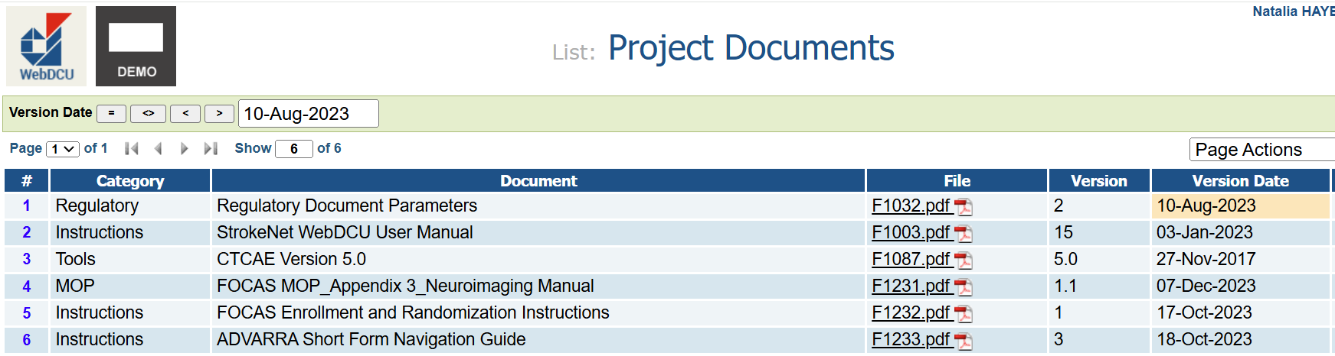
Filter
For date or numerical data, you can use the “>” (greater than) or “<” (less than) filters.

Slide 24
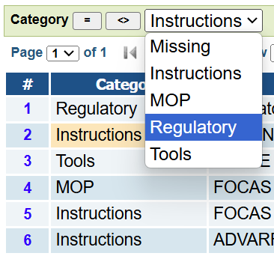
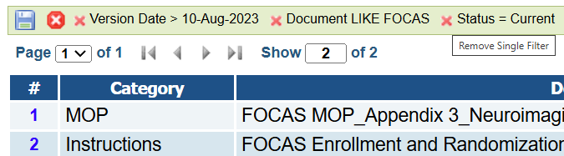
Filter
If you have multiple filters, you can click the larger ‘X’ to remove all filters at the same time.
Clicking the drop-down menu will show you all the options you can choose from under that column.
Clicking the red ‘X’ next to the filter to remove it.

Slide 25
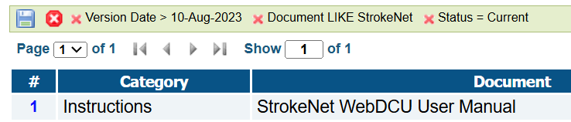
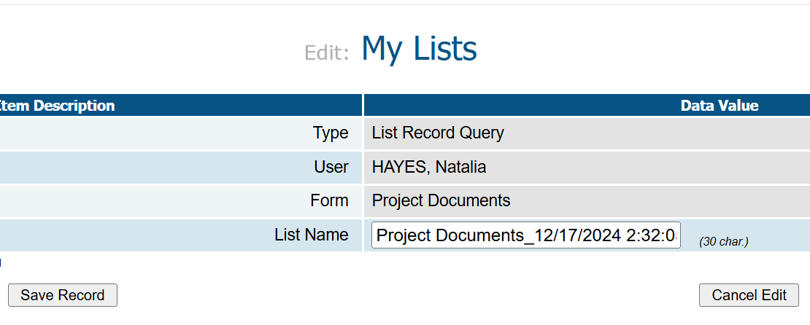
Filter
To reuse multiple filters, click the save icon (if available for your study). This saves the pattern in 'My Lists' under the Toolbox, where you can name and store it.

Slide 26
Screen Failures

Slide 27
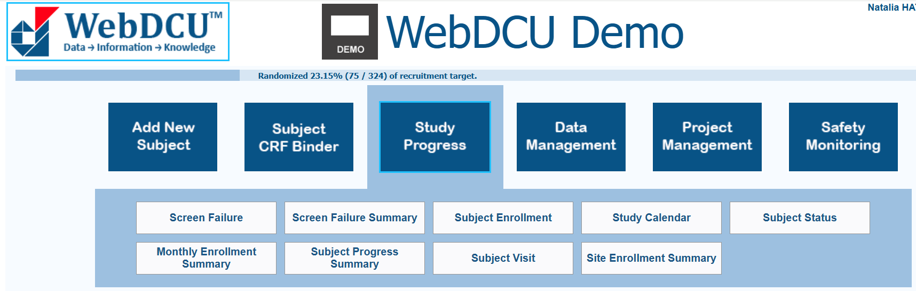
Adding a Screen Failure
The Screen Failure table under the Study Progress tile lets you add, view, or edit screen failure forms.
Selecting it opens the List Record page.
The Screen Failure Summary table is where you can see a summary of your site’s Screen Failure data per month.

Slide 28
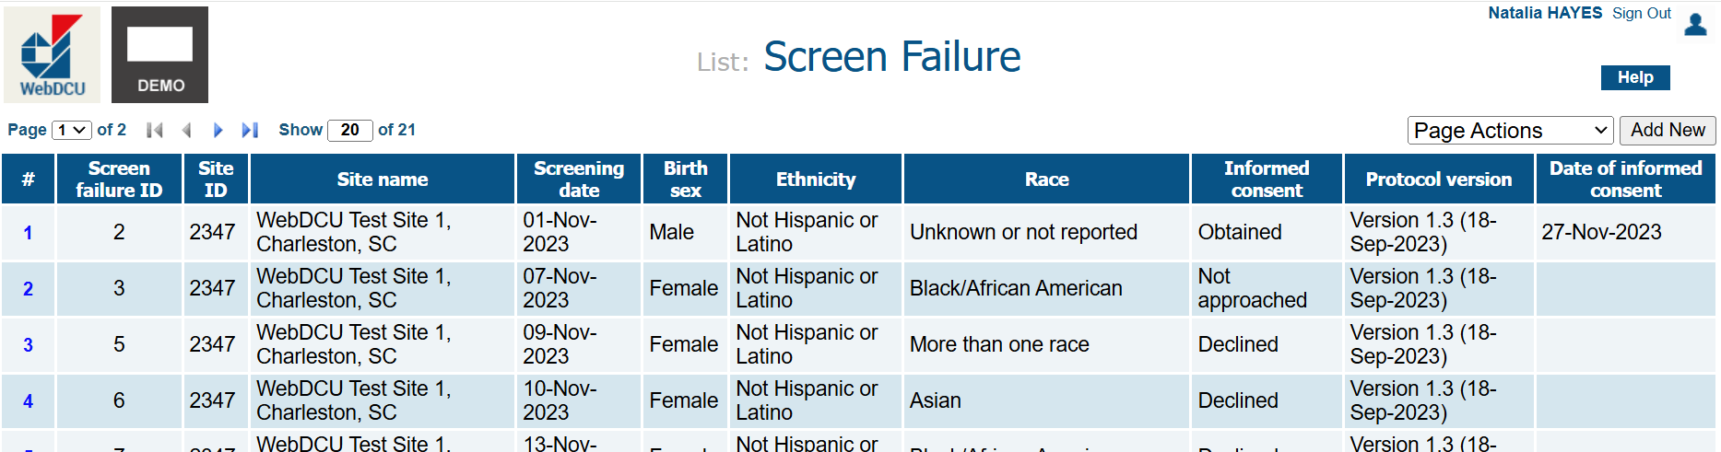
Adding a Screen Failure
To add a new Screen Failure, select the ‘Add New’ button in the upper right-hand corner.

Slide 29
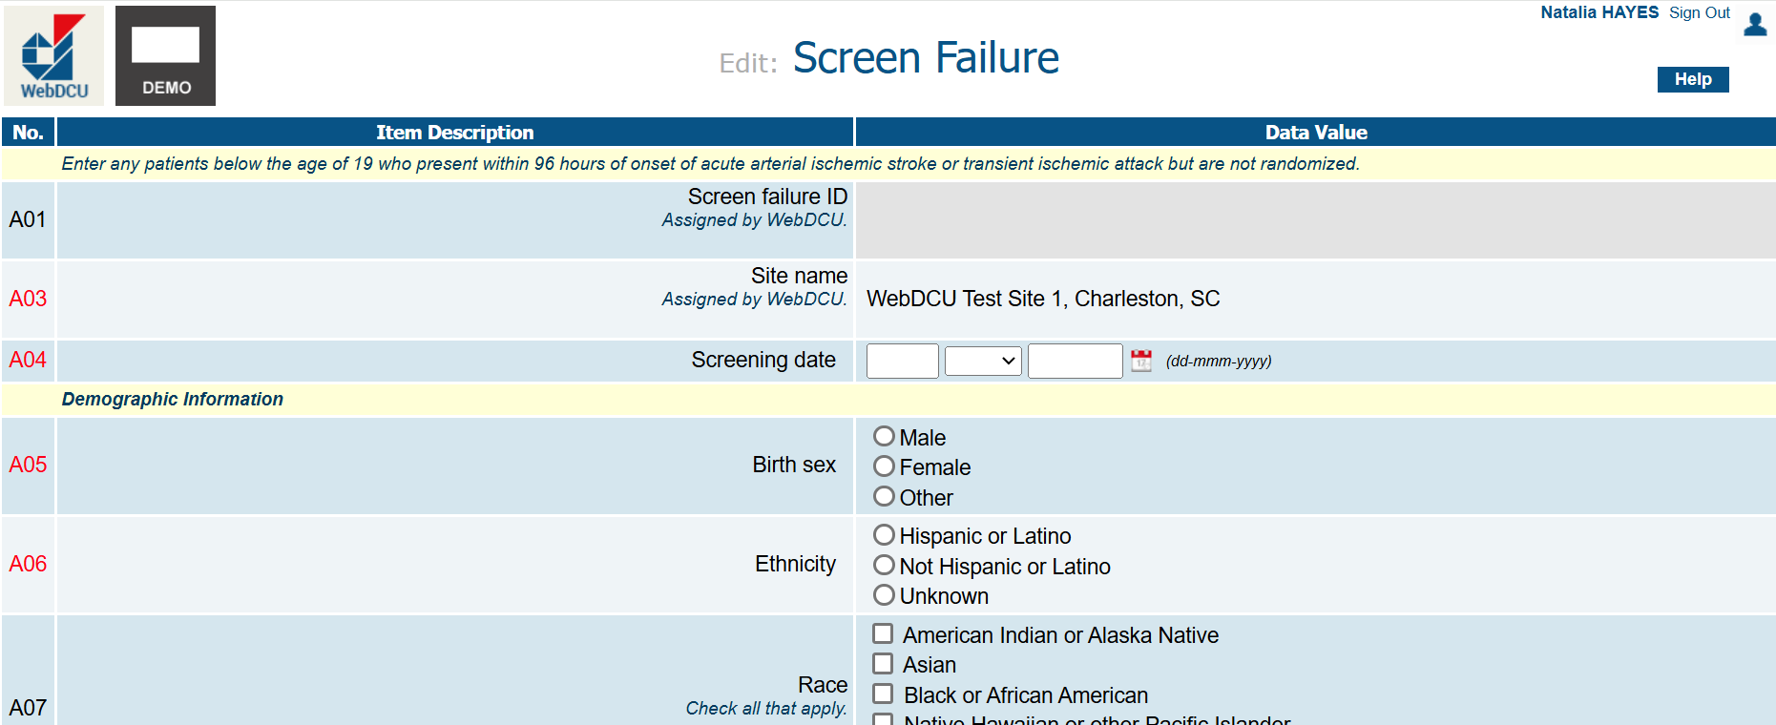
Adding a Screen Failure
Complete the form, marking any ineligibility criteria if the Screen Failure was due to ineligibility. This gives us perspective on why a participant was not added to the study. Questions in red on the far left, are required for some studies and must be answered for the form to save.

Slide 30
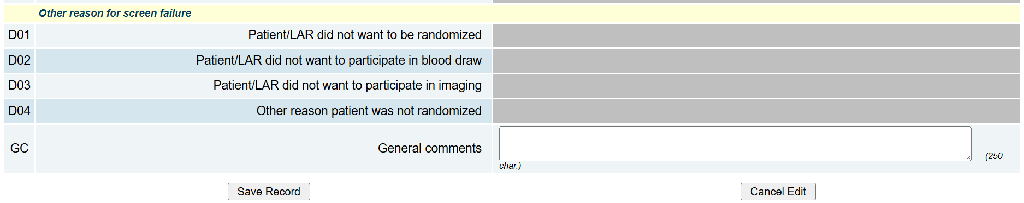
Adding a Screen Failure
Then select ‘Save Record’ at the bottom of the form if you are ready to save the information or ‘Cancel Edit’ if you do not want to save any data.

Slide 31
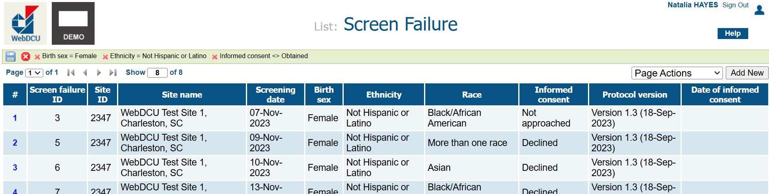
Viewing a Screen Failure
To view a Screen Failure, select the blue highlighted number at the far left of the record you want to view. You may need to filter/sort.

Slide 32
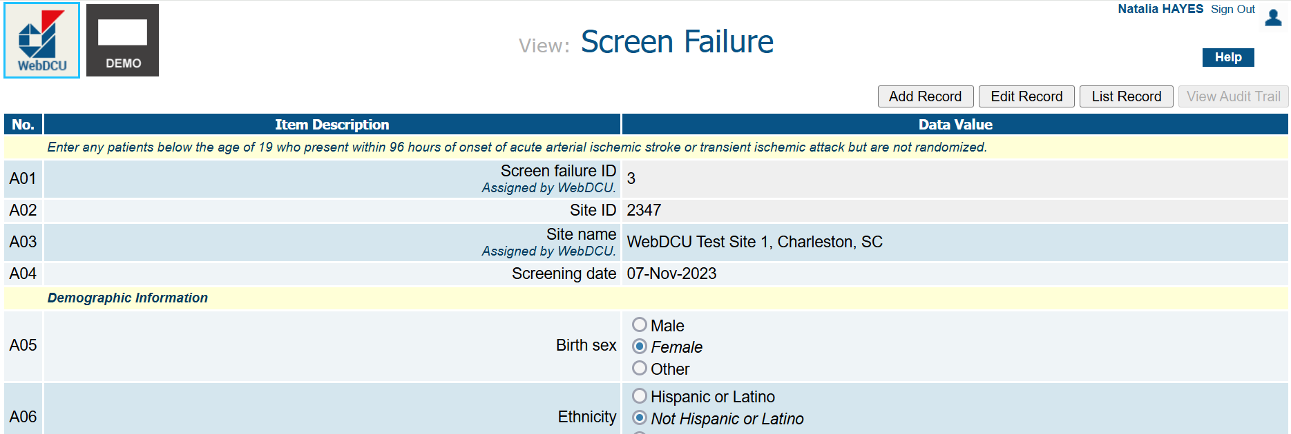
Viewing a Screen Failure
In the upper right-hand corner, select ‘Edit Record’ to make necessary changes. Select ‘View Audit Trail’ to view any changes that have already been made. If the ‘View Audit Trail’ button is not clickable (seen here), it means no changes have been made. Select ‘List Record’ to go back to the Screen Failure table.

Slide 33
Study Progress Tile

Slide 34
Subject Enrollment Table
The Subject Enrollment table holds the information that you entered when you clicked on the ‘Add New Subject’ tile and saved a new record.

Slide 35
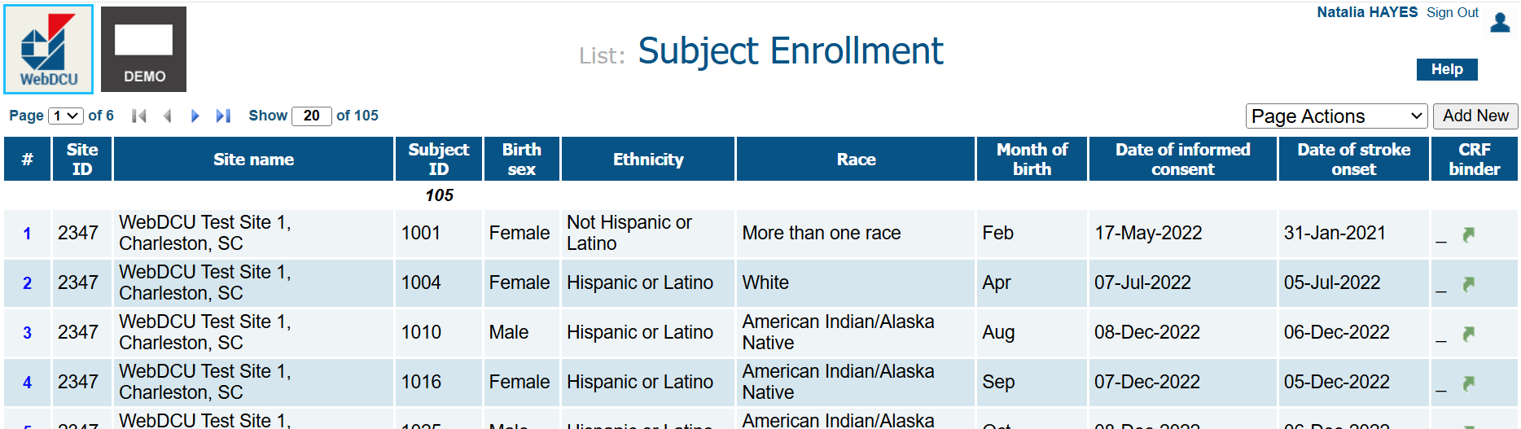
Vewing a Subject Enrollment Entry
Click 'Add New' to add a Subject Enrollment.
To view or edit a record, select the blue number on the left.
Use filter/sort if needed.

Slide 36
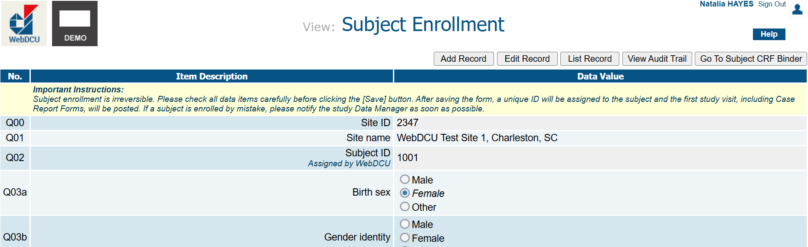
Vewing a Subject Enrollment Entry
Click ‘Edit Record’ to modify data, and ‘Save Record’ to confirm changes. Use the top-right hand buttons to add a record, return to the list, view the Audit Trail, or access the subject’s CRF Binder.

Slide 37
Study Calendar
This shows all the subject visit dates for your site. Some studies do not use this tool.

Slide 38
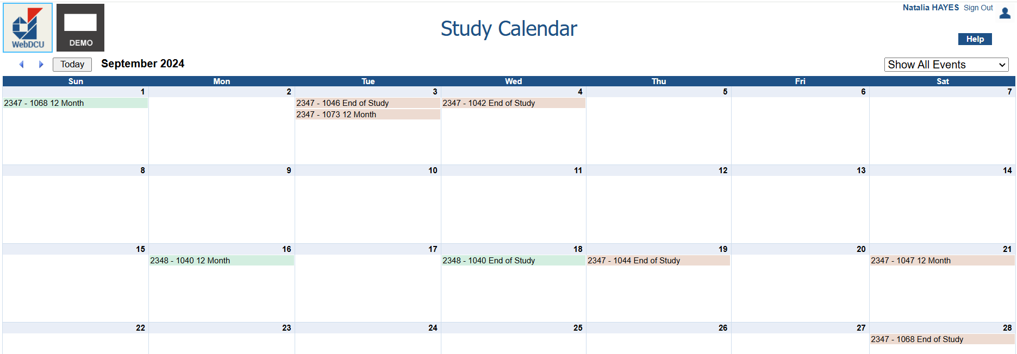
Study Calendar
Green visits are visits already added to the subject's CRF binder.
Red visits are next projected visits.
Clicking on the subject visit will take you to the Subject's CRF Binder.

Slide 39
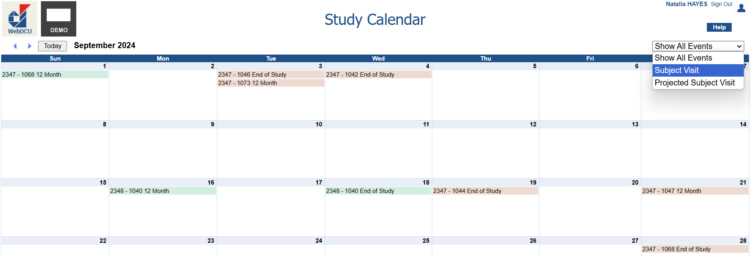
Study Calendar
Use the ‘Show All Events’ filter to view current Subject Visits or projected visits.
Use the blue arrows in the upper-left hand corner to scroll through months or find today’s date.

Slide 40
Subject Visit
The Subject Visit Table is a list view of the study calendar and gives you a list view of each visit that has been posted for the subject as well as the next visit that needs to be conducted.

Slide 41
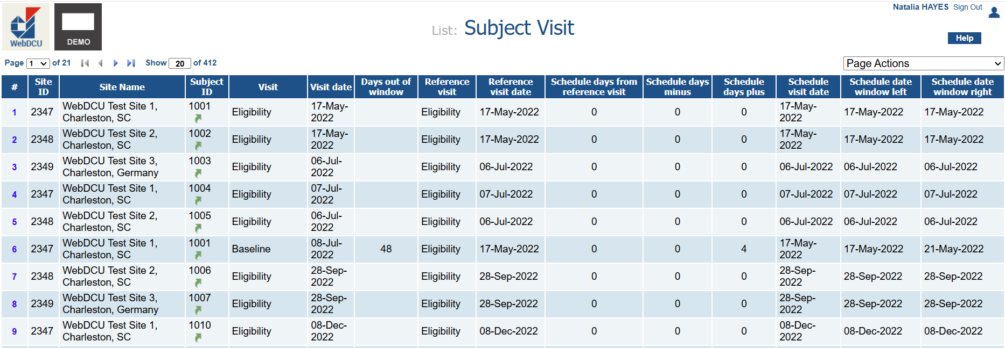
Subject Visit
From left to right, view Site ID, Site Name, Subject ID, Visit, Visit Status, and Visit Date. The ‘Days out of window’ column shows if a visit was early or late by showing a value in the column.

Slide 42
Subject Visit
The next columns show:
Reference visit: the visit the current one is based on
Reference visit date: the date of the reference visit
Days from reference visit and allowed window (may not work for floating visits).

Slide 43
Subject Visit
The final section shows the visit's required date range. Click the blue number for details on that record or select ‘List Record’ to return to the list view.

Slide 44
Subject Visit
Click the blue number to view detailed visit information.

Slide 45
Subject Status
The Subject Status table shows enrollment, last visit, next visit (if overdue), and reasons for early termination, providing an overview of the subject's study status.

Slide 46
Monthly Enrollment Summary
The Monthly Enrollment Summary table will show you the overall enrollment summary for the trial broken down by month.

Slide 47
Subject Progress Summary
The Subject Progress Summary table shows you how many subjects are at which visit for your site. This table will also show you how many have terminated early after each visit.

Slide 48
Site Enrollment Summary
The Site Enrollment Summary table provides a breakdown of your site’s screened, consented, randomized, terminated, and completed subjects, along with the retention percentage.

Slide 49
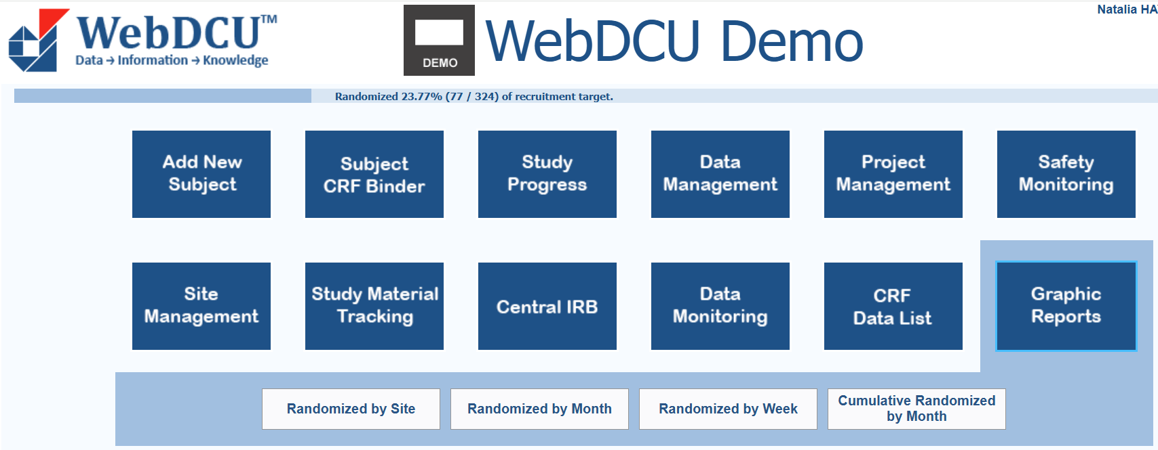
Graphic Reports
The Graphic Reports tile includes:
Randomized by Site - bar graph of subjects randomized by site
Randomized by Month - line graph of subjects randomized monthly
Randomized by Week - line graph of subjects randomized weekly
Cumulative Randomized by Month - line graph comparing monthly randomization to the target.

Slide 50
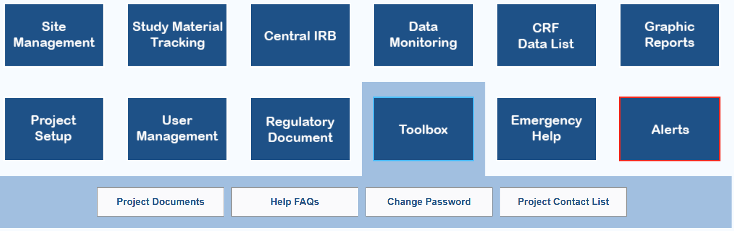
Toolbox
The Toolbox tile provides access to:
Project Documents: key study materials like protocols, MOP, and guidelines.
Helpful FAQs: answers to common questions about WebDCU, CRFs, and rule violations.
Project Contact List: study team contact info, including the Data Manager.

Slide 51
Subject CRF Binder Basics

Slide 52
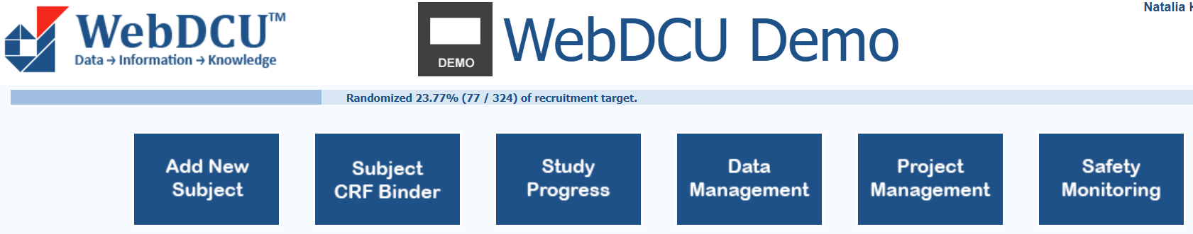

Add New Subject
Select ‘Add New Subject’ to enroll a new subject. This will take you to the subject enrollment form.
After you have saved the Subject Enrollment Form, click the green arrow that appears to go to the Subject CRF Binder.

Slide 53
Subject CRF Binder
You can access the Subject CRF Binder from the main page, where all case report forms are posted.

Slide 54
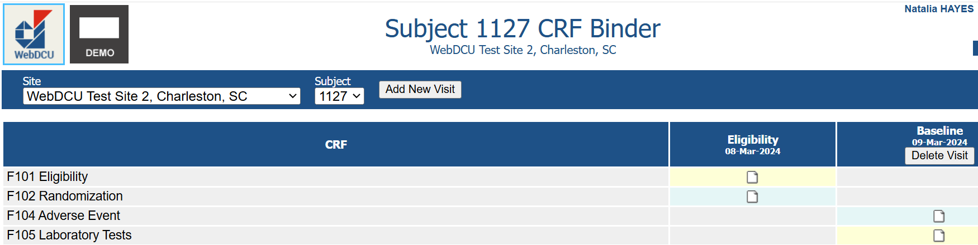
Subject CRF Binder
Use the dropdown to select a different subject. WebDCU posts the first visit, then you can add subsequent visits as the subject progresses through the study.

Slide 55
Subject CRF Binder
To add a new visit, select ‘Add New Visit’. If a visit was added in error and no data entered, click ‘Delete Visit.’ If data entry was attempted, contact your Data Manager to delete the visit.

Slide 56
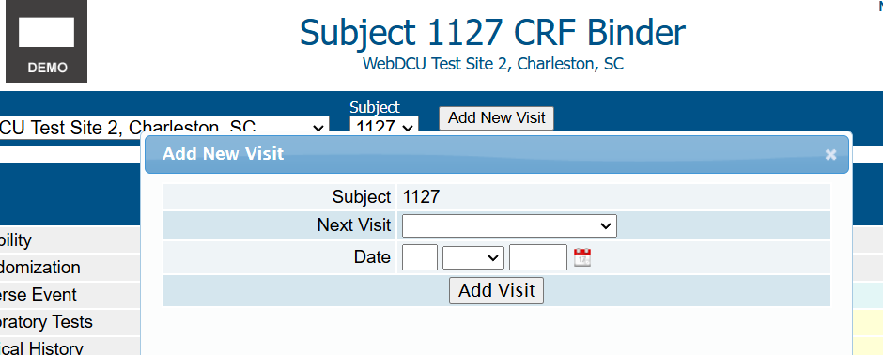
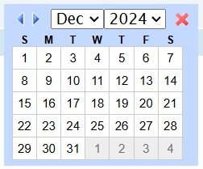
Subject CRF Binder
Adding a new visit enables a pop-up to appear. Choose the next visit, enter the date of the visit, and click ‘Add Visit.’ CRFs post based on the CRF schedule and protocol. For the ‘Date’ field, type the date in DD-MMM-YYYY format or click the calendar icon to select a date using a calendar.

Slide 57
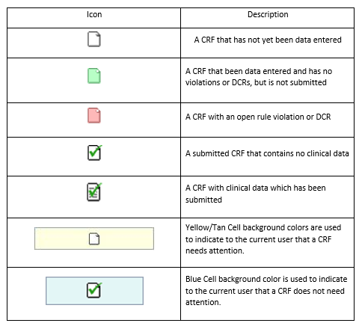
Subject CRF Binder Icons

Slide 58
Rule Violations

Slide 59



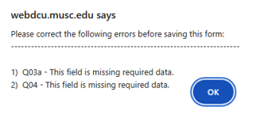
Rejections
Protocol Violations
Warnings
Triggers when required data are missing or erroneous, preventing CRF submission until corrected. Cannot be dismissed.
Typically triggers on F101 Eligibility, blocking CRF saving and subject enrollment/randomization. When dismissing, provide a brief explanation for the violation.
Triggers when data are missing or when one question’s response depends on another's completion.
No Save
Block CRF saving until a question is answered, showing a pop-up with the required field. Cannot be dismissed.

Slide 60

Dismiss a Rule Violation
Click on the ‘Pencil and Paper’ icon
In the text box, briefly explain why data is missing or outside the parameters.
Once complete, click ‘Confirm Rule Violation’
If you need to go back and edit the response, just click the pencil icon again.
Responses should be clear and concise
Avoid adding spaces, ".", or "N/A" to rule violations, as they may prompt a data manager query. Responses may appear as typed in external reports.

Slide 61
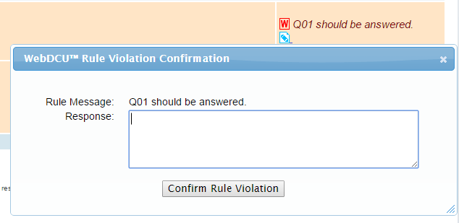
Dismiss a Rule Violation

Slide 62
Data Clarification Requests (DCRs) or Queries

Slide 63
Data Clarification Requests (DCRs)
What are DCRs
Responding to a DCR
How data managers, monitors, and other site personnel request to sites that data be reviewed, confirmed, or updated.
Also referred to as queries.
They are located at the bottom of eCRFs.
Non-CRFs such as the Subject Enrollment or Screen Failure forms cannot be queried.
If changes are required, first make the change to the eCRF, then add a response to the query.
Click ‘Edit CRF’ to make changes, then click ‘Save Record’ and ‘Submit CRF’.
To respond to the query, click ‘Add Response,’ enter your reply, and click ‘Save Response.’
If no edits are needed, confirm data accuracy. Contact the Data Manager if unsure about the DCR request.

Slide 64
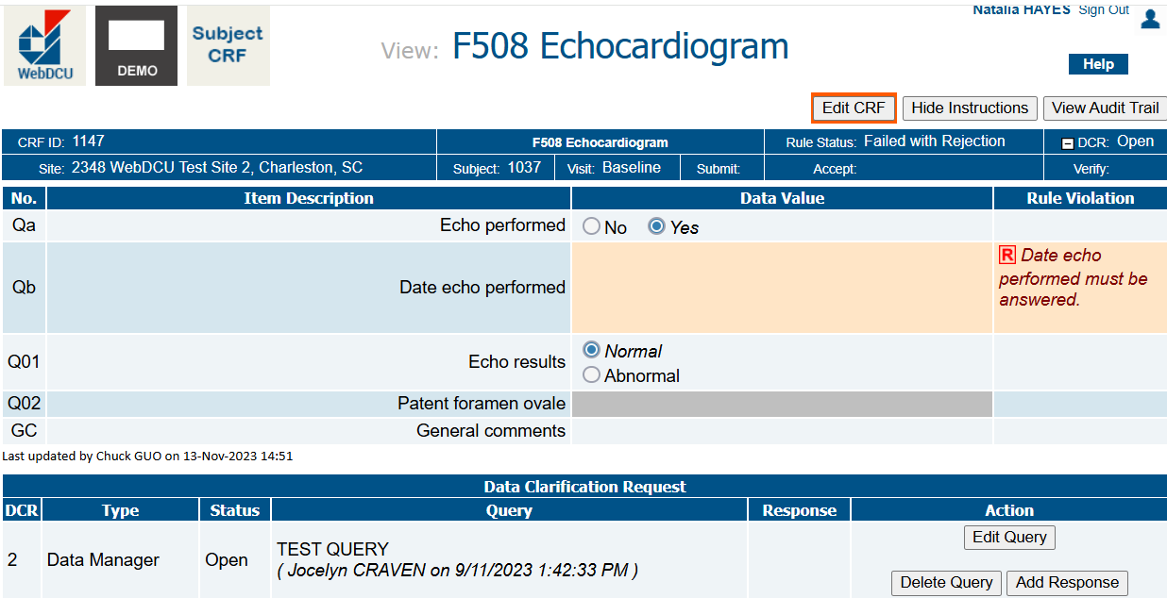
Click ‘Edit CRF’ to make changes, then click ‘Save Record’ and ‘Submit CRF’. To respond to the query, click ‘Add Response,’ enter your reply, and click ‘Save Response.’

Slide 65
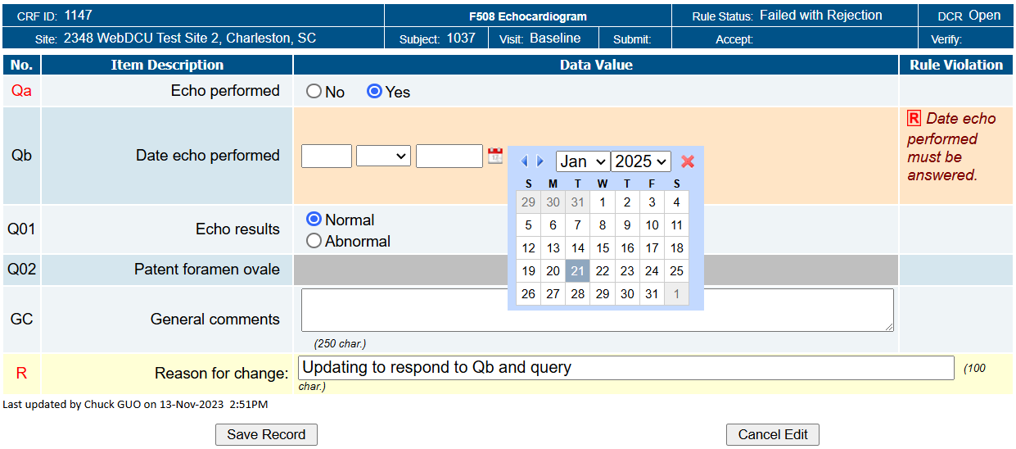
Click ‘Edit CRF’ to respond to the question where the rule is triggered. Add the ‘Reason for change’. Then click ‘Save Record’ and ‘Submit CRF’.

Slide 66
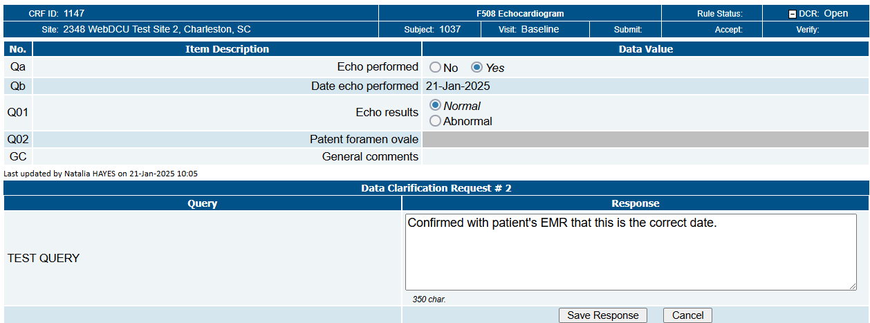
Click ‘Add Response’, type in your response.
Note: Please add that you confirmed with your source documentation or with your site PI or the assessor who conducted the assessment. Click’ Save Response’.

Slide 67
Adding a Team Member & Delegation of Authority Logs (DOAs)

Slide 68
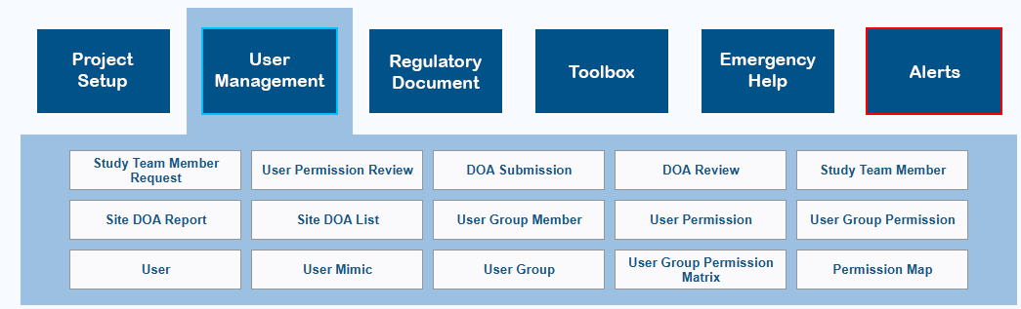
Requesting a New Study Team Member
To add a new study team member to a DOA, first go to the ‘Study Team Member Request’ table.

Slide 69
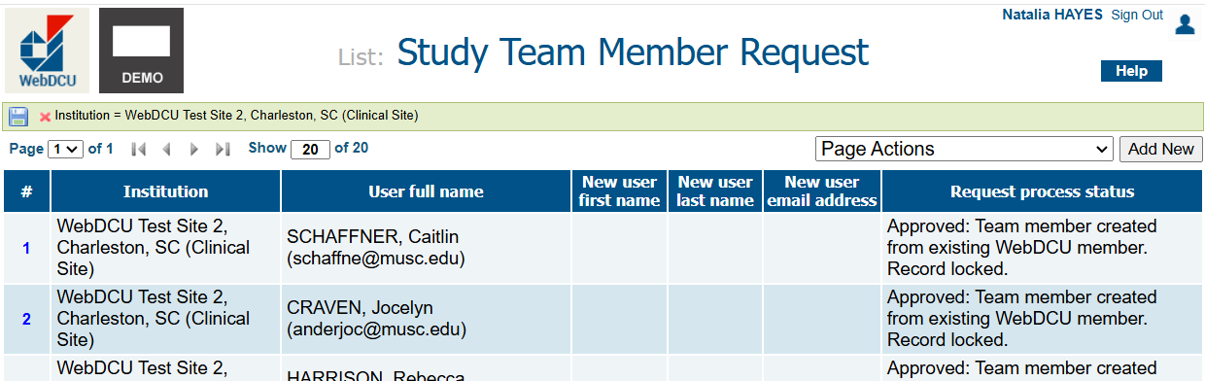
Requesting a New Study Team Member
Click the ‘Add New’ button to add a new team member to your site.

Slide 70
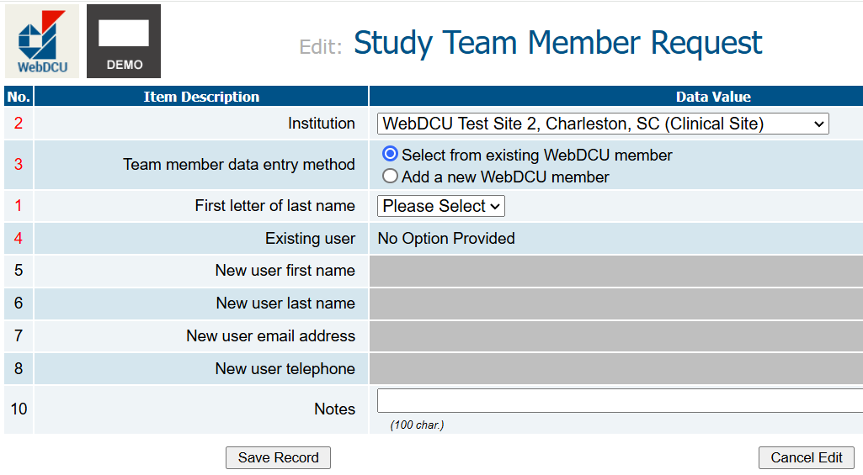
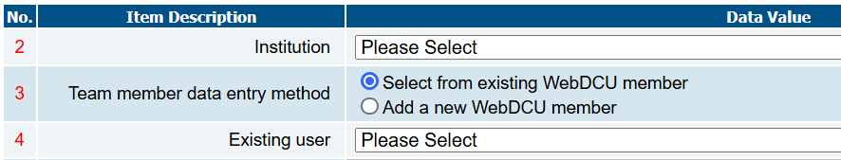
Select your site from the 'Institution' dropdown. Check if the team member is in WebDCU by clicking ‘Select from existing WebDCU member’ and searching the ‘Existing user’ dropdown. Avoid adding duplicate accounts by ensuring you check to see if the team member is already in the system, as this will set the user to ‘pending’ and require Data Manager assistance.

Slide 71
For some studies, the search dropdown might be 'First letter of last name’.

Slide 72
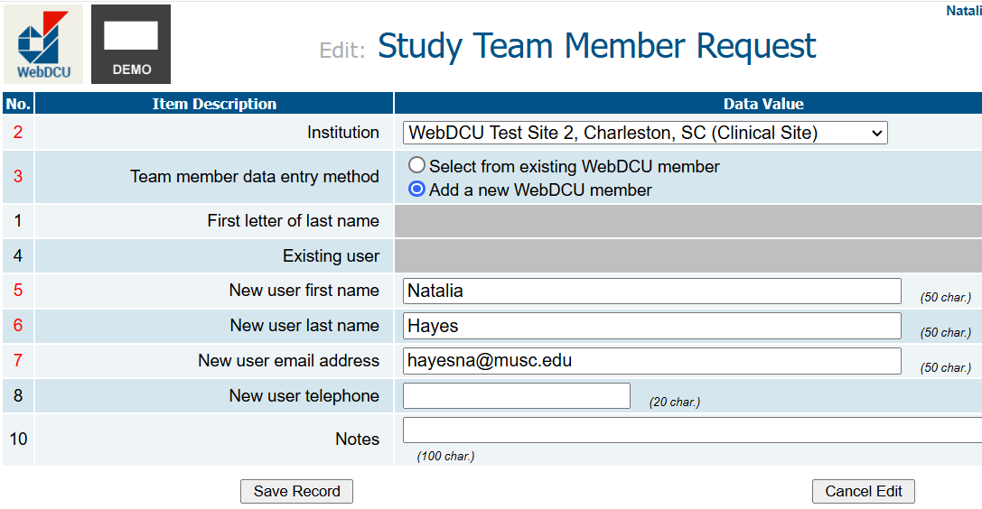
If the team member isn't listed, select 'Add a new WebDCU member,' enter their details, and click 'Save Record’ to save and submit your new study team member request, or 'Cancel Edit.’ If the user is approved, it will be indicated on this page. If approval is required, your Data Manager will be needed.

Slide 73
Completing and Submitting a DOA
Next, to add the new approved user to your site’s DOA, or update your site’s DOA for any reason, click on the ‘DOA Submission’ table.

Slide 74
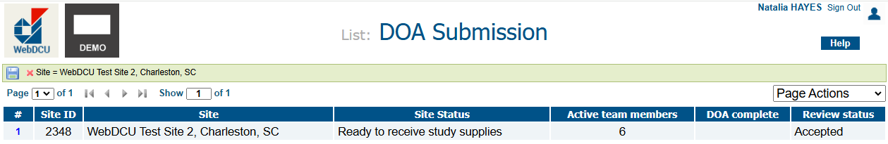
Completing and Submitting a DOA
Click the blue number to view your site’s DOA and begin editing.

Slide 75
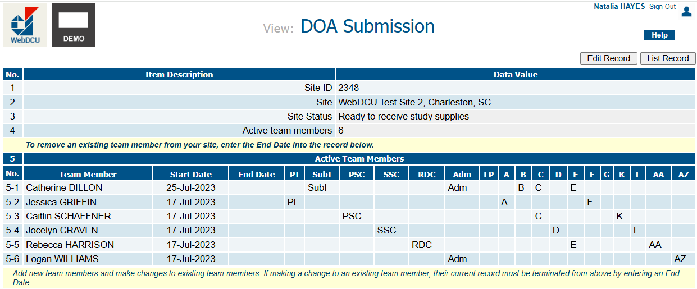
Completing and Submitting a DOA
Click ‘Edit Record’ to edit your site’s DOA.

Slide 76
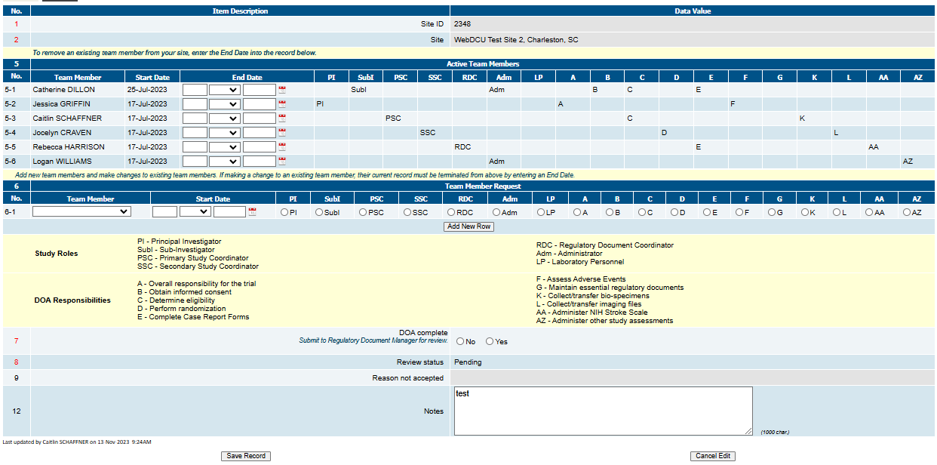
To add a team member, select their name in the dropdown under section 6 ‘Team Member’. You can add multiple team members at the same time by clicking the ‘Add New Row’. Enter their start date and assign roles and responsibilities using the radio buttons. Refer to the keys at the bottom of the page.
To remove a team member, enter an end date next to their name in section 5 under ‘Active Team Members’.
To change roles/responsibilities, add an end date in section 5, then re-add them in section 6 with new roles, ensuring start and end dates are consecutive (e.g., March 1st end, March 2nd start).

Slide 77
To save without submitting for review, set ‘DOA complete’ to ‘No’ and click ‘Save Record.’ You can then return later to edit and complete. When finished, set ‘DOA complete’ to ‘Yes,’ add notes if applicable (max 1000 characters), and click ‘Save Record’ to submit for review. Avoid going past the 1000-character limit in the ‘Notes’ section as this will inhibit saving.

Slide 78
Thank You!
Do you have any questions?
Please email you study specific Data Manager or myself at hayesna@musc.edu

