Slide 1
WebDCU Trial Resources

Slide 2
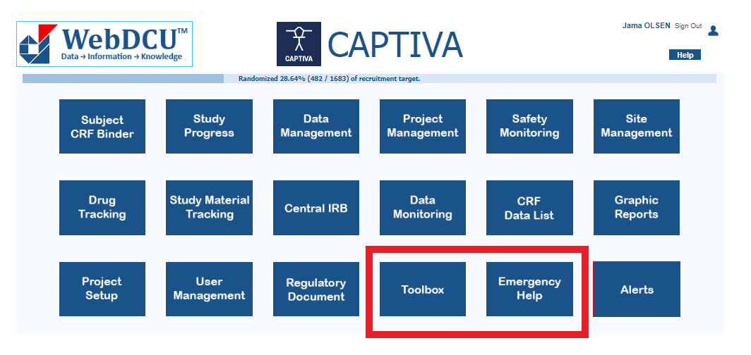
Who you gonna call?
Resources in WebDCU

Slide 3
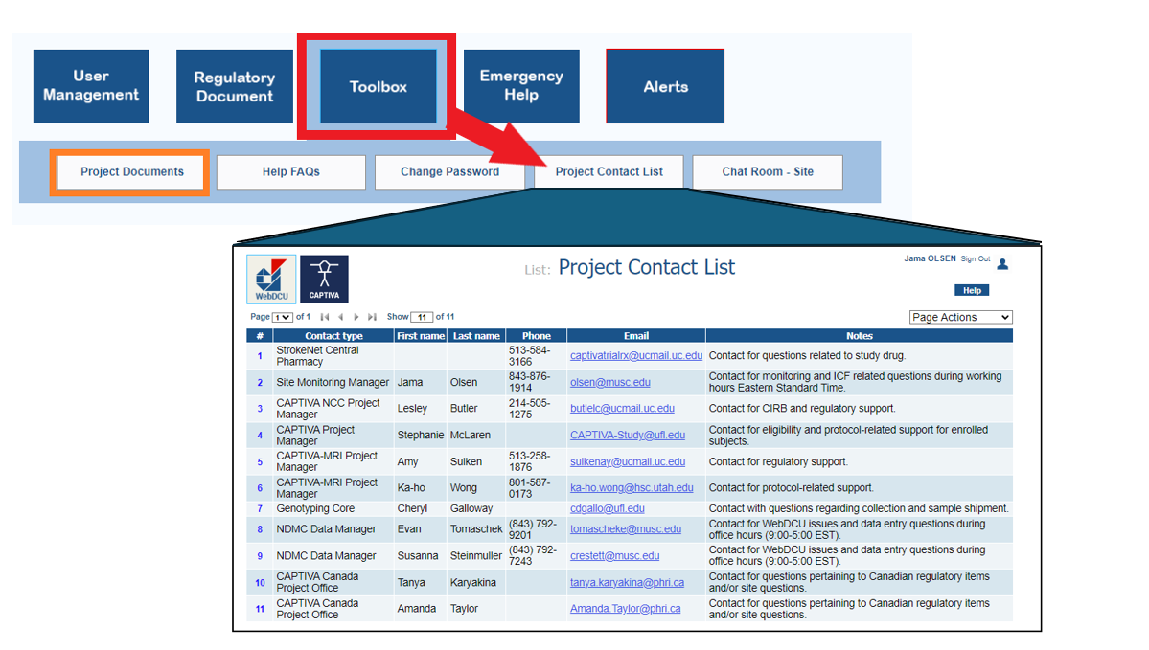

Slide 4
