Slide 1
PI and Coordinator Webinar
April 24, 2018

Slide 2
Enrollment
33 patients consented
13 eligible for randomization (39%)
8 randomized

Slide 3
Top enrolling sites
Site | Consented | Randomized
University of Cincinnati Medical Center | 5 | 2
Memorial Hermann Texas Medical Center | 4 | 2
UPMC Presbyterian Hospital | 3 | 1
UF Health Shands Hospital | 2 | 1
OSU Wexner Medical Center | 2 | 0
Harborview Medical Center | 2 | 0
University of Iowa Hospitals & Clinics | 2 | 0
NYP Columbia University Medical Center | 2 | 0
Northwestern Memorial Hospital | 2 | 0

Slide 4
Top enrolling sites
Site | Consented | Randomized
Hospital of the University of Pennsylvania | 1 | 1
University of Minnesota Medical Center | 1 | 1
NYP Weill Cornell Medical Center | 1 | 0
Christiana Hospital | 1 | 0
Hennepin County Medical Center | 1 | 0
Brigham and Women's Hospital | 1 | 0
Mercy St. Vincent Medical Center | 1 | 0
Intercoastal Medical Group | 1 | 0
Spectrum Health Hospitals Butterworth | 1 | 0

Slide 5
Site startup
95 completed trial agreements
78 CIRB submissions
55 CIRB approvals
36 readiness calls
34 sites released to enroll

Slide 6
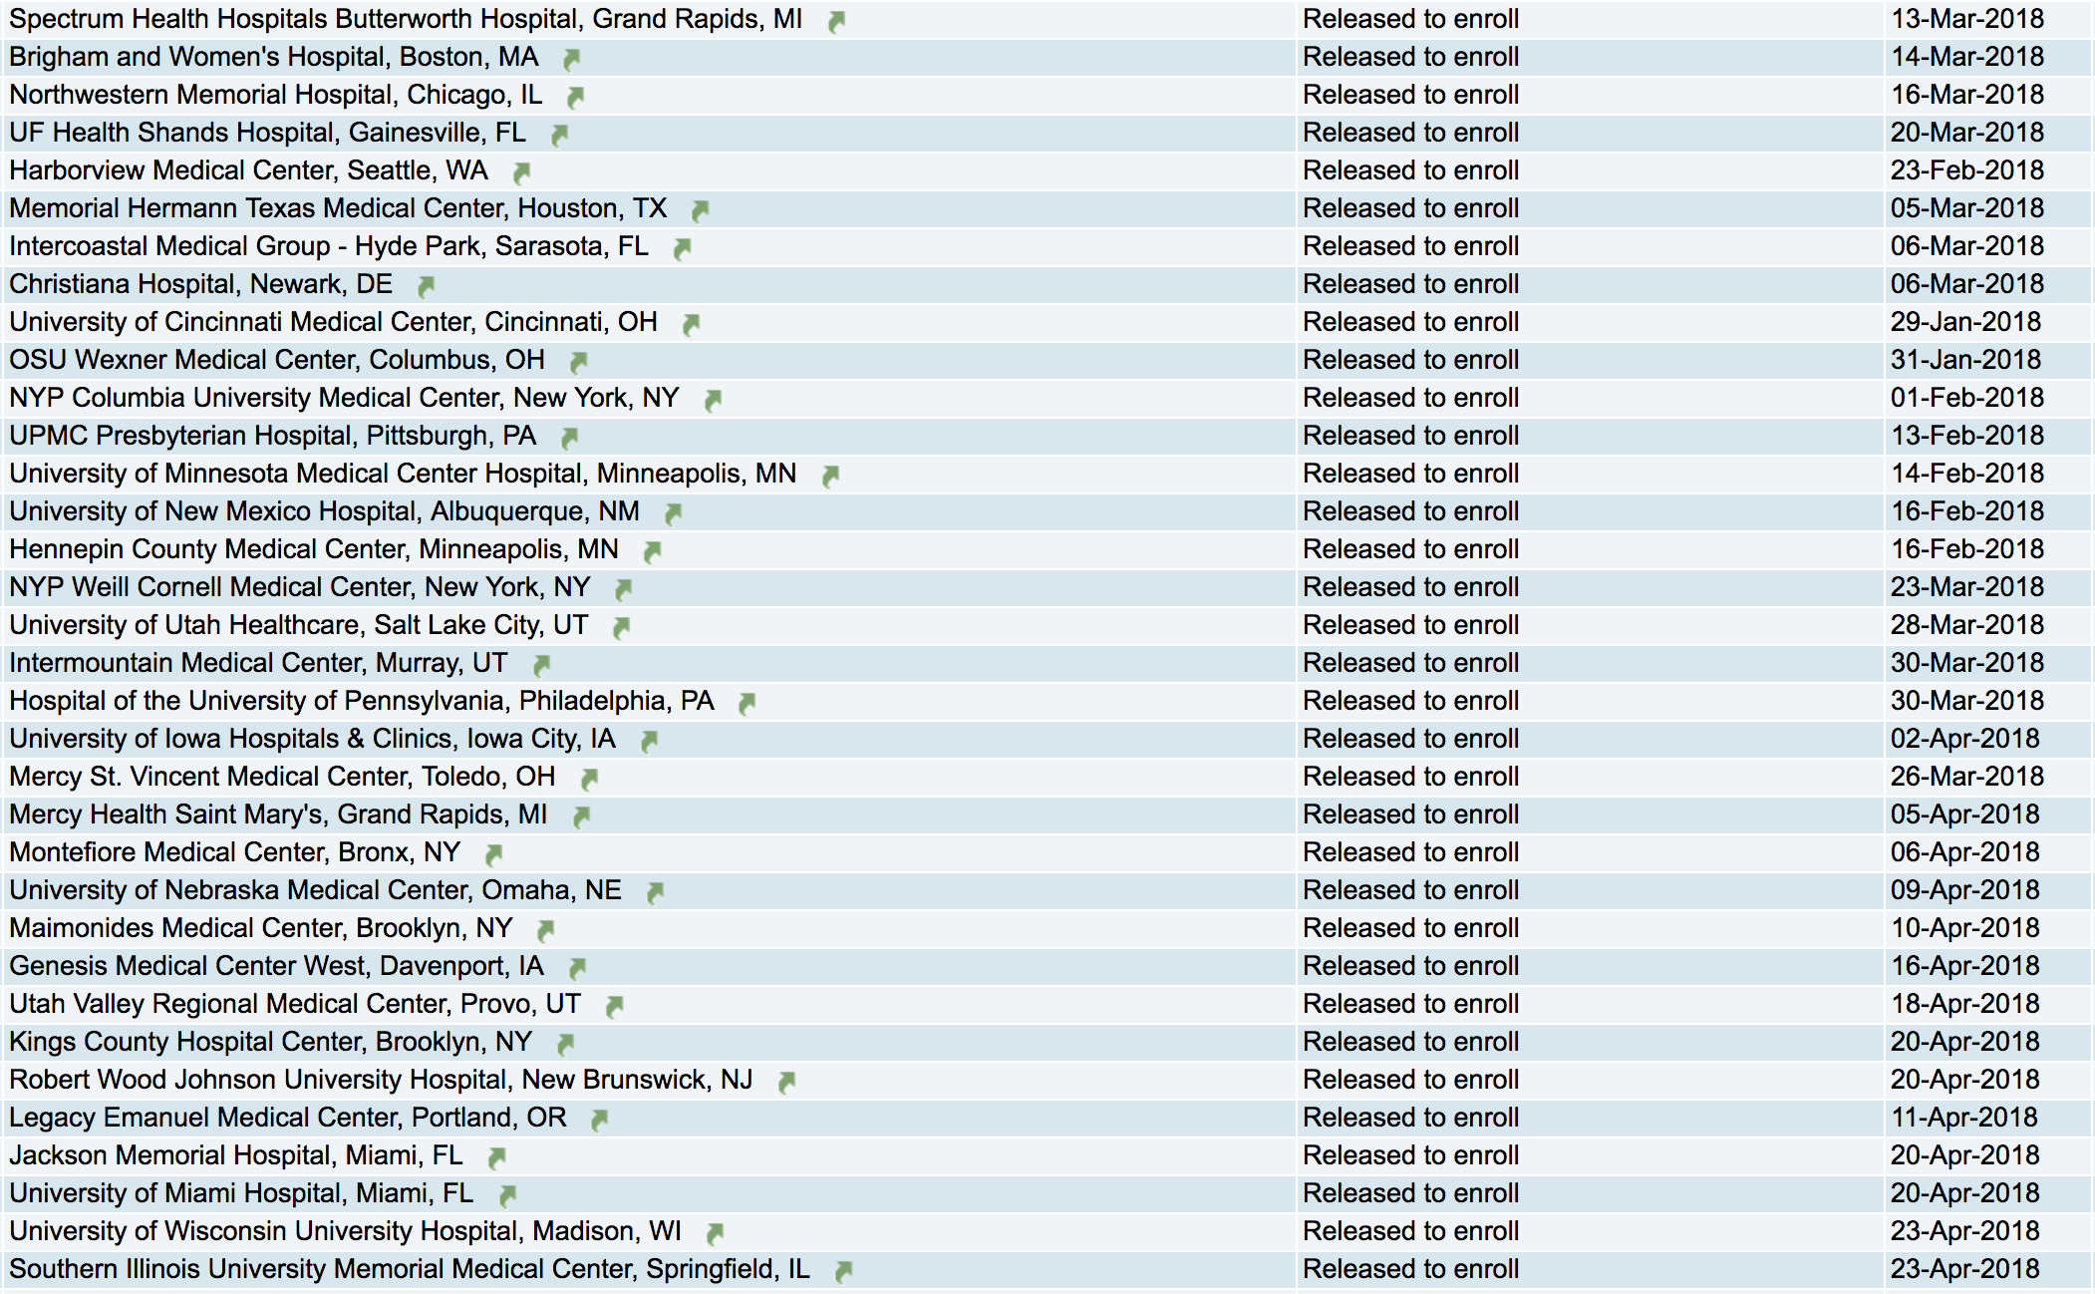

Slide 7
Protocol trial agreements
Many trial agreements are still pending
Site PI should manage this actively:
Identify responsible parties
Check in with them regularly
This makes a big difference
Seek support from institutional/departmental leadership
We are happy to help however we can!

Slide 8
IRB process
Institutional processes vary
Scenario 1: Local IRB context form -> CIRB -> local IRB acknowledgement
Scenario 2: Local IRB approval -> CIRB
Really engage with your IRB leadership to figure out the path
Otherwise, you will waste a lot of time!

Slide 9
Study Wide Consent Modification
Minor changes are required to both the main and pregnant partner consent
Main consent
2 follow-up phone calls were missing and typographical errors were corrected
Pregnant Partner consent
Certificate of Confidentiality language added
Minor revision to the confidentiality section for consistency with the language in the main consent
Minor changes to keep terminology consistent throughout the document

Slide 10
CIRB Assistance Plan
The CIRB will administratively make the changes to the documents for the sites whose initial review is currently in process, so when they are approved they will have the changes incorporated in their approved documents.
For sites that have not yet submitted full packets to the CIRB (and for replacement sites), we will provide the new template and work with them to get the changes incorporated in their initial approval.
For the sites already approved we will administratively make the changes and submit the amendments for them and provide them new approved documents as quickly as possible over the coming weeks.

Slide 11
Maintaining confidentiality
De-identifying ECGs and safety/outcome event data
- Remove ALL identifiers (name, DOB, MRN, etc)
- Identifiers are sometimes still visible when manually removed. Preferred de-identification method is electronic removal using Adobe Acrobat or other PDF editor
Echocardiograms: Do best to deidentify; plan to send echocardiogram from first patient consented to Echo Core Lab
Uploading ICFs
- Only document uploaded to WebDCU that SHOULD have identifiers
Informed Consent | ECG/Safety Packets
Stored temporarily and deleted as soon as consent has been reviewed. | Stored long term.
Identifiers necessary for monitoring of consent document | Identifiers are not necessary for review of ECGs and Safety Packets

Slide 12
Identifying eligible patients
Experience at Memorial Hermann
Experience at OSU

Slide 13
Determining eligibility for consent
Can consent as soon as standard-of-care tests are completed
As early as 24 hours after admission after echo, ECG, imaging, telemetry, etc
Standard-of-care tests must be from after stroke onset
But let us know if there is an otherwise eligible patient who doesn’t have this (e.g., had a recent echo or vascular imaging and team does not want to repeat)
Miscellaneous
Hemorrhagic conversion is NOT an exclusion (though will delay randomization)
Large-vessel occlusion is NOT an exclusion if it is not atherosclerotic

Slide 14
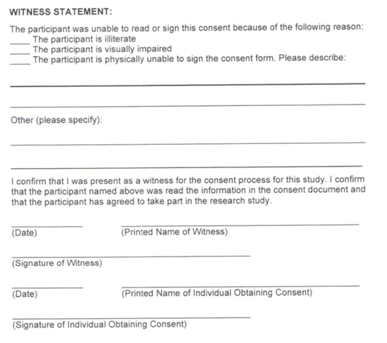
Consent process
LAR is appropriate ONLY when a subject is incapable of giving informed consent (e.g. due to neurological deficit)
When subject is capable of giving consent, but is unable to physically sign the consent:
- Impartial witness should be present during consent process and sign consent document
- If possible, subject should ‘make their mark’ on signature lines

Slide 15
Testing for atrial cardiopathy
Echo
Left atrial dimension/diameter
Current protocol requires this measurement—if your site reports only atrial volume, inquire if they report the left atrial diameter for you
All echos should be deidentified and saved on a DVD; ship first one when convenient and batch future DVDs and send twice a year
ECG
Upload first ECG after stroke; upload another ECG only if requested by ECG Core
NT-proBNP
Complete CRF 503 and include a copy with shipment; ship immediately at room temp on Sun-Thu

Slide 16
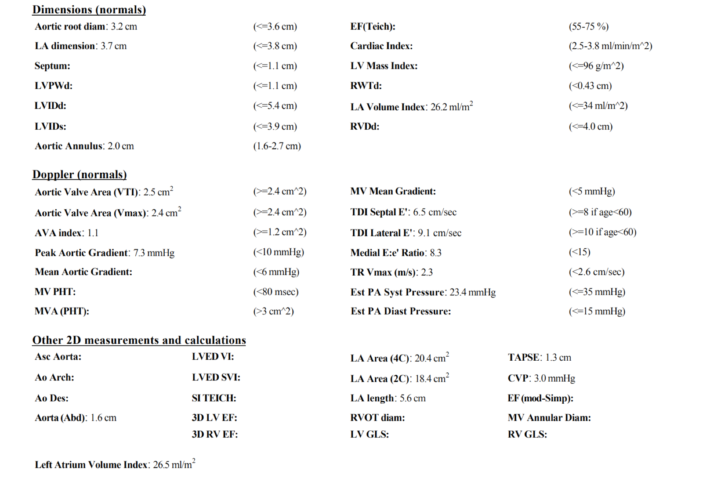

Slide 18
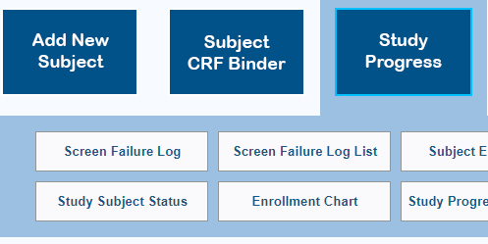
Randomization Eligibility
Use [Study Subject Status] tab to check status of eligiblity for randomization:
Use drop down menu to find subjects who are eligible
An automated email will be sent by WebDCU when a subject is determined to be eligible or ineligible, but will not be sent in real time.
If a subject is ineligible for randomization, please complete the ‘End of Study’ visit

Slide 19
Randomization and study drug
Randomization as early as 3-14 days post-stroke
Randomization as late as 120 days post-stroke
OK to start study drug 12 hours after last dose of open-label antithrombotic therapy
For example, if patient received aspirin in the morning and then was randomized, could start study drug that evening

Slide 20
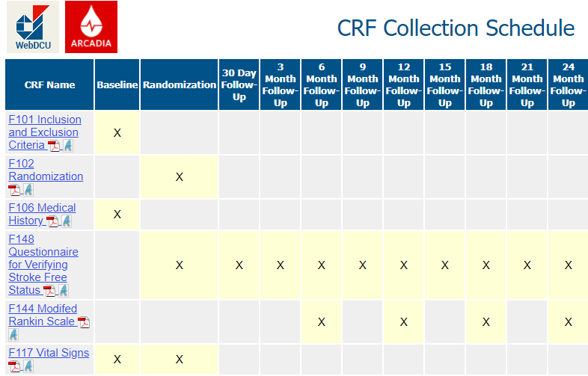
CRFs
Click on the name of the CRF linked in blue to access the PDF version
PDFs of individual CRFs can be accessed under the [CRF Collection Schedule] tab

Slide 21
Hotline
24-hour telephone hotline
Please use it for any urgent questions
Eligibility, randomization, unblinding, etc
1-877-427-2234 (1-877-4AR-CADI): useful to save in your cell phone
The hotline automatically calls the four PIs in succession
Please let it ring
And call back if no luck—one of us will pick up!
Please email arcadia@ucmail.uc.edu with non-urgent questions

Slide 22
Recruitment materials and study tools
Clinic signs for physicians
Patient brochure
Newsletters
Video
Toolbox for minority recruitment

Slide 24
Newsletter
Enrollment updates
Protocol/MOP amendments
Regulatory updates
Scientific updates
Other issues?

Slide 25
Next steps
Please complete trial agreements and CIRB submissions
Actively screen
Send us feedback—we will make changes as needed to make this trial successful!

