Slide 1
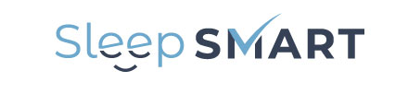
Introduction to:
Sleep for Stroke Management And Recovery Trial
NIH/NINDS U01NS099043

Slide 2
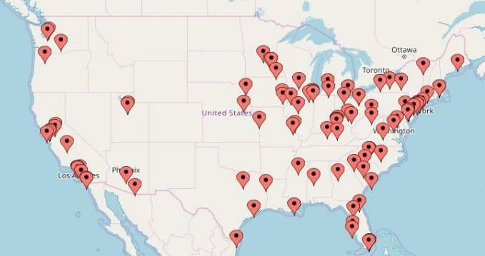
110 sites
Notes:
We have been selected as one of 110 hospitals to take part in an exciting new clinical trial called Sleep SMART. The trial is being implemented through the NIH-funded clinical trials network, StrokeNet.

Slide 3
Background
Post-stroke/TIA sleep apnea prevalence ~75%
Risk factor for incident and recurrent stroke, post-stroke deaths, and poor functional outcome after stroke
Notes:
Surprisingly, sleep apnea is extremely common after stroke. About three quarters of stroke patients tested after stroke have sleep apnea – a prevalence similar to hypertension. Sleep apnea is a risk factor for incidence and recurrent stroke, post-stroke mortality, and poor functional outcome after stroke. So post-stroke sleep apnea appears to be very important.

Slide 4
Background
Observational studies have shown much better outcomes for sleep apnea patients who use their CPAP
Pilot trials and observational studies have shown safety of CPAP in acute stroke patients
Attractive target for intervention, especially given that its treatment is very low risk
Notes:
Furthermore, observational studies have shown that people who use CPAP have better outcomes related to stroke than those who don’t, and pilot studies have established its safety in the stroke population. Because of its high prevalence, link to bad outcomes, and availability of a low risk treatment, CPAP, sleep apnea is an attractive target for an intervention trial.

Slide 5
AHA secondary prevention guidelines 2014
“Given these generally promising albeit mixed results across the randomized trials and the observational cohort studies, what is clearly needed is a randomized trial with adequate sample size to examine whether and the extent to which treatment of sleep apnea with CPAP improves outcomes such as stroke severity, functional status, and recurrent vascular events.”
Notes:
Because of the potential promise but yet unproven benefits of sleep apnea treatment for stroke, the American Heart Association has called for a large scale clinical trial to test whether treatment of sleep apnea after stroke helps prevent the next stroke or helps improve recovery after stroke. Sleep SMART intends to answer these very important questions. We are very excited to have the opportunity to help figure out the answers.

Slide 6
Study Synopsis
Phase 3 multicenter, prospective randomized open-, blinded-endpoint (PROBE) controlled trial
110 sites nationwide – recruitment from acute or rehab hospitalization
~3000 participants randomized, 15,000 participants screened
Enrollment over 4 years
Notes:
Sleep SMART is a late phase, randomized controlled trial where the outcome assessors are blinded to treatment assignment. Participants are recruited from an acute stroke or rehabilitation hospitalization from a participating center. Sleep SMART will require about 3,000 participants to be randomized to achieve the aims. To accomplish this, we anticipate having to consent and screen about 15,000 participants for OSA across all sites, so this trial is very large. Enrollment is scheduled to continue for 4 years.

Slide 7
Objectives and Primary Endpoints
Objectives: Determine whether treatment of obstructive sleep apnea (OSA) with positive airway pressure started shortly after acute ischemic stroke or high risk TIA (1) reduces recurrent stroke, acute coronary syndrome, and all-cause mortality 6 months after the event, and (2) improves stroke outcomes at 3 months in patients who experienced an ischemic stroke.
Primary Endpoints: (1) Prevention endpoint: the composite outcome of recurrent stroke, acute coronary syndrome, or all-cause mortality at 6 months, (2) Recovery endpoint: functional outcome at 3 months.
Secondary Endpoints: neurological, cognitive, and quality of life outcomes at 3 months.
Notes:
The objectives of Sleep SMART are to determine whether treatment of obstructive sleep apnea (OSA) with positive airway pressure started shortly after acute ischemic stroke or high risk TIA (1) reduces recurrent stroke, acute coronary syndrome, and all-cause mortality 6 months after the event, and (2) improves stroke outcomes at 3 months in patients who experienced an ischemic stroke. The primary endpoint for prevention is the composite outcome of recurrent ischemic stroke, acute coronary syndrome, and all-cause mortality. These are assessed at 6 months. The primary endpoint for the recovery aim is functional outcome, measured by the mRS-9Q at 3 months. Other important outcomes are assessed including neurological, cognitive, and quality of life.

Slide 8
Notes:
This figure depicts the Sleep SMART flow. Patients are assessed for eligibility based on their clinical characteristics. Eligible patients who consent have a sleep apnea test the first night after consent. If qualifying OSA is identified, and without an abundance of central apneas, the participant then uses aCPAP for one night: the run-in night. If the participant uses the aCPAP for >=4 hours that night, does not have treatment emergent central sleep apnea (defined as a central apnea index of >10), and agrees to move forward after this CPAP experience, the participant is randomized. Participants are followed for 6 months with in-person assessments at 3 and 6 months.

Slide 9
Inclusion criteria
Inpatient at an enrolling site
≥ 18 years old
Ischemic stroke, or TIA with ABCD²≥4 within the prior 14 days
Notes:
The eligibility criteria for Sleep SMART are quite broad. To be eligible, age must be at least 18, the patients must have an ischemic stroke or a high risk TIA defined by an ABCD^2 score of 4 or greater. Last known well time must be within 14 days of consent. We want to get to patients as soon as possible though because the testing and initiation of treatment has to be done while the participants are still in the hospital. There are some exclusion criteria as well – most are to avoid instances where aCPAP may increase theoretical risk. I won’t show the list because it’s long and each one is pretty uncommon.

Slide 10
Night after consent
Screen for sleep apnea with Nox T3 device
Apply device at night
Collect in AM
Upload to FusionHealth, a sleep medicine technology company
Data processed that day to determine presence or absence of qualifying OSA
No sleep apnea or too much central sleep apnea: provide T3 results; participation complete
Notes:
On the first night that occurs after the consent is signed, a sleep apnea test is performed with the Nox T3 device to identify qualifying OSA. The research coordinator applies the device in the evening and collects the device the following morning. The data collected are uploaded to Fusion Health where the tracings are reviewed and edited where appropriate, and scored by an automated process. On that same day, Fusion Health, a sleep medicine technology company partnering with Sleep SMART, lets the study team know whether the participant has qualifying OSA. Participants receive the T3 results when their participation in Sleep SMART is over.

Slide 11
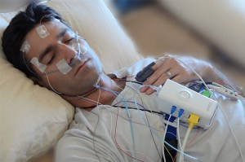
Routine polysomnography: no
Notes:
In routine clinical practice, to assess for OSA, full laboratory-based polysomnography is performed. As seen here, it involves a lot of wires and probes and can be intolerable and unfeasible in the acute stroke setting.

Slide 12
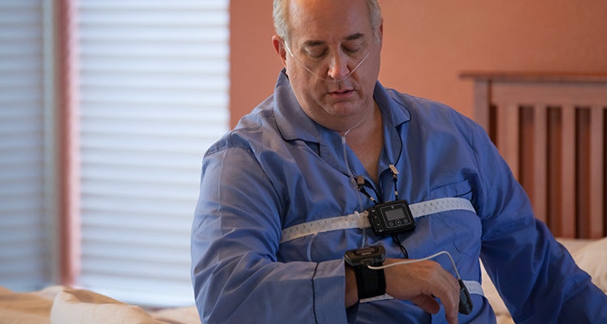
Nox T3: yes
Notes:
Sleep SMART uses a much simpler device, the Nox T3, shown in this slide, to assess for OSA. It includes the device that clips onto the gown, a nasal cannula that measures nasal pressure, chest sensor, a wrist unit with finger oximetry probe, and two bands that fit around the chest and abdomen to assess respiratory effort. The research study coordinator applies the device. If the participant needs to have the device removed during the night for a clinical test, it can be removed easily. The chest bands and nasal cannula are new for each participant. The rest of the device is wiped down after each use.

Slide 13
Next night: aCPAP run-in night
If the participant has qualifying OSA, the run-in night is conducted
The participant uses aCPAP for one night to determine randomization eligibility
  RT checks on participant during night and troubleshoots any issues
Participant eligible for randomization if:
  Used aCPAP for ≥4 hours
  aCPAP central apnea index <10
  Willing to continue with Sleep SMART
Does not meet randomization criteria: provide T3 results; participation complete
Notes:
If the participant has qualifying OSA, the next major step is the aCPAP run-in night. aCPAP is sometimes called “smart CPAP.” aCPAP senses the requirements of the patient and adjusts the pressure it delivers on a breath-by-breath basis. In this way, each participant receives individualized care – to keep his/her airway open during the night.
Prior to the conduct of the run-in night, the participant is fit with a mask, provided training, and practices how to place and remove the mask. This is especially important in those with hand dysfunction. The learning curve is very steep, so practice can makes a big difference. Sleep SMART selected mask options for participants with hand and arm dysfunction in mind.
aCPAP is provided for one night to determine randomization eligibility. The RT checks on the participant during the night to assure comfortable mask fit with little leak and helps troubleshoot any issues.
If the participant’s use of aCPAP is 4 or greater hours, the central apnea index is below 10 (suggesting against treatment emergent central sleep apnea), and the participant agrees to continue, he/she is eligible for randomization.
Participants who are not eligible for randomization are provided the results of their sleep apnea test and discharged from Sleep SMART with gratitude.

Slide 14
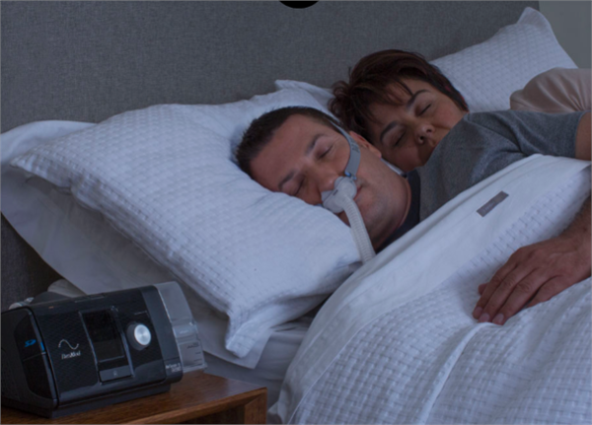
ResMed AirSense 10
Notes:
The Airsense aCPAP device is shown in this slide. The device is plugged into an electrical outlet, has a humidifier, and a tube that delivers air under pressure to the mask. Sleep SMART offers different masks – nasal mask, nasal pillows, and full face mask – in different sizes so we can get the right fit for the participants. We also offer a variety of headgears so make sure the participants are comfortable. If the participants aren’t comfortable, we want to know so we can exchange the equipment or make the needed adjustments to help them with their CPAP use.

Slide 15
Recruitment/retention
Recruitment video
Study brochures
Compensation for participants
  Baseline info + T3: $25
  Run-in night: $25
  3 month outcomes: $75
  6 month outcomes: $75
aCPAP use monitored remotely; telemedicine-based care management
Outcomes: Provision for home visits or telephone follow-up
Notes:
Several features of Sleep SMART help make it more attractive and feasible for participants.
Recruitment is facilitated by a recruitment video and study brochure.
Participants are provided compensation for their time and effort as follows:
Baseline info + T3: $25
Run-in night: $25
3 month outcomes: $75
6 month outcomes: $75
Fusion Health monitors aCPAP use remotely and provides care management via telemedicine. This means that participants receive state-of-the-art OSA care in the comfort of their own homes. This convenience is very helpful to post stroke patients.
Outcomes are obtained in person, but home visits, and as a last resort, telephone follow-up are options.

Slide 16
aCPAP arm: state-of-the-art care
6 months of aCPAP + guideline concordant care
Assistance with aCPAP by RT during hospitalization
Participant and caregiver review aCPAP video, written materials
Telemedicine-based care management after discharge
  Remote monitoring of use, residual AHI, mask leak
  Proactive management and troubleshooting (including send new equipment directly to participant)
    technology team
    respiratory therapy team
    sleep medicine physicians
Notes:
The intervention arm receives 6 months of aCPAP plus guideline-concordant care. Regarding aCPAP, assistance with its use should be provided by an RT during the participant’s hospitalization. The RT should check in during each night of use. The participant and caregiver should be shown the Sleep SMART training materials and all questions should be answered.
Following discharge from the hospitalization, Fusion Health assumes support for the aCPAP management. Fusion has a wealth of experience in remote aCPAP care management and will apply its proven support methods to the Sleep SMART intervention population. A care manager will proactively monitor each intervention participant’s use of aCPAP. This includes amount of use, air leak through the mask, and how well the treatment alleviates sleep apnea based on the residual AHI. The care manager will attempt to intervene to address any issues but is also able to escalate any issue to a technology team, respiratory therapy team, or a sleep medicine physician within Fusion Health. This comprehensive service will optimize aCPAP use and effectiveness in a manner convenient for stroke patients. Fusion Health also has the ability to replace masks and other supplies by mail.

Slide 17
Control arm
6 months of best medical therapy (without aCPAP)
Notes:
The control group receives standard, guideline-concordant stroke care. As you know, most stroke patients are not tested or treated for sleep apnea, and it is not part of stroke guidelines to do so.

Slide 18
After the trial care
Intervention participants: may keep their aCPAP and associated supplies
We offer referral to sleep medicine practitioner at trial end to both groups
Notes:
What happens when a participant completes Sleep SMART?
Intervention participants may keep their Sleep SMART aCPAP and associated supplies. If they intend to continue to use their aCPAP, they should do so under the care of a sleep medicine practitioner.
Both intervention and control participants should be offered referrals to sleep medicine providers at the conclusion of their participation in Sleep SMART.

Slide 19
How can you be involved?
Journal of Neuroscience Nursing 2016; 48: 133-142
Notes:
Nurses of course can play a key role in CPAP management, as demonstrated in the article shown on the slide. Nurses also command great respect from patients, for good reason. Sleep SMART does not require a formal role for neuroscience nurses, but we understand that your help is critical nonetheless to the success of the trial’s implementation. Patients will talk to you about the trial and will ask your opinion. They will sense your attitude about the trial and may welcome encouragement in their use of trial equipment. We want to make sure that you are familiar with any trial that is ongoing in your unit and as we gear-up for Sleep SMARTs start, and we get excited about the opportunity it provides patients, we hope that you will get excited too. There will be challenges, but the trial address a very important clinical question, in efficient ways, and ways that take patients and their caregivers into consideration. We look forward to partnering with you on this – to try to find ways to help stroke patients recover.

